Slide 1
Measuring the impact of a large-scale urban water infrastructure investment in
Dar es Salaam, Tanzania
Findings from a six-year impact evaluation
Danae Roumis, John Feighery, Jeff Alwang, Olga Rostapshova, Carina Rosado

Slide 2
Measuring the impact of a large-scale urban water infrastructure investment in
Dar es Salaam, Tanzania
Findings from a six-year impact evaluation
A different beast:
Danae Roumis, John Feighery, Jeff Alwang, Olga Rostapshova, Carina Rosado

Slide 3
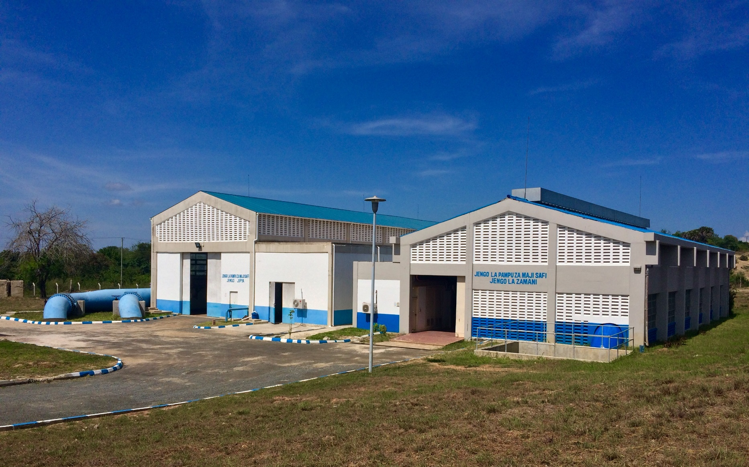

MCC Tanzania Water Sector Project
Tanzania Compact I:
$698.1 million, 2008–2013
Investments in transportation, energy, & water
Water Sector Project:
$54.6M disbursed
GoT $26M transmission main (Dar es Salaam)
Dar es Salaam
Expand capacity of Lower Ruvu Treatment Plant from 180 to 270 million liters per day

Slide 4
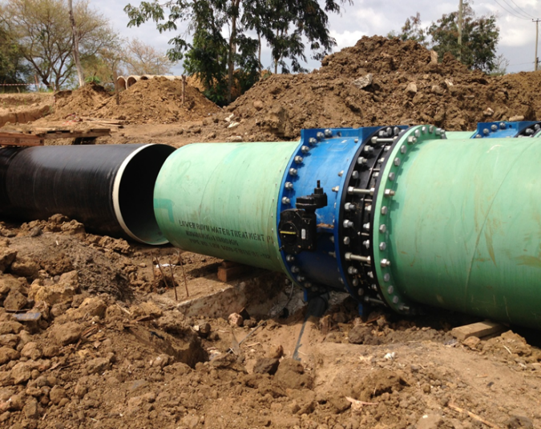
GoT-funded transmission main
Enabled new capacity as of July 2017
Notes:
Plant expansion completed in 2015
Supply increase from 180 to 270 MLD
Roll-out from March-July 2016
Supply increases realized only after new transmission main completed in 2016

Slide 5
MCC Tanzania Water Sector Project
Activity
Outputs
Outcomes
Objectives
Lower Ruvu Plant Expansion
Increase water production
Improve water service coverage
Increase water consumption
Improve water service quality
Changes in water expenditures
Impact pathways:
Improved supply for those already connected before the intervention
(direct)
Improved access for those who obtained a connection after the intervention
(indirect)
Improve water quality
Reduce time fetching water
Notes:
Also indirect benefits of quality – though MCC didn’t directly fund any network

Slide 6
Impact Evaluation
Connected
Pre-intervention
(2015)
Unconnected
Post-intervention
(2017)
Always-connected
Newly-connected
Still-unconnected
Always-connected
(n=239)
Analyze impact of improved supply by comparing changes over time for the same households before and after the intervention
Pre-Post: Fixed-effects panel regression
Analyze impact of improved access by comparing households with and without a new connection
Coarsened exact matching (CEM)
Notes:
Newly connected households:
Supplementary sample: 443 households
Panel: 116

Slide 7
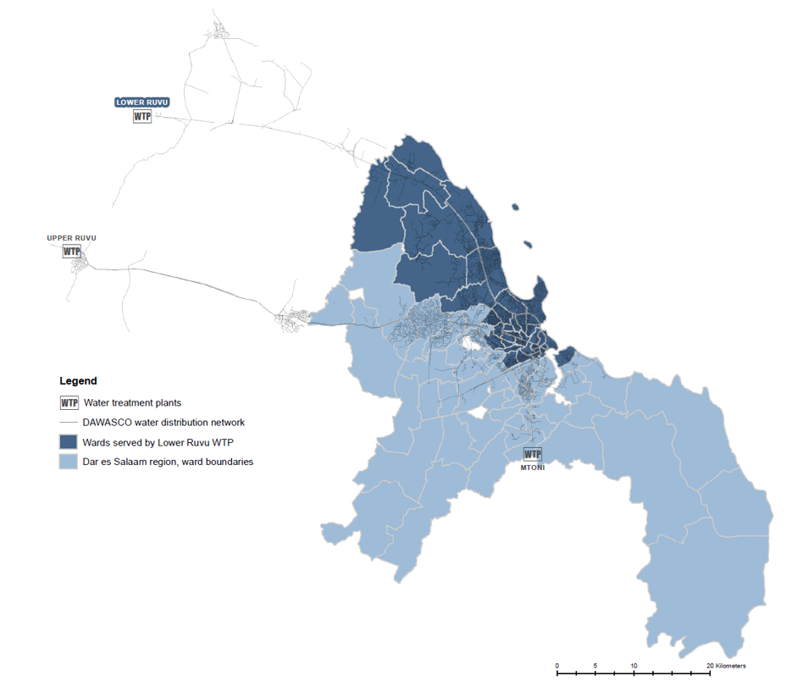
Data
Household survey 1481 households
Pressure logging devices 41 households, 1 wk./HH. 4 network points, 6-7 wks.
Utility Data Customer database Billing, consumption Performance indicators
Water quality testing System (raw, treated, network): 430 Household taps: 262 Public taps: 111 Other sources: 32 Point of consumption: 406
Focus group discussions 16 focus groups
Notes:
Most wards served by the Lower Ruvu WTP are located in the municipal districts of Kindondoni, Ilala, Ubungo, and Kigamboni, with a small number of wards from Temeke district.
Data listed here is only at endline – much more data for other phases for same categories.

Slide 8
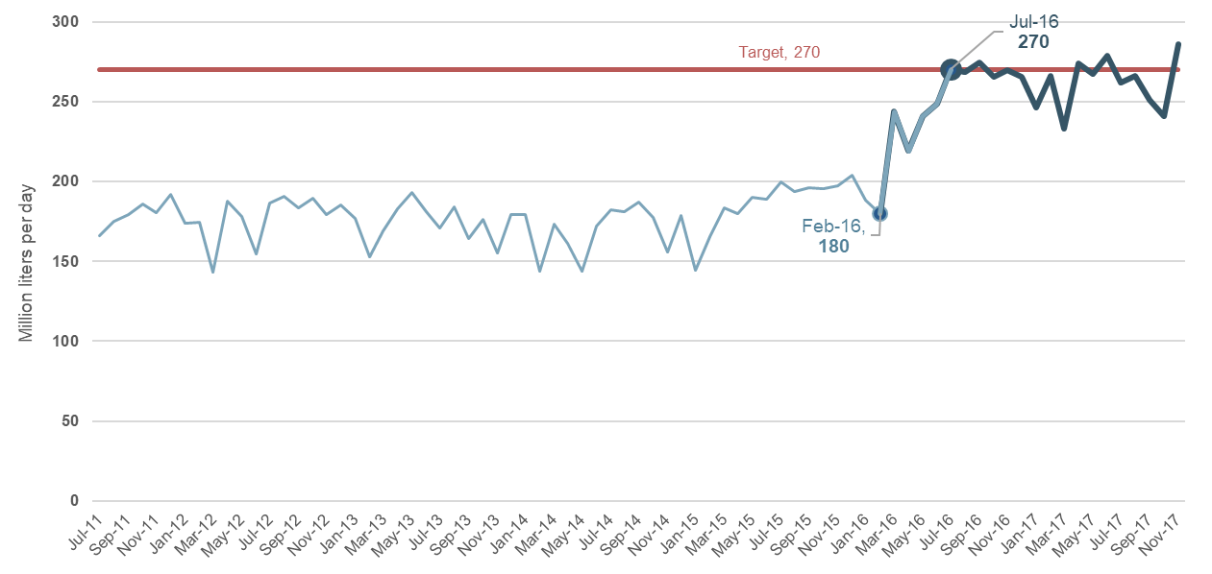
Findings:
Production volume
Increase water production

Production volume reached target of 270 MLD in July 2016
Works are in good condition and the plant has sustained target to date
Notes:
Source: DAWASCO monitoring data (2017)

Slide 9
Findings:
Service Coverage
Improve water service coverage

3x increase in # new conn./ month in study areas
Trend started before interventions (anticipation)
WSP enabling factor, utility activities likely direct cause
LR supply increase
Notes:
Source: DAWASCO monitoring data & customer database (2017)

Slide 10
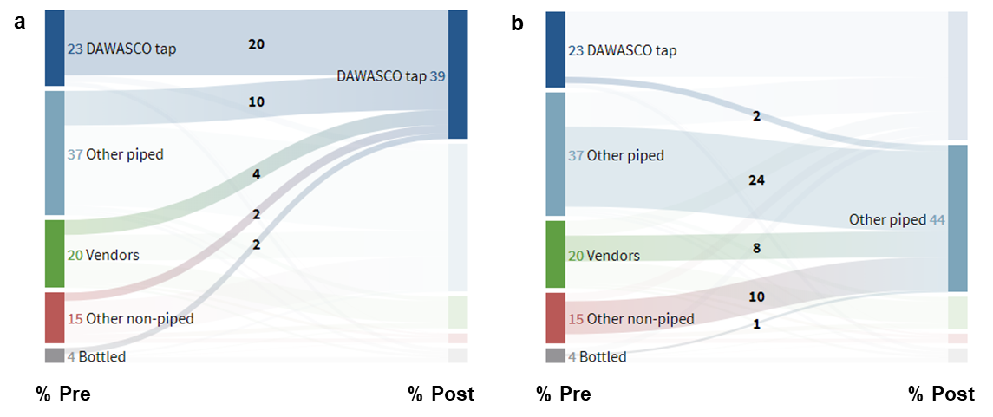
Findings:
Service Coverage
Improve water service coverage

Use of piped water (tap on premises, kiosks, a neighbor’s tap, or public tap) for main source of drinking water nearly doubled among household surveyed in both phases.
Use of an improved source (JMP) increased in the study area – from 62% to 85%
Multiple concurrent source use & substitution effects important especially in urban areas
Notes:
Graphic shows panel household
Household survey data also shows increases in access several related indicators.
The majority of those who switched to another piped source were previously using vendors or another non-piped source.
Increasingly, households are not having to prioritize DAWASCO sources for obtaining drinking water only.
Increases in the use of DAWASCO sources for cleaning and sanitation are especially noteworthy in the context of the WSP objectives, since these activities are also closely linked with the presence of water-related illnesses.

Slide 11
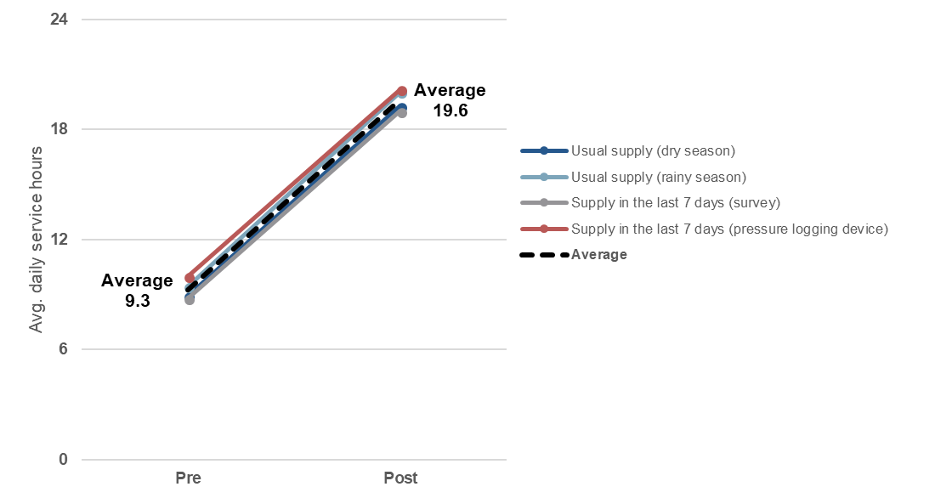
Findings:
Service quality
Improve service quality

Increase from about 9 to 20 average service hours per day
Intermittent service persists in some areas of the city, such as those at higher elevations.
A majority (two-thirds) of households that were connected before the intervention reported continuous service (24/7) – a three-fold increase from before the intervention
Notes:
Note: specify types of households
High degree of correspondence between direct measurements and survey

Slide 12
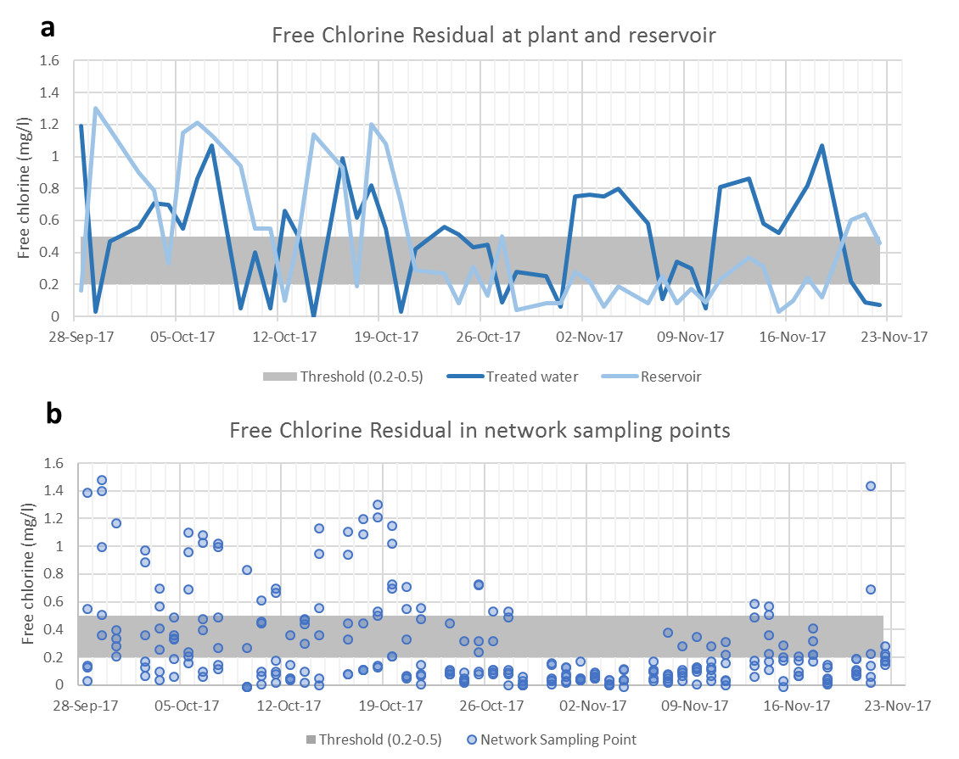
Findings:
System
Water Quality

Slide 13
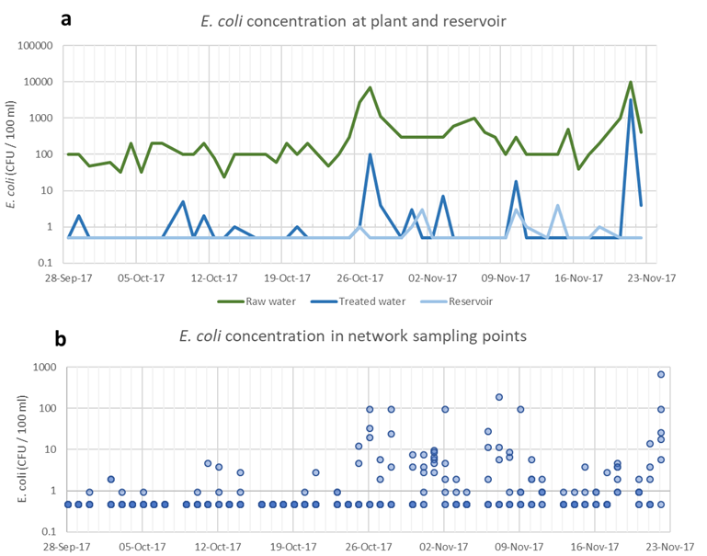
Findings:
System
Water Quality

Slide 14
Findings:
Water Quality
Improve water quality

Compliance with WHO guideline for E. coli significantly increased in households and public taps
Piped supply twice as likely to comply compared to other sources, and compares favorably with similar studies
Remaining contamination events can be reduced by ensuring adequate free chlorine residual at all times and further reducing turbidity
Household stored water quality was poor (21% compliance)
Data from comparable studies
In other countries:
India (4)
Addis Ababa (2)
Ghana (5)
Nigeria (6)
Other sources
Ethiopia (1)
Rwanda (3)

Slide 15

Findings:
Water consumption
Increase in water consumption
~
Supply improvements are associated with increased consumption, holding all else constant.
However, on balance other factors resulting in reductions during the period measured.
Improved access (a new connection) is associated with a statistically significant increase in consumption, of about 83 lpcd, allowing these households to consume at recommended levels.
Recommended level
(Descriptive data: median daily per capita water consumption)
Notes:
GET #s from REPORT

Slide 16
Findings:
Water expenditures
Changes in water expenditures
~
Supply improvements not associated with changes in water expenditures, holding all else constant.
Net, slight reduction in reported expenditures during study.
Rainy season: improved access (new connection) associated with significant increase in total expenditures, but decrease from sources other than own tap.
Dry season: no significant effect (more cons. w/ no significant change in exp.)
(Descriptive data: median water expenditures, 2017 TSH)
Notes:
Newly connected (from report):
We estimate that total weekly per capita water expenditures for newly connected households is about 540 shillings higher than it would have been had they not connected, while expenditures from other sources is about 560 shillings lower.
These results suggest that in the dry season, newly connected households have the convenience of a reliable source of good-quality water without expending additional resources. In the rainy season households with a new connection spend more for the convenience of reliable water on-premises.
The presence of more abundant water sources, partly due to the interventions may have lowered the price of non-tap water. Households that are not happy with the quality of their tap and continue to purchase rainy season water from non-tap sources have benefited from the decline in overall water prices noted above.

Slide 17
Findings: Time spent fetching water
Reduce time fetching water

Supply improvements not associated with statistically significant reduction of about 1.5 hours per week
Improved access associated with statistically significant reduction of about 2 hours per week
In both cases, smaller (though still significant) reductions in the rainy season, reportedly due to households’ use of other sources.
Qual:
Time savings benefits women and children specifically, able to engage in productive activities (work and school) or other desired activities
Reduced time for unconnected households as well, suggesting positive spillover
Notes:
About 10 minutes per hour increase in supply

Slide 18
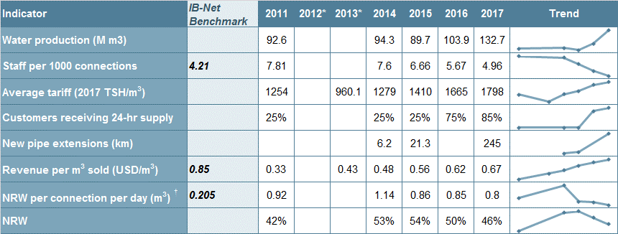
Findings: Sustainability
DAWASCO is in a stronger financial position compared to the past, taking steps to improve operational efficiency, expanding network, and improving cost recovery
Notes:
The ability to sustain impacts depends largely on operational efficiency and ability to mitigate the capacity to perform maintenance and repairs.
Sustaining the project impacts will depend on ability to expand services and meet growing demand, while continuing to improve financial position

Slide 19
Conclusions
Substantial improvements in supply and access have had positive and measurable impacts on households living in areas supplied by Lower Ruvu WTP. Collectively, these changes are expected to lead to longer-term, positive economic impacts on households in Dar es Salaam.
Provided DAWASCO continues initiatives to strengthen its financial position and operational challenges are resolved at the Lower Ruvu WTP, it is likely that the observed impacts can be sustained, at least in the medium-term.

Slide 20
Not your mother’s single-arm RCT
Notes:
Certain outcomes might take longer to manifest… some of MCC outcomes far downstream (e.g. illness)

Slide 21
Design
Challenges | Adaptations
Implementation Construction of works; transmission main Contamination of comparison group | Re-designed x2, timeline extended, but 1 yr. impacts Planned ‘midline’ became updated baseline Supplemental sample (utility data, GIS analysis)
Assumptions / Theory of change Intermittency → continuity assumed Coverage vs. continuity of service trade-offs Sanitation, hygiene, storage not built in | Process study added to design Survey modules measure storage, some hygiene
Urban Context High mobility within growing urban areas Multiple concurrent source use, substitution, etc. | More aggressive tracking protocol Source ‘matrix’/‘portfolio’ (all sources & uses), primary & secondary; plus water storage and treatment
Measuring Intermittency Lack of utility data/bulk meter data Survey vs. direct observation | Pressure logging devices Cognitive interviewing sub-study
Water Quality Required methods/measurement Where is quality breaking down? Disseminating results + ethical considerations | Independent lab, WHO compact dry plate method WQ testing points across distribution system Notifications to households & utilities Results workshop with utility
Outcomes Loss of comparison group for supply arm Attribution & utility activities: connections, metering, tariffs; coverage vs. continuity | Adaptation of methods (supply arm), no counterfactual Collaboration with utility + interviews, reports, data

Slide 22
Design
Challenges | Adaptations
Implementation Construction of works; transmission main Contamination of comparison group | Re-designed x2, timeline extended, but 1 yr. impacts Planned ‘midline’ became updated baseline Supplemental sample (utility data, GIS analysis)
Assumptions / Theory of change Intermittency → continuity assumed Coverage vs. continuity of service trade-offs Sanitation, hygiene, storage not built in | Process study added to design Survey modules measure storage, some hygiene
Urban Context High mobility within growing urban areas Multiple concurrent source use, substitution, etc. | More aggressive tracking protocol Source ‘matrix’/‘portfolio’ (all sources & uses), primary & secondary; plus water storage and treatment
Measuring Intermittency Lack of utility data/bulk meter data Survey vs. direct observation | Pressure logging devices Cognitive interviewing sub-study
Water Quality Required methods/measurement Where is quality breaking down? Disseminating results + ethical considerations | Independent lab, WHO compact dry plate method WQ testing points across distribution system Notifications to households & utilities Results workshop with utility
Outcomes Loss of comparison group for supply arm Attribution & utility activities: connections, metering, tariffs; coverage vs. continuity | Adaptation of methods (supply arm), no counterfactual Collaboration with utility + interviews, reports, data

Slide 23
Design
Challenges | Adaptations
Implementation Construction of works; transmission main Contamination of comparison group | Re-designed x2, timeline extended, but 1 yr. impacts Planned ‘midline’ became updated baseline Supplemental sample (utility data, GIS analysis)
Assumptions / Theory of change Intermittency → continuity assumed Coverage vs. continuity of service trade-offs Sanitation, hygiene, storage not built in | Process study added to design Survey modules measure storage, some hygiene
Urban Context High mobility within growing urban areas Multiple concurrent source use, substitution, etc. | More aggressive tracking protocol Source ‘matrix’/‘portfolio’ (all sources & uses), primary & secondary; plus water storage and treatment
Measuring Intermittency Lack of utility data/bulk meter data Survey vs. direct observation | Pressure logging devices Cognitive interviewing sub-study
Water Quality Required methods/measurement Where is quality breaking down? Disseminating results + ethical considerations | Independent lab, WHO compact dry plate method WQ testing points across distribution system Notifications to households & utilities Results workshop with utility
Outcomes Loss of comparison group for supply arm Attribution & utility activities: connections, metering, tariffs; coverage vs. continuity | Adaptation of methods (supply arm), no counterfactual Collaboration with utility + interviews, reports, data

Slide 24
Design
Challenges | Adaptations
Implementation Construction of works; transmission main Contamination of comparison group | Re-designed x2, timeline extended, but 1 yr. impacts Planned ‘midline’ became updated baseline Supplemental sample (utility data, GIS analysis)
Assumptions / Theory of change Intermittency → continuity assumed Coverage vs. continuity of service trade-offs Sanitation, hygiene, storage not built in | Process study added to design Survey modules measure storage, some hygiene
Urban Context High mobility within growing urban areas Multiple concurrent source use, substitution, etc. | More aggressive tracking protocol Source ‘matrix’/‘portfolio’ (all sources & uses), primary & secondary; plus water storage and treatment
Measuring Intermittency Lack of utility data/bulk meter data Survey vs. direct observation | Pressure logging devices Cognitive interviewing sub-study
Water Quality Required methods/measurement Where is quality breaking down? Disseminating results + ethical considerations | Independent lab, WHO compact dry plate method WQ testing points across distribution system Notifications to households & utilities Results workshop with utility
Outcomes Loss of comparison group for supply arm Attribution & utility activities: connections, metering, tariffs; coverage vs. continuity | Adaptation of methods (supply arm), no counterfactual Collaboration with utility + interviews, reports, data

Slide 25
What can we learn?
Process evaluation a critical part of evaluation efforts
Urban context needs to be considered fully when designing data collection tools, measurement strategies, and underlying assumptions of project logic – SDGs and new JMP are a move in this direction
Underlying assumptions better tailored to context (urban), realism about outcomes attainable in intermittent systems & through specific types of investments; understand trade-offs (coverage vs. continuity); anticipate heterogeneity of impacts
Mixed method design important for results but also for learning about measurement; helped strengthen the evaluation as it was re-designed & adapted
Coordination & collaboration with utility/providers essential, don’t underestimate time required to do properly; additional opportunities to support & leverage utility M&E efforts

Slide 26
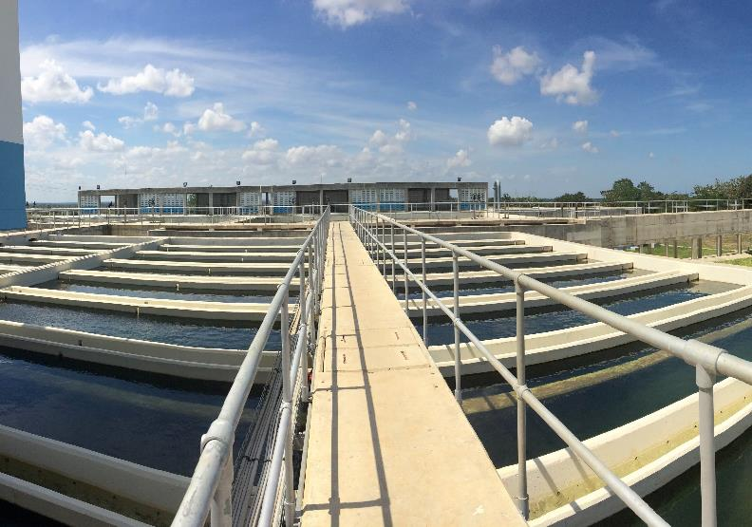
Thank you
Notes:
MCC Remarks (Shreena)

