Slide 1
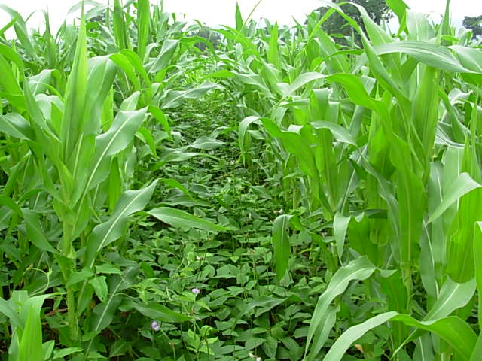
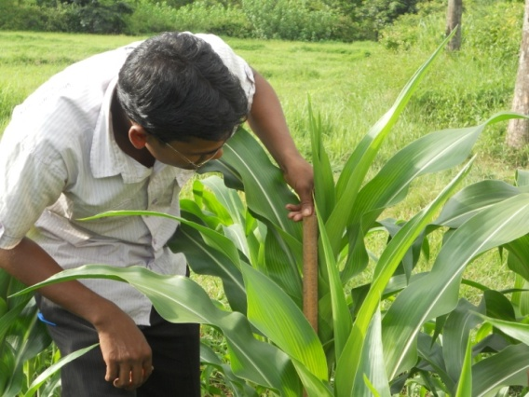
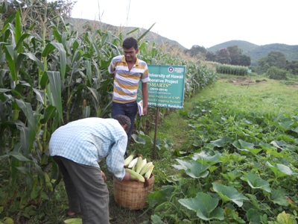



Effect of tillage and intercropping on crop productivity, profitability and soil fertility under tribal farming situations of India
Aliza Pradhan¹, T. Idol¹, P. K. Roul², K. N. Mishra², C. Chan-Halbrendt¹, J. Halbrendt¹ and C. Ray³
¹Dept. of Natural Resources & Environmental Management, University of Hawaii, Manoa,
²Odisha University of Agriculture & Technology, India.
³Dept. of Civil and Environmental Engineering, University of Hawaii, Manoa

Slide 2
Conservation Agriculture Production Systems
CAPS concept developed by USAID Sustainable Agriculture and Natural Resource Management (SANREM) program
Based on integration of CA practices
Minimum soil disturbance
Continuous organic soil cover
Appropriate crop rotation

Slide 3
Conservation Agriculture Production Systems
CAPS intended to work together to sustain yields and natural resource quality
SANREM goals are to improve:
Crop yield and natural resource quality
Household and community livelihoods
Gender equity
Social and technological networks

Slide 4
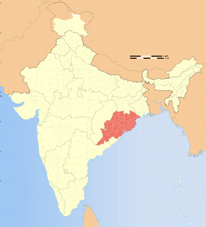
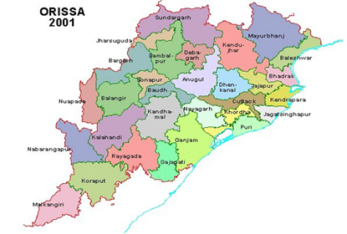
The Study Area: District of Kendujhar, Odisha, India
Kendujhar
State of Odisha
Map of India
Tribal village: Tentuli, approx. 60 households
Subsistence farmers, averaging < 2 ha land/household in cultivation
Rely on low input, rain-fed rice and maize based cropping systems

Slide 5
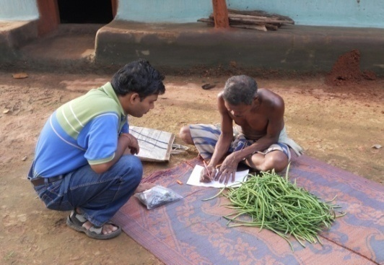
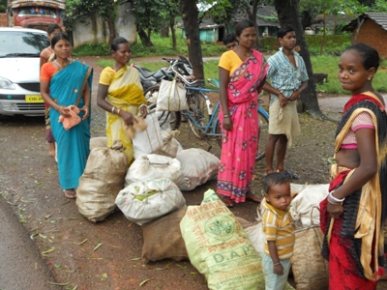
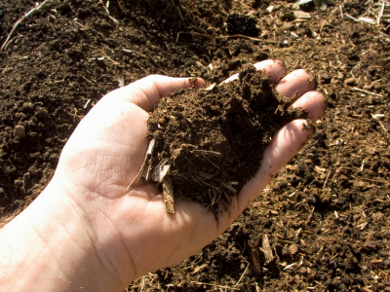
Objective
Assess the effects of reduced tillage, intercropping
and residue cover on a) crop yield b) profitability c) soil physico-chemical properties

Slide 6
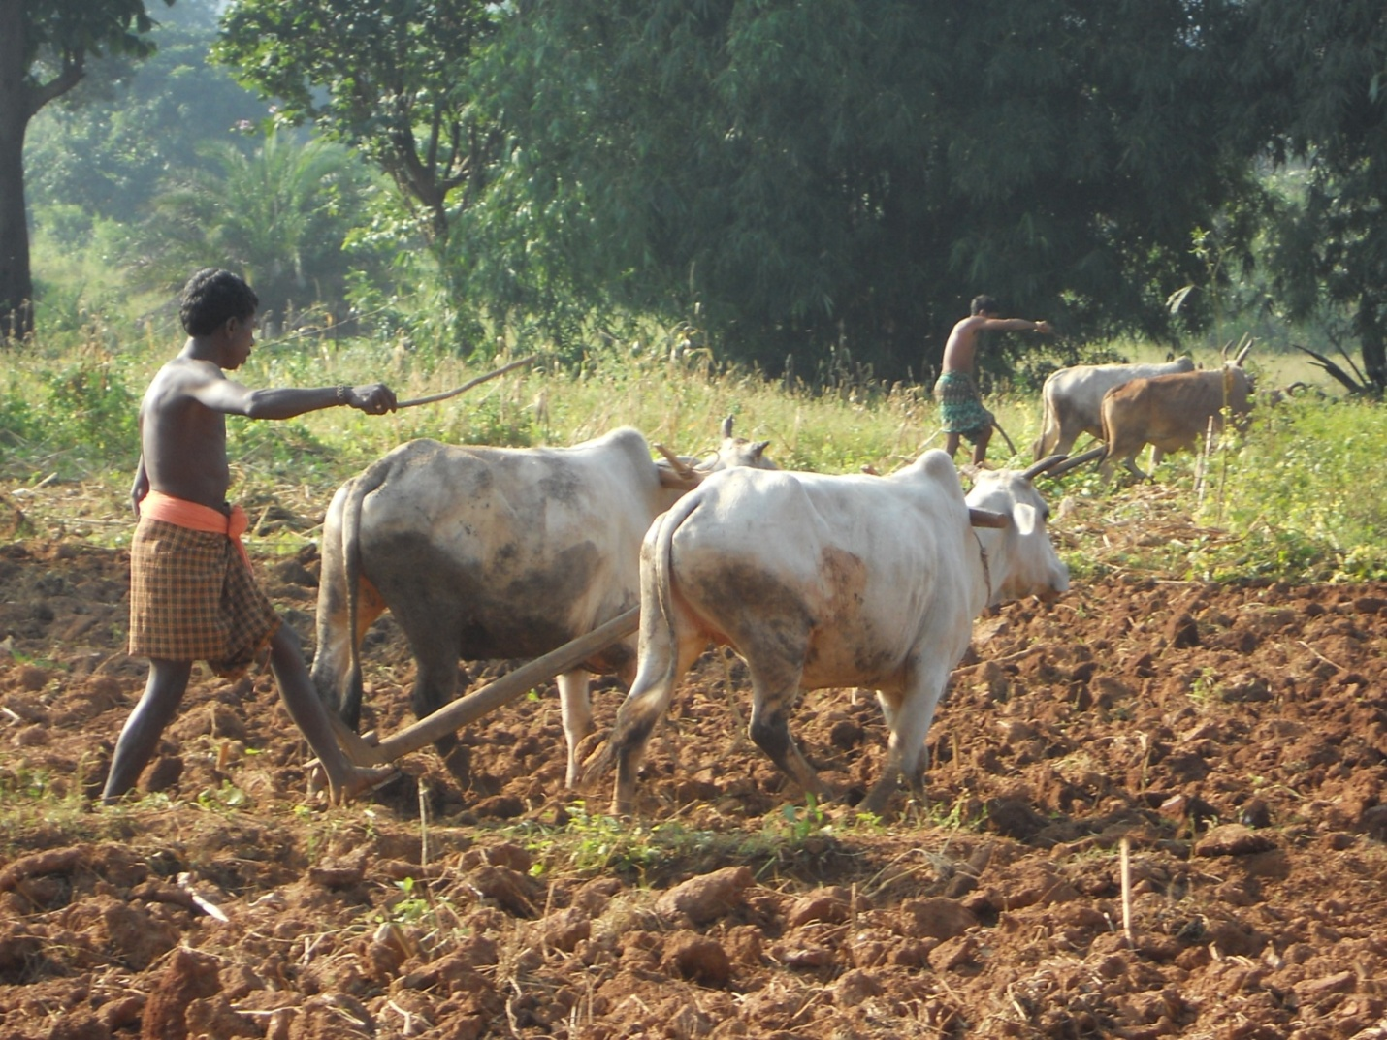
On farm trial

Slide 7
20 household/farm fields in Tentuli participated in Yr 1
4 treatments, randomized block design
Improved varieties of maize (Zea mays) cowpea (Vigna unguiculata) mustard (Brassica juncea)
Treat | Season |  | Ground cover (%) | Tillage
 | 1st season (Jun-Oct) | 2nd season (Nov-Jan)
T1 | Maize | Mustard | 0 | Conventional
T2 | Maize + cowpea | Mustard | 90 | Conventional
T3 | Maize | Mustard | 60 | Minimum
T4 | Maize + cowpea | Mustard | 90 | Minimum

Slide 8
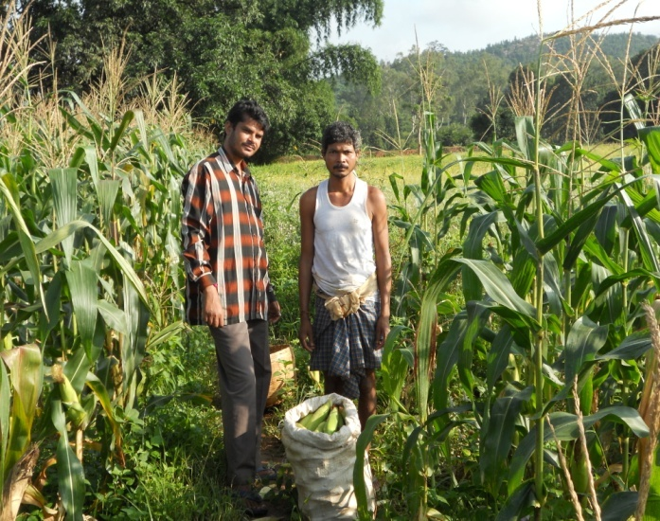
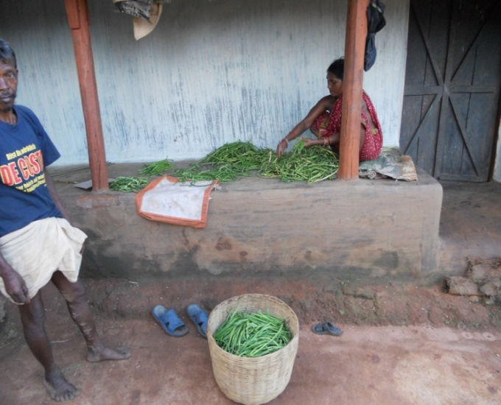
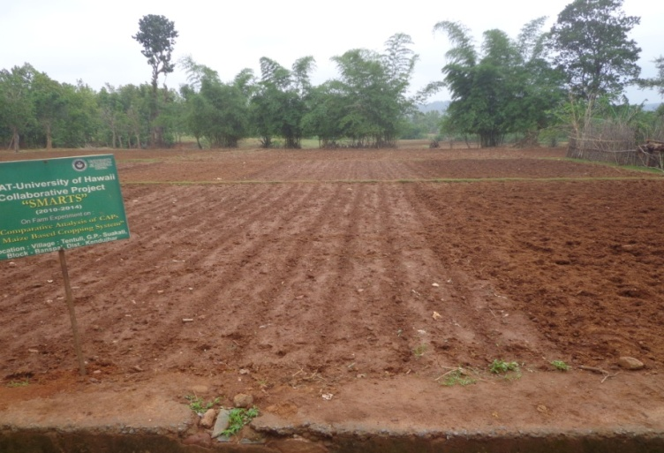
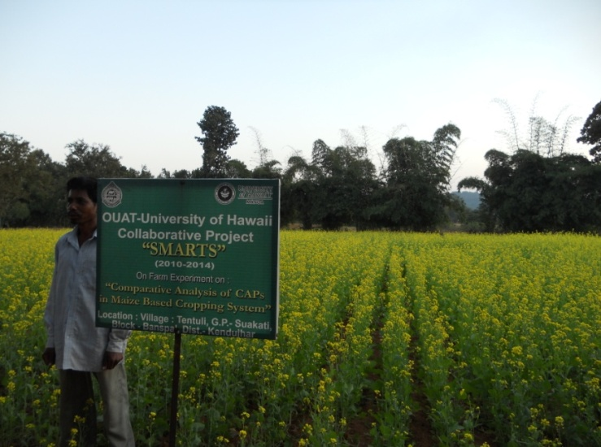
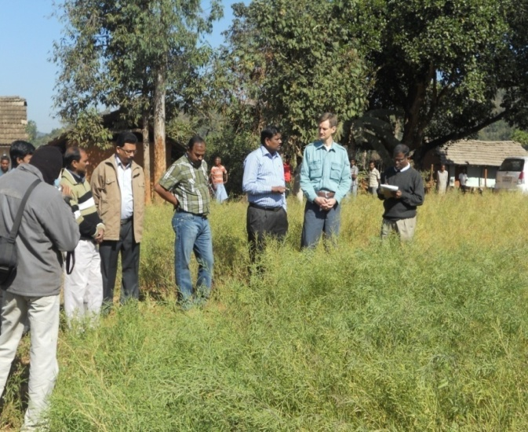
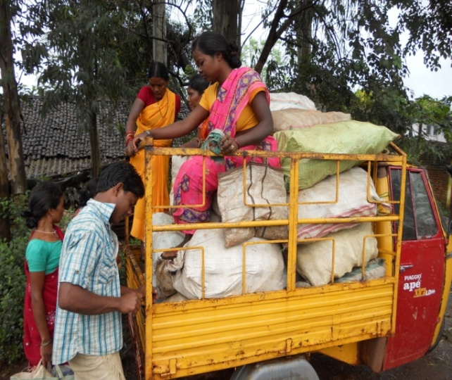
On farm trials showing MT and CT
Harvesting maize
Cowpea yield
Mustard as cover crop
Cover crop trial visit
Harvest ready to sell

Slide 9
Results
Significant interaction effect of tillage and intercropping
Cowpea was an additional yield.
Intercropping had significant effect on mustard yield.
Figure 7. Interaction effect of tillage and intercropping on maize yield

Slide 10
Profitability
MT + intercropping had highest labor requirement
+71% compared to control
Mainly due to weeding and harvesting.
Also had highest profitability
+27% compared to control ($518 ha⁻¹ yr⁻¹)
Cowpea provided additional income
Mustard yield higher in intercropped treatments

Slide 11
Soil
No significant effect of treatments after 1 year
MT + intercropping showed positive trends
bulk density
organic C
extractable nutrients

Slide 12
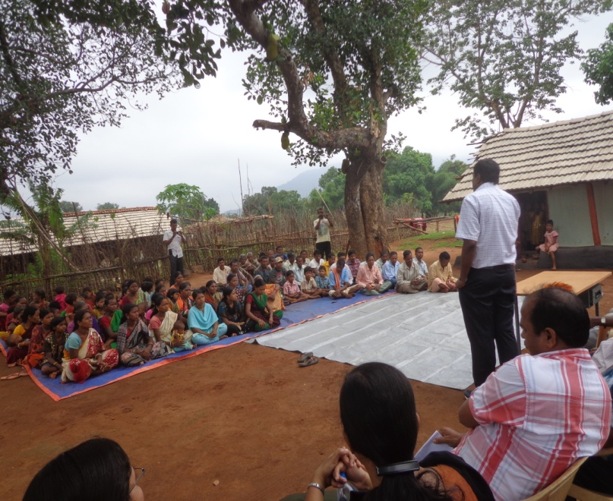
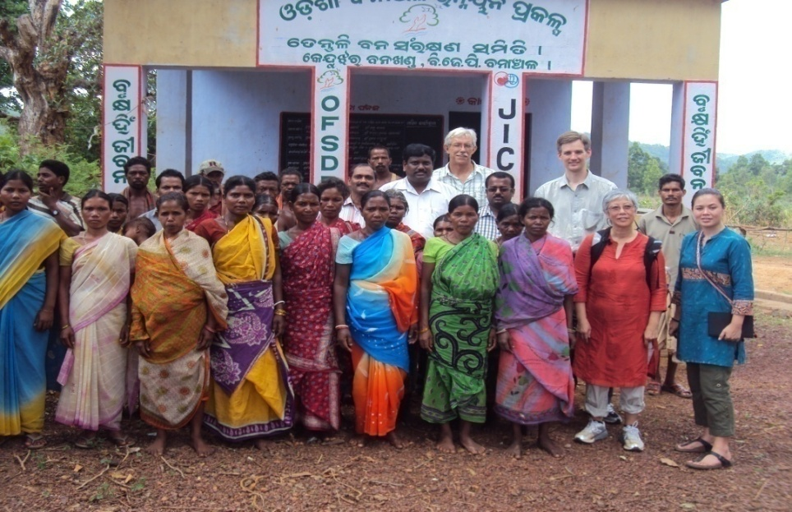
Conclusion
Full implementation of locally adapted CAPS shows promise for meeting SANREM goals
Field days demonstrating CAPS resulted in requests from additional farmers in Tentuli and neighboring villages to participate

Slide 13
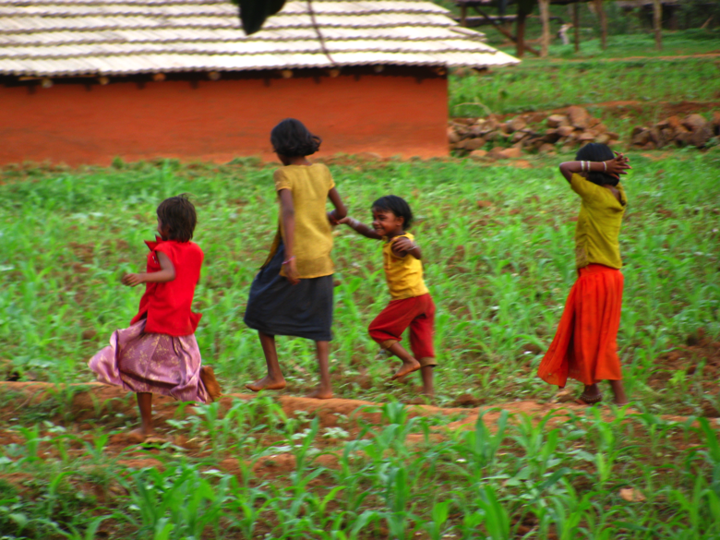
Mahalo (Thank you)

