Slide 1
Developing a Survey to Determine Student Perceptions of Readiness at the Beginning of an Educational Leadership Program
Michael Kelly, Ed. D.
John Gratto, Ed. D.
Virginia Tech

Slide 2
Introduction
Reason for the study
Program information
Council for the Accreditation of Educator Programs (CAEP)

Slide 3
CAEP-Advancing Excellence in Educator Prep Programs
Three CAEP standards buttress the importance of this study. Pertinent CAEP “Advanced Program Components” are as follows:
Satisfaction of Completers 4.4: The provider demonstrates, using measures that result in valid and reliable data, that advanced program completers perceive their preparation as relevant to the responsibilities they confront on the job, and that the preparation was effective.
Quality and Strategic Evaluation 5.1: The provider’s quality assurance system is comprised of multiple measures that can monitor advanced program candidate progress, advanced completer achievements, and provider operational effectiveness. Evidence demonstrates that the provider satisfies all CAEP standards.
Continuous Improvement 5.3: The provider regularly and systematically assesses performance against its goals and relevant standards, tracks results over time, tests innovations and the effects of selection criteria on subsequent progress and completion, and uses results to improve program elements and processes (CAEP, 2015).

Slide 4
Literature Review
Current literature
  Orr & Orphanos (2011)
  Stanford Educational Leadership Institute
  Baker University

Slide 5
Literature Review
Accreditation Agencies
  CAEP
  UCEA
  ISLLC/ELCC

Slide 6
Literature Review
State Standards
  Florida
  California
  Connecticut

Slide 7
Methodology
Instrument
  Internship objectives
  Likert scale
  Sections (6)
Population
  Locations
  Students

Slide 8
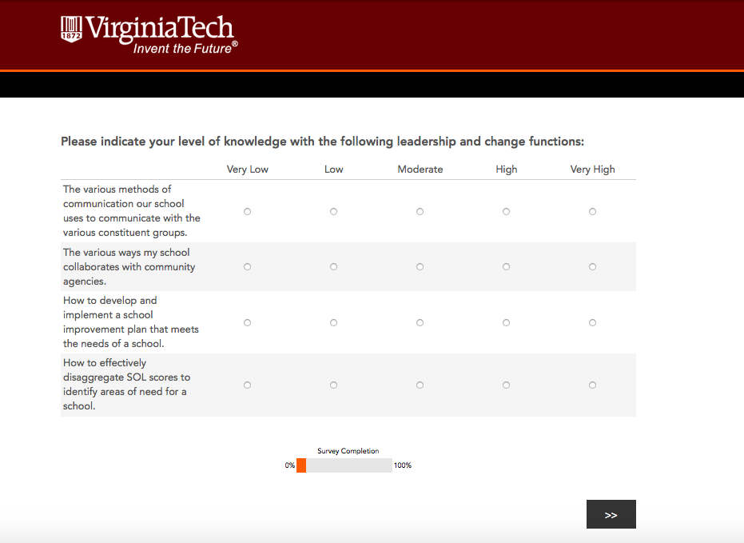
Sample Survey Question

Slide 9
Methodology
Validity
  Faculty review
  Panel of experts
Reliability
  Cronbach’s Alpha
  Section then whole
Data collection and analysis

Slide 10
Survey Questions
Knowledge of leadership and change functions
  The various methods of communication our school uses to communicate with the various constituent groups.
  The various ways my school collaborates with community agencies.
  How to develop and implement a school improvement plan that meets the needs of a school.
  How to effectively disaggregate SOL scores to identify areas of need for a school.

Slide 11
Findings
Knowledge of leadership and change functions
Case Processing Summary |  | N | %
Cases | Valid | 48 | 94.1
 | Excludedª | 3 | 5.9
 | Total | 51 | 100.0
Cronbach's Alpha | N of Items
.632 | 4

Slide 12
Survey Questions
Knowledge of curriculum and instructional supervision
  The process used by the school system to develop curriculum, pacing charts, and scope and sequence guides.
  The process used by the school system to adopt textbooks and other instructional materials.
  The instructional technology needs of the faculty and district or school staff.
  The process of how to develop a master schedule in a school.

Slide 13
Findings
Knowledge of curriculum and instructional supervision
Case Processing Summary |  | N | %
Cases | Valid | 48 | 94.1
 | Excludedª | 3 | 5.9
 | Total | 51 | 100.0
Cronbach's Alpha | N of Items
.872 | 4

Slide 14
Survey Questions
Knowledge of student services
  The process my school system uses for identifying and providing services for students with disabilities.
  The policies and procedures required for meeting the needs of students identified under the Section 504 of the Vocational Rehabilitation Act of 1973.
  The process my school uses to identify students considered at-risk.
  The process an administrator must follow when handling student discipline situations.

Slide 15
Findings
Knowledge of student services
Case Processing Summary |  | N | %
Cases | Valid | 48 | 94.1
 | Excludedª | 3 | 5.9
 | Total | 51 | 100.0
Cronbach's Alpha | N of Items
.804 | 4

Slide 16
Survey Questions
Knowledge of school system operations
  My school system's accounting procedures, the monthly financial statements, and the annual financial audit.
  The budget process and timeline used by the central office each year to develop the school system budget.
  The budget process and timeline used by my principal each year to develop the school budget.
  The requirements for conducting emergency drills in our school system.

Slide 17
Findings
Knowledge of school system operations
Case Processing Summary |  | N | %
Cases | Valid | 48 | 94.1
 | Excludedª | 3 | 5.9
 | Total | 51 | 100.0
Cronbach's Alpha | N of Items
.850 | 4

Slide 18
Survey Questions
Knowledge of school board policies
  The process used to develop a school board policy.
  The school board’s policy and regulations regarding professional ethics and diversity.
  The crisis intervention plan for my school.
  The school system's policy for "bring your own device" (BYOD) related to students.

Slide 19
Findings
Knowledge of school board policies
Case Processing Summary |  | N | %
Cases | Valid | 48 | 94.1
 | Excludedª | 3 | 5.9
 | Total | 51 | 100.0
Cronbach's Alpha | N of Items
.896 | 4

Slide 20
Survey Questions
Knowledge of human resource functions
  How to implement a professional development plan in a school.
  The process administrators must go through to conduct teacher observations in my school system.
  The process a principal must undergo to place a staff member on a plan of action for improvement.
  The process an administrator must follow to screen, interview and hire new faculty and staff members.

Slide 21
Findings
Knowledge of human resource functions
Case Processing Summary |  | N | %
Cases | Valid | 48 | 94.1
 | Excludedª | 3 | 5.9
 | Total | 51 | 100.0
Cronbach's Alpha | N of Items
.627 | 4

Slide 22
Findings
Reliability of complete survey instrument
Case Processing Summary |  | N | %
Cases | Valid | 48 | 94.1
 | Excludedª | 3 | 5.9
 | Total | 51 | 100.0
Cronbach's Alpha | N of Items
.927 | 24

Slide 23
Conclusions and Future Study
Conclusions
  Validity
  Reliability
Future Study
  Low n value
  Qualitative study of faculty implementation
  Study upon program completion

Slide 24
Questions and Close
Michael Kelly, Ed. D.
michk66@vt.edu
John Gratto, Ed. D.
john1112@vt.edu

