Slide 1
Text Transformation
May 5th, 2015
CS 4624 - Multimedia/Hypertext
Virginia Tech, Blacksburg, VA 24060
Members: Stephen Fenton, Dustin Thompson, Kevin Cox, Zach Henke
Client: Nathan Hall

Slide 2
Client Information
Nathan Hall- VTechWorks Librarian
nfhall@vt.edu
2038 Newman Library (0434)

Slide 3
Introduction
VTTI, Virginia Tech Transportation Institute wants to update their website to show off their publications, and wants the citations from the publications to be searchable by field.
Our initial goal was to deliver a comma separated file (CSV) file of ~ 1500 citations separated into different fields.
Notes:
Also it will allow the citations to be ordered by a certain column.
The Fields: Author, Year, Title, Publication, Location, Date, Volume, Issue, Pages

Slide 4
Parsing
We developed a program which could parse through the list of citations for us, and separate them into the proper fields.
It uses a tree of regular expressions which start out very broad and become more specific.

Slide 5
Tree Tool
We developed a helper program which we use to build a tree of regexes.
It uses capturing groups to separate the different fields.
It gets more specific as you move deeper down the tree.
Can import and export regex tree files.

Slide 6
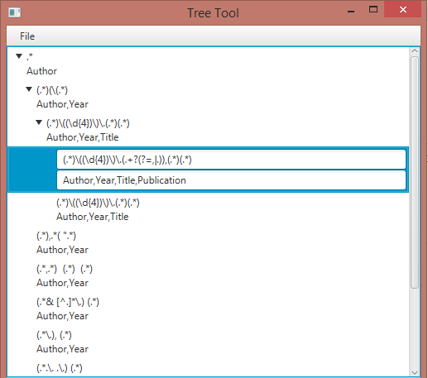
Tree Tool - Simple

Slide 7
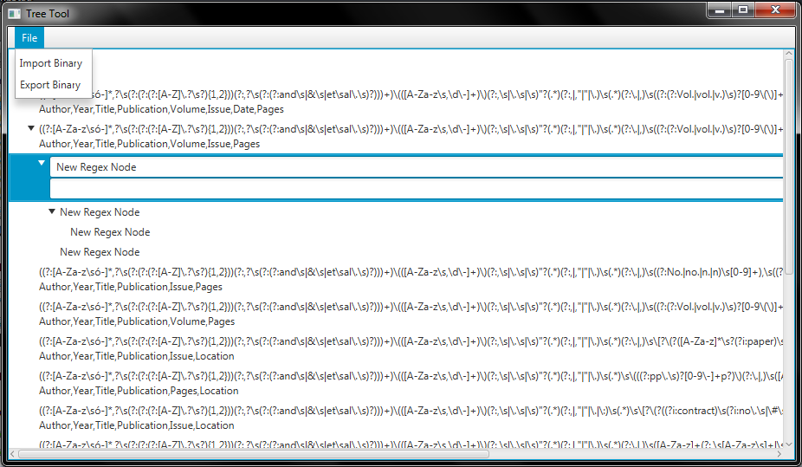
Current Regex Tree

Slide 8
Parsing Program
Uses a tree file created by our tree tool to parse through the list of citations.
Allows you to select which tree file you use, the citations you are parsing, and an output destination.
Creates two files, the csv of parsed citations, as well as a failed output file for if it missed any of them.

Slide 9
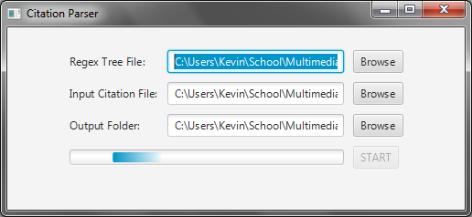
Parsing Program

Slide 10
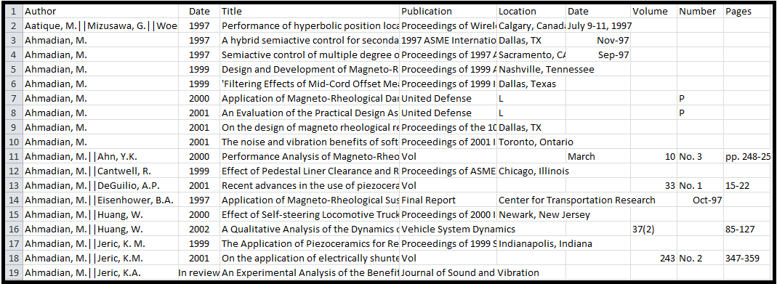
Output
Program outputs to a CSV file with labeled columns

Slide 11
Extensibility
Our project is very extensible because a different regex tree could be developed by someone to match the format of the citations they need it for. It can be specifically trained to look for certain things.
It does require some development work and knowledge of regular expressions.

Slide 12
Lessons Learned
Dealing with a wide variety of different formats within one file is extremely difficult.
Learned a lot about the use of regular expressions.
Early research/work is the key to success
Don’t underestimate the amount of work, and work diligently.

Slide 13
Alternatives
Besides our own parsing program, we looked into Brown University’s freecite tool.
We developed a small program which sends our list of citations to freecite using its API, and then outputs it to a CSV.
This can be used when you need something quick, but it isn’t customizable.

Slide 14
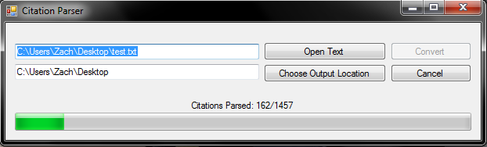
Alternatives

Slide 15
Acknowledgements
Thank you to our client Nathan Hall for being very helpful and friendly with us.

Slide 16
Questions?

