Slide 1
Managing Library Social Media with HootSuite: a case study
Jennifer Nardine
Virginia Tech University Libraries
October 26, 2012

Slide 2





Social Media – the Dream: Time Saver
Notes:
seven functional building blocks: identity, conversations, sharing, presence, relationships, reputation, and groups
six different types of social media: collaborative projects (for example, Wikipedia), blogs and microblogs (for example, Twitter), content communities (for example, YouTube), social networking sites (for example, Facebook), virtual game worlds (e.g., World of Warcraft), and virtual social worlds (e.g. Second Life).

Slide 3


Social Media - the Reality: Time Suck
Notes:
Most Facebook audience members expect at least one update per day, while Twitter followers appear to lose interest in a stream that updates less frequently than three to five times daily (PR News 2011).
-instant response to any incoming message
-few libraries can employ full time social media person – often falls to webmaster, librarian or other faculty/staff

Slide 4
Virginia Tech Libraries First Foray
2007 – first Facebook account
2008 – first Flickr account
The plan:
  Webmaster would take in materials from all Reference and Instruction faculty/staff and post them promptly
The reality:
  RIS team didn’t have time to send enough materials for regular updates
  Webmaster had enough other work so he couldn’t fill the gap

Slide 5
Virginia Tech, Take 2
Spring, 2010 –
  Revival of Facebook and Flicker accounts
  Creation of Twitter account
Result: one busy Outreach & Instruction Librarian
<= me

Slide 6
Take 2, Phase 2
Late 2010 - creation of Social Media Working Group with goals:
  Increase posting frequency
  Reduce time spent on social media research and posting
  Bolster interactivity of all social media, i.e. start conversations with users
  Find a way for multiple library users to be responsible for all accounts without sharing passwords
  Establish a concrete plan and method for maintaining the streams of information indefinitely

Slide 7


The Solution – Dashboards
The contenders
Notes:
dashboard is a software tool that allows an administrator to manipulate feeds to and from multiple social media outlets through a single control panel

Slide 8
 | TWEETDECK | HOOTSUITE
Purpose | To enhance Twitter use | To efficiently manage brands via social media
Website quote | Tweetdeck is an app that brings more flexibility and insight to power users. (Tweetdeck 2012) | HootSuite is a social media management system for businesses and organizations to collaboratively execute campaigns across multiple social networks from one secure, web-based dashboard. (HootSuite 2012)
Interface with | Twitter, Facebook | Facebook, Twitter, LinkedIn, Google+, Foursquare, Mixi, MySpace, WordPress, etc
Functionality | Filter for important items Schedule tweets ahead of time Monitor and manage unlimited number of accounts Stay current with notifications of new tweets Displays incoming and outgoing messages in one stream | Allows users to manage multiple social profiles Schedule messages and tweets Track brand mentions Analyze social media traffic Displays incoming and outgoing traffic in easy-to-read columns in one window
2011 Plans & pricing | Free | Free – 1 profile, message scheduling, 2 RSS $5.99/month – 1 team member, unlimited twitter accounts $1500/month, unlimited
2012 plans & pricing | Tweetdeck has been purchased by and absorbed into Twitter. It is still free, but very focused on Twitter, with other social media given less attention. | Free – 1 profile, message scheduling, 2 RSS PRO ($9.99/month) – 5 profiles, message scheduling, 2 free users, 1 free enhanced analytics report, Google analytics integration, Facebook insights integration, Unlimited RSS
Notes:
Enterprise (price unlisted) – unlimited profiles, 10 free reports, unlimited users, unlimited RSS feeds, Enhanced analytics, Vanity URL, tier 1 support, VIP setup, opt out of ads, archive tweets, 10 seats at Hootsuite certification program

Slide 9
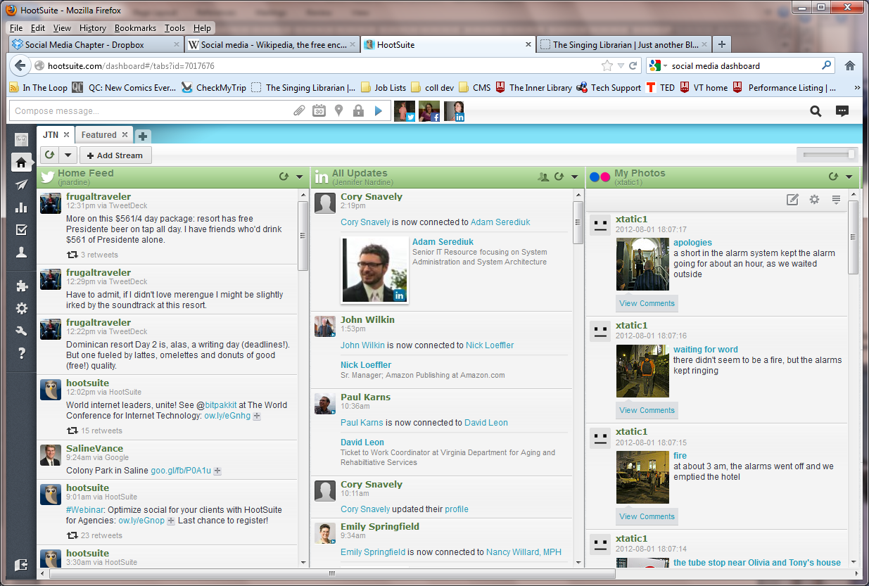
The Winner – Hoot Suite
Notes:
After reviewing each platform, we chose to start with a free HootSuite account. We based our decision on these observations and concerns:
While our dashboard use was in pilot mode, we had no start-up funding for paid accounts
The ability to create and schedule posts in one interface and send them to multiple networks appeared to be a great time-saver
The HootSuite dashboard display was, in our opinion, both better organized and easier to read than Tweetdeck’s interface
HootSuite was designed to work with multiple social media platforms equally, rather than being primarily optimized for Twitter
HootSuite’s original purpose was closer to our goals than was Tweetdeck’s
We liked the potential ability to “buy up” our account, with the option to include multiple users and added analytic capacity in the future
One librarian had already done her own dashboard comparison and found HootSuite to be more user-friendly, so we could leverage her significant experience with it and thus reduce the initial steep grade of our dashboard learning curve

Slide 10
Best Practices
One, central password for all admins
Post at least 5 times/day
Standard message categories:
  Resources
  Services
  Campus-level Announcements
  General Interest
Streamline process by posting in batches
Notes:
Resources: A weekly post on a new acquisition
A weekly post about an already-available item or database of interest
Services: A weekly post about a service offered by VTL, such the availability of online reference sessions or off-campus sign-in to databases
Intermittent posts about changes in hours of operation, the library’s exam week coffee service, and other end-of-semester events
Welcome messages to groups coming to Newman Library for tours or instruction
Campus level announcements: A “go team” post before major sporting events
Information about holidays, vacations, and closures
General Interest: A weekly post wishing a notable person from the past or present a happy birthday
At least one post per week from the Chronicle of Higher Education
Links from the campus calendar and the student newspaper, at least once per week

Slide 11
Results
Fewer interactions with readers than ideal
  Still a notable time lag between send and respond
Increased “likes” and “follows”
Decrease in time spent on updating despite adding more feeds
  Batch entry and pre-scheduling instrumental in change

Slide 12
So how do you do it?

Slide 13
Resources
Kietzmann, J.H., Hermkens, K., McCarthy, I.P., & Silvestre, B.S. 2011. Social Media? Get Serious! Understanding the Functional Building Blocks of Social Media. Business Horizons, 54, 241-251.
How To...Wrangle Your Reputation Online. 2011. PR News, August 1. ProQuest (2412995411).
SocialBrite. 2012. “Top 10 Social Media Dashboard Tools.” November 9, 2010. http://www.socialbrite.org/2010/11/09/top-10-social-media-dashboard-tools/ .

Slide 14
Questions?
  Contact me:
    Jennifer Nardine, jnardine@vt.edu
  Look for the chapter in the forthcoming book: Time Organization for Librarians: Beating Budget and Staff Cuts

