Slide 1
AI System RPG
Jason Lao, Daniel Sabanov, Devin Toms, Kurt Grzybowski
CS 4624: Multimedia, Hypertext, and Information Access
Professor Edward A. Fox
Virginia Tech, Blacksburg VA 24061
May 03, 2023

Slide 2
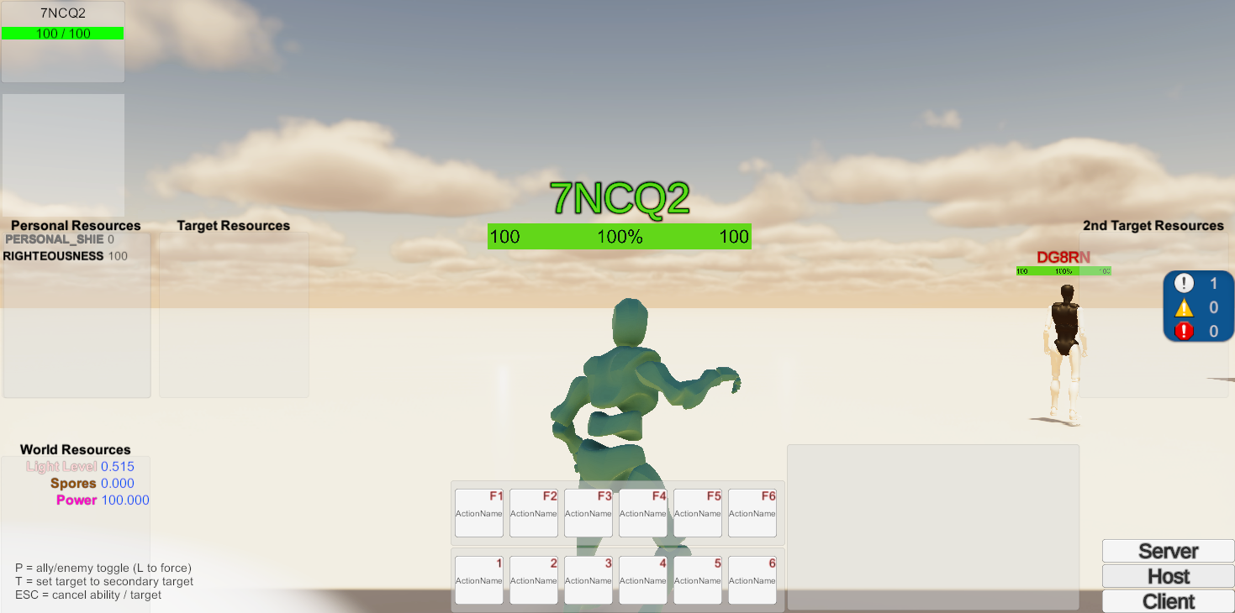
Outline
Project Description
Design
Implementation
  Routine System
  Black Box
Testing
Future Work
Lessons Learned
Acknowledgements
A screenshot of the current build of the game.
Notes:
Jason

Slide 3
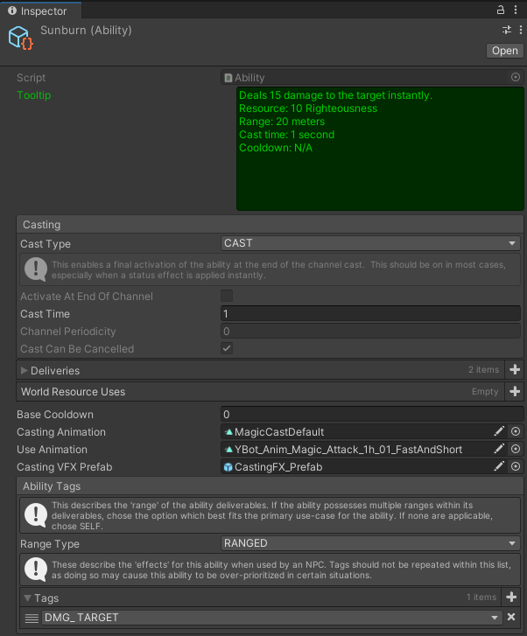
Project Description
We were tasked with creating an AI with the following capabilities:
  The AI must be able to interact with the implemented ability system effectively
  The AI is under the same restraints as a player character
  The AI can either be an enemy or an ally
We chose to use a routine-based solution, where we created a Black Box function to deduce the best course of action
Ability Tags were created in order to better categorize the possible abilities the AI is capable of using and what they can do
Notes:
Jason

Slide 4
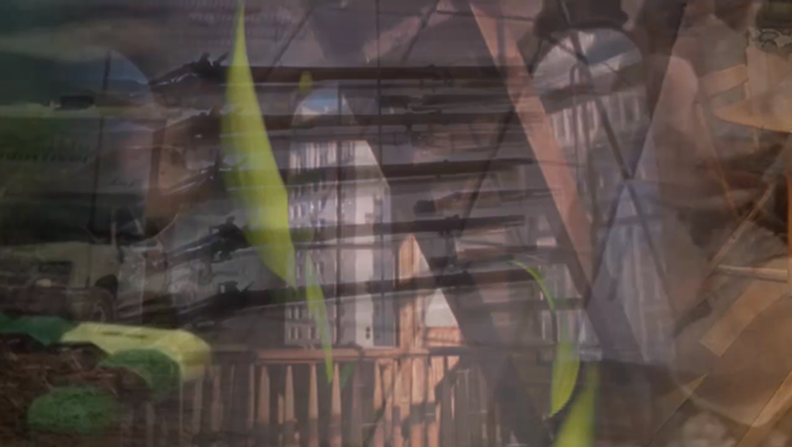
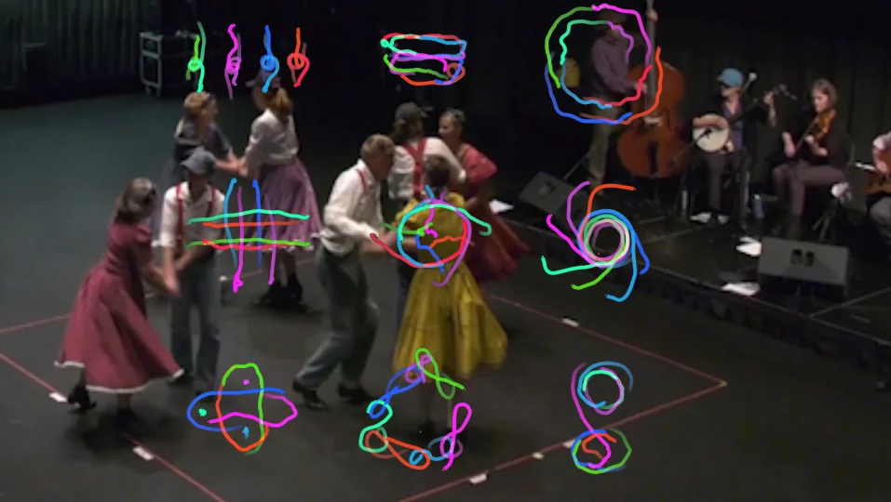
Background
Client: Prof. Zach Duer
  Assistant prof. at VT School of Visual Arts
Developing RPG for >1 year
  Completed:
    Modular ability system
    Animation system
    Multiplayer networking
nothing_nomeanings
Square Dance Cubed
Notes:
Jason

Slide 5
Requirements
NPC’s need AI
  Engage with players and against players
Deal with Modular ability system
  No set abilities
Feel “Real”
  Same access to information as characters
  Flexibly use abilities
Notes:
Jason

Slide 6
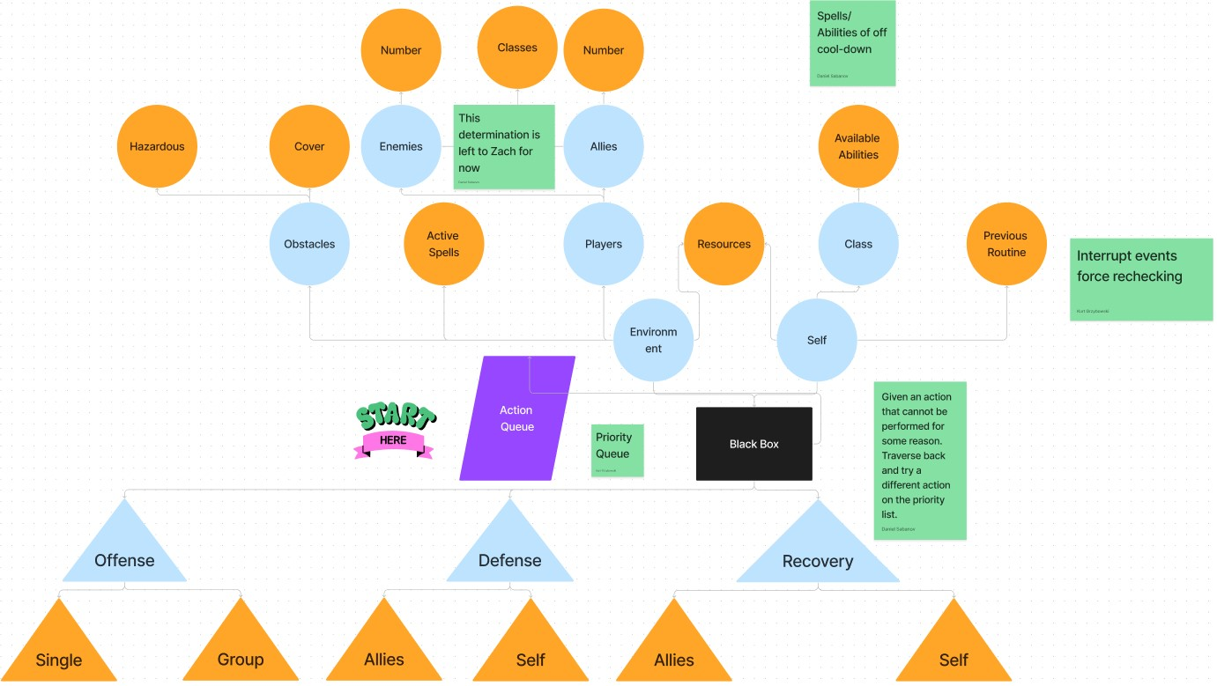
Design
Notes:
Routines control what abilities will be used
Kurt
The following flow-chart represents our mindset when making the Black Box, taking into account information and the routines made
Routines are what abilities will be utilized the the AI
Ability Tags were created in order to help the AI understand the uses of its abilities
Legend:
Circle: Info we want to take into account
Triangles: Routines

Slide 7
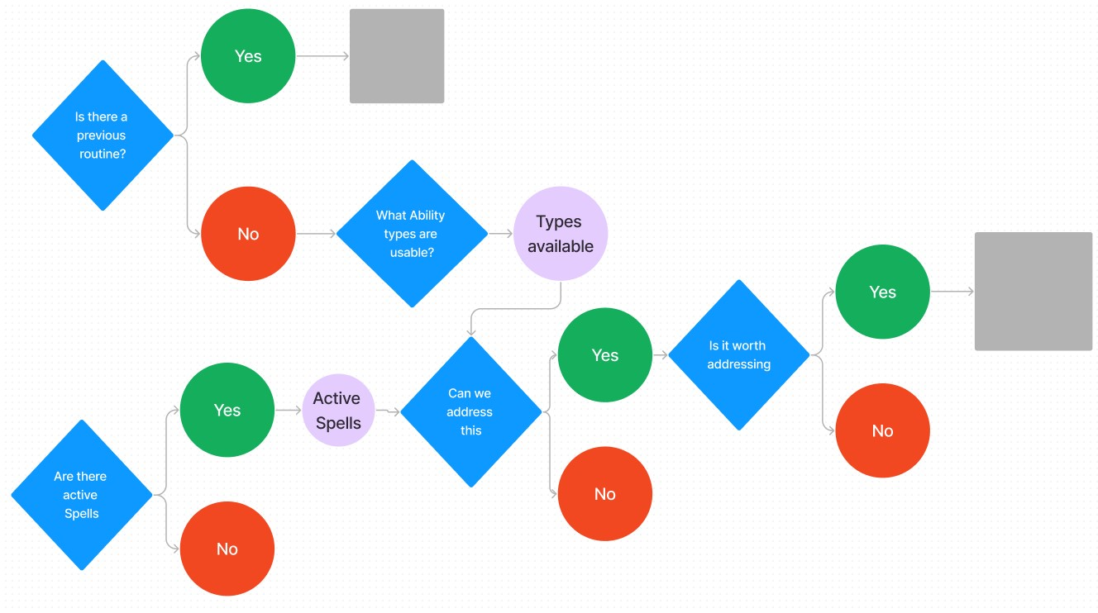
BlackBox
Notes:
Kurt

Slide 8
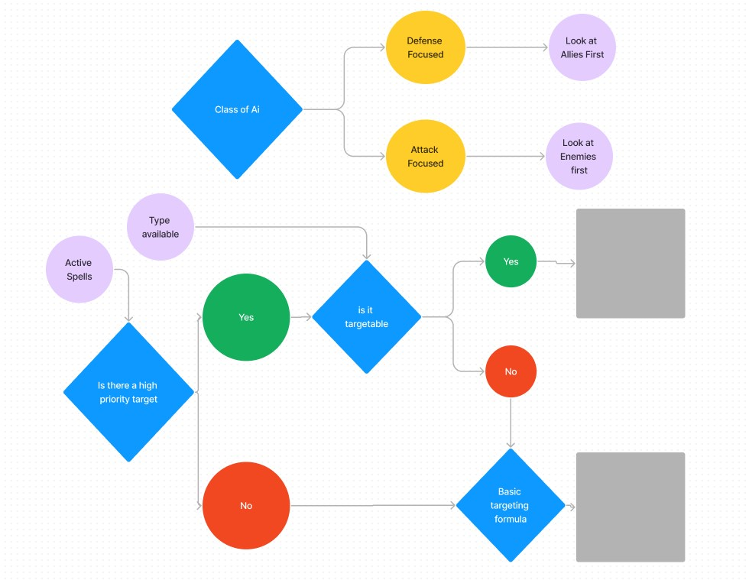
BlackBox
Notes:
Kurt

Slide 9
Implementation
Four main things that were implemented:
Routines - Controls AI behavior
Ability Queue - A queue meant to hold multiple abilities to be used in succession (can only hold 3 abilities)
Ability Tags - Categorization of abilities an AI is capable of using in order for the AI to know what it can do
Black Box - A file that controls total AI behavior using all previously mentioned concepts, it is the AI’s “brain” so to speak
Notes:
Devin

Slide 10
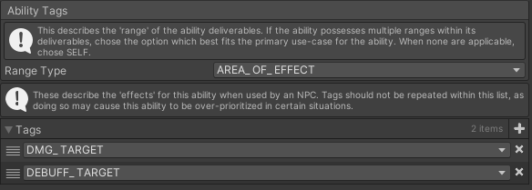
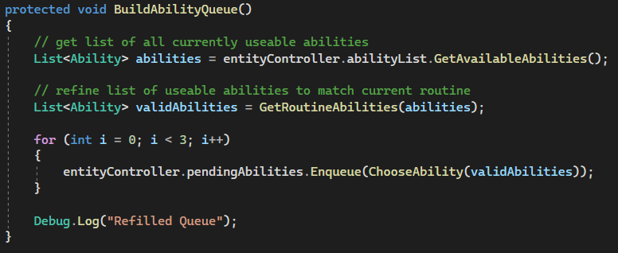
Routine System
AI behavior controlled through a series of “states”
PickRoutine state reads from Black Box to find best routine state
Routine fills Ability Queue based on ability tags
Ability tags customizable by designer
Notes:
Devin

Slide 11
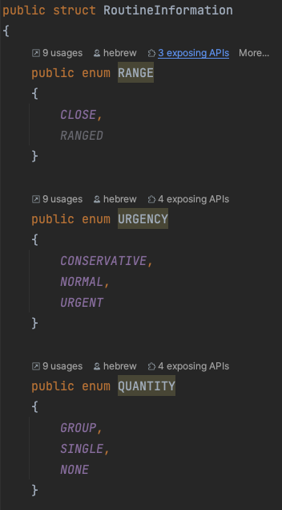
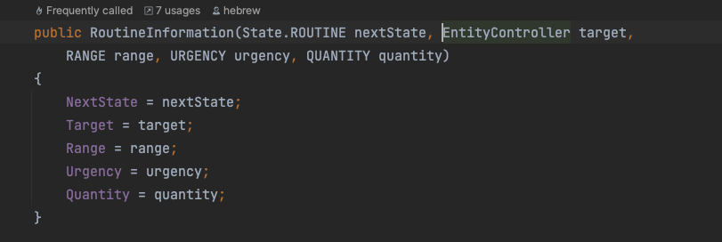
BlackBox
Evaluates the environment and selects the best general strategy (state)
  Attack
  Defend
  Heal
Notes:
Daniel

Slide 12
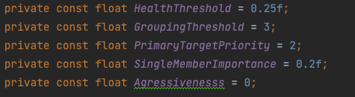
BlackBox Logic
Each time the character needs to decide on the next action, the NextRoutine() function is called.
The function runs through a set of conditionals to evaluate the situation
As soon as a condition is met, creates a RoutineInformation struct and returns
These conditionals can be adjusted by interacting with prespecified global parameters
Notes:
Daniel

Slide 13
Testing
For our testing, Professor Duer provided us with various scripts in which we can build and create various scenarios for testing purposes. This provides us with a great deal of control over testing for the Black Box and the Routine System:
  We can control how NPCs are spawned
  We can control where NPCs appear
  We can control what kind of NPCs are made, enemies or allies
This allows us to test AOE attacks, healing allies, crowd control abilities, and test attack range, damage, radius, etc.
The game's user interface (UI) elements and Unity's built-in console provide another potential testing tool, and can be used to test AI instances interactions on a more fine-grained level.
Notes:
Daniel

Slide 14
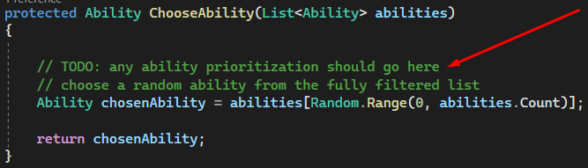
Future Work
Next Few Weeks
  Tweak any misfitting variables
  Document non-implemented planned features
Future Teams
  Incorporate AI into both the Black Box and Routine System
  Incorporate more variables from the environment
  Add focus on non-combat situations
Notes:
Kurt

Slide 15
Acknowledgements
We would like to thank our client, Zach Duer, Dr. Fox, and the TAs for providing us with the opportunity to work on this project and providing us with the necessary resources to succeed.
Notes:
Daniel

Slide 16
References:
https://sova.vt.edu/faculty/zduer/
https://www.zachduer.com/

