Slide 1
YouTube Video Analysis
Akhil Bachubhay, Danny Chhour,
Heji Deng, Trung Tran
CS 4624 Multimedia, Hypertext, and Information Access
Edward A. Fox
Virginia Tech, Blacksburg VA 24061
May 7, 2021

Slide 2
Outline
Overview
Project Deliverables
Implementations
Data and Results
Future Plan
Acknowledgments
References

Slide 3



Overview
Transcripts
Comments
Metadata
Gamer Success
over time
Downloads
Analyzed
with
Used to
Assess

Slide 4
Project Deliverables
01
Views
Duration
Likes
Dislikes
Frequency Counts per Video
02
Transcripts
Comments
Metadata
Code for Downloading Data
03
Transcripts
Comments
Metadata
Analysis

Slide 5
Implementation - Download Data - Metadata
Title | Views | Date Published | Duration | Likes | Dislikes | ID | Transcript | Comments | Playlist ID
Cities: Skylines Industries - Quick Start Guide to Forestry Industry #1 | 434678 | 2018-10-20T10:45:00Z | 1855 | 4875 | 224 | KmoT0flN8XQ | yes | yes | PLR5G_Kc9r-JDgtRnpSd4AYKHTY_Iq7L-7

Slide 6
Implementation - Download Data - Transcripts
Text | Start | Duration
well here we are in the city of spring | 0.03 | 6.78
wood sent in by Finn and we had lots of | 3.449 | 6.031
problems here in the industry area so | 6.81 | 4.23
we're gonna be concentrating on this | 9.48 | 3.39
today it's a nice big city lots of other | 11.04 | 5.22
places set up okay but where's the other | 12.87 | 5.31
place over here this is all industry as | 16.26 | 4.74

Slide 7
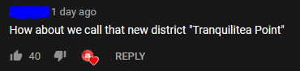
Implementation - Download Data - Comments
API
CID | Author | Text | Time | Votes
Ugzy8oMkL66spvfPTNF4AaABAg | Killerstarlight | <a href="https://www.youtube.com/watch?v=ZTRykbo9E8g&amp;t=10m25s">10:25</a> You never know, the cars could always be ghosts. | 2021-03-16T07:26:20Z | 1
No API
CID | Text | Time | Votes | Heart
UghdvskRrVsXj3gCoAEC | if you changed the roads you placed at 7:08 to ramps. it might help your traffic problem | 6 years ago | 0 | FALSE

Slide 8
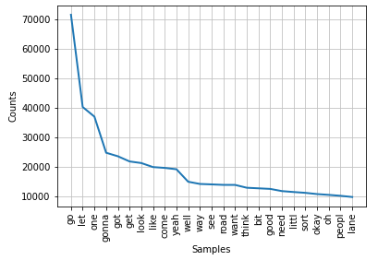
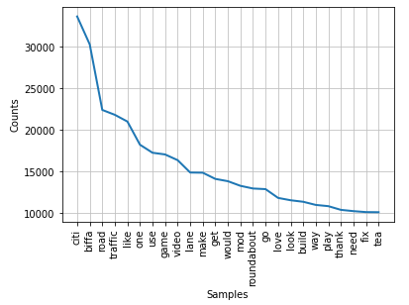
Data and Results
Word Frequency of Transcripts
Word Frequency of Comments
Notes:
Danny’s

Slide 9
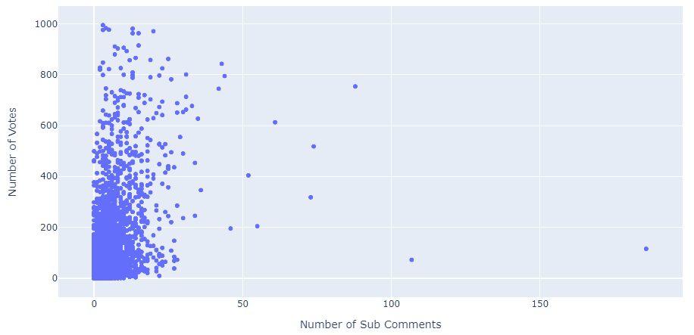
Data and Results
Number of Votes vs. Number of Replies
Notes:
Danny’s

Slide 10
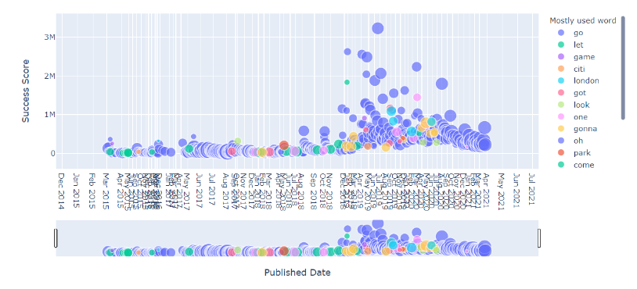
Data and Results

Slide 11


Future Plan
Create a GUI to use the program
Optimizing the time it took to download the data
Create a better model to analyze the data

Slide 12

Acknowledgements
Florian Zach, PhD, Assistant Professor, Howard Feiertag Department of Hospitality and Tourism Management, florian@vt.edu
Office: 355 Wallace Hall, Virginia Tech
295 West Campus Drive
Blacksburg, VA 24061
https://htm.pamplin.vt.edu/directory/zach.html

Slide 13
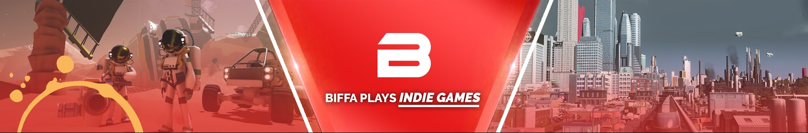
References
How we got the transcripts: https://pypi.org/project/youtube-transcript-api/
How we got the comments:
https://github.com/egbertbouman/youtube-comment-downloader
How we got general video information: https://developers.google.com/youtube/v3/docs
Youtuber: https://www.youtube.com/user/Biffa2001

Slide 14
Questions?

