Slide 1

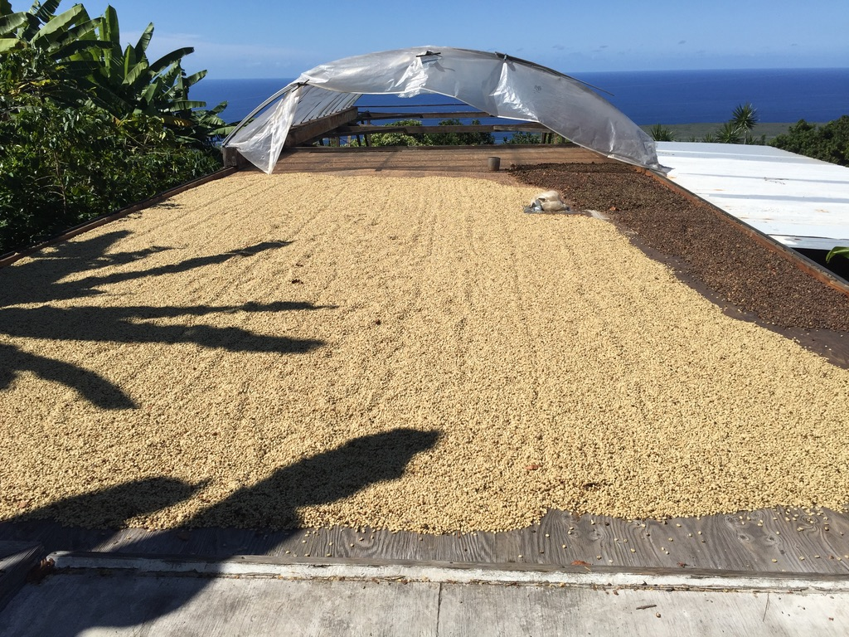
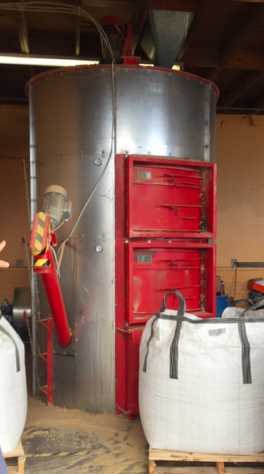
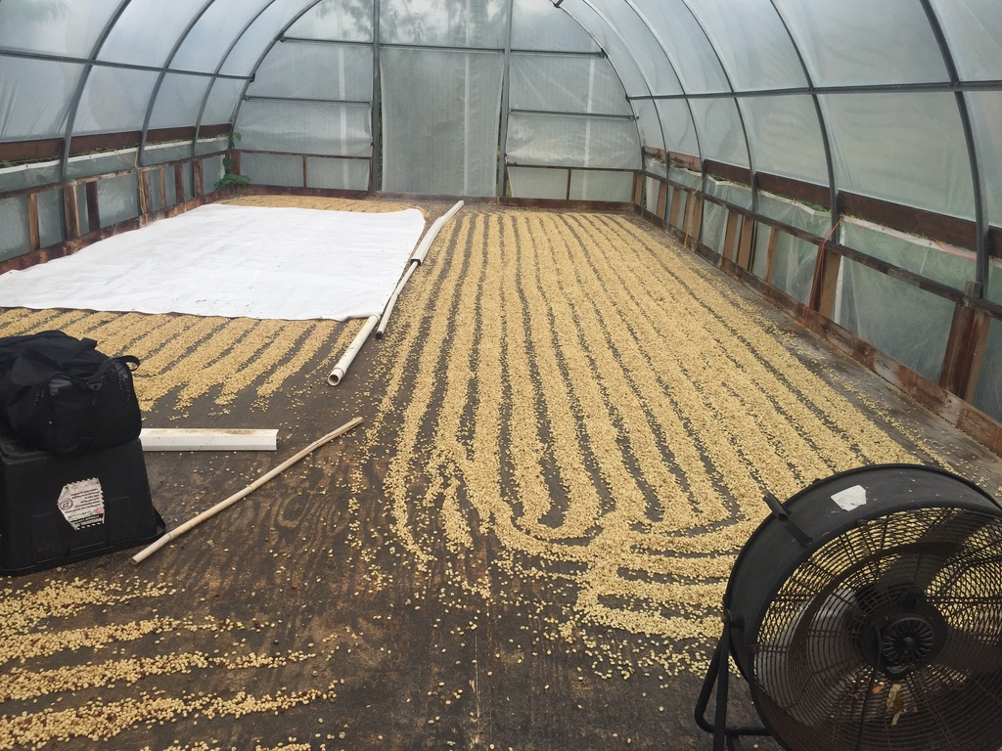
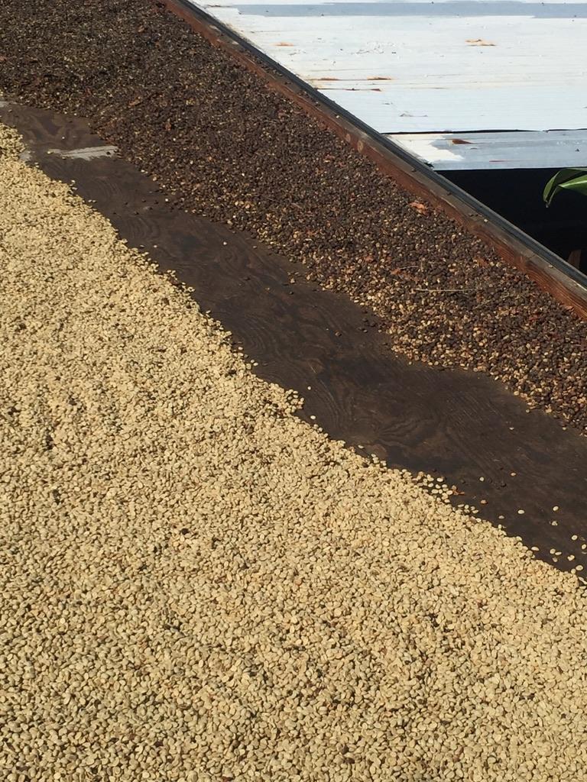
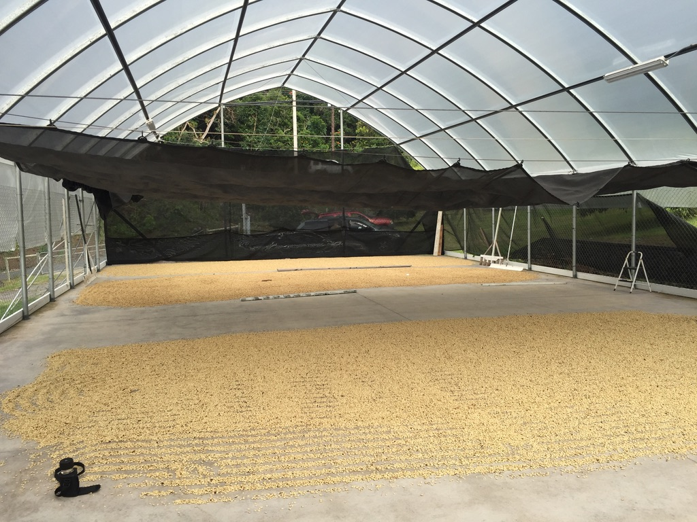
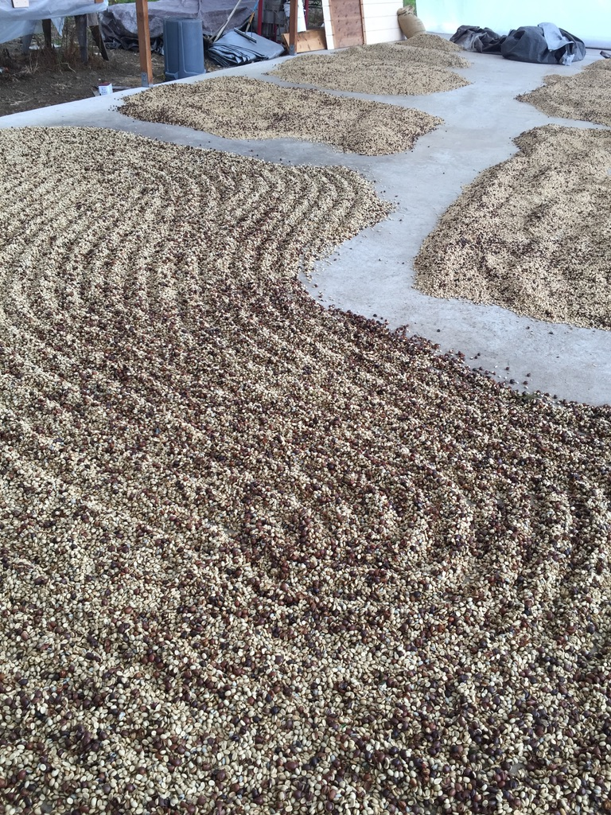
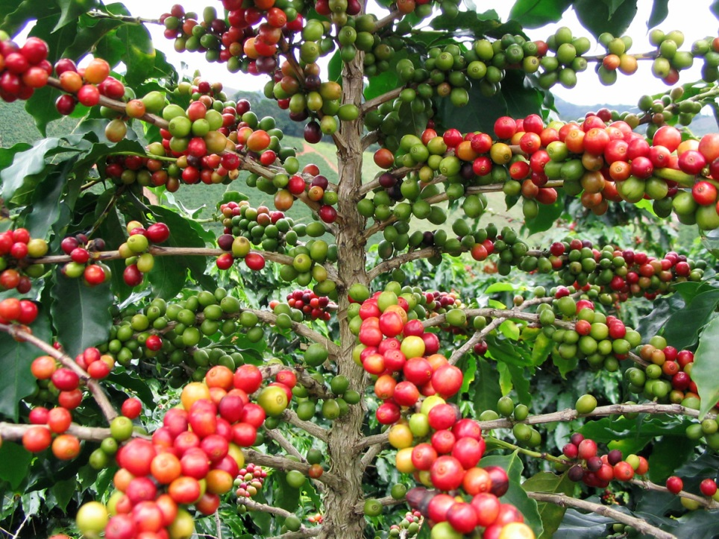
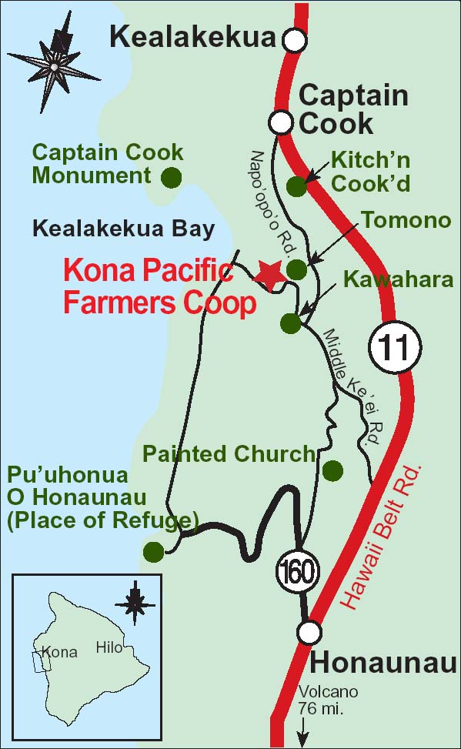
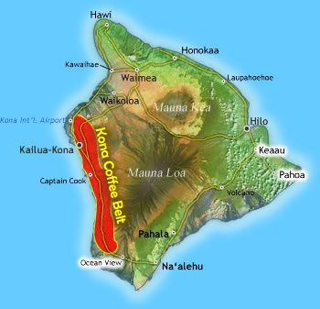
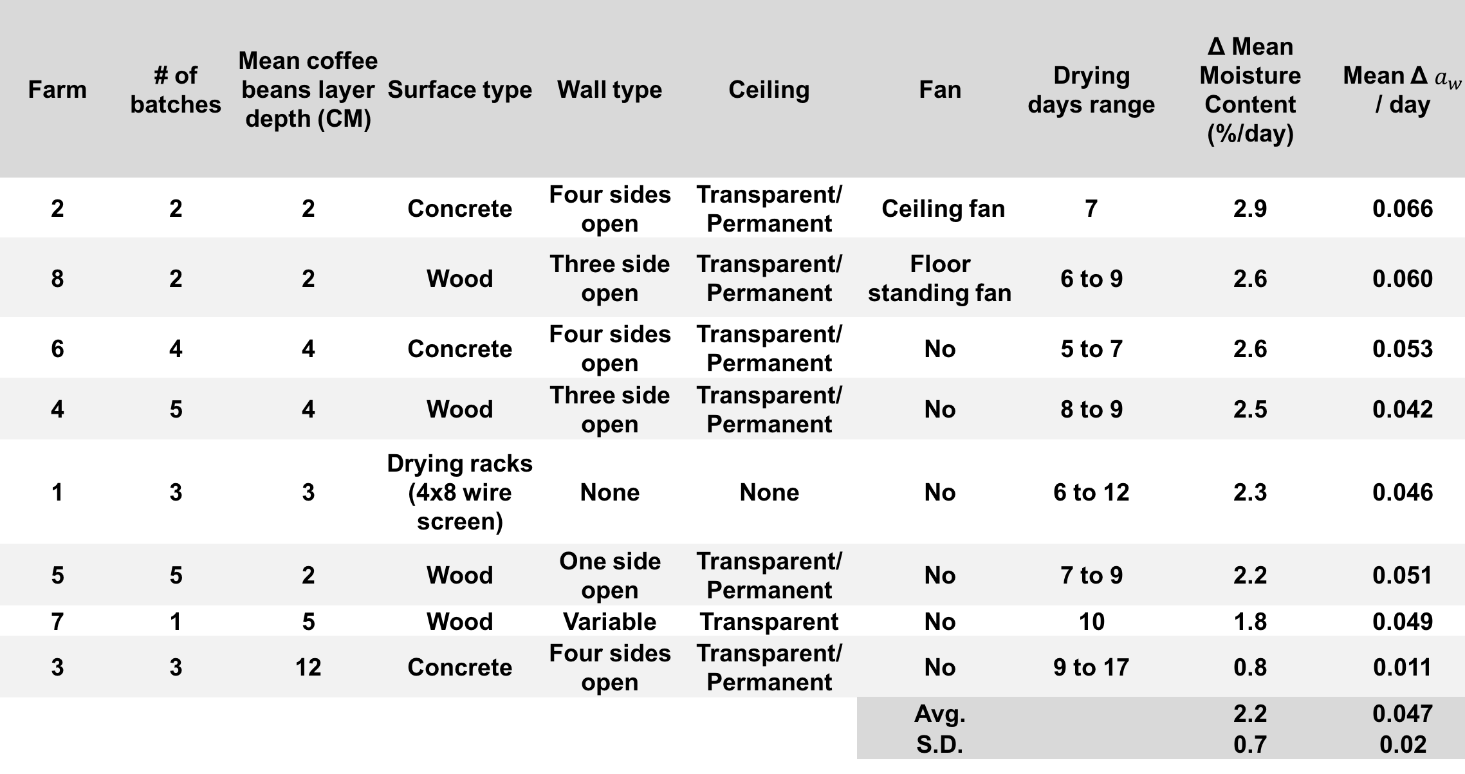
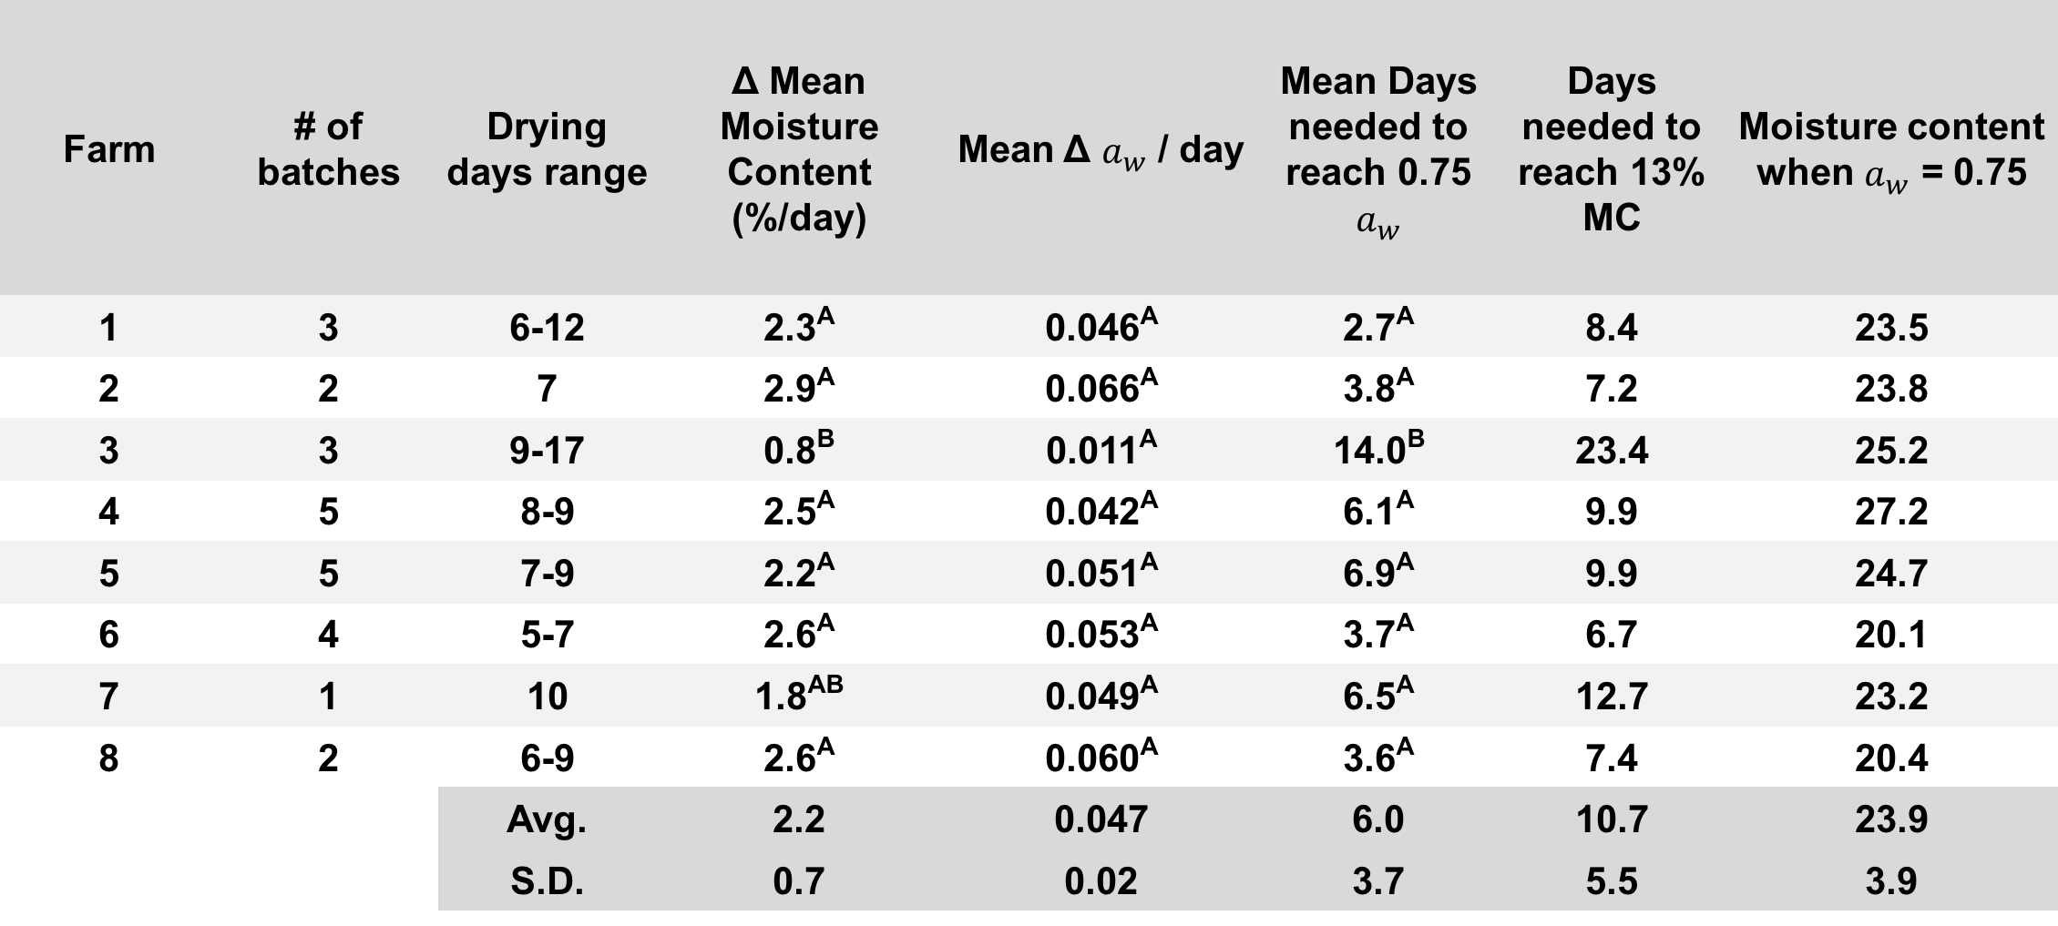
Evaluating post-harvest practices for the quality and safety of Kona coffee
Hassan Masri¹, Joseph Eifert¹, Renee Boyer¹, Laura Strawn^{1,} Zachary Easton²
¹Department of Food Science & Technology, Virginia Tech, Blacksburg, VA. ²Department of Biological Systems Engineering, Virginia Tech, Blacksburg, VA.
ABSTRACT
METHODS
DRYING AND PROCESSING TECHNIQUES
Introduction: Coffee grown in the United States, primarily from the state of Hawai’i, represents less than 1% of the world’s supply. Kona coffee, grown on the western side of the island of Hawai’i, is the most recognized and highest valued Hawaiian coffee. The majority of this coffee is sun-dried after harvest and washing. Sun-dried coffee should reach 9-13% moisture within 4 to 6 days. Reducing water activity (a_{w}) below 0.75, especially in the first week of drying, is important for preventing or limiting mold growth.
Purpose: The purpose of this study was to compare drying rates of Kona coffee bean batches using a_{w} and moisture content % measurements, and evaluate factors affecting the drying time of sun-dried Kona coffee.
Method: Ten Kona region farms were visited in the fall of 2017 to measure the drying rate of coffee bean batches and to record observations on the post-harvest handling and storage of coffee beans and the environmental conditions during drying. Daily measurements of coffee moisture level, water activity, bean layer depth and coffee temperature were recorded along with air temperature, relative humidity and cloud cover during drying for 30 batches.
Results: Most sun-dried batches reached 13% moisture in 6 to 10 days. Initial moisture content (31.6 ± 4.3%), and drying yard characteristics varied greatly among farms. Coffee batches reached 0.75 a_{w} within 6 days on average, but some batches required more than 10 days. Allowing airflow around drying beans and maintaining a bean layer depth of less than 5 cm appeared to improve drying rates.
Significance: Drying coffee parchments within 7 days post-harvest can inhibit growth of molds that may impact quality or molds that could produce mycotoxin. Controlling the drying conditions, including raking the layered beans, and monitoring moisture content can accelerate, or improve the consistency of, batch drying time.
30 batches of newly-harvested coffee beans were sampled from 10 coffee drying yards in the Kona region on the island of Hawai’i. Three coffee bean samples from each batch were collected and tested for percent moisture (40 g each) and for water activity level (5 g each). Measurements from three samples per batch per day were averaged to determine a drying rate over time.
RESULTS
For 8 farms that sun dry their coffee beans, an average of 6.0 + 3.7 days were needed to achieve 0.75 a_{w}. The average moisture content was 21.3% at 0.75 a_{w}.
Farm | # of batches | Drying days range | Δ Mean Moisture Content (%/day) | Mean Δ $a_{w}$ / day | Mean Days needed to reach 0.75 $a_{w}$ | Days needed to reach 13% MC | Moisture content when $a_{w}$ = 0.75
1 | 3 | 6-12 | 2.3^{A} | 0.046^{A} | 2.7^{A} | 8.4 | 23.5
2 | 2 | 7 | 2.9^{A} | 0.066^{A} | 3.8^{A} | 7.2 | 23.8
3 | 3 | 9-17 | 0.8^{B} | 0.011^{A} | 14.0^{B} | 23.4 | 25.2
4 | 5 | 8-9 | 2.5^{A} | 0.042^{A} | 6.1^{A} | 9.9 | 27.2
5 | 5 | 7-9 | 2.2^{A} | 0.051^{A} | 6.9^{A} | 9.9 | 24.7
6 | 4 | 5-7 | 2.6^{A} | 0.053^{A} | 3.7^{A} | 6.7 | 20.1
7 | 1 | 10 | 1.8^{AB} | 0.049^{A} | 6.5^{A} | 12.7 | 23.2
8 | 2 | 6-9 | 2.6^{A} | 0.060^{A} | 3.6^{A} | 7.4 | 20.4
 |  | Avg. | 2.2 | 0.047 | 6.0 | 10.7 | 23.9
 |  | S.D. | 0.7 | 0.02 | 3.7 | 5.5 | 3.9
Open shed drying yard
Mechanical dryer
Batches from farms (3, 7) dried slowest and had greater depth
Farm | # of batches | Mean coffee beans layer depth (CM) | Surface type | Wall type | Ceiling | Fan | Drying days range | Δ Mean Moisture Content (%/day) | Mean Δ $a_{w}$ / day
2 | 2 | 2 | Concrete | Four sides open | Transparent/ Permanent | Ceiling fan | 7 | 2.9 | 0.066
8 | 2 | 2 | Wood | Three side open | Transparent/ Permanent | Floor standing fan | 6 to 9 | 2.6 | 0.060
6 | 4 | 4 | Concrete | Four sides open | Transparent/ Permanent | No | 5 to 7 | 2.6 | 0.053
4 | 5 | 4 | Wood | Three side open | Transparent/ Permanent | No | 8 to 9 | 2.5 | 0.042
1 | 3 | 3 | Drying racks (4x8 wire screen) | None | None | No | 6 to 12 | 2.3 | 0.046
5 | 5 | 2 | Wood | One side open | Transparent/ Permanent | No | 7 to 9 | 2.2 | 0.051
7 | 1 | 5 | Wood | Variable | Transparent | No | 10 | 1.8 | 0.049
3 | 3 | 12 | Concrete | Four sides open | Transparent/ Permanent | No | 9 to 17 | 0.8 | 0.011
 |  |  |  |  |  | Avg. |  | 2.2 | 0.047
 |  |  |  |  |  | S.D. |  | 0.7 | 0.02
Wood drying surface
Parchment and natural coffee
OBJECTIVE
Coffee beans that are dried to <0.75 a_{w} in four days can prevent mycotoxigenic fungi from forming toxins. Current drying procedures, for Kona coffee, are variable and could influence the potential of mycotoxigenic fungi to grow and form toxins. Therefore, determination of the drying times and drying rates of common coffee beans drying processes is needed so producers can ensure minimal fungal damage and mycotoxin development.
KONA HAWAII
Kona coffee is internationally known and commands some of the highest prices in the world. Most farms are less than five acres (two hectares) in size and are operated by individual families. The variety Kona Typica is grown almost exclusively here. Composed of more than 630 farms ranging in elevation from 500′ to 3,000′ (150 to 915 meters), this region defines the Hawaii coffee belt for most people. With approximately ~3,800 acres (1,537 hectares) of farming land, that produce ~18 million lbs. of coffee cherries (8.16 million kg) and ~2.4 million lbs. of green beans (1.09 million kg) annually. Sun drying is a common practice for most coffee processors in the area but it is not the only way to dry the coffee beans.
Water activity and % moisture were slightly correlated
Concrete drying surface
Piled coffee beans
CONCLUSIONS
The control of water activity (a_{w}) below 0.75 in the first 4 days is a critical factor to control or inhibit mycotoxigenic molds from producing Ochratoxin A (OTA). Sun drying methods to dry coffee beans have adverse impacts on the stability of a_{w} and moisture content during the drying process. On average, coffee beans required 6.0 + 3.7 days to achieve 0.75 a_{w}. The average moisture content was 21.3% at 0.75 a_{w}. Important factors to control and improve drying techniques include drying surface type, raking the coffee beans at a consistent interval, providing adequate air circulation, and ensuring separation between new and old batches. Even though water activity is a good indicator of food safety control, measurements fluctuated during the drying over time, for several batches.

