Slide 1

The Library Connection
Andrea L. Ogier | VTArtWorks Project Co-Director
Director, Data Services | University Libraries | Virginia Tech

Slide 2
The Library Connection
Content Ownership & Publishing
Community Archiving & Repository Development
Institutional Trust
Impact Metrics

Slide 3
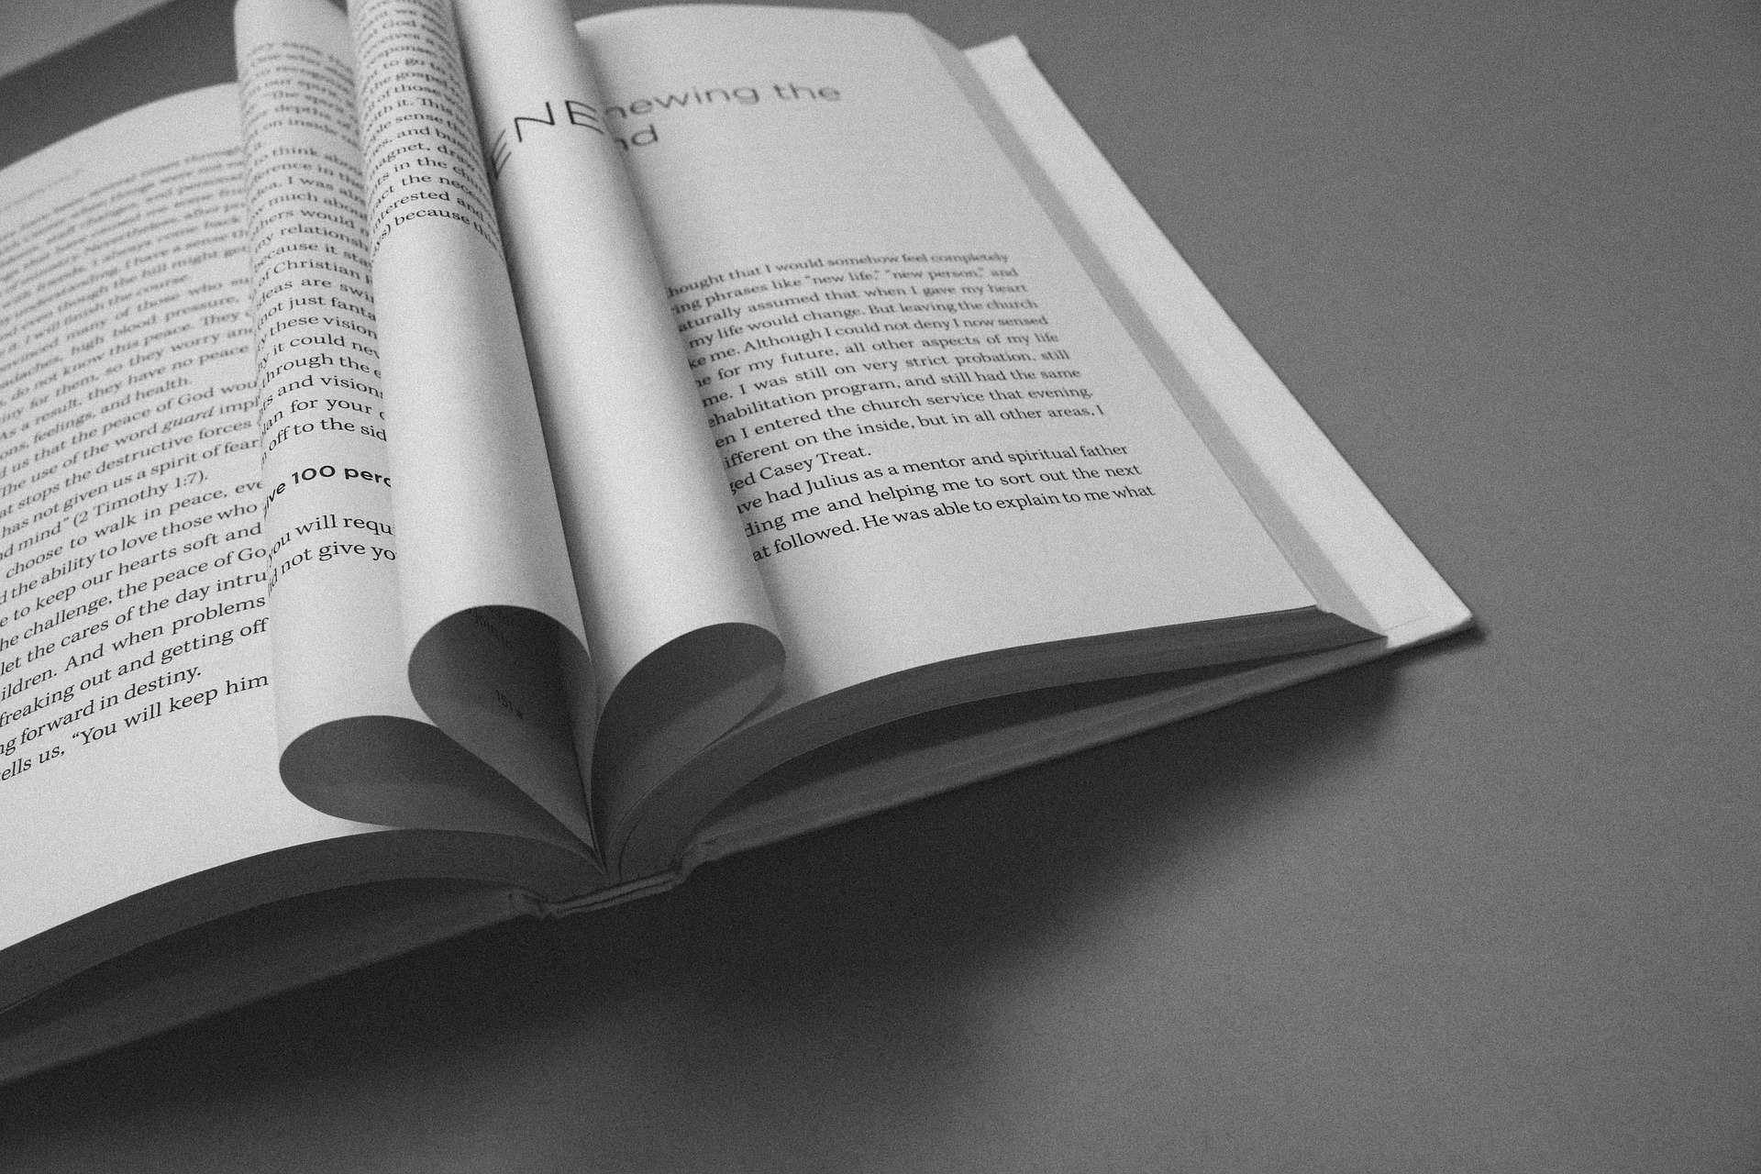
Content Ownership and Publishing
Digital Publishing
Open Access
Copyright
Documentation

Slide 4
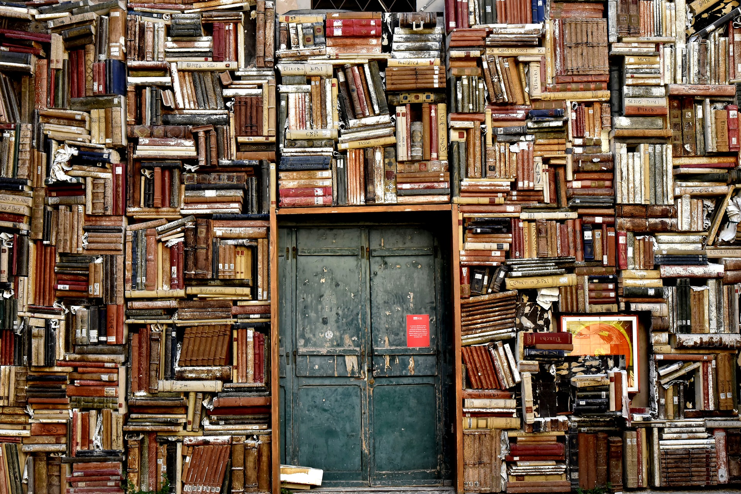
Community Archiving &
Repository Development
Reducing technical barriers
Supporting on-the-fly or in-the-field deposit and use
Bringing communities together around a shared history and experience

Slide 5
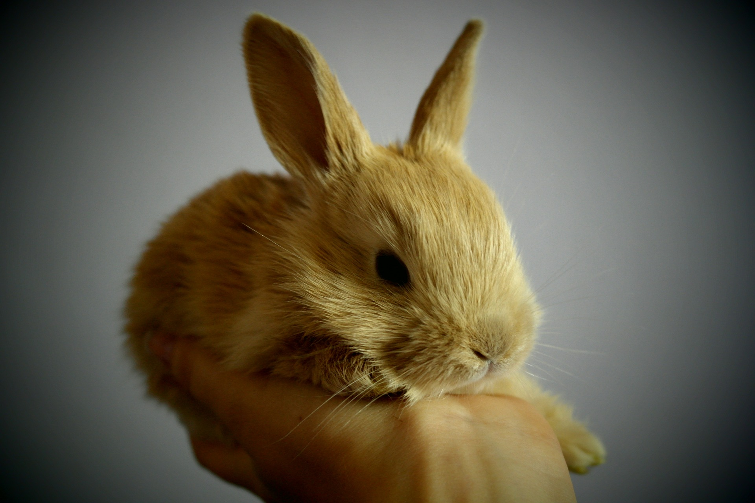
Institutional Trust

Slide 6

Impact Metrics
Scholarly Citation Metrics vs. Altmetrics
Altmetrics are broader measures of impact for digital objects, including:
Social media
News media
Pageviews
Downloads
Wikipedia pages
Blog mentions

Slide 7
The Platform (Now)
Communication Forum
Digital Archive

Slide 8
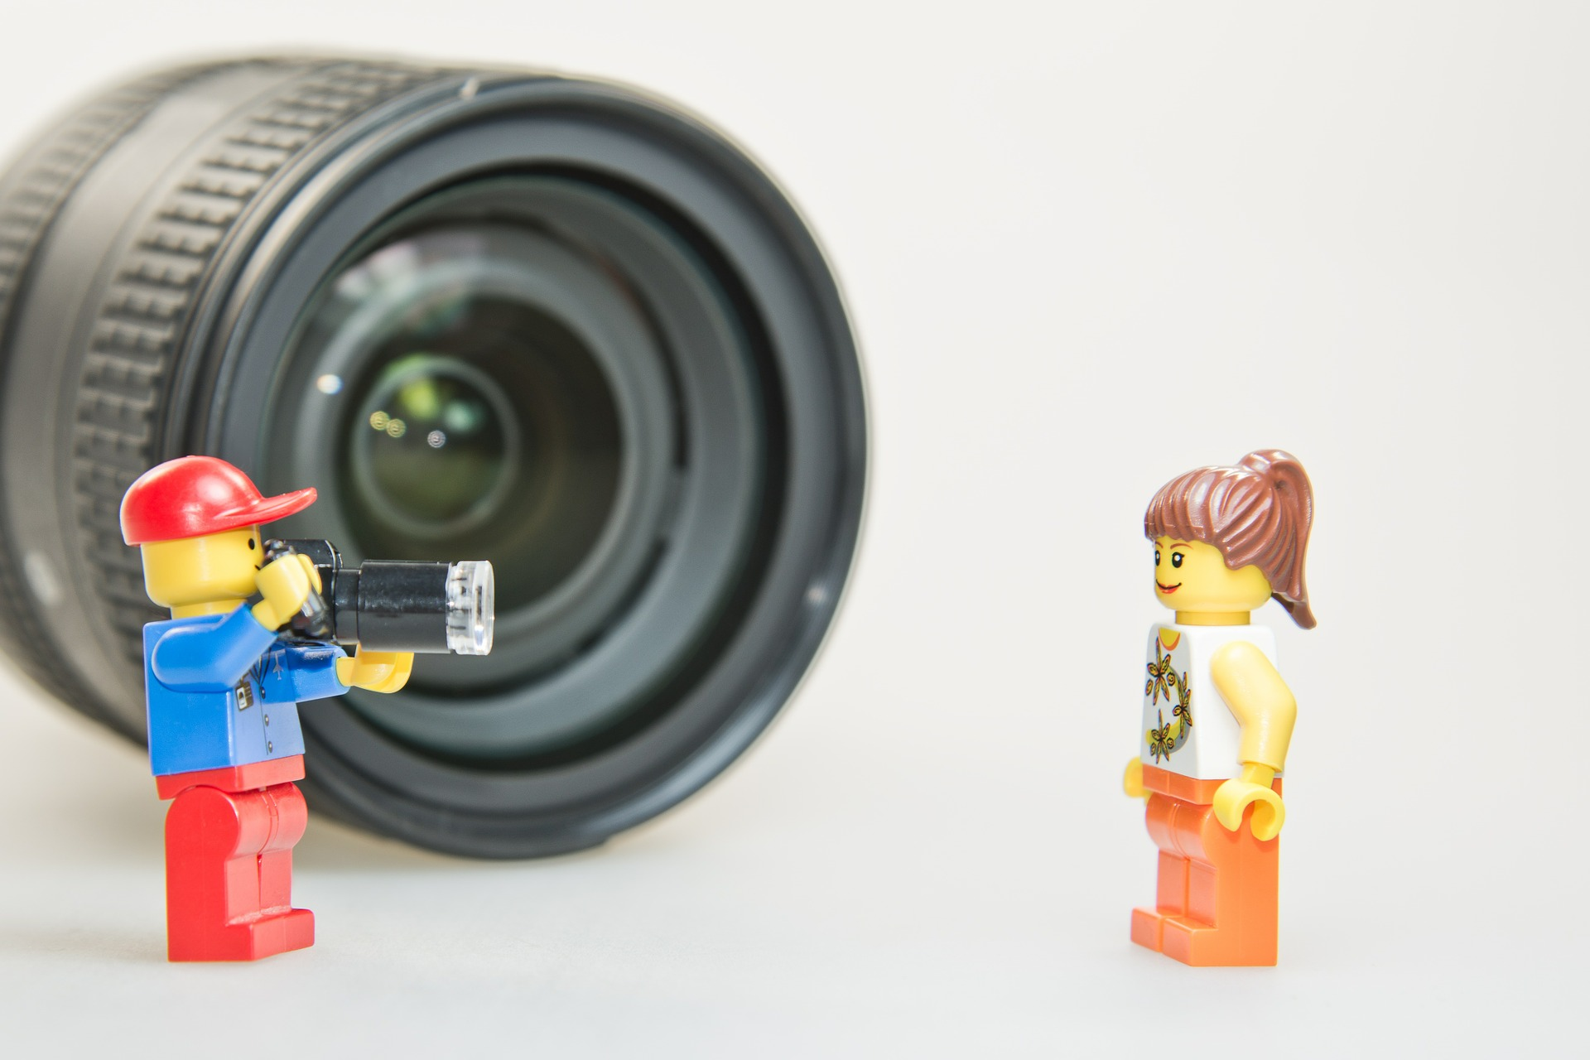

Slide 9
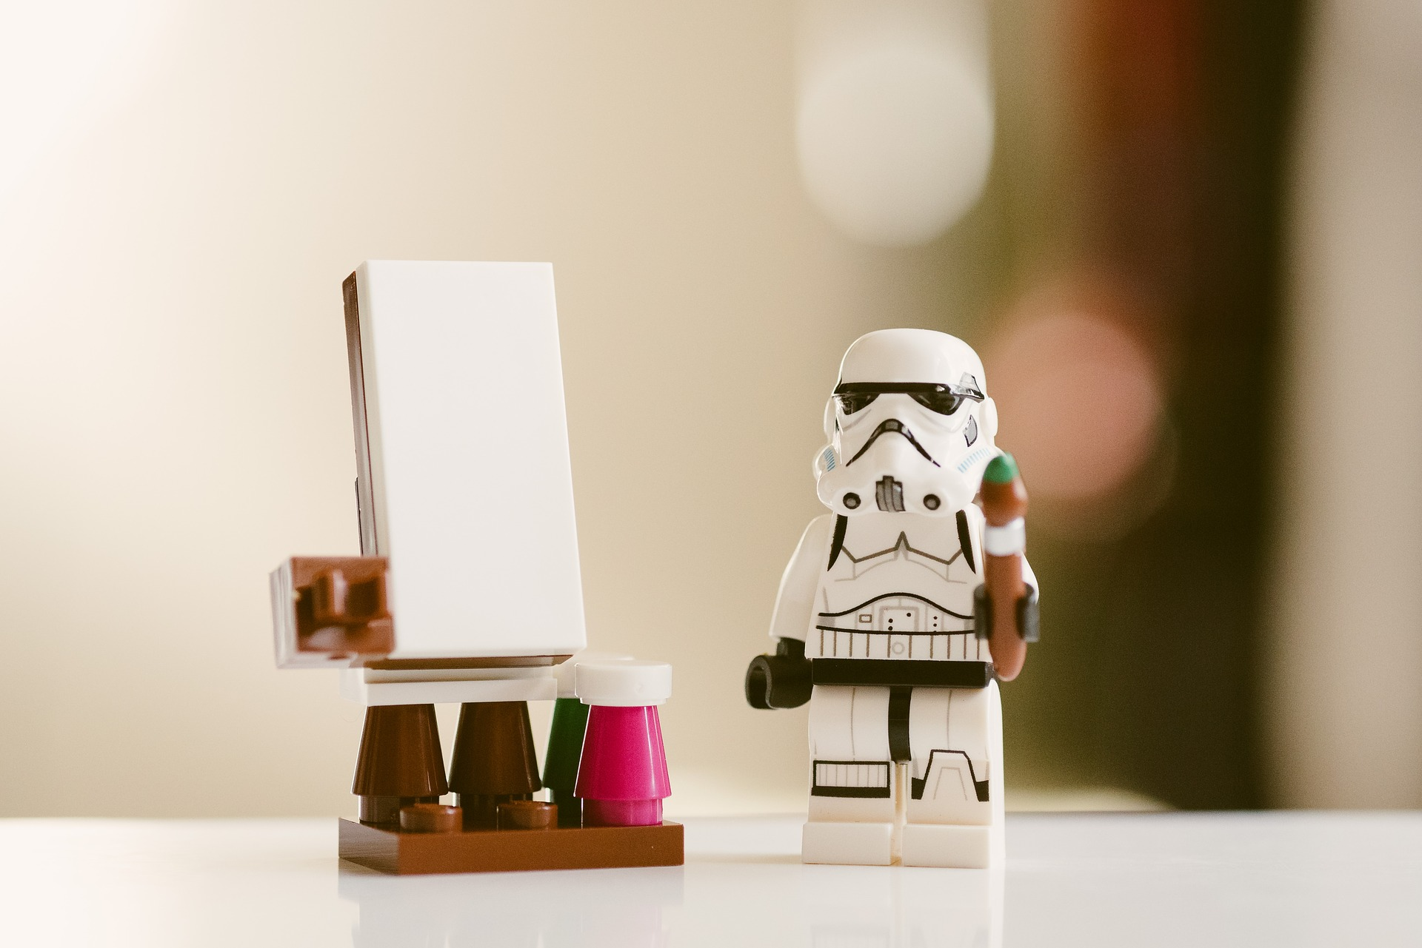

Slide 10
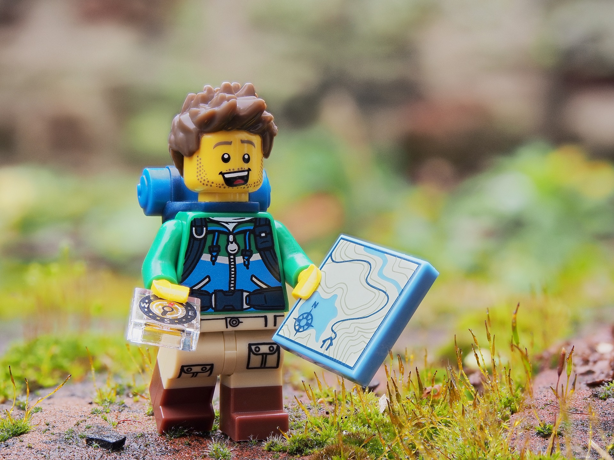

Slide 11
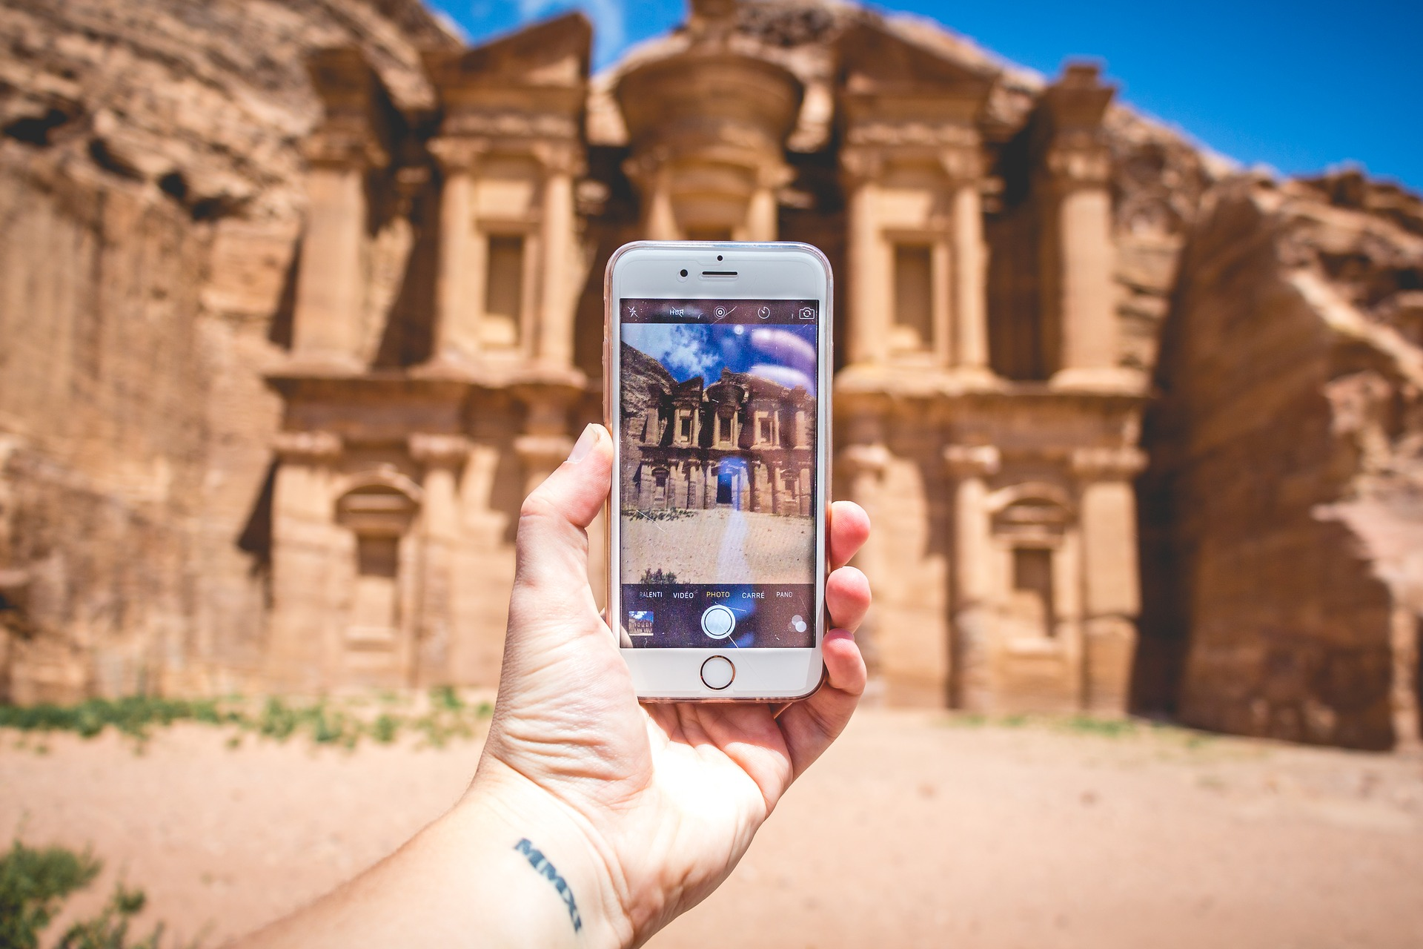

Slide 12
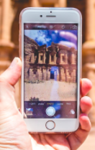
The Platform (Later)
Communication Forum
Digital Archive

Slide 13
The Platform: How it all COULD fit together
Project Communication Forum
Related Project Communication Forum
Related Project Communication Forum
Digital Archive

Slide 14
central index

Slide 15
network of online culture hubs

Slide 16
An online collaborative hub for dialog and resource sharing,
a common purpose to support a vibrant civic and economic future.
Build a network of online ‘cultural hubs’ each with their own unique domain, expertise and purpose.
Joined together by a stream of discussion, resource sharing, collaboration, and in-person meetups.
Measure and share the outcomes and key learnings of the work.
(borrowed from Rylan Peery’s Imagining America Slides)

