Slide 1
Virginia Tech Themed WordPress Themes
Project Client:
Jennifer Sparrow
Team Members:
Scott Magee
Ken Pham
Matthew Ng
Blacksburg
3/6/2014
VT CS 4624

Slide 2
Objective
-create 3-4 different templates
For use by internal Virginia Tech sites
  Gives sites a consistent look & feel
  Prevents abuse by others

Slide 3
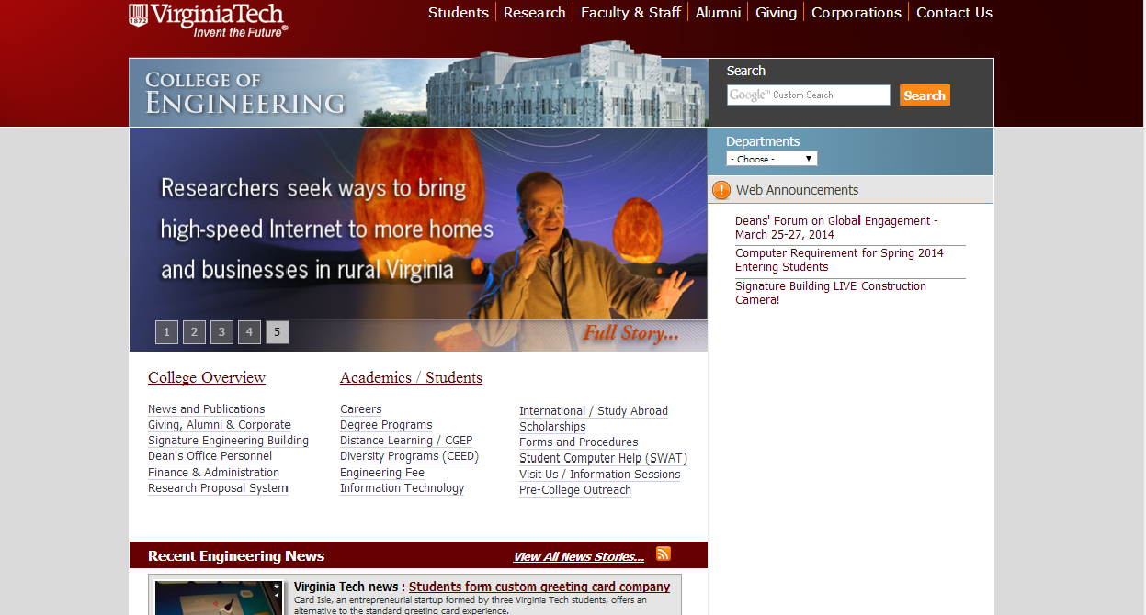

Slide 4
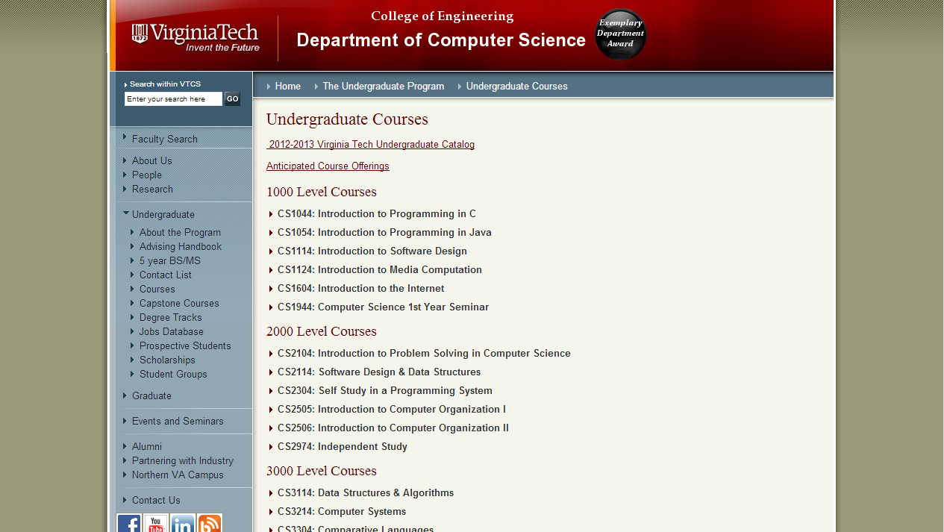

Slide 5
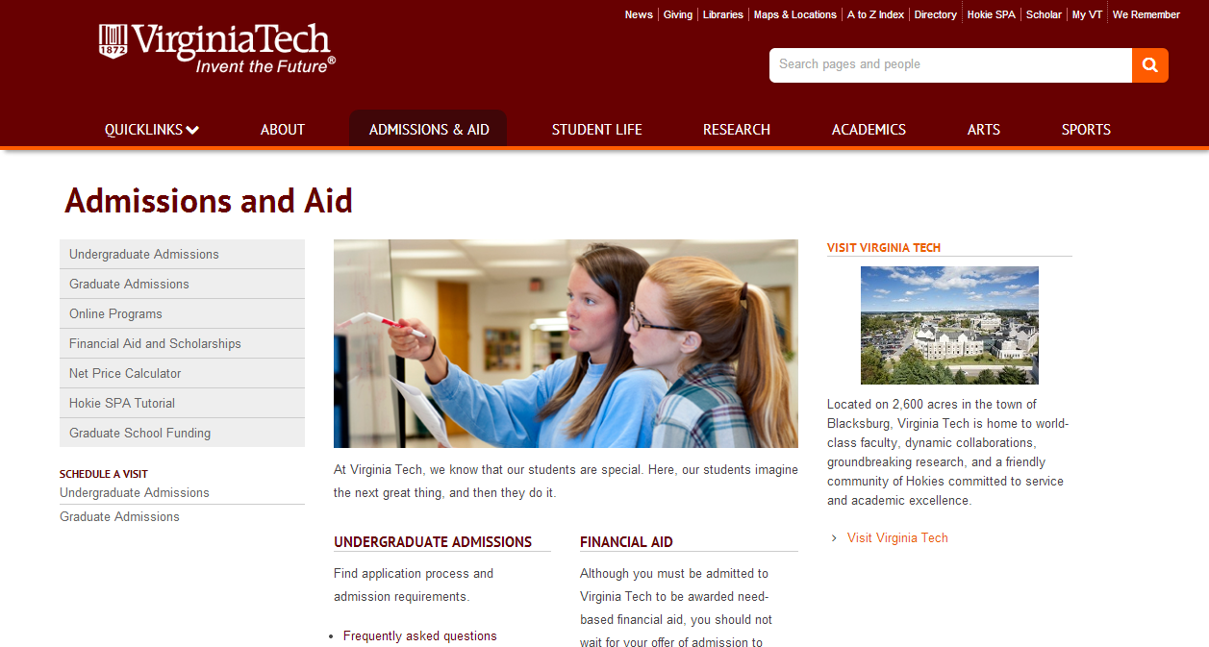

Slide 6
WordPress
-Use current drag and drop templates to create child templates
We will be using drag and drop templates to create the vt themed wordpress templates. These templates will be a foundation for the templates that we want to create as they will provide already usable code for us to use. Child templates are when we take a current template and use its current code to create another template

Slide 7
Tools
-BitNami/WordPress
PHP
HTML
CSS
Notepad++
Google Chrome(Developer tools)

Slide 8
Child Template
-Overwrite vs override
Overwrite
  copy all code over to use
  bigger, more control over template
Override
  Only alter snippets of code affecting child
  Smaller and simpler
  Can make use of parent theme updates

Slide 9
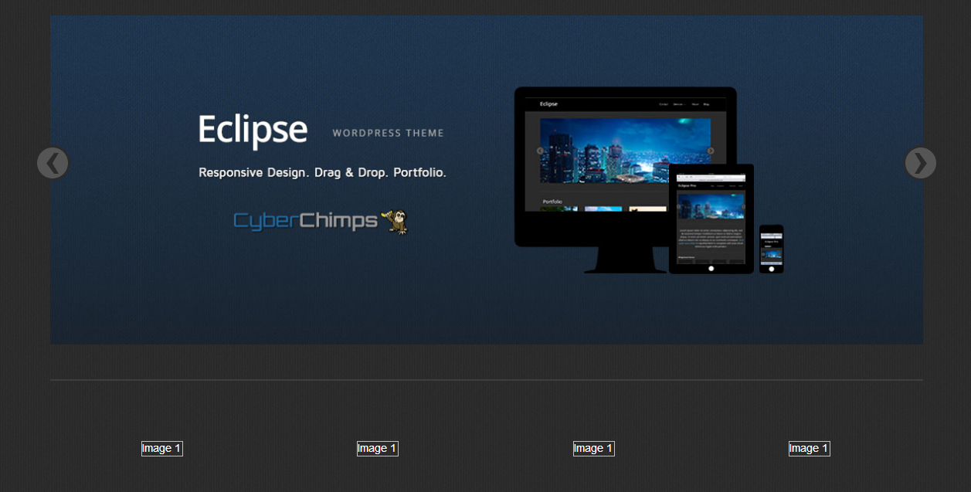

Slide 10
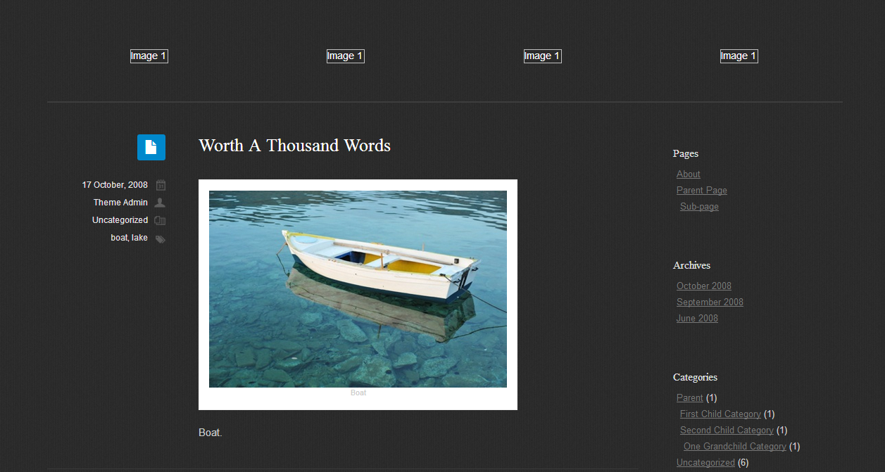

Slide 11
These two picture slides show a current drag and drop template that we will possibly use as it has similar format as current vt sites, and other similar look and feels that we can use to create a consistant look between our templates and other vt templates

