Slide 1

Wikipedia Hadoop
Steven Stulga
Spring 2016
CS 4624 multimedia/hypertext/information access
Professor Edward Fox
Client: Shivam maharshi

Slide 2
Background
Goal: Import the entire English Wikipedia with full revision history into Apache Hadoop and configure it to be searchable from Apache Solr
A prototype outlining the process
  importing the data
  converting the data
  configuring the system

Slide 3
Implementation
Creating a prototype
  Downloading small segment of dataset
  Uncompressing, extracting, converting this data
  Import it into local HDFS
  Configure Solr to index data
Follow same steps for full data on cluster
  MUCH larger set of data
  Working on true cluster

Slide 4
Data comparison
 | Prototype Test Data | English Wikipedia Current Version | English Wikipedia with Full Revision History
Size Compressed | 365 KB | 23.2 GB | 107 GB
Size Decompressed | 46 MB | 51 GB | 10 TB
Number of Articles | 21 | 5,137,000 | 5,137,000

Slide 5
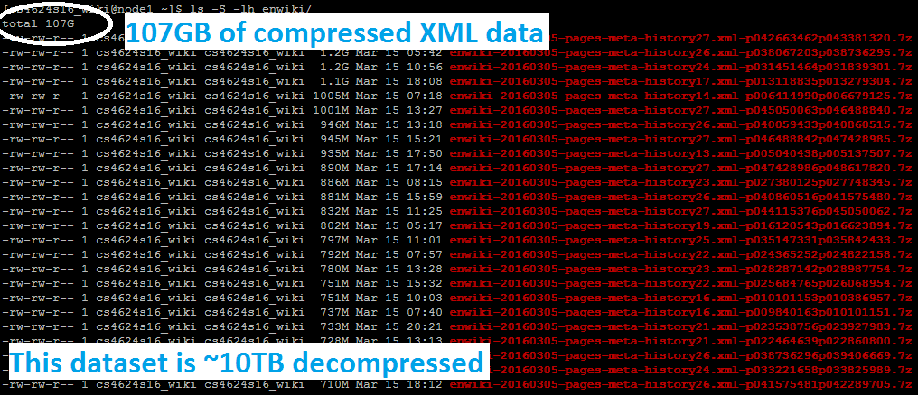
Successes

Slide 6
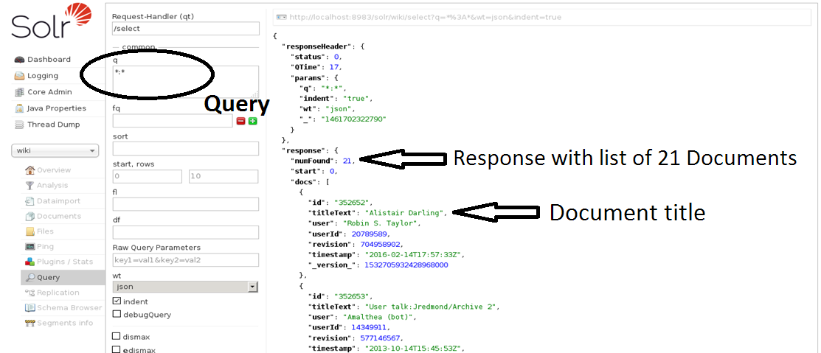
Successes

Slide 7
Lessons Learned
Work with data in small pieces
There isn’t always the “how to” guide you need
Implement full prototype and outline all steps
Effective learning requires more time and research than you expect
Communication can be slow and hinder progress

Slide 8
Acknowledgements
Shivam Maharshi, the client, for presenting the project and giving guidance about how to start and tackle challenges
Sunshin Lee, who provided access to the remote machine and answered questions about execution on the machine
Dr. Fox, for great feedback and help with the presentation and documentation

Slide 9
Thank you!
Questions?

