Slide 1
TextMining
Jianchi Wei, Chongyu He & Chenyu Mao
CS 4624 Multimedia, Hypertext & Information Access
Edward Fox
Virginia Tech, Blacksburg VA
24061
May 10, 2022

Slide 2
Outline
Project Review
Work Timeline
Project Design
Front End
Lessons Learned
Future Work
Acknowledgments
References

Slide 3
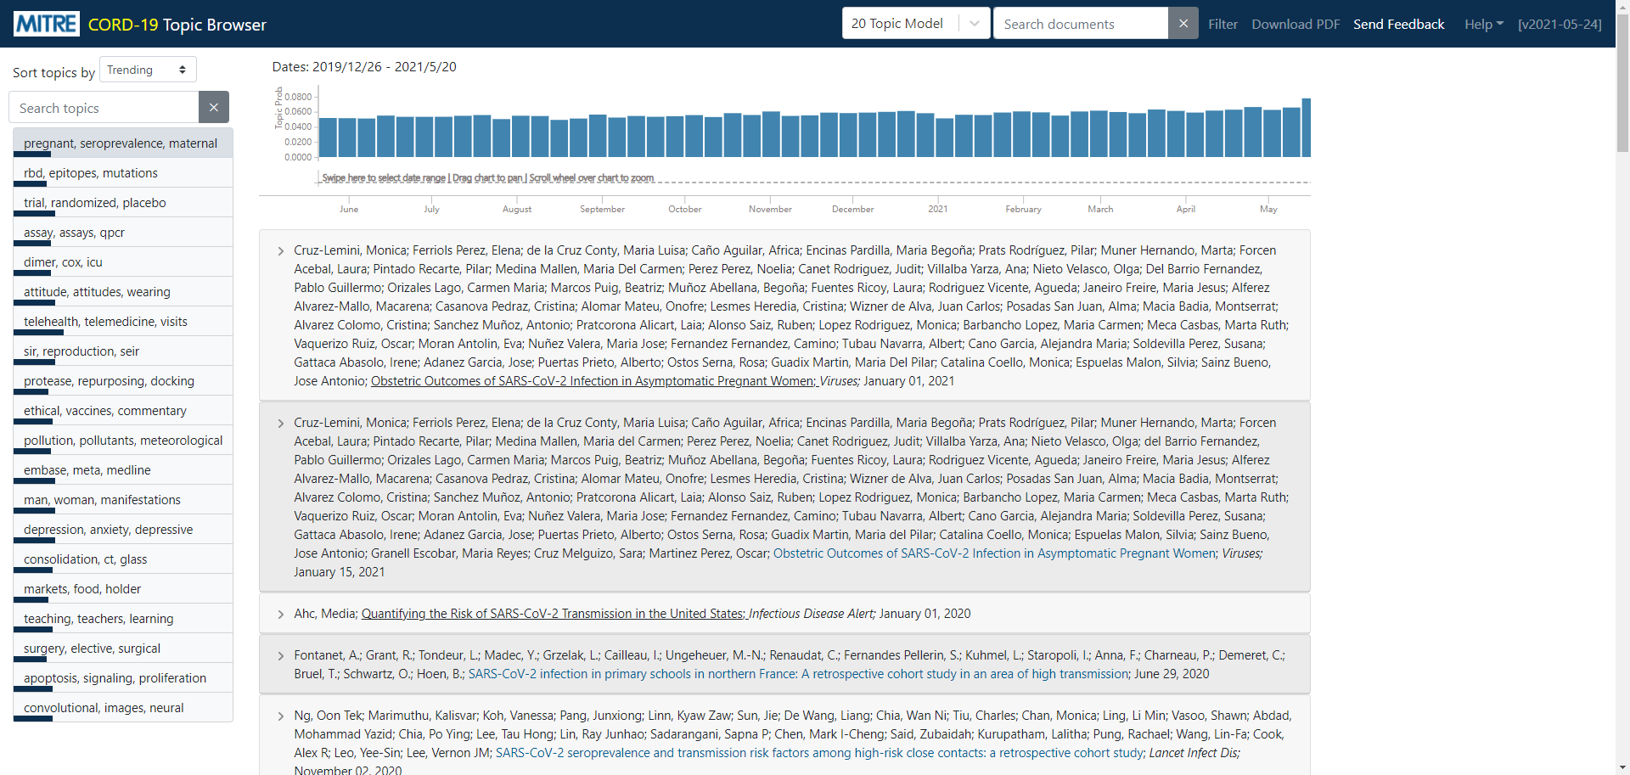
Project Review
Extract valuable information and keys from Electronic Theses and Dissertations (ETDs).
Using LDA, ProdLDA, NeuralLDA, and CTM models for summarizing topics.

Slide 4
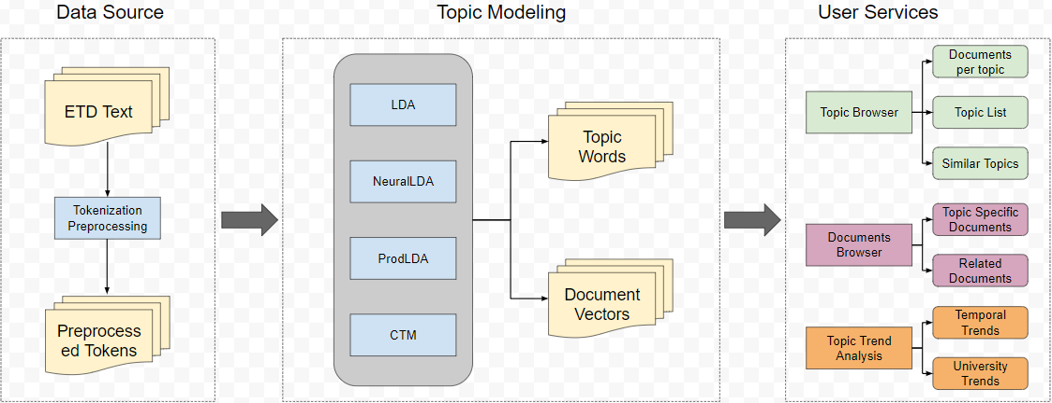
Project Detail

Slide 5
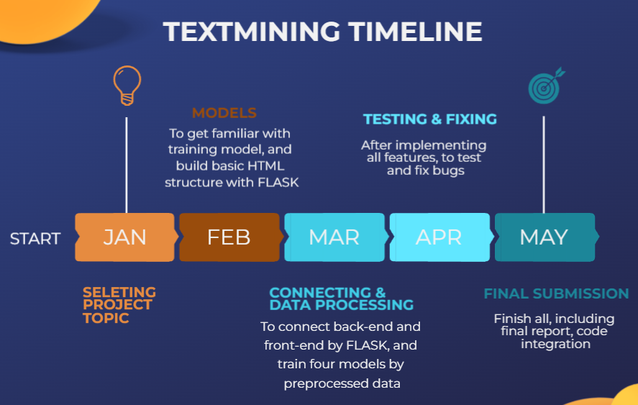
Work TimeLine

Slide 6
Project Design
Index page
Topic page
Document page
Advanced research page
Search keyword page

Slide 7
Front End Demo
The video for the demonstration is in the file TextMiningDemo.mp4.

Slide 8

Lessons Learned
Front End with FLASK
Combination of JavaScript, CSS, and HTML
Testing data

Slide 9

Future Work
Deploy to server

Slide 10
Acknowledgement
Aman Ahuja
aahuja@vt.edu
Professor Edward A. Fox
fox@vt.edu

Slide 11
References
[1] Aman Ahuja, Chenyu Mao, Chongyu He, Jianchi Wei, Edward A. Fox, 25th International Symposium on Electronic Theses and Dissertations – ETD 2022, Novi Sad, Serbia
September 7 - 9, 2022, submitted for review
[2] T. Hofmann, Probabilistic latent semantic indexing, in Proceedings of the 22nd annual international ACM SIGIR conference on Research and development in information retrieval (1999), pp. 50–57
[3] D.M. Blei, A.Y. Ng, M.I. Jordan, Latent Dirichlet Allocation, Journal of machine learning research 3, 993 (2003)

