Slide 1
Forest co-management in Guinea: a multi-scale, multi-output ex-post impact analysis
Bradford Mills, Virginia Tech
Daniel Suryadarma and Mathurin Zida, CIFOR

Slide 2
Research Question
Have LAMIL project innovations yielded quantifiable durable contributions to CGIAR SLOs eight years after cessation of project activities?
  Primary interest
    Institutional processes for forest co-management
  Also
    Specific household production technologies

Slide 3
LAMIL Project Background
Four sites (forest reserves and adjacent villages)
  Nialama
  Sincery Ousa
  Balayan-Souroumba
  Souti-Yanfu

Slide 4
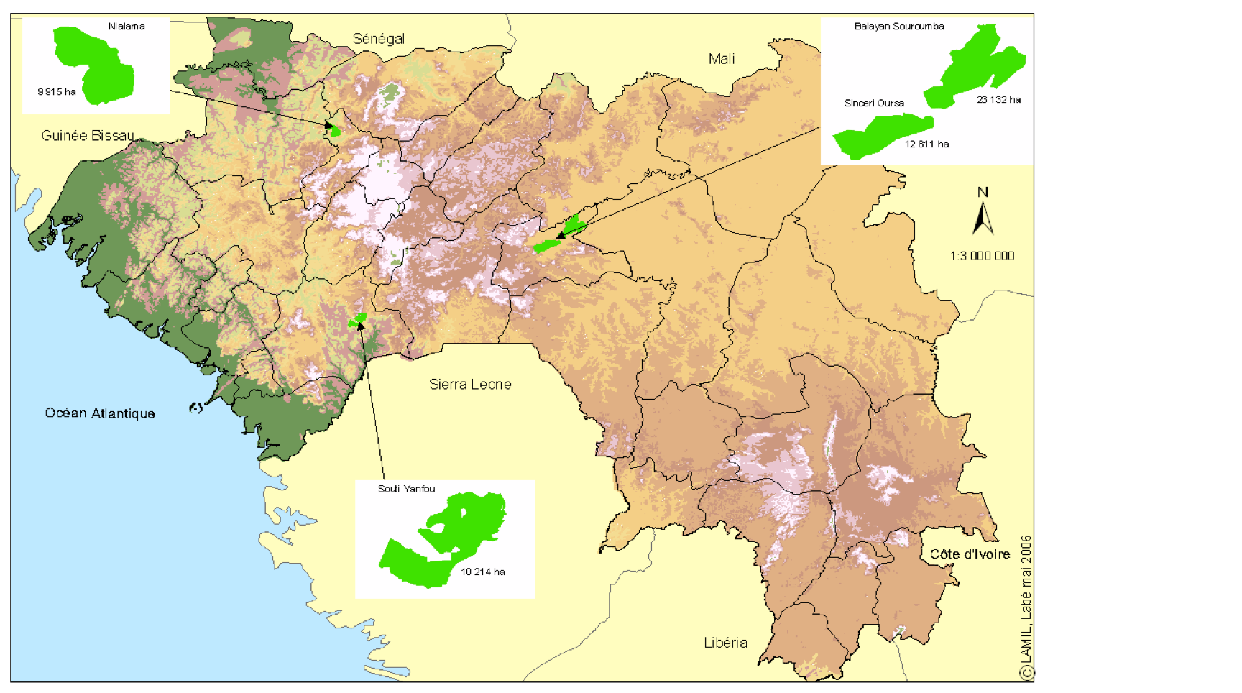
Map

Slide 5
Project(s)
ENRMA: 1999 - 2005
  Established co-management at sites
  Little community buy-in
LAMIL: 2005 – 2008
  Co-management with active and effective Forest Management Committees
  Agroforestry technologies
  Improved seed

Slide 6
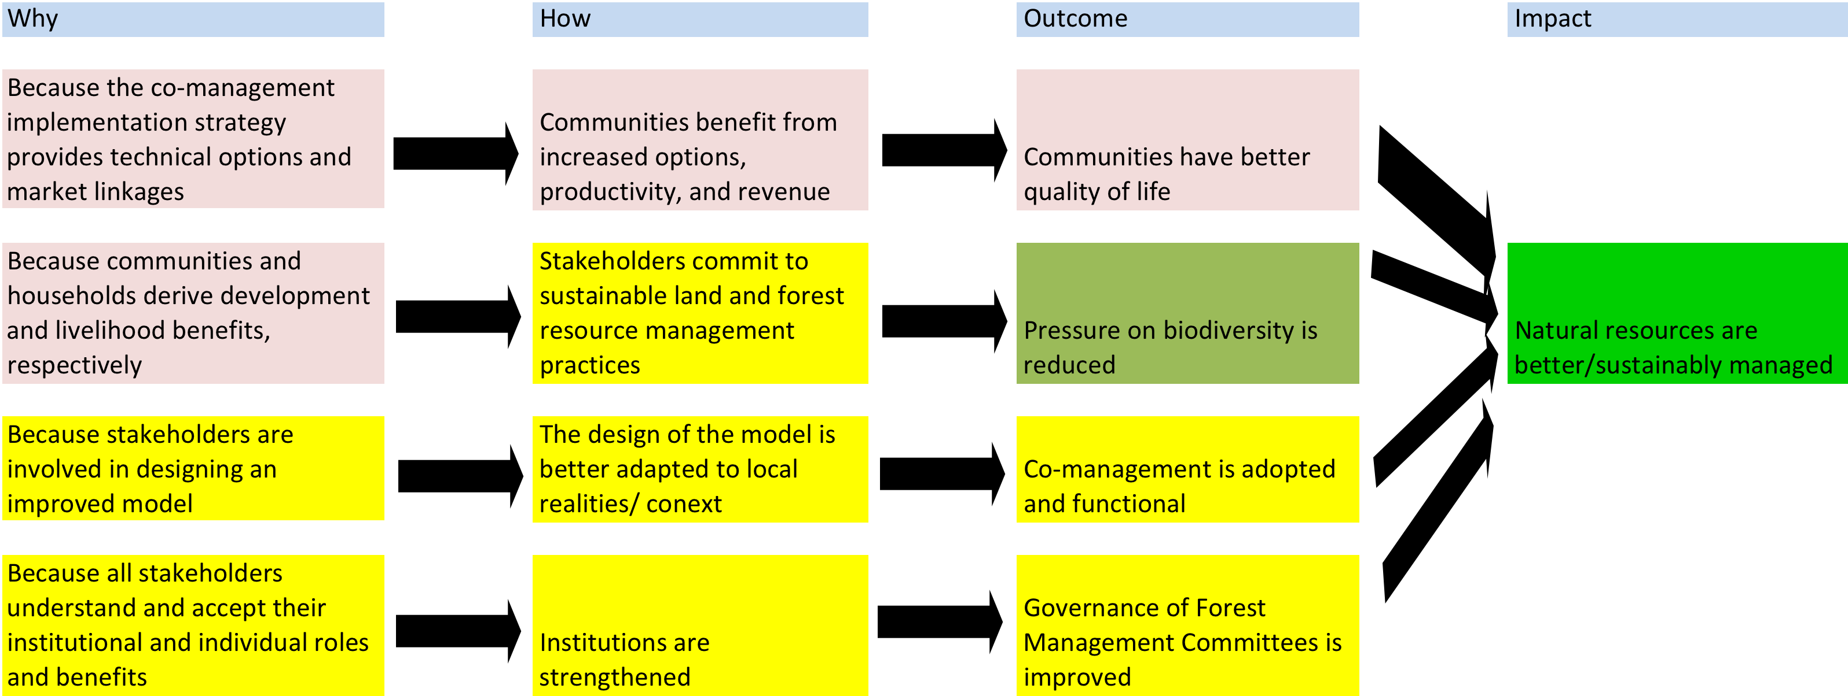
Theory of Change

Slide 7
Impact Pathway
Temporal dimension
  Project ended 2008
  Sustainable impacts eight years later?
Spatial dimension
  Successful innovations spread
  Evidence of spread to other areas
  Problem – contamination of control reserve areas

Slide 8
Impact Pathways – Evidence of Success
Forest reserves
    Sustainably managed
  Indicator
    Higher levels of land use classified as forest
    Lower levels of land use classified under human and agricultural use
Households
    Higher levels of benefit flows from forest-based, agro-forestry, and agricultural products
  Indicators
    Increased benefit flows from forest products
    Increased income flows from improved seeds
    Increased income flows from agroforestry products

Slide 9
Study framework
Forest Level
  Four treated reserves (Nialama, Sincery Ousa, Balayan-Souroumba, Souti-Yanfu)
  Four control reserves (Fello Digue, Botocoly, Sourela, and Selouma)
  Two dropped reserves (Bakoun, Selli-Koro)
  Local forest/agriculture officers and GIS expert with local knowledge of the areas chose control reserves

Slide 10
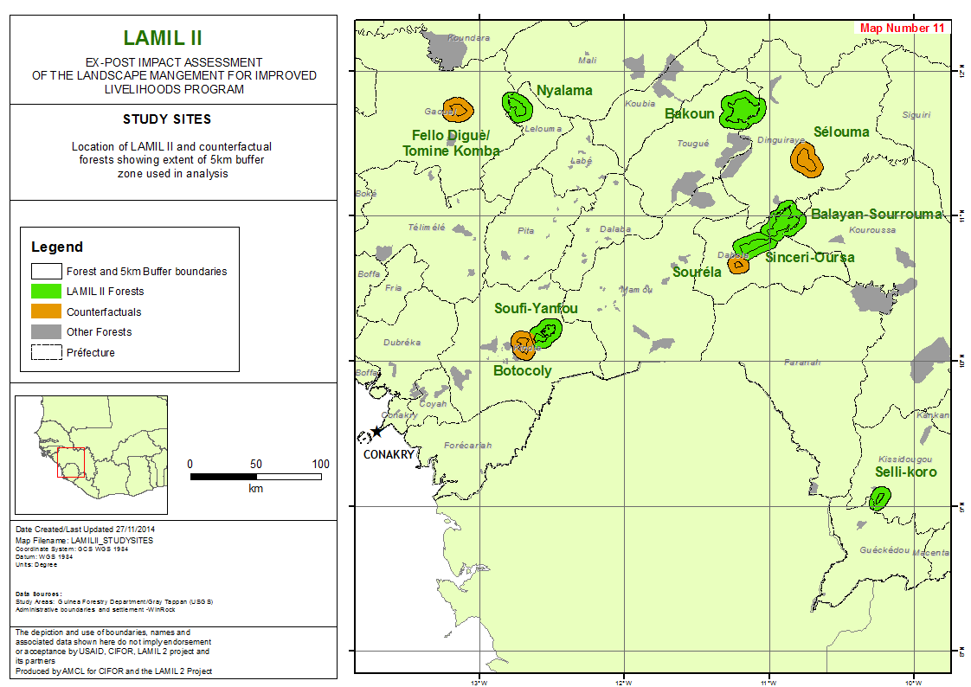

Slide 11

Plan of attack

Slide 12
A two level analysis of benefits
Forest reserve level
  Changes in land use associated with the project
    In reserves and in 5km buffer
Household level
  Differential flow in benefits associated with project interventions

Slide 13
Existing Land Use Data
Remote sensing images for the 10 forest reserves
  Digitized for pre- and post-intervention periods:
  1999, 2004, 2010 and 2013
  2015/16?
  Data on adjacent (5km) forest buffer zones also digitized
    potential land use spillovers outside of the reserves.
  Land use classified into 22 land cover classes
    gallery forest to human habitation
    33,000 polygons
      Land cover/ land use in each year
      Classification of changes between periods

Slide 14
Empirical Specification
Difference in difference models
  Relative changes in land use in the project reserve areas (polygons) compared to control areas (polygons)
    prior to project interventions (1999-2004)
    during the project intervention period (2004-2010)
    After project intervention (2010-2013).
  Also, relative changes in land use reserve boundary areas (polygons) compared to boundaries of control areas (polygons)

Slide 15
Evidence of Project Impact
Lower differential rates of loss of forest land use types (and lower rate of gain in human land use types) in treated reserves during project period
Insignificant or continued lower rates of loss of forest land use types in treated reserves post-project
  Retained benefits
Lower, or insignificant, differential rates of forest land use types in boundary areas of treated reserves during and post-project
  Minimal negative spillover

Slide 16
Key identifying assumption
Differential changes in land use types in reserve areas in project and post-project periods stem from LAMIL interventions

Slide 17
Issues
Pre-LAMIL co-management interventions in treatment reserves (1999 – 2004)
  Two other control reserves: Bakoun, Selli-Koro
    Treated pre-LAMIL, but not in LAMIL
  Employ to differentiate pre-LAMIL treatment effect
If co-management strategies have spilled over into control reserves
  Lower impact estimates – if still positive then we can think of it as lower bound
  Test for evidence of spillovers in household questionnaire

Slide 18
Forest Level Output
Estimates of magnitude of maintained difference in land use types due to LAMIL eight years after project cessation
Environmental benefit flows associated with differential land use
  Value of sequestered carbon – complex, need to quantify the value of ecosystem services.

Slide 19
Household Level
Household surveys conducted in 16 villages:
  2 adjacent to each of 4 treated reserves
  2 adjacent to each of the 4 control reserves
  Select pairs of control and treatment villages with similar characteristics pre-LAMIL:
    Populations
    Distance to forests
    Distance to roads/markets

Slide 20
Household Level
Randomly select 30 households in each village
2 treat X 4 reserves X 2 villages X 30 hhs =
480 households
No household survey data for power tests
Theoretically, if control and treatment households have same variance in outcomes
  Can detect effects larger than 0.25 stand. dev.
  Again, without secondary data we cannot yet say whether 0.25 SD is “big” or “small”.

Slide 21
Innovation sustainability and spread
Major innovations examined:
  Co-management with active and effective Forest Management Committees
  Agroforestry technologies
  Improved seed
Establish current use of innovations and year of first adoption

Slide 22
Innovations
Focus on Forest Management Committees
  Indicators of active reserve management
    Have an active forest management plan and co-management contract
    Control forest access
      Manage member forest use
      Receive funds from non-member use
  Establish through
    Discussions with key informants with historical knowledge of committee formation (DNEF, local government committees)
    Village household survey
      Knowledge of forest management
        Note – members tend to be a small share of the population of the surrounding villages
      Questions will address:
        own participation in FMCs,
        knowledge of FMC activities and perceived level of reserve management
Generate an index of operational effectiveness of FMCs

Slide 23
Innovations
Improved seed
  Household survey indicators
    Use of improved seed delivery system
    Groundnuts
      Fleur 11 or ICG (FDRS 4) – Find local names
    Maize
      K91-01 or CMS 475 – Find local names
    Cassava
      091/02324 or 9810581 – Find local names
  Technology exposure through social networks
    Close relatives using improved seed

Slide 24
Innovations
Agroforestry technologies
  Household survey indicators
    Use of agroforestry plots in buffer zones
    Use of tree nurseries
    Use of Ziziphus Mauritiana, Grevillea Robusta, Live fencing, and improved fodder banks
  Technology exposure through social networks
    Close relatives using agroforestry technologies

Slide 25
Household adoption of seed and agroforestry innovations
Estimate discrete household adoption
  Control for adjacency to treatment area reserves
  Household covariates
    Retrospective covariates (10 years ago)
  Technology social network

Slide 26
Household Livelihood Benefit Flows
Household survey information:
  GF value of forest products sold or consumed
  GF value of agroforestry products sold or consumed
  GF value of agricultural products sold or consumed
  Household dietary diversity food security score
Template: CIFOR’s Poverty and Environment Network Project Household Surveys

Slide 27
Strategy for Household Livelihood Impact Analysis
If little contamination of control area households
  Non-parametric propensity score matching models
    Nearest neighbor or smoothed weighted matching estimators
    Based on propensity to be in a treated area
      Pre-treatment (as possible) household and village characteristics
      Pre-treatment land use patterns
Key identification assumption – Livelihood differences stem from differential adoption in observationally equivalent treated and control households

Slide 28
Strategy for Household Livelihood Impact Analysis
If substantial contamination of control area households
  Local average treatment effects on the treated
      Livelihood benefit measure regressed on:
        Observed (endogenous) adoption
        Inverse Mills-Ratio from adoption probit
        Current household and village characteristics
        Exclude technology exposure to social network variables
Identification assumption: household technology social networks influence adoption propensity, but only influence livelihood benefits through adoption
Unobserved heterogeneity captured in Mills-Ratio from adoption equation

Slide 29
Household Level Outputs
Estimates of durability of seed and agroforestry technology adoption in villages adjacent to treated reserves
Estimates of spread of seed and agroforestry technologies to villages adjacent to control reserves
Estimates of value of differential flow of household livelihood benefit flows from:
  Co-managed forests
  Improved seeds
  Agroforestry innovations

Slide 30
Aggregation of impact estimates
Money metric indicators of differential natural resource system and ecosystem service flows and household livelihood flows
Economic value of environmental benefits of retained forest land usage
    In four treated reserve areas
    In control areas that have adopted crucial components of LAMIL generated co-management strategies
Economic value of livelihood benefits from co-managed forests, improved seeds, agroforestry innovations

Slide 31
Risks
No quantitative trace of LAMIL impacts
  2014 qualitative impact analyses suggests this is not the case.
  Statistically insignificant impact estimates are valuable
    additional diagnostics to draw lessons for future community forest management programs.
LAMIL innovations have spread so widely that a counterfactual control area can’t be established
  Methods proposed allow for robust estimation of impact with fairly high levels of control area contamination.

Slide 32
Output Summary
The durability and spread of innovations generated by the LAMIL project in Guinea
Environmental and livelihood impacts associated with LAMIL innovations

Slide 33
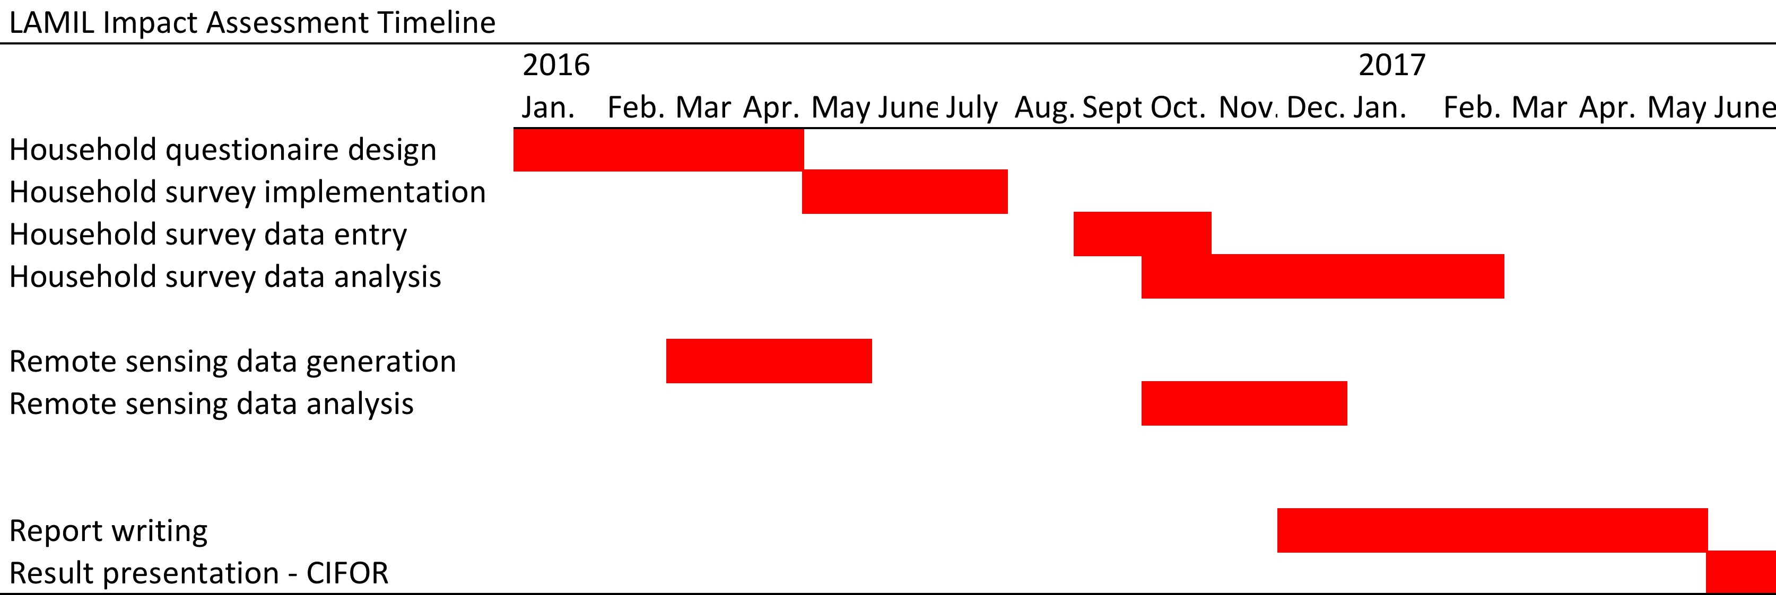

Slide 34
