Slide 1
Fall Fertilization
-vs-
Spring Fertilization
Hay Land
Field Study: Campbell County Virginia
Todd Scott

Slide 2
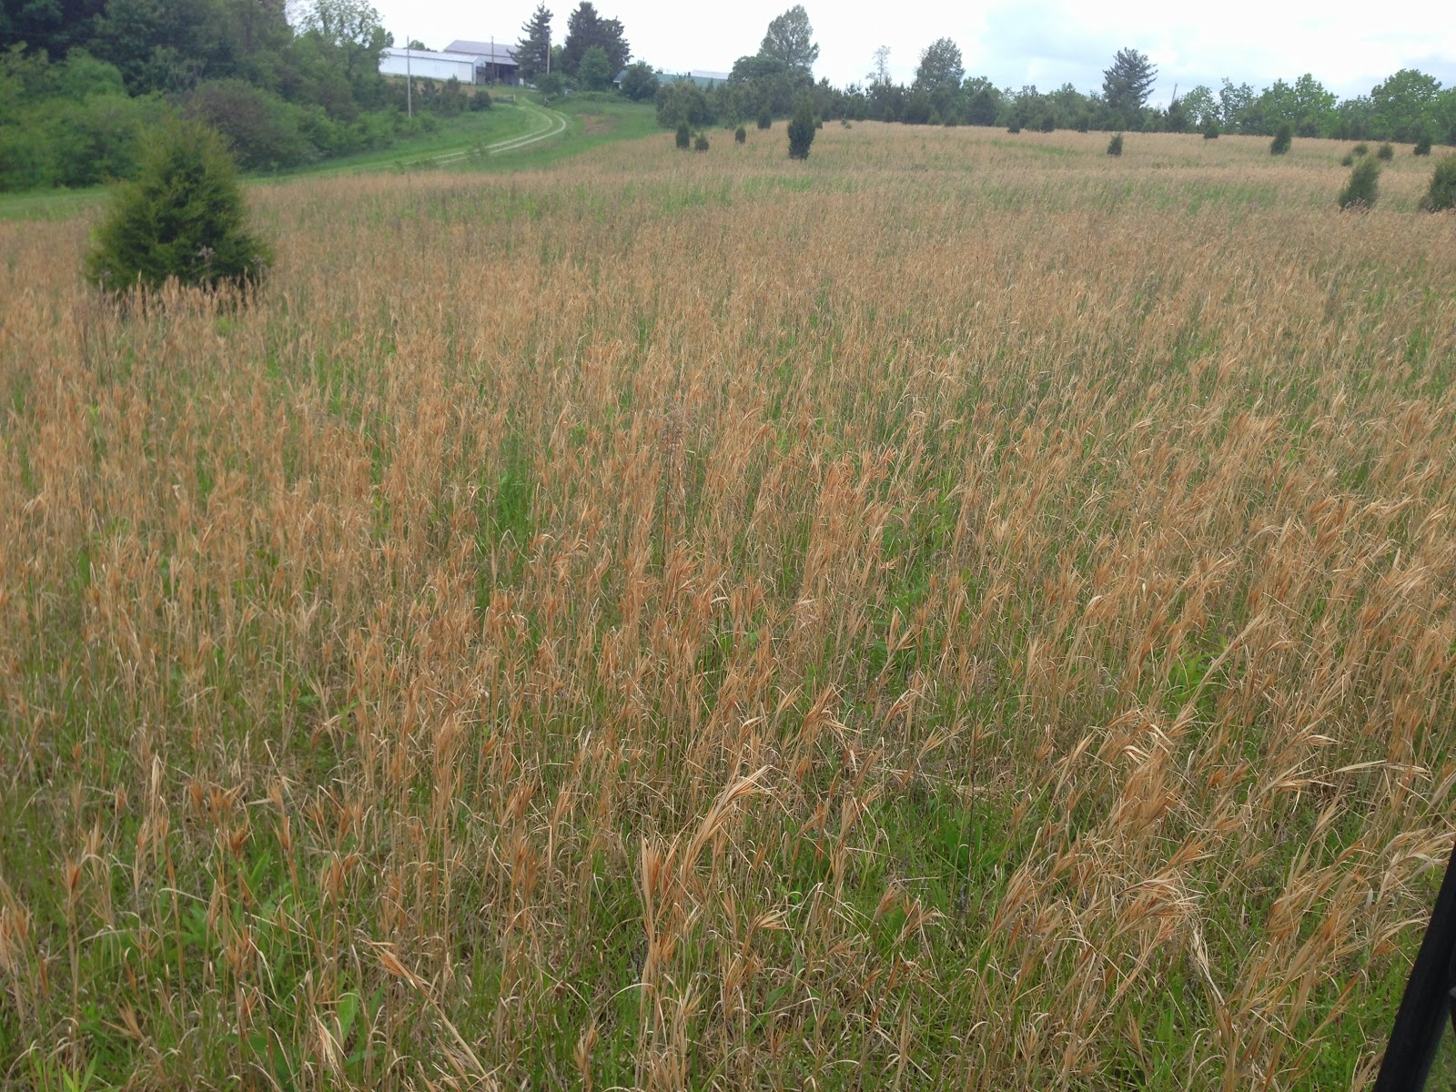
Acquired the hay field in Spring of 2015. Field looked similar to this.
What would you guess the pH to be?

Slide 3
Field History
Land owners have a successful full time business with no desire to farm. Own 50-75 acres most is woods or cut for yard and runway for ultralight plane. (Park Like setting) Small 4 acre field. No charge for rent just want field cut a couple times a year to keep it looking good.
Neighboring farmers for the last 20 years have cut the land for hay. To my knowledge very little fertilizer has been applied. That is pretty obvious from soil reports.

Slide 4
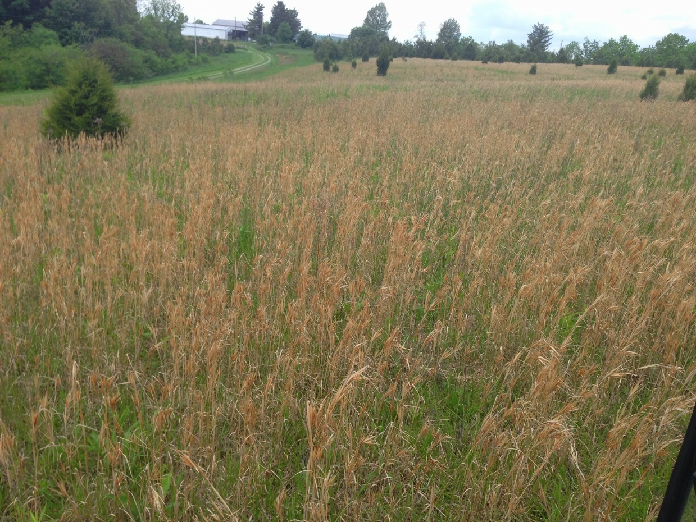
What did you guess the pH to be?
A. 5.2
B. 5.4
C. 6.4
D. 7.2

Slide 5
pH 6.4 You can’t beat that!!

Slide 6
Can the pH be 6.4?

Slide 7
Soil Test Report 4/2/2015

Slide 8
2015 Hay Production
First cutting was taken from the field on 5/7/2015
Hay was cut at 1 p.m.
Field walk before cutting I noticed 70% weed coverage

Slide 9
Some of our best thoughts are on a tractor!
  My thoughts while cutting:
  “Hay was very thin, lots of weeds (winter annuals),broom sage and moss”
  “Really not worth driving equipment over the land to cut, weed pressure 60-70%”
  “I really hope I can get these bales out of the field before Scott Tweedy and
  neighboring farmers make fun of me!”
  “ Is it worth my time and the fertilizer investment to fix this field?”
  “I hope my wife doesn’t ask how many bales I made!”
  How many bales do you think I got from this 4 acre field?

Slide 10
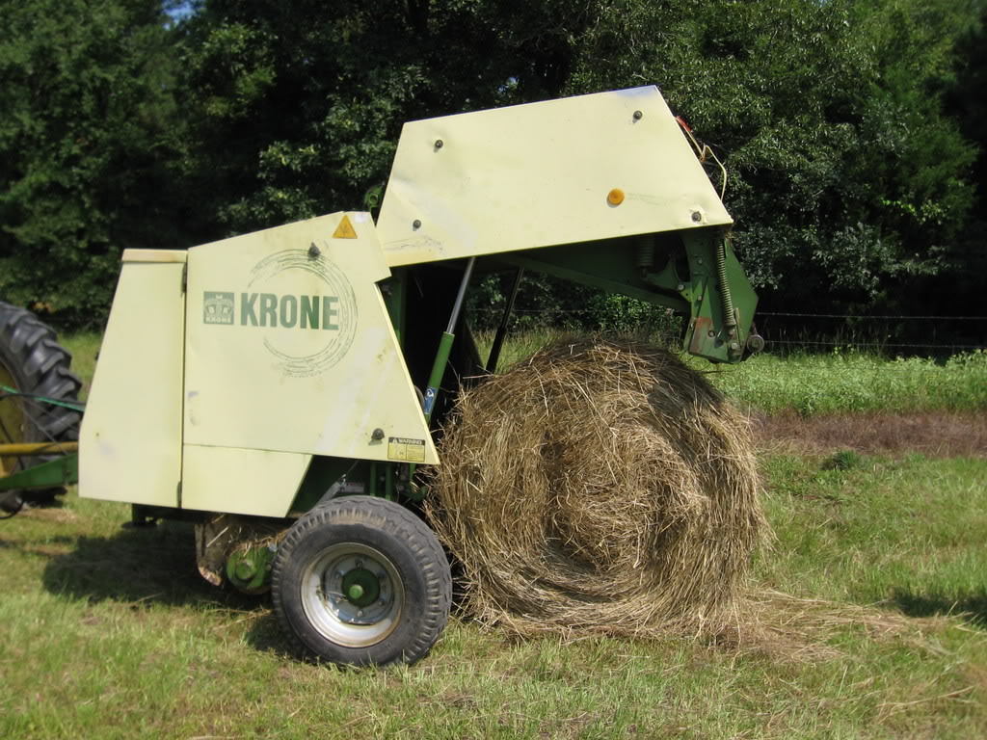
Krone KR125 Baler
4x4 bales: weight 750-800 lbs.

Slide 11
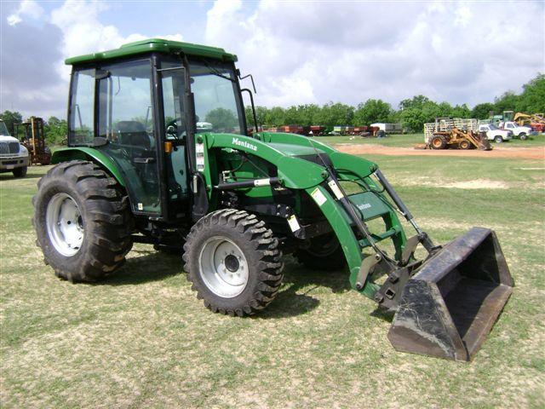
1.5 - 2 gallons diesel used per hour

Slide 12
2015 Hay Calculations
Four Acre Field
2 hours to cut = 4 gallons diesel
2 hours to rake = 4 gallons diesel
1.5 hours to bale = 3 gallons diesel
Total cost fuel $2.50 x 11 gallons = $27.50
Estimated labor $15 hr x 5.5 hours = $82.50
Good or bad production, the Total Cost for me =$110.00

Slide 13
Hay Math
My bales weigh 750 – 800 lbs.
Can buy this size bale for $20 - $25 per bale, sometimes cheaper!
Hay value is $120 per ton I should sale 4x4 bales for $40 each.
$40 for 4x4 Round bale…probably Not going to happen anytime soon!

Slide 14
How many bales do you think I got from 4 acres first cutting?

Slide 15
Hard to Swallow Math
Baled 4 bales!
I have a 6 acre field that produces 55-70 roles just on first cutting each year just down the road. Yields 4-5 tons of hay per acre.
This field yielded 1.5 tons for 4 acres or 750 lbs. of hay per acre!
Cost me $27.50 per bale in 2015 with no fertilizer or rent cost.

Slide 16
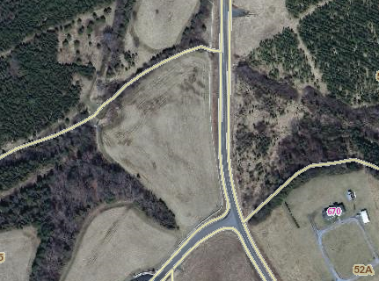
Field Trial Plan

Slide 17
Field Trial
Four acre field will be cut in two equal halves
Road/Fence side will receive 250 lbs. of 19-19-19 in spring.
Tree side will receive 30-60-120 in Fall 60 lbs. nitrogen in spring
I am slightly concerned with the edge effect on the tree side

Slide 18
Fertilizer Cost
Tree Side (Fall Fertilization) 30-60-120 $121 per acre 8/15/2015
Tree Side (Spring 60lbs N) $ 36 per acre 3/25/2016
Fall Fertilization trial cost total $157 per acre
Road/Fence side (250 lbs 19-19-19) $67 per acre 3/25/2016
Spring Fertilization trial cost total $67 per acre
Rained .8 tenths of inch on 3/27/2016 (Can’t ask for better timing!)
Fertilized on 3/25/2016

Slide 19
Fertilization Cost Comparison 2015
Fall
Fuel & labor cost = $27.50
Fertilizer cost = $157.00
Total production Cost = $184.50 per acre
Spring
Fuel & labor cost = $27.50
Fertilizer cost = $67.00
Total production Cost = $95.00 per acre

Slide 20
Field walk before cutting!
Watch out for seed ticks!
Wood side fall 30-60-120 with spring 60lbs N
  In 2015 field walk, I’d say this field was 60-80% weeds
  *Jointhead Arthraxon noticed
  Spring 2016 field walk this side I observed 20% weeds or less.
  Fence side spring 250 lbs. 19-19-19 = 48 lbs. N 48 lbs. P 48 lbs. K per acre
  In 2015 field walk, again 60-80% weeds (prior to any fertilization)
  In 2016 field walk, I observed 40%-50% weeds, but fescue was starting to shade them out.

Slide 21
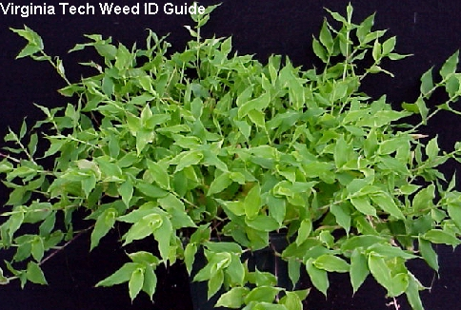
Jointhead Arthraxon
Seems to be showing up in wet areas of yard/fields.

Slide 22
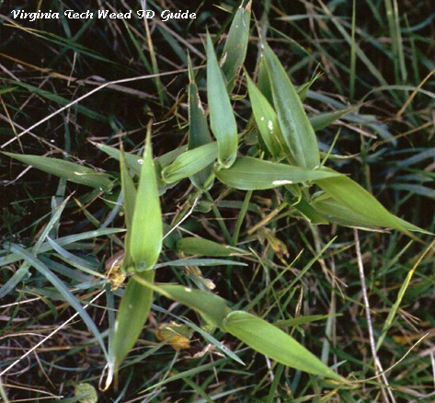
Deer-Tongue Grass
(similar to Jointhead Arthraxon)

Slide 23
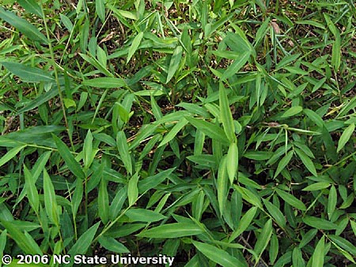
Stilt Grass
(Also similar to Jointhead, usually found in wooded area)

Slide 24
Spring 2016 - first cutting hay 5/24/16
Cut late due to heavy rains in early May!
How many bales do you think I got total?
Remember in 2015 I got 4 bales first cutting!
16 bales
22 bales
32 bales
36 bales

Slide 25
Field Break Down
Tree Side (30-60-120) lbs. acre fall application and 50 lbs. acre N in spring
Yielded 24 bales or (9000 lbs./acre) = 4.5 tons forage/acre
Fence Side 250 lbs. (19-19-19)
Yielded 12 bales or (4500 lbs./acre) = 2.25 tons forage/acre
Last year I got 750 lbs. per acre first cutting! Big difference……

Slide 26
Cost Break Down
Fall Application $185 per acre (24 bales)
Spring Application $95 per acre (12 bales)
  So which would you pick?
  Maybe on rented land with no lease agreement I’d pick the 19-19-19
  Drying time was also different! Tree side (fall) needed an extra day to dry.

Slide 27
Per bale Cost Comparison 2016
Fall Application $185 per acre/24 roles
  Cost per bale = $7.70
Spring Application $95 per acre/12 roles
  Cost per bale = $7.92
  Where you save $ is in equipment cost. Cost you ½ as much on the fall fertilized land!

Slide 28
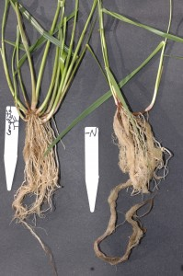
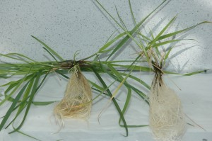
Nutrient deficient plant is on the right. Note that the roots seem to be finer on the Nutrient deficient plant but the entire root system is larger. (from University Deleware study)

Slide 29
Fertilizer Removed per ton hay
Per Ton
N = 50 lbs.
P = 15 lbs.
K = 60 lbs.
Fertilizer recommendations were 70-60-130
Fall I applied 30-60-120 with 50-60 Units N in spring
Spring got 48-48-48

Slide 30
2nd Cutting Hay 7/20/16 Field Walk
Noticed the Jointhead Antraxon was not as thick seems fertilizer and thicker fescue slowed its spread on both sides of field.
No Jointhead on fall side noticed a few plants found on spring side
Seems fall fertilized land has more hemp dogbane
(maybe coincidence ?)
Spring land still had less hemp dogbane but still more annual weeds and broom sage.
Fall fertilized side has a lot more tillers! Stand thicker

Slide 31
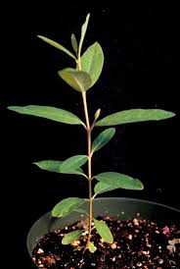
Hemp Dogbane

Slide 32
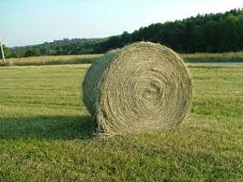
How Many Bales 2nd Cutting

Slide 33
2nd Cutting June 20th 2016
Fall Side 30-60-120 Rolled 4 bales
Spring Side 19-19-19 Rolled 4 bales
1.5 tons hay per acre

Slide 34
Final Math 2016 Cost per Bale
Fall $185 (1^{st)} + $110 (fuel/labor) / 28 bales
$295/28 = $10.54 per bale
Spring $95 (1^{st)} + $110 (fuel/labor) / 16 bales
$/16 = $12.80 per bale

Slide 35
Food For Thought!
Nutrients removed per ton hay
N = 50 lbs.
P = 15 lbs.
K = 60 lbs.
Fall Side (total hay tonnage removed) 6 tons per acre
Spring Side (total hay tonnage removed) 4 tons per acre

Slide 36
Hay Analysis
Sampled 5/31/16
Fall Applied 30-60-120 Spring Applied 19-19-19
Protein – 10.4 Protein – 10.2
TDN – 55.9 TDN – 56.8
Moisture - 18.6 Moisture - 17.7

Slide 37
Questions around the Dinner Table!
“I’d like a new rake” me “I’d like an in ground pool” wife
2016
I purchased a (new to me) Used 2006 Krone 38 Swadro Rotary rake…
Questions wife asks at table!
What is wrong with your old one?
Why do you need a new rake?
Do I want to ask how much that costs?

Slide 38
New (used) Rake Math
Payed $3500.00 for Krone Rake
Cost to buy same size bale $20 Cost to produce $10
$3500/10 = 350 bales to pay for it.
I bale 150-180 bales each year. Takes 2 years to pay for!
I can justify that to the wife!

Slide 39
Future Dreams while driving a tractor
New Tractor $45,000 45,000/10 = 4500
Need to bale 4500 bales. 4500/180 = 25 years
Take me 25 years to pay for a new tractor with hay savings!

Slide 40
Fertilizer Fall for 2017
Spread N-30 lbs., P-60 lbs., K- 120 lbs. (9/27/2016) rained well after!
Cost just for fertilizer $70 per acre
Fuel and time cost near $100 acre
I was later spreading this year do to dry weather in late Aug. – Sept.
What I noticed from the tractor seat!
  Both sides had an improved fescue stand, with fall fertilized still thicker.
  Jointhead grass was greatly reduced on both sides
  Spring side had more broom sedge while fall side had more hemp dogbane.

Slide 41
Main Point……..
Are you keeping enough records on your farm?
Do you know what it cost you per bale of hay?
Thank You,
Questions or Comments?

