Slide 1

Library6Btweets
Final Presentation
By: Pranav Dhakal, Yash Bhargava, Daniel Burdisso, Kenneth Powell, Anna Herms
Edward A. Fox
CS 4624: Multimedia, Hypertext, and Information Access
Virginia Tech, Blacksburg VA 24061
Date: 12. 07. 2021
Notes:
Pranav

Slide 2
Outline
Project overview
Timeline
Work completed
Future Work
References
Acknowledgements
Questions
Notes:
Pranav

Slide 3



Project Overview
Our goal is to consolidate over 6 billion tweets from the Digital Library Research Laboratory (DLRL) into a unified schema. Currently there are three types of collection systems that are storing the tweet data:
yourTwapperKeeper (YTK)
Social Feed Manager (SFM)
Digital Methods Initiative Twitter Capture and Analysis Toolset (DMI-TCAT)
Technology utilized: Python, MySQL database, JSON objects
Notes:
Pranav

Slide 4
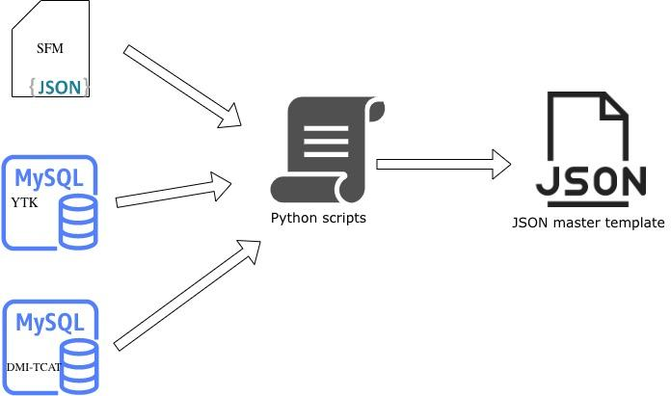
Notes:
Pranav

Slide 5

Timeline
Sept.
Oct.
Nov.
Milestones 1 & 2
Milestones 3 & 4
Milestones 5-8
Complete script for reading in DMI-TCAT data
Begin prototyping for JSON collection level schema
Finalize JSON unified tweet master schema
Finalize JSON collection-level schema
Complete script(s) for converting old data to new schema
Test script for converting tweet data to the JSON master schema
Establish team roles
Meet with client
Establish requirements and milestones
Complete Python scripts for reading in YTK and SFM data
Notes:
Yash

Slide 6
Work Completed: Summary
Tweet converter scripts
SFM individual tweet converter
SFM collection-level converter
YTK individual tweet converter
YTK collection-level converter
DMI-TCAT individual tweet converter
DMI-TCAT collection-level converter
Testing scripts
Unit tests
Tweet data validators
The next slides will discuss some of this work
Notes:
Yash

Slide 7
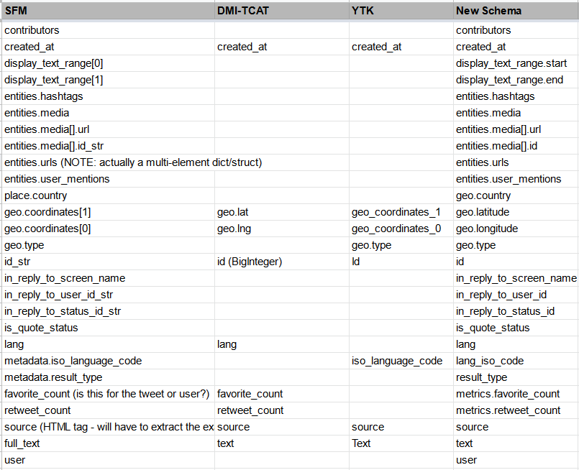
Finalized Individual Tweet Schema
V2
+
SFM
YTK
DMI-TCAT
...
Notes:
Anna

Slide 8
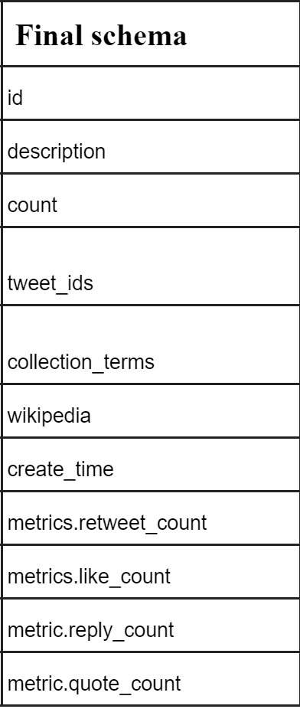

Finalized Collection-Level Schema
+
Ids
...
Notes:
Anna

Slide 9
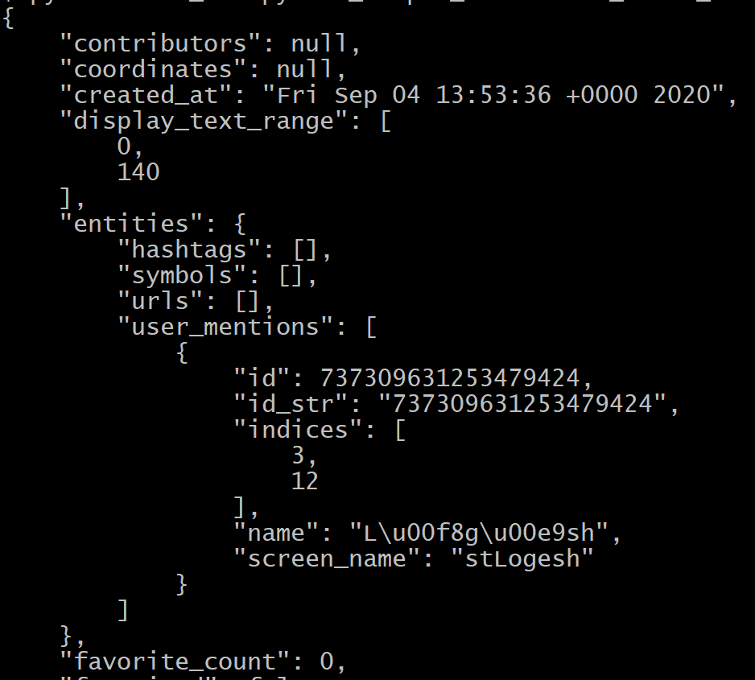
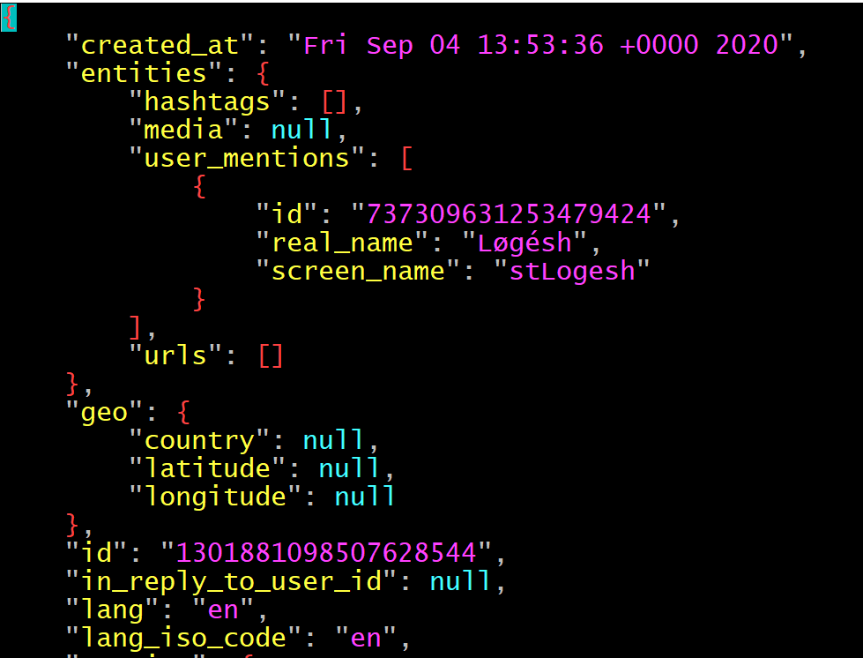
Work Completed: SFM Individual Tweet Converter
Start of SFM Tweet Object
Start of New Schema Tweet Object
Notes:
Kenneth

Slide 10
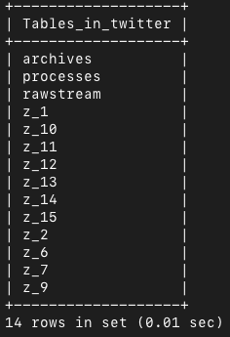
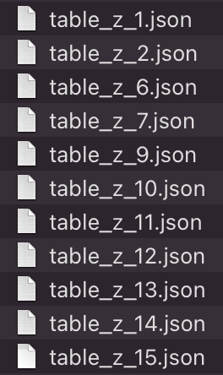
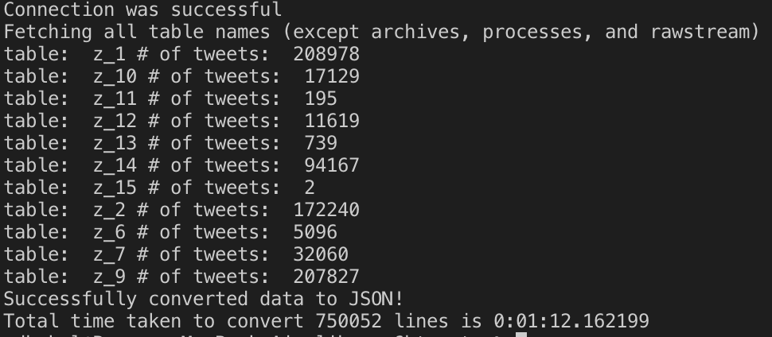
Work Completed: YTK Individual Tweet Converter
Running the script
Sample tables in YTK
JSON output

Slide 11
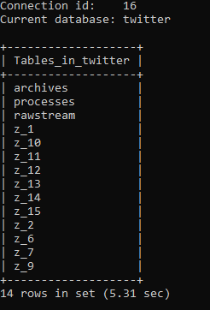
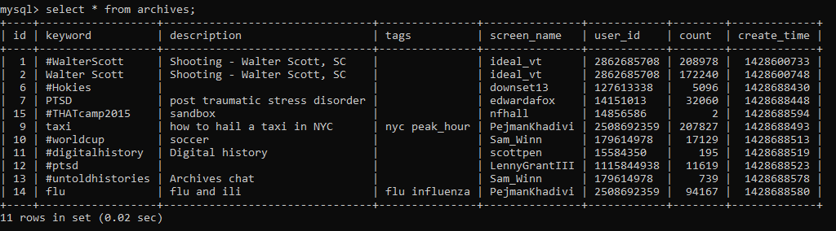
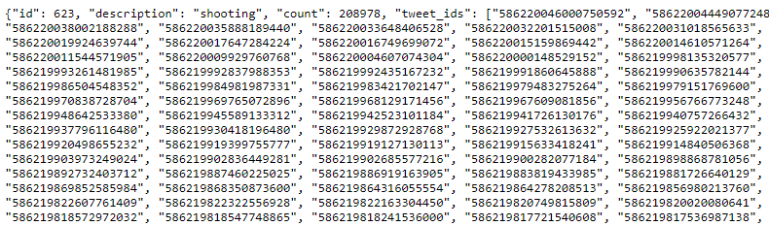
Work Completed: YTK Collection Tweet Convertor
Archives Table Sample
Partial Example of YTK Collection Output
Sample Tables in YTK
Notes:
Daniel

Slide 12
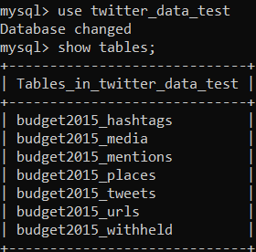
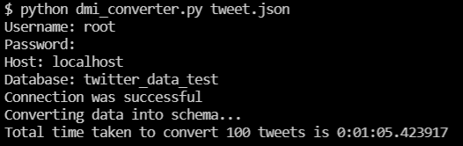
Work Completed: DMI-TCAT
Query code example
Sample tables in MySQL
Sample input and time taken for conversion
Notes:
Yash

Slide 13
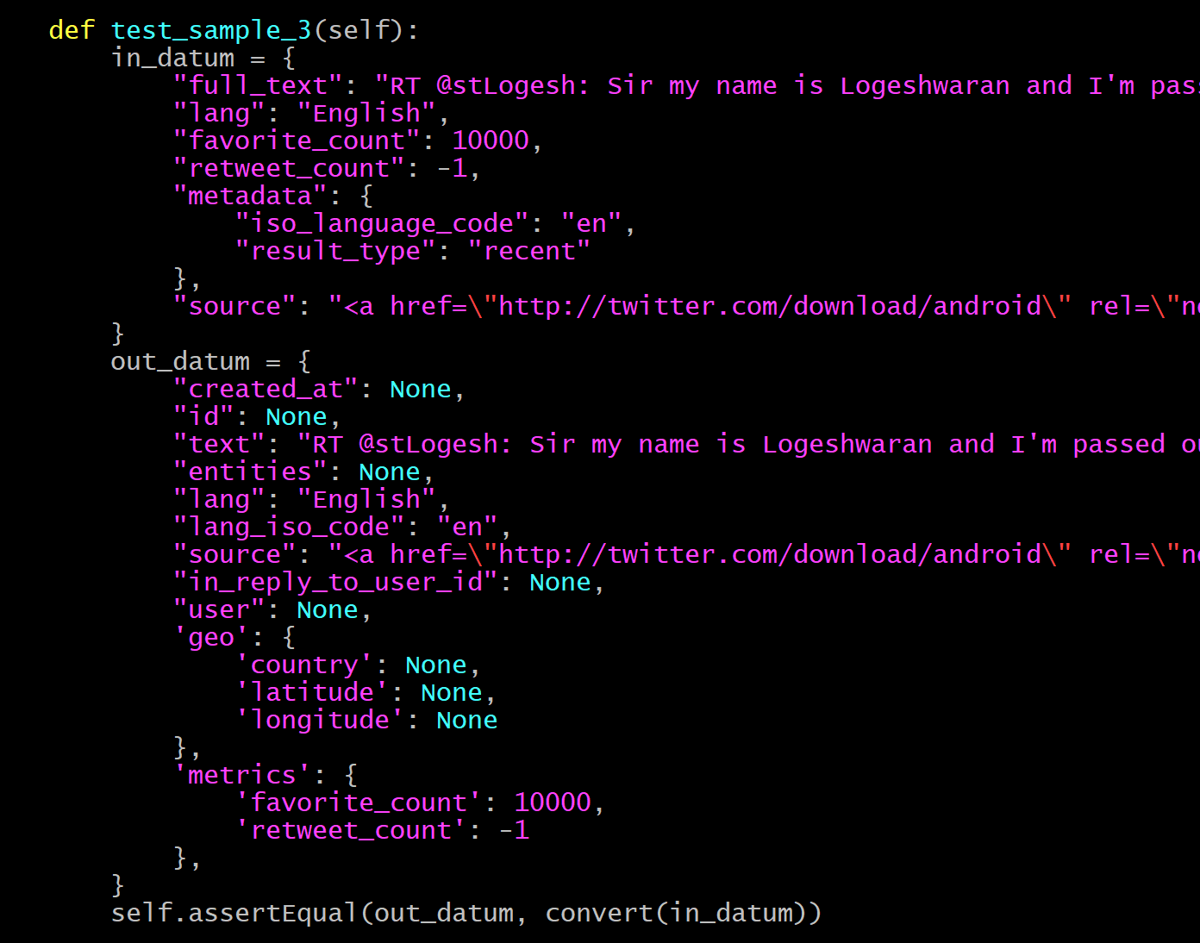
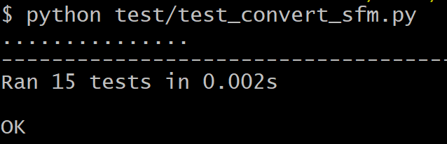
Work Completed: SFM Converter Unit Tests
How to execute the tests
Test case example
Notes:
Kenneth

Slide 14
Validator Scripts
Used for testing
Two scripts:
Validator for individual tweet data
Validator for collection-level data
Sanity checks all data in a file
Notes:
Kenneth

Slide 15
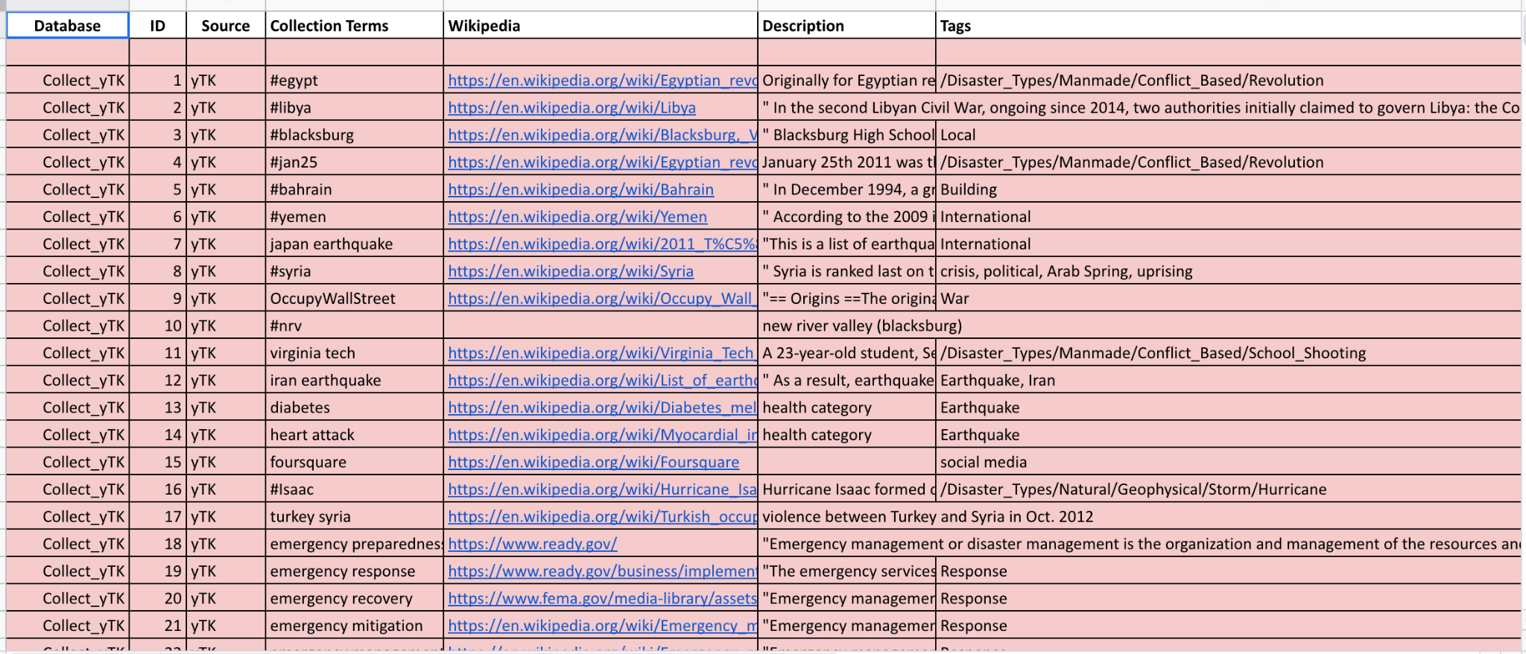
Future Work
Performance Improvement of Scripts - Time taken to convert tweets
Converting 6 billion tweets - Can take significant amount of time
Link SFM and DMI-TCAT to Events Archives collection table
Notes:
Daniel

Slide 16
References
Twitter API Reference
https://developer.twitter.com/en/docs/twitter-api/tweets/lookup/api-reference/get-tweets-id
https://developer.twitter.com/en/docs/labs/fields
Twitter V2 Data Dictionary
https://developer.twitter.com/en/docs/twitter-api/data-dictionary/object-model/tweet
Tweet Collection Management Report
https://vtechworks.lib.vt.edu/bitstream/handle/10919/101520/TWT_CS5604_F2020_Report.pdf?sequence=13&isAllowed=y
Events Archiving
http://eventsarchive.org/
Notes:
Daniel

Slide 17
Acknowledgements
We would like to thank our client, Xinyue Wang, and Dr. Fox for their help on this project.
Notes:
Daniel

Slide 18

Any Questions?
Notes:
Daniel

