Slide 1
The CHANDLER Antineutrino Detection System and Nuclear Reactor Monitoring
Jonathan Link
Center for Neutrino Physics, Virginia Tech
Virginia Tech Nuclear Engineering Seminar
October 20, 2023

Slide 2
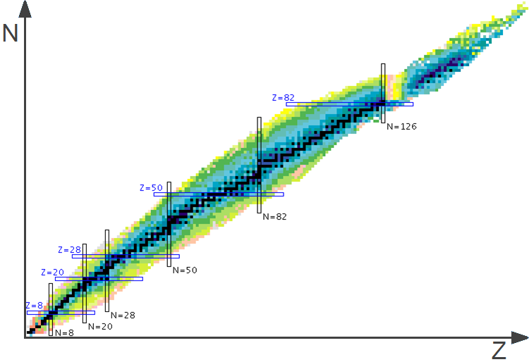
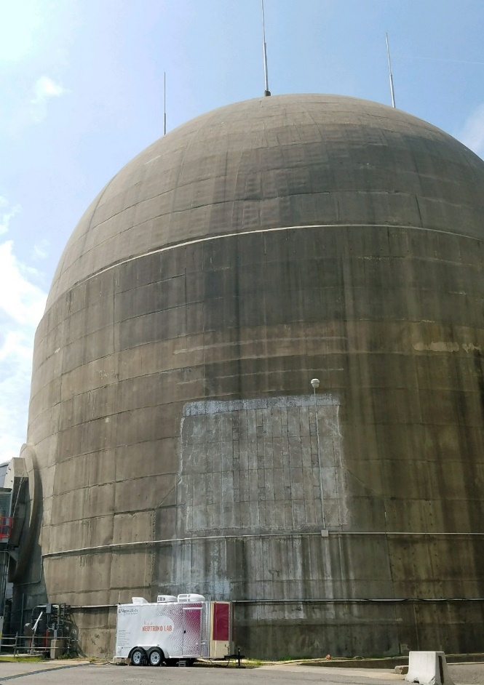
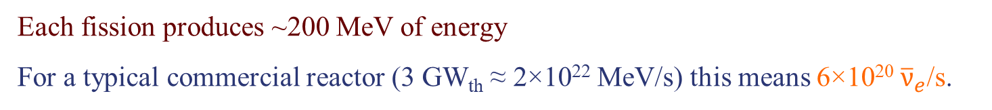
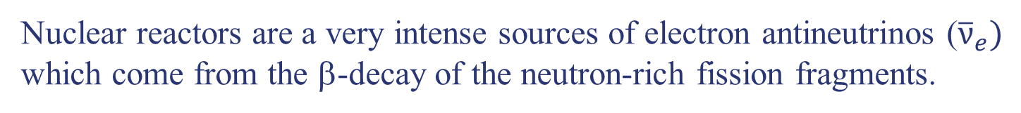
Reactors as a Neutrino Source
Nuclear reactors are a very intense sources of electron antineutrinos (${\overline{ν}}_{e})$ which come from the β-decay of the neutron-rich fission fragments.
Known Isotopes
n
Typical Fission
n
n
Each fission produces ~200 MeV of energy
For a typical commercial reactor (3 GW_{th} ≈ 2×10²² MeV/s) this means 6×10²⁰ ${\overline{ν}}_{e}$/s.
and an average of 6 neutrinos,

Slide 3
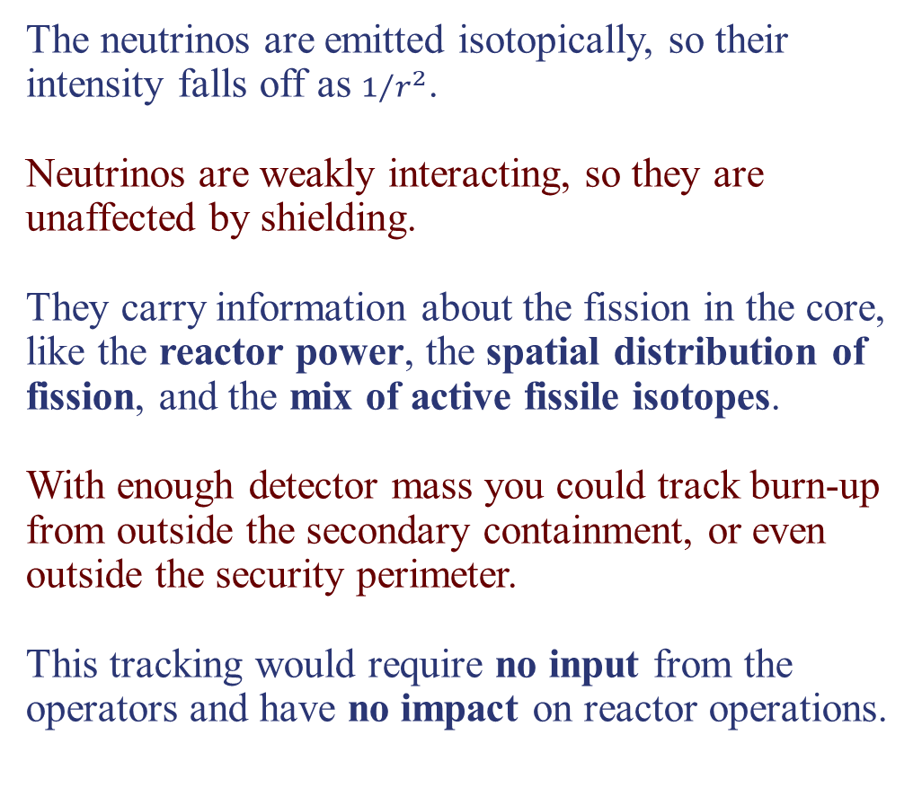
Reactors as a Neutrino Source
The neutrinos are emitted isotopically, so their intensity falls off as $1/{r^{2}}$.
Neutrinos are weakly interacting, so they are unaffected by shielding.
They carry information about the fission in the core, like the reactor power, the spatial distribution of fission, and the mix of active fissile isotopes.
With enough detector mass you could track burn-up from outside the secondary containment, or even outside the security perimeter.
This tracking would require no input from the operators and have no impact on reactor operations.

Slide 4
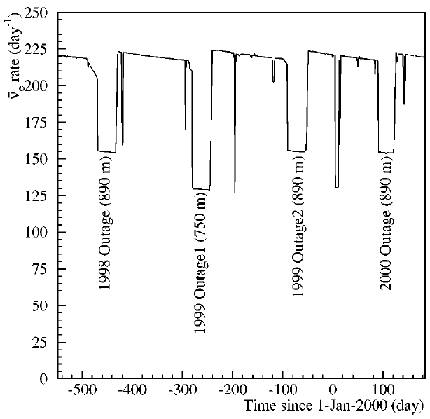
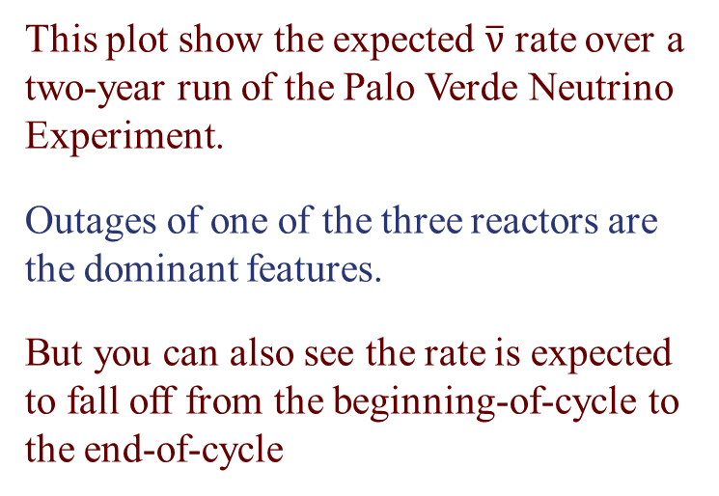
Burnup and the Neutrino Detection Rate
It’s long been known that the rate of antineutrino detection falls off as plutonium fission grows as a fraction of the total.
This plot show the expected $\overline{ν}$ rate over a two-year run of the Palo Verde Neutrino Experiment.
Outages of one of the three reactors are the dominant features.
But you can also see the rate is expected to fall off from the beginning-of-cycle to the end-of-cycle
Rev. Mod. Phys. 74, 297 (2002)

Slide 5
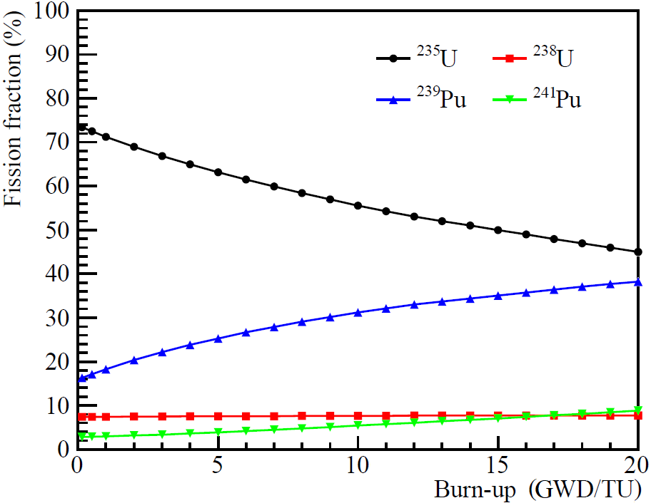
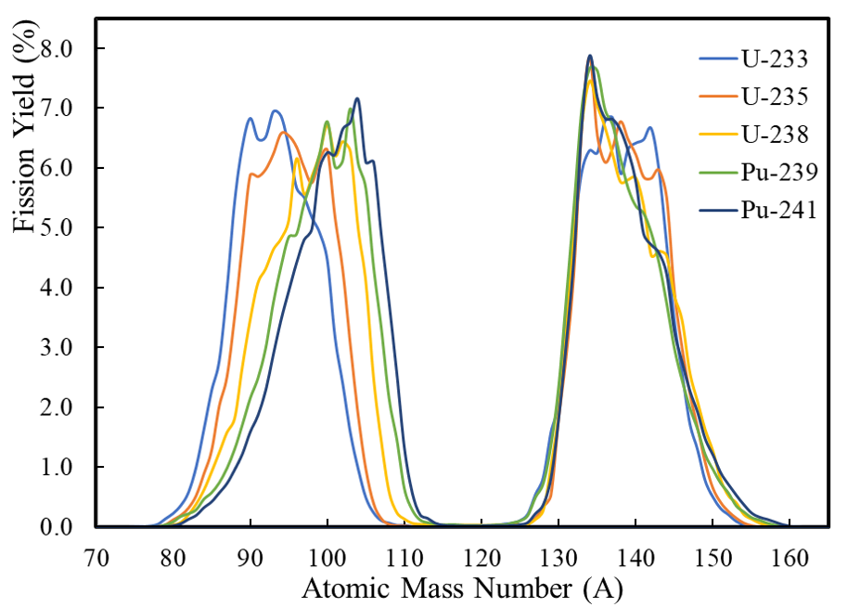
Burnup Evolution of the Neutrino Spectrum
As the fuel burns in a low-enriched uranium reactor, the mix of fissile isotopes evolves,
Chinese Phys. C 41, 013002 (2017)
http://nndc.bnl.gov
And each fissile isotope has a unique set of fission fragment yields.

Slide 6
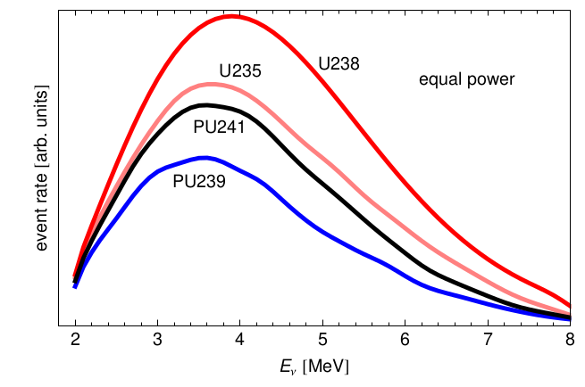
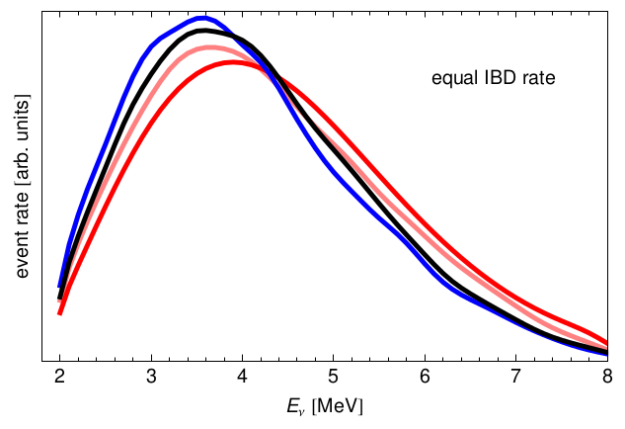
Burnup Evolution of the Neutrino Spectrum
Each fissile isotope has a unique inverse beta decay spectrum.
There are significant differences in the rate, with ²³⁵U having a higher rate than ²³⁹Pu.
But there are also measurable differences in the antineutrino spectral shape.
Thus, careful measurement of the antineutrino energy spectrum could be used to track the reactor fuel burn-up in real time.

Slide 7
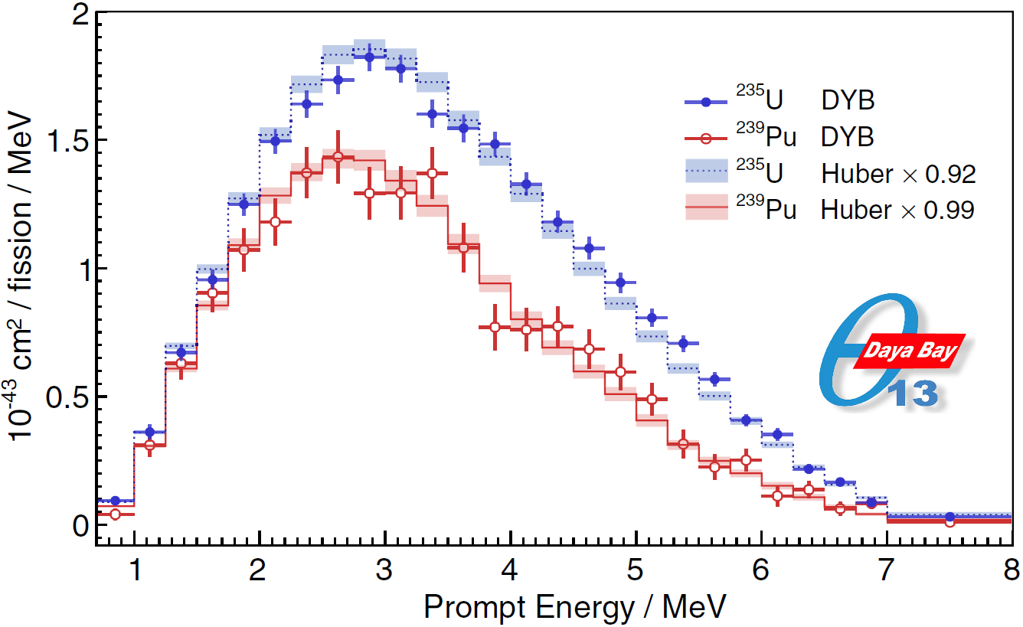
Daya Bay’s Neutrino Spectral Decomposition
Using burn-up data from the reactor operators, the Daya Bay Collaboration was able to decompose the neutrino spectra from the different fissile isotopes.
The data clearly show that the different fissile isotopes indeed have unique neutrino spectra.
This study was done with detectors at 360 meters from two reactors, operating with out-of-sync refueling cycles.
Phys. Rev. Lett. 123, 111801 (2019)
Imagine this analysis with detectors located 25 meters from a single reactor.

Slide 8
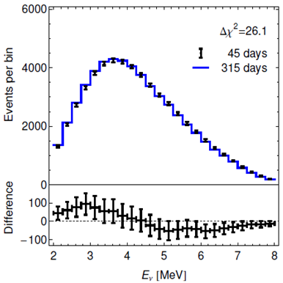
Application to Nuclear Non-Proliferation
Neutrino monitoring has been proposed as a non-invasive verification scheme to be used in nuclear treaties with nations such as Iran and North Korea.
The basic idea is to look for changes in the neutrino energy spectrum indicative of a diversion of weapons grade plutonium.
A main stumbling block to the full embrace of neutrino safeguards has been the inability to demonstrate a viable detector technology.
Safeguards detectors must:
  be portable, reliable and low-cost,
  have good energy resolution, and
  be free of potential hazards such as flammable liquids.
Huber et al. PRL 113, 042503

Slide 9

The Nu Tools Study
Commissioned by the National Nuclear Security Administration’s office of Defense Nuclear Non-proliferation,
It released its final report in August 2021:
https://www.osti.gov/biblio/1826602/
The report found promising potential for applications of neutrino detectors in
  Future Nuclear Deals, and
  Monitoring Advanced Nuclear Reactors
The NNSA is now funding a follow up program to build a Mobile Antineutrino Demonstrator.

Slide 10
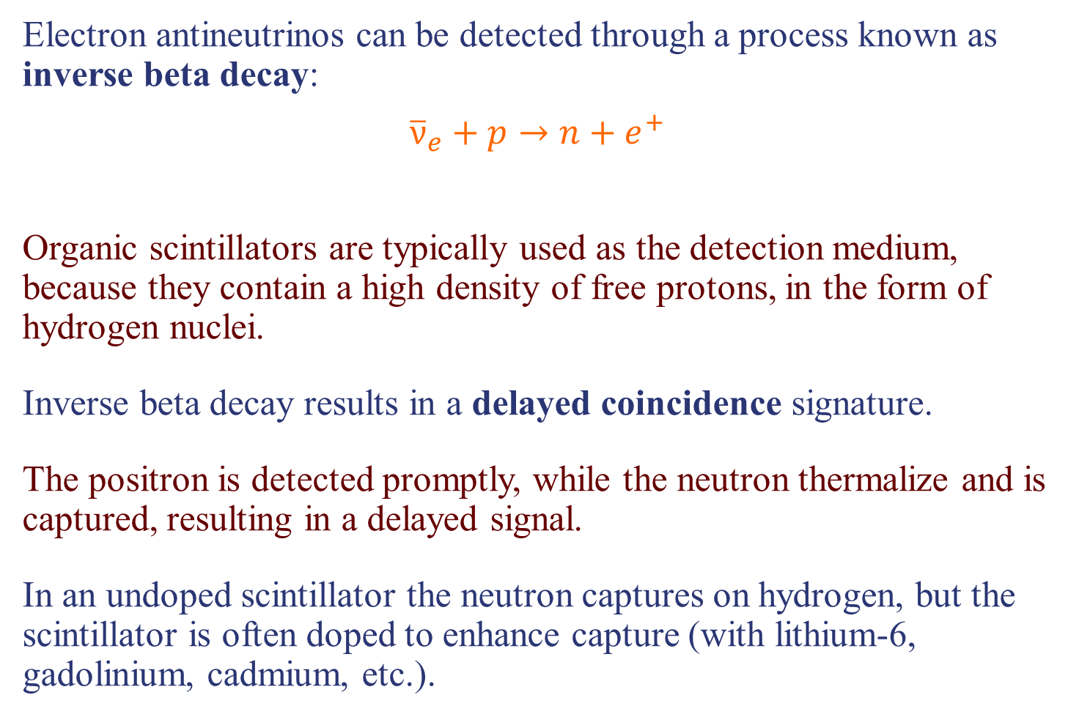
Reactor Neutrino Detection
Electron antineutrinos can be detected through a process known as inverse beta decay:
$${\overline{ν}}_{e}+p→n+e^{+}$$
Organic scintillators are typically used as the detection medium, because they contain a high density of free protons, in the form of hydrogen nuclei.
Inverse beta decay results in a delayed coincidence signature.
The positron is detected promptly, while the neutron thermalize and is captured, resulting in a delayed signal.
In an undoped scintillator the neutron captures on hydrogen, but the scintillator is often doped to enhance capture (with lithium-6, gadolinium, cadmium, etc.).
n + ⁶Li → ³H + ⁴He

Slide 11
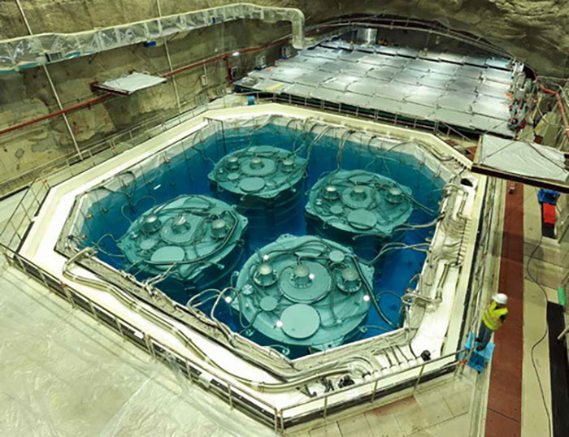
Reactor Neutrino Backgrounds
The weak signal from neutrino interactions can be easily overwhelmed by cosmic-rays and conventional radiation.
By requiring a delayed coincidence, we can eliminate the vast majority of these backgrounds.
The remaining backgrounds include random coincidences and cosmic-ray fast neutrons.
When a fast neutron hits a proton in the scintillator, the recoiling proton can mimic the positron.
The coincidence is completed when the neutron thermalizes and is captured.
The Daya Bay Far Detector Hall
To control backgrounds, neutrino detectors are usually located deep underground and surrounded by thick layers of low-activity shielding.
This is not an option for applications detectors!

Slide 12
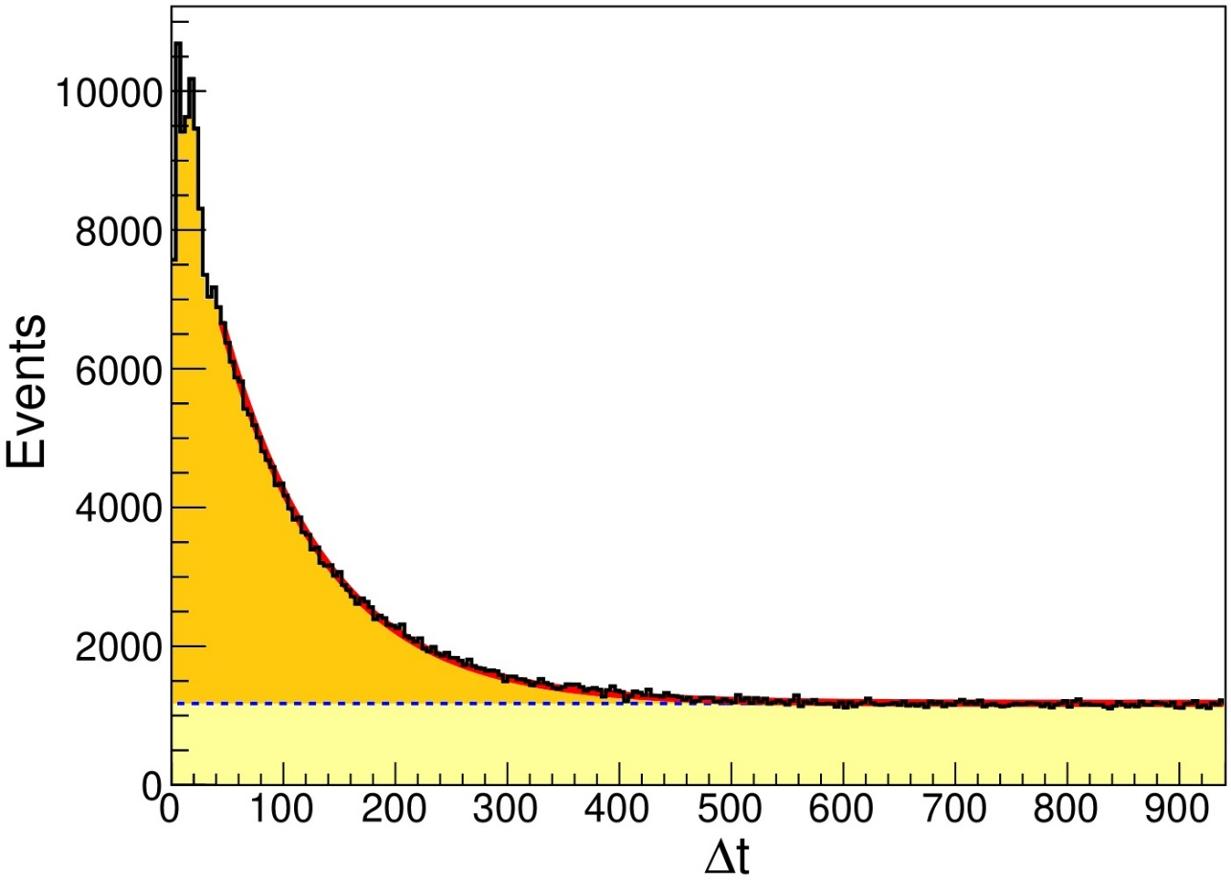
Reactor Neutrino Backgrounds
Random coincident backgrounds have no structure in the separation time between the prompt and delayed signals,
That’s why fast neutrons are a much more problematic background to an inverse beta decay selection.
Phys. Rev. Applied 13, 034028 (2020)
Random coincident events can easily be removed by a flat subtraction.
But for correlated events, like fast neutrons and inverse beta decay, the neutron capture time is an exponential distribution.
Correlated Events
Random Coincident Events

Slide 13
The CHANDLER Technology

Slide 14
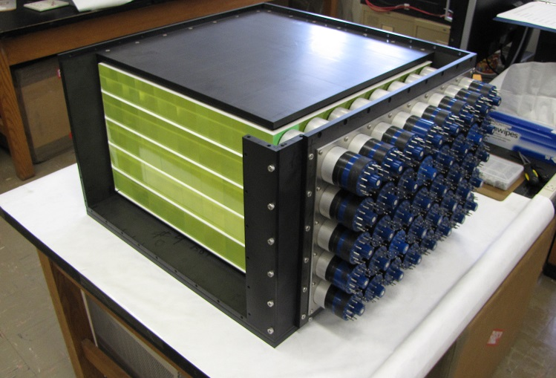
The CHANDLER* Reactor Neutrino Detector
CHANDLER was designed, from the start, to be a robust, mobile detector technology, suitable for a wide range of applications.
It uses a highly-segmented array of plastic scintillating cubes as the neutrino target and positron detector,
And thin sheets of lithium-6 doped zinc sulfide (ZnS) scintillator to tag the neutron capture.
The MiniCHANDLER Prototype, open during assembly to show the cubes and ⁶Li-doped ZnS sheets
*Carbon Hydrogen Anti-Neutrino Detector with a Lithium Enhanced Raghavan optical lattice

Slide 15
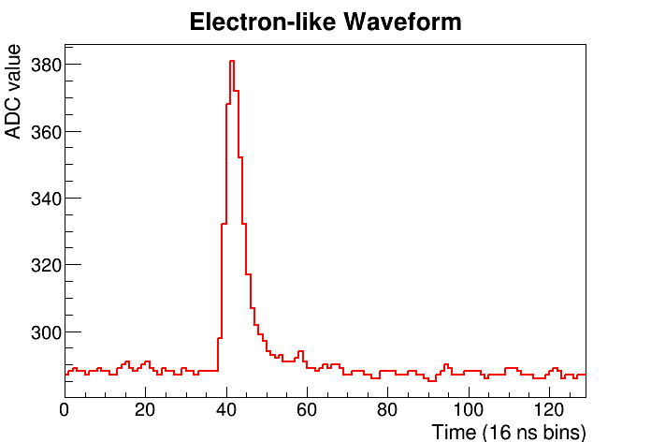
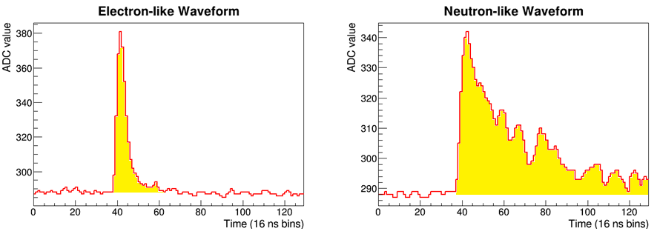
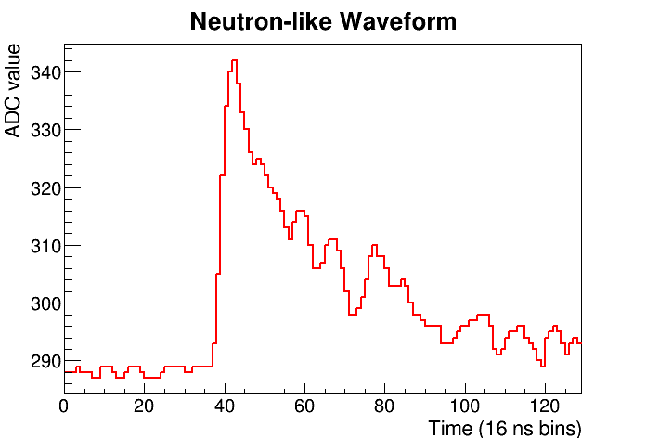
Neutron Identification in CHANDLER
The positron signal is formed in the cubes which give short in duration light pulse of about 10 ns,
Neutron capture light comes from the ZnS, which releases its scintillation light over much longer time scale (~200 ns)..
For each hit cell, we can compute a simple neutron ID metric as the ratio of the pulse integral to the pulse height.
The higher the neutron ID the more neutron-like the event.
pulse integral
pulse height

Slide 16
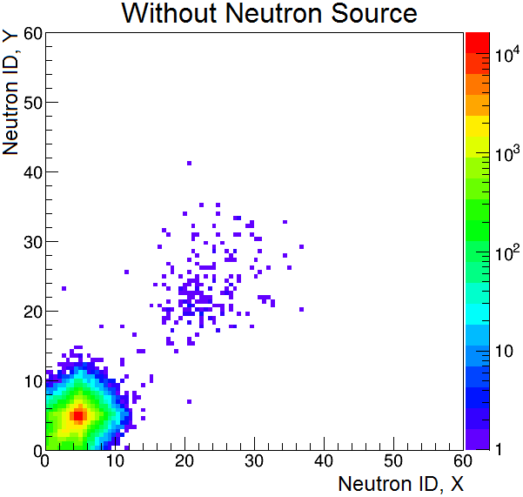
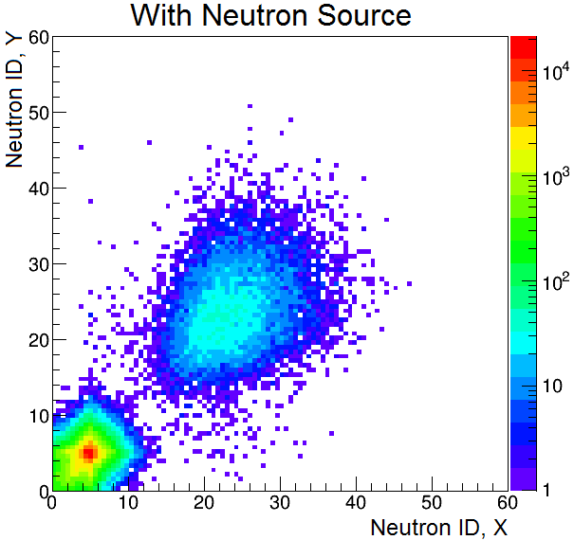
Neutron Identification in MicroCHANDLER
A 2D plot of x- and y-view neutron IDs show a clear neutron/positron separation.
When the source is removed the events in the neutron region mostly go away.
The remaining neutrons candidates are consistent with cosmic-ray neutrons.
Neutrons
Positrons

Slide 17
The CHANDLER* Reactor Neutrino Detector
CHANDLER was designed, from the start, to be a robust, mobile detector technology, suitable for a wide range of applications.
It uses a highly-segmented array of plastic scintillating cubes as the neutrino target and positron detector,
And thin sheets of lithium-6 doped zinc sulfide (ZnS) scintillator to tag the neutron capture.
Light is transported along the rows and columns of cubes by total internal reflection, and readout by photomultiplier tubes.
The MiniCHANDLER Prototype, open during assembly to show the cubes and ⁶Li-doped ZnS sheets
*Carbon Hydrogen Anti-Neutrino Detector with a Lithium Enhanced Raghavan optical lattice

Slide 18
The Raghavan Optical Lattice
The cubes are optically connected in layers and sandwiched between sheets of ⁶Li-loaded ZnS scintillator for neutron detection.
Light from the cubes is transported by total-internal-reflection, along the rows and columns of cubes, to the edge of the detector, where it’s readout by photomultiplier tubes.
Light from the sheets is absorbed in the cubes and retransmitted by a wavelength-shifter so that it can also be captured by total-internal-reflection.
This Raghavan Optical Lattice allows us to achieve excellent spatial resolution over a large, unbroken detector mass.
Jonathan Link

Slide 19
The CHANDLER* Reactor Neutrino Detector
CHANDLER was designed, from the start, to be a robust, mobile detector technology, suitable for a wide range of applications.
It uses a highly-segmented array of plastic scintillating cubes as the neutrino target and positron detector,
And thin sheets of lithium-6 doped zinc sulfide (ZnS) scintillator to tag the neutron capture.
Light is transported along the rows and columns of cubes by total internal reflection, and readout by photomultiplier tubes.
The high segmentation is used to tag the gammas from positron annihilation, and thus reject correlated backgrounds like fast neutrons.
The MiniCHANDLER Prototype, open during assembly to show the cubes and ⁶Li-doped ZnS sheets
*Carbon Hydrogen Anti-Neutrino Detector with a Lithium Enhanced Raghavan optical lattice

Slide 20



The Signal and the Noise
High segmentation allows us to tag the positron annihilation gammas interacting in neighboring cubes.
Neutrons are tagged by the slow scintillation decay time of the zinc sulfide scintillator (200 ns vs 10 ns).
The time ordered coincidence of a positron and a neutron tag separates IBDs from background.
$${\overline{ν}}_{e}$$
n
Inverse Beta Decay (IBD)
${\overline{ν}}_{e}+p→e^{+}+n$
$$e^{+}+e^{−}→γ+γ$$
$$n+{}_{ }^{6}{Li}→{}_{ }^{4}{He}+{}_{ }^{3}H$$
Cosmic-Ray Fast Neutron
$n+p→n+p$
$$n+{}_{ }^{6}{Li}→{}_{ }^{4}{He}+{}_{ }^{3}H$$
γ
γ
e⁺
p
p
n
n
⁶Li
⁴He
⁶Li
⁴He
Positron (e⁺)
Annihilation γs
³H
³H
Proton
Detected Light
Neutron Capture
Detected Light
Neutron Capture
In the field we saw 85 correlated fast neutrons for every IBD event, so we need powerful tools to reject them!
time
time
10 ns
50 μs
200 ns
10 ns
50 μs
200 ns

Slide 21
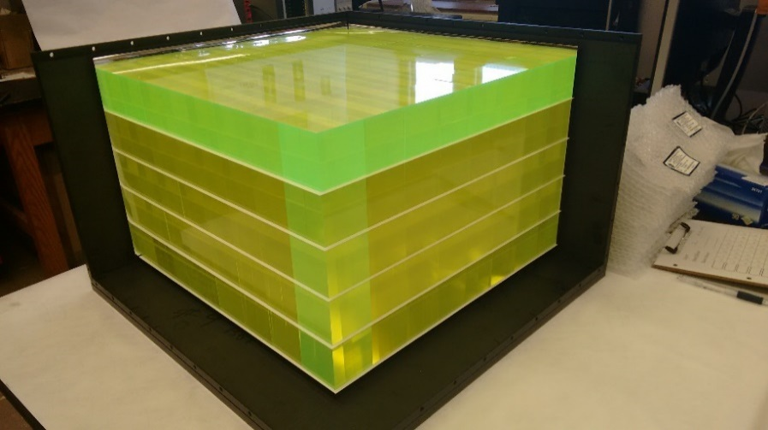
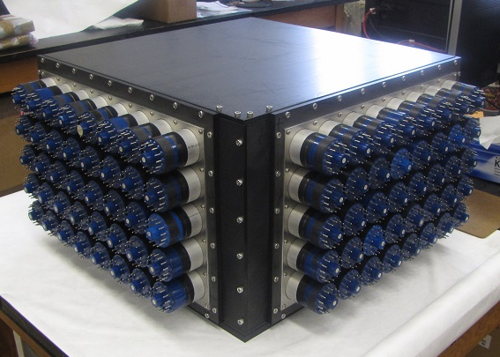
MiniCHANDLER in Pictures
The 80 channel MiniCHANDLER detector was completed in fall 2016.

Slide 22
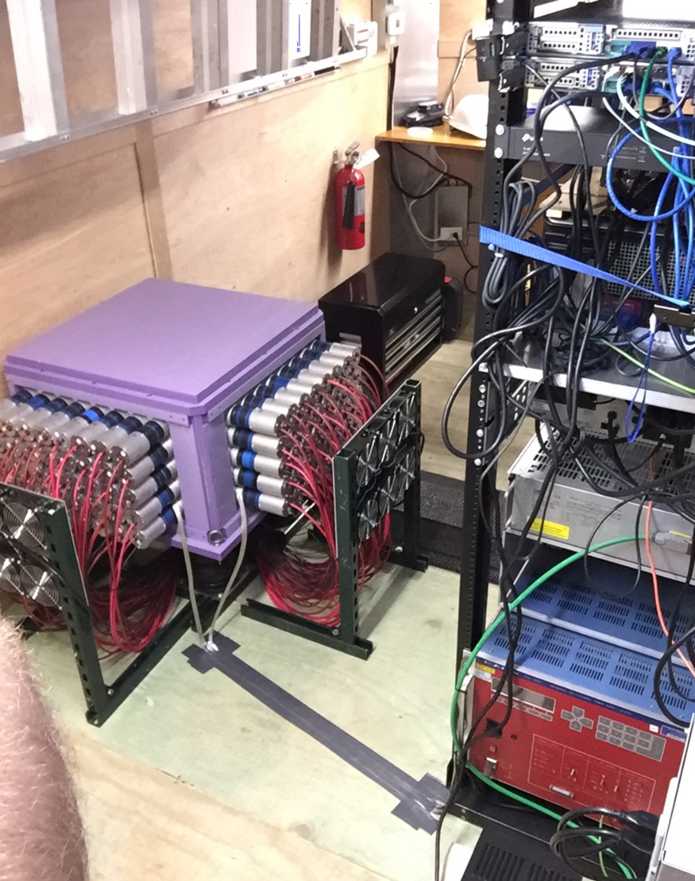
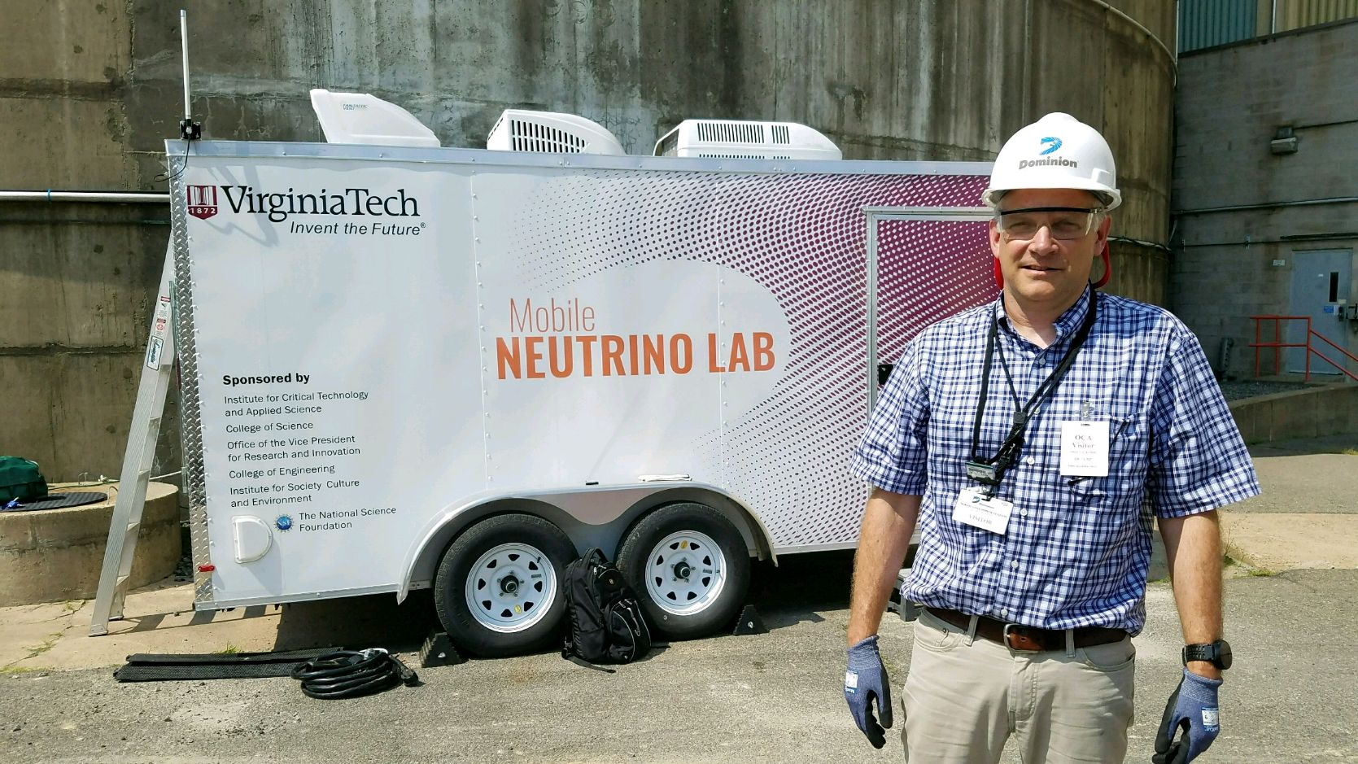
The Mobile Neutrino Lab
The MiniCHANDLER prototype was installed in our Mobile Neutrino Lab and deployed to the North Anna Nuclear Generating Station.

Slide 23
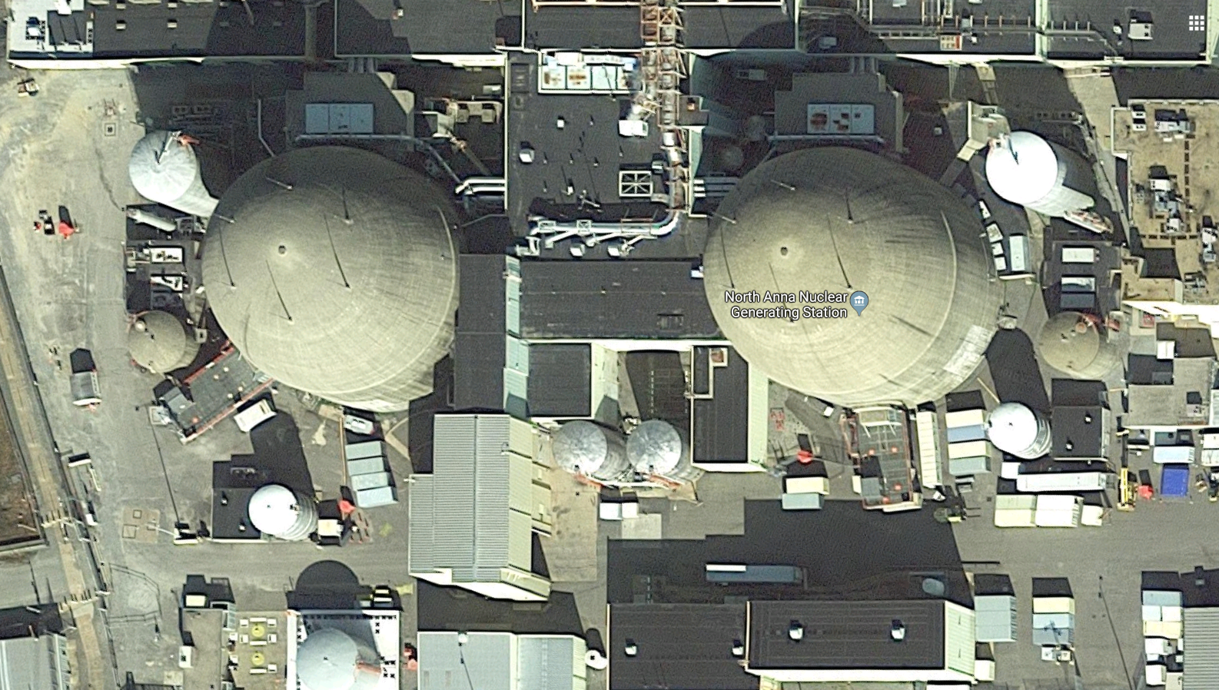

The Mobile Neutrino Lab at North Anna
Jonathan Link

Slide 24
The Mobile Neutrino Lab
The MiniCHANDLER prototype was installed in our Mobile Neutrino Lab and deployed to the North Anna Nuclear Generating Station.
With this deployment MiniCHANDLER would become:
  The first demonstrated mobile neutrino detector,
  The first unshielded reactor neutrino detector, and
  One of the world’s smallest neutrino detectors.

Slide 25
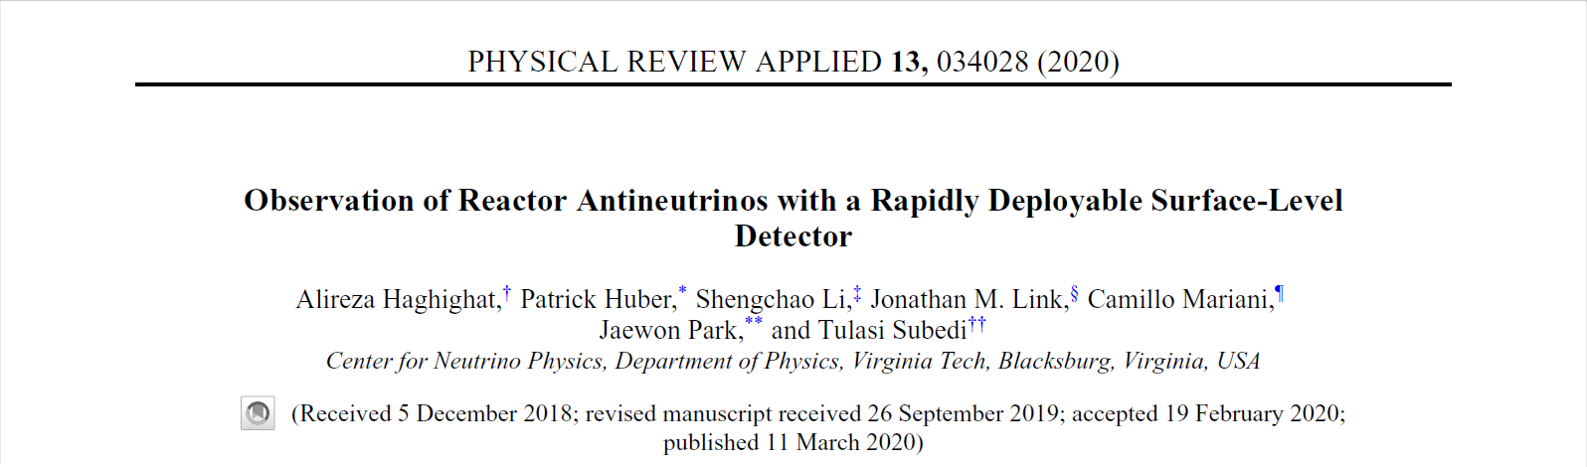
The MiniCHANDLER Analysis

Slide 26
The IBD Event Selection
The inverse beta decay candidates included all positron-like events in the 1000 μs preceding a neutron.
The positron candidate energy were reconstructed from the pattern of PMT light collected in each detector plane.
We applied a spatial separation cut between the positron and neutron.
Topological selections were used to reject multiple proton recoils and tag evidence of the annihilation gammas:
  Total energy outside the primary cube <1 MeV
  No single cube outside the primary cube with E>511 keV
  At least one cube outside the primary with energy >100 keV

Slide 27
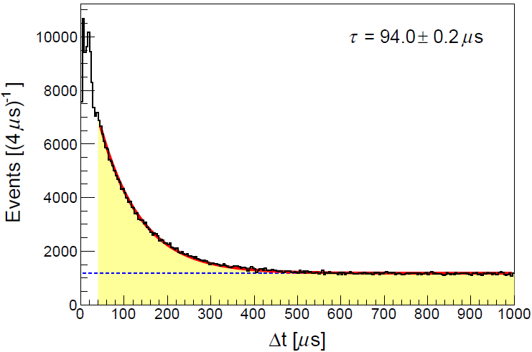
Fitting Δt for Correlated Events
We sorted our IBD candidates into energy bins of 1 MeV.
In each bin, the positron-neutron Δt distribution was fitted with an exponential plus flat distribution,
To extract the time-correlated event rate we integrate the exponential part of the Δt distribution.
Phys. Rev. Applied 13, 034028 (2020)
Correlated Events
Random Coincident Events

Slide 28
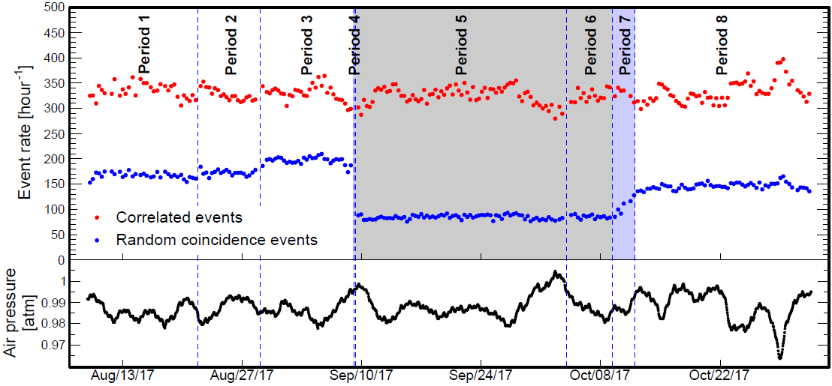
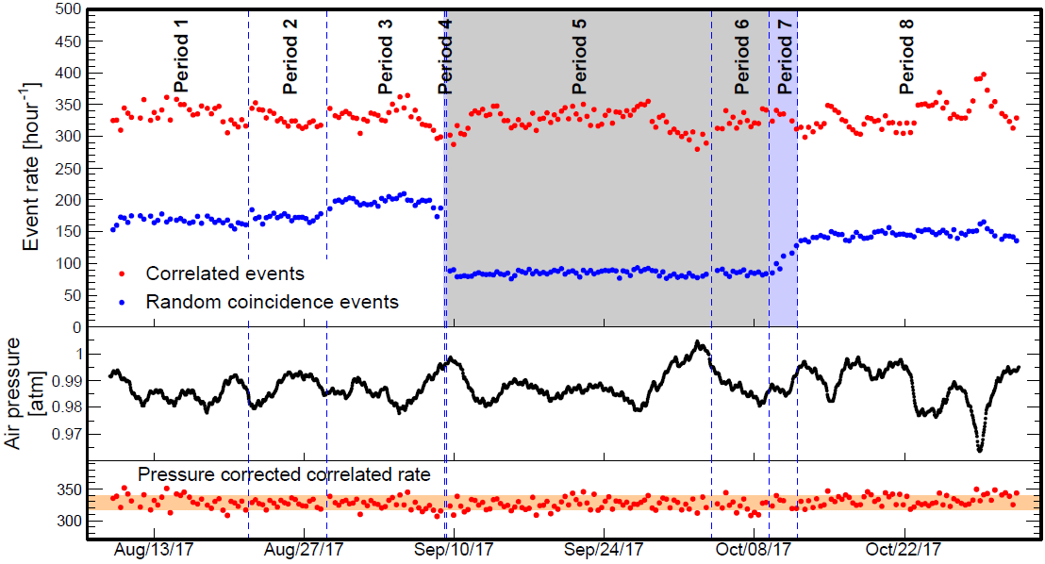
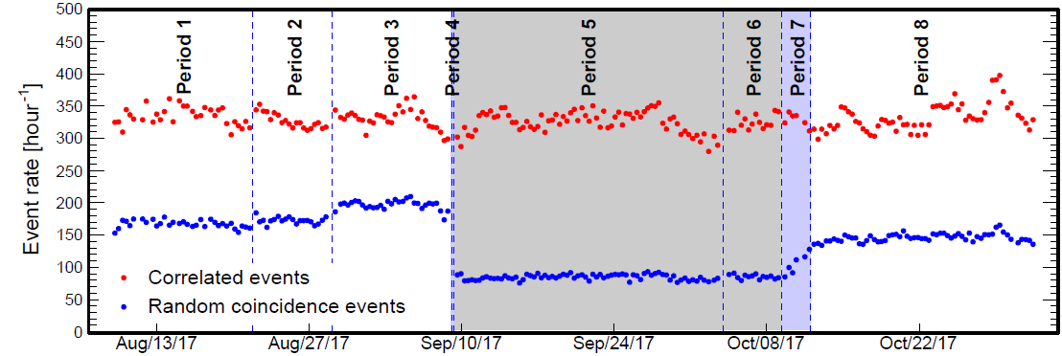
Time Correlated Fast Neutrons
Phys. Rev. Applied 13, 034028 (2020)
No topological selections applied.
Reactor-off
Random events with Δt < 500 μs
Most of the time correlated events are fast neutrons,
and their rate is independent of the reactor power.
The fast neutron rate is inversely correlated with atmospheric pressure.
After a pressure correction, we found that the average correlated rate in the reactor-off period was lower than in reactor-on by about 4 events/hour.
Which is consistent with the expected inverse beta decay rate.

Slide 29
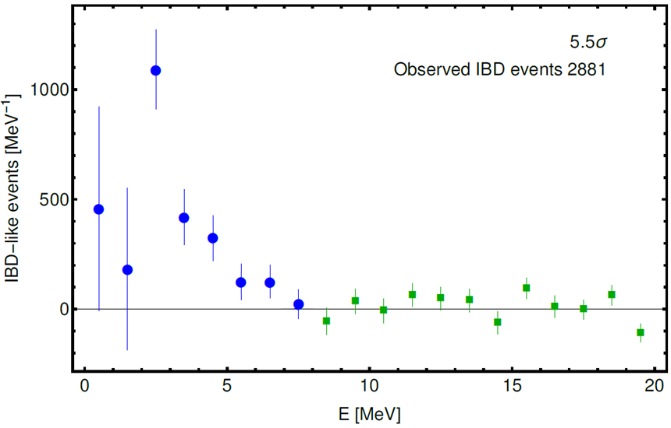
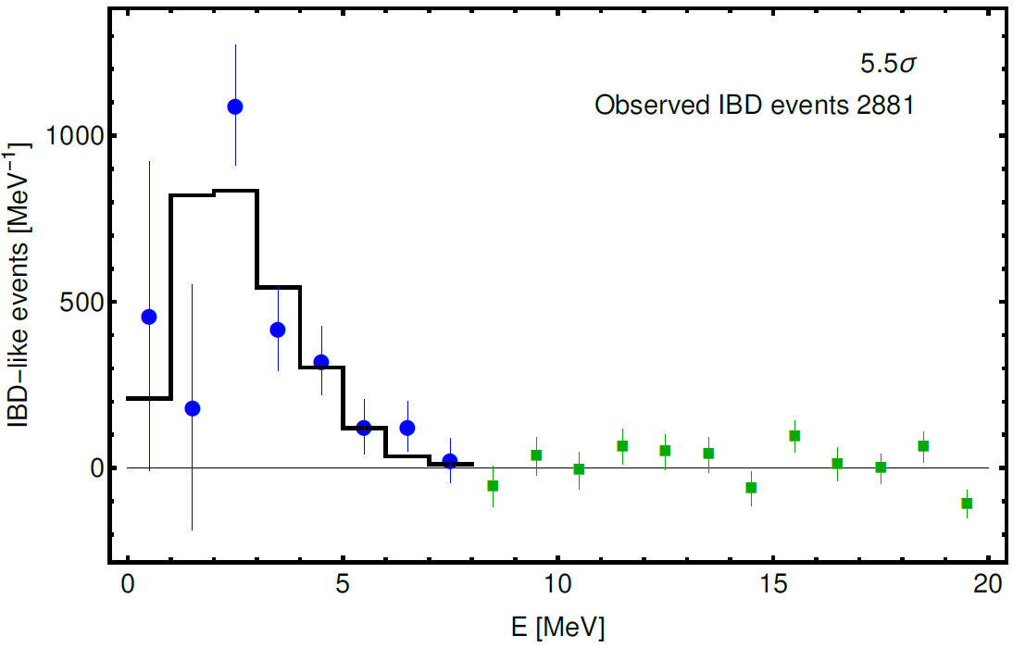
The IBD Analysis Results
To further eliminate the correlated background, we performed a reactor-off subtraction.
We used energy bins beyond the signal region (from 8 to 20 MeV) to scale the reactor-off absolute rate to match the reactor-on rate.
We fit this excess to the inverse beta decay spectrum from Monte Carlo (black histogram).
Phys. Rev. Applied 13, 034028 (2020)
The excess below 8 MeV are neutrino events.

Slide 30
Cross Check with Rate Only Analysis
We conducted a rate only analysis by making a 3 to 8 MeV cut in energy to avoid random coincident event.
Atmospheric pressure and DAQ efficiency corrections were applied. These corrections are non-trivial.
We observe a rate-only 3.5σ excess in reactor-on with respect to reactor-off.
The observed rate is consistent the expected rate.

Slide 31
Neutron Detection in MiniCHANDLER
As an inverse beta decay detector, CHANDLER is highly sensitive to thermal neutrons from the reactor.
This can be seen in the drop in the random coincident rate during the reactor shutdown.
Phys. Rev. Applied 13, 034028 (2020)
About half of the neutrons contributing to the random coincident rate are from the reactor.

Slide 32
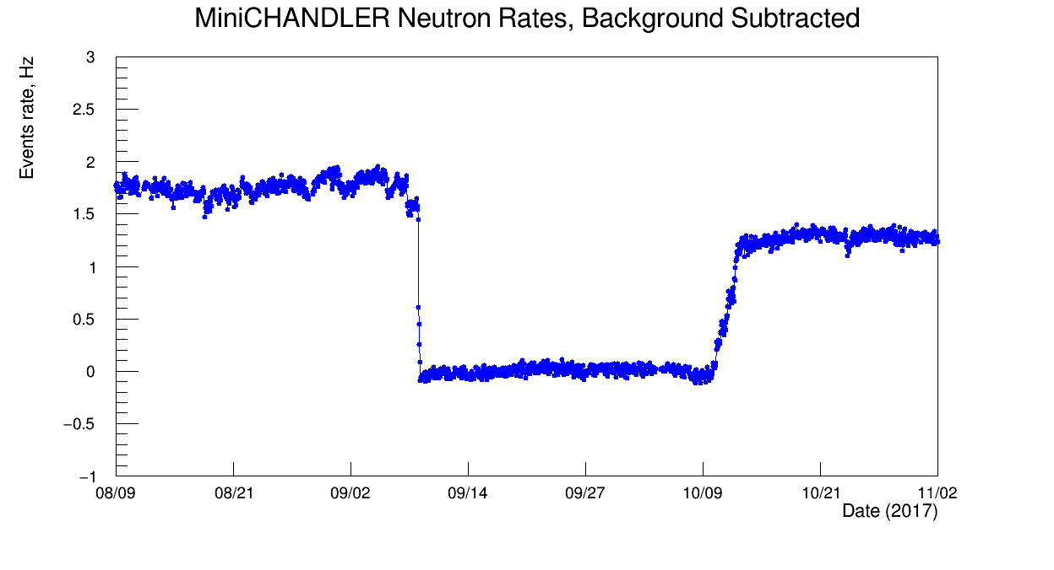
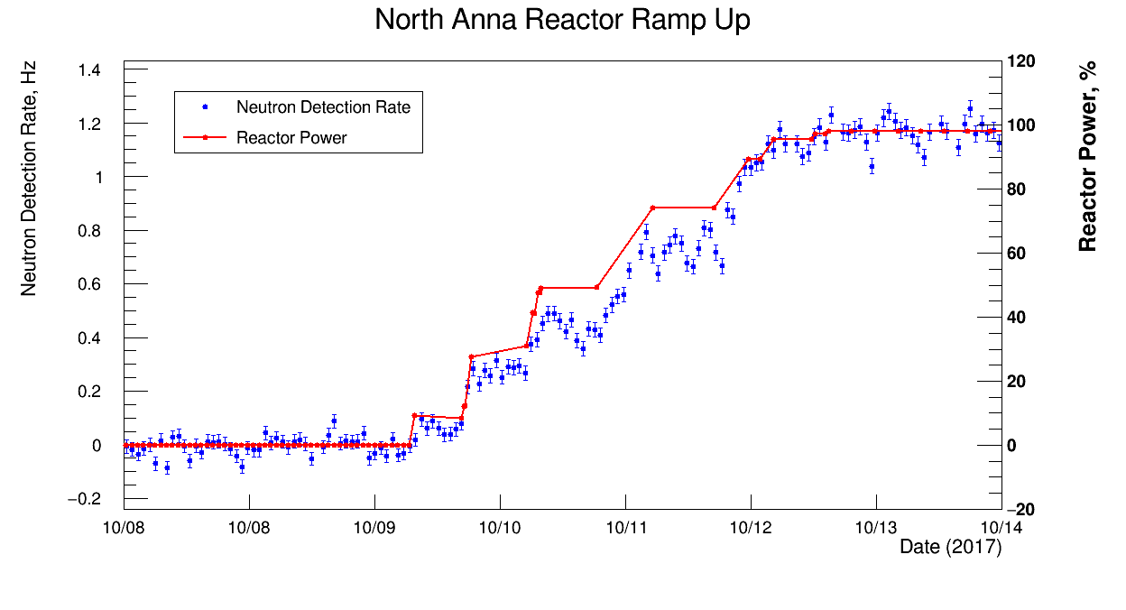
Neutron Detection in MiniCHANDLER
We can also see the reactor neutrons in the direct thermal neutron detection rate.
Here it’s plotted with the pressure-corrected cosmic neutron rate subtracted.
Preliminary
We can zoom in on the reactor power ramp-up period
Our data matches the step structure of the power in time,
But the change in the neutron rate does not match change in power as I would naively expect.
Preliminary

Slide 33
Neutron Detection in MiniCHANDLER
This may be related to a larger mystery we’re tracking in the neutron detection rate over time.
Preliminary
The neutron detection rate at the end-of-cycle is about 40% higher that at the beginning-of-cycle.
This is matches the central claim of a Chalk River paper in Nature Communications
[Nat Commun 10, 1959 (2019)] but will it hold up under scrutiny?

Slide 34

Multimodal Detection
If its true that both antineutrinos and neutrons carry important information about the state of the reactor core and fuel cycle,
Then combining both streams of information should provide better fidelity on the real-time state of the reactor.
Prof. Haghighat has named this “multimodal detection”.
This is one area of study in our NRC grant.

Slide 35
CHANDLER Future Prospects

Slide 36

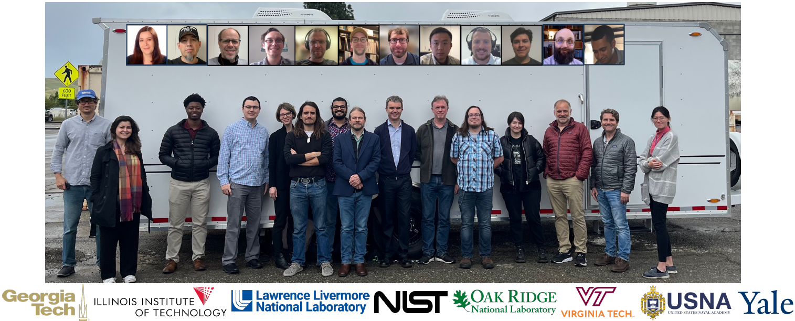
The Mobile Antineutrino Demonstrator (MAD)
CHANDLER has been selected as one of the technologies for the Mobile Antineutrino Demonstrator (MAD) Project.
The goals of the NNSA funded MAD Project are two-fold:
  To develop a robust and mobile reactor neutrino detector technology.
  To identify applications of neutrino detection in nuclear instrumentation and nuclear security.

Slide 37
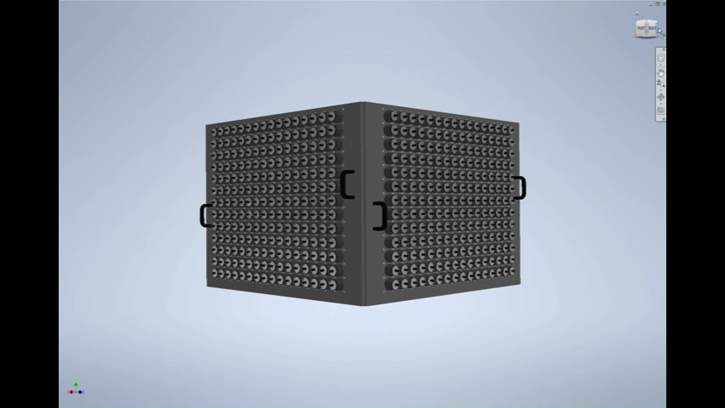
The Detector Structure
Through MAD we are funded to build a 630 kg CHANDLER Prototype.
It will consist of
    832 photomultiplier tubes,
    6400 scintillating (half) cubes and
    22 square meters of ⁶Li-loaded ZnS sheets

Slide 38
Future Upgrades
Going from MiniCHANDLER to full CHANDLER, there are several known enhancements:
New Optics: improves energy resolution, pattern recognition and background rejection.

Slide 39
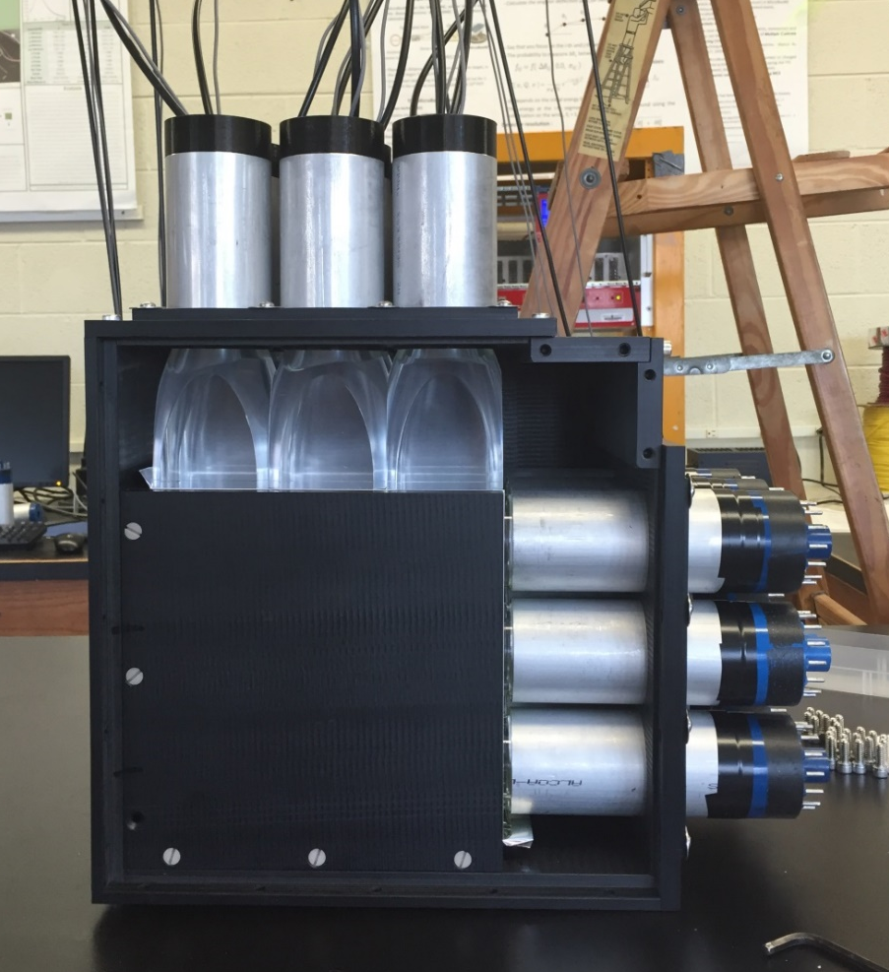
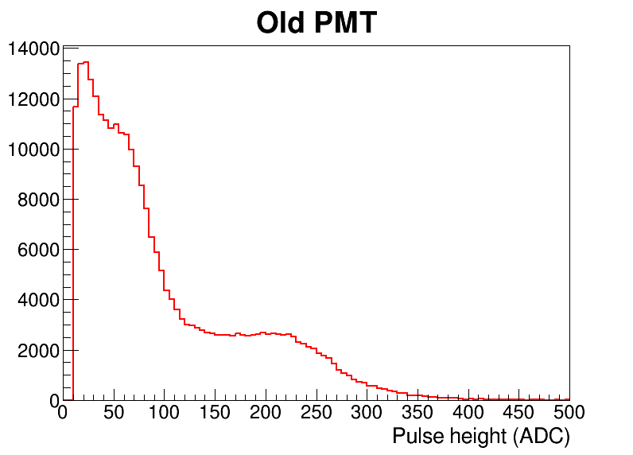
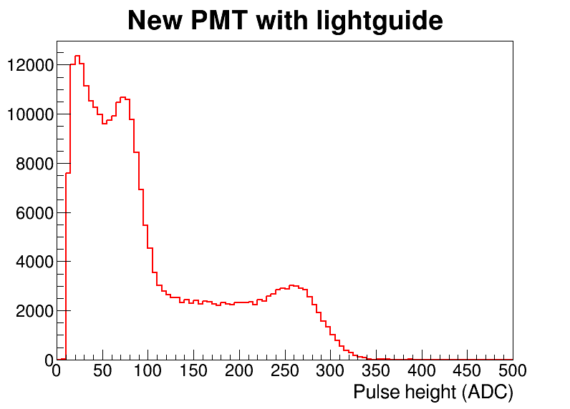
MiniCHANDLER Upgrades: New Optics
We rebuilt our MicroCHANDLER prototype with half new optics.
We used a ²²Na source to compare the energy response in the new and old optics.
The new light collection improves the energy resolution by at least a factor of 2.
The annihilation gamma Compton edge and continuum are now distinct features.
(As used in the original MiniCHANDLER)
511 keV
Compton Edge
511 keV
Compton Edge
1273 keV Compton Edge
1273 keV Compton Edge

Slide 40
Future Upgrades
Going from MiniCHANDLER to full CHANDLER, there are several known enhancements:
New Optics: improves energy resolution, pattern recognition and background rejection.
Larger Detector: faster event accumulation and better detection efficiency from neutron and annihilation gamma containment.
PMTs on Four Sides: improves the pattern recognition and the energy resolution.
Half Cubes: increases ⁶Li tagging efficiency and lowers the random coincident background rate.

Slide 41
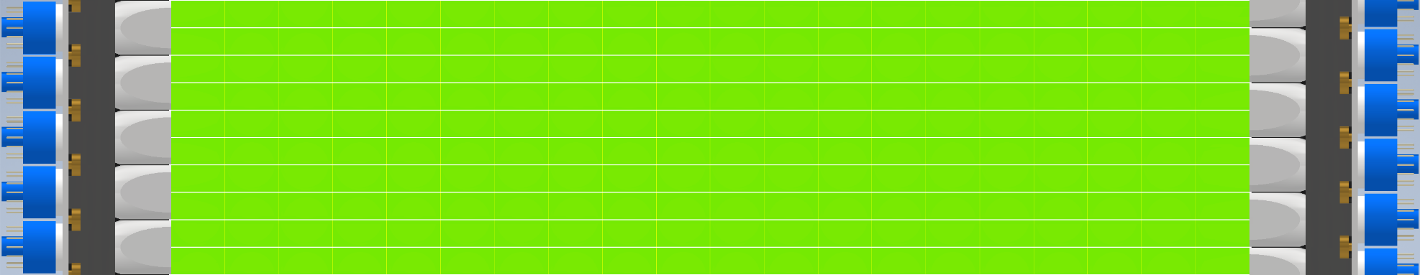
Half Cubes
The half cubes upgrade doubles the effective ⁶Li density in the detector.
The opposing PMTs are offset by a half-cube to take advantage of the extra spatial information.
Configuration | ⁶Li Capture | Time to 90% Capture | Volume for 90% Capture
Full Cubes | 51% | 229 μs | 37 cubes
Half Cubes | 69% | 120 μs | 24.5 cubes
The half cubes upgrade increases the ⁶Li capture efficiency by 35%, while increasing the cost of the detector by only 12%.
Half cubes lower the capture time and capture spatial separation, thus reducing the random coincident background rate.

Slide 42
Future Upgrades
Going from MiniCHANDLER to full CHANDLER, there are several known enhancements:
New Optics: improves energy resolution, pattern recognition and background rejection.
Larger Detector: faster event accumulation and better detection efficiency from neutron and annihilation gamma containment.
PMTs on Four Sides: improves the pattern recognition and the energy resolution.
Half Cubes: increases ⁶Li tagging efficiency and lowers the random coincident background rate.
Electronics Upgrade: lowers cost, improves data quality and pattern recognition.

Slide 43
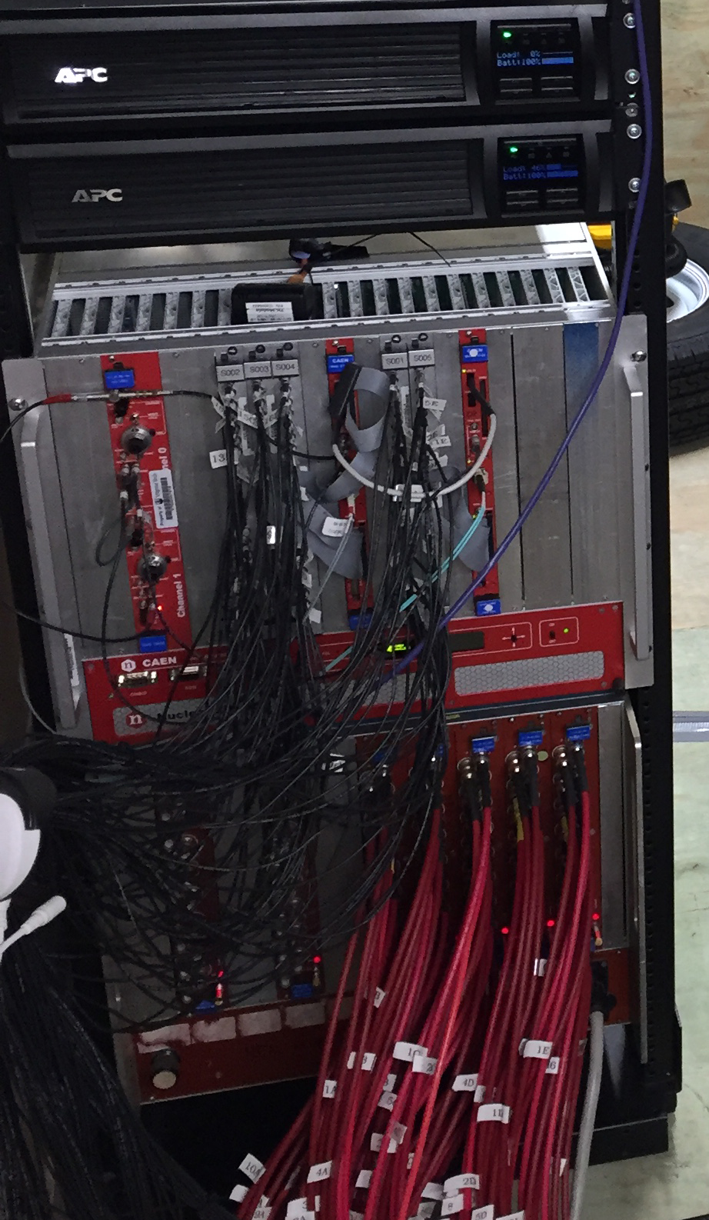
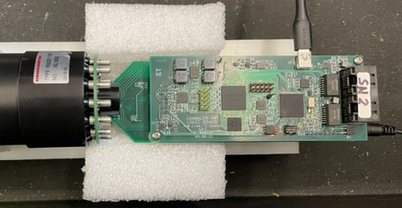
Electronics Upgrade
Old Electronics
We are pursuing a major upgrade to our electronics.
New Electronics
All-in-one PMT Base
Data Acquisition Electronics
This base puts the high voltage, digitizer and a fully programmable trigger, all at the PMT.
  Uses power over Ethernet
  No channel-to-channel crosstalk
  No signal attenuation
  ADC dynamic range goes from 12 bits to14 bits
  Dynamic trigger threshold for superimposed hits
  On-board, programmable neutron/positron ID
PMT High Voltage Power Supply

Slide 44
Future Upgrades
Going from MiniCHANDLER to full CHANDLER, there are several known enhancements:
New Optics: improves energy resolution, pattern recognition and background rejection.
Larger Detector: faster event accumulation and better detection efficiency from neutron and annihilation gamma containment.
PMTs on Four Sides: improves the pattern recognition and the energy resolution.
Half Cubes: increases ⁶Li tagging efficiency and lowers the random coincident background rate.
Electronics Upgrade: lowers cost, improves data quality and pattern recognition.
Water Shield: to further reduce fast neutron backgrounds

Slide 45
Final Thoughts…
CHANDLER is designed for above-ground, reactor neutrino detection, suitable for a range of application in nuclear instrumentation and security.
The MiniCHANDLER prototype successfully observed reactor neutrinos in a 4½ month run at the North Anna Nuclear Power Plant.
Neutron and multimodal detection may open door to further applications.
Anticipated upgrades will significantly improve the detector’s performance.

Slide 47
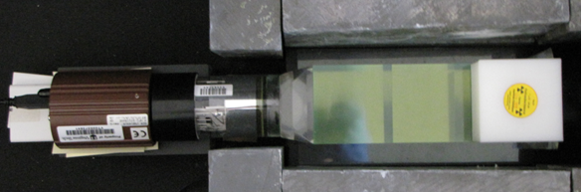
Light Collection and Energy Resolution
An LED flasher was used to determine the resolution as a function of MCA channel.
The ²²Na Compton edge is at 1.06 MeV. At two cubes from the PMT it reconstructs at channel 20, which corresponds to an energy resolution of 6.5%.

Slide 48
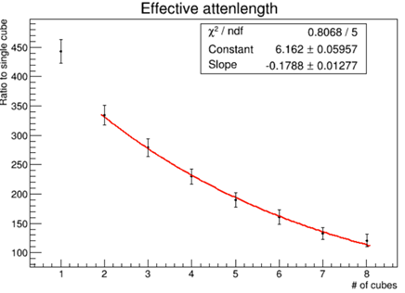
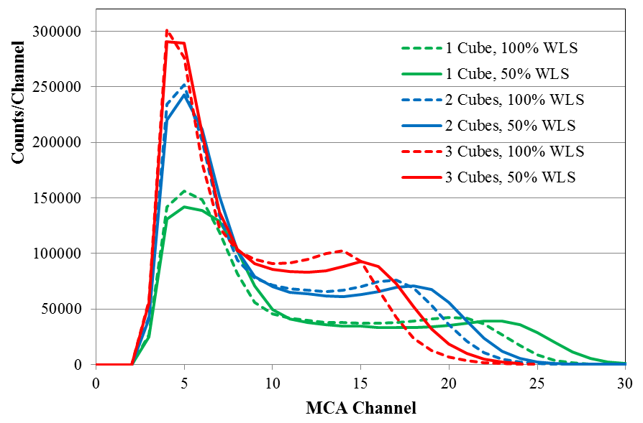
Wavelength Shifter Concentration
The wavelength shifter (WLS) dopant could be a significant source of attenuation.
Effective Attenuation Length for 50% WLS Concentration
The Compton edge of ²²Na was used to study the relative light output.
²²Na (E_{γ} of 511 and 1274 keV)
  λ = 34.7 cm
Halving the WLS concentration increases the attenuation length by 10%.
The light collection with lower WLS is greater at each position.

Slide 49
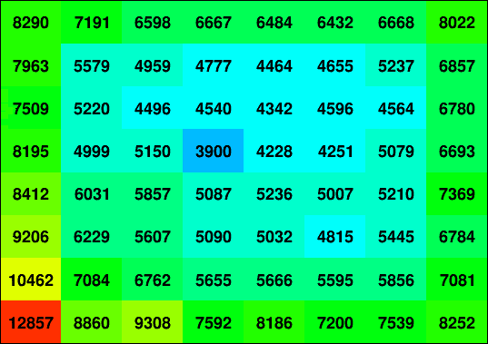





The Detector is Now Commissioned
Cosmic neutrons by cube cell in MiniCHANDLER:
Thermal neutrons entering the detector capture predominantly in the surface cubes.
In the middle of the detector we see fewer captures.
Attenuation causes some fall off in the neutron rate across the detector, but it’s a small effect.
56 hours of data

Slide 50



Research and Development Effort
Cube String Studies have been used to study light production, light collection, light attenuation, energy resolution and wavelength shifter concentration.
MicroCHANDLER is a 3×3×3 prototype which we are using to test our full electronics chain, develop the data acquisition system, study neutron capture identification and measure background rates.
MiniCHANDLER is a full systems test (8×8×5) which was deployed at the North Anna Nuclear Power Plant for four months in 2017, with the goal of demonstrating neutrino detection.

Slide 51

Effective Attenuation Length Study
LED Flasher
PMT1
PMT2
Cube: 1 2 3 4 5 6 7 8 9 10
Average Effective Attenuation Length λ = 31.3 cm
Data
There are two contributions to the effective attenuation:
  Bulk attenuation in the plastic and
  Fresnel reflection at the cube interfaces.

Slide 52

Optics of the Raghavan Optical Lattice
Fresnel Reflections
The optics are based on the interface of PVT (n=1.58) and air (n=1).
The critical angle (θ_{c}) is 39.27°
The Brewster angle is 32.22°
Because θ_{c} < 45° any light capable of passing between cubes will necessarily fall into the total-internal-reflection (TIR) channel in that direction.
Brewster Angle
Critical Angle
Each of the four TIR channels is open to 11.3% of the light produced in a cube.
45.2% of all light falls into one of the four TIR channels.
Most channeled light that gets reflected off of a cube surface perpendicular to the channel direction will reach the PMT in the opposite direction.

Slide 53


GEANT4: Detector Response vs. Cube Position
Simulation
Most of the observed light is collected in the four TIR channels of the hit cube.
About 20% of light is unchanneled, with the largest share in the adjacent PMTs.
*
Simulation
The largest excursion from the mean is in the corner cells.
*
(The conversion to p.e./MeV assumes light guides, and a PMT maximum quantum efficiency of 25%.)

Slide 54



Attenuation Length in the Lattice (Aside)
In the simulations, the attenuation length measured in the cube string study is a critical input parameter.
The effective attenuation length that we’re measuring in the MiniCHANDLER lattice is significantly better.
Allows a bigger detector and gives a significant improvement in energy resolution.
Preliminary
  λ = 34.7 cm
  λ = 56 cm

Slide 55


MCNP6: Neutron Transport and Capture
 | ⁶Li Capture | Time to 90% Capture | Volume for 90% Capture
Full Cube, 350 μm Sheet | 51% | 229 μs | 37 cubes
Full Cube, 500 μm Sheet | 55% | 209 μs | 35 cubes
Half Cube, 350 μm Sheet | 69% | 120 μs | 24.5 cubes
Half Cube, 500 μm Sheet | 73% | 103 μs | 23 cubes

Slide 56

MCNP6: Neutron Transport and Capture
 | ⁶Li Capture | Time to 90% Capture | Volume for 90% Capture
Full Cube, 350 μm Sheet | 51% | 229 μs | 37 cubes
Full Cube, 500 μm Sheet | 55% | 209 μs | 35 cubes
Half Cube, 350 μm Sheet | 69% | 120 μs | 24.5 cubes
Half Cube, 500 μm Sheet | 73% | 103 μs | 23 cubes
The initial neutron directionality is apparent in the capture position.
ν Flux
GEANT4

Slide 57
Neutron Identification in MicroCHANDLER
The 18-channel MicroCHANDLER prototype is ideal for testing neutron tagging.
The positron signal (formed in the cubes) is short in duration,
While the ZnS light (from neutron capture) is released over much longer time.
For each hit cell, we compute a simple neutron ID variable as the ratio of the pulse integral to the pulse height.
pulse integral
pulse height

Slide 58
Neutron Identification in MicroCHANDLER
Then we plot the neutron ID from the x-view vs. the neutron ID from the y-view
When the source is removed the events in the neutron region mostly go away.
The neutrons candidates that remain are consistent with the cosmic ray flux.

Slide 59

Improved Neutron Selection
The different classes of events clearly separate into distinct bands.
In the overlap region positron-like events out number the neutron candidates.
So good neutrons candidates must be above both red lines.
Neutron-like
Positron/gamma-like

Slide 60


Improved Neutron Selection
In CHANDLER we can see neutron capture light on both sides of the sheet.
We use this to determine which sheet captured the neutron.
Starting with good neutrons tagged in the middle layer, we look for neutron-like light in the top or bottom layers.
The sheet is determined by the layer with the larger amplitude,
But degeneracies are rare.
Neutron Source

Slide 61


Improved Neutron Selection
Looking at good middle layer neutrons in the top/bottom layer shows the neutron band extending into the overlap region without a hint of contamination from the positron/gamma band.
Middle/Top
Middle/Bottom
Requiring the neutron to be above the red lines in at least one layer recovers most neutrons.
And the light in the adjacent layers is used to discriminate between the two sheets.

Slide 62


Neutron Misidentification
To study neutron misidentification we removed the lithium from one of the sheets.
With cosmogenic neutrons candidates, less than 1 in 50 comes from the ⁶Li-free sheet, so fake neutrons are a tiny fraction of the cosmic neutron background.
1.7% of events
98.3% of events
⁶Li-free sheet
⁶Li sheet
Notes:
89/5638 = 0.0158, 5036/5638=0.8932

Slide 63


Neutron Misidentification
To study neutron misidentification we removed the lithium from one of the sheets.
With cosmogenic neutrons candidates, less than 1 in 50 comes from the ⁶Li-free sheet, so fake neutrons are a tiny fraction of the cosmic neutron background.
In the overlap region above the ⁶Li-free sheet we see a few events, where the sheet determination was incorrect due to insufficient light in both the top and bottom layers. This represents less than 1% of all neutron candidates.
2.4% of events
97.6% of events
1.6% of events
89.3% of events
⁶Li-free sheet
⁶Li-free sheet
⁶Li-free sheet
⁶Li sheet
⁶Li sheet
⁶Li sheet
28 events
Notes:
89/5638 = 0.0158, 5036/5638=0.8932

Slide 64

Design Studies with MicroCHANDLER
We rebuilt MicroCHANDLER with a fully engineered mechanical structure.
Half of the PMTs in the new design are Hamamatsu R6231-100 with acrylic light guides.
This was used to test the mechanical
structure concept for MiniCHANDLER.

Slide 65


MiniCHANDLER Mechanical Structure
The MiniCHANDLER mechanical structure uses rubber o-rings, aluminum spacers and clamp plates to provide a light tight seal around each PMT.
The result is a light tight box that supports each PMT centered on its cube row or column.

Slide 66

Vertical Muons: A Novel Calibration Source
Vertical muons are defined as passing through a vertical column of cubes including all five detector layers.
MiniCHANDLER has a vertical muon rate of about 10 mHz per cube column.
Selecting vertical muons gives us a narrow distribution of cube path lengths.
As minimum ionizing particles,
muons deposit energy from a
Landau distribution.
We use the most probable value
(11.4 MeV/layer) as our calibration
point.
With an energy near the reactor ν
endpoint, this is a unique calibration
source in reactor neutrino detection.
Vertical muons provide an as-built light collection map and energy calibration point for each individual cube.

Slide 67

Vertical Muons and Attenuation
Vertical muons can be used measure the effective light attenuation across the lattice. The attenuation is significant, but easy to characterize.
This nicely matches the attenuation found from the compton edge of ²²Na, which sits at the lower-end of the energy scale,
Demonstrating that the detector optics are independent of energy.

Slide 68
The IBD Event Selection
The inverse beta decay candidates include all positron-like events in the 1000 μs preceding a neutron.
The positron candidate energy is reconstructed from the pattern of PMT light collected in each detector plane.

Slide 69

The Raghavan Optical Lattice Reconstruction
It’s not trivial…
To select IBD events, we need to see 511 keV gammas Compton scattering in the detector, potentially in the same plane as a 7 MeV positron.
Using the cube-by-cube response functions, we create a transfer matrix that maps the energy depositions in n² cubes to the light observed in the 2n PMT in a layer.
$${\vec{p}}_{PMTs}=ℳ∙{\vec{e}}_{cubes}$$
The reconstruction requires an effective inversion of this transfer matrix,
$${\vec{e}}_{cubes}=ℳ^{−1}∙{\vec{p}}_{PMTs}$$
But since n > 2, there are more unknowns than equations, and this problem is underdetermined.
So, we construct a likelihood function which we minimize by varying the cube energy depositions (${\vec{e}}_{cubes}$).
We start with one hit cube. In each iteration we add one additional cube.
If min(L_{i}) – min(L_{i+1}) < ΔL_{cutoff} we accept that iteration.

Slide 70
The IBD Event Selection
The inverse beta decay candidates include all positron-like events in the 1000 μs preceding a neutron.
The positron candidate energy is reconstructed from the pattern of PMT light collected in each detector plane.
We apply a spatial separation cut between the positron and neutron.

Slide 71

Neutron Positron Spatial Separation Cut
Random coincident events have no spatial correlation.
Fast neutrons do have a spatial correlation, but the neutrons tend to travel further before capture.
The spatial separation cut
was optimized on data.
Fortunately, the optimal
point is quite clear.
In our high background
environment a relatively
tight cut works best.
Note: In an ROL, the separation cut has no reconstruction bias.
Δd ≤ 1.5 cube lengths

Slide 72

Topological Selection
The topological selections were essential to extracting a significant signal in MiniCHANDLER:
These selections will improve dramatically with the improved optics.
And, a larger detector will better contain the annihilation gammas and multiple proton recoils.
Signal Significance [Δχ²]

