Slide 1

Open Education:
Exploring Philosophy, Potential & Practices
Anita Walz, University Libraries, Virginia Tech @arwalz
March 8, 2018 ~ Colloquium on Scholarly Communication, American University
Notes:
Philosophy = values behind XYZ

Slide 2

Happy Open Education Week!
#openeducationwk
Notes:
Lived and worked in DC for 7 years in early 2000s.

Slide 3
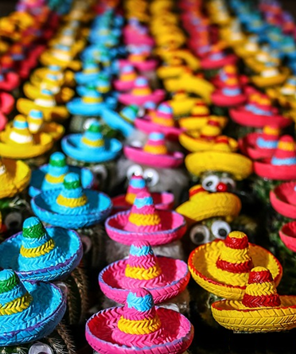
Open Education, Copyright & Scholarly Communication Librarian
Economics, Math
+ legal studies
Open Education
Copyright / Open Access
Image [Public Domain] https://cdn.pixabay.com/photo/2015/02/11/13/08/cactus-632405_640.jpg

Slide 4
Support for Open Education at Virginia Tech
Consultations on: Copyright, Creative Commons, Publishing (broadly defined), Technology
Open Textbook Adoption Workshop
OpenVT (& OpenVA) Listservs
Grants & Technical Support for creating and adapting OER:
Learning opportunities (Annual “Open Education Week” events)
Learning Community / Teaching Inquiry Group
Media / Crowdfunding campaign

Slide 5
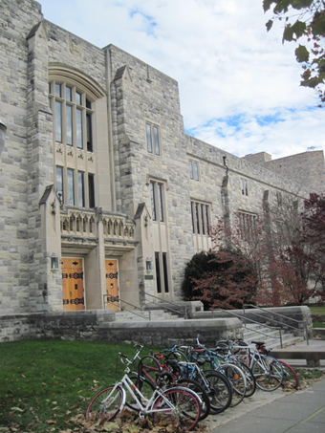
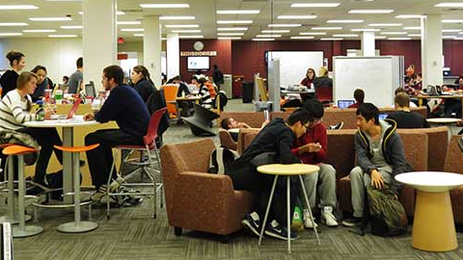
Traditional library services +
New studios focus on “making”
Data transformation
3D printing
Data Visualization
Media Design Studio
Virtual Reality Studio
~34,000 (full time equivalent) students
Photo of Newman Library by Anita Walz CC BY 4.0

Slide 6

Getting to Know You. . .

Slide 7
What is Open Education?

Slide 8
Open education encompasses resources, tools and practices that employ a framework of open sharing to improve educational access and effectiveness worldwide.

Slide 9
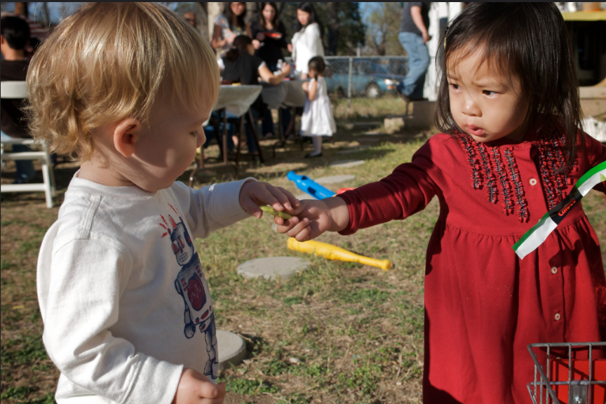
© Enoch Lai “Sharing is Caring” CC BY NC ND

Slide 10
Knowledge sharing
Technology
Collaboration
in service of learning

Slide 11

Open Educational Resources
Open Pedagogy
value framework

Slide 12
Open Educational Resources

Slide 13
OER are teaching, learning, and research resources that reside in the public domain or have been released under an intellectual property license that permits their free use and re-purposing by others.
. . . including full courses, course materials, modules, textbooks, streaming videos, tests, software, and any other tools, materials, or techniques used to support access to knowledge.
-Hewlett Foundation

Slide 14
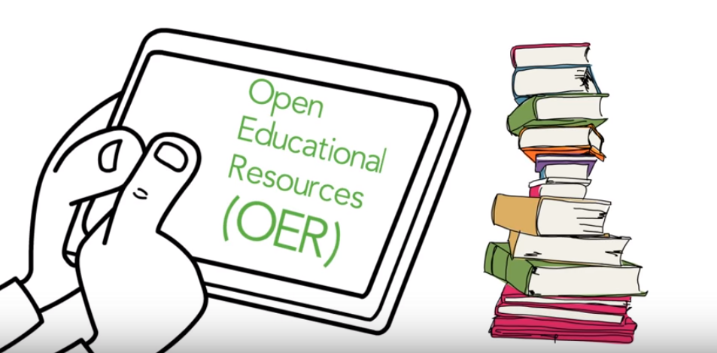
Screenshot from “A Review of the Effectiveness & Perceptions of Open Educational Resources As Compared to Textbooks” https://youtu.be/SX0K0hb_xKE © Open Education Research Group. CC BY 4.0
Screenshot from “A Review of the Effectiveness & Perceptions of Open Educational Resources As Compared to Textbooks” https://youtu.be/SX0K0hb_xKE © Open Education Research Group. CC BY 4.0c

Slide 15
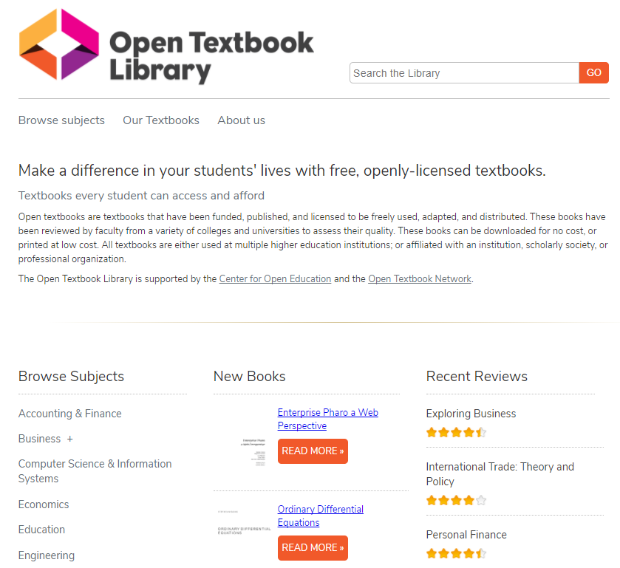

Screenshots from https://openstax.org and https://open.umn.edu/opentextbooks

Slide 16
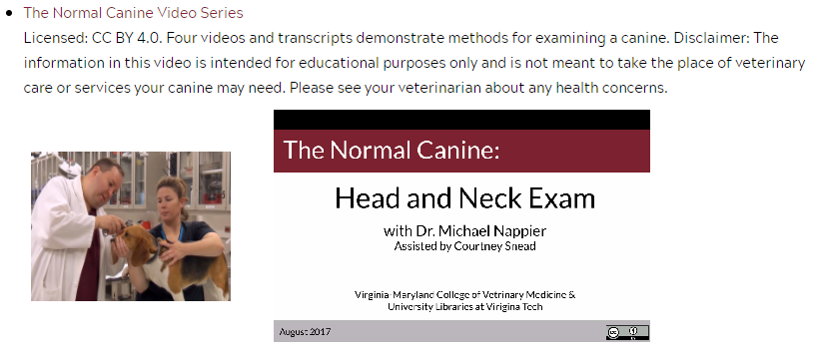
http://hdl.handle.net/10919/78748

Slide 17

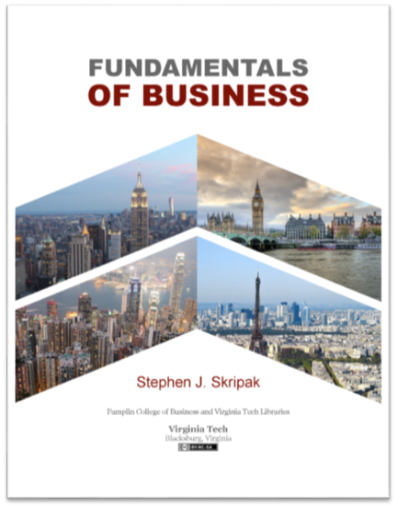
Open Textbooks at Virginia Tech
https://vtechworks.lib.vt.edu/handle/10919/70959
Cover design: Robert Browder
Cover image: (c) Michelle Yost. Total Internal Reflection (cropped by Robert Browder) is licensed with a Creative Commons Attribution-ShareAlike 2.0 license.
Cover design: Trevor Finney. “Hong Kong Skyscrapers” by Estial, cropped and modified by Trevor Finney CC BY-SA 4.0; “Paris vue d’ensemble tour Eiffel” by Taxiarchos228, cropped and modified by Poke2001 and Trevor Finney CC BY 3.0; “London Bridge” by Skitterphoto, cropped and modified by Trevor Finney, Public Domain; “New York” by Mscamilaalmeida, cropped and modified by Trevor Finney, Public Domain.

Slide 18
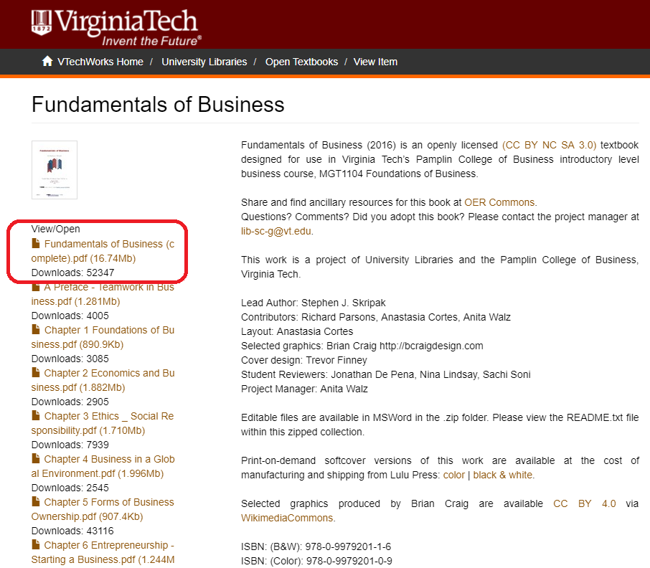
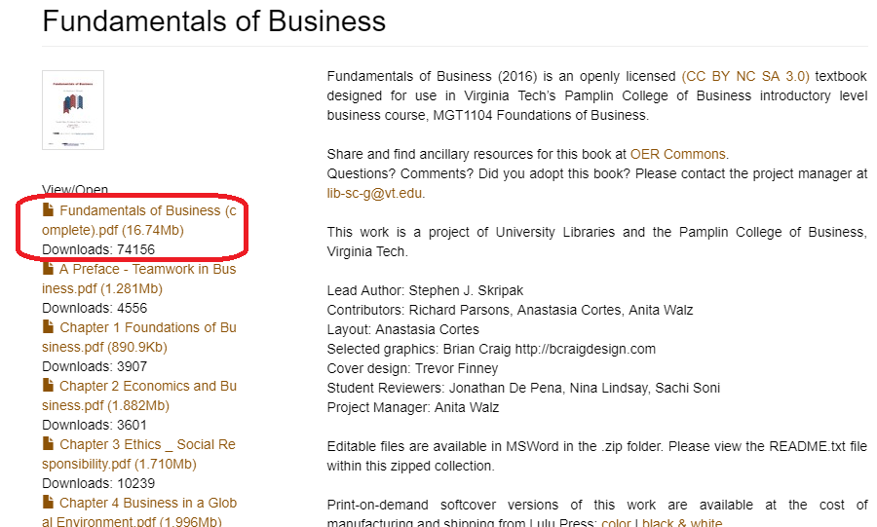

Slide 19

Creative Commons
Licenses
5 R permissions
Can anyone . . .
Retain it?
Reuse it?
Revise it?
Remix it?
Redistribute it?
http://opencontent.org/definition
This material is based on original writing by David Wiley, which was published freely under a Creative Commons Attribution 4.0 license
https://creativecommons.org/licenses

Slide 20


Slide 21
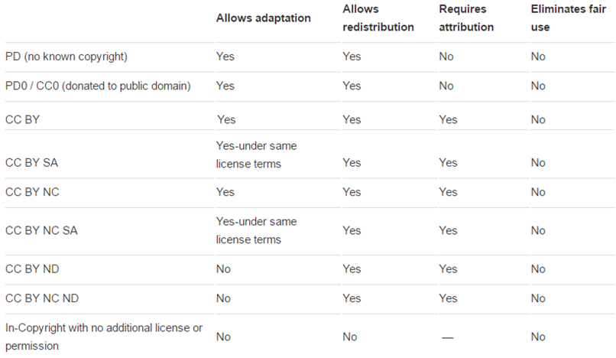
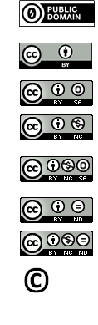
Most open
Least open

Slide 22
What’s the potential here?

Slide 23
Anyone can create, adapt & share if they:
Understand the licenses
Can extract content
Create in a format others can use
Attribute 3rd party works

Slide 24
Potential areas of growth: critical thinking, communication
Understand the licenses
-- understanding of copyright, information ethics
Can extract content
-- digital literacy / technical / software skills
Create in a format others can use
-- reflection regarding barriers others may face
Attribute 3rd party works
-- give credit
→ Leverages the power of the web
→ Enormous creative potential

Slide 25
What problems could this solve?

Slide 27
Open Educational Resources
Open Pedagogy
value framework

Slide 28
Open Pedagogy

Slide 29
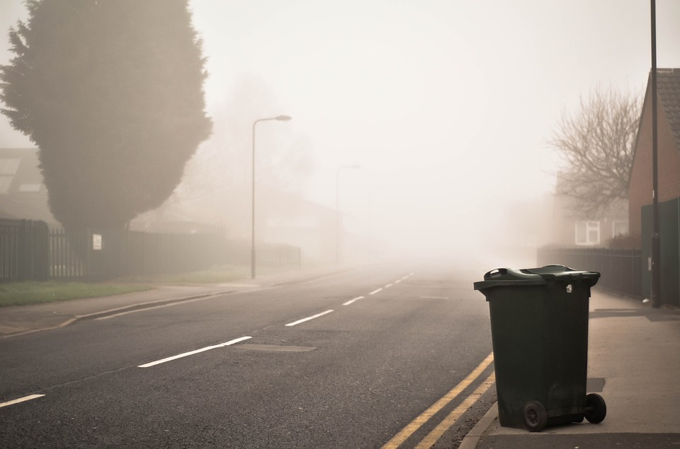
Non-disposable assignment
Image source [Public domain]: https://images.unsplash.com/photo-1495770283154-c990d0050a12

Slide 30
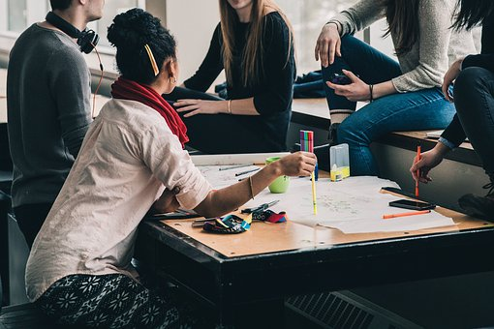
Create
Adapt or
Modify with the intent of sharing
Student agency / choice
Valuing access by others
Instructor as “coach”
Themes:
autonomy and interdependence; freedom and responsibility; democracy and participation
Image [public domain]: https://pixabay.com/en/people-girls-women-students-2557396

Slide 31

Student engagement & motivation
Deeper learning approaches
Real world connections
Produces value for the real world
Image [public domain]: https://cdn.pixabay.com/photo/2015/10/30/12/18/thumb-1013968_960_720.jpg

Slide 32
Baeten, M., Kyndt, E., Struyven,. K., Dochy, F., (2010) Using student-centred learning environments to stimulate deep approaches to learning: Factors encouraging or discouraging their effectiveness. Educational Research Review, 5(3), 243-260. doi.org/10.1016/j.edurev.2010.06.001
DeRosa, R., and Jhangiani, R. (2017) Open Pedagogy. In Mays, E. (2017) A guide to making open textbooks with students. Retrieved from https://press.rebus.community/makingopentextbookswithstudents/chapter/open-pedagogy
Hendricks, C. (2015) Non-disposable assignments in intro to philosophy [Blog post]. Retrieved from http://blogs.ubc.ca/chendricks/2015/08/18/non-disposable-assignments-intro-philosophy
Morgan, T. (2016, December 21). Open pedagogy and a very brief history of the concept. [Blog post]. Retrieved from https://homonym.ca/uncategorized/open-pedagogy-and-a-very-brief-history-of-the-concept

Slide 33
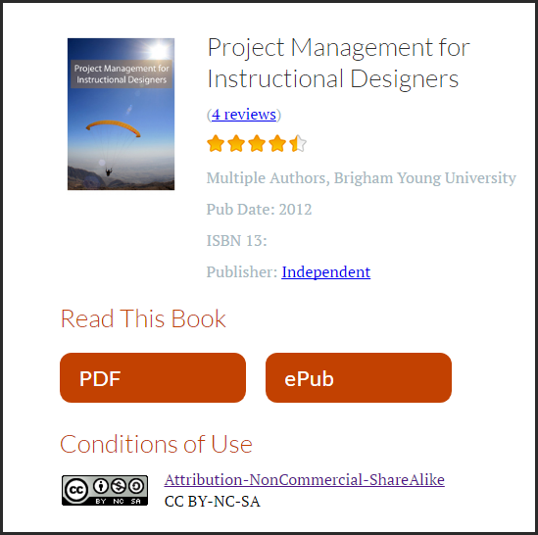

Slide 34
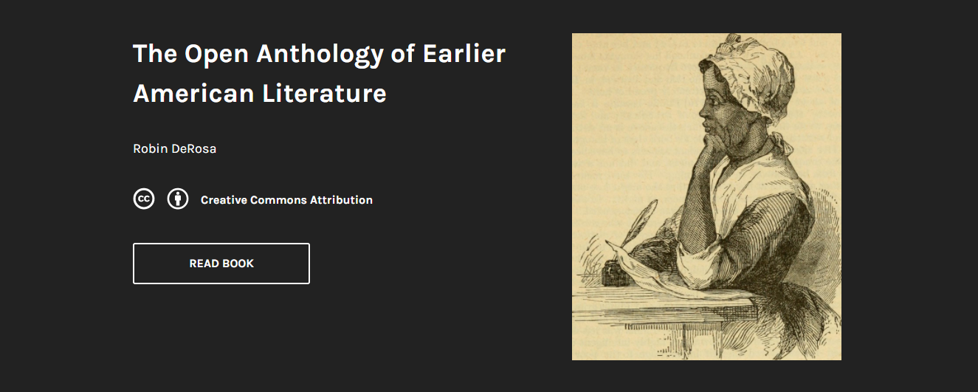
https://openamlit.pressbooks.com
http://robinderosa.net/uncategorized/my-open-textbook-pedagogy-and-practice

Slide 35
What’s the potential here?

Slide 36
Allows learners to . . . Allows instructors to . . .
Connect with people and ideas in the real world
Get feedback beyond the instructor
Explore areas of interest in a supportive context
Explore developing their digital persona
Learn, alongside students
Develop skill in coaching and authentic assessment
Include students in research programs
Obtain meaningful feedback

Slide 39
Open Educational Resources
Open Pedagogy
value framework

Slide 40
value framework

Slide 41
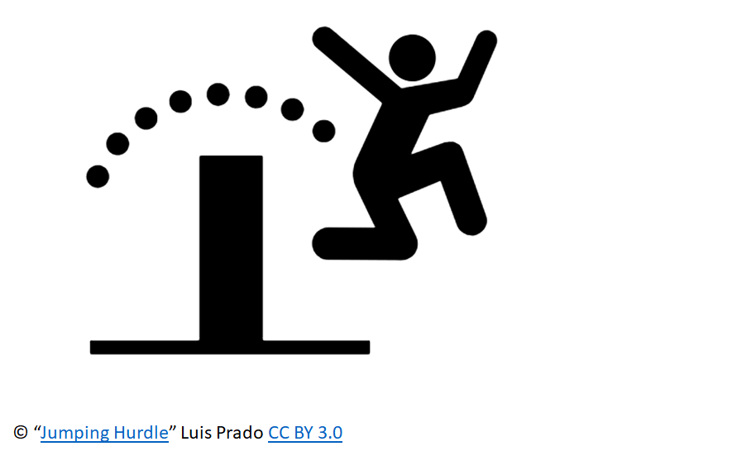
Open Education Is:
a movement
a philosophy
a broad, expanding set of value-driven practices.

Slide 42
Outward facing
Adapted from: McKernan, R., Skirko, T., & West, Q. (2015) Librarians as open education advocates: Readings on being an open advocate. Retrieved from https://openedadvocates.pressbooks.com/chapter/definition-of-open-education

Slide 43
Inclusive:
Reducing all sorts of barriers and expand possibilities . . .
Adapted from: McKernan, R., Skirko, T., & West, Q. (2015) Librarians as open education advocates: Readings on being an open advocate. Retrieved from https://openedadvocates.pressbooks.com/chapter/definition-of-open-education
Notes:
What can I give rather than what can I get . . .

Slide 44
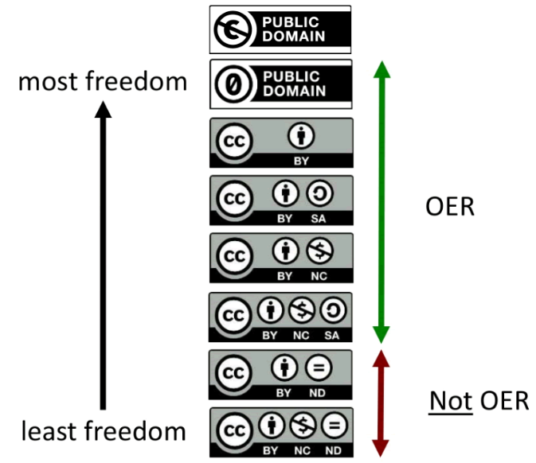
Open Licenses
Adapted from: McKernan, R., Skirko, T., & West, Q. (2015) Librarians as open education advocates: Readings on being an open advocate. Retrieved from https://openedadvocates.pressbooks.com/chapter/definition-of-open-education

Slide 45
Feedback:
& Collaboration
Adapted from: McKernan, R., Skirko, T., & West, Q. (2015) Librarians as open education advocates: Readings on being an open advocate. Retrieved from https://openedadvocates.pressbooks.com/chapter/definition-of-open-education

Slide 46
New Ideas
. . . about teaching
. . . about research
Adapted from: McKernan, R., Skirko, T., & West, Q. (2015) Librarians as open education advocates: Readings on being an open advocate. Retrieved from https://openedadvocates.pressbooks.com/chapter/definition-of-open-education

Slide 47
Giving Credit
Adapted from: McKernan, R., Skirko, T., & West, Q. (2015) Librarians as open education advocates: Readings on being an open advocate. Retrieved from https://openedadvocates.pressbooks.com/chapter/definition-of-open-education

Slide 48

Lever
Public domain. By Jakob Ukrop. https://thenounproject.com/term/lever/4927

Slide 49
What can I do
to make what I do
more OPEN?

Slide 50
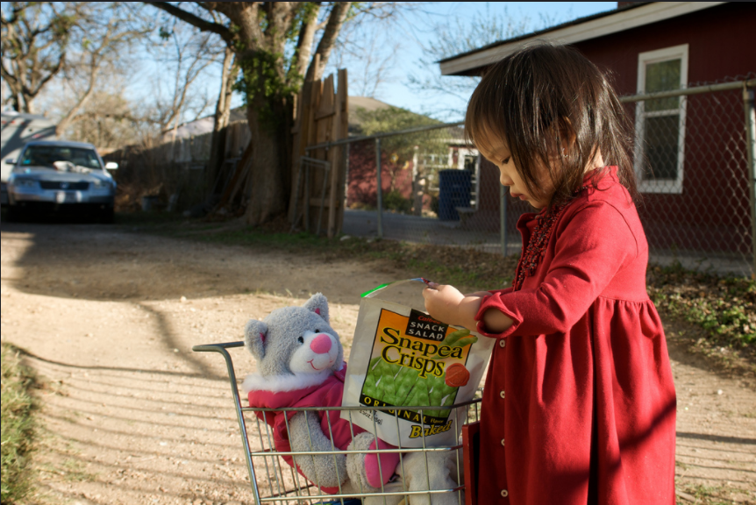
© Enoch Lai https://flic.kr/p/64rz9n CC BY NC ND

Slide 51
Thank you!
Anita Walz
arwalz@vt.edu
Twitter: @arwalz

