Slide 1


Chapter 6
Synthesize Analysis and Determine a Firm’s Strategic Issue
Strategic Management
MGT 4394
Notes:
These slides serve as a study guide for “Chapter 6: Synthesize Analysis and Determine a Firm’s Strategic Issue” in Strategic Management and Case Analysis: An Integrated Approach ©Lori Anderson, Dirk Buengel, and Joseph J. Simpson, which is provided at https://doi.org/10.21061/strategicmanagementandcaseanalysis under an open license, Creative Commons BY NC-SA 4.0. The slides are also provided at https://hdl.handle.net/10919/138831 under the same open license, Creative Commons BY NC-SA 4.0.
Note to Instructors: These study guides are intended to be a concise and comprehensive accompaniment that follows the logic of the textbook. Our intention is to support you in your instruction and is based on our experience that it can be easier and quicker to remove slides you do not want to include than to create additional slides.

Slide 2
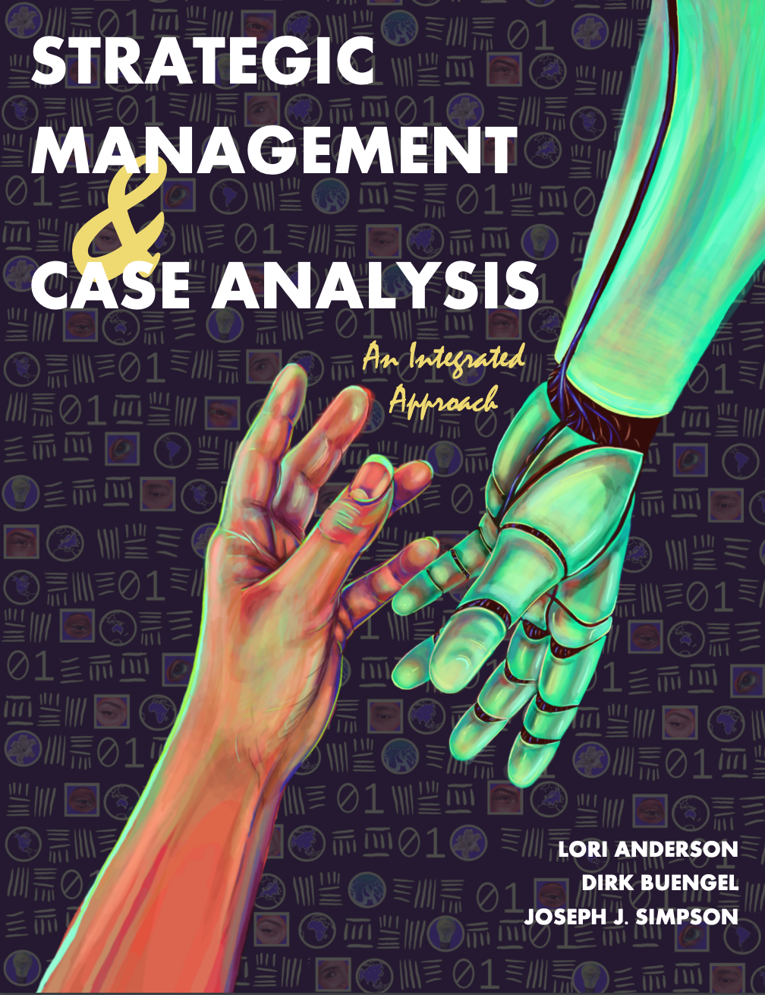
Study Guide
These slides serve as a study guide for “Chapter 6: Synthesize Analysis and Determine a Firm’s Strategic Issue” in Strategic Management and Case Analysis: An Integrated Approach by Lori Anderson, Dirk Buengel, and Joseph J. Simpson, which is provided under an open license, Creative Commons BY NC-SA 4.0. The slides are also provided under the same open license, Creative Commons BY NC-SA 4.0.
Notes:
Note to students: These study guides are intended to be a concise and comprehensive accompaniment that follows the logic of the textbook and may support your learning, mastery, and application of these concepts. They are are intended to supplement, not replace, your review of the textbook and any other sound study strategies you have made, such as taking notes to support your most effective learning.

Slide 3
Learning Objectives, 1 of 3
After you have engaged with the concepts in this chapter, you will understand and be able to apply the following key strategic management concepts.
How to determine a firm’s strategic issue
How to determine strategic alternatives
How to evaluate alternatives
How to develop an implementation plan to execute the recommended strategic alternative
How to confirm line of sight and coherence across the entire case analysis
Notes:
These are the learning objectives for Chapter 6.

Slide 4
Learning Objectives, 2 of 3
After you have engaged with the concepts in this chapter, you will understand and be able to apply the following key strategic management concepts.
How to determine a firm’s strategic issue
How to determine strategic alternatives
How to evaluate alternatives
How to develop an implementation plan to execute the recommended strategic alternative
How to confirm line of sight and coherence across the entire case analysis
Notes:
These are the learning objectives for Chapter 6.

Slide 5
Learning Objectives, 3 of 3
You will be equipped to
Analyze the analysis you have completed so far and complete a SWOT analysis
Determine major areas of strategic concern
Determine a strategic issue
Determine strategic alternatives, evaluate them, and recommend one
Determine line of sight and congruence throughout the entire case analysis
Write an implementation plan to implement your recommended strategic alternative
Write and/or present your case analysis
Notes:
These are the learning objectives for Chapter 6.

Slide 6
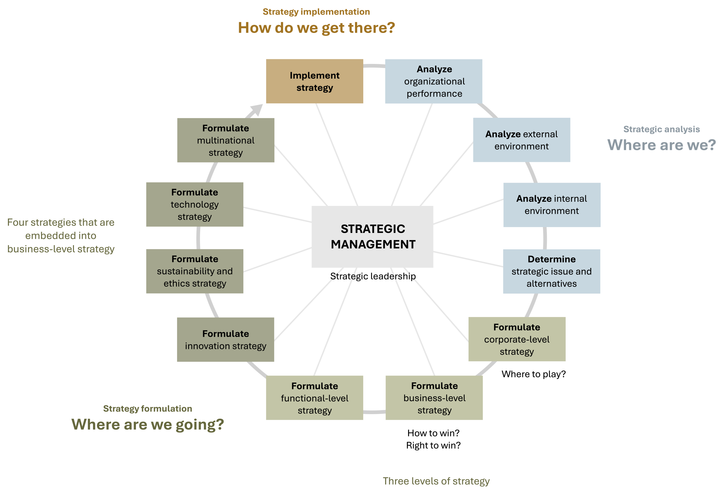
Determine Strategic Issue and Alternatives in the AFI Framework
Figure 1.3: The analysis, formulation, implementation (AFI) framework [Kindred Grey. 2025. CC BY-NC-SA.]

Slide 7
Strategic Analysis: Where Are We?
Strategic management’s foundations rest in three essential questions that align with the three stages of strategic management:
Strategic analysis: Where are we?
Strategy formulation: Where are we going?
Strategy Implementation: How are we going to get there?
Like all strategic analysis, determining a firm’s strategic issue and alternatives addresses the question of where a firm is.

Slide 8
Step 4 in Case Analysis
4. Synthesize the Organization Performance, and External and Internal Analysis using SWOT Analysis.
Synthesize the organizational performance, and internal and external analysis using a SWOT analysis.
Ensure line of sight and congruence between the analysis from the strategic management frameworks and the SWOT analysis.
Notes:
This is step 4 in case analysis.
4. Synthesize the Organization Performance, and External and Internal Analysis using SWOT Analysis.
Synthesize the organizational performance, and internal and external analysis using a SWOT analysis.
Ensure line of sight and congruence between the analysis from the strategic management frameworks and the SWOT analysis.

Slide 9
Determine Strategic Issue and Strategic Alternatives
Synthesize analysis and determine a firm’s strategic issue and alternatives to evaluate where a firm currently stands.
Critical fourth step AFI framework.
Steps 4-13 in the Case Analysis Process.

Slide 10
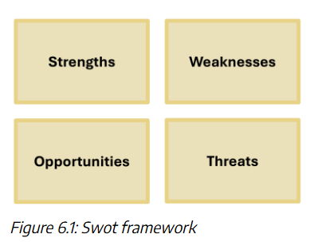
SWOT Framework
A tool used to analyze a firm’s strengths, weaknesses, opportunities, and threats
[ Kindred Grey. 2025. CC BY-NC-SA.]\
Notes:
A SWOT framework is a tool used to categorize a firm’s strengths, weaknesses, opportunities, and threats.
By convention, the SWOT framework places strengths, weaknesses, opportunities, and threats in a grid with four quadrants. Strengths and weaknesses are on the top of the grid and opportunities and threats are on the bottom of the grid.
In contexts other than as part of the strategic management process, organizations use a SWOT framework as a standalone tool.

Slide 11
SWOT in Strategic Management, 1 of 2
SWOT is a tool for synthesizing analysis, combining organizational factors, internal performance, and external factors
The goal: Identify the strategic issue the firm must address
Notes:
In strategic management, a SWOT framework is used to synthesize the analysis you have conducted so far.
Synthesize means to review, critically examine, and combine diverse elements into a coherent whole. Synthesis is combining different concepts to create a new understanding, making a new whole from individual parts.
To conduct a SWOT in strategic management, you synthesize the analysis you have conducted so far of a firm’s organizational performance, external environment, and internal environment. To synthesize the analysis you have conducted so far means to review, critically examine, and combine the diverse elements of your previous analysis into a coherent whole.
When you synthesize the analysis you have conducted so far using a SWOT framework, this is referred to as a SWOT analysis because you analyze the analysis you have conducted so far to complete the SWOT analysis. You are not returning to the case to conduct additional analysis from the case using a SWOT framework.
In strategic management, a SWOT framework is never used as a standalone tool. It is used only after you have completed your analysis of a company to synthesize your analysis. In strategic management, once you have completed your SWOT analysis you use your completed SWOT analysis to determine the firm’s strategic issue.

Slide 12
SWOT in Strategic Management, 2 of 2
In strategic management, a SWOT framework is used to synthesize the analysis you have conducted so far.
Synthesize means to review, critically examine, and combine diverse elements into a coherent whole.
Synthesis is combining different concepts to create a new understanding, making a new whole from individual parts. This means to review, critically examine, and combine the diverse elements of your previous analysis into a coherent concept.
Notes:
In strategic management, a SWOT framework is used to synthesize the analysis you have conducted so far.
Synthesize means to review, critically examine, and combine diverse elements into a coherent whole. Synthesis is combining different concepts to create a new understanding, making a new whole from individual parts.
To conduct a SWOT in strategic management, you synthesize the analysis you have conducted so far of a firm’s organizational performance, external environment, and internal environment. To synthesize the analysis you have conducted so far means to review, critically examine, and combine the diverse elements of your previous analysis into a coherent whole.
When you synthesize the analysis you have conducted so far using a SWOT framework, this is referred to as a SWOT analysis because you analyze the analysis you have conducted so far to complete the SWOT analysis. You are not returning to the case to conduct additional analysis from the case using a SWOT framework.
In strategic management, a SWOT framework is never used as a standalone tool. It is used only after you have completed your analysis of a company to synthesize your analysis. In strategic management, once you have completed your SWOT analysis you use your completed SWOT analysis to determine the firm’s strategic issue.

Slide 13
Using SWOT in Strategic Management
When you synthesize the current analysis using a SWOT framework, this is referred to as a SWOT analysis. You are not returning to the case to conduct additional analysis from the case when you use a SWOT framework.
You are conducting a second level of analysis on the analysis you have conducted on the organizational performance, external environment and internal environment.
In strategic management, a SWOT framework is never used as a standalone tool.
Notes:
In strategic management, a SWOT framework is used to synthesize the analysis you have conducted so far.
Synthesize means to review, critically examine, and combine diverse elements into a coherent whole. Synthesis is combining different concepts to create a new understanding, making a new whole from individual parts.
To conduct a SWOT in strategic management, you synthesize the analysis you have conducted so far of a firm’s organizational performance, external environment, and internal environment. To synthesize the analysis you have conducted so far means to review, critically examine, and combine the diverse elements of your previous analysis into a coherent whole.
When you synthesize the analysis you have conducted so far using a SWOT framework, this is referred to as a SWOT analysis because you analyze the analysis you have conducted so far to complete the SWOT analysis. You are not returning to the case to conduct additional analysis from the case using a SWOT framework.
In strategic management, a SWOT framework is never used as a standalone tool. It is used only after you have completed your analysis of a company to synthesize your analysis. In strategic management, once you have completed your SWOT analysis you use your completed SWOT analysis to determine the firm’s strategic issue.

Slide 14
Organizational Performance
Review mission, purpose, vision, values, goals, financials, market position, and balanced scorecard
SWOT Placement:
External related -> opportunities or threats (bottom of grid)
Internal related -> strengths or weaknesses (top of grid)
Notes:
Organizational performance analysis involves evaluating a firm’s mission, vision, values, goals, financials, market position, and balanced scorecard. This provides insight into both the internal and external aspects of the business. By critically reviewing this information, we can identify which factors reflect internal strengths or weaknesses and which relate to external opportunities or threats. This step is essential in feeding accurate, categorized insights into the SWOT analysis and ensuring our strategic decisions are based on a comprehensive understanding of how the organization is performing.
Use the organizational performance analysis instrument to support the step.
First examine your analysis of the firm’s organizational performance and decide which elements of your analysis relate to the company’s external environment and which elements relate to the firm’s internal environments. For example, you may decide that your analysis of a firm’s market position relates primarily to the external environment and your analysis of the company’s balanced scorecard may relate predominantly to the internal environment. This requires critical thinking and judgment.
Next decide whether those elements of your organizational performance analysis that relate primarily to the external environment represent opportunities or threats. Place those elements that you assess as opportunities in the opportunities box of your SWOT analysis. Place those elements that you assess as threats in the threats box of your SWOT analysis.
Then decide whether those elements of your organizational performance analysis that relate primarily to the internal environment represent strengths or weaknesses. Place those elements that you assess as strengths in the strengths box of your SWOT analysis. Place those elements that you assess as weaknesses in the weaknesses box of your SWOT analysis.

Slide 15
External Analysis
Use tools like PESTEL, Porter’s Five Forces, and Strategic Group Mapping
Focus on elements outside the firm’s control
SWOT Placement:
External analysis -> opportunities or threats (bottom of grid)
Notes:
External analysis examines the outside factors that influence a company's success but are beyond its direct control. Using tools like PESTEL, we assess the political, economic, social, technological, environmental, and legal environments. With Porter’s Five Forces, we evaluate industry competition, supplier and buyer power, and the threat of new entrants or substitutes. Strategic group mapping helps position the firm among its competitors. This analysis identifies external opportunities the firm can capitalize on and threats it needs to mitigate, both of which are essential inputs for the SWOT framework and overall strategic planning.
Use the PESTEL analysis instrument, the Porter’s Five Forces analysis instrument and the strategic group mapping analysis instrument to support this step . Place your external analysis in the bottom half of the grid as opportunities and threats because external analysis addresses those issues outside a firm’s control.

Slide 16
Internal Analysis
Focuses on factors within the firm’s control
Use tools like VRIO and Value Chain analysis
SWOT Placement:
Internal analysis -> strengths or weaknesses (top of grid)
Notes:
Internal analysis involves evaluating the resources, capabilities, and core competencies within a company to determine what the organization does well and where it may fall short. Using tools like the VRIO framework and value chain analysis, you identify areas of strength (such as valuable resources or efficient processes) and weakness (like skill gaps or outdated systems). These findings are then categorized into the top half of the SWOT grid: strengths and weaknesses. This process helps determine which internal factors are most relevant, impactful, and important to the firm’s overall strategic position, creating a solid foundation for strategic decision-making.

Slide 17
SWOT Analysis
Consider the analysis you have conducted so far.
Do not place every aspect of your analysis into your SWOT analysis.
Decide which elements of your analysis impact the firm the most, are most relevant to the company, and are most important to the company.
The evaluation step in the analysis you have conducted so far supports you in this assessment.
Deciding which elements to place in the SWOT framework requires critical thinking and judgment.
This step of conducting your SWOT analysis provides you with a draft SWOT analysis.
Notes:
Internal analysis involves evaluating the resources, capabilities, and core competencies within a company to determine what the organization does well and where it may fall short. Using tools like the VRIO framework and value chain analysis, you identify areas of strength (such as valuable resources or efficient processes) and weakness (like skill gaps or outdated systems). These findings are then categorized into the top half of the SWOT grid: strengths and weaknesses. This process helps determine which internal factors are most relevant, impactful, and important to the firm’s overall strategic position, creating a solid foundation for strategic decision-making.

Slide 18
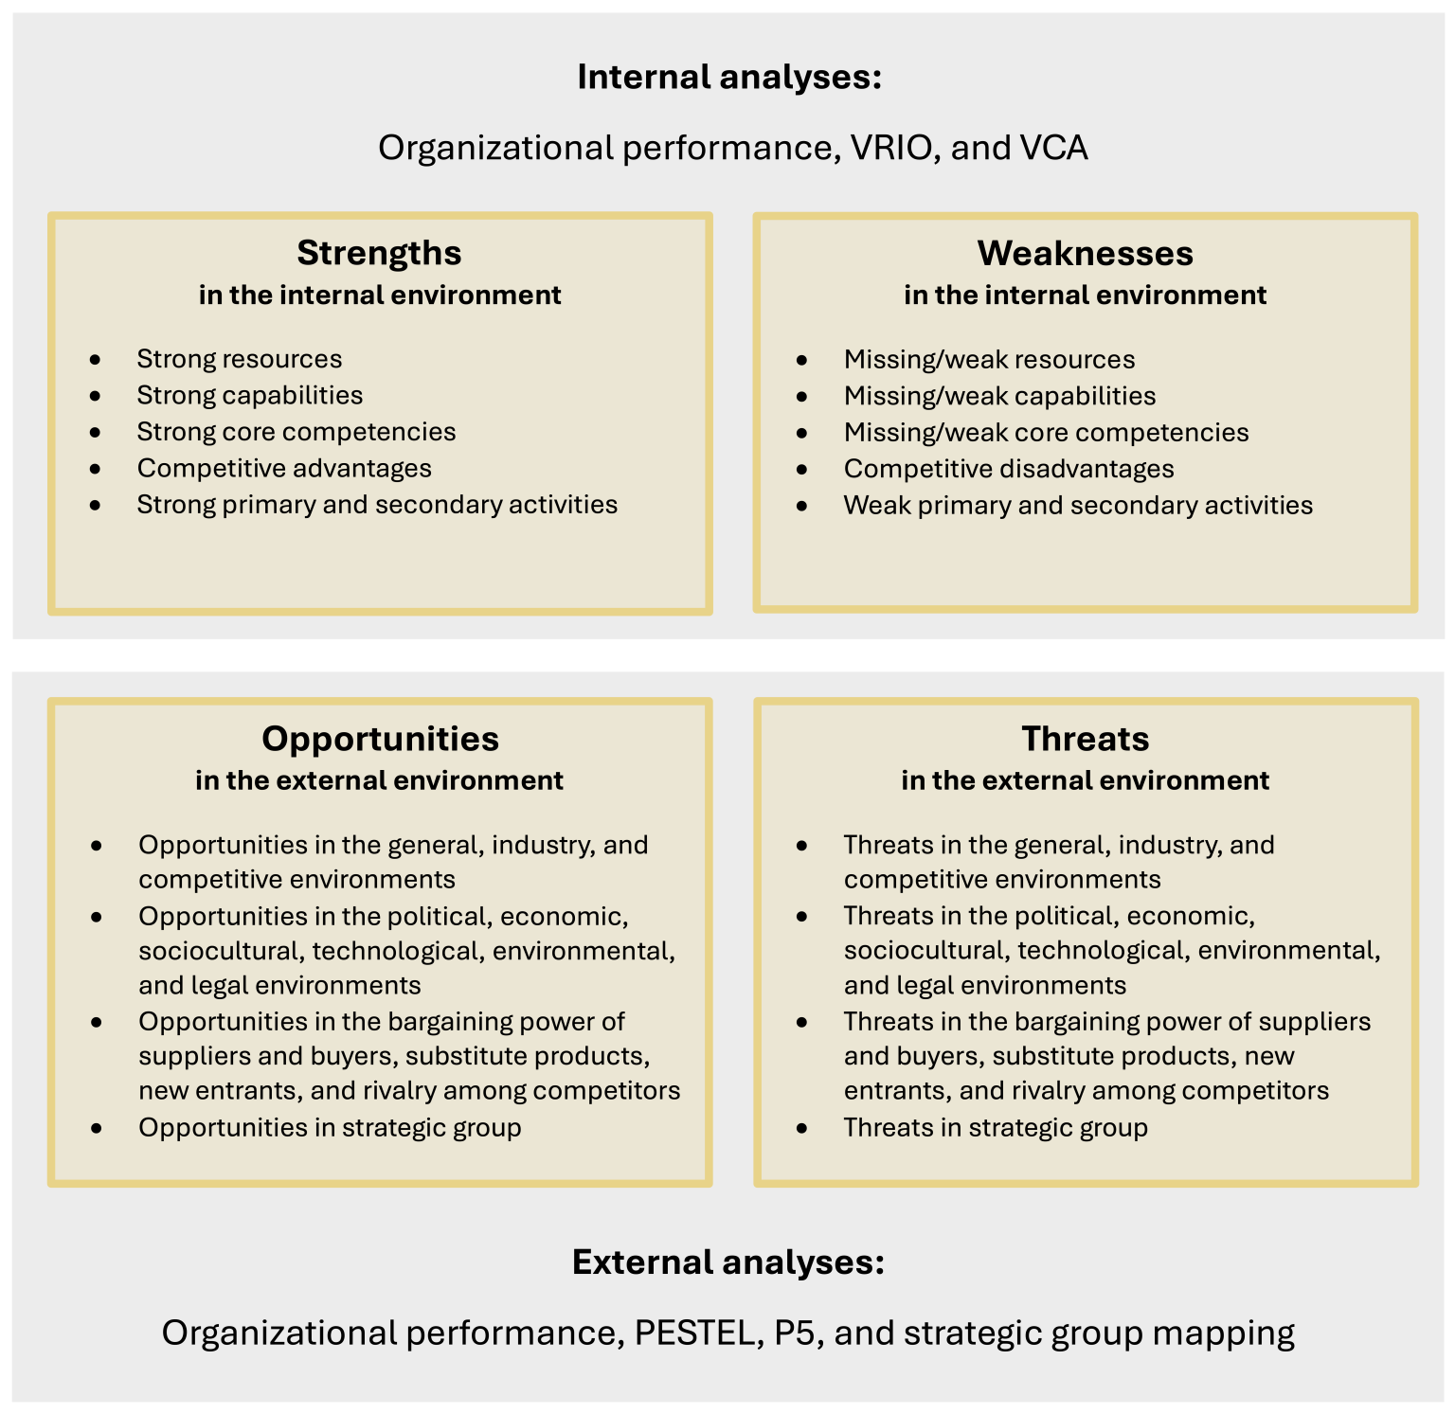
SWOT in Strategic Management
Figure 6.2: Synthesize analysis using a SWOT framework [Kindred Grey. 2025. CC BY-NC-SA.]
Notes:
To conduct a robust SWOT analysis, begin by accurately assessing which elements of the analysis you have conducted far represent strengths, weaknesses, opportunities, and threats. This gives you a draft SWOT analysis. Then synthesize the analysis in your draft SWOT analysis. Next confirm line of sight and congruence. Now you have a final SWOT analysis.
The first step in conducting a SWOT analysis is to accurately assess which elements of the analysis you have conducted far represent strengths, weaknesses, opportunities, and threats. Then you place your previously conducted analysis into the correct categories of a SWOT analysis.
In strategic management it is important to place the analysis you have conducted so far that relates to the external environment of the firm in the bottom half of the grid as opportunities and threats. This is because external analysis addresses those issues external to a company and outside a firm’s control. Issues outside a company’s control are the opportunities and threats a company faces.
Then place the analysis you have conducted so far that relates to the internal environment of the company on the top of a SWOT framework as strengths and weaknesses. This is because internal analysis addresses those issues internal to a company and within a firm’s control. Issues within a company’s control are the company’s strengths and weaknesses.
You do not place every aspect of your analysis into your SWOT analysis. A SWOT analysis is used to focus the analysis you have conducted so far. Decide which elements of your analysis impact the firm the most, is most relevant to the company, and is most important to the company. The evaluation step in the analysis you have conducted so far supports you in this assessment. This requires critical thinking and judgment.

Slide 19
Synthesize SWOT Analysis
Stand back and review your draft SWOT analysis.
Think of your draft SWOT analysis from a holistic perspective.
Critically examine each element of your previous analysis that you have now placed into your draft SWOT analysis.
Combine elements of your draft SWOT analysis that relate.
Notes:
Now that you have completed a draft SWOT analysis, you synthesize the analysis you have placed in your draft SWOT analysis.
To synthesize the analysis in your draft SWOT analysis, stand back and review your draft SWOT analysis. Think of your draft SWOT analysis from a holistic perspective. Critically examine each element of your previous analysis that you have now placed into your draft SWOT analysis. Combine elements of your draft SWOT analysis that relate.

Slide 20
Confirm Line of Sight and Congruence, 1 of 4
Once you have synthesized your analysis in your draft SWOT analysis, determine a clear line of sight and congruence between the analysis from the strategic management frameworks and your SWOT analysis.
Notes:
Once you have synthesized your analysis in your draft SWOT analysis, determine a clear line of sight and congruence between the analysis from the strategic management frameworks and your SWOT analysis.
A few questions to consider include.
Is there a clear line of sight between the analysis from the strategic management frameworks and the SWOT analysis?
Is the logic clear how the analysis from the strategic management frameworks supports the SWOT analysis?
Is there a clear logic behind what analysis from the strategic management frameworks is placed in which category of the SWOT analysis?
Is there congruence between the analysis from the strategic management frameworks and the SWOT analysis?
Ensure that everything that is included in your SWOT analysis is included in an analysis instrument.
Ensure that nothing is present in your SWOT analysis that is not included in an analysis instrument.
This gives you your final SWOT analysis.

Slide 21
Strategic Issue
The most important, urgent, broad, long-term matter that the company is facing.
Result of multiple causes in multiples areas of a business and require significant organizational talent and resources to resolve.
Addressing a strategic issue moves a firm towards its mission, purpose, and vision, and should be congruent with its values.
Focuses on the present and specific organizational context and addresses what is happening with this firm, at this time, in this place, and under these circumstances.
Notes:
A firm’s strategic issue is the most important, urgent, broad, long-term matter that the company is facing.
Strategic issues are the result of multiple causes in multiples areas of a business and require significant organizational talent and resources to resolve.
Addressing a strategic issue moves a firm towards its mission, purpose, and vision, and should be congruent with its values.
A strategic issue focuses on the present and specific organizational context, and addresses what is happening with this firm, at this time, in this place, and under these circumstances.

Slide 22
Determine a Firm’s Strategic Issue, 1 of 2
Based on SWOT analysis, a strategic issue must reflect the analysis of organizational performance, and the external and internal environments
It is important to avoid jumping to conclusions without using a structured approach based on thorough analysis
Notes:
To determine a firm’s strategic issue, it’s essential to base the issue on a thorough SWOT analysis of the company’s organizational performance, external, and internal environments. Rushing into defining a strategic issue without a structured approach can lead to unreliable results. It's important to identify themes from the SWOT analysis and use those themes to determine the firm's major areas of strategic concern. After identifying these areas, you must confirm that they align with the insights from the SWOT analysis, ensuring that there is a clear connection between the themes and the key strategic concerns the company is facing. This process ensures that the strategic issue is grounded in robust analysis and accurately reflects the company’s current situation.

Slide 23
Determine a Firm’s Strategic Issue, 2 of 2
Determine themes in your SWOT analysis.
Use these themes to determine a firm’s major areas of strategic concern.
Confirm line of sight and congruence between the themes in your SWOT analysis and the major areas of strategic concern.
Notes:
First determine themes in your SWOT analysis. Use these themes to determine a firm’s major areas of strategic concern. Then confirm line of sight and congruence between the themes in your SWOT analysis and the major areas of strategic concern.

Slide 24
Determine Themes in Your SWOT Analysis, 1 of 2
Critically think about each strength, weakness, opportunity, and threat in your SWOT analysis
Identify which ones relate and how they relate.
Notes:
To determine a firm’s major areas of strategic concern, first determine themes in your SWOT analysis. Critically think about each strength, weakness, opportunity, and threat in your SWOT analysis and identify which ones relate and how they relate.
A few questions to consider include:
Are there themes within the categories?
In the strengths?
In the weaknesses?
In the opportunities?
In the threats?
Are there themes between the categories?
Between any two, three, or four of the categories: strengths, weaknesses, opportunities, threats?
Keep working with your SWOT analysis until all strengths, weaknesses, opportunities, and threats are assigned to a theme.

Slide 25
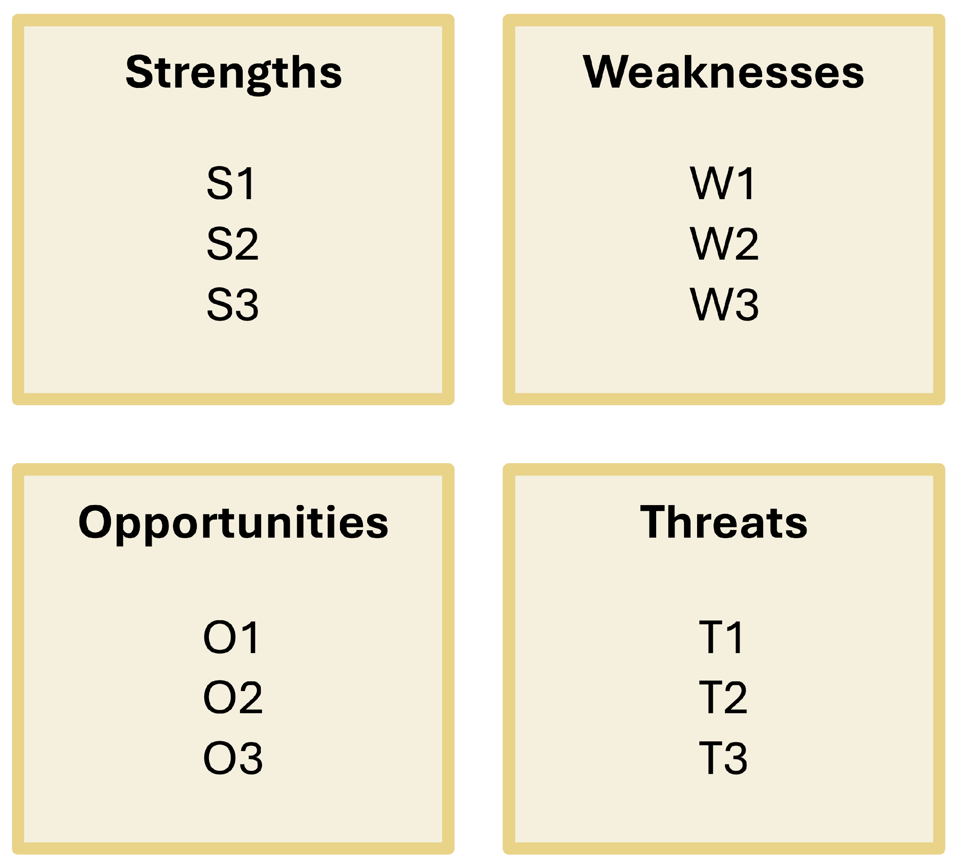
Determine Themes in Your SWOT Analysis, 1 of 2
Figure 6.3: Determine themes in your SWOT analysis [Kindred Grey. 2025. CC BY-NC-SA.]
Notes:
To determine a firm’s major areas of strategic concern, first determine themes in your SWOT analysis. Critically think about each strength, weakness, opportunity, and threat in your SWOT analysis and identify which ones relate and how they relate.
A few questions to consider include:
Are there themes within the categories?
In the strengths?
In the weaknesses?
In the opportunities?
In the threats?
Are there themes between the categories?
Between any two, three, or four of the categories: strengths, weaknesses, opportunities, threats?
Keep working with your SWOT analysis until all strengths, weaknesses, opportunities, and threats are assigned to a theme.

Slide 26
Example, 1 of 4
You determine three themes in your SWOT analysis, competition, innovation, and technology.
Notes:
Let’s take an example to illustrate this process. Let’s say you determine three themes in your SWOT analysis, competition, innovation, and technology.

Slide 27
Determine Major Areas of Strategic Concern, 1 of 2
Identify top 3 urgent major areas of strategic concern from SWOT themes
Ensure areas are mutually exclusive and aligned with SWOT themes
Confirm congruence between SWOT analysis and strategic concern
Notes:
Identify major areas of strategic concern based on the themes from your SWOT analysis. These are the most urgent strategic issues a firm must address to ensure success both now and in the future. Aim for about three major areas, as this is typically manageable and reflects the key challenges most companies face.
Ensure each area is mutually exclusive,and confirm the line of sight and congruence between the themes in your SWOT and the strategic concerns. Key questions to ask include: Is there a clear connection between the SWOT themes and strategic concerns? Do the themes support the concerns? Ensure everything in your SWOT analysis is addressed in the strategic concerns.

Slide 28
Step 6 in Case Analysis, 1 of 2
6. Determine major areas of strategic concern.
Identify the major areas of strategic concern from the SWOT analysis and any additional analysis of strategies.
Ensure line of sight and congruence between the SWOT analysis and the major areas of strategic concern.
Notes:
This is step six in case analysis.
We move to step 6 of case analysis because step 5 is “as appropriate to the case, analyze strategies: corporate level, business level, innovation, sustainability and ethics, technology, and multinational strategies.” That step addresses information that may be considered when determining a strategic issue but is not central to learning how to determine a strategic issue, so it is omitted here.

Slide 29
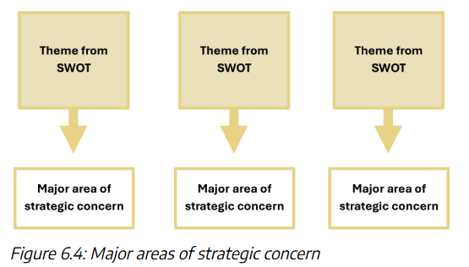
Determine Major Areas of Strategic Concern, 2 of 2
[Kindred Grey. 2025. CC BY-NC-SA.]
Notes:
Identify major areas of strategic concern based on the themes from your SWOT analysis. These are the most urgent strategic issues a firm must address to ensure success both now and in the future. Aim for about three major areas, as this is typically manageable and reflects the key challenges most companies face.
Ensure each area is mutually exclusive,and confirm the line of sight and congruence between the themes in your SWOT and the strategic concerns. Key questions to ask include: Is there a clear connection between the SWOT themes and strategic concerns? Do the themes support the concerns? Ensure everything in your SWOT analysis is addressed in the strategic concerns.

Slide 30
Example, 2 of 4
Competition, innovation, and technology are the 3 major areas of strategic concern.
Notes:
For example, competition, innovation, and technology are the 3 main areas of strategic concern.

Slide 31
Step 6 in Case Analysis, 2 of 2
6. Determine Major Areas of Strategic Concern
Identify the major areas of strategic concern from the SWOT analysis and any additional analysis of strategies.
Ensure line of sight and congruence between the SWOT analysis and the major areas of strategic concern.
Notes:
This is step 6 in case analysis.
6. Determine Major Areas of Strategic Concern
Identify the major areas of strategic concern from the SWOT analysis and any additional analysis of strategies.
Ensure line of sight and congruence between the SWOT analysis and the major areas of strategic concern.
Step 5 of case analysis is, ‘as appropriate to the case, analyze strategies: corporate level, business level, innovation, sustainability and ethics, technology, and multinational strategies.’ It addresses information that may be considered when determining a strategic issue but is not central to learning how to determine a strategic issue, so it is omitted here.

Slide 32
Determine Strategic Issue, 1 of 2
Rank order the major areas of strategic concern and place them in descending order of importance to the firm.
Identify the relationships between the major areas of strategic concern and write phrases that capture these relationships.
Place the phrases between the major areas of strategic concern. This is your draft strategic issue.
Notes:
First, rank order the major areas of strategic concern and place them in descending order of importance to the firm. Then identify the relationships between the major areas of strategic concern and write phrases that capture these relationships. Place the phrases between the major areas of strategic concern. This is your draft strategic issue.

Slide 33
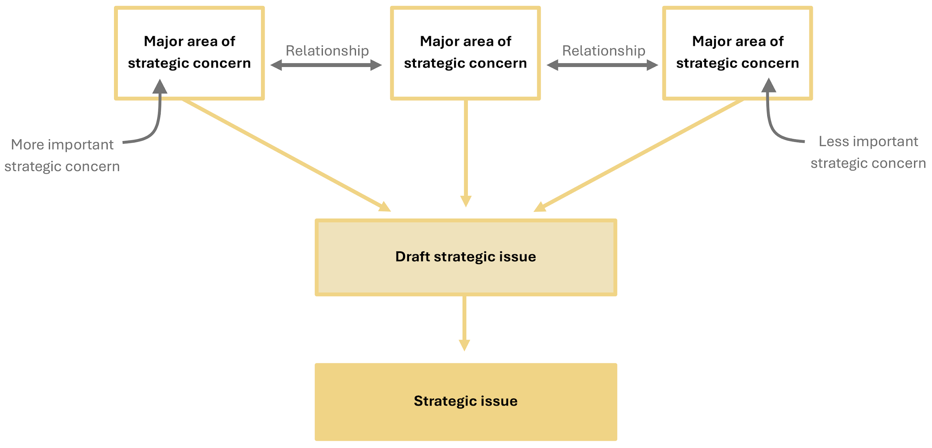
Determine Strategic Issue, 2 of 2
Figure 6.5: Identify a strategic issue [Kindred Grey. 2025. CC BY-NC-SA.]

Slide 34
Example, 3 of 4
How can [company] continue to innovate so that it can successfully capitalize on rapidly changing technology in an increasingly competitive market.
You have moved from a draft strategic issue to a more refined and final strategic issue.
Notes:
In our example, you determined competition, innovation, and technology are the major areas of strategic concern. Let’s say you rank order these in order of importance to the case as follows, innovation, technology, and competition.
Now you determine the relationships of the major areas of strategic concern are as follows. The firm needs to innovate so that it can address technology and deal with competition. This is your draft strategic issue.
Now stand back and critically think about your draft strategic issue from a holistic perspective and finalize it based on your in-depth knowledge of the case. Your final strategic issue may be, ‘How can [company] continue to innovate so that it can successfully capitalize on rapidly changing technology in an increasingly competitive market. You have moved from a draft strategic issue to a more refined and final strategic issue.
You arrived at this final strategic issue through your in-depth knowledge of the case. You know that the company is a leader in innovation, so you frame innovation as something they are going to continue to do.
You also know that although they are a leader in innovating to use existing, and especially new technology, developing new technology is not aligned to their mission and vision. Therefore, you frame your final strategic issue as capitalizing on rapidly changing technology. You know they want to use the latest technology, but not develop it.
Finally, you know that while their market position has been historically strong, they have had some very recent challenges to their market position from some new companies in the market. You frame the final strategic issue as competing in an increasingly competitive market.

Slide 35
Confirm Line of Sight and Congruence, 2 of 4
Confirm line of sight and congruence between the major areas of strategic concern and the draft strategic issue.
Notes:
Confirm line of sight and congruence between the major areas of strategic concern and the draft strategic issue.
A few questions to consider include.
Is there a clear line of sight between the major areas of strategic concern and the draft strategic issue?
Is the logic clear between the major areas of strategic concern and the draft strategic issue?
Is there congruence between the major areas of strategic concern and the draft strategic issue?
Ensure that everything that is included in your major areas of strategic concern is included and the draft strategic issue.
Ensure that nothing present in your major areas of strategic concern is not included in the draft strategic issue.
Review the draft strategic issue from a macro, big picture orientation that considers the entire situation facing the firm. Stand back and critically think about your draft strategic issue from a holistic perspective and finalize it based on your in-depth knowledge of the case.

Slide 36
Step 7 in Case Analysis
7. Determine Strategic Issue
Determine the strategic issue from the major areas of strategic concern.
Ensure line of sight and congruence between the major areas of strategic concern and the strategic issue.
Notes:
This is step 7 in case analysis.
7. Determine Strategic Issue
Determine the strategic issue from the major areas of strategic concern.
Ensure line of sight and congruence between the major areas of strategic concern and the strategic issue.

Slide 37
Strategic Alternatives, 1 of 3
A strategic alternative is an action that addresses and has the potential to resolve every aspect of a strategic issue.
All strategic alternatives resolve the same strategic issue, just in different ways.
Notes:
A strategic alternative is an action that addresses and has the potential to resolve every aspect of a strategic issue.
All strategic alternatives resolve the same strategic issue, just in different ways.

Slide 38
Strategic Alternatives, 2 of 3
Address root causes; they do not address or mask symptoms.
Forward looking.
Do not fix yesterday’s problems.
Realistic practically and ethically.
Economically viable.
Notes:
Strategic alternatives address root causes; they do not address or mask symptoms. Strategic alternatives are forward looking. They do not fix yesterday’s problems. Strategic alternatives are realistic practically and ethically. They are economically viable.

Slide 39
Strategic Alternatives, 3 of 3
It is important that strategic alternatives are well developed and explained and can be implemented by the firm.
Notes:
It is important that strategic alternatives are well developed and explained and can be implemented by the firm.

Slide 40
Determine Strategic Alternatives
Develop and prioritize 3 strategic alternatives that fully address all areas of the strategic issue
Alternatives must tackle root causes, be realistic and ethical
Each alternative should be clearly aligned with the strategic issue and offer a viable solution path
Notes:
Develop 3 strategic alternatives that fully address all areas of the strategic issue.
Alternatives must tackle root causes, be realistic and ethical
Each alternative should be clearly aligned with the strategic issue and offer a viable solution path

Slide 41
Example, 4 of 4
SA1 ‘to partner with a [technology company name]’.
SA2 ‘to invest heavily in talent acquisition and succession planning specifically aimed at innovation leaders.’
SA3 ‘to backwardly integrate into their value chain and acquire a [technology company name]’.
Notes:
One strategic alternative may be ‘to partner with a [technology company name]’. From your knowledge of the case, you know which company the firm is likely to consider. You also know that the firm you are analyzing is not in direct competition with the technology company, so a partnership may be a viable option to explore. It could be mutually advantageous for both companies. You also know the firm engages in a variety of cooperative relationships with other firms, so their culture would support such an alternative.
Another strategic alternative may be ‘to invest heavily in talent acquisition and succession planning specifically aimed at innovation leaders.’ You know from your knowledge of the case that the founders of the company remain their corporate leaders and are instrumental in setting the culture of innovation in the firm. However, while this hands-on approach was a key to their early success, the firm’s age and maturity and changing market conditions means it is time to ensure the company’s early success can continue into the future.
A third strategic alternative may be ‘to backwardly integrate into their value chain and acquire a [technology company name]’. You know that one of their current suppliers is small technology company that may be inclined to consider this option. This would require the firm to change their mission and vision to align with becoming a producer of the technology, rather than just a consumer of it.

Slide 42
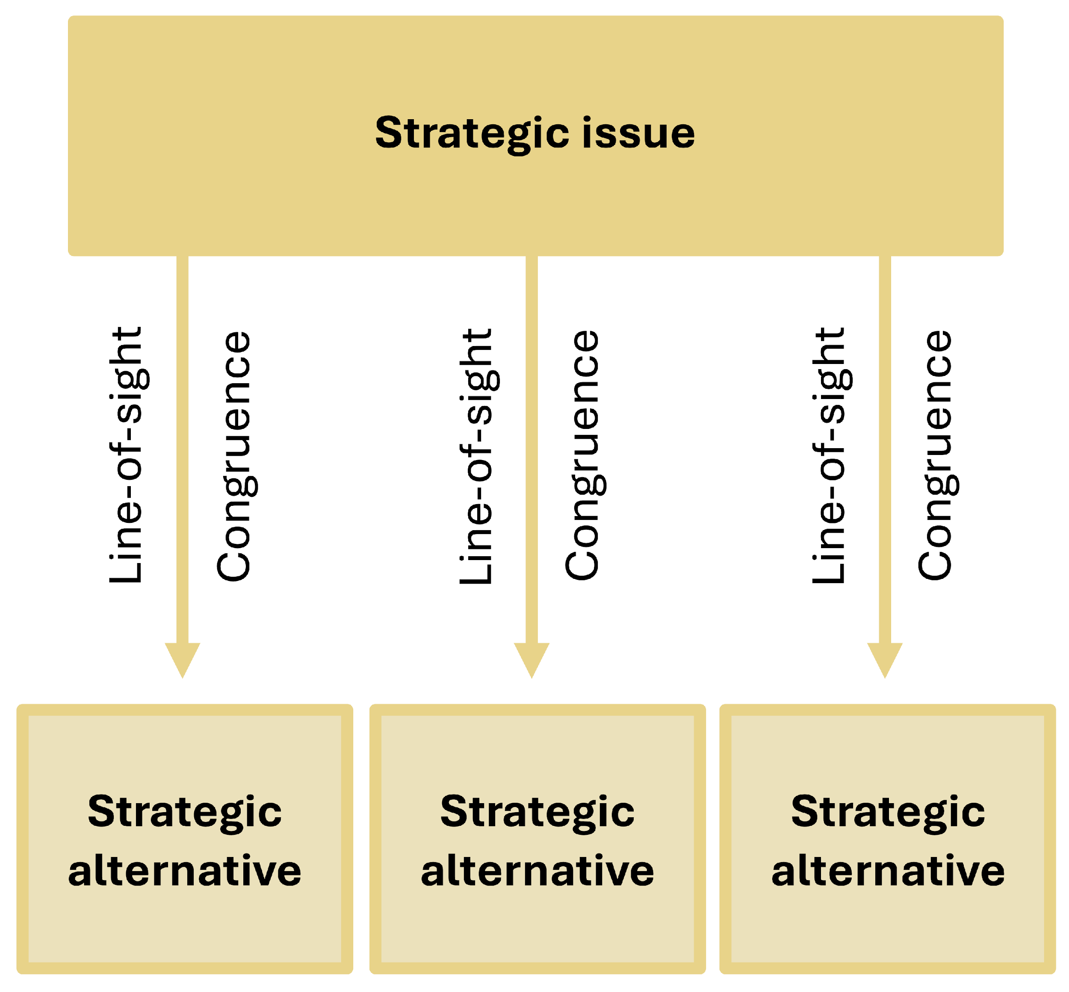
Confirm Line of Sight and Congruence, 3 of 4
Figure 6.6: Strategic alternatives [Kindred Grey. 2025. CC BY-NC-SA.
Notes:
Confirm line of sight and congruence between the strategic issue and the strategic alternatives.
A few questions to consider include:
Is there a clear line of sight between the strategic issue and the strategic alternatives?
Is the logic clear between the strategic issue and the strategic alternatives?
Is there congruence between the strategic issue and the strategic alternatives?
Ensure that everything that is included in the strategic issue is addressed by each strategic alternative.
Ensure that nothing present in the strategic issue is not addressed by each strategic alternative.

Slide 43
Step 8 in Case Analysis
8. Determine Strategic Alternatives
Determine the strategic issue from the major areas of strategic concern.
Ensure line of sight and congruence between the major areas of strategic concern and the strategic issue.
Notes:
This is step 8 in the case analysis process.
8. Determine Strategic Alternatives
Determine the strategic issue from the major areas of strategic concern.
Ensure line of sight and congruence between the major areas of strategic concern and the strategic issue.

Slide 44
Evaluate Strategic Alternatives, 1 of 2
Identify criteria to evaluate alternatives (e.g., feasibility, alignment with mission, profitability)
Compare how each alternative addresses the strategic issue
Assess fit with firm’s values, resources, and environments
Consider financial realism and potential to create competitive advantage
Use a comparison table to evaluate and justify your recommendation
Notes:
Once you have identified three strategic alternatives, the next step is to evaluate and recommend one. If you are conducting an abbreviated case analysis, you may not evaluate your three strategic alternatives.
This process begins by selecting evaluation criteria that reflect the firm’s specific context. Common criteria include how well each alternative addresses the strategic issue, whether it aligns with the firm’s mission, vision, values, and whether it fits within the internal and external environments. It is also important to assess whether each alternative leverages the firm’s current or needed resources, capabilities, and core competencies to create a competitive advantage. Financial feasibility is another critical factor. Alternatives must be realistic given the firm’s resources and should aim to improve profitability by adding value. Once the criteria are chosen, each strategic alternative is evaluated using a comparison table that explains how it meets or fails to meet each criterion. The most suitable and feasible alternative is then recommended based on this analysis.

Slide 45
Evaluate Strategic Alternatives, 2 of 2
Criteria | Strategic alternative 1 | Strategic alternative 2 | Strategic alternative 3
1. Resolves the strategic issue
2. Is congruent with the firm's mission, purpose, vision, and values
3. Is consistent with the external environment
4. Is consistent with the internal environment
5. Is consistent with the existing or needed firm resources, capabilities, and core competencies
6. Creates a competitive advantage for the firm
7. Adds value
8. Is realistic given available funding
9. Enables the firm to earn profit. (A) Adds value and increases price (B) Adds value without increasing cost
10. Improves profitability
Figure 6.7: Evaluate strategic alternatives
Notes:
Once you have identified three strategic alternatives, the next step is to evaluate and recommend one. If you are conducting an abbreviated case analysis, you may not evaluate your three strategic alternatives.
This process begins by selecting evaluation criteria that reflect the firm’s specific context. Common criteria include how well each alternative addresses the strategic issue, whether it aligns with the firm’s mission, vision, values, and whether it fits within the internal and external environments. It is also important to assess whether each alternative leverages the firm’s current or needed resources, capabilities, and core competencies to create a competitive advantage. Financial feasibility is another critical factor. Alternatives must be realistic given the firm’s resources and should aim to improve profitability by adding value. Once the criteria are chosen, each strategic alternative is evaluated using a comparison table that explains how it meets or fails to meet each criterion. The most suitable and feasible alternative is then recommended based on this analysis.

Slide 46
Step 9 in Case Analysis
9. Evaluate Strategic Alternatives
Determine criteria to evaluate the strategic alternatives.
Use criteria to evaluate the strategic alternatives.
Clearly indicate how the strategic alternatives meet the evaluation criteria.
Notes:
This is step 9 in the case analysis process.
9. Evaluate Strategic Alternatives
Determine criteria to evaluate the strategic alternatives.
Use criteria to evaluate the strategic alternatives.
Clearly indicate how the strategic alternatives meet the evaluation criteria.

Slide 47
Recommend a Strategic Alternative
If you conduct an abbreviated case analysis, you may not have used criteria to evaluate your strategic alternatives. In this case, use critical thinking to recommend the best strategic alternative. You may still explain why you chose the strategic alternative that you did.
If you use criteria to evaluate your strategic alternatives, explain how the strategic alternative you recommend best meets the criteria you use.
Notes:
Once you have determined three strategic alternatives, you now recommend one. . If you conduct an abbreviated case analysis, you may not have used criteria to evaluate your strategic alternatives. In this case, use critical thinking to recommend the best strategic alternative. You may still explain why you chose the strategic alternative that you did. If you use criteria to evaluate your strategic alternatives, explain how the strategic alternative you recommend best meets the criteria you use.

Slide 48
Step 10 in Case Analysis
10. Recommend Strategic Alternative
Recommend one strategic alternative using the evaluation criteria.
Notes:
This is step 10 in the case analysis process.
10. Recommend Strategic Alternative
Recommend one strategic alternative using the evaluation criteria.

Slide 49
Design an Implementation Plan, 1 of 2
Plan execution, including assumptions (demand, costs, competition)
Outline timeline, stages, activities, and responsibilities
Address new resources (financial, human, technology)
Consider value chain changes, new capabilities, and organizational structure
Notes:
An implementation plan outlines how to execute the recommended strategic alternative. It includes assumptions about factors like demand, costs, competitor reactions, and customer behavior. The plan should define the timeline, stages, activities, and who is responsible for each task. It also addresses new resources needed, such as financial, human, and technological resources. The plan may require changes in the value chain, new capabilities, or adjustments to the organizational structure. It's essential to ensure the plan is realistic and considers how the firm will handle the implementation process, including necessary adjustments to systems and incentives for successful execution.

Slide 50
Design an Implementation Plan, 2 of 2
Criteria | Recommended strategic alternative
1. Assumptions regarding implementation of the strategic alternative. (a) Changes in demand (b) Price and costs that factor in competitor reactions (c) Customers' willingness to pay a higher price (d) Realistic cost projections
2. An implementation timeline (a) Stages of the implementation plan (b) Duration of activities in each implementation plan (c) Activities in each implementation plan (d) Duration of activities in each implementation plan (e) Who is responsible for each activity
3. New resources required (a) financial: available cash, stocks, loans (b) Human (c) Facilities (d) Technology
4. New or revised value chain activities
5. New resources, capabilities, or competencies required
6. Changes needed in organization structure
7. Changes needed in firm infrastructure (a) New position needed (b) Restructuring
Figure 6.8: Design an implementation plan
Notes:
Use this table to design the implementation plan against the criteria you choose. Delete criterion that you do not use and add criterion that you use that do not appear in the table. Place a robust description of whether, how, and in what ways the strategic alternative you recommend to be implemented meets each criterion.

Slide 51
Confirm Line of Sight and Congruence, 4 of 4
Line of sight and congruence are important throughout the case analysis process.
Notes:
Line of sight and congruence are important throughout the case analysis process. Up to now, you have considered line of sight and congruence within a strategic management tool, among strategic management frameworks, and between steps in the case analysis process. It is now time to assess line of sight and congruence across the entire case analysis. Review the entire strategic analysis and ensure there is direct and clear logic connecting all elements in the strategic analysis and confirm there is a one-to-one relationship between two or more things.

Slide 52
Step 12 in Case Analysis
12. Confirm Line of Sight and Coherence Across the Entire Case Analysis.
Notes:
This is step 12 in the case analysis process.
12. Confirm Line of Sight and Coherence Across the Entire Case Analysis.

Slide 53
Write and/or Present the Case Analysis
Now that you have conducted a case analysis you will likely write it as an assignment and/or present it.
A case analysis is not a data dump of every point of information produced.
It is a presentation of a coherent and logical narrative.
Notes:
Now that you have conducted a case analysis you will likely write it as an assignment and/or present it. A case analysis is not a data dump of every point of information produced. It is a presentation of a coherent and logical narrative.

Slide 54
Step 13 in Case Analysis
13. Write and/or Present Case Analysis
Notes:
This is step 13 in the case analysis process.
13. Write and/or Present Case Analysis

Slide 55
Demonstrate Your Knowledge, Skills, and Competence
Use these questions to test your knowledge of the chapter:
Describe a SWOT framework and how it is utilized in strategic management. Explain why you place your external analysis on the bottom of the grid and your internal analysis on the top of the grid. Discuss why a SWOT analysis is never used as a standalone tool in strategic management.
Unpack the definition of a strategic issue to be sure you understand all its critical elements.
Describe how you determine the major areas of strategic concern for a firm.
Describe how to use major areas of strategic concern to identify a company’s strategic issue.
Notes:
Use these questions to test your knowledge of the chapter.
Describe a SWOT framework and how it is utilized in strategic management. Explain why you place your external analysis on the bottom of the grid and your internal analysis on the top of the grid. Discuss why a SWOT analysis is never used as a stand-alone tool in strategic management.
Unpack the definition of a strategic issue to be sure you understand all its critical elements.
Describe how you determine the major areas of strategic concern for a firm.
Describe how to use major areas of strategic concern to identify of a company’s strategic issue.
By answering these questions robustly, you have demonstrated your thorough knowledge of how to synthesize your analysis and determine a firm’s strategic issue. This is essential to robust case analysis. Well done!

Slide 56
Demonstrate Your Knowledge, Skills, and Competence - Part 2
Use these questions to test your knowledge of the chapter:
Describe the criteria you may use to evaluate a firm’s strategic alternatives and how you would use these to recommend a strategic alternative.
Describe the criteria you may use to design an implementation plan.
Describe what confirming line of sight and congruence across the entire case analysis involves and why this is essential to a robust case analysis.
By answering these questions, you have demonstrated your thorough knowledge of how to synthesize your analysis and determine a firm’s strategic issue. This is essential to robust case analysis. Well done!
Notes:
Use these questions to test your knowledge of the chapter.
Describe the criteria you may use to evaluate a firm’s strategic alternatives and how you would use these to recommend a strategic alternative.
Describe the criteria you may use to design an implementation plan.
Describe what confirming line of sight and congruence across the entire case analysis involves and why this is essential to a robust case analysis.
By answering these questions robustly, you have demonstrated your thorough knowledge of how to synthesize your analysis and determine a firm’s strategic issue. This is essential to robust case analysis. Well done!

