Slide 1

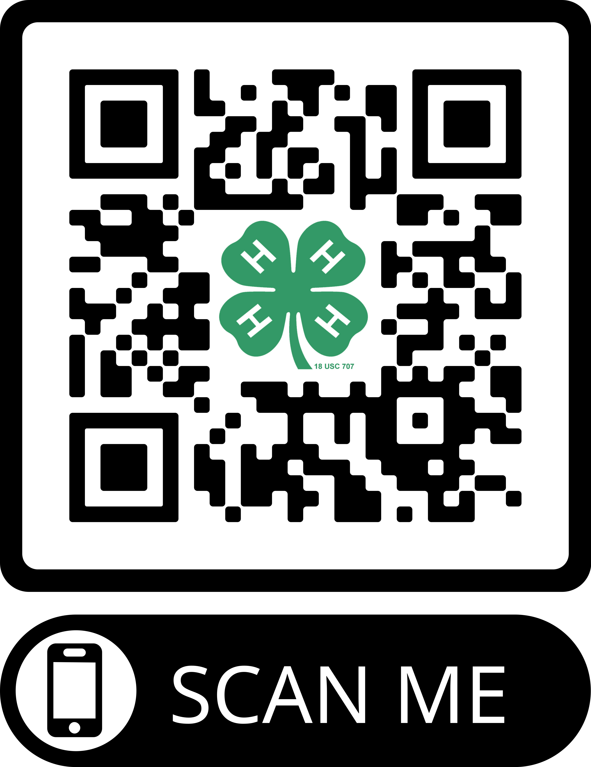

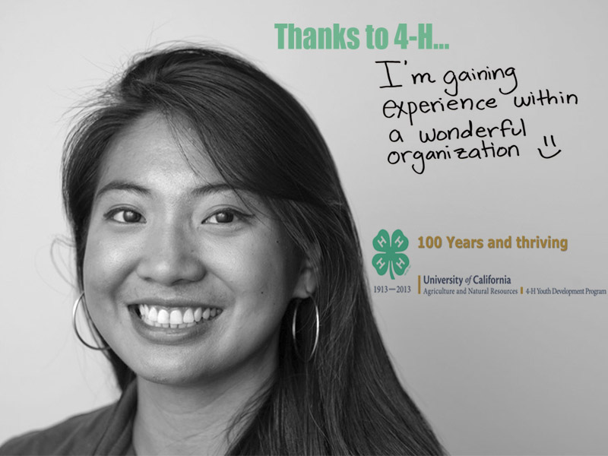
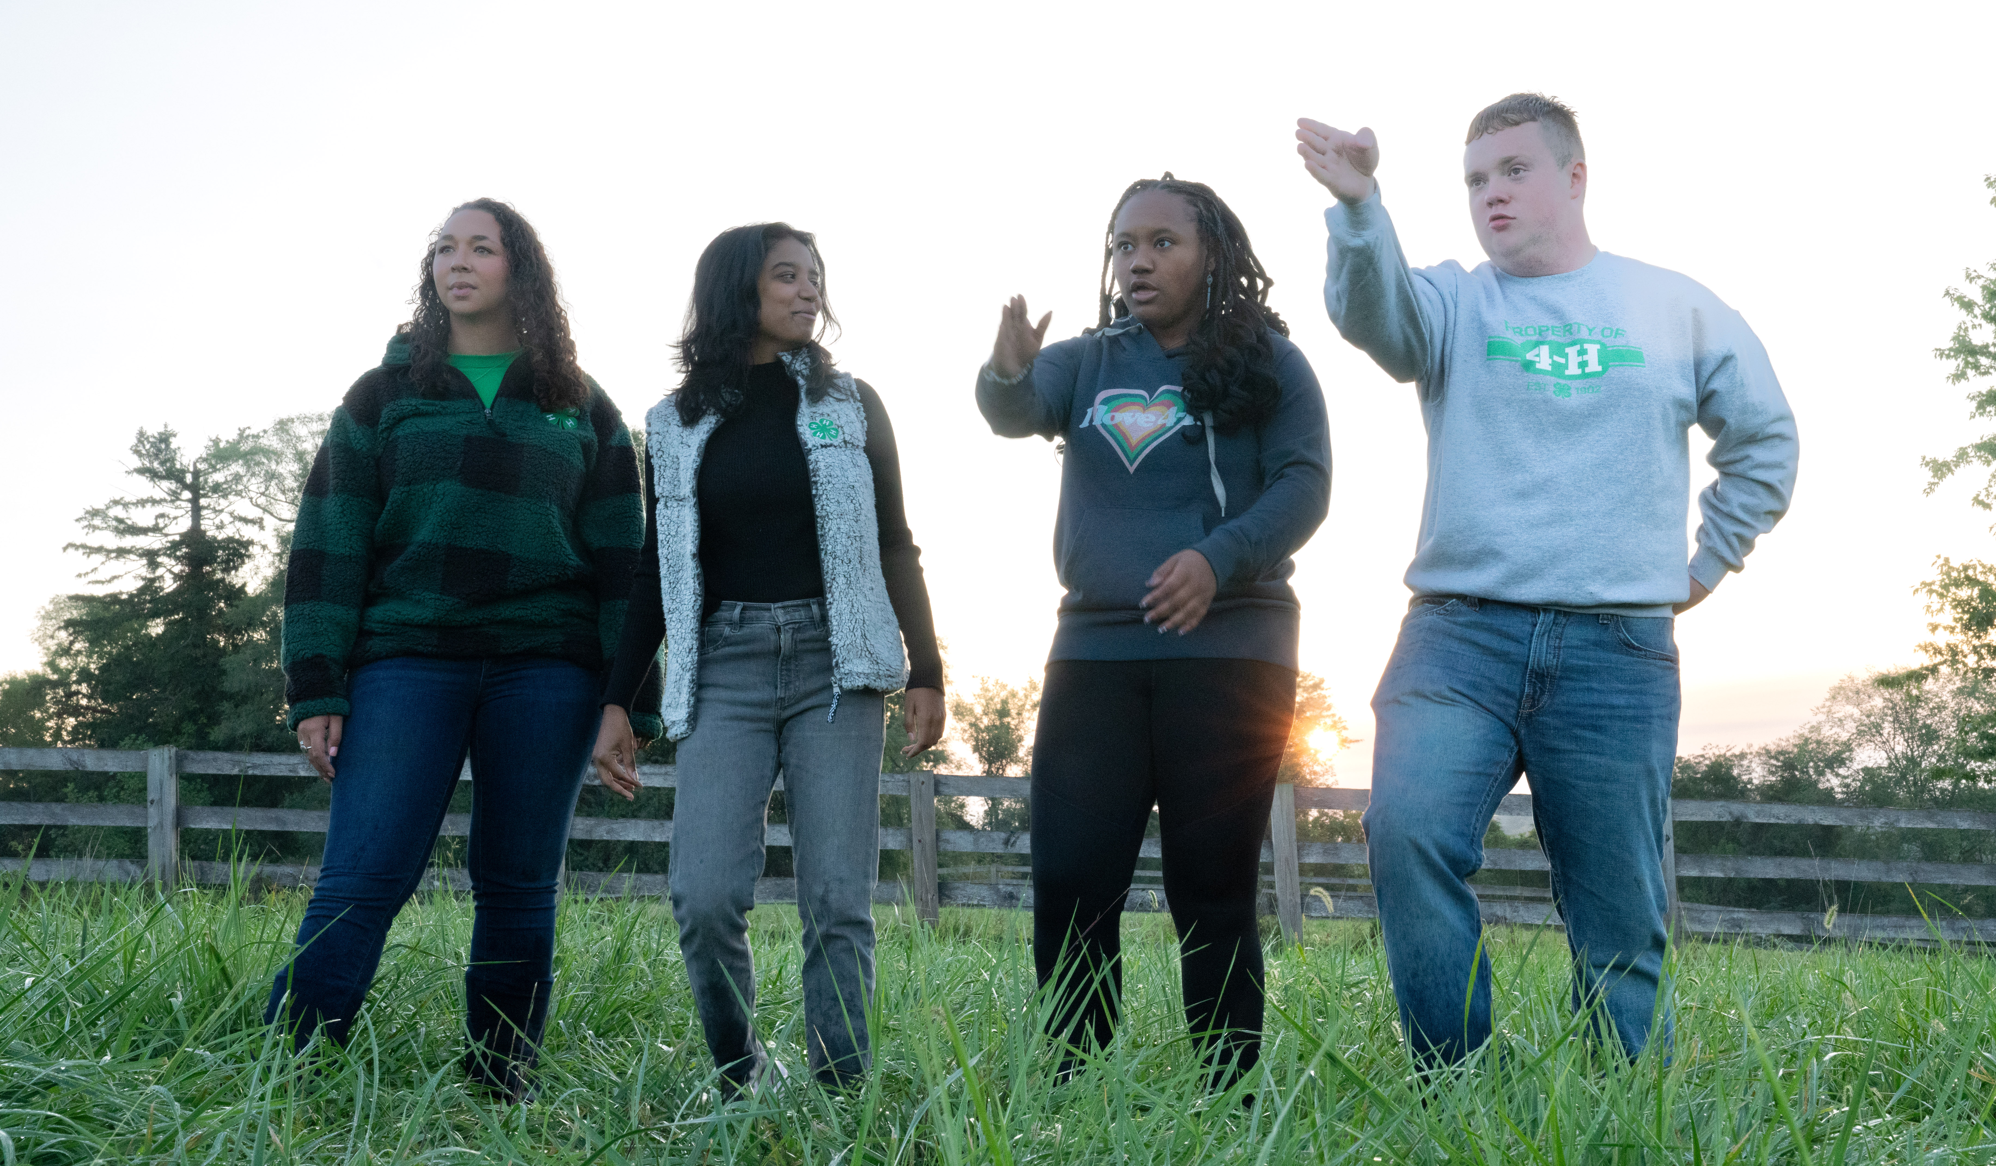
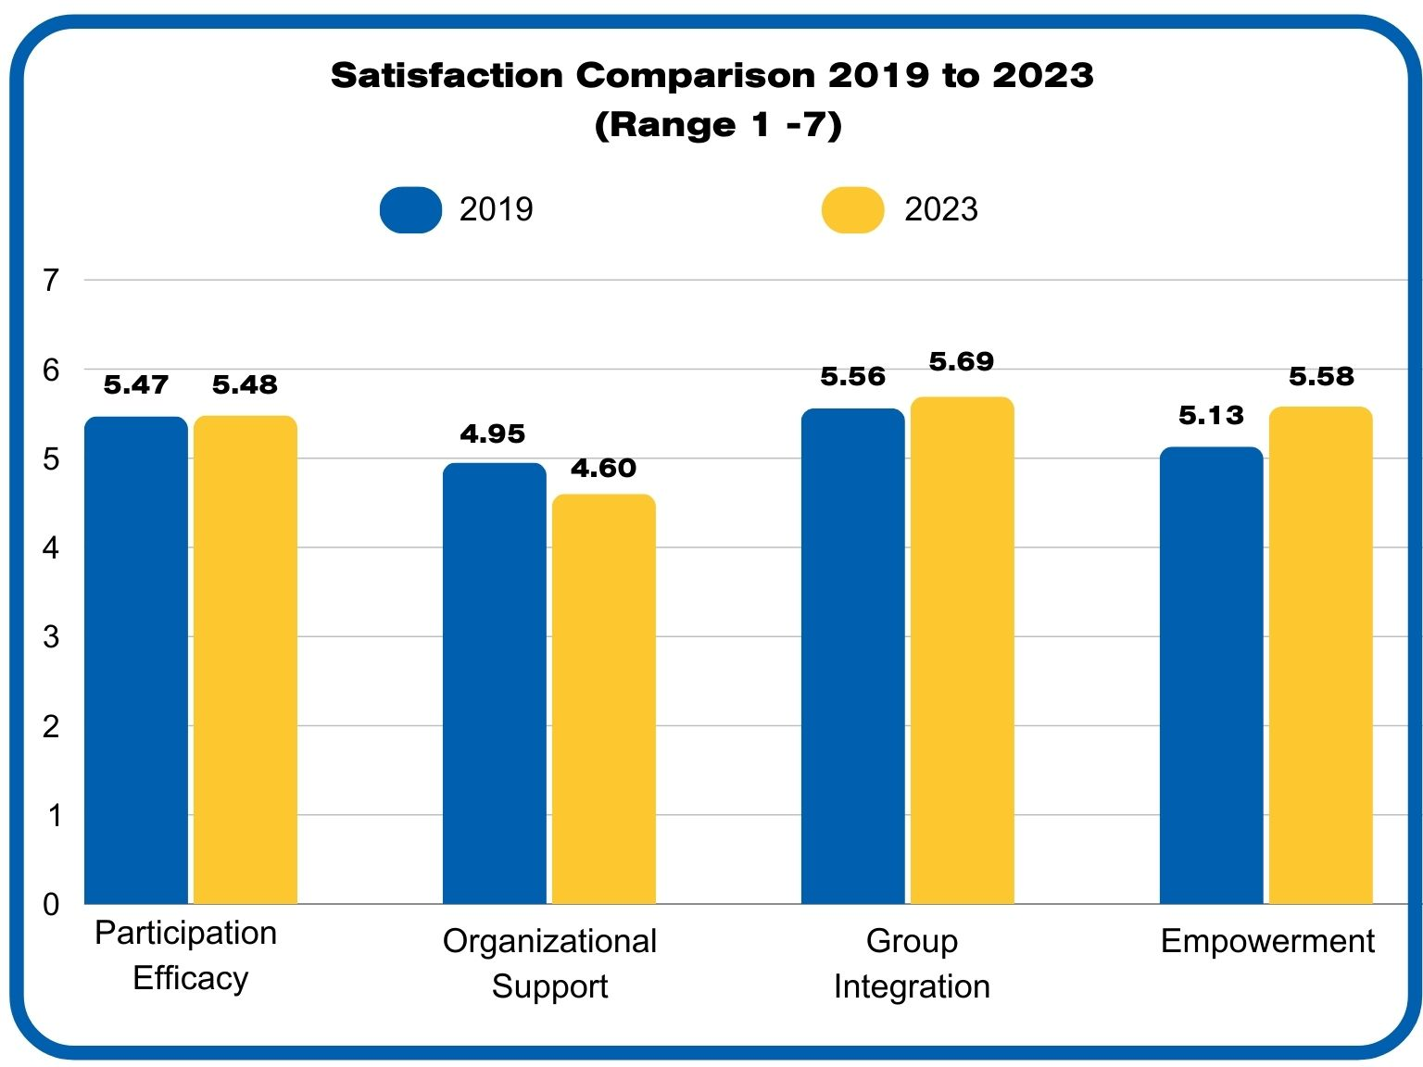
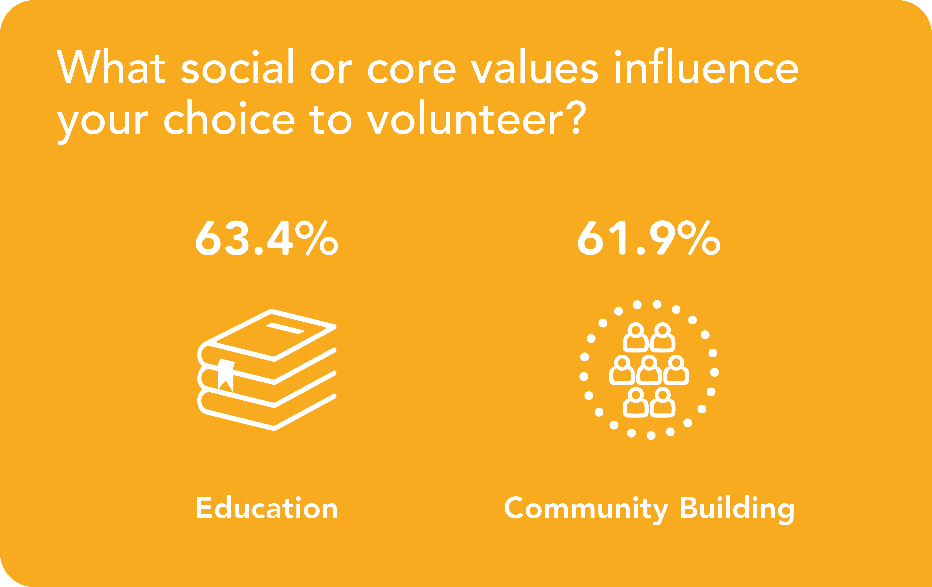
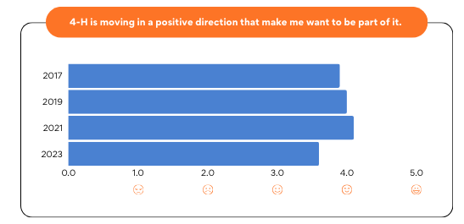


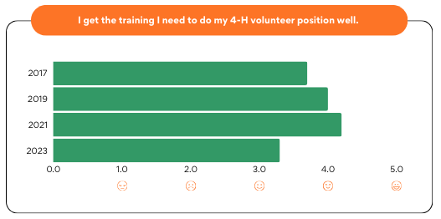
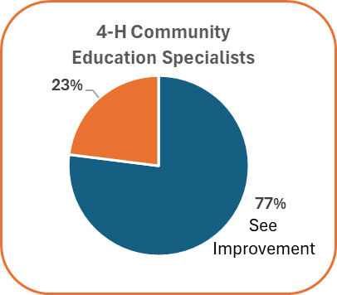
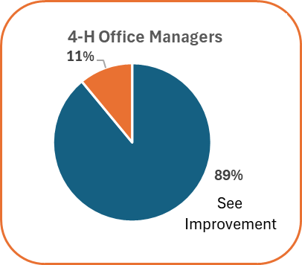

Evaluating Shifting Trends in Youth Development Volunteerism
University of California 4-H Youth Development Program
Study 1: Satisfaction
Gemma Miner, Tamekia Wilkins, & Matthew Rodriguez
Volunteers’ satisfaction assessed in 2019 and 2023 on
(1) Participation Efficacy, satisfaction with efforts to benefit others; (2) Support, satisfaction with educational resources and emotional support from paid staff; (3) Group Integration, social relationship with other volunteers; and (4) Empowerment, satisfaction with the flexibility to fulfill volunteer assignment and incorporate knowledge and skills
Study 2: Climate
Steven M. Worker
Longitudinal survey measuring 4-H organizational climate around brand, leadership, communication, satisfaction, training, and respect, administered in 2017, 2019, 2021, and 2023.
Introduction
Youth development volunteers play a key role delivering educational programming, achieving youth development outcomes, and fulfilling the organizations' missions.
We assessed various aspects of 4-H youth development volunteer experience, satisfaction, and trends in order to strengthen recruitment, retention, support, and acknowledgement.
Study 3: Gen Z
Gemma Miner and Roshan K. Nayak
A multistate study assessed Gen Z adults' motivation and volunteer preferences, including factors that influence their decisions to volunteer with an organization.
Study 4: Support
Roshan K. Nayak, Keith Nathaniel, Zeva Cho
We evaluated the effectiveness of a staffing restructure to assess the new staffing model's effect on volunteer satisfaction, training needs, retention, and conflict resolution.
Steven M. Worker, Roshan K. Nayak, Gemma Miner, Tamika Wilkins, Matthew Rodriguez, Keith Nathaniel, & Zeva Cho
American Evaluation Association 2024 Conference

