Slide 1

Integrative
STEM Education
As “Best Practice”
Mark Sanders
Professor Emeritus
Integrative STEM Education
Virginia Tech
Technology Education Research Conference
Surfers Paradise, Queensland, Australia
December, 2012

Slide 2
Overview
Historical Perspectives
Integrative STEM Education Defined
Rationale / Validation
Investigating iSTEM Education
Q & A

Slide 3
Historical
Perspectives

Slide 4
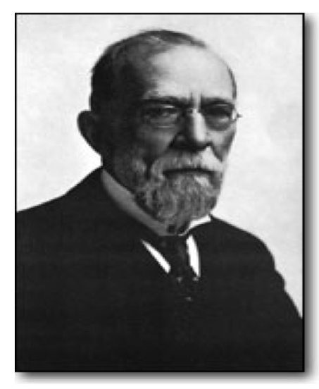
Historical Perspective
Dr. Calvin M. Woodward
1870s: Professor of Mathematics, Washington U

Slide 5

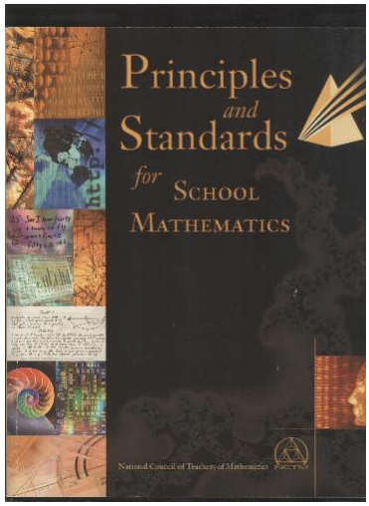
Historical Perspective
School Science & Mathematics
(launched 1900)
National Math Standards (PSSM)
NCTM, 1989/2000)
  “Making connections builds mathematical understanding.”

Slide 6
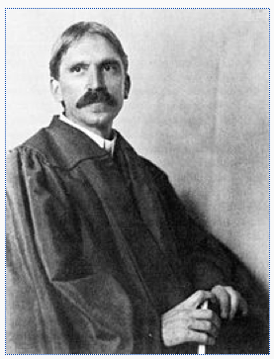
Historical Perspective
John Dewey
“There is no such thing as genuine knowledge and fruitful understanding except as the offspring of doing.” (1916)
“As in the case of other tools, math and science can be learned only by use.” (1916)

Slide 7
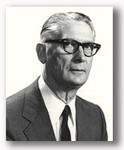
Historical Perspective
Donald Maley (1959)
“Where else in the school [other than the Industrial Arts Lab] is there the possibility for the application of math and science so closely resembling society outside of school”?
R & E 9th grade course

Slide 8
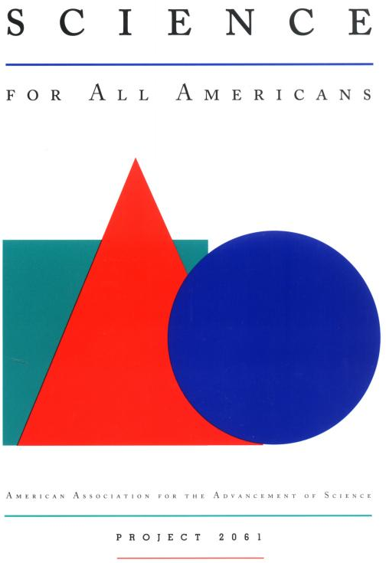
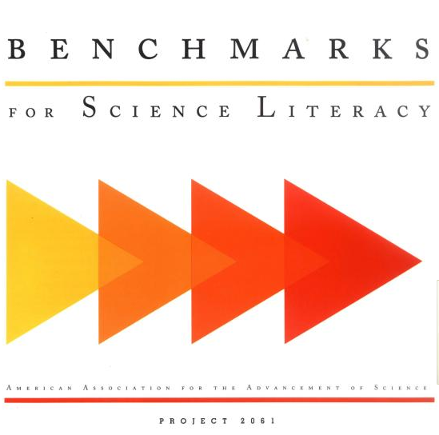
Historical Perspective
James Rutherford
  Science for All Americans (1989)
“It is the union of science, mathematics, and technology that forms the scientific endeavor.”
“The ideas and practice of science, mathematics, and technology are so closely intertwined that we do not see how education in any one of them can be undertaken well in isolation from the others.” (1993)

Slide 9

Historical Perspective
National Science Ed Standards, (NRC, 1996)
“Science & Technology” Standard”
Thou shalt do Technological design in science class
(Design / Make / Communicate)

Slide 10
What is
“Integrative
STEM
Education?”

Slide 11
“Integrative STEM Education is...
a much more explicit term than “STEM Education”
refers to instructional approaches that situate Math & Science learning…
in the context of engineering design problems
(Design / Make / Evaluate / Iterate)

Slide 12

What’s an Engineering Design problem?
Design Brief
Design a paper airplane that remains aloft for the maximum possible time.
Design
Make
Evaluate
Iterate
FUN !

Slide 13

About Engineering Design challenges:
Great for “kids” of all ages
Great context for applying math and science
Most design challenges are NOT iSTEM Ed

Slide 14
Integrative STEM Education:
The Operational Definition
technological/engineering design-based learning approaches…
that intentionally integrate the concepts and practices of science and /or mathematics education with the concepts and practices of technology and engineering education.
may be enhanced through further integration with other school subjects, such as language arts, social studies, art, etc.” (Sanders & Wells, 2006).

Slide 15
iSTEM Ed– Scope
For ALL students, K-PhD
Does NOT replace all (or even most) “silo” instruction
Occurs during and /or after school

Slide 16
iSTEM Ed– Pedagogy
Technological Design-based pedagogy
  Design / Make / Evaluate / Iterate
Students usually work in teams
Teachers sometimes work in teams
Engages & assesses grade-appropriate S, T, E, & M concepts and practices
“Purposeful Design & Inquiry”

Slide 17
Why iSTEM Ed as “Best Practice” Candidate?

Slide 18
Because It’s an exemplar of many “Learning Principles”
Learning is an active process
Motivation is integral to cognition
Learning occurs through social interaction
Knowledge is contextual
Embodied cognition
iSTEM Ed nails these Learning Principles!
    Bransford, Brown, & Cocking, 1999; Bruning, Schraw, Norby, & Ronning, 2004)

Slide 19
iSTEM Ed as Best Practice, because…
It’s been shown to increase student:
Interest;
motivation;
Engagement;
learning (achievement); and
retention
See, for example…

Slide 20
LRDC Study– Mehalik, Doppelt, & Schunn (JEE, 2008)
Design-based science vs. Scripted Inquiry Science
Investigated 1053 students in 46 science classes (Pittsburgh / LRDC)
CONCLUSION: An engineering design approach employed by science teachers…
significantly improved core science content knowledge (achievement), engagement, and retention compared to the traditional scripted inquiry science comparison group.
“The systems design approach was most helpful to low-achieving African American students.”

Slide 21
Engineering Is Elementary Research
EiE reports 3.8 million students & 41 thousand teachers using the EiE curriculum
Their studies over past 6 years conclude:
“EiE students perform significantly better than control groups on engineering, technology, and science questions; and
EiE participation enhances interest, engagement, and performance among under-represented populations”

Slide 22
OK… So maybe it’s a good idea… but… Why should TE consider iSTEM Ed as a “Best Practice” Candidate?

Slide 23
Why should TE consider iSTEM Ed as “Best Practice”?
Technology Ed has been investigating / validating iSTEM Ed since Woodward (1870s) and Maley (late 1950s) developed iSTEM Ed courses
TE iSTEM Ed curriculum projects since the early 1990s
For example…

Slide 24
Elementary (K-5) iSTEM Ed Curricula
  Mission 21 (1992)
  Project UpDate (1990s)
  Children’s Engineering Convention (1996)
  City Technology (2001)
  Children Designing & Engineering (2002)
  Engineering by Design - I³ (ITEA 2004)
  Engineering by Design – TEEMS )ITEEA
  Engineering is Elementary (2004)

Slide 25
Middle School iSTEM Ed Curricula
  TSM Connection Activities (1996)
  IMaST (1998)
  Gateway to Technology (PLTW)
  Engineering By Design (ITEA, 2005)
  Building Math
  Design & Discovery
  Infinity Project
  Learning By Design
  Lego Engineering
  A World in Motion

Slide 26
High School iSTEM Ed Curricula
  Phys-Ma-Tech (1993)
  Principles of Engineering (NY, 1995)
  Project Lead the Way (1997)
  Tech-Know (Peterson, et al., 2000 )
  Engineering by Design
  Designing for Tomorrow
  Engineering the Future
  Material World Modules
  A World in Motion

Slide 27
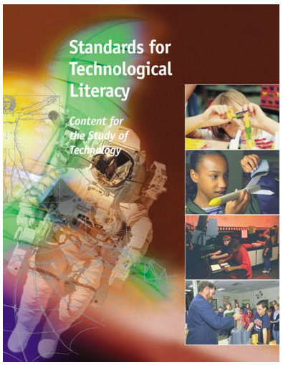
STL (ITEA, 2000) Validates iSTEM Ed
Engineering Design
Connections with Science, Math & other subjects
It’s now the ITEEA…
  Can’t do “E” without M & S!
iSTEM Ed = design-based Engineering Ed?

Slide 28
TE University Programs providing iSTEM Ed Options
Virginia Tech: Integrative STEM Ed Grad Program
  Founded 2005
  Graduate Certificate, MAED, EdS, EdD, PhD
College of New Jersey: MST Teacher Ed Program
Illinois State University: STEM Ed Master’s Option

Slide 29
The Engineering community (NAE) promoting iSTEM Ed for a decade
2002: NAE’s #1 recommendation was:
“Integrate engineering content into non-technical K-12 classes”
Their current Project:
  “Toward Integrated STEM Education: Developing A Research Agenda”

Slide 30
So, here’s THE critical question for TE…
Given: “Technological literacy for All” (1985)
In the 21st century, shouldn’t a technologically literate person…
be able to apply math, science, and engineering concepts & practices in solving authentic problems?
Do we really want to argue “NO” to this Q?
If “NO,” is TE viable in the 21st century curriculum?

Slide 31
Consider: Next Generation Science Standards
“What is different in the NGSS
is a commitment to fully integrating engineering and technology
into the structure of science education
by raising engineering design to the same level as scientific inquiry
when teaching science disciplines at all levels,
and by according core ideas of engineering and technology the same status as core ideas in the other major science disciplines.

Slide 32
In 2003, I said YES to THAT Question…
And, thus envisioned and then co-developed our Integrative STEM Education Graduate Program…
Which investigates & validates iSTEM Ed as Best Practice
Moreover, I’m suggesting that others in TE…

Slide 33
Investigate iSTEM Ed as Best Practice
Establish Design Experiments (Brown, 1992)
In each… create the best possible iSTEM “learning ecology”
  (Lab + Curriculum + Instructional Procedures)
Investigate student learning (using mixed methods)
Continuously employ data to revise the pedagogy
  To improve / validate pedagogy as “Best Practice!”
Pose / investigate “humble theories” (about learning)
  To develop new theories of technological learning!

Slide 34
What might become of TE in the 21st century…
  if TE teachers and researchers could provide convincing evidence…
  that TE’s version of iSTEM Ed significantly improves student interest, engagement, learning & retention of science and math concepts & practices?

Slide 35





.

Slide 37
Courses taught by iSTEM Ed faculty
Core Courses
  STEM Ed Foundations
  STEM Ed Pedagogy
  STEM Ed Trends & Issues
  STEM Ed Research
Other iSTEM Ed Courses
  Biotechnology Literacy by Design
  Readings in STEM Education
  Field Study (Integrative STEM Ed)

Slide 38
iSTEM Ed State Frameworks
New York
Massachusetts
Pennsylvania
Maryland

Slide 39
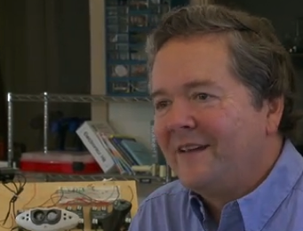
Maker
Movement
Dale Dougherty
Make Magazine
Maker Faire
  90,000 (SF)
  50,000 (NYC)

Slide 40
Historical Perspective
Donald Maley (1959)
“Where else in the school [other than the Industrial Arts Lab] is there the possibility for the application of math and science so closely resembling society outside of school”?

Slide 41
Future Directions
National / State integrative Frameworks
Articulated K-12 iSTEM Ed Curriculum
iSTEM Ed Specialists
Professional Development
Investigate iSTEM Ed learning
Rethink School Infrastructure

Slide 42
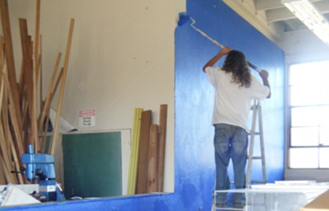
Makerspaces Project
1000 HS Makerspaces by 2015
Anyone care to apply?

Slide 43
Why do iSTEM Ed?
There’s a growing body of research that supports the integrative approaches to STEM Education
Because of it’s potential to get kids interested in / excited about STEM learning.

