Slide 1
Virginia Tech: Open Access Activities and Policy Development
Gail McMillan: gailmac@vt.edu
Director, Scholarly Communication, University Libraries
Virginia Polytechnic Institute and State University
Oct. 26, 2017
Notes:
[Virginia Tech’s approach to OA activities and their steps towards an OA Policy]
These sides were prepared for the Digital Science sponsored OA week webinar “Fostering OA: Drivers and Motivations,” Oct. 26, 2017. There were 90 participants.

Slide 2


“The discovery and dissemination of new knowledge are central to its mission.”
Notes:
To give some context: Virginia Tech is a public university, with 31,000 students and 1500 faculty. Its located, 2,000 ft. up in the Blue Ridge Mountains.
The university’s mission statement begins with a declaration that as “a public land-grant university [we serve] the Commonwealth of Virginia, the nation, and the world community. The discovery and dissemination of new knowledge are central to its mission.” https://www.president.vt.edu/about-the-office/mission-vision/index.html
As a public institution, any one may walk into the library and use its resources and services. Since the late 1980s the library has used this model for the digital resources we create. Our goal is to make publicly available both born digital, original materials created by the university community as well as the analog resources that we digitize

Slide 3
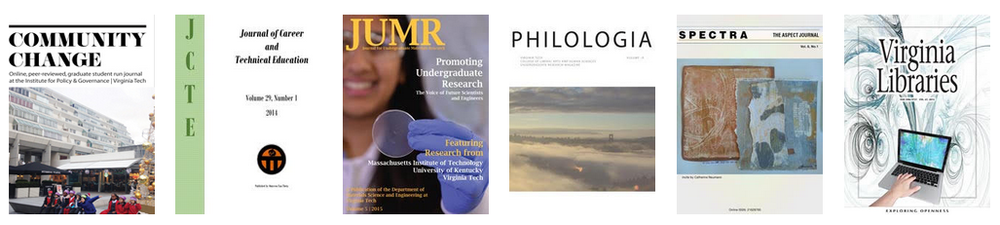
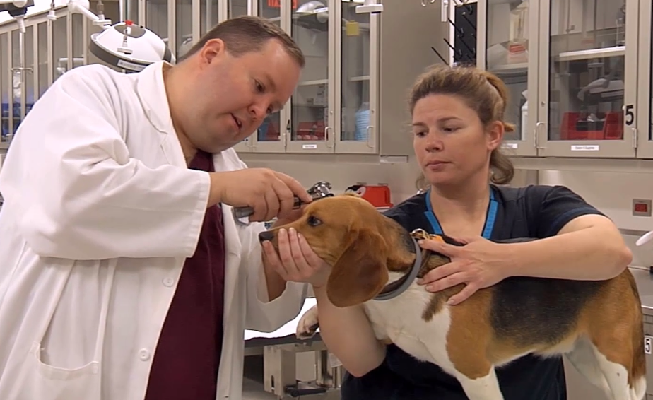

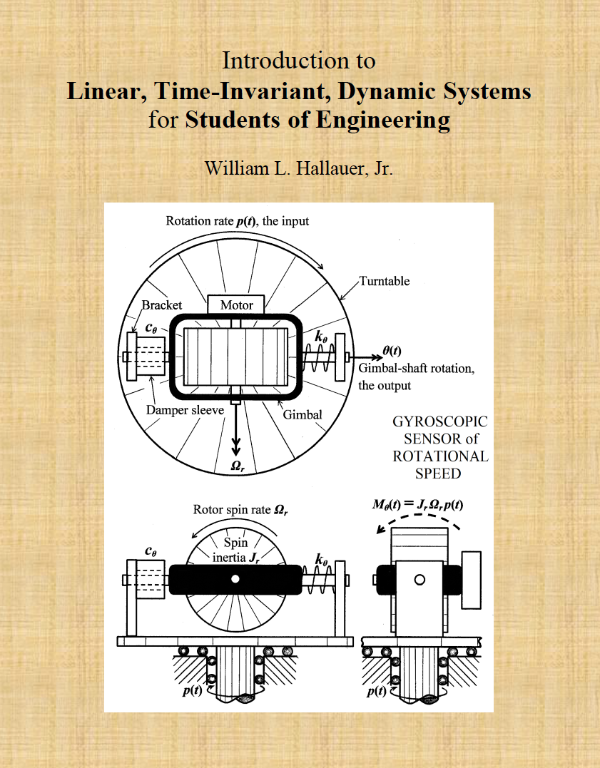
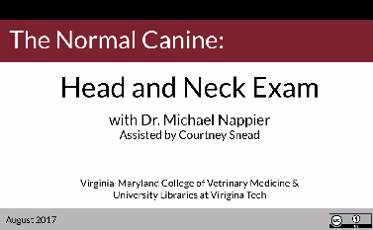
VT Libraries’ OA Activities: Publishing https://scholar.lib.vt.edu/ejournals/
https://guides.lib.vt.edu/oer/
Notes:
Since 1989 VT Libraries has published electronic journals. The top row shows 6 of over a dozen titles we currently publish. There are another 2 dozen OA journals archived. All but 2 are immediate OA, none are subscription-based. They are edited by our students and faculty but also by faculty at other universities.
At the bottom of this slide you see a two of the open text books that we published. Fundamentals of Business (pub’d in 2016) has had more than 34, 000 downloads. [Intro to Linear, etc… was pub’d last month after the author reclaimed his copyright and has had >1000 downloads.]
We have an OER incentive program called the Open Education Initiative Faculty Grant. It provides up to $3,000 each to four faculty who submit successful proposals outlining how they will create or adapt an open curricular resource. The first of these grants resulted in what you see at the bottom right, one in a series of Veterinary Medicine course videos. An electromagnetics open textbook will be released in Jan. 2018.

Slide 4
VT Libraries’ OA Activities: Subvention Funds
VT Open Access Monograph Publishing Initiative
12 American universities and AAU, ARL, AAUP
59 publishers
VT Open Access Subvention Fund
$150,000 fiscal year 2018 (data as of Oct. 17, 2017)
Notes:
We have subvention funds that support both OA books and journals.
To ensure that our faculty can continue to publish their books with quality presses, the Provost’s Office, in conjunction with the academic colleges and University Libraries, offers an Open Access Monograph Publishing Initiative. We are one of 12 universities participating in a program sponsored by the Association of American Universities (AAU), the Association of Research Libraries (ARL), and the Association of American University Presses (AAUP). The initiative is designed to advance the wide dissemination of scholarship by humanities and humanistic social sciences faculty by funding publishing in free, open access, digital editions of peer-reviewed and professionally edited monographs.
During the initial 5 years this program will support the publication of 3 monographs per year by providing publishing grants of $15,000 each. In return, the cooperating presses agree to publish an open access edition of each work with a Creative Commons license.
The VT Open Access Subvention Fund supports up to $1500 per article. To qualify, authors must not have other sources of funding, such as an active NSF or NIH grant. For hybrid OA journals, the publishers must have reduced institutional subscription prices, or plan to reduce prices next year, based on the number of open access articles in the journal. Not many qualify.
This subvention fund has grown each year since it began in 2013 with $24,000. In the first year we received 28 requests and supported 21 articles. Last year we received 110 requests and supported 80 articles with a $100,000 budget. This year is our budget is $150,000; we have received 45 requests in less than 4 months [funded 31, 69%].

Slide 5

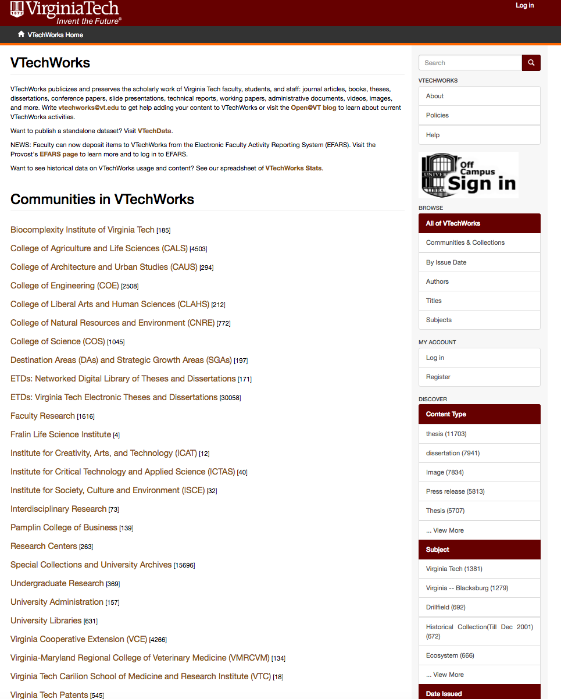
Notes:
In 2011 we created a DSpace OA repository and named it VTechWorks. It has 63,000 items comprised largely of research and scholarship generated by members of the university community.
VTechWorks has grown through several automated systems. For example,
Faculty uploaded over 1200 articles last year using the link from Symplectic Elements Electronic Faculty Activity Reporting System (EFARS).
With SWORD protocol we have ingested 800 VT-authored articles from BioMed Central, MDPI, and Hindawi.
We harvested more than 500 US patents by Virginia Tech inventors using a script written one of our undergraduate students, which is now available as Patent-Harvest on GitHub.
And, of course, ETDs. Since 1997 students have been required to submit Electronic Theses and Dissertations online to the Graduate School and after approval they are automatically added into VTechWorks. [There are about 30,000 ETDs though that includes some scanned TDs also.] All will be publicly available though students have the option to limit access or embargo for one year.
Our manual procedures include
Asking authors who receive subvention fund support to deposit their articles but when they don’t a staff member locates and uploads them.
Students from the Computer Science Department deposit their technical reports.
And, the library has scanned or harvested from the VT web over 4000 publications from the Virginia Cooperative Extension[, which produces public resources by Virginia's land-grant universities]

Slide 6
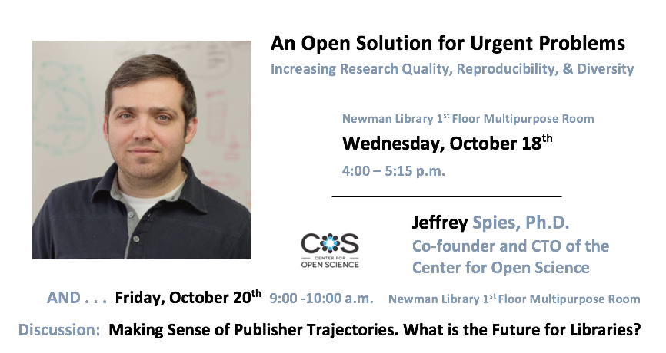

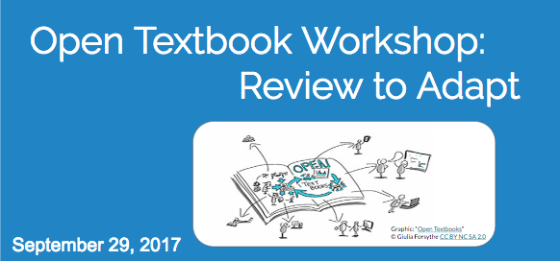

Open@VT
Notes:
These fliers and banners represent some of the OA events that the library typically organizes each year.
University participation varies. The OA Week Forum is well attended and the OA speaker can be a draw since we began sponsoring keynotes with the academic colleges.
For OpenCon the library and the Graduate School sponsor two graduate students to attend when it’s in the US and one when it is outside the US.
[There are many more library initiatives generating OA interest and resources.
Digital Humanities is a growing area. Special Collections provides open scholarship beyond the general IR with an Omeka interface.]

Slide 7
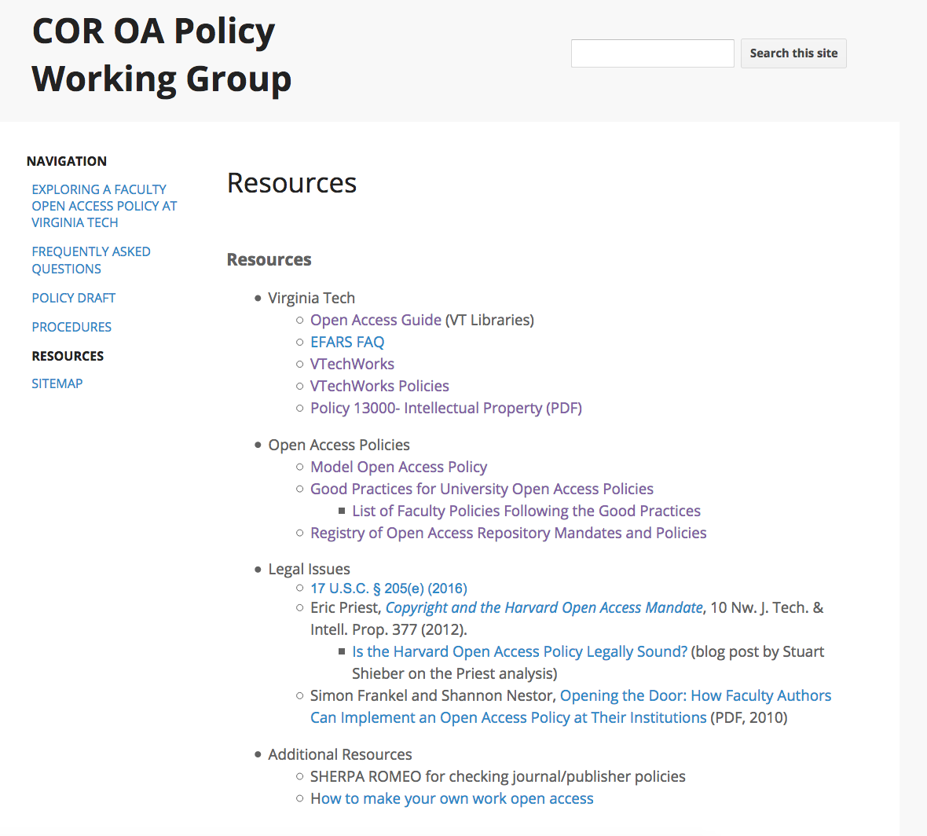
VT OA Policy https://sites.google.com/a/vt.edu/cor-oa-policy-working-group/
Notes:
Lastly, while the library adopted an OA policy in 2013, just last November the university’s Commission on Research created a faculty working group to explore options for a university-wide open access policy. After discussing and researching, talking to Peter Suber and University Counsel, anticipating FAQs, and developing a web site, our working group drafted a policy based on the Harvard model [which says OA is a mandate but no one is policing and opting out is easy]. Last spring we began outreach and will continue until we feel the time is right to suggest a resolution and vote by the Faculty Senate, which the Commission on Research could take forward.

Slide 8
Virginia Tech: Open Access Activities and Policy Development
Gail McMillan: gailmac@vt.edu
Director, Scholarly Communication, University Libraries
Virginia Polytechnic Institute and State University
Oct. 26, 2017
Notes:
That’s a quick view of many of the OA activities at Virginia Tech. We have also financially supported OA initiatives such as Knowledge Unlatched and Open Library of the Humanities.
But I’d like to conclude with a note that we have done these with ad hoc funding, largely from our Collections Budget and some from my department budget. We have just begun to discuss how to be more strategic about funding our OA activities.
We’re very interested in the “2.5% Commitment” proposal put forward by David Lewis, dean of the library at Indiana and Perdue Universities (http://hdl.handle.net/1805/14063). Also, VT is a member of the Association of Southeastern Research Libraries, which has begun a discussion based on Roger Schonfeld‘s Ithaka S+R report, “Red Light, Green Light: Aligning the Library to Support Licensing.“
That‘s it. Thank you.

