Slide 1
Crisis Events Digital Library
Chase Dillard
Jake Sundstrom
Thomas Moore
Tristan Coates
Alejandro Martinez
CS 4624, Multimedia/Hypertext, Instructor: Mohamed Farag
Virginia Tech, Blacksburg VA 24061
4/29/25

Slide 2
Outline
Review
Work Completed
Requirements
Deliverables
System Architecture
Database Schema
Timeline
What We’d do Differently
Demo
Future Enhancements
Acknowledgements
References

Slide 3
Review
Purpose:
To create a digital library to manage and view different crisis events
Features:
Login and Logout
Adding Crisis events
Comparing and Categorizing Crisis events

Slide 4
Work Completed
Web Pages for all planned pages
Registration, login, and logout functionality
Functionality to add events
Set up the Database
Registration
Event Pages
Event Comparison
Notes:
The purpose of this project is to build a comprehensive website that contains detailed information about crisis events in the United States. The website acts as a digital library of objects, where each object represents a crisis event. The system will store for each event, what happened where, when, how, why, and any other important details. Another feature that this application will provide is the visualization and comparison of different events.

Slide 5
Requirements
Recents Page
Collection Comparisons
Authentication
Text Classification
Notes:
Our project requirements include:
A recents page that allows users to view the most recently created and visited crisis events.
A collection comparisons page that allows the user to compare crisis events that are classified as the same or similar events.
Authentication which includes: Registration, logging in, and seeing information about events and collections of events specific to a single authenticated user.
Text classification that will be used to fill out event metadata and populate event details

Slide 6
Deliverables
Website that takes in web pages and generates a corresponding digital library
Source code
User manual
Developer manual
Notes:
Deliverables: A website that takes a set of webpages about a crisis event as input and generates the corresponding digital library. Also the source code, user manual, and developer manual.

Slide 7
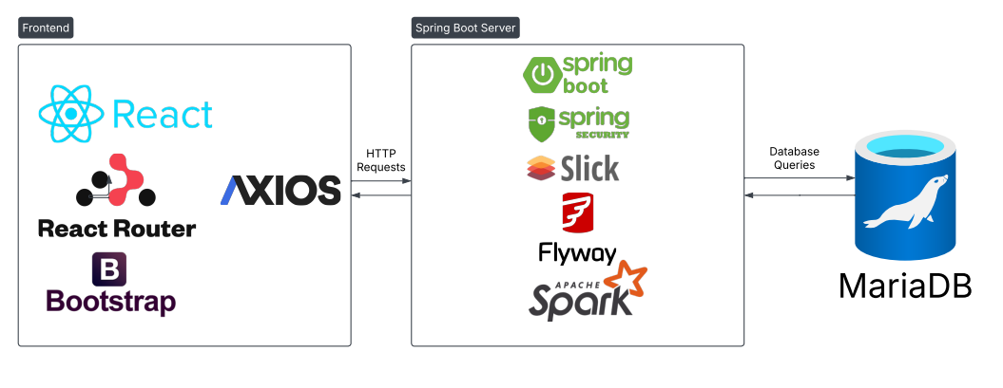
System Architecture
Notes:
Our system architecture remained consistent with presentation 1. However, we did not make it to implementing text classification. If we were to continue working on this project, we would still use Apache Spark in order to do so.

Slide 8
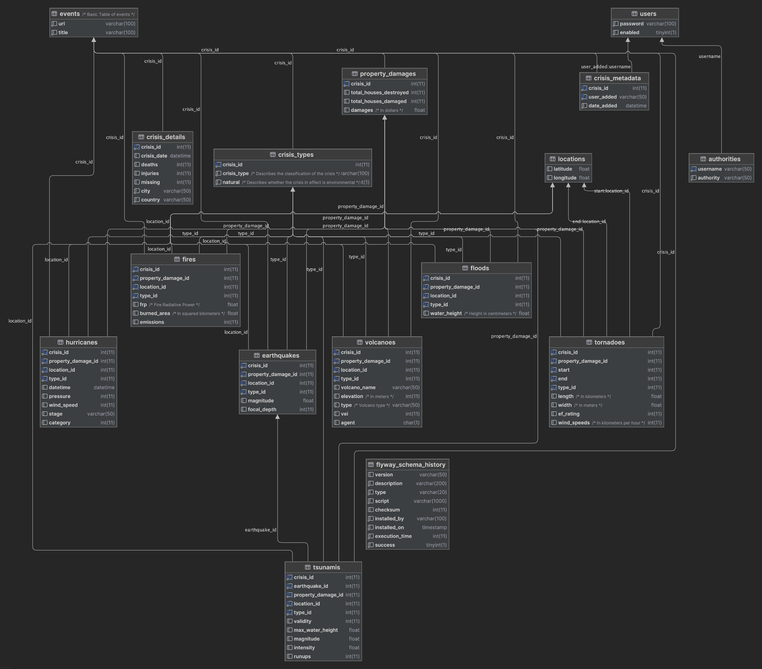
Database Schema

Slide 9
Timeline
Ability to parse URLs for content
Basic Event Info displayed on frontend
Event Search Functionality
4/04
5/02
4/18
Application can generate a web page for each event in database
User Manual is up to date
Event Comparison Fully Implemented

Slide 10
What We’d do Differently
Clarify more project goals and expectation upfront
Better and more frequent documentation
More written communication
Improve task delegation

Slide 11
Demo

Slide 12
Future Enhancements
Text Classification
Update Record Functionality
Better Visuals
Optimized API calls
Event Images
More Event Information
More User Roles

Slide 13

Acknowledgements
Our Client, Mohamed Farag
Research Associate in the Center for Sustainable Mobility
Received Ph.D. in computer science from Virginia Tech in 2016
Received M.Sc. degree in computer science from the Arab Academy for Science, Technology, and Maritime Transport (AAST) in Alexandria, Egypt, in 2010

Slide 14
References
Mohamed Farag | Virginia Tech Transportation Institute. (n.d.). https://www.vtti.vt.edu/staffdir/bio.php?&pn=04208

