Slide 1
Treeviz
By Conner Caprio, Moira Pelton, Austin Zensen
Dr. Fox: CS4624 Multimedia , Hypertext, and Information Access
Virginia Tech Blacksburg VA 24061
5/2/2019

Slide 2

Outline
Project Overview Recap
Project Walkthrough
Project Completed
Deep Dive
End of Semester Timeline Comparison
Lessons Learned
Future Work
Acknowledgements
Notes:
Use case walkthrough is essentially walking through like a student would by going to code workout / opendsa and finding the exercise we wrote code for

Slide 3
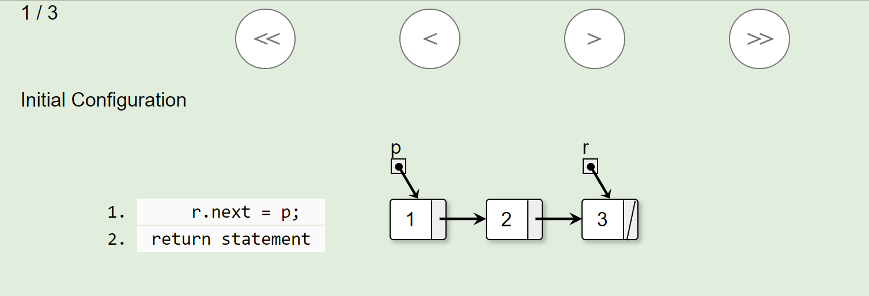
Brief Overview
Create visualization of student code from CodeWorkout exercises to help students find bugs more easily and increase understanding of data structures
Notes:
Lets get rid of this now that we have stuff with only the trees

Slide 4
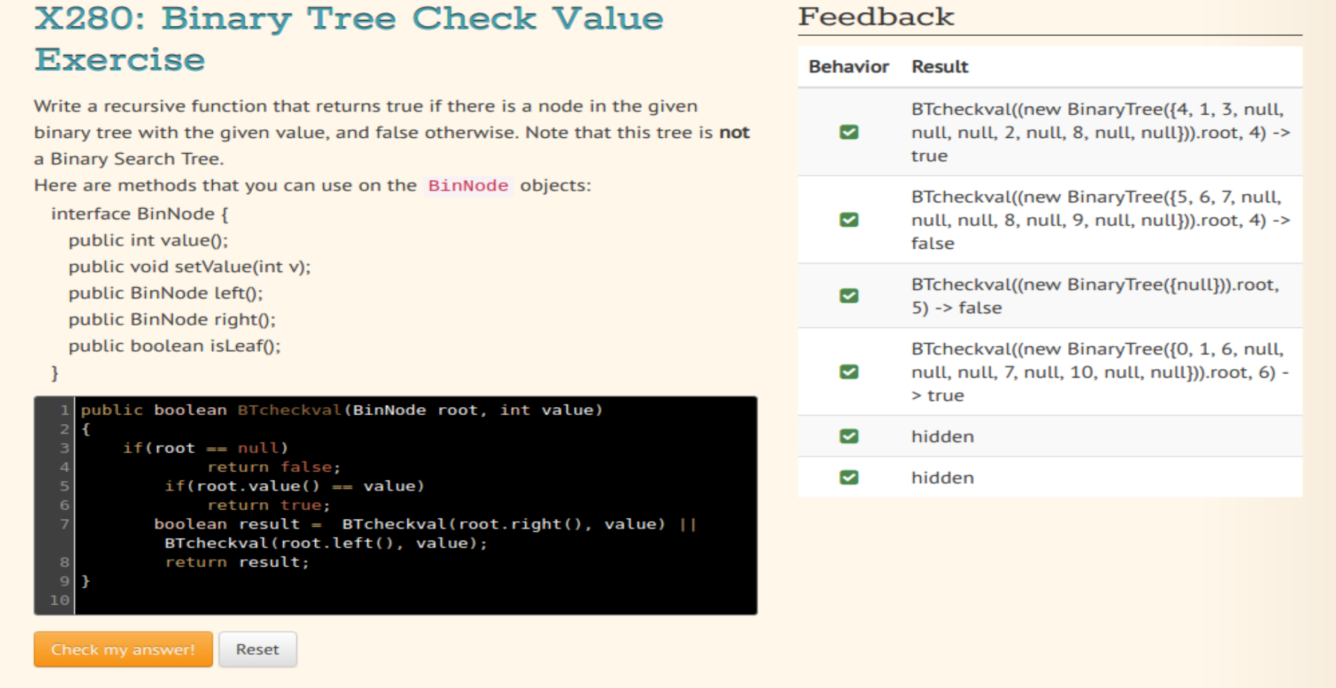
Project Walkthrough
https://opendsa-server.cs.vt.edu/ODSA/Books/Everything/html/BinaryTreeInfFlw.html
Notes:
65% of people are visual learners
http://www.phschool.com/eteach/social_studies/2003_05/essay.html

Slide 5
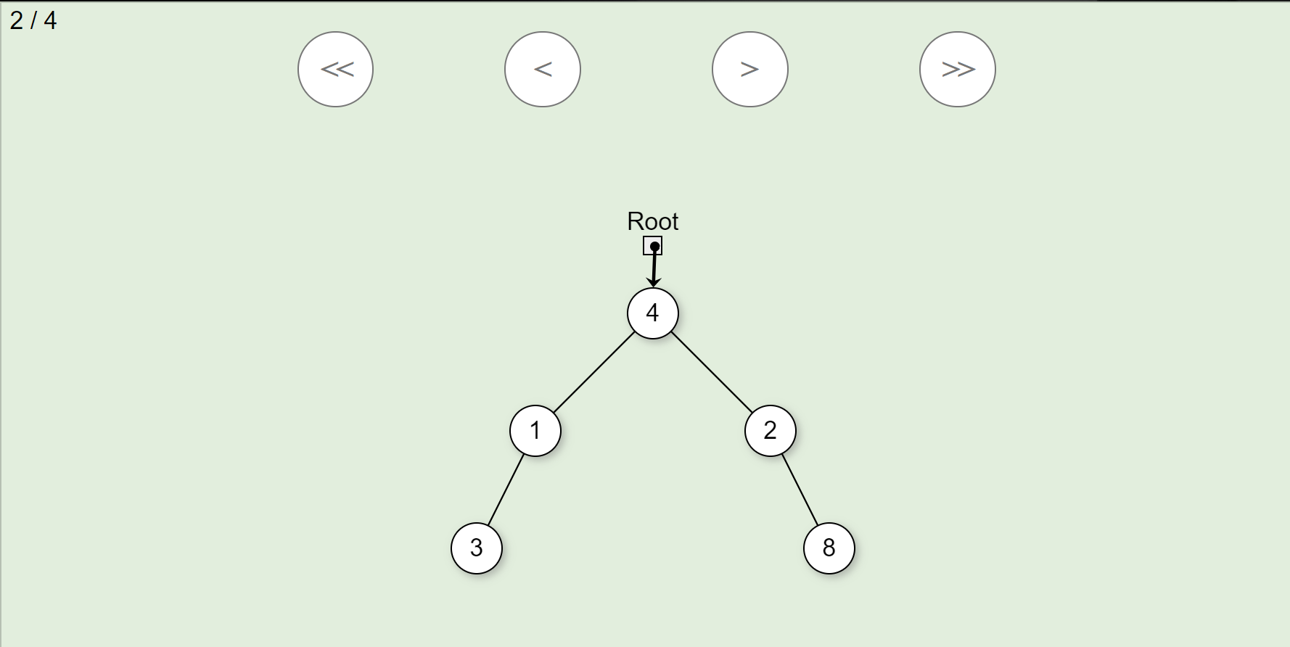
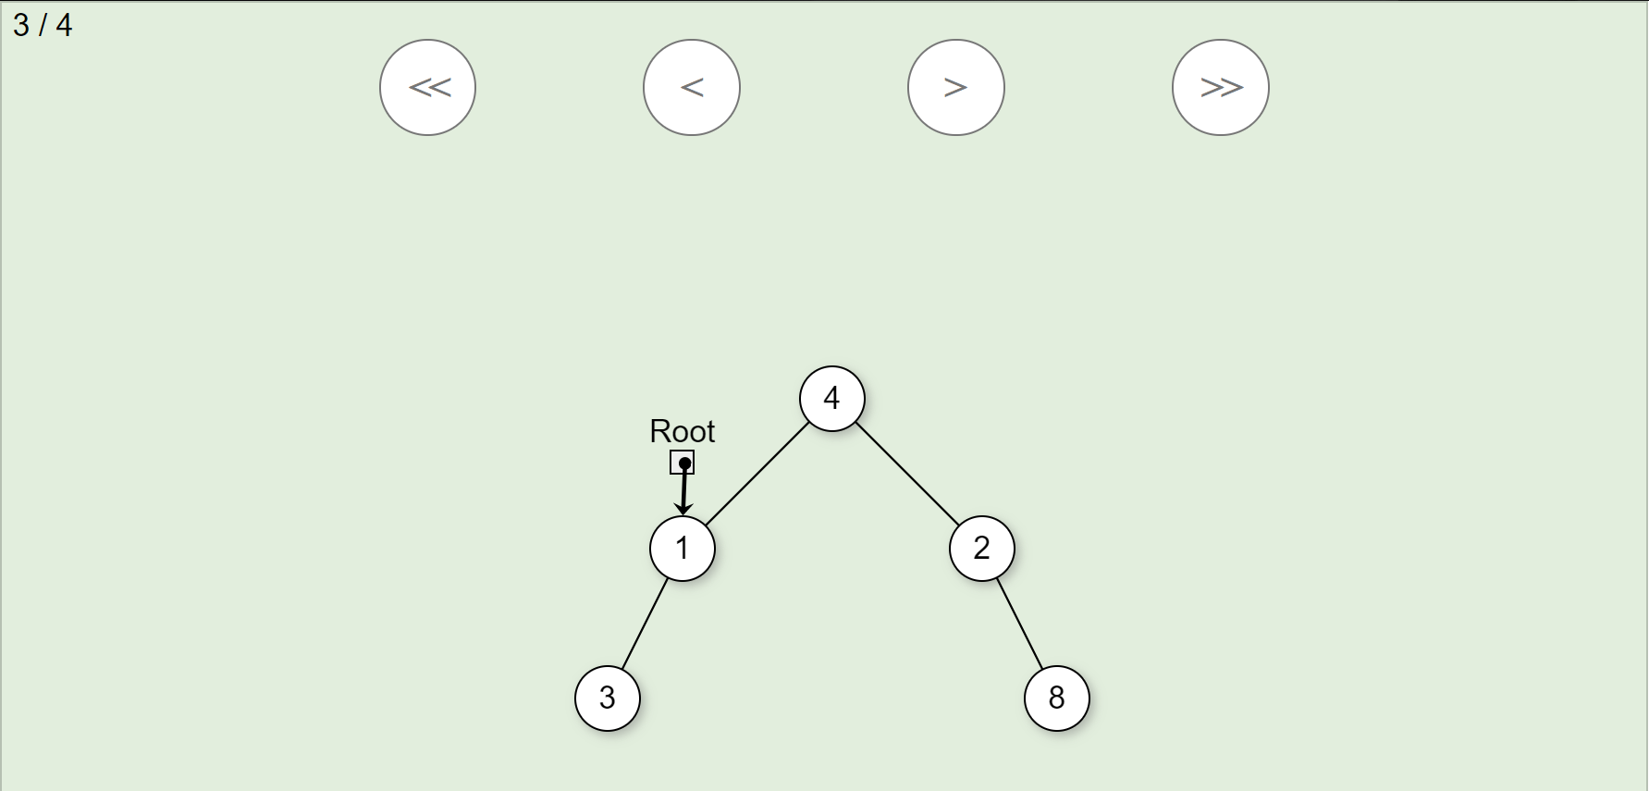
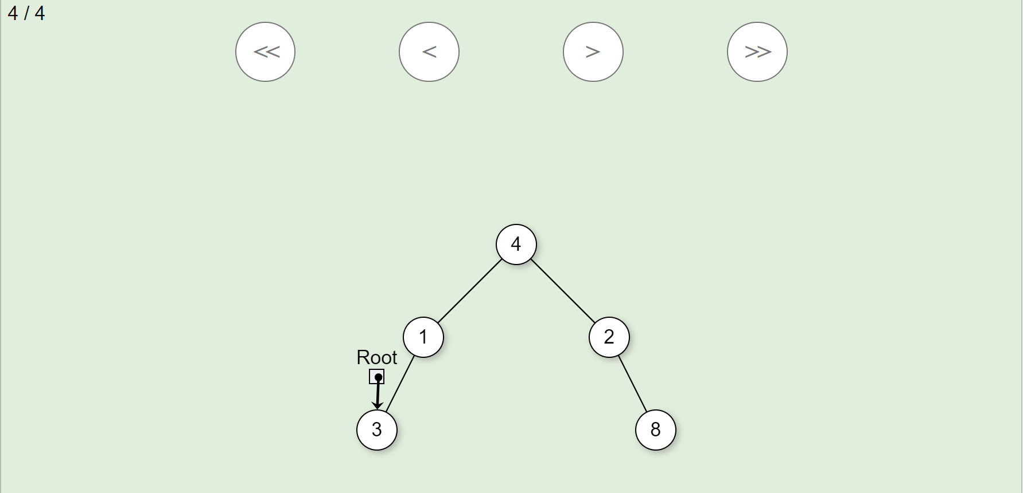
Project Walkthrough (cont.)
Pointing to root node, value of 4
Pointing to first left child, value 1
Pointing to second left child, value 3

Slide 6
Completed Project Work
Implemented binary tree visualizations
All code is compatible with existing code
Used JSAV library to visualize binary tree
Included JSAV pointers to show recursive value checking
Notes:
Instead of progress only have completed so it doesnt seem like theres still work done and then we’ll compare it to what should have been done at this point in time on our timeline

Slide 7
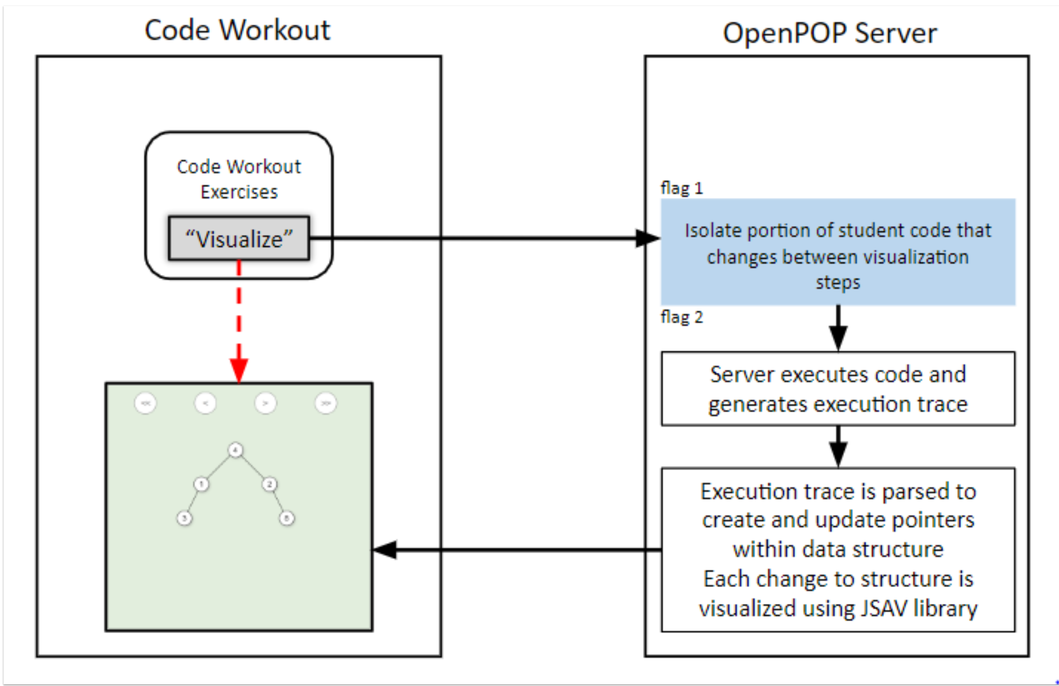
Quick Deep Dive
System Diagram of interaction between CodeWorkout and OpenPOP Server (OPEN Pointer OPerations)
Notes:
Dive into how the code travels and whatnot.

Slide 8
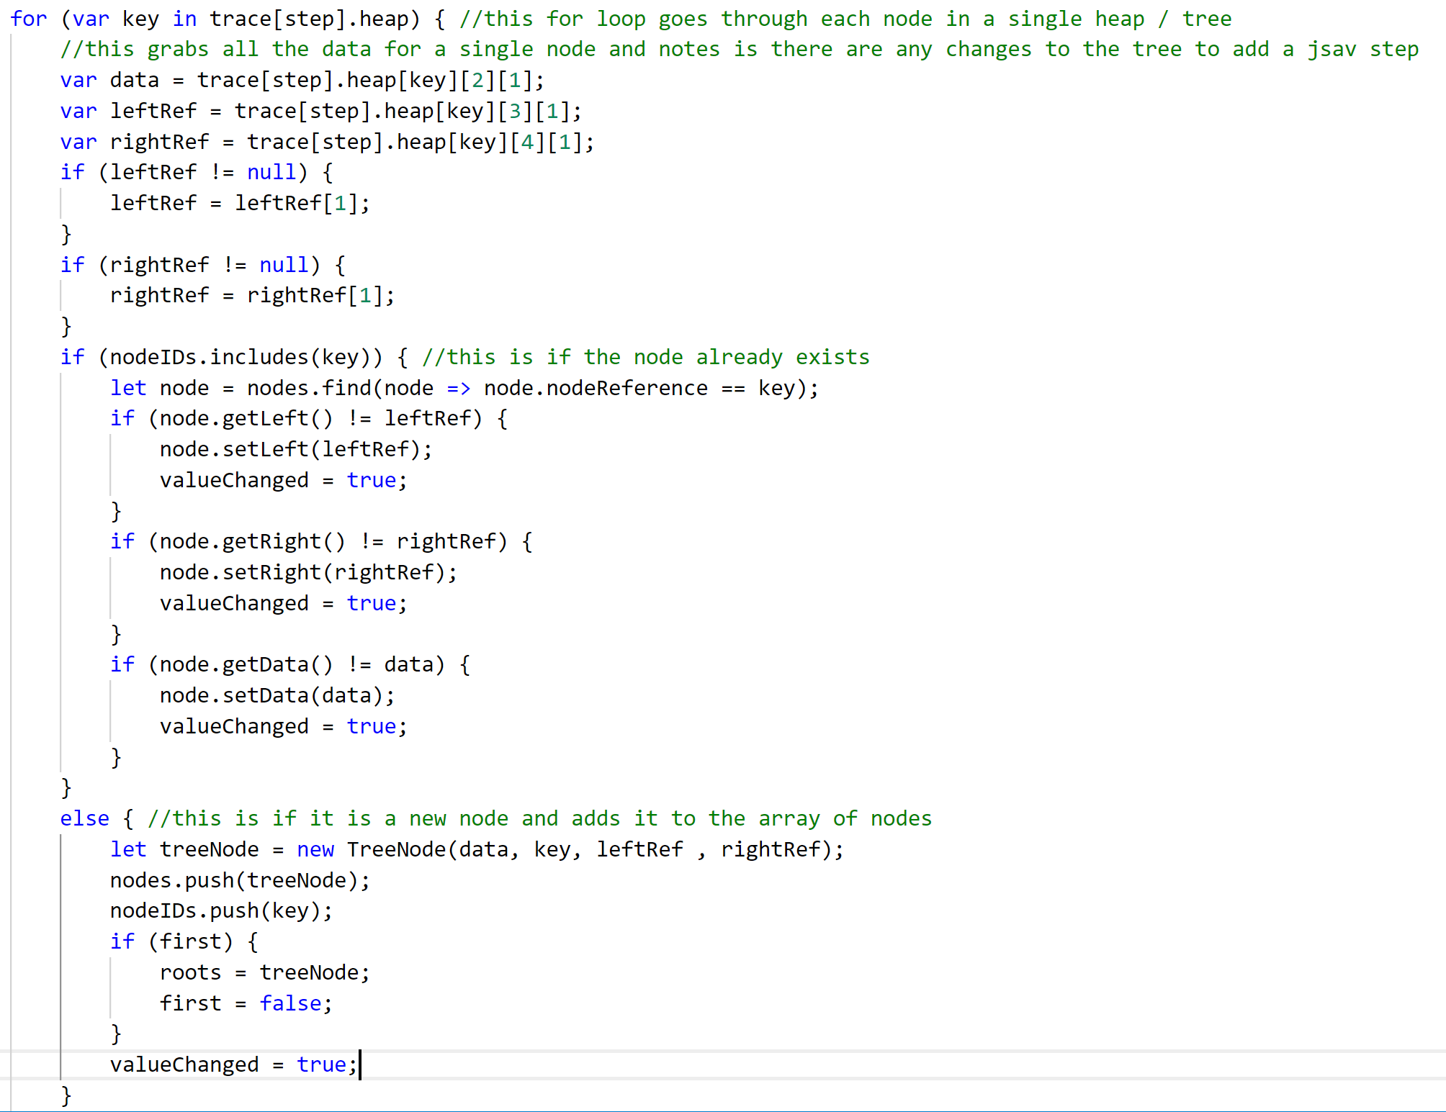
Grabs all data for a single node
Checks if any values have changed if the node already existed
Adds the node to an array of nodes if it doesn’t already exist
Notes:
Update all this shit

Slide 9
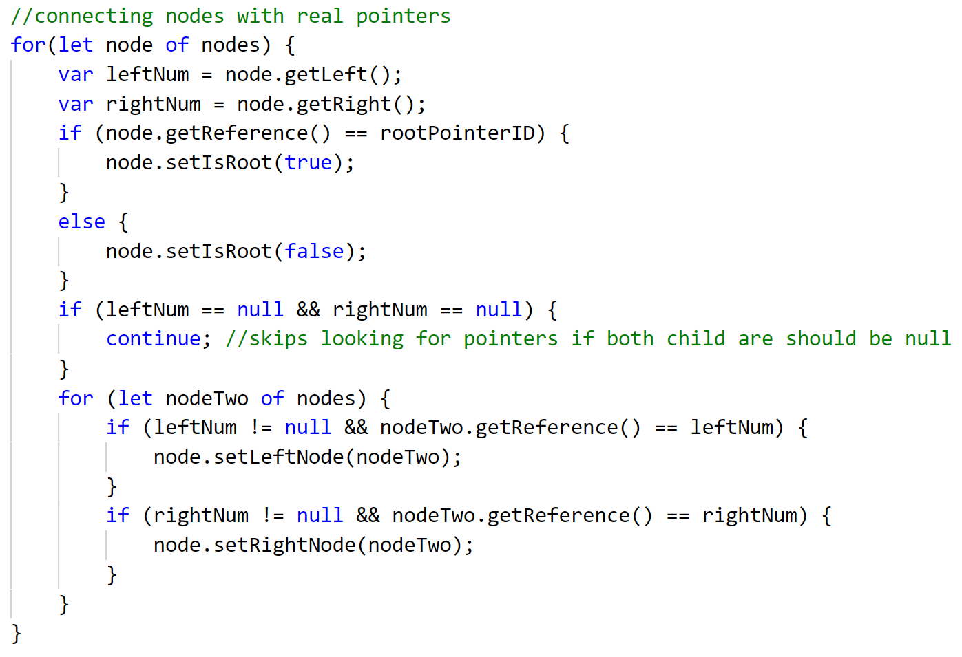
Goes through all nodes and sets their child nodes with pointers to tree node objects
Notes:
Need new pics of the code

Slide 10
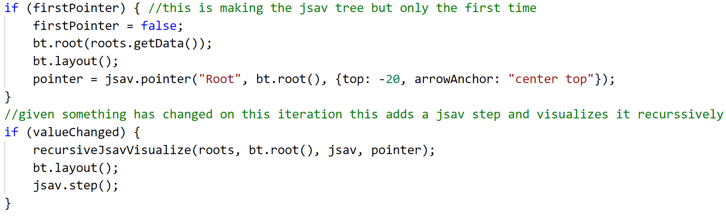
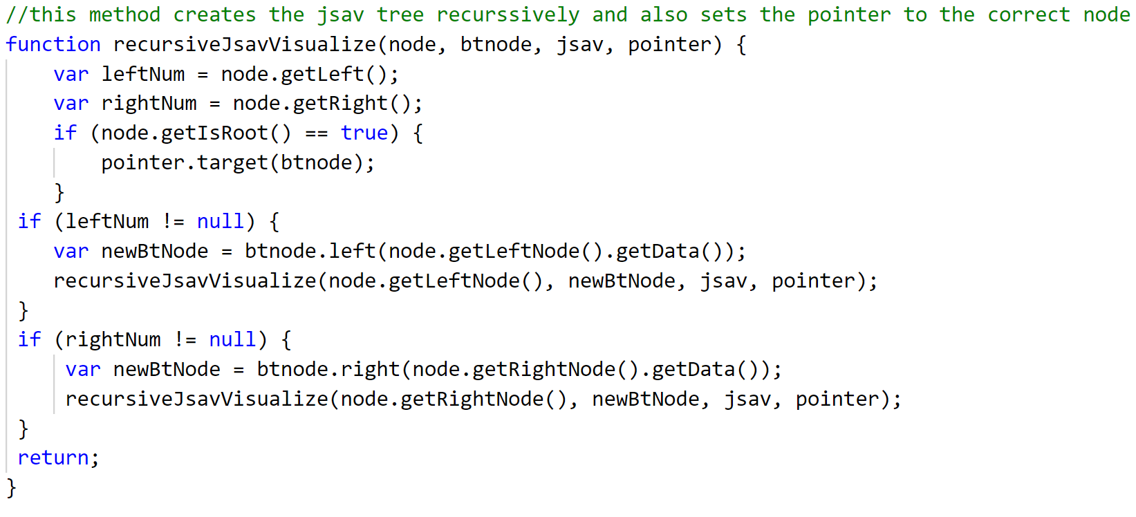
Creates JSAV binary tree, pointer to the root, and sets first visualization step
Makes the tree recursively for the JSAV object

Slide 11

Project Timeline
Create tree from trace
Write code for basic tree visualization
Visualize multiple steps of students code
User Testing
Notes:
No testing bc we didnt have access to server so we could only work with code that we knew was correct.

Slide 12

Lessons Learned
Constant communication with client will help project stay on deadline
Having Windows vs. Linux made the project more difficult
The JSAV api is very easy to work with when visualizing data structures
Analyzing binary tree data from a stack trace introduces timing errors when creating nodes
Notes:
Update this to challenges throughout the whole semester

Slide 13

Future Work
Implement project work in all OpenDSA Tree exercises
Expand project to include other data structures
Hash table
M-nary tree
Optimize current code
Notes:
This will be future work so like if new students were to work on this

Slide 14



Acknowledgements
Mostafa Mohammed
PHD Student @ VT
Dr. Cliff Shaffer
CS Professor @ VT
OpenDSA
CodeWorkout
Notes:
Add in the new acknowledgements like doc. shaffer

Slide 15

Questions?
Notes:
Perfect lol

