Slide 1
DLA Library Audio Collection
Robert Kania & Luke Gusukuma
3/21/2012
Virginia Tech
CS 4624

Slide 2
Overview
Background
Original Idea
New Plan
Roadblocks
Our Progress
Current System Proposal

Slide 3
Background
Audio files dating to 1994
Metadata mapped from recital sheets

Slide 4
Original Idea
Audio Conversion
Metadata Extraction
Streaming?

Slide 5
Plans Change.
But….

Slide 6
New Plan
Metadata Extraction
Just Streaming
Security/Legal issues
Runs on mobile devices
Audio Conversion

Slide 7

Roadblocks
Change of plans
Unnecessary research
HTML5

Slide 8
Our Progress
COMPLETED
Client Meetings
Initial Research
Possible Solution
Talked to VBS
Researched HTML5
Michael Dunston
URL Hashing
HTTP Live Streaming
Kaltura
Keith Gilbertson
Upcoming
Implement Possible Solution
Test
Present Solution to Client
Notes:
Client will need to customize our idea as well to integrate with their current system.

Slide 9
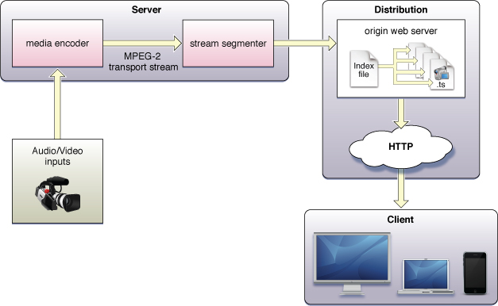
Current System Proposal
Our
Transfer Audio Files
Library Server

Slide 10
Questions/Comments?

