Slide 1

Open Educational Resources:
A Quick Overview for Teachers
Created for the WAMS Biocybersecurity Design Summit~ February 12, 2022
Anita Walz, Associate Professor,
Assistant Director of Open Education and Scholarly Communication Librarian,
University Libraries at Virginia Tech
Archived at http://hdl.handle.net/10919/112264
Template and VT logos are property of Virginia Tech and not subject to the open license.
Notes:
Objectives:
What are open educational resources?
Characteristics and examples of…

Slide 2

What are open educational resources (OER)?
https://pixabay.com/illustrations/question-question-mark-response-1015308/
Notes:
Discussion

Slide 3
What are open educational resources (OER)?
Free (to anyone)
Permission given for
customization
Any format or medium

Slide 4
Open Educational Resources (OER) are freely and publicly available teaching, learning, and research resources that reside in the public domain or have been released under an intellectual property license that permits their free use, reuse, modification, and sharing with others.
They include full courses, course materials, modules, textbooks, streaming videos, tests, software, and any other tools, materials, or techniques used to support access to knowledge." - Hewlett Foundation (adapted)

Slide 5
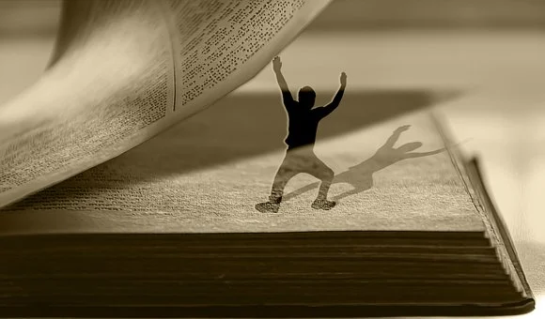
Wait … why is this important?
Photo source: Pixabay
Notes:
This is important because you might want to reuse something that YOU did not create and which you do not own.

Slide 6

Photo source: Pixabay
Notes:
There is a problem. There are barriers to freely using and sharing.

Slide 7
COPYRIGHT -- a barrier to broad sharing
Works are AUTOMATICALLY under copyright -- event when a © is not added
Copyright lasts life + 70 years
Ok to use in your classroom
≠ fair to share more broadly
Notes:
A brief overview of U.S. Copyright.

Slide 8

Sharing with people you already know
https://pixabay.com/photos/thumb-favorite-hand-arm-handle-422147/
Notes:
We already share with people we know, and we often tell them “it’s ok to make this your own and use it.”

Slide 9
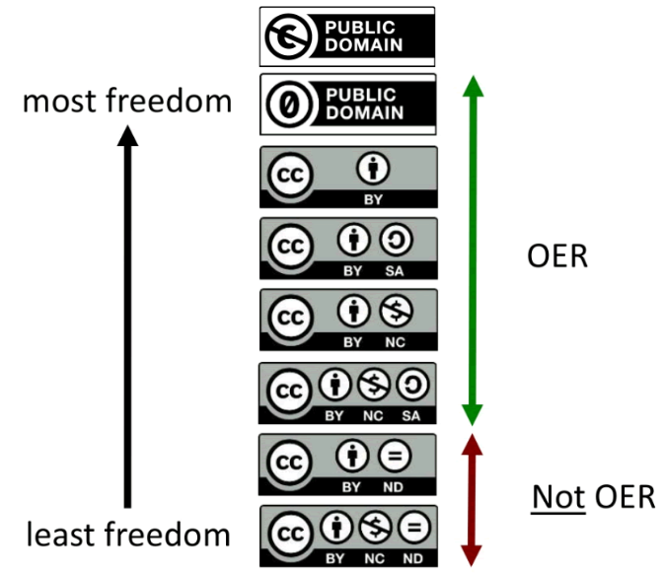

Sharing beyond people you already know
6 minute video: https://youtu.be/io3BrAQl3so
Unpacking Creative Commons licenses: http://hdl.handle.net/10919/64276
Additional reading: https://guides.lib.vt.edu/oer/cc
Notes:
But sharing beyond people we already know requires something different. We need to communicate up front what we want people to be able to do with our work . . . Creative Commons licenses allow us to do that!

Slide 10

Find materials you can customize and share
With CC-licenses, permission is already granted!
Photo source: Pixabay
Notes:
Because others’ have already shared and granted permission up front using Creative Commons licenses.

Slide 11
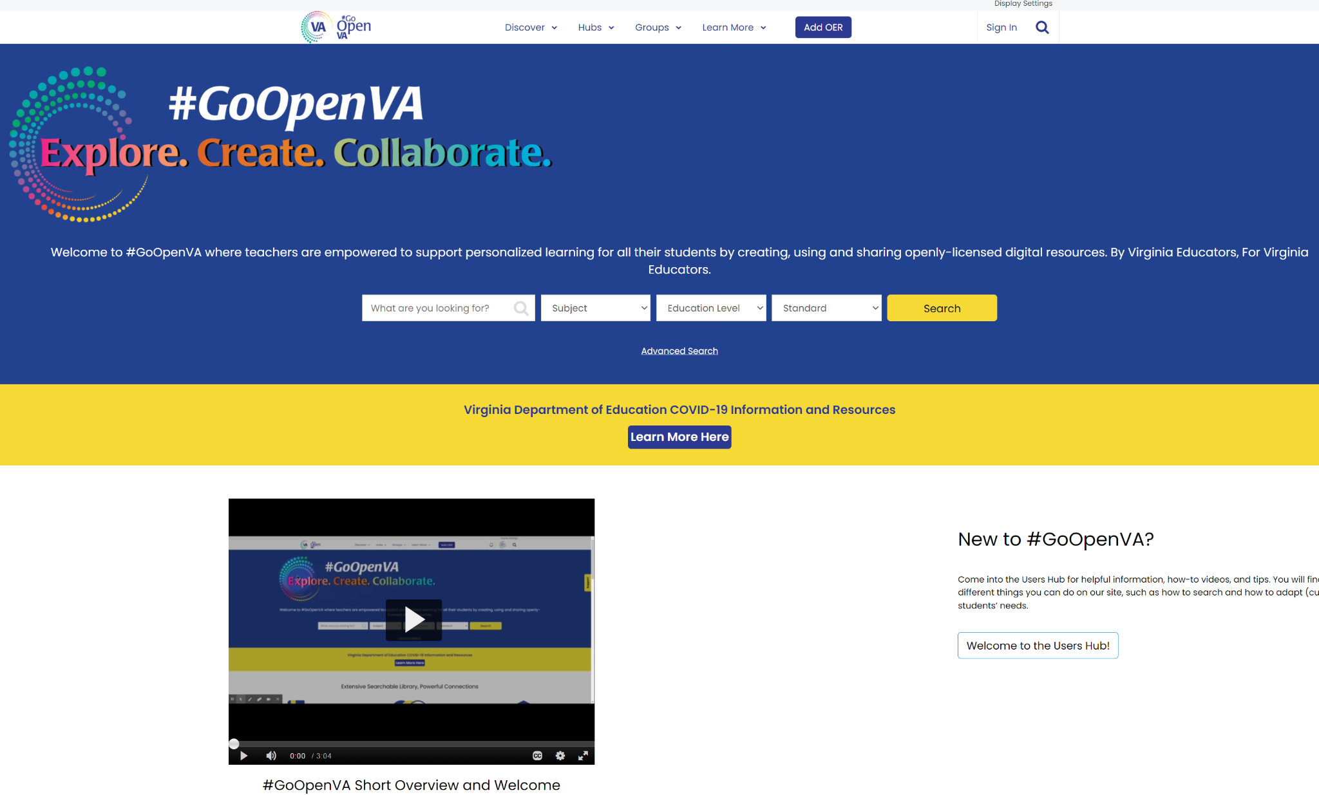
https://goopenva.org (PreK-12 focus) funded by VA Dept of Education
For higher ed, see: https://vivaopen.oercommons.org (curated for Virginia) and
OERCommons https://www.oercommons.org (all levels, all locations)
Notes:
For this project, we are proposing that content be put in a place where Virginia educators are already looking for it. Later in the project, it will be added to the national-level OER Commons site where people beyond Virginia educators can find it.

Slide 12
Find + Evaluate
Can I use this? (Is this OER?)
Free to use
Has an open license (or free of copyright/in the Public Domain)
Does this fit my needs (or am I distracted by the pretty format?)
Who is the target audience for this?
Is it accessible for persons with disabilities?
Is it easy to customize?
Must I (and how) give credit if I use this in my work?
Example 1: https://www.oercommons.org/courses/california-foundation-for-agriculture/view
Example 2: https://www.oercommons.org/authoring/61359-the-egg-cellent-egg-launch
Example 3: Images https://www.google.com/advanced_image_search
Example 4: The High-Tech Vertical Farmer (YouTube) https://www.youtube.com/watch?v=AGcYApKfHuY
Or https://youtu.be/PzJLO-OsEJo?t=591
Use + Mark
Evaluation rubrics from Achieve: https://www.achieve.org/publications/achieve-oer-rubrics
See images you can use at: https://guides.lib.vt.edu/oer/images
Best practices for attribution of Creative Commons licensed works https://wiki.creativecommons.org/wiki/Best_practices_for_attribution
Notes:
Let’s practice.
1. Is THIS OER? How do I know?
2. Does this fit my needs?
3. If I am permitted to use it, how do I give credit?

Slide 13
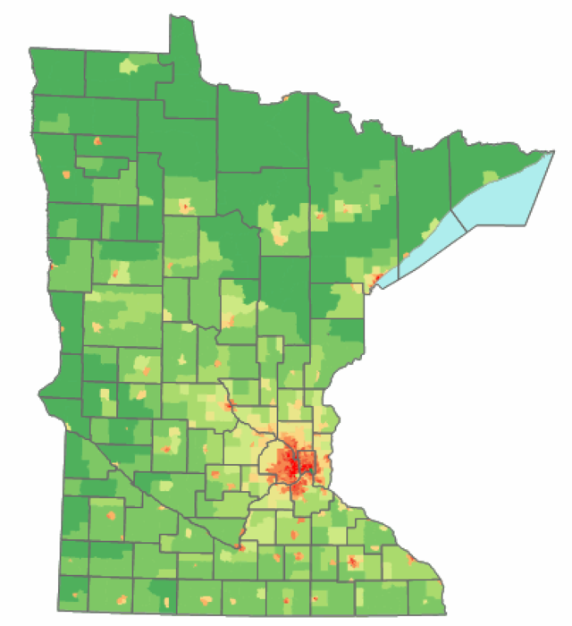
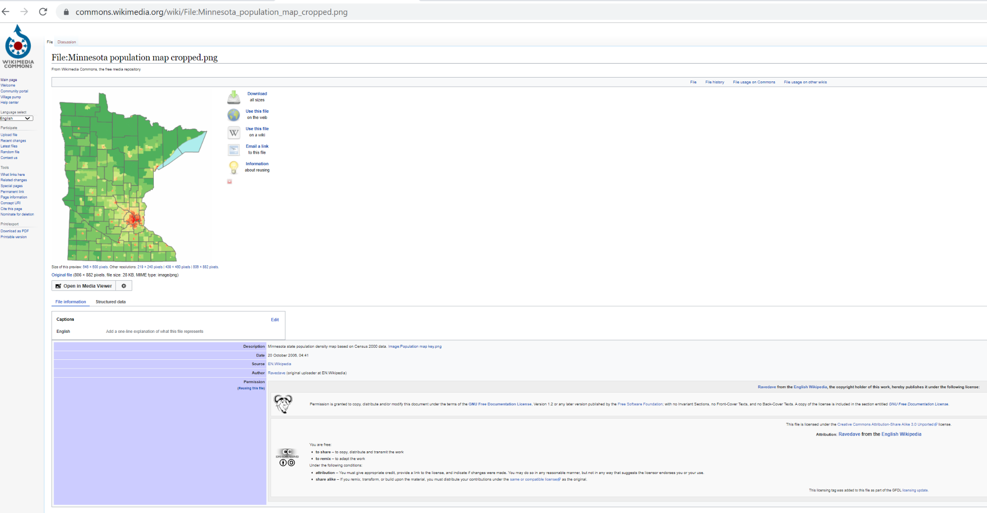
MN population map cropped © Ravedave CC BY SA 3.0 https://commons.wikimedia.org/wiki/File:Minnesota_population_map_cropped.png
Notes:
An example

Slide 14
Thank you and discussion
Anita Walz arwalz@vt.edu

