Slide 1

Understanding Model Uncertainty—An Application of Uncertainty Quantification to Wind Energy
Larry Berg¹, Ben Yang^{1,2}, Yun Qian¹, Po-Lun Ma¹, Sonia Wharton³,
Vera Bulaevskaya³, Huiping Yan¹, and Will Shaw¹
¹Pacific Norwest National Laboratory
²School of Atmospheric Sciences, Nanjing University
³Lawerence Livermore National Laboratory

Slide 2
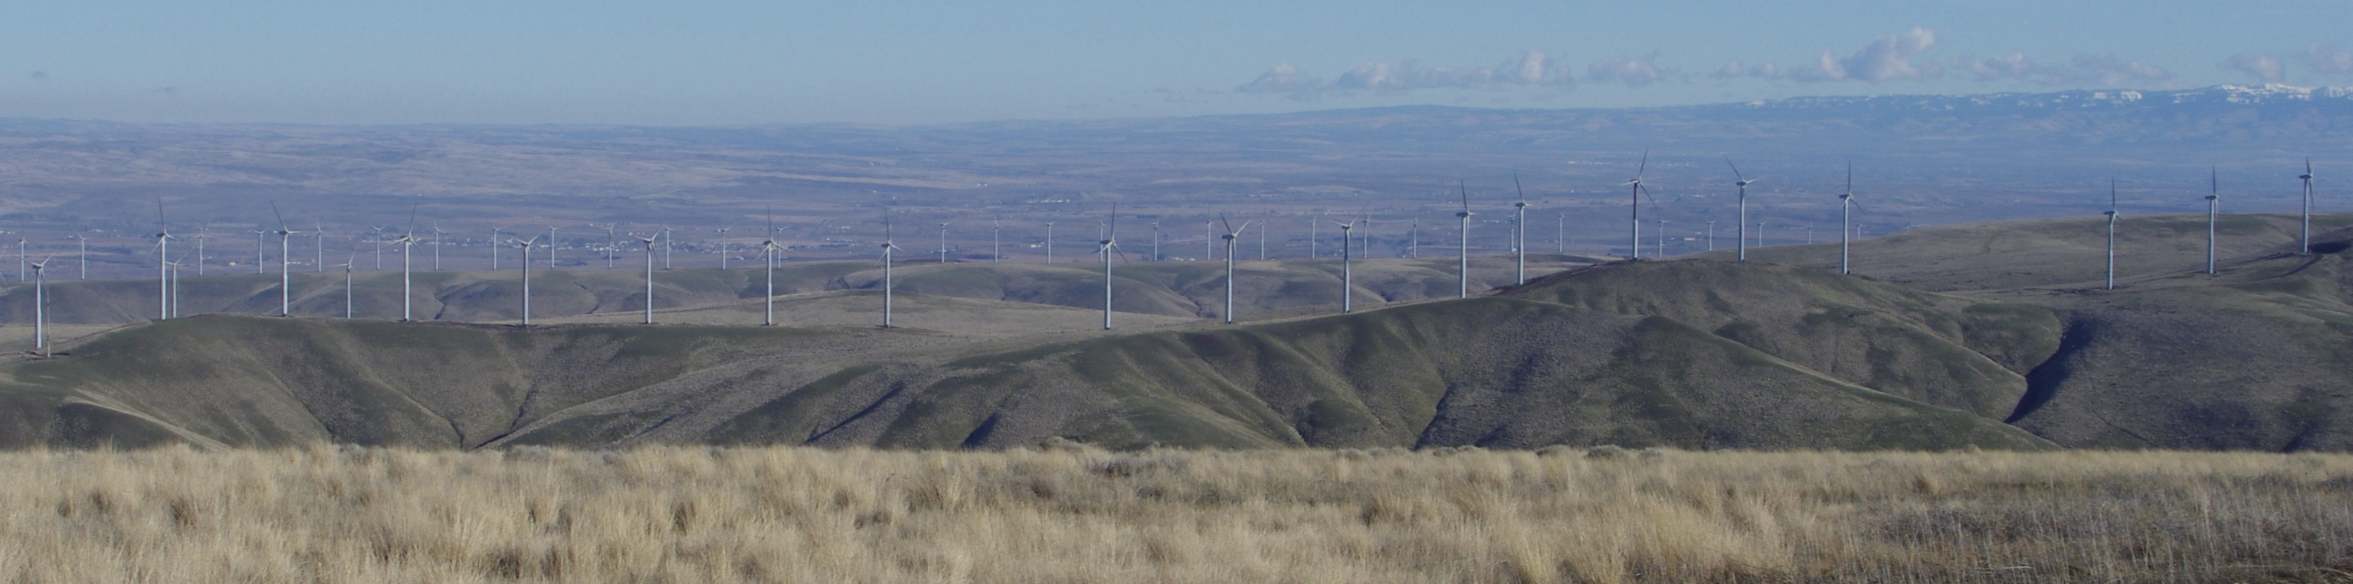
Motivation
US Department of Energy (DOE) is planning a second Wind Forecast Improvement Project (WFIP2)
Focused on improving simulations of wind and power in areas of complex terrain via improvements in model physics
A wide range of measurements are possible
  What are the key parameters within the surface and boundary-layer parameterizations?
Use Uncertainty Quantification (UQ) to identify important parameters
  Effort focused on what is going on “under the hood”, not combinations of different physics packages
Notes:
MYNN=Mellor-Yamada-Nakanishi-Niino

Slide 3
What is Uncertainty Quantification?
Parameterizations in atmospheric models include a large number of assumed parameters
  How sensitive are our results to these values or their functional form?
  Example from MYNN PBL scheme (for calculation of momentum flux)
Systematic approach to determine the model sensitivity to a wide number of parameters
  A smarter way than varying one parameter at a time
Length Scale
Stability Function
TKE

Slide 4
UQ Methodology
Selected MYNN PBL scheme (e.g. Nakanishi and Niino 2009) and Revised YSU Surface Layer (Jiménez et al. 2012) scheme
  Widely used in research applications and by industry scientists
  Identified 26 parameters
Defined range of values
  Based on literature or scientific intuition
  Checks to make sure ranges stay realistic—some parameters depend on others in complicated ways
Run simulations using a wide range of values
  Select values in a smart way (via quasi-Monte Carlo sampling) to explore parameter space and limit the number of simulations required
  Simulations completed for a single month (May)
Construct Generalized Linear Model (GLM) based on full simulations for statistical analysis

Slide 5
Experimental design
Revised YSU SFC scheme
14 parameters: z_{o}, K, Monin-Obukhov stability functions
MYNN PBL scheme
12 parameters: TKE dissipation rate, TKE diffusion, Pr number, closure constants, length scales
Quasi-Monte Carlo (QMC)—Determine parameter values to use in WRF simulations
WRF parent simulations at 10-km resolution (with nudging)
256 sets of simulations: WRF @ 3.3 km resolution
Generalized linear model (GLM) analyses
Derive a subset of the most important parameters

Slide 6
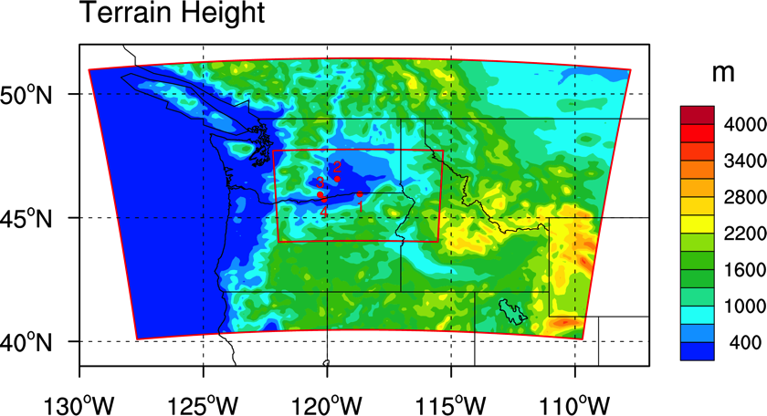
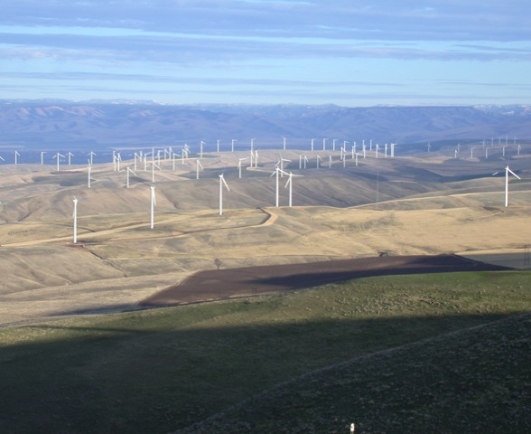
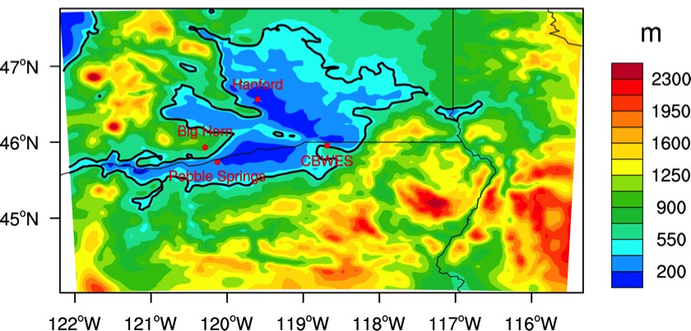
Study Area and Terrain Height
Focused on the site of the Columbia Basin Wind Energy Study (CBWES)
  Conducted in an
  operating wind farm in
  north-central Oregon.
Inner domain
Stateline Wind Energy Center:
454 660-KW Vestas V-47 Turbines
300-MW installed capacity

Slide 7
Impact on Wind Power
Wind speed and wind power predictions are highly sensitive to the values of PBL Parameters

Slide 8
Impact on Wind Power
Wind speed and wind power predictions are highly sensitive to the values of PBL Parameters
Spread in wind speed
Spread in power

Slide 9
Sensitivity of 80-m Winds to Boundary-Layer Parameters: Relative Contribution (Daytime)
TKE Diffusion
Pr Number
TKE dissipation rate
Closure Constants
Length Scales

Slide 10
Sensitivity of 80-m Winds to Boundary-Layer Parameters: Relative Contribution (Nighttime)
TKE Diffusion
Pr Number
TKE dissipation rate
Closure Constants
Length Scales
June 11, 2015
10

Slide 11
Sensitivity of 80-m Winds to Boundary-Layer Parameters to Terrain Slope
Daytime
Nighttime
TKE dissipation rate
TKE Diffusion
Pr Number
Closure Constants
Length Scales
Length Scale Factor
Length Scale Exponent

Slide 12
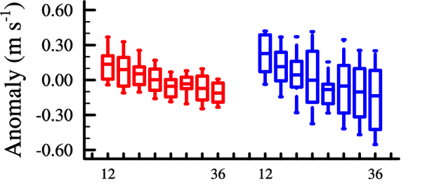
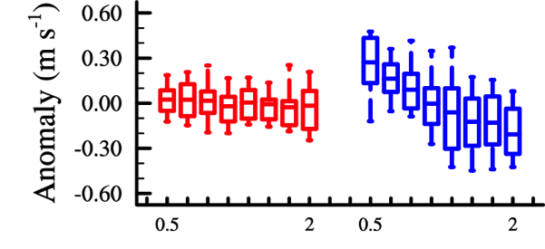
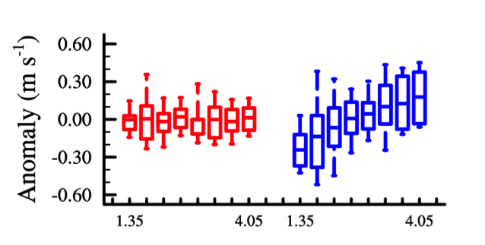
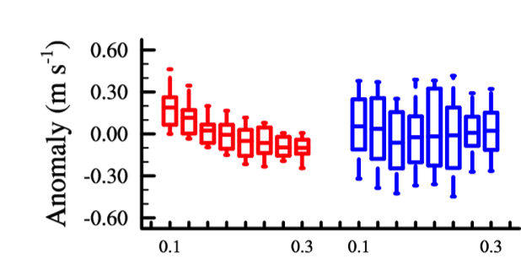
Response of 80-m wind to PBL parameters at CBWES
TKE Dissipation Rate
Pr Number
Variability associated with other parameters
Daytime
Nighttime
Variability associated with parameter
Length Scale Factor
Length Scale Exponent
Anomaly wind speed: Difference from average over the study period

Slide 13

Response of 80-m wind to PBL parameters at all sites
Hanford
Big Horn
CBWES
Pebble
Springs
TKE Dissipation
Rate
Length Scale
Factor
Length Scale
Exponent
Pr Number
Consistent Results for All Locations
Daytime
Nighttime

Slide 14
Sensitivity of 80-m Winds to Surface Parameters: Relative Contribution
Main factors: z₀ and k
z₀
k
z₀
k
Elevation

Slide 15
Summary and Conclusions
A UQ study has been completed to investigate the sensitivity of WRF simulations to a number of parameters used in the surface and PBL schemes
  Range in wind speed yields large variability in wind power
Largest sensitivities were found for z₀, TKE dissipation rate, TKE length scales, and Pr number
  Sensitivity to TKE dissipation rate and TKE length scales also function of terrain slope
New field studies should be designed to constrain these values, including measurements of:
  z₀: accurate wind speed profiles and/or drag plates
  TKE throughout the PBL depth
  Parameters used in the M-O stability functions for stable conditions
Next steps: expand analysis to use additional time periods and PBL and/or surface schemes
POC: larry.berg@pnnl.gov

Slide 16
Conclusion
Notes:
Add something about spatial distribution.
What about land surface models? We could also vary

Slide 17
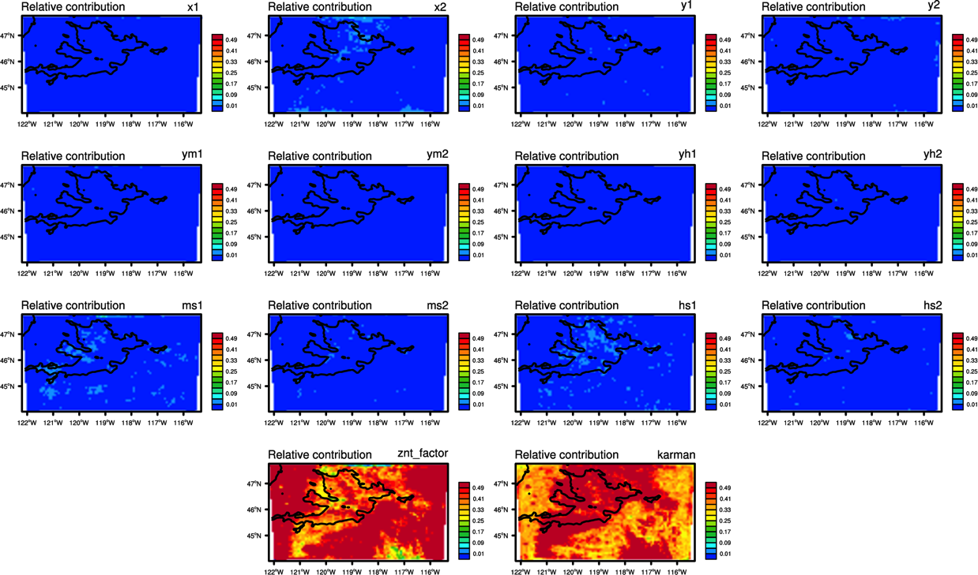
Sensitivity of 80-m Winds to Surface Parameters: Relative Contribution
Main factors: z₀ and k
Daytime (6-18 LST)

Slide 18
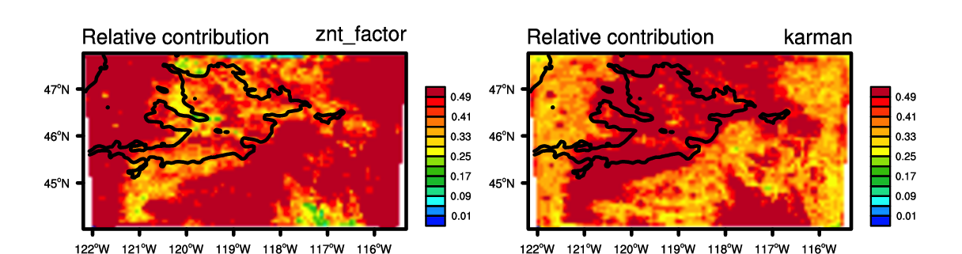
Sensitivity of 80-m Winds to Surface Parameters: Relative Contribution
Main factors: z₀ and k
Daytime (6-18 LST)
Relative Contribution: z₀
Relative Contribution: Von Karman

Slide 19
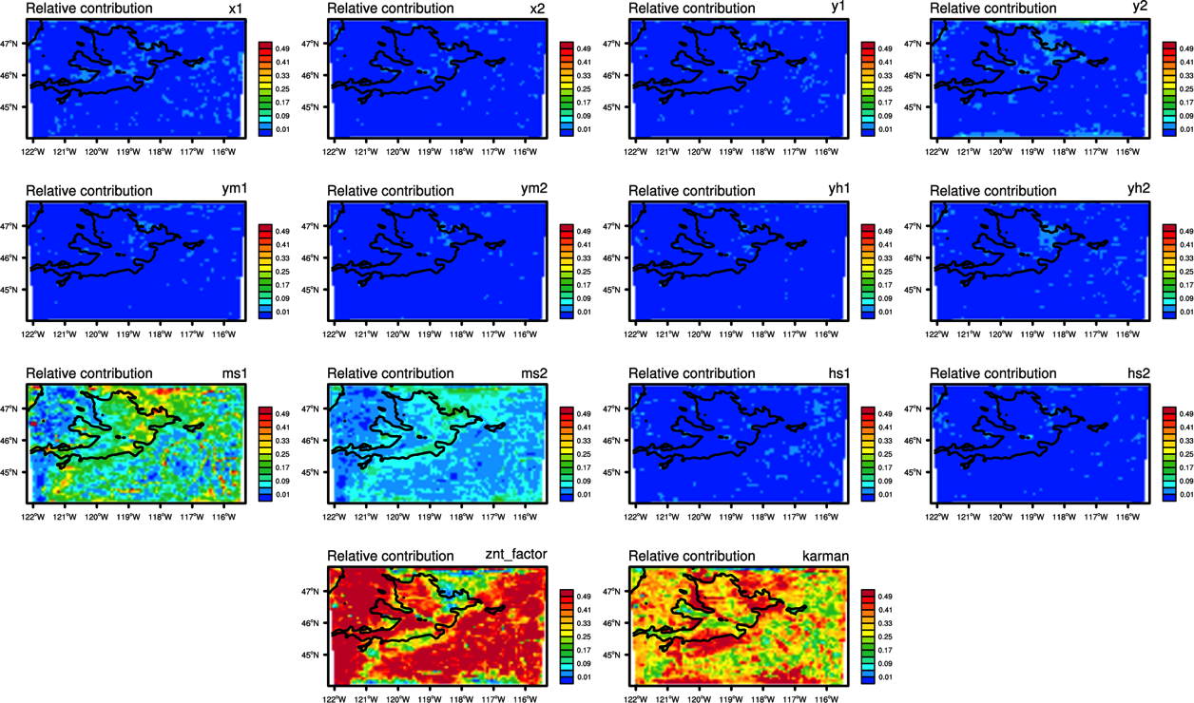
Sensitivity of 80-m Winds to Surface Parameters: Relative Contribution
Main factors: z₀ and k, increased dependence on M-O functions
Nighttime (18-6 LST)

Slide 20
Identification of Surface Parameters
Parameter name | description | default value | estimated range
x1 | X=(1.-16.*zolf)**(1/4) Used for the calculation of psim_unstable | 16 | (14, 18)
x2 | X=(1.-16.*zolf)**(1/4) | 4 | (3.5, 4.5)
y1 | Y=(1.-16.*zolf)**(1/2) Used for the calculation of psih_unstable | 16 | (14, 18)
y2 | Y=(1.-16.*zolf)**(1/2) | 2 | (1.5, 2.5)
ym1 | YM=(1.-10.*zolf)**(1/3) Used for the calculation of psim_unstable | 10 | (9.7, 11.6)
ym2 | YM=(1.-10.*zolf)**(1/3) | 3 | (2.5, 3.5)
yh1 | YH=(1.-34.*zolf)**(1/3) Used for the calculation of psih_unstable | 34 | (26, 42)
yh2 | YH=(1.-34.*zolf)**(1/3) | 3 | (3.0, 3.5)
ms1 | psim_stable=-6.1*log(zolf+(1+zolf**2.5)**(1./2.5)) | 6.1 | (4.8, 9.4)
ms2 | psim_stable=-6.1*log(zolf+(1+zolf**2.5)**(1./2.5)) | 2.5 | (1.1, 2.5)
hs1 | psih_stable=-5.3*log(zolf+(1+zolf**1.1)**(1./1.1)) | 5.3 | (4.5, 9)
hs2 | psih_stable=-5.3*log(zolf+(1+zolf**1.1)**(1./1.1)) | 1.1 | (1.1, 2.5)
znt_factor | znt_new=znt*znt_factor | 1 | (1.0, 2.0)
karman | Von Karman constant | 0.4 | (0.35, 0.4)

Slide 21
Identification of Boundary-Layer Parameters
Parameter name | description | default value | estimated range
b1 | used in definition of the dissipation rates | 24 | (12,36)
sqfac | TKE Diffusion factor | 2 | (1.5, 4.5)
pr | turbulent Prandtl number | 0.74 | (0.5, 2)
c3 | closure constant | 0.34 | (0.33, 0.5)
c5 | closure constant | 0.2 | (0.1, 0.3)
g1 | closure constant | 0.229 | (0.1768, 0.2395)
alp1 | Used in calculation of the turbulence length scale (LT) | 0.23 | (0.115, 0.345)
alp2 | Used in calculation of the turbulence length scale (LB) | 0.65 | (0.5, 1.0)
alp3 | Used in calculation of the turbulence length scale (LB) | 3 | (2.5, 7.5)
alp4 | Used in calculation of the turbulence length scale (LS) | 20 | (20, 100)
cns | Used in calculation of the turbulence length scale (LS) | 2.1 | (1.35, 4.05)
ls_exp | Exponent on equation to determine LS that is based on results from LES | 0.2 | (0.1, 0.3)
TKE dissipation rate
TKE Diffusion
Pr Number
Closure
Constants
Length Scales

