Slide 1


Partnering with Virginia Cooperative Extension to enrich your classroom STEM programming
Ruth Wallace, Sr. Extension Agent, 4-H Youth Development, Buckingham County
Jennifer Bowen, Sr. Extension Agent, 4-H Youth Development, Mecklenburg County
Jennifer Townsend, Third Grade Teacher, Prince Edward County Elementary School
Natalie Reeves, Third Grade Teacher, Prince Edward County Elementary School
Notes:
Intro selves

Slide 2
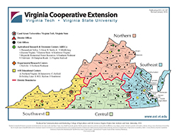
Virginia Cooperative Extension: The best kept secret in the Commonwealth
VCE brings the resources of Virginia’s land-grant universities, Virginia Tech and Virginia State University, to the people of the Commonwealth.
107 offices throughout the state covering every county, 11 agricultural research and extension center, and 6 4-H educational centers
Program areas:
Agriculture and Natural Resources
Family and Consumer Sciences
SNAP-Ed
Community Viability
4-H Youth Development
Notes:
Ruth

Slide 3
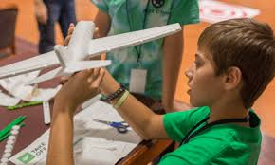

4-H National Mission Mandates
Citizenship
Healthy Living
STEM
Notes:
Jennifer – what is 4-H

Slide 4
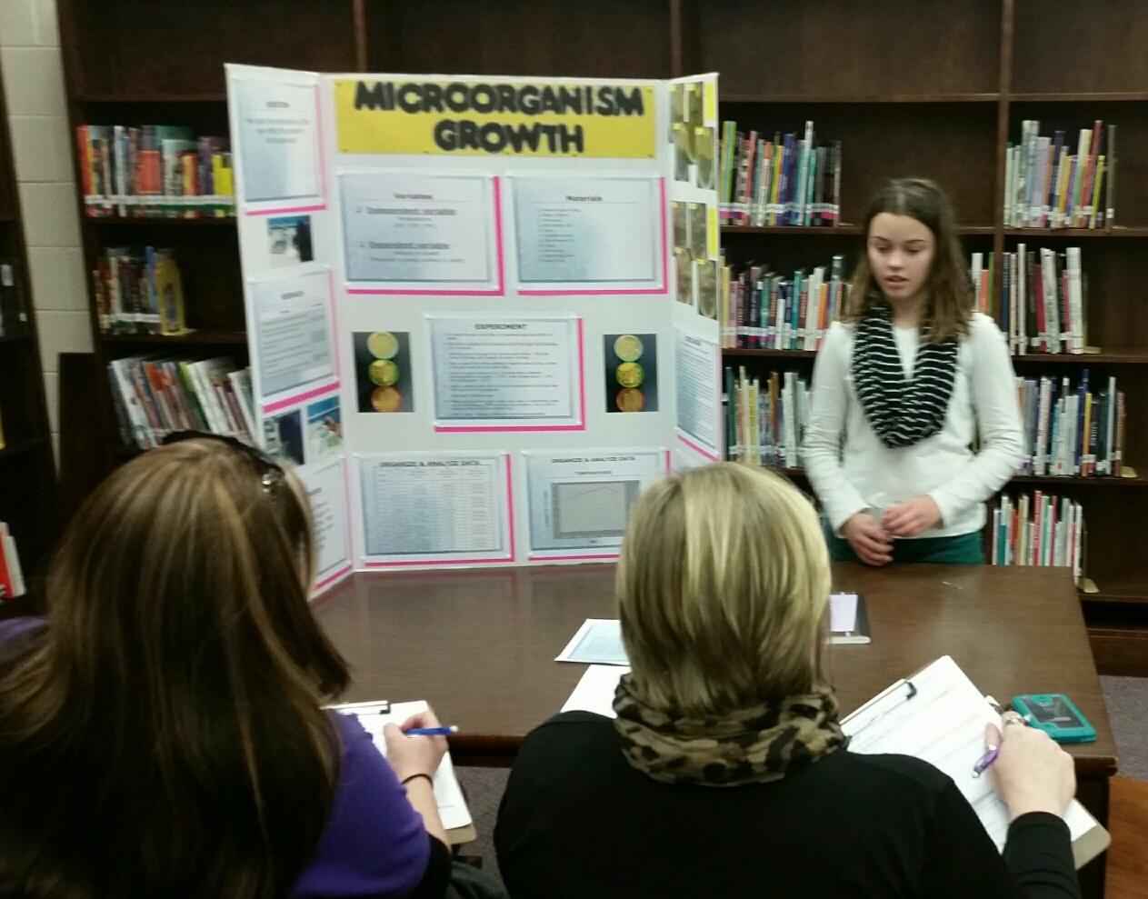
Ways to Partner in the Classroom
Traditional In-School Clubs
School Enrichment
Ongoing
Stand-alone programs
4-H Science Fair Partnership
After-School Programming
Resources and Training
All 4-H programs are SOL-based and can be tailored to meet the needs of each classroom.
Notes:
Ruth

Slide 5

What can we offer?
Branded Programs
Rockets to the Rescue
EcoBot Challenge
Drone Discovery
Motion Commotion
Custom Designed Programs
Notes:
Jennifer

Slide 6
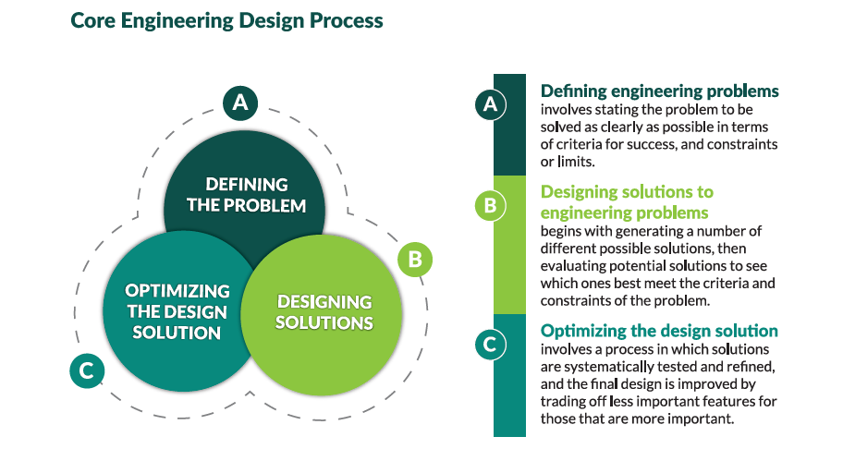
Notes:
Jennifer

Slide 7

https://www.youtube.com/watch?v=teCpdzBTrdw
Notes:
Ruth

Slide 8
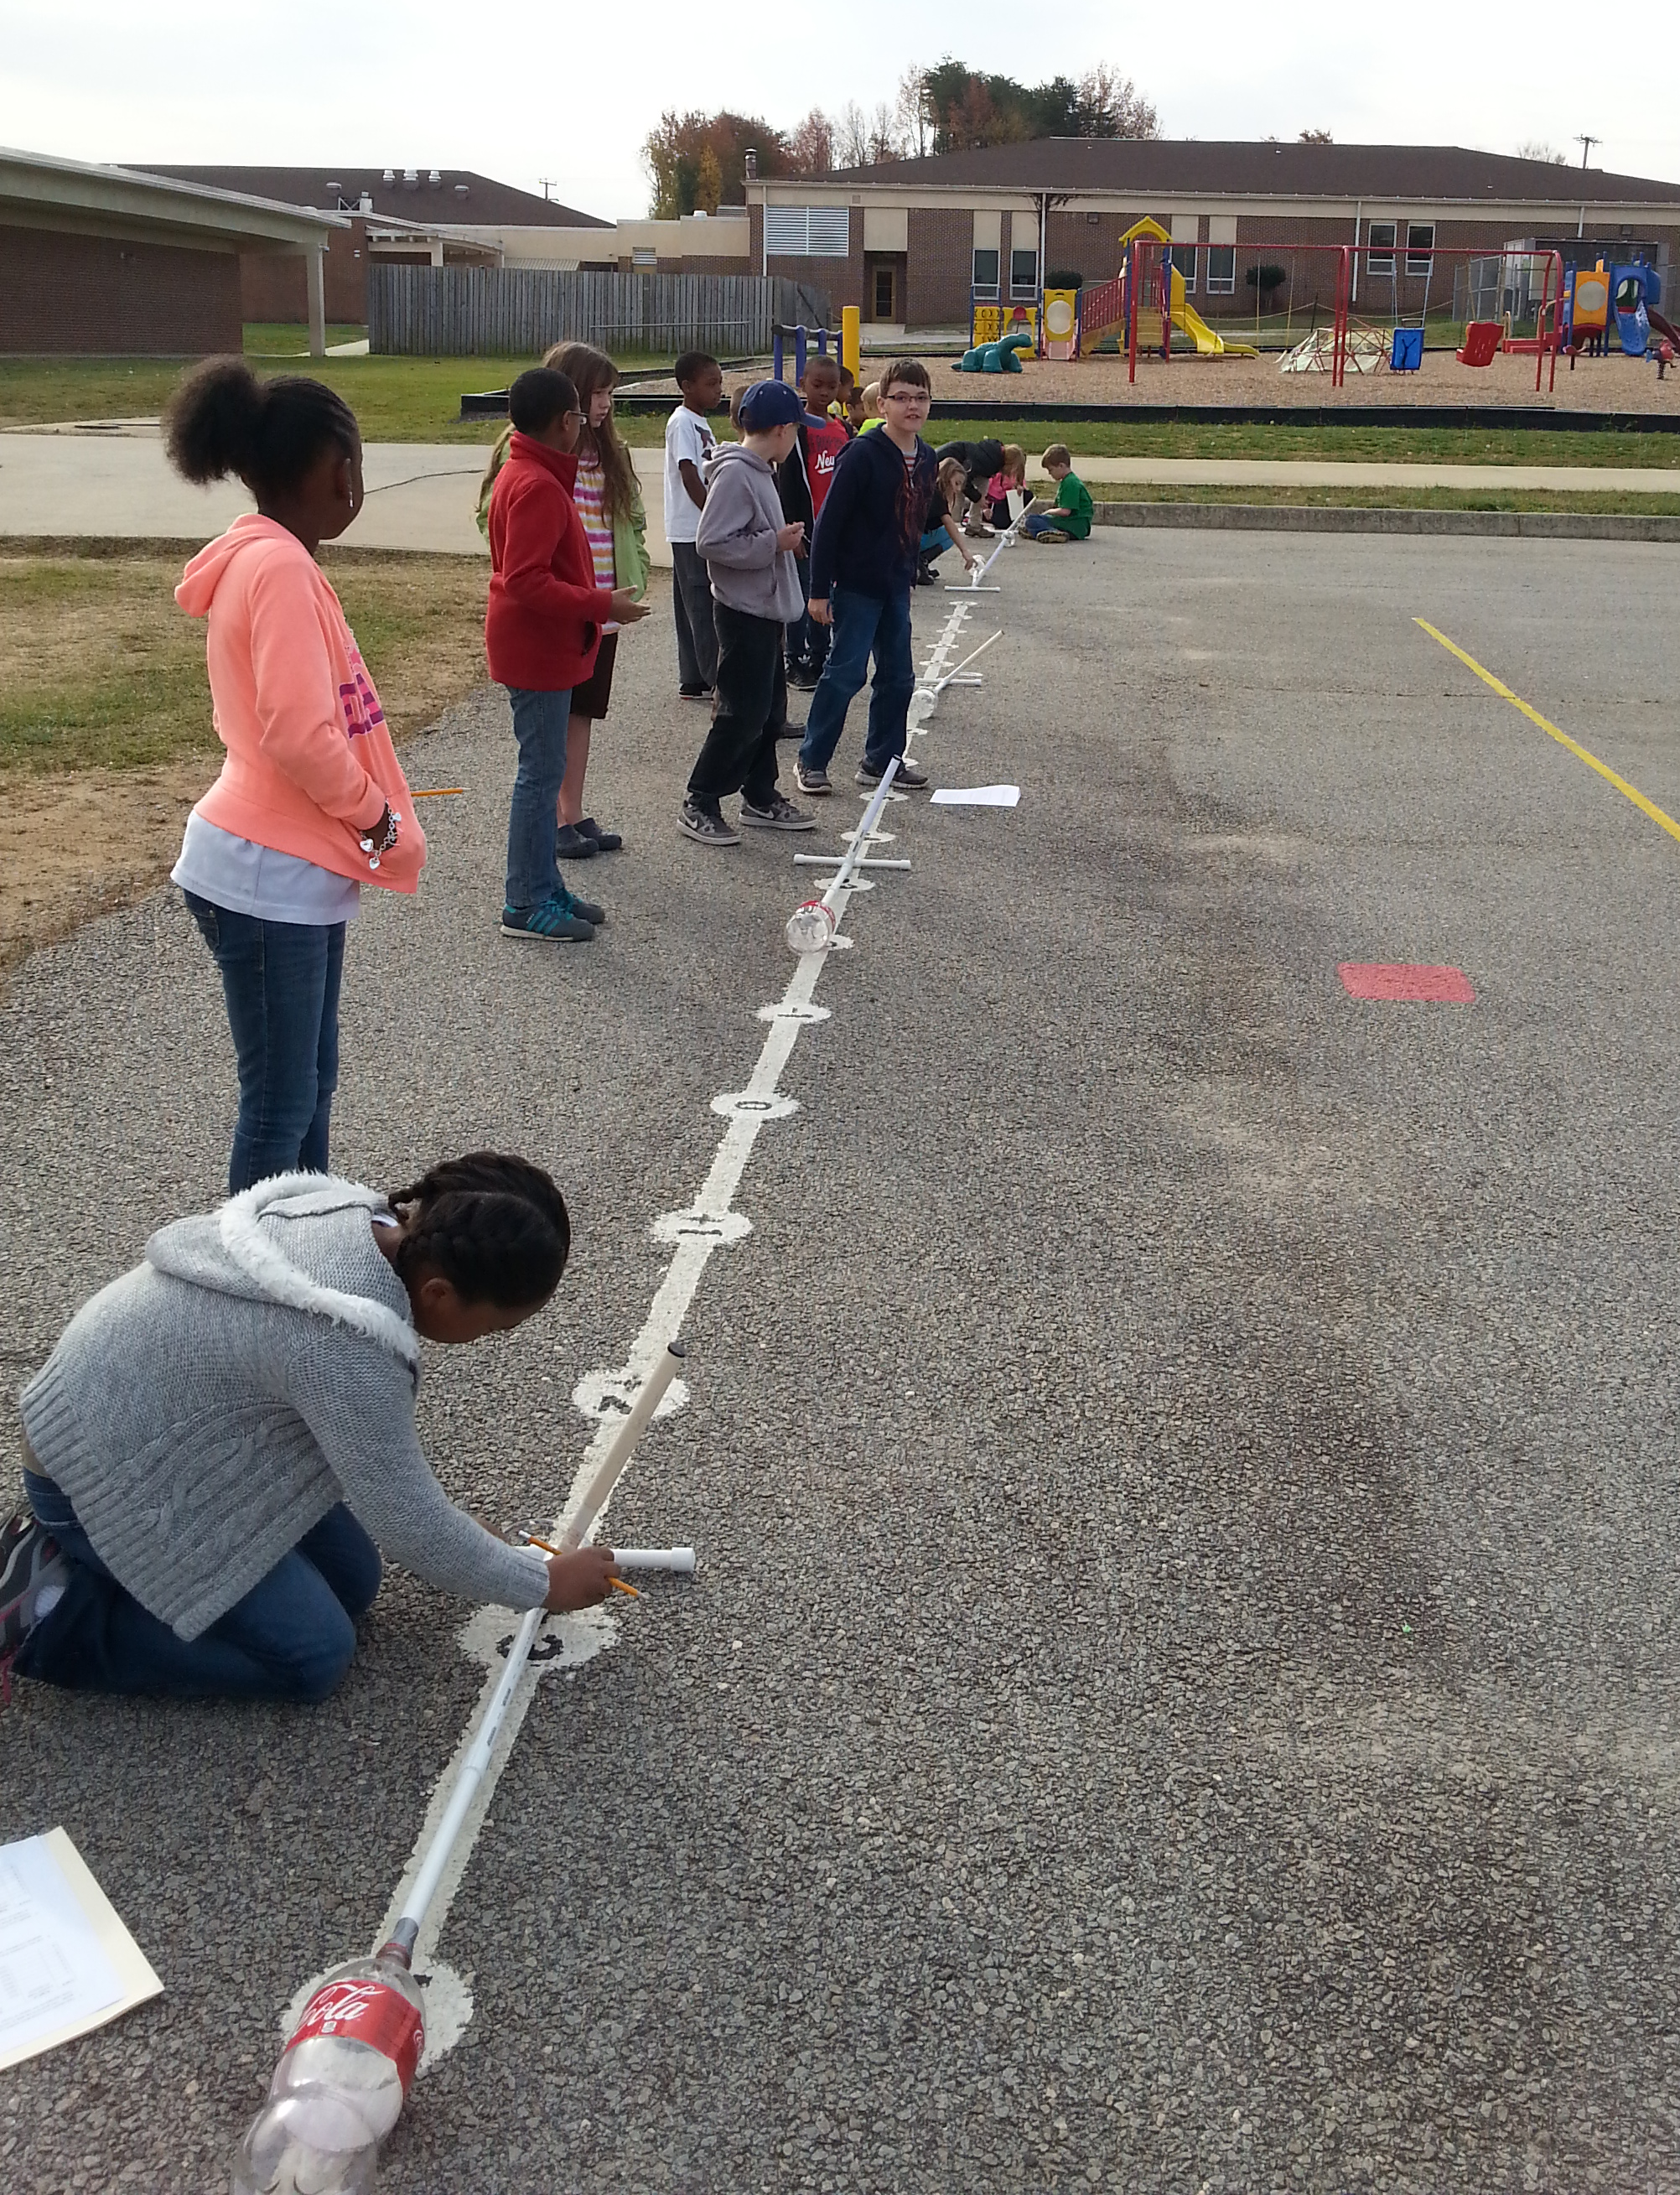
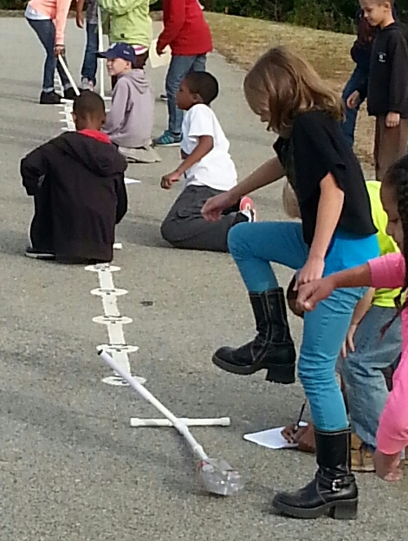
Rockets to the Rescue Project Addresses
Scientific Investigation, Reasoning and Logic
Force, Energy, Motion
21st Century Skills
Creativity
Collaboration
Communication
Critical Thinking
Notes:
Ruth

Slide 9
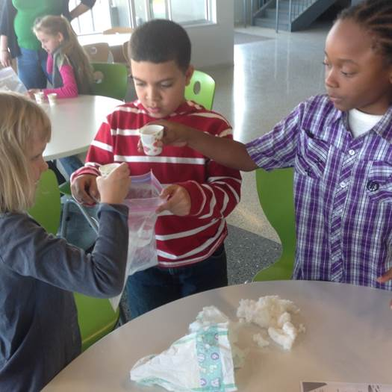
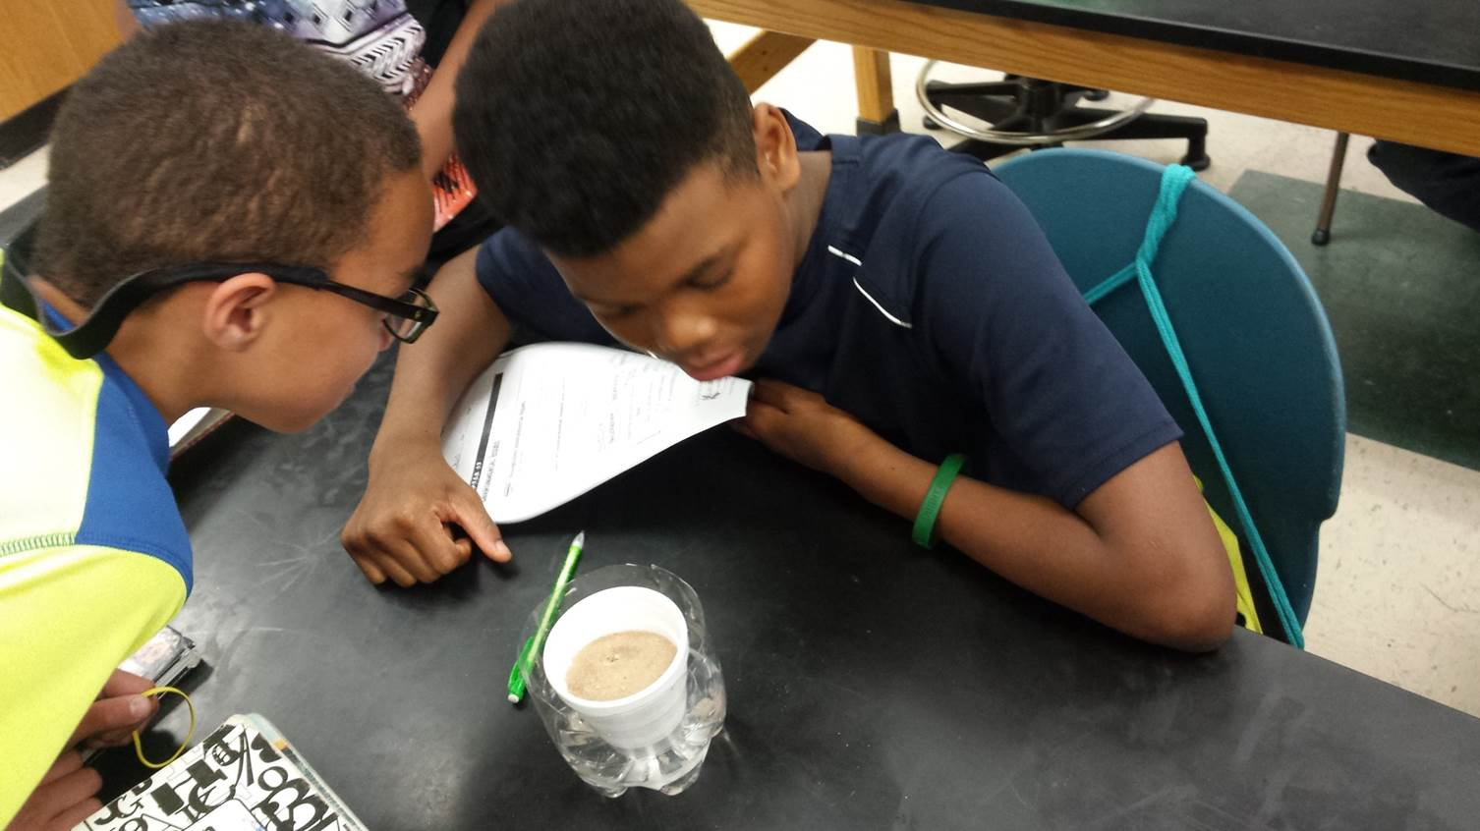
Getting Started in Your County
Contact your local Extension Office
www.ext.vt.edu (Click on “Local Offices”)
Notes:
Jennifer

