Slide 1
NRV Tweets
Midterm Presentation
VT CS4624, Blacksburg, VA
Sponsors: Mohamed Magdy,
Dr. Andrea Kavanaugh, Ji Wang
Ben Roble, Justin Cheng,
Marwan Sbitani

Slide 2
Virtual Town Square data
Tweets
Facebook Groups
Websites
RSS Feeds
Notes:
Marwan

Slide 3
Events and tags
Data from Tweets/FB/RSS within the NRV
Scanned for events
Tweets/posts/messages are grouped together if they’re related
Tagged with keywords
Notes:
Justin

Slide 4
Categorizing Data
Tagging
Machine learning algorithms
etcML
Latent Dirichlet Allocation (LDA)
Searching
Solr
Notes:
Ben

Slide 5
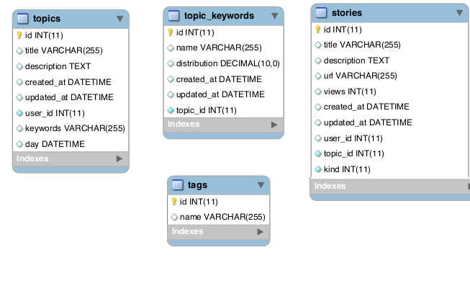
Example Data Schema
Notes:
ben

Slide 6
Data Example
{
'id' : 4898,
'title' : 'University Distinguished Awards…..',
'description' : 'BLACKSBURG May 10….’
'views' : 76,
'updated_at' : '2014-02-09 10:10:53',
‘topic_id' : 3729,
…
}
Notes:
ben

Slide 7
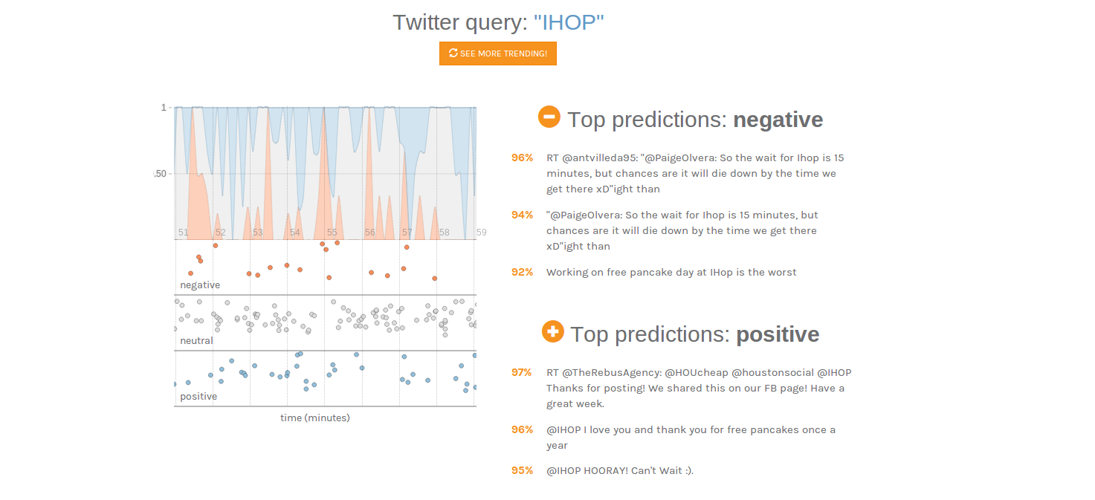
Notes:
Ben

Slide 8
Solr
Powerful search engine platform
Allows queries of large amount of Media data that we’ve collected.
Notes:
Justin

Slide 9
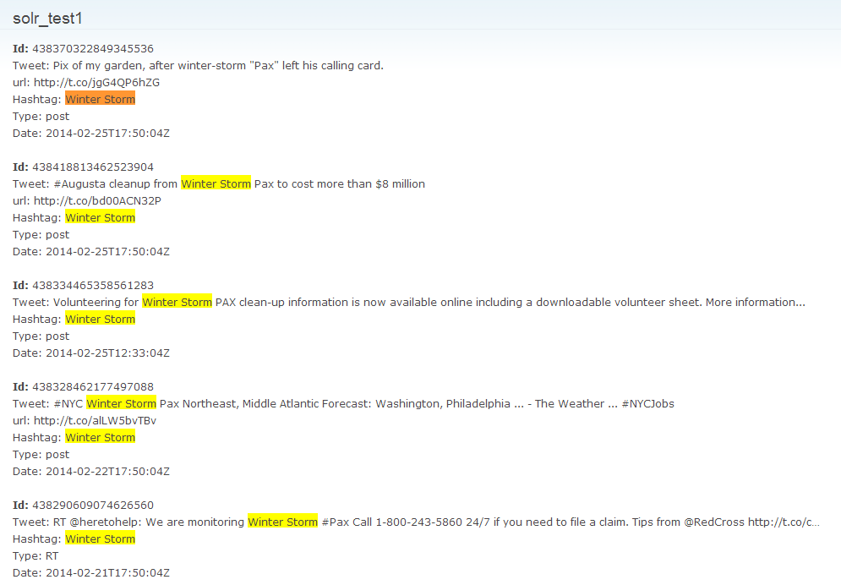
Query: Winter Storm
Notes:
Justin

Slide 10
Data Aggregation
Database tables
Hadoop (HDFS)
Virtual Town Square (VTS)
Trend Timeline from Tweets
Notes:
Marwan

Slide 11
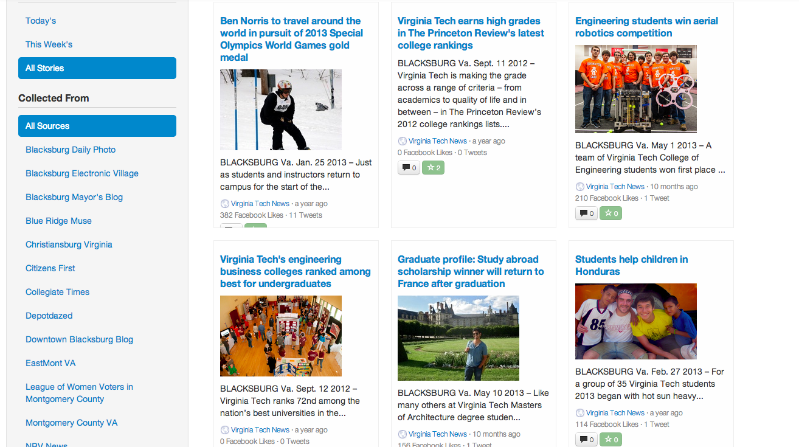
Notes:
Justin

Slide 12
Current progress
Data access progress
Solr progress (news stories)
Tweet tagging progress
Notes:
Ben

Slide 13
Future progress & Deliverables
Integration with VTS
News searchable
Tweets tagged, searchable
Facebook info tagged, searchable
Notes:
Marwan

Slide 14
Possible uses
Single source for local news
Historical reference of events
Tracking of event social impact
Researching of trends
Forecasting of event responses

Slide 15
Timeline
Feb 6 - Initial Meeting
Feb 19 - Raw tweet data accessed, Solr tool reviewed
March 5 - Initial research completed on associating news stories with topics
March 19 - Initial research completed on associating Tweets with topics
April 9 - Best topical modeling tool selected
April 23 - Tweets and news stories associated with topics and searchable with Solr
May 7 - Final report delivered

