Slide 1
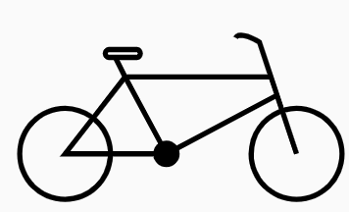

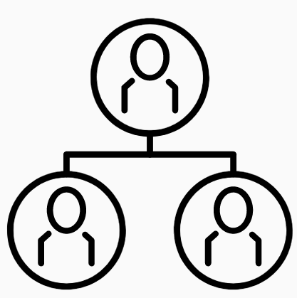





Part II: Using Others' Original Works, legally
In Service of Others:
Honoring Others’ Copyrights -- and Making Your Work Useful (to others)
© BBicycle by Fahmihorizo - CC BY 3.0 https://thenounproject.com/search/?q=bicycle&i=1272852
© Photography by monkik CC BY 3.0 https://thenounproject.com/search/?q=photography&i=2588421
© Bucket by Ema Dimitrova, BG - CC BY 3.0 https://thenounproject.com/term/bucket/71705
© Family by Andrei Yushchenko CC BY 3.0 https://thenounproject.com/search/?q=family+tree&i=2558850
© Harvest by Chattapat CC BY 3.0 https://thenounproject.com/search/?q=harvest&i=3973361
© Build by Adrien Coquet CC BY 3.0 (flipped) https://thenounproject.com/search/?q=build&i=2085889
@ Graduates by ProSymbols CC BY 3.0 https://thenounproject.com/icon/graduates-1971073
© Anita Walz. Licensed under CC BY 4.0
http://hdl.handle.net/10919/112264
Notes:
Today’s topic is “In Service of Others: Honoring Others’ Copyrights -- and Making Your Work Useful (to others)”
In this presentation we will explore copyright through a series of analogies. Our goal is to help you understand what copyright is (and isn’t), how you already interact with copyright every day, and how to extend the usefulness of what you make so that others can actually use it, while honoring others’ copyrights.

Slide 2
Categorizing works you may want to integrate into your own
My original work
Someone else’s work
Works marked as Public Domain or created by a U.S. Gov Employee, or expressed in a fixed medium in the U.S. pre 1920-ish*
If you did not sell or give away exclusive rights, use it as you wish.
Do you have enough rights to justify your use? You’ll need to research the terms of use for this item.
Use it as you wish [in the U.S.]
Citing your source is good scholarly practice but not legally required.
Uh oh!
Assume © unless otherwise noted
Public Domain in the U.S. is a moving wall. See https://guides.library.cornell.edu/copyright/publicdomain
© Bucket by Ema Dimitrova, BG - CC BY 3.0 https://thenounproject.com/term/bucket/71705/
© BBicycle (adapted) by Fahmihorizo - CC BY 3.0 https://thenounproject.com/search/?q=bicycle&i=1272852
Notes:
If you own a bicycle, it’s pretty clear that you have rights to lend it out, sell it, keep it, paint it, take it on a world tour, and ride it wherever it is legal to do so. And the same with materials in the Public Domain -- works that were created by a U.S. Government employee, or published in the U.S. as of a 1920ish date. (Note that works in the U.S. are continually entering the Public Domain. See Copyright Term and the Public Domain from Cornell University for authoritative information.) But what about when someone else owns the bicycle [the middle bucket on the slide]? What rights to do have if you are not the owner? Is there any situation in which (perhaps in a true emergency) you might be justified in borrowing something you did not own -- for a use that was warranted?

Slide 3
Two Dilemmas … when creating with sharing in mind
May I use portions of others’ original works in my open educational resource? How do I do this legally, ethically, and technically?
I want others to use my work in flexible ways. Of what do I need to be mindful when planning to create and share my work?
© Build by Adrien Coquet CC BY 3.0 (flipped) https://thenounproject.com/search/?q=build&i=2085889
Notes:
Well, this poses a problem doesn’t it because we WANT to draw on a lot of sources when we create. Our work is often better when we draw on others’ expertise and what they have made.
How do we answer the two dilemmas? What exemptions exist for you to use others' works -- and what rights do others have to use your works?

Slide 4
“third party” and a bicycle
Ownership
Context
Permission
© BBicycle by Fahmihorizo - CC BY 3.0 https://thenounproject.com/search/?q=bicycle&i=1272852
Notes:
Here is our proverbial bicycle again. Copyright is a lot like this bicycle example. In the same way that someone owns an unlocked, unaccompanied bicycle, someone likewise owns the digital artifact you found freely on the web, the picture published in a book you own, the architectural model your classmate built, or the cool diagram you saw on a conference poster. In the same way as borrowing a bicycle, you must obtain some sort of permission to use in-copyright works when those rights don’t belong to you. This includes student academic work -- because students own their own work!

Slide 5

Principle 6: There ARE legal and ethical ways to use others’ in-copyright works
3. Obtain permission for your specific, proposed use
2. Leverage a U.S. Copyright exemption that addresses your specific, proposed use
Fair Use
TEACH Act
1. Choose to use works that already have a license that permits your specific, proposed use
© Made^{AU} ”vegetables” CC BY https://thenounproject.com/icon/vegetables-3057284
Notes:
Principle 6: There ARE legal and ethical ways to use others’ in-copyright works in your openly-licensed and publicly-shared works.
There are three basic options. We’ll take these from the bottom, up -- in the order we typically think of them -- then we’ll talk about level of effort, which is why they are displayed in the opposite order. You don’t need to memorize every detail about these, just reflect on the three kinds of exemptions exist for using others’ works -- or others using your work.
3. Obtaining permission to use in-copyright materials for specific purposes -- similar to obtaining permission to borrow Hawa’s bicycle.
2. Options established through U.S. Copyright Law which use of works under the terms of “Fair Use” the TEACH Act, on which some teachers will (rightly) rely. Because TEACH Act exemptions require that twenty-two! factors[footnote]University of Texas Libraries (n.d.). TEACH Act Checklist. https://guides.lib.utexas.edu/copyright/teachactchecklist[/footnote] be met, and one of those factors is “share only with my class,” the TEACH Act exemption is not useful for our “share for many uses and many classrooms” types of uses.
And 1. Using materials for which permission has already been granted (and under the terms of the permission granted --- note that CC licenses always require attribution and see the Best Practices for Attribution - Creative Commons
See the Creative Commons, Best practices for attribution document linked from the bottom of the slide. https://wiki.creativecommons.org/wiki/Best_practices_for_attribution document at the bottom of the slide. This permission is also known as a “license”.

Slide 6
Knowledge check
What are the three options for you to use another’s work, or for others to use your work?
Do these rules apply to work created by students? (Yes. See your campus IP policy)
*Note that using another’s idea, language, argument structure, etc always requires citation as to affirm academic integrity and avoid plagiarism.

Slide 7
Options for using others’ works -- organized by level of effort
1. Choose to use works bearing a license that covers your specific, proposed use
2. Leverage a U.S. Copyright exemption that addresses your specific, proposed use
Fair Use
TEACH Act
3. Obtain permission for your specific, proposed use
© Made^{AU} ”vegetables” CC BY https://thenounproject.com/icon/vegetables-3057284
Notes:
The [3,2,1] is the order in which we might commonly think of these options. However, if we think of them from “least effort” to “greatest effort” we start at with number 1 … where permission is already granted … rather than seeking out new permission.
You don’t have to recall all of the details (yet) but it is important for you to remember these THREE options so that you can understand certain acceptable practices.
The three options are choosing to use works that already have a license allowing your specific, proposed use (and yes, we’ll talk more later about “specific, proposed uses”), secondly leveraging an exemption in U.S. copyright law -- such as Fair Use, or third, obtaining permission for your specific, proposed use.

Slide 8
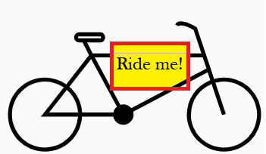
Resource: A Framework for Any U.S. Copyright Question
Is the work protected by copyright?
In Copyright and I own the copyright
In-Copyright and someone else owns it
In the Public Domain (≠ free online)
Do I already have permission? Is there a license that allows my proposed use?
Creative Commons license
Terms/Conditions of Use
Is there a specific exemption in copyright law that covers my proposed use?
Fair Use
If all of the above failed, I need to obtain permission.
Adapted from: http://hdl.handle.net/10919/56505 CC BY SA
Notes:
Let’s pull together some of what you already know into a framework:
The first step, in order to use something is to determine if the work is indeed protected by copyright. From the “bucket” example, you already know that the work is in copyright or it’s in the Public Domain, and that if it is in copyright that you own or have rights to it, or you don’t own or have rights to it.
Adapted from: A Framework for Analyzing any U.S. Copyright Problem]
Let’s talk quickly through these three relevant options in the Framework for any U.S. Copyright Question. We'll dive deeper into each one momentarily. After confirming that material is indeed in-copyright, we ask:
Does the work already have a license permitting my proposed use?
Creative Commons licenses (which always require attribution) are one such license which is appended on an in-copyright work;
Another license might be covered in the “Terms of use” section described on a website.
(We’ll return to Creative Commons licenses and Terms of Use in a moment.)
By way of analogy, this would be a bit like Hawa placing a sign on her bicycle stating “Free to ride on Wednesday thru Friday from 4-6pm. Return in the condition borrowed or better.”
2. Is my proposed use more fair than infringing according to an informed Fair Use analysis? -- Because you’re not getting permission from a person, fair use is all about CONTEXT. A Fair Use analysis is one you conduct yourself to determine if a use is more fair or more infringing. It’s based on totaling up results for four factors established by copyright law: 1. The type of use, 2. The character of work you’re using, 3. How much of the work you’re using, and 4. The degree of harm to the commercial market for your proposed use. This would be using Hawa’s bicycle without her permission but in a way that has minimal impact to her, might use only part of the bicycle, and/or uses it in a novel way it was generally not planned to be used.
Two helpful tools include
the “Fair Use Evaluator” which can help you to organize your fair use evaluation, and
Best Practices in Fair Use for Open Educational Resources (Pages 11-14).
(We’ll return to the Fair Use in a moment.)
If steps 1 & 2 are not fruitful, seek (and obtain) permission:
3. Have I obtained permission for my specific, proposed use? This is the copyright owner indicating that they grant you permission for your specific, particular use. This would be like you asking Hawa for permission to use the bicycle between 3-5pm on Tuesday, and Hawa saying “Yes, you may use my bicycle between 3 and 5pm on Tuesday, but please don’t ride it thru the mud.” It usually involves a lot of context, e.g. where/to whom, what format, how long, etc. (For further information, see the U.S. Copyright Office's circular on obtaining permission.) We’ll talk further about a helpful way you can obtain permission, AND establish helpful reuse rights as well -- again, a little later.
In case you're looking for a framework, see the “Framework for Analyzing any U.S. Copyright Problem”
Let's look a bit deeper at the three options

Slide 9
Does the work already have a license permitting my proposed use?
You might already have a license or permission
Creative Commons licenses (which always require attribution) are one such license which is appended on an in-copyright work
Another license might be covered in the “Terms/Conditions of Use” section described on a website.
Best practices for attribution - Creative Commons licenses: https://wiki.creativecommons.org/wiki/Best_practices_for_attribution
Notes:
Does the work already have a license permitting my proposed use?
As we mentioned earlier, a work might have a Creative Commons license or some other type of open license. Alternatively, your proposed use might already be covered in the "Terms/Conditions of Use" section described on a website.

Slide 10
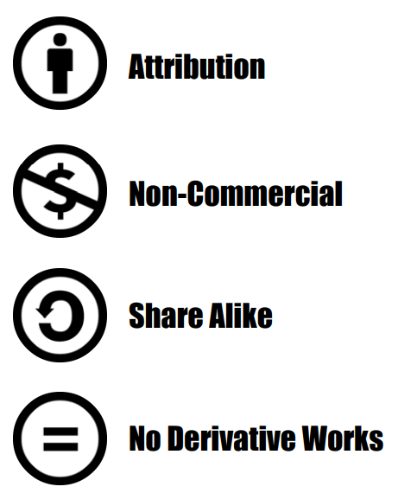
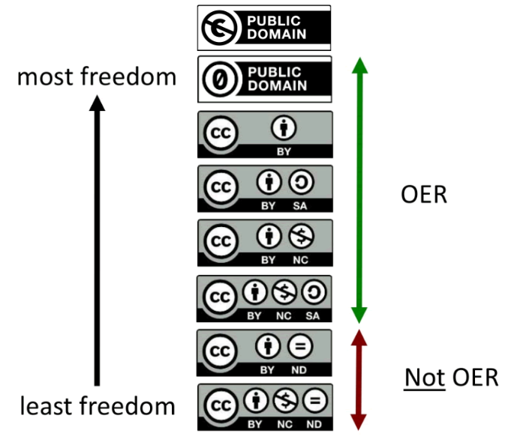
Creative Commons Licenses
Brochure on CC licenses http://hdl.handle.net/10919/77420
Notes:
What are Creative Commons licenses? Creative Commons licenses are free license markers that a copyright owner or their authorized agent add to an original work. The licenses do not remove copyright but are a layer on top of copyright, and move the permission to use the work from "All Rights Reserved" to "Some Rights Reserved." They enable the creator of a work to indicate to others what uses are permitted.
There are six licenses (at the bottom) and two Public Domain markers (at the top). The licenses have up to three of four icons each as you can see on the right -- BY attribution (the person, which reminds us that we are required to give attribution), NC or Non-Commercial (the crossed out currency system which indicates that primarily commercial uses are prohibited), SA or ShareAlike (the leftward arrow which indicates that any adaptions be licensed under the same terms as the original), and ND or No Derivatives (the equal sigh which tells us that we cannot make and redistribute a changed version). The two public domain markers (CC PD and CC0 indicate respectively, that a work has "no known copyright," or that it has to the degree possible been donated to the Public Domain by its creator and marked as such.
The public domain markers and licenses are displayed in the order of most freedom at the top to least freedom at the bottom. They are named according to the sequence of their icons. For example, the fourth one in the list is referenced as: CC BY SA or Creative Commons Attribution ShareAlike. The bottom two icons are ND or "no derivatives," . . .

Slide 11


Not all CC-licenses allow derivatives
These licenses (ND) are not “open licenses” as they do not allow derivatives.
Notes:
and do not allow redistribution with changes. While they are still valuable, because they do not allow adaptation and sharing, they are thus not considered to be open licenses. Nor are they considered to be open educational resources (OER).

Slide 12





Read more here: https://creativecommons.org/licenses
OER definition: http://www.hewlett.org/strategy/open-educational-resources/
No known copyright
Donated to the public domain (and marked as such)
Creative Commons Attribution License (CC BY)
Creative Commons Attribution Share-Alike License (CC BY SA)
Creative Commons Attribution Non-Commerical License (CC BY NC)
Creative Commons Attribution Non-Commercial ShareAlike (CC BY NC SA)
Open Educational Resources
Notes:
Here is a list of the open licenses and PD markers, plus a link to an introductory brochure on Creative Commons licenses.

Slide 13
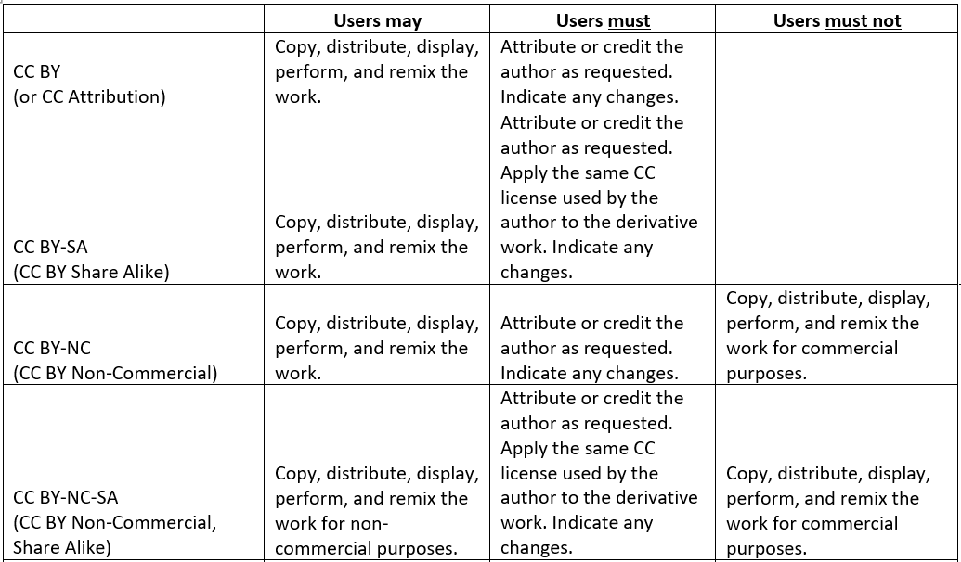

Unpacking Creative Commons licenses
Adapted from “Unpacking Creative Commons licenses” http://hdl.handle.net/10919/64276
Notes:
What do the licenses allow, require or prohibit people from doing? Because we are specifically concerned about making our resources useful for others, we've included discussion only those licenses which allow adaptation and redistribution in the chart.

Slide 14
What can I do with Creative Commons licensed works (minus ND-licensed works)?
Retain - Make, own, and control copies of the content (store, manage, download, duplicate)
Reuse - Use the content in various ways (in class, study group, extension, journal article, on the radio, in a video, website etc.)
Revise - Adapt, modify, alter the content (reformat or translate)
Remix - Combine revised or original content with other materials to create something new (i.e. mashup)
Redistribute - Share copies of original content, revised content, or remixes with others
Source: This material is based on original writing by David Wiley, which was published freely under a Creative Commons Attribution 4.0 license at http://opencontent.org/definition
Notes:
There are a lot of things you can do with Creative Commons licensed works (those that allow derivatives, anyway). These are often called the 5R permissions (retain, reuse, revise, remix, and redistribute.) [Footnote]This material is based on original writing by David Wiley, which was published freely under a Creative Commons Attribution 4.0 license at http://opencontent.org/definition [/Footnote] As mentioned before, there are some restrictions. There are CC-licensed works that prohibit primarily commercial uses. And, there are others which require any derivatives to have the same license.

Slide 15
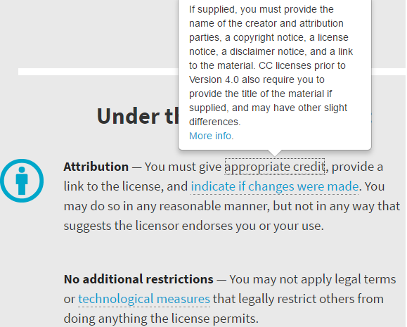
Creative Commons example
© David Lenker Strawberry CC BY 2.0
Attribution is always required when using CC-licensed materials.
© David Lenker Strawberry CC BY 2.0
Source: https://creativecommons.org/licenses/by/4.0/
More about Creative Commons licenses: https://creativecommons.org/licenses
Best practice for attributing CC-licensed materials: https://wiki.creativecommons.org/wiki/Best_practices_for_attribution
Notes:
One VERY IMPORTANT thing to know is that all CC-licenses require attribution. You can read about the licenses -- and read the individual licenses -- here.

Slide 16
Licensing your overall work (and attribution of the pieces within)
Overall license:
© Ellingson, Steven W. (2018) Electromagnetics, Vol. 1. Blacksburg, VA: VT Publishing. https://doi.org/10.21061/electromagnetics-vol-1
CC BY-SA 4.0
Example item within:
Cover Image: © Michelle Yost. Total Internal Reflection https://flic.kr/p/dWAhx5 is licensed with a Creative Commons Attribution-ShareAlike 2.0 license https://creativecommons.org/licenses/by-sa/2.0 (cropped)
Notes:
If a picture, photo, textbook, etc. has a Creative Commons license on it which allows derivatives, you may incorporate it into your own work, or build on it with attribution. You'll also want to make certain that the licensed works within your overall work are compatible with the overall Creative Commons license you put on your work. For example, if your overall license allows commercial use, best practice is not to include non-commercial items within. For further information see: Wiki/cc license compatibility.

Slide 17
Video: Get Creative! On the origins of Creative Commons
https://youtu.be/BlhJUJ9DC4A

Slide 18
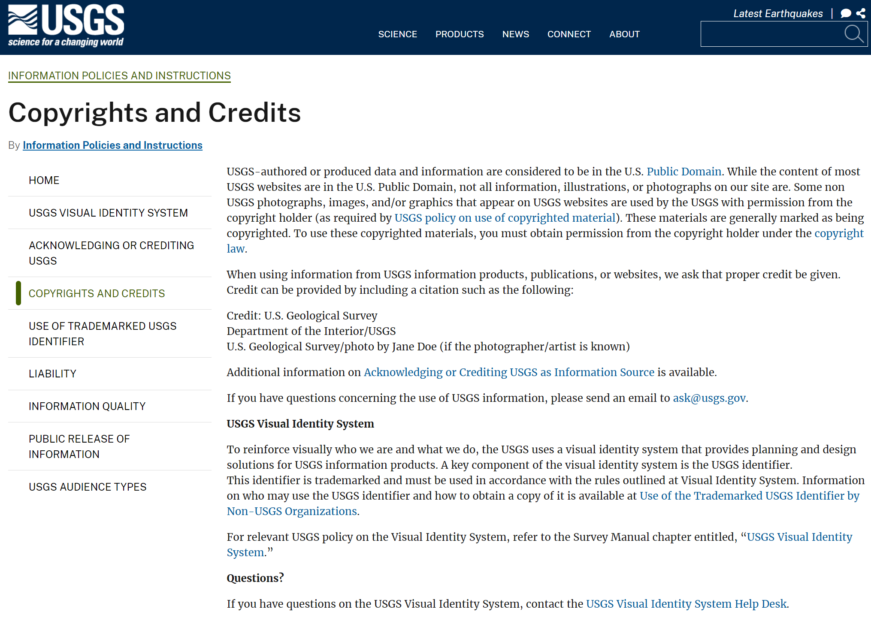
Terms of Use: Example
Website footer -> Legal -> Information Policies and Instructions -> Copyrights and Credits
https://www.usgs.gov/information-policies-and-instructions/copyrights-and-credits
Notes:
If a resource does not have a Creative Commons license, sometimes the "Terms of Use" on a parent website or in the frontmatter of the resource indicate what rights you might have. Here are two examples: U.S. Geological Service and TeacherTube. Can you come up with a third example? Possible one more permissive?

Slide 19

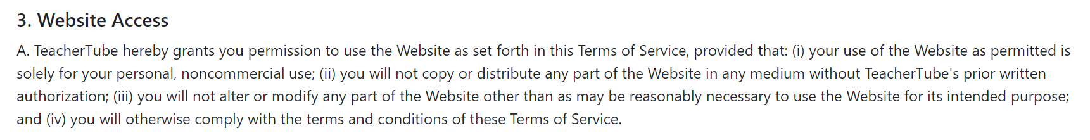
Terms of Use: Example
“. . . solely for your personal, noncommercial use . . . “
https://www.teachertube.com/terms-of-use

Slide 20
What is your “specific, proposed use”?
Examples
Display a high-resolution image in a class lecture
Insert an excerpt of a published paragraph or image and cite it. Distribute the overall work under a specific Creative Commons license.
Reproduce thumbnail image on the internet in a non-commercial setting to a global audience
Reproduce a high-resolution image in a commercial printed and (in perpetuity) digital publication with an anticipated print distribution of 1,000 and a digital subscriber audience of 15,000.
For which of these would you conduct a fair use analysis? For which would you already know that you should obtain permission?
Notes:
Let's talk about specific, proposed uses. Here are several examples of specific, proposed uses:
Display a high-resolution image in a class lecture
Insert an excerpt of a published paragraph or image and cite it. Distribute the overall work under a specific Creative Commons license.
Reproduce thumbnail image on the internet in a non-commercial setting to a global audience
Reproduce a high-resolution image in a commercial printed and (in perpetuity) digital publication with an anticipated print distribution of 1,000 and a digital subscriber audience of 15,000.
For which of these would you conduct a fair use analysis? For which would you already know that you should obtain permission?

Slide 21
What is your “specific, proposed use”?
For example:
I want to use to make a point in my lesson plan --
which will be shared with the public under a
Creative Commons license.
(The picture would be marked as © by someone else and is not subject to the Creative Commons license.)
May I do this?
This picture which is
© by someone else.
Notes:
You might ask - what does “my specific use” mean, and why does this matter?
In the same was as lending a bicycle, owners of things may wish to enforce limits on how long you do something with their work, where it is shared, and how it might be changed…. [In the same way that Hawa might say “No, I don’t permit you to use my bicycle in a race thru the mud…” or no, you may not borrow it for a week…]
How about this example? Thinking about your specific use -- especially how broad it is -- can help you know how much effort your project might be. Take a moment to read through the example "allowable uses." Which seem most permissive? Which are more restrictive but still useful? If someone wanted to use your work, would they be able to do what they wanted to do?

Slide 22
Activity: Compare “proposed uses” with “allowable uses”
Examples of your use:
Display a high-resolution image in a class lecture
Insert an excerpt of a published paragraph or image and cite it. Distribute the work under a specific Creative Commons license.
Reproduce thumbnail image on the internet in a non-commercial setting to a global audience
Reproduce a high-resolution image in a commercial printed and (in perpetuity) digital publication with an anticipated print distribution of 1,000 and a digital subscriber audience of 15,000.
Examples of “allowable uses” / terms/conditions of use
For research or personal study only (Interlibrary loan)
Copy, redistribute, remix, transform, and build upon for any purpose, even commercially WHEN attribution is provided. No additional restrictions may be added. (Creative Commons Attribution license - CC BY)
Classroom instruction, student assignments (personal use only), in a dissertation for library deposit… (ArtStore)
Notes:
Take a moment to compare proposed uses with allowable uses. . . then we'll give you a change to document your specific use . . . and if we want to later we'll return to this and to examine the possibilities for whether or not you can use something in the way you've proposed, and how.

Slide 23
Your turn: Determining “your specific, proposed use”
What do you want to use?
Nature/context of the use (share where, with whom, in what medium, for how long, and to what end? Will I add value to or otherwise transform it?).
What is the nature of the work? Is the work more “creative” or more factual?
How much of the work do you plan to use? In what size or resolution?
Commercial interests Is the work currently for sale? Does your proposed use compete with the copyright owner’s market?
Notes:
Now, it's your turn. What is a specific use you might have? What might you want to use, how, how much etc. Answer each of the questions on the "Your Turn" slide.
DISCUSSION / SHARING

Slide 24
Sharing (optional)

Slide 25
Fair Use:
Is my proposed use more fair than infringing according to an informed Fair Use analysis?
Think again about your specific use
How do you hope to use the copyrighted work?
How creative (vs. factual) is the work? Has the work already been published?
How much or how substantive is the part of the work you are using?
Does my proposed use harm the original copyright holder's market for their work?
Section 107 of the Copyright Act provides the framework for Fair Use
Not all educational use is fair use.
Outreach and sharing beyond your classroom changes the “purpose and character of the use”
Notes:
This is not a trick question. Not all educational use is fair use. And your proposed use -- especially if you are planning to share in a context broader than your classroom -- is broader that prior situations you have considered. A proposed, specific use should include aspects of:
How do you hope to use the copyrighted work?
How creative (vs. factual) is the work? Has the work already been published?
How much or how substantive is the part of the work you are using?
Does my proposed use harm the original copyright holder's market for their work?
There are a few things to know about fair use:
Section 107 of the Copyright Act provides the framework for Fair Use -- it describes the four factors.
Not all educational use is fair use.
Outreach and sharing beyond your classroom changes the “purpose and character of the use”

Slide 26
Is my proposed use more fair than infringing according to an informed Fair Use analysis?
FOUR FACTORS OF FAIR USE
Type of use
Character of the work
How much you’re using
+ Impact on the owner’s profit
= More fair or not very fair?
Uses that are more fair
Non-profit edu, limited audience
Factual
Using only a small part
Zero or minimal impact
Uses that are less fair
Large or unlimited audience
Creative
Using a large % of the work
Direct financial impacts
MORE FAIR MORE INFRINGING
Your proposed use might (or might not) be more “fair” than more “infringing”
Notes:
Uses are on a continuum. Some may be more fair. Some may be more infringing. A key question to ask is “how can I make my use MORE fair.”

Slide 27
What is Fair Use?
Fair use is a legal doctrine that promotes freedom of expression by permitting the unlicensed use of copyright-protected works in certain circumstances. Section 107 of the Copyright Act provides the statutory framework for determining whether something is a fair use and identifies certain types of uses—such as criticism, comment, news reporting, teaching, scholarship, and research—as examples of activities that may qualify as fair use. Section 107 calls for consideration of the following four factors in evaluating a question of fair use:
Purpose and character of the use, including whether the use is of a commercial nature or is for nonprofit educational purposes: Courts look at how the party claiming fair use is using the copyrighted work, and are more likely to find that nonprofit educational and noncommercial uses are fair. This does not mean, however, that all nonprofit education and noncommercial uses are fair and all commercial uses are not fair; instead, courts will balance the purpose and character of the use against the other factors below. Additionally, “transformative” uses are more likely to be considered fair. Transformative uses are those that add something new, with a further purpose or different character, and do not substitute for the original use of the work.
Nature of the copyrighted work: This factor analyzes the degree to which the work that was used relates to copyright’s purpose of encouraging creative expression. Thus, using a more creative or imaginative work (such as a novel, movie, or song) is less likely to support a claim of a fair use than using a factual work (such as a technical article or news item). In addition, use of an unpublished work is less likely to be considered fair.
Amount and substantiality of the portion used in relation to the copyrighted work as a whole: Under this factor, courts look at both the quantity and quality of the copyrighted material that was used. If the use includes a large portion of the copyrighted work, fair use is less likely to be found; if the use employs only a small amount of copyrighted material, fair use is more likely. That said, some courts have found use of an entire work to be fair under certain circumstances. And in other contexts, using even a small amount of a copyrighted work was determined not to be fair because the selection was an important part—or the “heart”—of the work.
Effect of the use upon the potential market for or value of the copyrighted work: Here, courts review whether, and to what extent, the unlicensed use harms the existing or future market for the copyright owner’s original work. In assessing this factor, courts consider whether the use is hurting the current market for the original work (for example, by displacing sales of the original) and/or whether the use could cause substantial harm if it were to become widespread.
In addition to the above, other factors may also be considered by a court in weighing a fair use question, depending upon the circumstances. Courts evaluate fair use claims on a case-bycase basis, and the outcome of any given case depends on a fact-specific inquiry. This means that there is no formula to ensure that a predetermined percentage or amount of a work—or specific number of words, lines, pages, copies—may be used without permission. https://www.copyright.gov/fair-use
Notes:
In detail, here are the four factors from the U.S. Copyright Office:

Slide 28
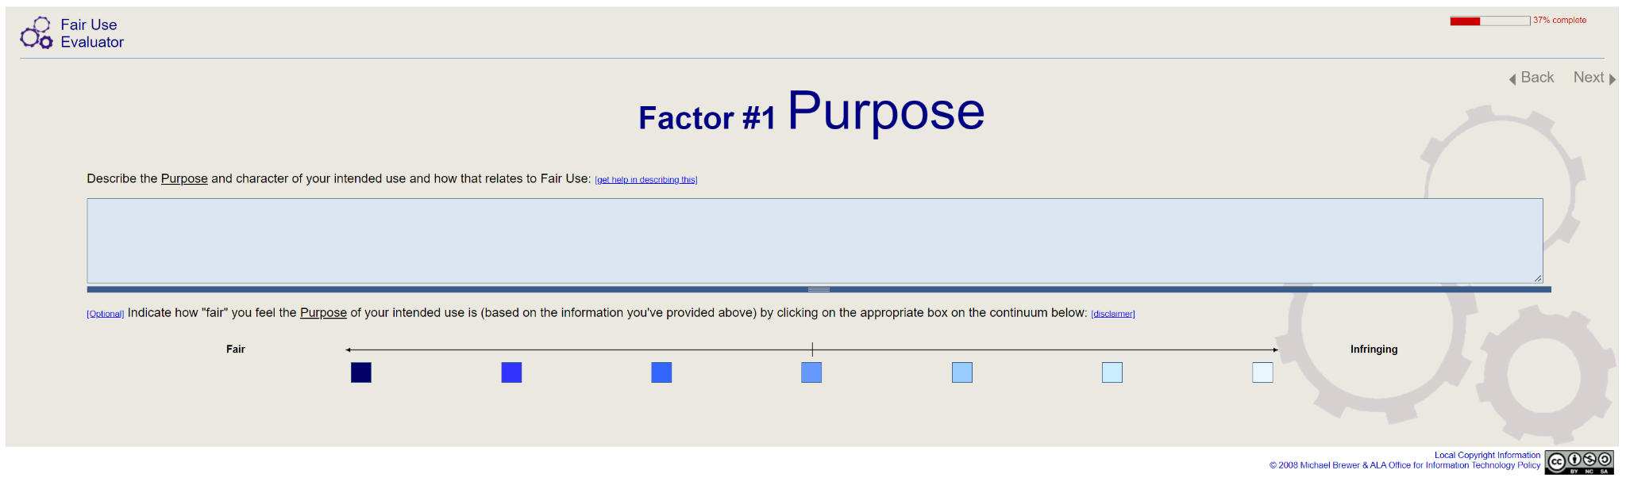
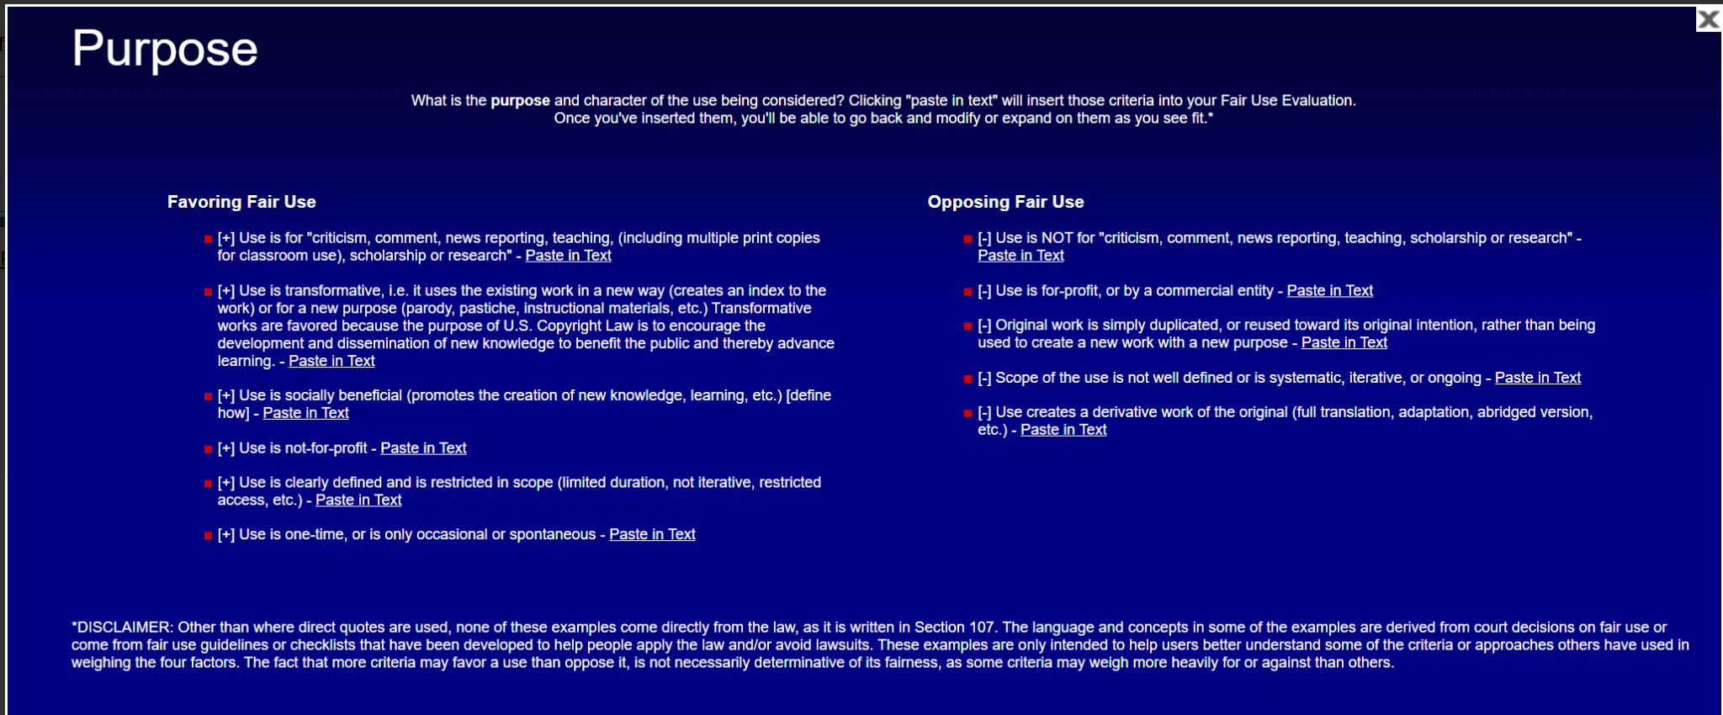
Tools and Resources for Fair Use
Fair Use Evaluator: https://librarycopyright.net/resources/fairuse/index.php
Code of Best Practices in Fair Use for Open Educational Resources
https://www.wcl.american.edu/impact/initiatives-programs/pijip/impact/best-practices-in-fair-use/best-practices-in-fair-use-for-open-educational-resources/
Notes:
Several resources may be helpful to you:
The Fair Use Evaluator
Code of Best Practices in Fair Use for Open Educational Resources (see pages 11-14)

Slide 29
Last resort -- Obtain permission
You’ve already confirmed the copyright status
Identify the copyright owner and their contact details.
Make your request: Describe the exact portion of the work you want to reproduce.
In detail, how you want to use the material (including duration and format)
Audience of your material
Whether the material is to be sold
(optional) Ask that the material be released under the same Creative Commons license as the overall work.
Get it in writing.
“How to Obtain Permission” https://www.copyright.gov/circs/m10.pdf
“Release form for Media, Illustrations, and Figures” http://hdl.handle.net/10919/105384
Notes:
And finally, as a last resort -- obtain permission. Again, obtaining permission goes beyond just asking for permission. Just as you need a "yes" from Hawa to use her bicycle, you must get to "yes" to be able to copy and redistribute the work. Further information for requesting permission is available in the U.S. Copyright Office circular #10. You'll need to identify and contact the owner of the work, describe how what you want to use, when and how you want to use it. You might also ask for the in-copyright work to be released under the same Creative Commons license as your overall work. And, get it all in writing
Several resources may be helpful to you:
Example: Release form for Media, Illustrations, and Figures
U.S. Copyright Office on How to Obtain Permission

Slide 30
What to do when you don’t have enough rights (or are not sure that you have enough rights)
Look for alternatives: Find openly-licensed or Public Domain equivalent material that meets the same need.
Consider asserting a fair use*. Use less, smaller, lower resolution. . . only as much as is necessary.
Use a work in a different or transformative* way than it was intended. Add value to the work.
Obtain permission. When, where, how much + may I release this under the same open license as my work?
Create original work. Take your own picture. Make your own drawing. Put the idea in your own words. [and cite it!]

Slide 31
Mark third-party content within your document
Examples:
Creative Commons license
Best Practices for Attribution of CC-license content
Example: © David Lenker Strawberry CC BY 2.0
Public domain (not in copyright)
USGS Website. Public Domain
Permission
© Author. Name of the work. Reproduced with permission. OR
© Author. Name of the work. Reproduced with permission under CC BY 4.0.
Fair Use
© Author. Name of the work. Adapted under fair use.
© Author. Name of the work. Used under fair use.
Notes:
Finally, if you use content that is not your own -- regardless of weather it is CC licensed, public domain, permission-granted or used under fair use, do other users a favor and indicate the status of that material. Here are some examples.

Slide 32
Review/Discuss
List the three options for you to use another’s work, or for others to use your work.
If you wanted to incorporate part of someone else’s work into yours, describe the steps you would take to determine if that is ok.
Which of the three options seems easiest for incorporating others’ work in your own?
Which of the three options requires that you think most carefully about your “proposed use?” Why is that important?
Does any of this change your thinking about how you might share?
© Anita Walz. Licensed under CC BY 4.0
http://hdl.handle.net/10919/112264

