Slide 1

Team 5 - Infrastructure & DevOps
Advised by Dr. Edward Fox
Subject Matter Experts: Dhanush Dinesh, Satvik Chekuri
December 5, 2023
CS5604: Information Storage and Retrieval
Blacksburg, VA 24061 USA

Slide 2
Introduction
The Infrastructure and DevOps team is responsible for facilitating API enablement, providing Database and Filesystem Access via APIs, orchestrating CI/CD pipelines and ensuring smooth deployment to the Endeavour Kubernetes Cluster for the other teams.
Team Members:
Adeyemi Aina
Amritha Subramanian
Hung-Wei Hsu
Shalini Rama
Vasundhara Gowrishankar
Yu-Chung Cheng
Notes:
Our responsibilities include enabling APIs, managing databases, handling filesystems, facilitating deployments to Endeavour, and overseeing the CI/CD pipeline.

Slide 3
Agenda
System Architecture
Troubleshooting
Kubernetes
Kafka Usage and Monitoring
APIs
Database
File System
CI/CD
Future Works
Notes:
Understanding Our System's Design and Structure
Discussion on Various Issues Encountered and Their Resolutions
Kubernetes
Kafka usage and monitoring
APIs
Database
File System
CI/CD

Slide 4
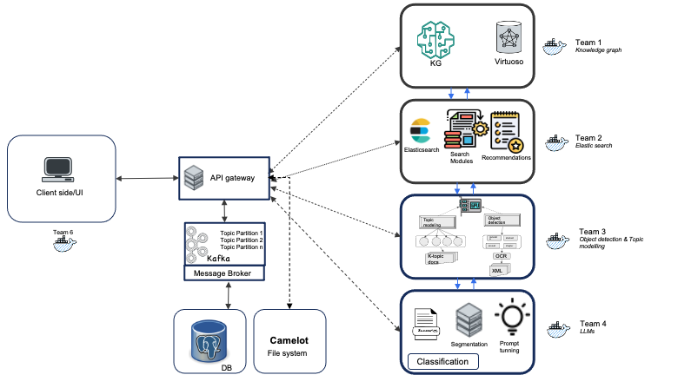
System Architecture
The design of the overall system is a Microservice architecture; each team’s service is a suite of independently deployable modular service all communicating through an API gateway to other services. The diagram below shows a holistic view of the system architecture.

Slide 5
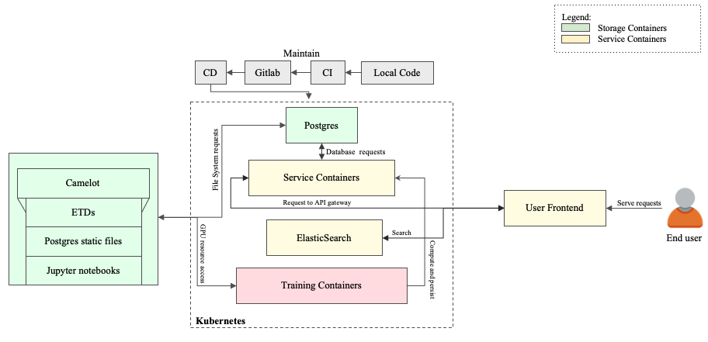
System Process Flow ^{1/2}
The diagram below gives an holistic view of the system and process flow of the microservices, including a detailed understanding of how individual components behave and interact with each other.

Slide 6
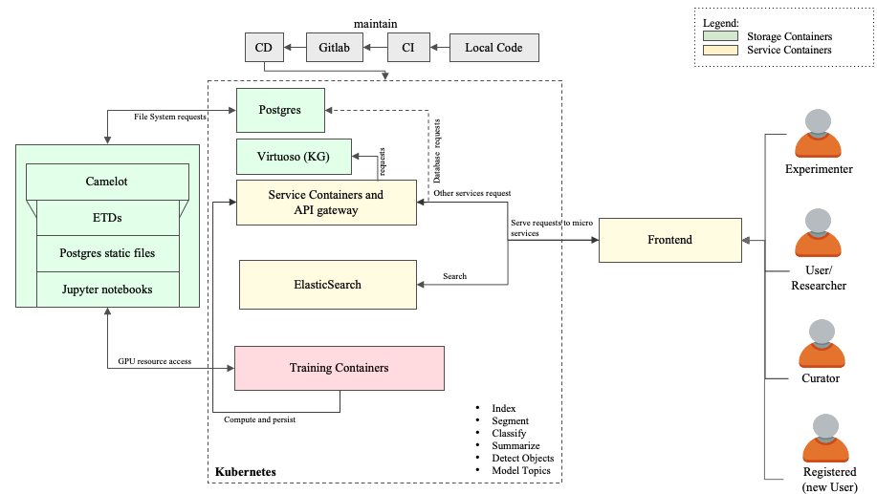
System Process Flow ^{2/2}
The diagram below gives a more detailed view of the system and shows the different personas interacting with the microservices from the other teams.

Slide 7
Troubleshooting
Security
  Provide a persistent storage to save the secure data.
    Token
    ElasticSearch config
CI/CD
  Disk
    GitLab-runner will not clean Docker data.
    Use cron job to clean it.
  VM’s Maximum Transmission Unit (MTU) problem
    Docker on VM can’t access GitLab.
    Align the MTU for Docker with VM.

Slide 8
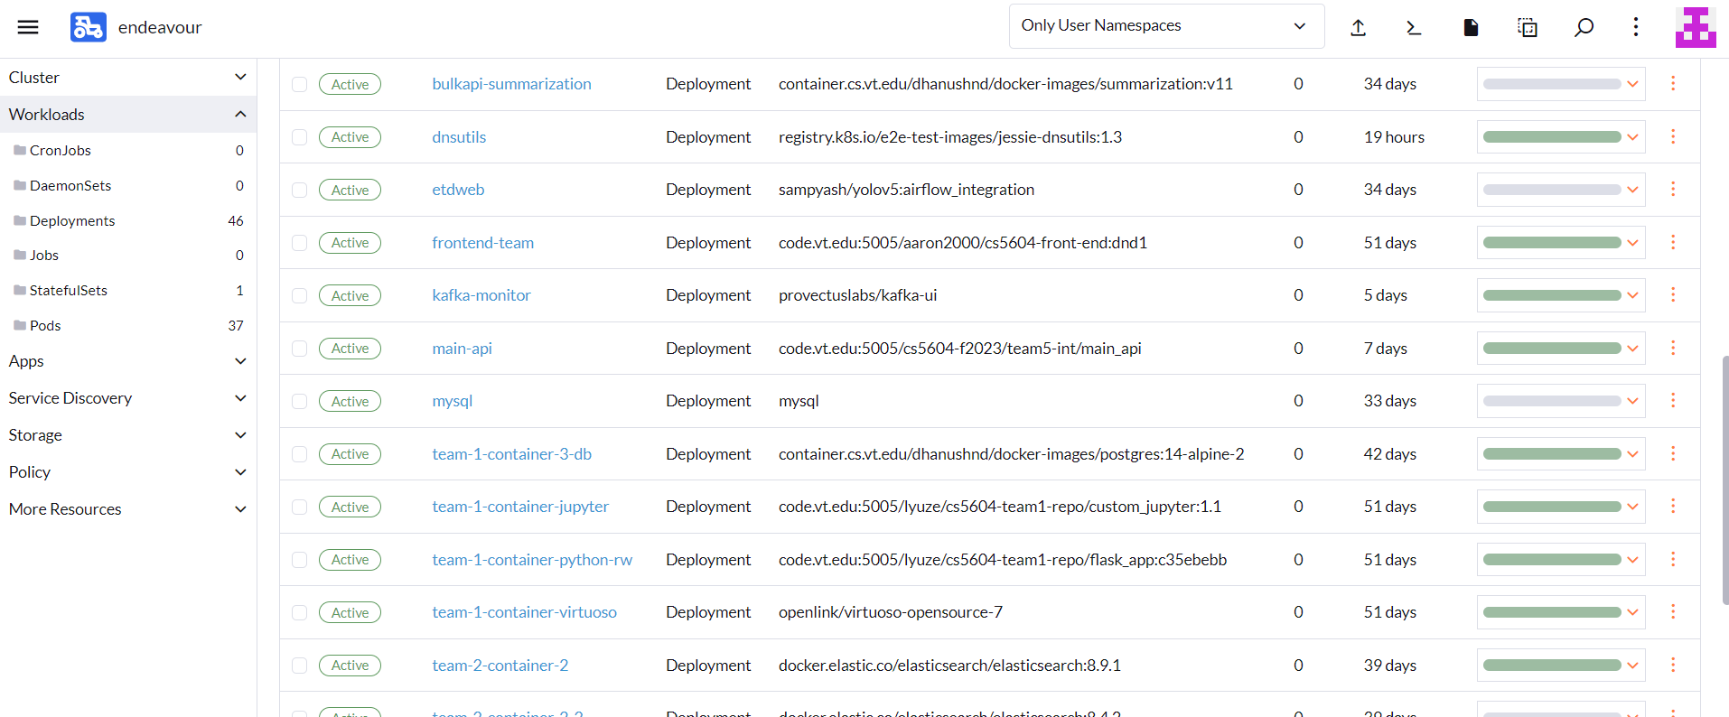
Migration
Provisioned cloud cluster resources:
  Created containers for each team with Jupyter environment.
  Use Camelot to provision persistent file system to containers.
  Use Ingress to enable external access to the cluster.
  Migrate containers to Endeavour.

Slide 9
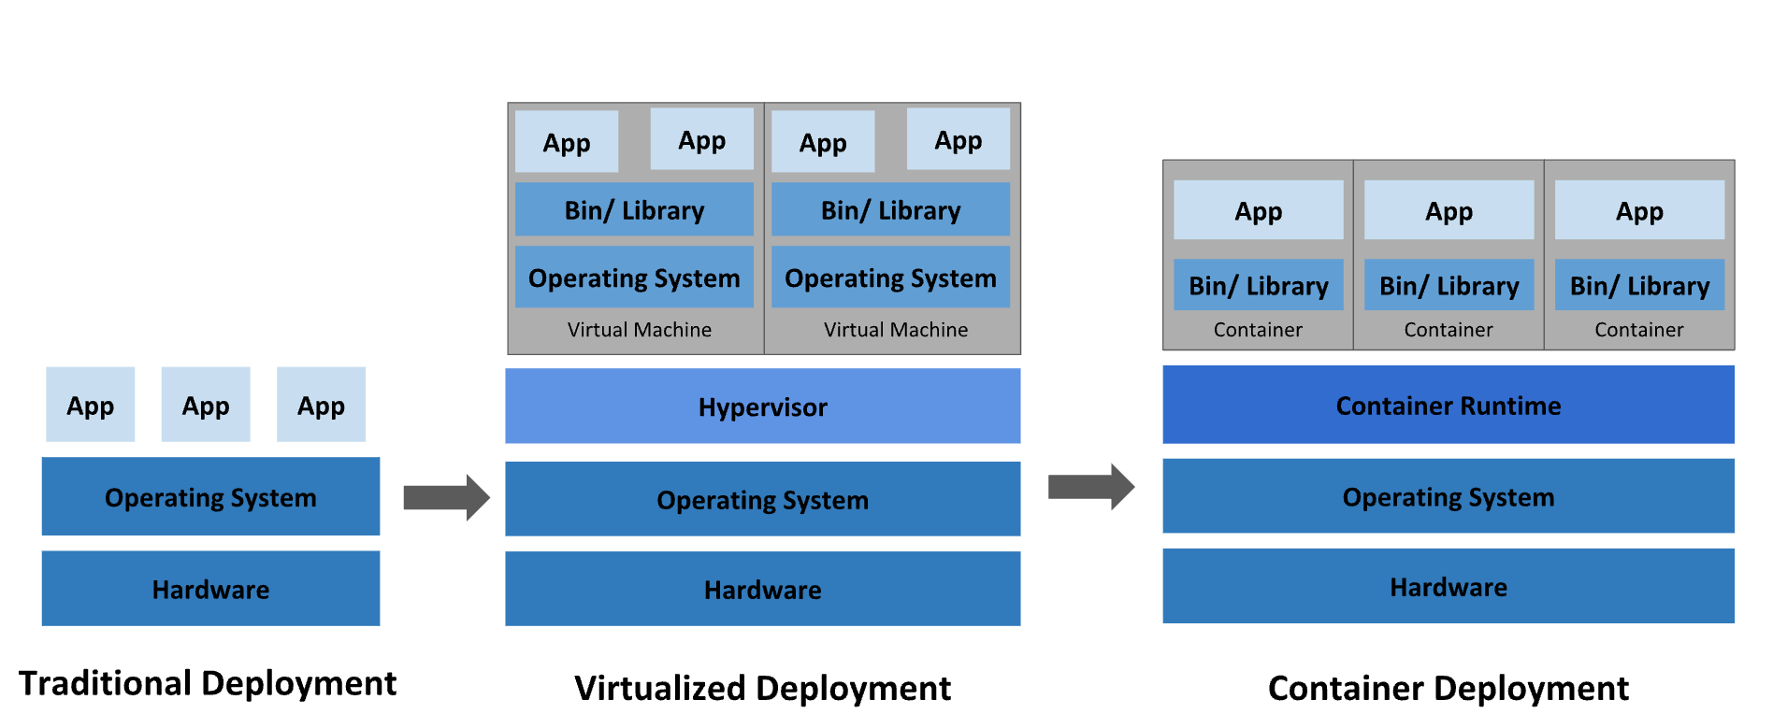
Kubernetes
https://kubernetes.io/images/docs/Container_Evolution.svg

Slide 10
Kubernetes & Rancher
Kubernetes (k8s)
  Open source container orchestration tool.
  Helps manage containerized application in different deployment environments.
  1 Master node, 1-N server nodes.
Kubectl is the k8s command line tool to control the k8s cluster manager.
Rancher
  Open-source platform on top of k8s.
  Provides all-in-one administration of clusters, easy-deployment.
  Provides user interface for users to interact with the cluster; easy to get started.
Notes:
Deployment - makes development easier, provide monitoring tools,

Slide 11
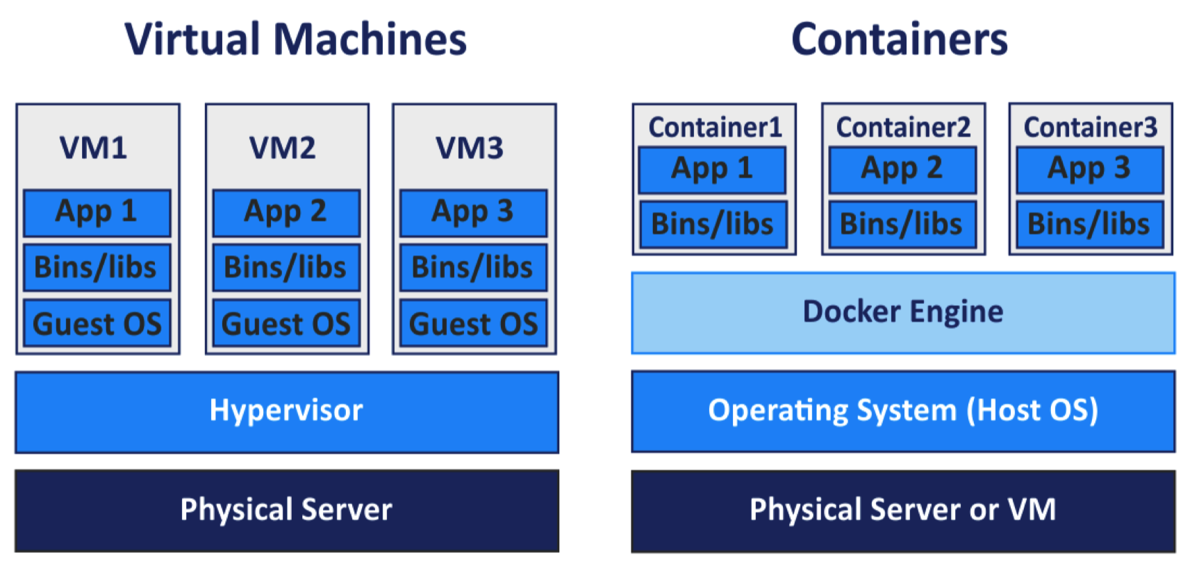


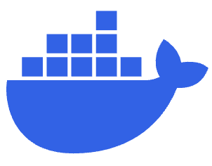

Docker and Containers
Docker
  Virtualization software
  Easy Applications Deployment
  Packages App with essential configuration and tools.
Container
  A standardized unit that includes everything needed to run an application.

Slide 12
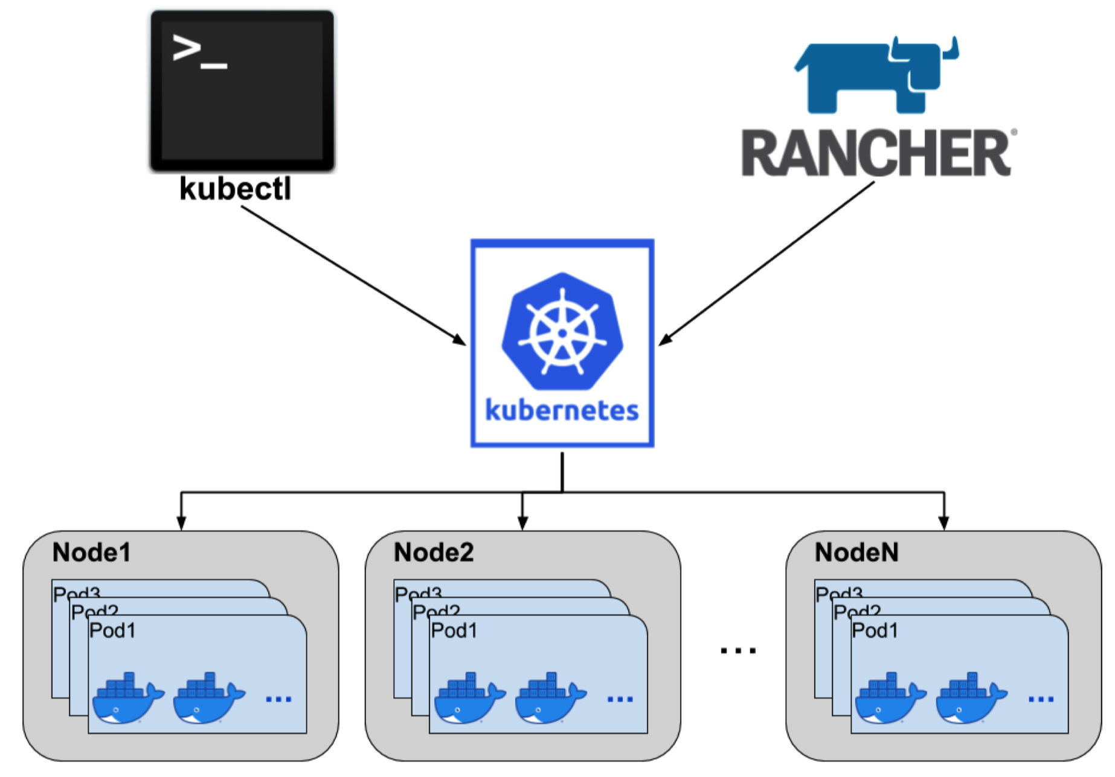
Relationship between k8s, kubectl and Rancher
Notes:
Think of Docker as a magic box. It lets us package our software with everything it needs to run, so it works the same way for everyone, no matter where it's used.
Imagine you have a lot of these magic boxes (Docker containers) and you need to organize them. That's where Kubernetes comes in. It's like a traffic cop, directing the boxes to where they need to go. Rancher is like a helper for Kubernetes, making it even easier to manage everything.

Slide 13

K8s Network
Calico Crushing
  Kubernetes’ “service” can’t forward network packets
  between each service.
Reproduce
  We built up a simple HTTP server to prove this issue to CS Tech Team.
Resolve
  CS Tech Team restart Calico to resolve it.

Slide 14
Kafka
The example code is located at https://code.vt.edu/cs5604-f2023/kafka_example.
How to create topic?
  Just subscribe or produce a message with any topic you like.
  You can check the topics on https://kafka-monitor.endeavour.cs.vt.edu/ui/clusters/broker-kafka/all-topics?hideInternal=true&page=1.
What needs to be decided between each TEAM?
  The topic name
  The data format
    String
    Binary data
    etc.
Notice: the message should not be bigger than 1MB.

Slide 15
API Implementation
In the development of the APIs, we adhered to some key RESTful principles to ensure it was efficient, scalable, and easy to maintain:
Client-Server Architecture: The client and the server operate independently, allowing each to evolve separately.
Uniform Interface: A consistent and standardized approach to how the client interacts with the application. This includes using standard HTTP methods (GET, POST, PUT) and URLs to manipulate resources.

Slide 16
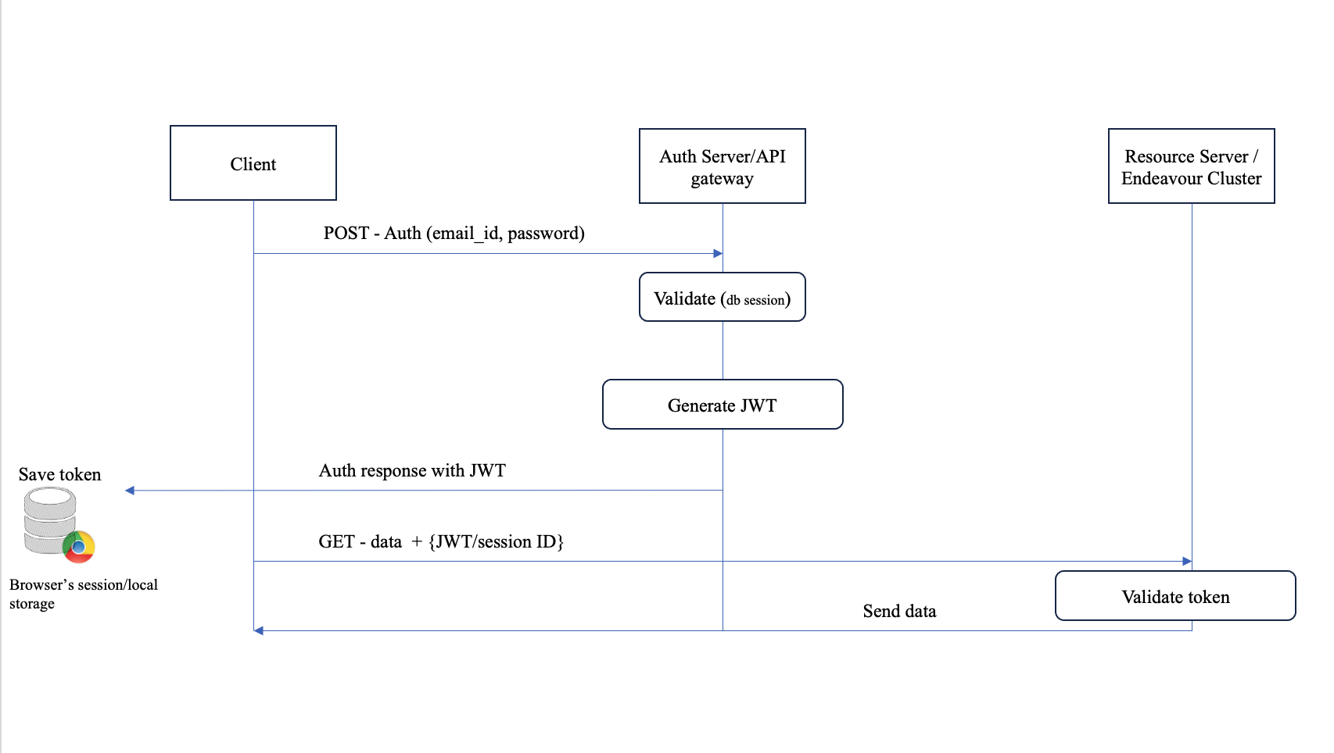
JWT Authentication
In the API gateway, a token-based authentication using JSON Web Tokens (JWTs) is implemented for user authentication. JWTs are an open standard that defines a compact and self-contained way for securely transmitting information between parties as a JSON object; the diagram below shows the cycle of the authentication.

Slide 17
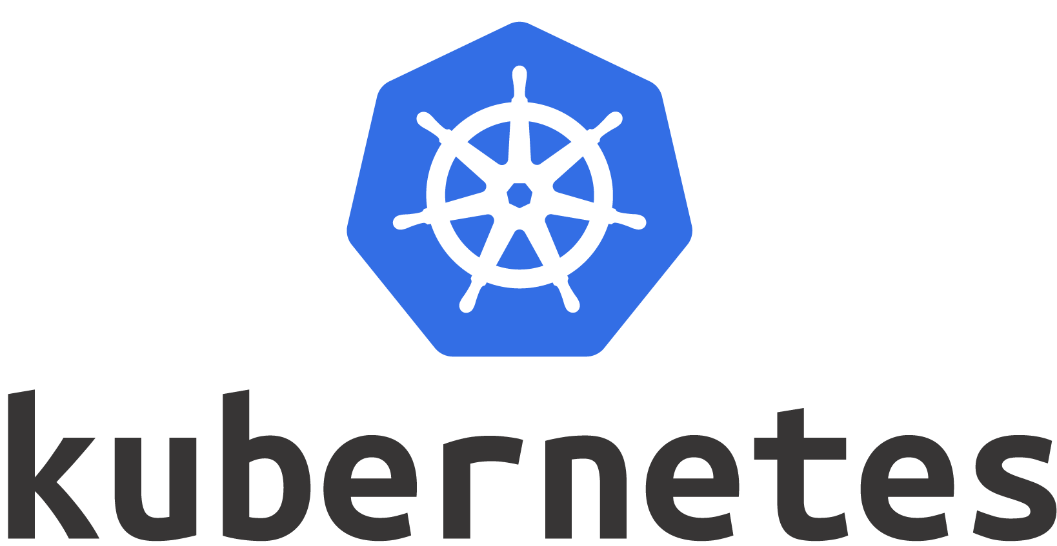
Security Measures
Sensitive Data Management: We used Kubernetes Secrets and config maps to store sensitive information for the Databases; Filesystem mount and other sensitive credentials are encoded on the Kubernetes cluster:
JWT Secret key
DB credentials and Container keys
API Keys
Camelot Service
(mount path)

Slide 18

Role Based Access Control
RBAC is a method of regulating access to a system or network resources based on the roles of individual users.
Roles Defined: Curator, Experimenter, Registered, and User. Each role has specific permissions and access levels.
Registered
User
Experimenter
Curator
Access Control: The system checks a user’s role before granting access to different parts of the application. For example, only Curators have access to user management, Curator screens and all other features of the system.

Slide 19
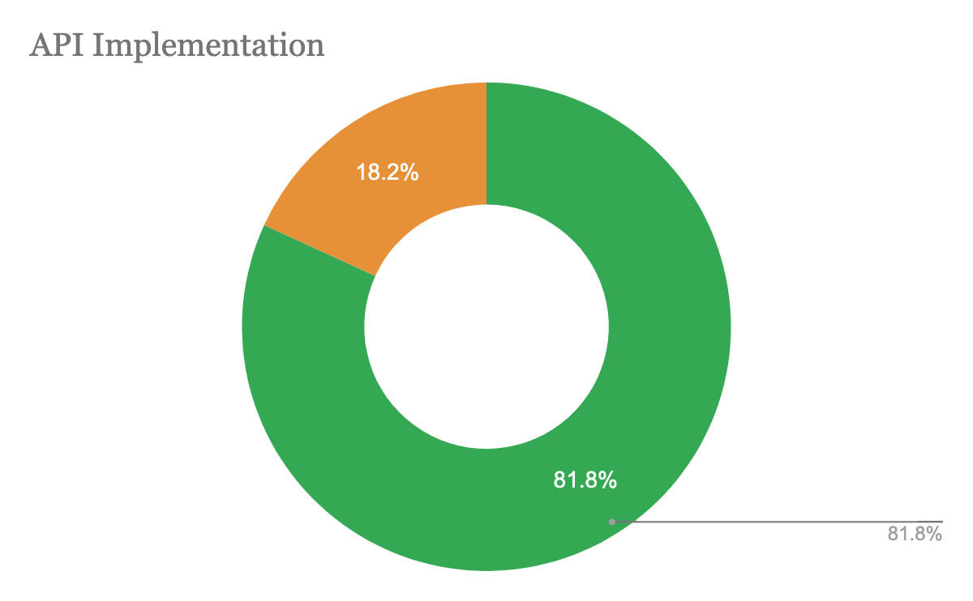
APIs
Work done
  Completed API documentation.
  Completed API gateway scaffold setup on the cluster.
  Exposed the API for Database connection
  Implemented Role Based Access Control.
  Secured all endpoints with API keys, JWT for user authentication.
Progress
  Implemented 45 out of 55 APIs.
  Address issues with the current implemented APIs.
  Validating API list with the respective teams.
  Write test routines for all API endpoints.
Future work
  Collaborate with the ElasticSearch team for a fine grained logging.
  Begin implementation openapi standards documentation with swagger.

Slide 20
File system
Work done
  Added path information to new Database schema.
  Created new path for 200+ segmented ETDs, update to Database schema.
  Finalized the structure of the file system while considering the new Database tables.
  Provided APIs to team 3 and team 4 regarding file system.
Future work
  Co-work APIs with team 3 and team 4.
  Address issues with the current implemented APIs.

Slide 21
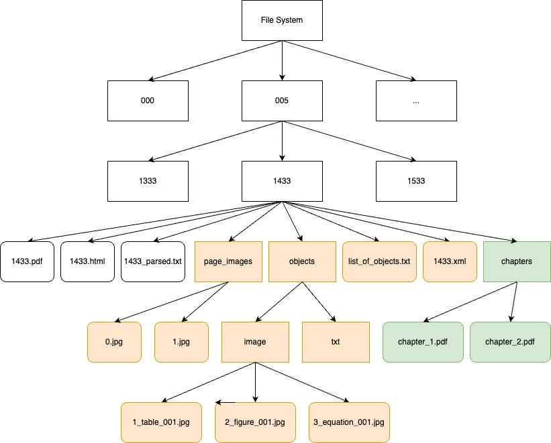
File system
Hierarchy

Slide 22
File system: APIs
GET API Endpoint to Retrieve ETD.
  services/etds/<int:etd_id>
GET API Endpoint to Retrieve PDF File.
  services/etds/<int:etd_id>/pdf
Save page image (page of .pdf).
  services/save-page-image
Retrieve page image with pageID.
  services/retrieve-page-image/<int:page_id>
Store the detected objects.
  services/store-object
Store the generated XML file.
  services/store-xml

Slide 23
Database
Milestones
  Initial Database version comprised of 9 tables.
  Developed a new Database schema with a set of additional tables.
  Established relationships between multiple tables for data consistency.
  Ensured a seamless migration process from the old Database schema to the new schema.
  Provided support to other teams regarding Database-related queries and issues.
  Ensured successful data population of ETD and ETDs_metadata tables.

Slide 24
Database Challenges
Choosing Data Types:
Encountered difficulties in selecting appropriate data types for columns during tables creation.
Resolved by collaborating with various teams to understand specific data needs and requirements.
Database Update:
Updating the Database with 500k records was time-consuming due to the data volume. Developed efficient scripts that significantly reduced the time required for data population.

Slide 25
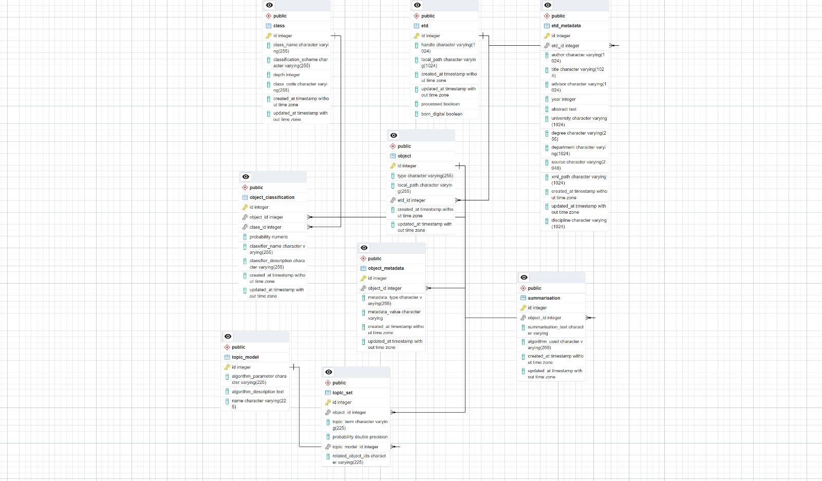
Old Database Schema
The below image represents the existing version of the Database schema and how the tables are related to one and other.

Slide 26
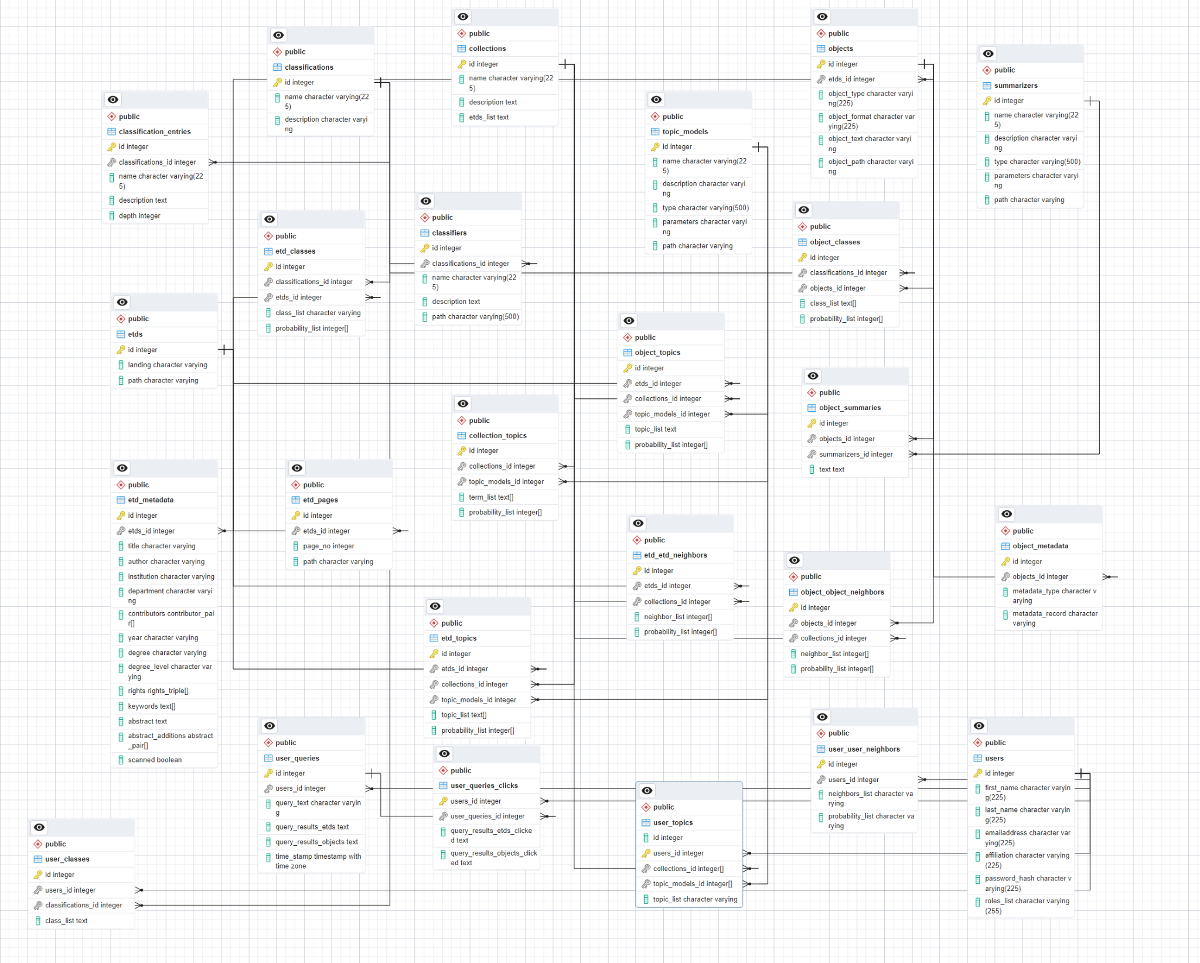
Current Database Schema

Slide 27
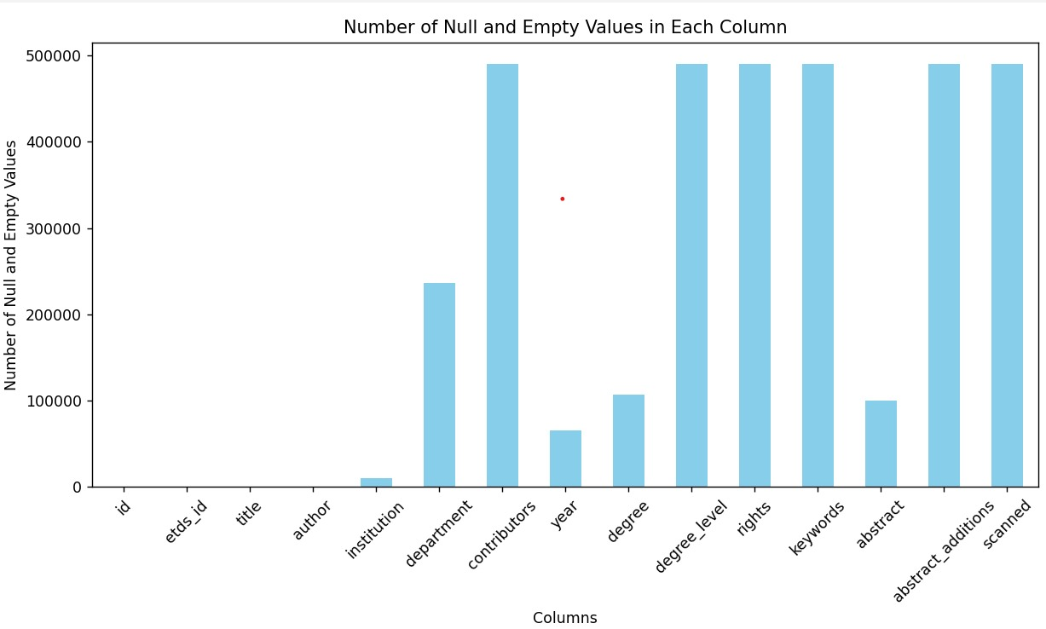
Database Statistics

Slide 28
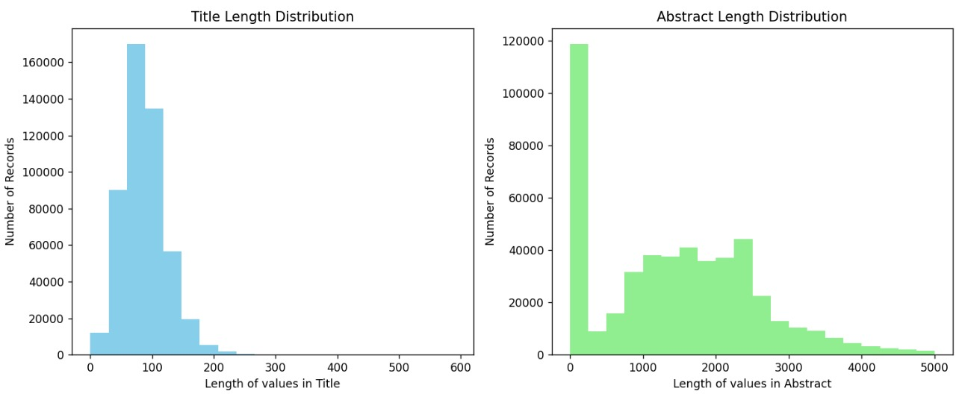

Slide 29
CI-CD
Milestones accomplished:
Create a group runner for the project.
Establish connection between group runner and Gitlab code-repository.
Create group token for running CI-CD setup.
Create sample CI-CD guide.
Test deployment pipeline that builds, tests and deploys to endeavour cluster.

Slide 30
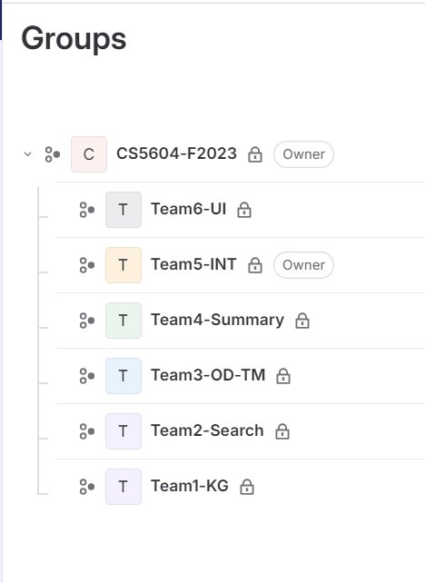
CI-CD
Gitlab Group to host codebase for all teams

Slide 31
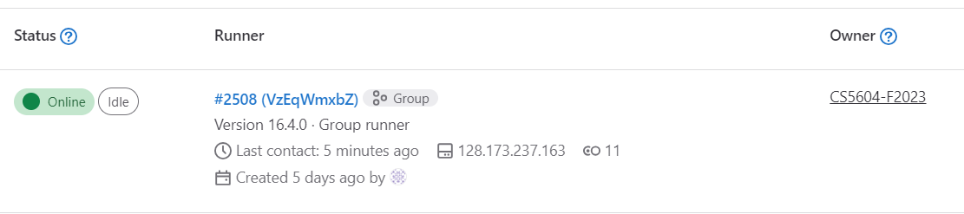
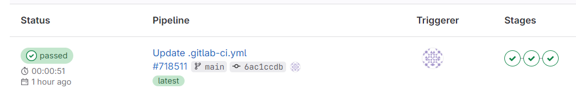
CI-CD
Group runner for the project that is connected to the Gitlab code-repository.
Test deployment pipeline to deploy to endeavour cluster.

Slide 32
Future Work
Implement CI-CD pipeline for Database.
Change the data types of the columns in the Database as per the requirement of other teams.
Address issues with the current implemented APIs.

Slide 33
Thank You!
Class of F23’
Dr. Fox
Satvik Chekuri
Xiao Liang
Danush Dinesh

