Slide 1
Strategies for Extending Your Hay Supply
Andy Overbay
Smyth Washington Cattleman’s Assocaiton
November 28, 2016

Slide 2
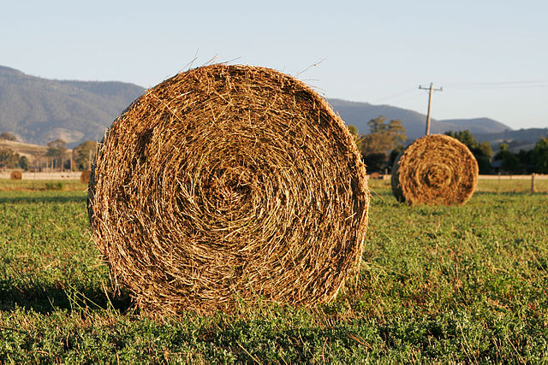
Determine what you need

Slide 3
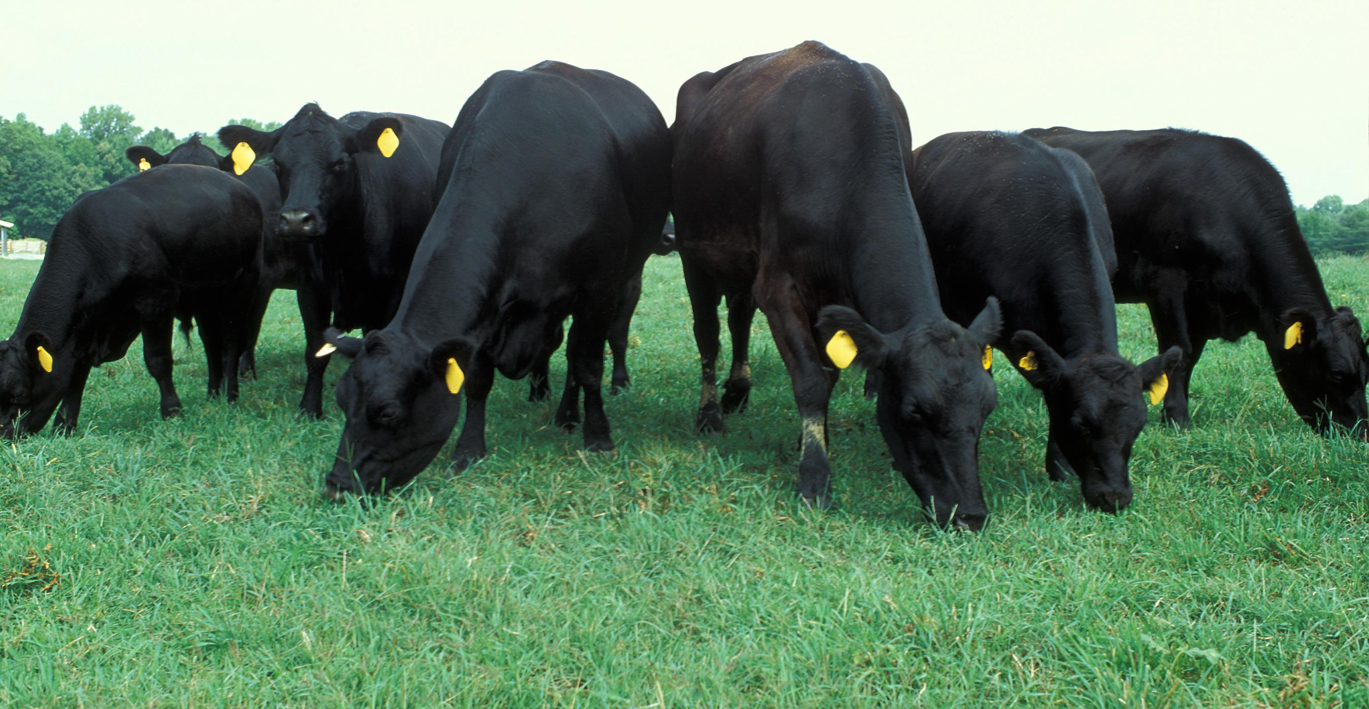
Determine what you need
How many animals are to be wintered?

Slide 4

Determine what you need
What are the animals’ nutritional needs ?
Mature cow eats
About 25-30#
27-32#/ Cow/Day
Weaned calves 50%
Yearlings 75%

Slide 5

Determine what you need
How many days are you going to feed?

Slide 6
Determine what you need
Example: 50 Cows and 10 replacement heifers
32#/Head x 123 days x 50 cows = 196,800 pounds
16#/Head x 123 days x 10 heifers = 19,680 Pounds
108.24 Tons

Slide 7
Determine what you have
What do your bales weigh?
    1000 pounds? 217 bales
    750 pounds? 289 bales
    400 pounds? 542 bales

Slide 8
Determine what you have
Are you going to be short?
How short?
What are the alternatives?

Slide 9

Now that we know where we stand, what are our options?
Buy supplemental grain/concentrates
Buy supplemental forages
Depopulate the herd

Slide 10
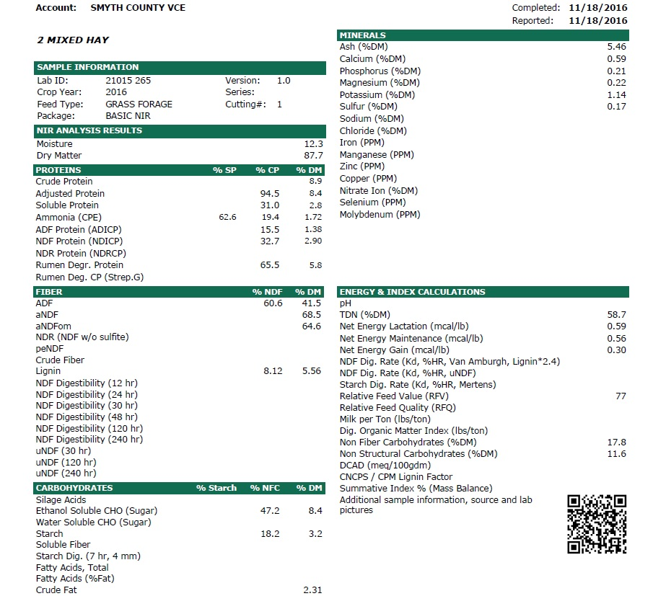
Supplemental Grain
Sample and test your on-hand hay

Slide 11
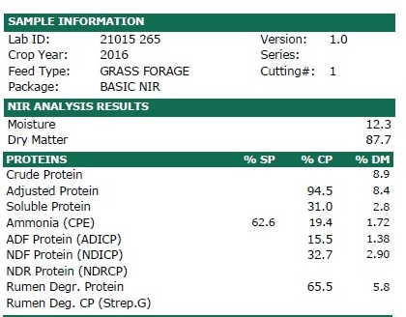

Slide 12
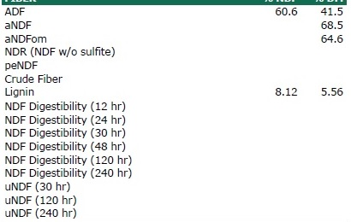

Slide 13
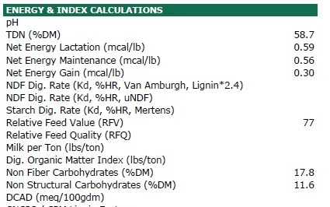

Slide 14
If this was your hay…..
Shelled Corn?
Cotton Seed Hulls?
Soybean Meal?
In this case…
Protein is the most lacking
nutrient

Slide 15
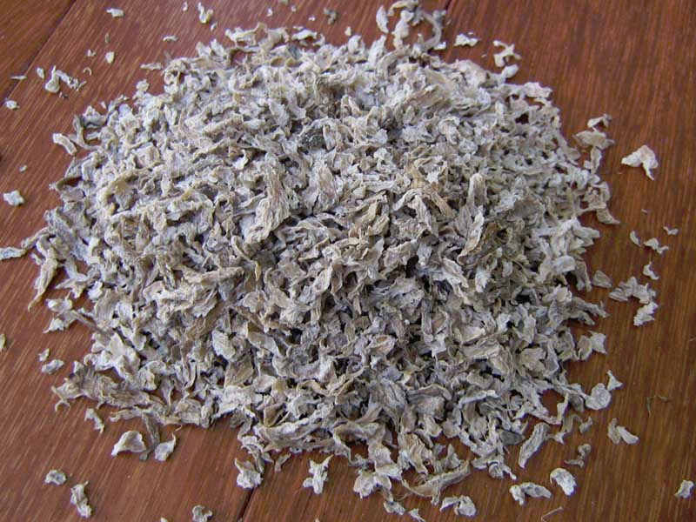
Supplementing forages with grain
Fiber sources
  Cotton Seed Hulls
  Soy Hulls
  Citrus Pulp
  Beet Pulp
  Cottonseed
  Brewers Grain

Slide 16
Supplementing forages with grain
Pros
  Easiest to find
Cons
  Expensive
  Digestive Limits

Slide 17
Supplementing Forages
Hay
Corn Silage
Maltlage

Slide 18
Supplementing Forages
Hay
  Buy on ton basis
  Buy at least as good as what you have
  Buy with the cattle in mind
  Consideration
    Cost/availability
    Freight
    Storage

Slide 19
Supplementing Forages
Corn Silage and Maltlage
  Cost (Corn $/Bushel Price X 10)
  Fiber and grain
  Considerations
    Availability
    Freight
    Storage
    Feeding schedule (Daily)
    Bunk Space/Design (24-30 inches for cows; 18+ for calves)

Slide 20
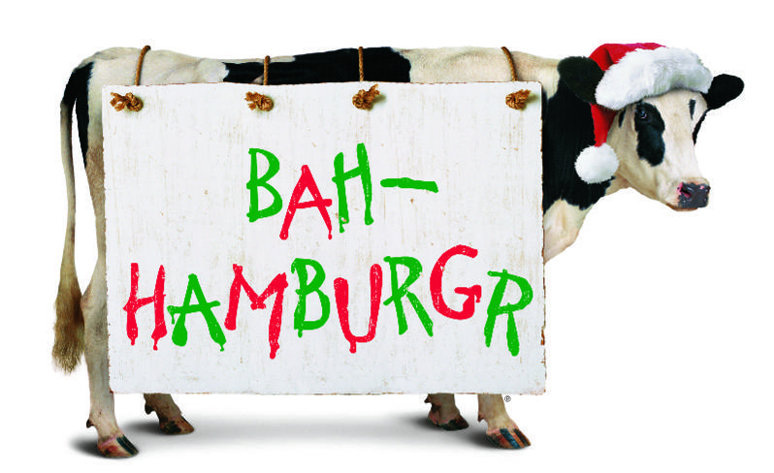
Depopulating the Herd

Slide 21
