Slide 1
Tracking FEMA
Kevin Kays, Emily Maier, Tyler Leskanic, Seth Cannon
Spring 2015 CS4624 Professor Edward Fox
Department of Computer Science at Virginia Tech

Slide 2
Background
Client: Seungwon Yang, postdoctoral researcher at GMU.
Goal: Using articles from CTRnet/IDEAL collections, graph trends for emergency management agencies.

Slide 3
Deliverables
A website showing interactive visualizations
All the scripts used for processing and visualizing data (for future work)
Git: https://git.cs.vt.edu/kkays/trackingfema

Slide 4
Implementation
Divided Implementation into four parts:
Parsing (Emily)
Processing (Kevin)
Visualizations (Seth)
Content Management System (Tyler)

Slide 5
Parsing
Python scripts to download all of the articles we’re using
Downloaded article base used iteratively in order to create output files
Output title, subtitle, author, date, body text, and anchor text

Slide 6
Parsing
Python using the BeautifulSoup library
It can pull HTML elements out of an article using almost any imaginable criteria
Each metadata type has set of functions that examine the document
Functions run successively until match found

Slide 7
Processing
Python and NLTK (www.nltk.org)
Run as a timed job in the background
Two major components:
Raw article processor creates “Mention Files”
Summary file creator organizes information

Slide 8
Processing
Raw Article Processor
Finds entity names in articles
Records count of entity names, organized by entity type (location, person, agency)
Summary File Creator
Creates single “Summary Files” for visualizing
“Locations by Disaster”, “Related people and agencies”, etc.

Slide 9
Visualization
Graphs using D3
JavaScript framework
Data Representation
Location by disaster
People involved by disaster
Organizations involved by disaster

Slide 10
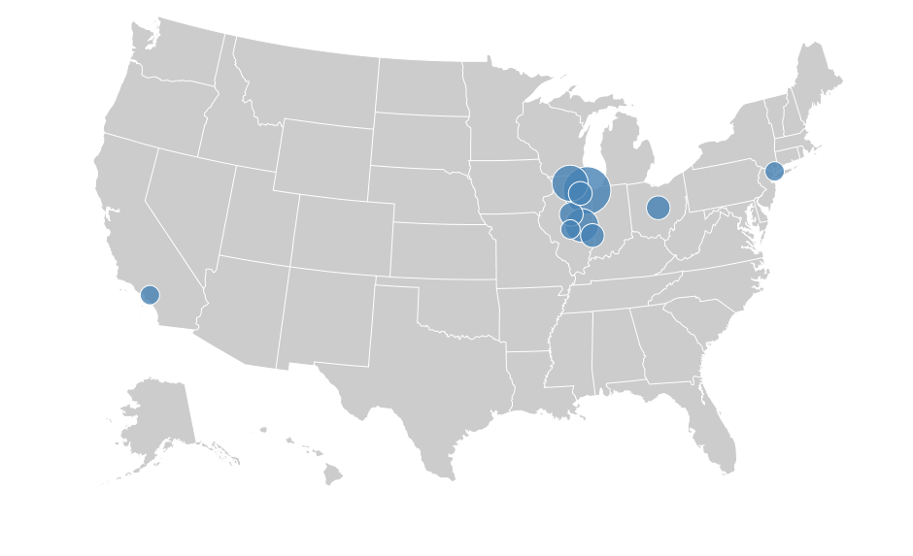
Northern Illinois University Shooting

Slide 11
CMS
RefineryCMS 2.1.5
Provide user friendly way to edit content of the site.
Built in webserver since it’s built on Rails.
Future possibility: execute parsing/data processing scripts through admin tool.
Bootstrap Front End Framework
Provides out of the box styling, that can be customized.
Enabled for fast responsive design so site can be used from a mobile phone.

Slide 12
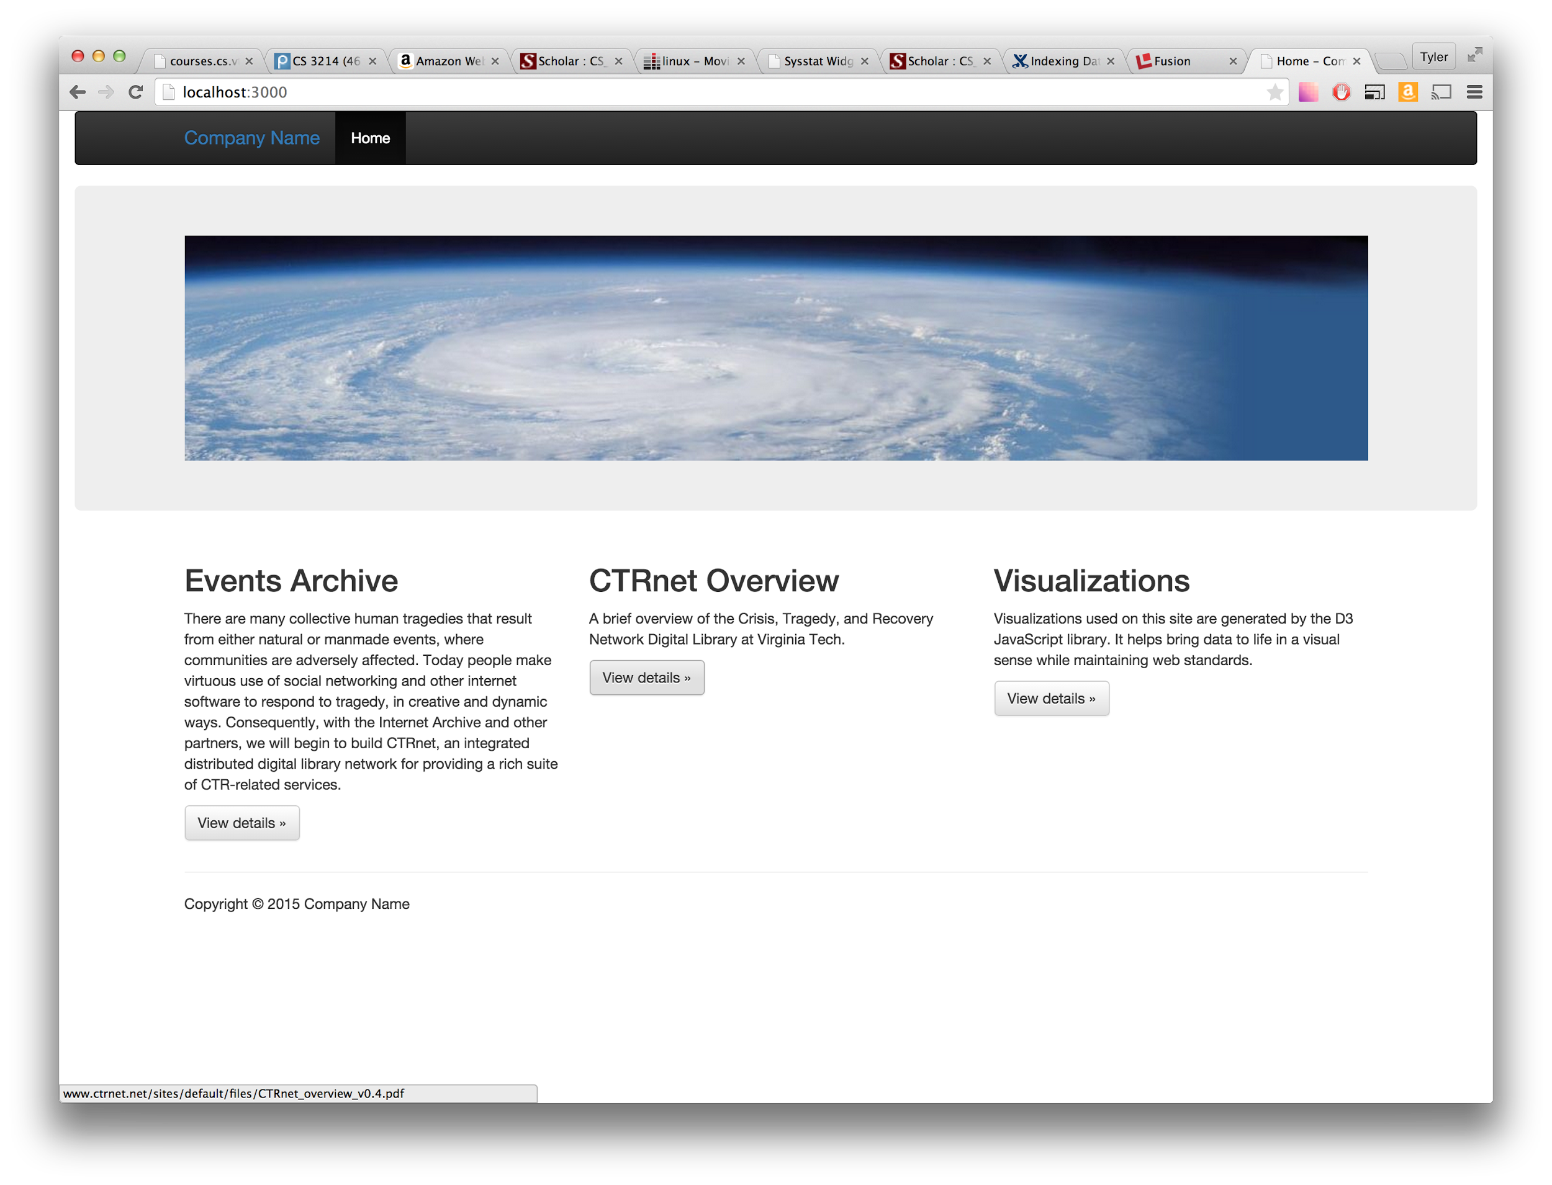
Homepage Layout

Slide 13
Suggested Improvements
Automate loading data into the visualizations
Process more types of information (dollar amounts, etc)
Add more metadata types to the parser
Use a different parser more like how humans read

Slide 14
What we learned
NLTK is complicated
Have more than one person per role

Slide 15
Acknowledgements
Seungwon Yang, our client, for the great opportunity, project idea, and suggestions.
Dr. Fox and Liangzhe Chen for the quick feedback and guidance with our report

Slide 16
Thank You
Questions?

