Slide 1
Tax Data Project
Nicky Huynh, Kaleb Barker, Long Nguyen, Jack Lacey
CS 4624 – Multimedia, Hypertext, and Information Access Capstone
Dr. Edward Fox, Virginia Tech, Blacksburg, VA 24061
Tuesday, May 3, 2022
Nicky Huynh, Kaleb Barker, Long Nguyen, Jack Lacey

Slide 2
Outline
Recap, Objectives & Deliverables
Project Timeline
Data Processing
990 Database – Design & Queries
Preliminary Database Analysis
Challenges, Lessons Learned, Future Work

Slide 3
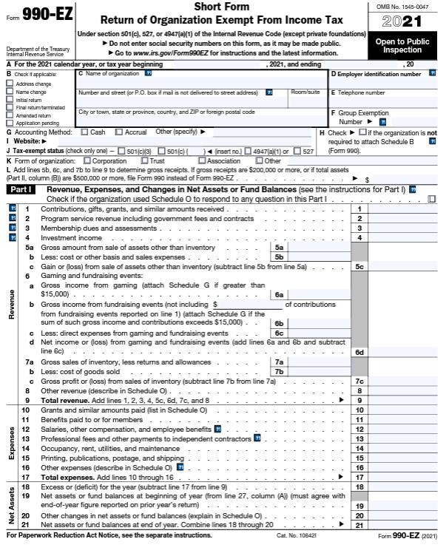
Project Recap
Motivation: Form 990 data is not easy to access or analyze
Goal: Create a database of 990 tax filings
Phases: Retrieval, processing, and analysis

Slide 4
Objectives & Deliverables
990 Database
Tables:
Standard 990
990-EZ
Officers
Business Master Files
1
Analysis & Documentation
Analyzing trends
Example Queries
User Guide
2
Data Conversion
CSV library of tourism office filings
3

Slide 5
Timeline
Feb 11
Feb 25
Mar 15
Apr 24
Apr 28
May 4
All data downloaded
EO Master Files uploaded
Common schema created
Completed processing data
Database populated
Database analyses

Slide 6
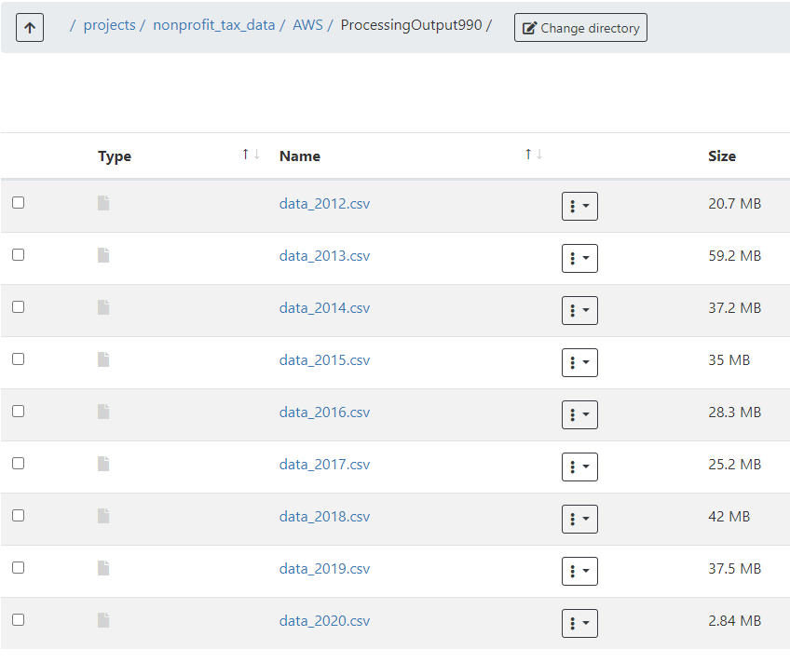
Data Processing
Over one million XML files
Single threaded extraction of data tag while preserving path tags
Processed using ARC job submission with Python scripts
Output to CSV for database ingestion

Slide 7
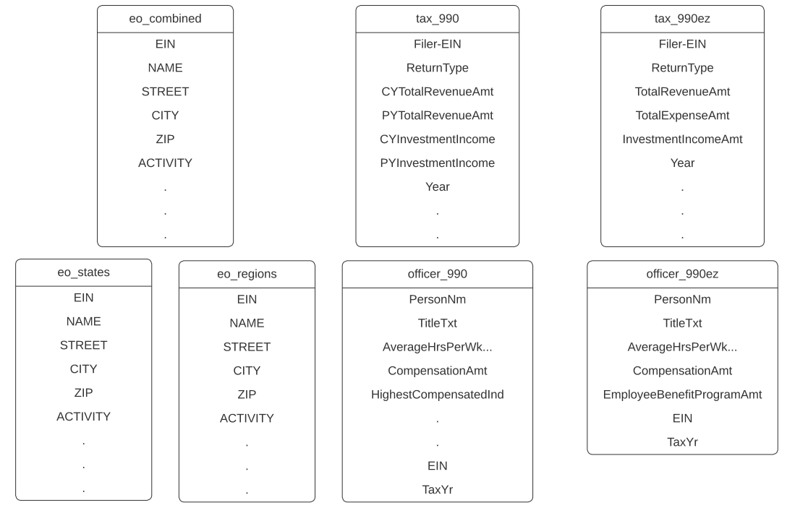
990 Database – Design

Slide 8
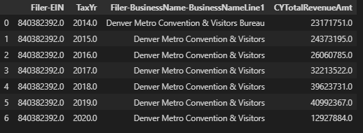
990 Database – Queries

Slide 9
Preliminary Database Analysis
Filer-BusinessName-BusinessNameLine1 | Filer-USAddress-CityNm | Filer-USAddress-StateAbbreviationCd | CYTotalRevenueAmt
OrlandoOrange County Convention & Visitors Bureau Inc | Orlando | FL | 80,519,755
FLORIDA TOURISM INDUSTRY MARKETING CORP INC | TALLAHASSEE | FL | 48,182,560
SAN DIEGO CONVENTION AND TOURIST BUREAU | SAN DIEGO | CA | 41,202,845
Denver Metro Convention & Visitors Bureau | Denver | CO | 40,992,367
ATLANTA CONVENTION AND VISITORS BUREAU INC | ATLANTA | GA | 35,729,622
HAWAII VISITORS & CONVENTION BUREAU | HONOLULU | HI | 34,731,961
Top 6 Tourism Offices in 2019
Mostly large cities in large population states
Top 30 is relatively constant over from 2013-2019

Slide 10
Preliminary Database Analysis
Filer-BusinessName-BusinessNameLine1 | Filer-USAddress-CityNm | Filer-USAddress-StateAbbreviationCd | CYTotalRevenueAmt
Denver Metro Convention & Visitors Bureau | Denver | CO | 12,927,884
CONVENTION & VISITORS BUREAU OF GREATER KANSAS CITY | KANSAS CITY | MO | 9,870,365
SAINT PAUL RIVERCENTRE CONVENTION AND VISITORS AUTHORITY | ST PAUL | MN | 9,717,353
BUFFALO NIAGARA CONVENTION & VISITORS BUREAU INC | BUFFALO | NY | 6,896,089
GRAND RAPIDSKENT COUNTY CONVENTION & VISITORS BUREAU DBA EXPERIENCE GRAND RAP | GRAND RAPIDS | MI | 6,496,669
VISITGREENVILLESC | GREENVILLE | SC | 6,156,731
Top 6 Tourism Offices in 2020
Smaller population states
No Florida tourism offices are in top 30
Tallahassee and Orlando offices did not submit tax form for 2020

Slide 11
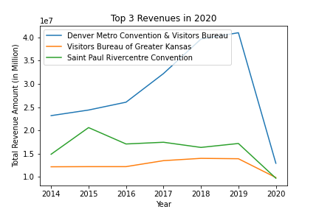
Sample Visualizations

Slide 12
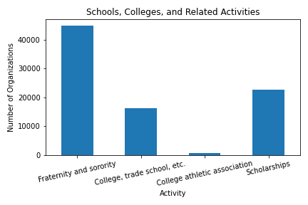
Sample Visualizations

Slide 13
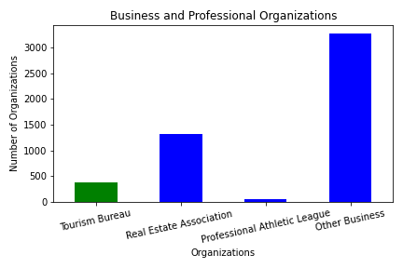
Sample Visualizations

Slide 14

Challenges
Lessons Learned
Creating a unified schema for hundreds of tags across several years
Processing Array Data: Organization Officers & Schedule Forms
Consistent communication between team members and client
Improve organization & planning

Slide 15
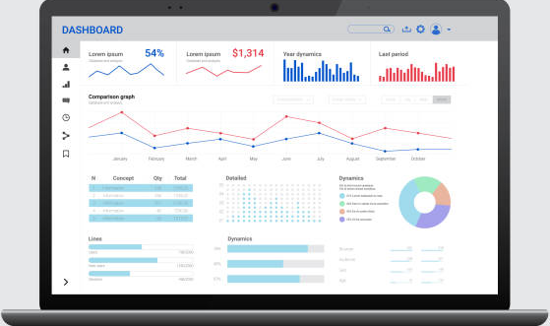
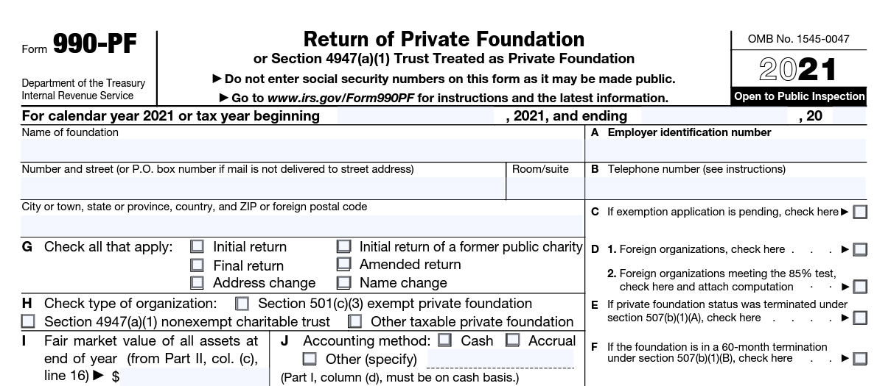
Future Work
Appending Tax Year 2021 data
Processing Forms 990-PF & 990-N
Processing other Form 990 Schedules
Creation of Web Dashboard
Notes:
Long

Slide 16

Acknowledgements
Client: Professor Florian Zach, Ph.D., Howard Feiertag Department of Hospitality and Tourism Management, Pamplin College of Business
Mentor: Dr. Edward A. Fox
VT Advanced Research Computing (ARC)

Slide 17
References
AWS S3 IRS 990 Bucket: https://registry.opendata.aws/irs990/
IRS Website Form 990 Data Download: https://www.irs.gov/charities-non-profits/form-990-series-downloads
SQLite Documentation: https://www.sqlite.org/index.html
Business Master File Information: https://www.irs.gov/charities-non-profits/exempt-organizations-business-master-file-extract-eo-bmf

