Slide 1


Final Report: Webpages (WP) Team
Jostein Barry-Straume, Cristian Vives, Wentao Fan, Peng Tan, Shuaicheng Zhang, Yang Hu, Tishauna Wilson
CS 5604: Information Storage & Retrieval
Instructed by Professor Edward Fox
Fall 2020
Virginia Polytechnic Institute and State University Blacksburg, VA 24061

Slide 2
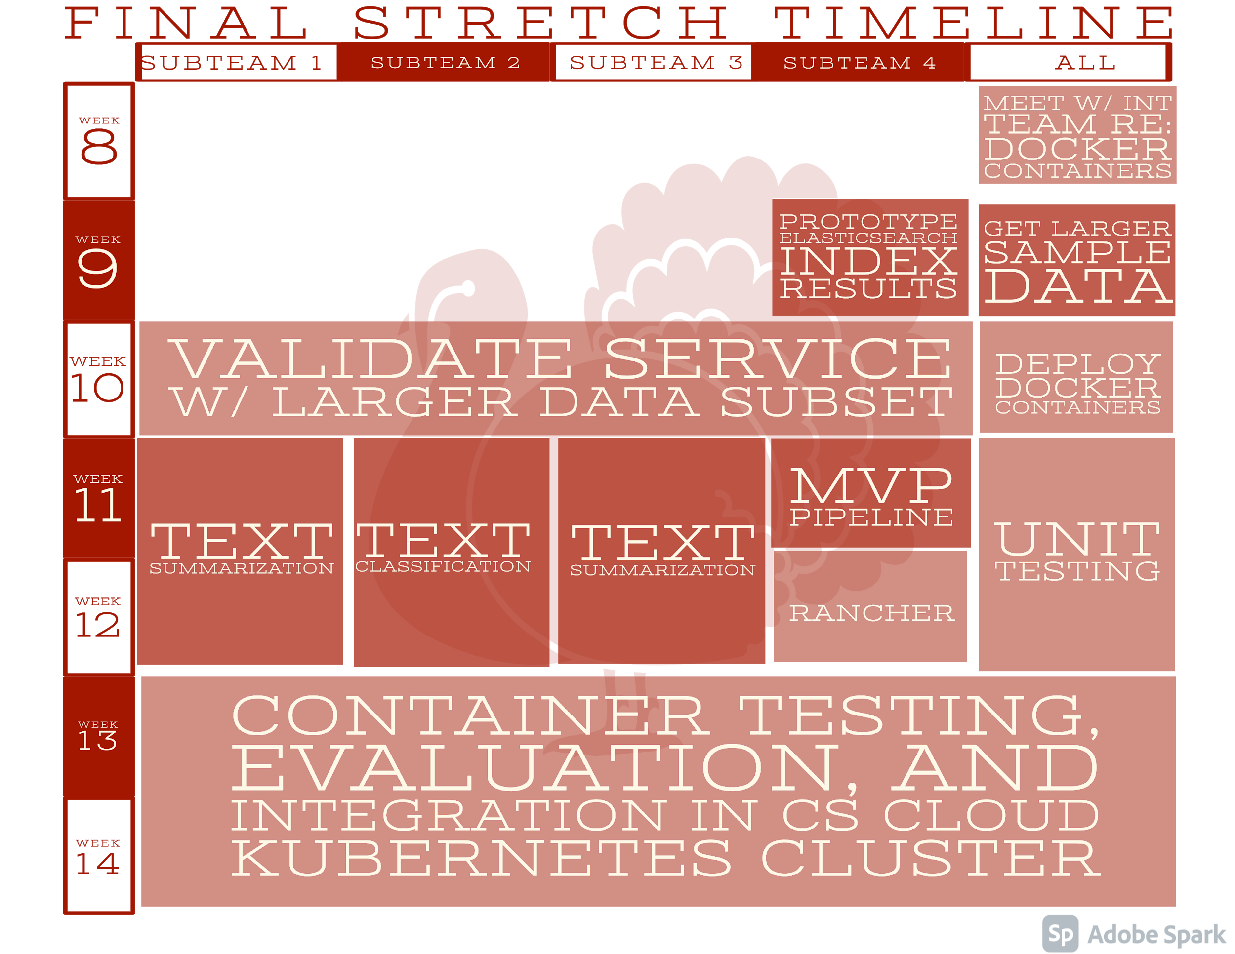

Slide 3
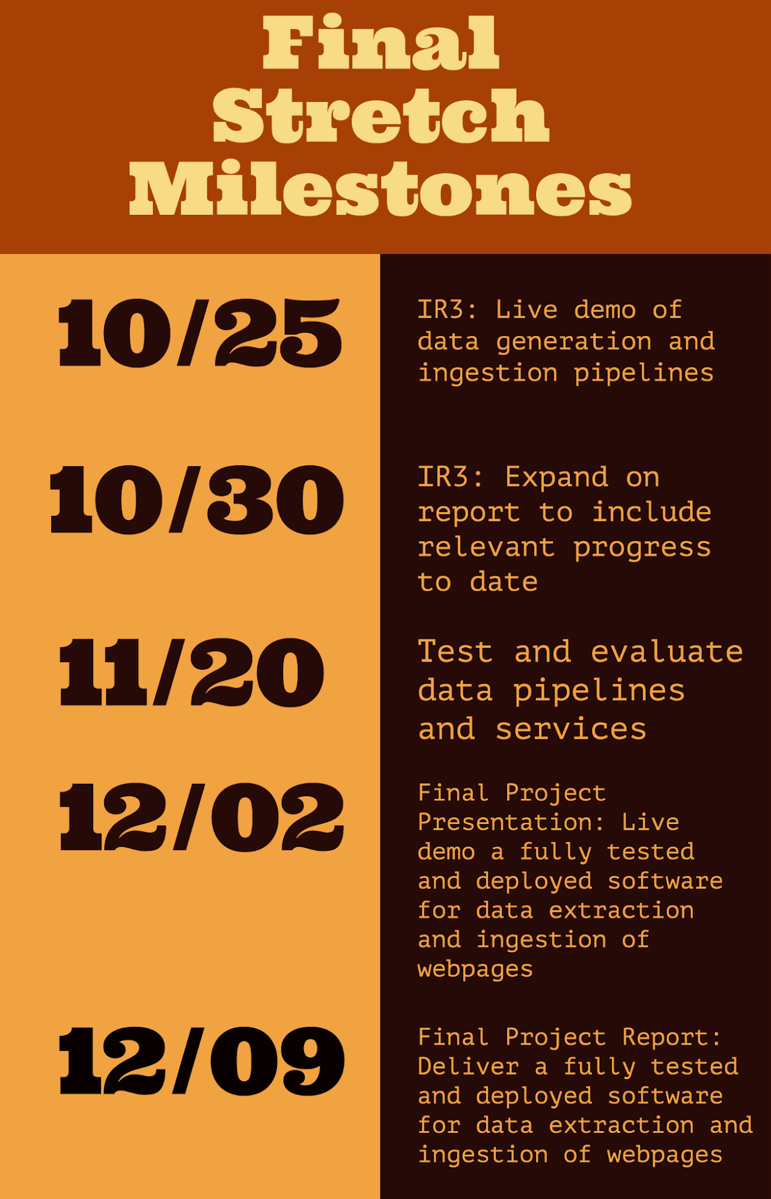

Slide 4
Service Table
service_id | service_name | service_description
1 | extract_url | Extracts URLs from Twitter tweets
2 | archive_webpage | Archives web pages based on their URLs
3 | extract_webpage | Extracts web page content from archived web pages
4 | index_data | Indexes web pages to the given endpoint with the following fields: URL, title, webpage_content, webpage_summary
5 | summarize_text | Provides summarization of web page textual content
6 | classify_text | A COVID-19 relevance classifier for a collection of text data

Slide 5
Goal Table
goal_id | goal_name | goal_description | goal_format | envrionment_variable
1 | tweet_file | RAW DATA | <Text file> | TWEET
2 | extract_url | EXTRACTED DATA | <Text file> | URL
3 | archive_webpage | STORED DATA | <warc.gz file> | WARC
4 | extract_webpage | PARSED DATA | <JSONL file> | JSONL
5 | index_data | SORTED DATA | <Elasticsearch index> | JSONL
6 | summarize_text | FILTERED DATA | <JSONL file> | WEBPAGE
7 | classify_text | CLASSIFIED DATA | <Text file> | WEBPAGE

Slide 6
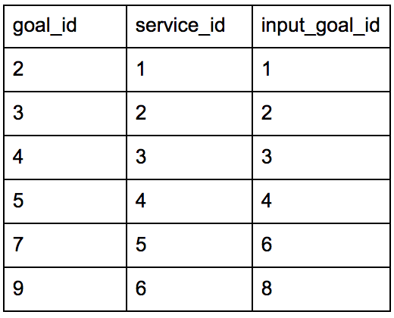
Reasoner Table

Slide 7

Input Data
Input data in form of tweets
Tweets represented as JSONL files
Extract URLs mentioned in tweets
Not all tweets contain URLs!

Slide 8
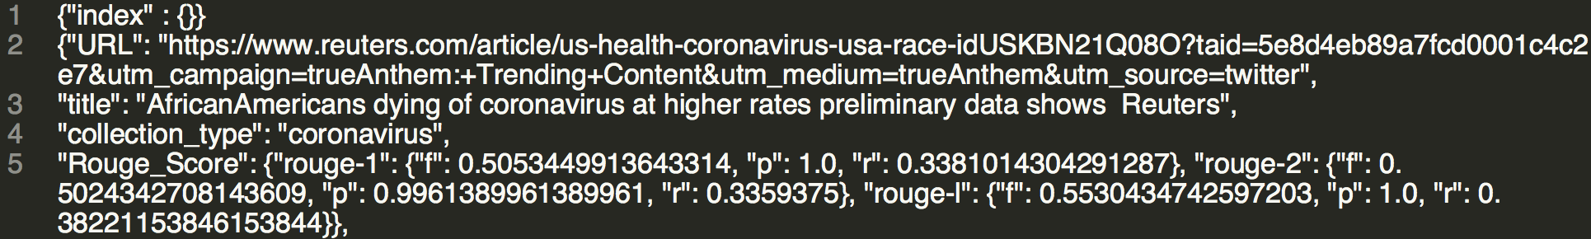
Elasticsearch Index Data Structure
One JSONL file per collection

Slide 9
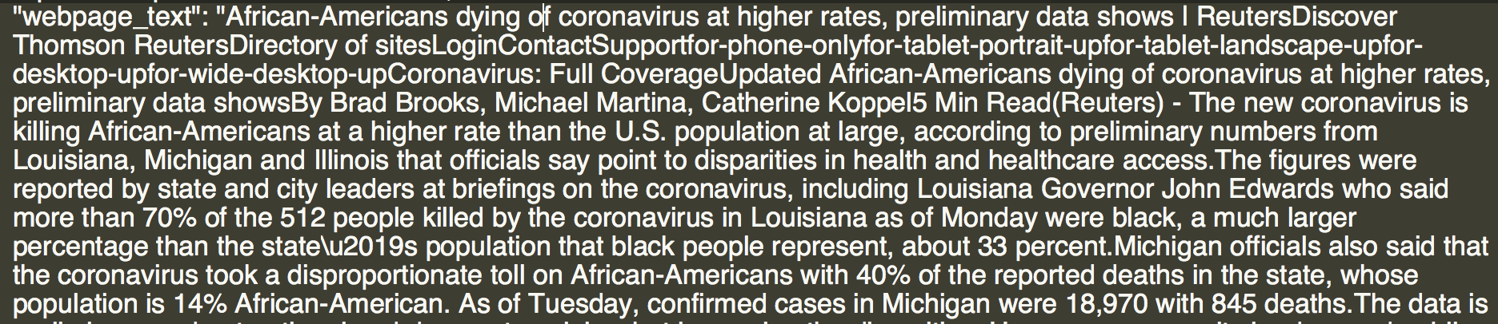
Elasticsearch Index Data Structure

Slide 10
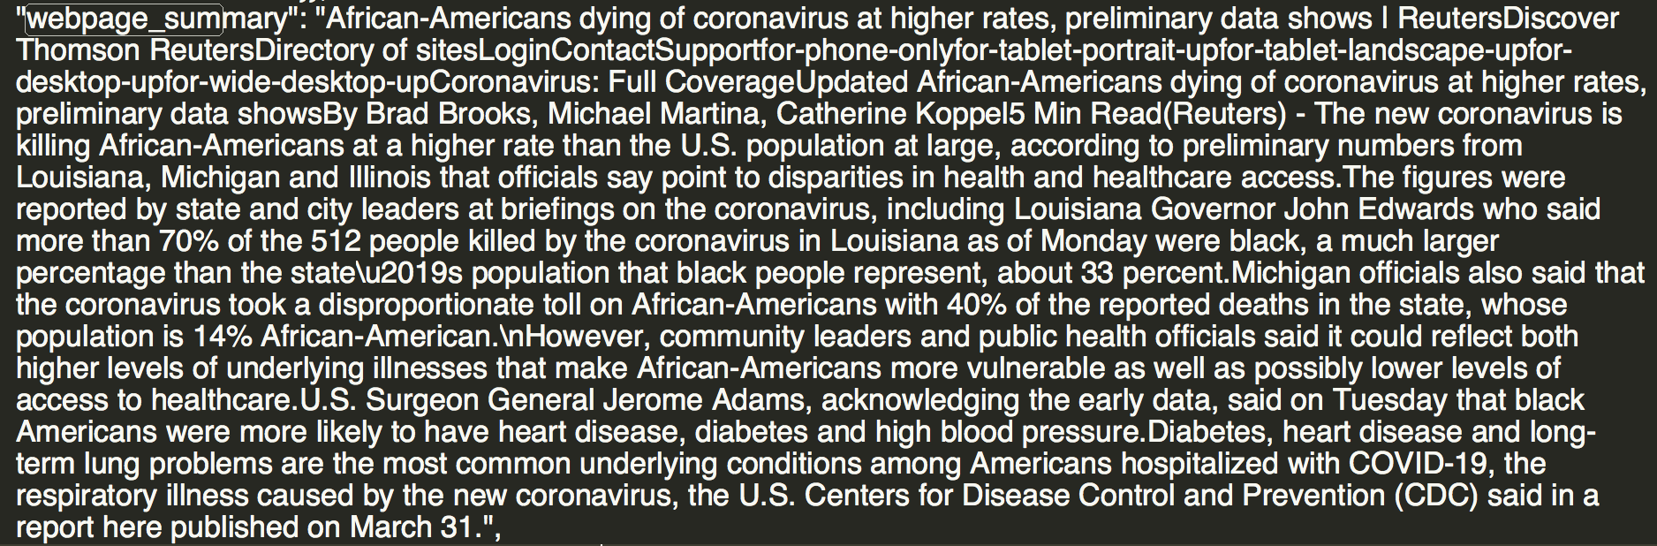
Elasticsearch Index Data Structure

Slide 11
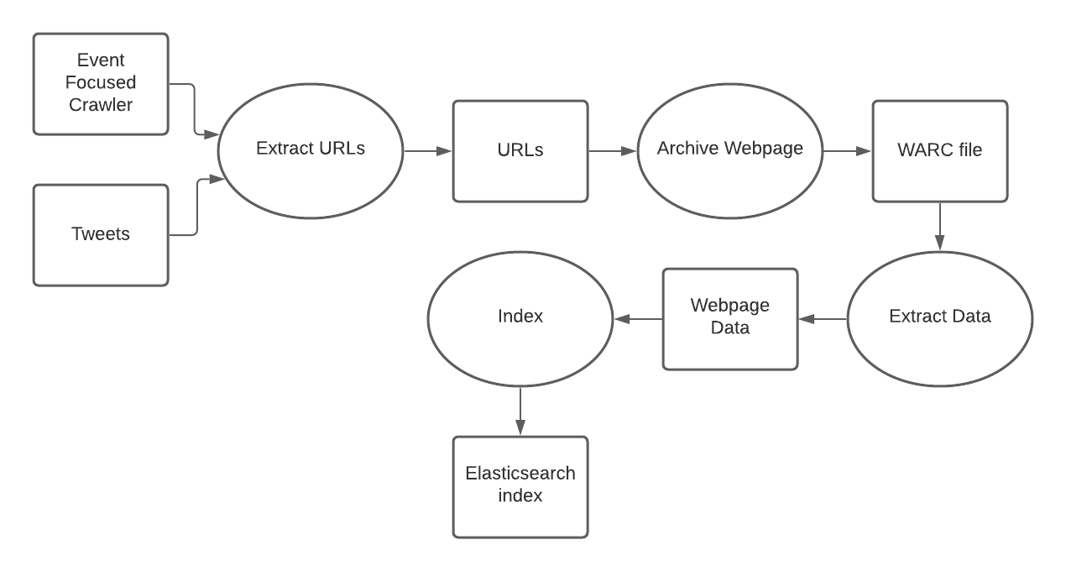
Data Ingestion Pipeline
Dockerized Services:
Input/Output:

Slide 12
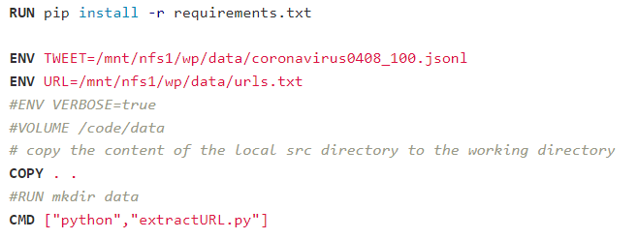
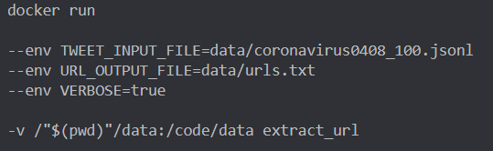
Dockerized Service I/O
Use of environment variables
Can override environment variables when running container
Use of volumes to provide I/O for services
extractURL Dockerfile
Running extract_url docker container

Slide 13
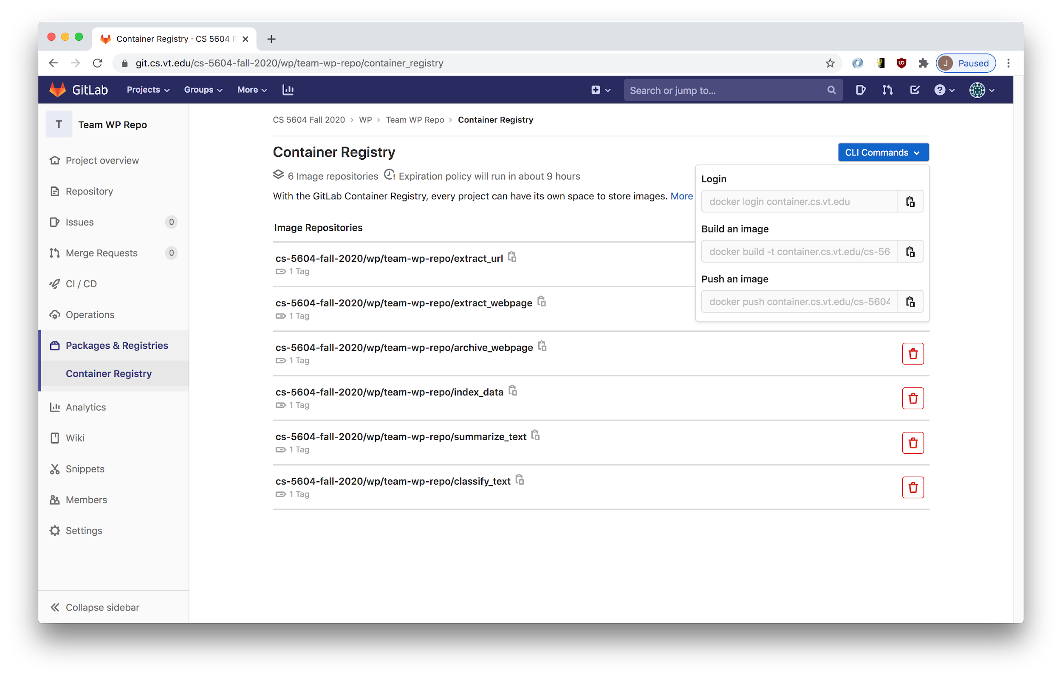
Gitlab Container Registry
https://git.cs.vt.edu/cs-5604-fall-2020/wp/team-wp-repo/container_registry

Slide 14
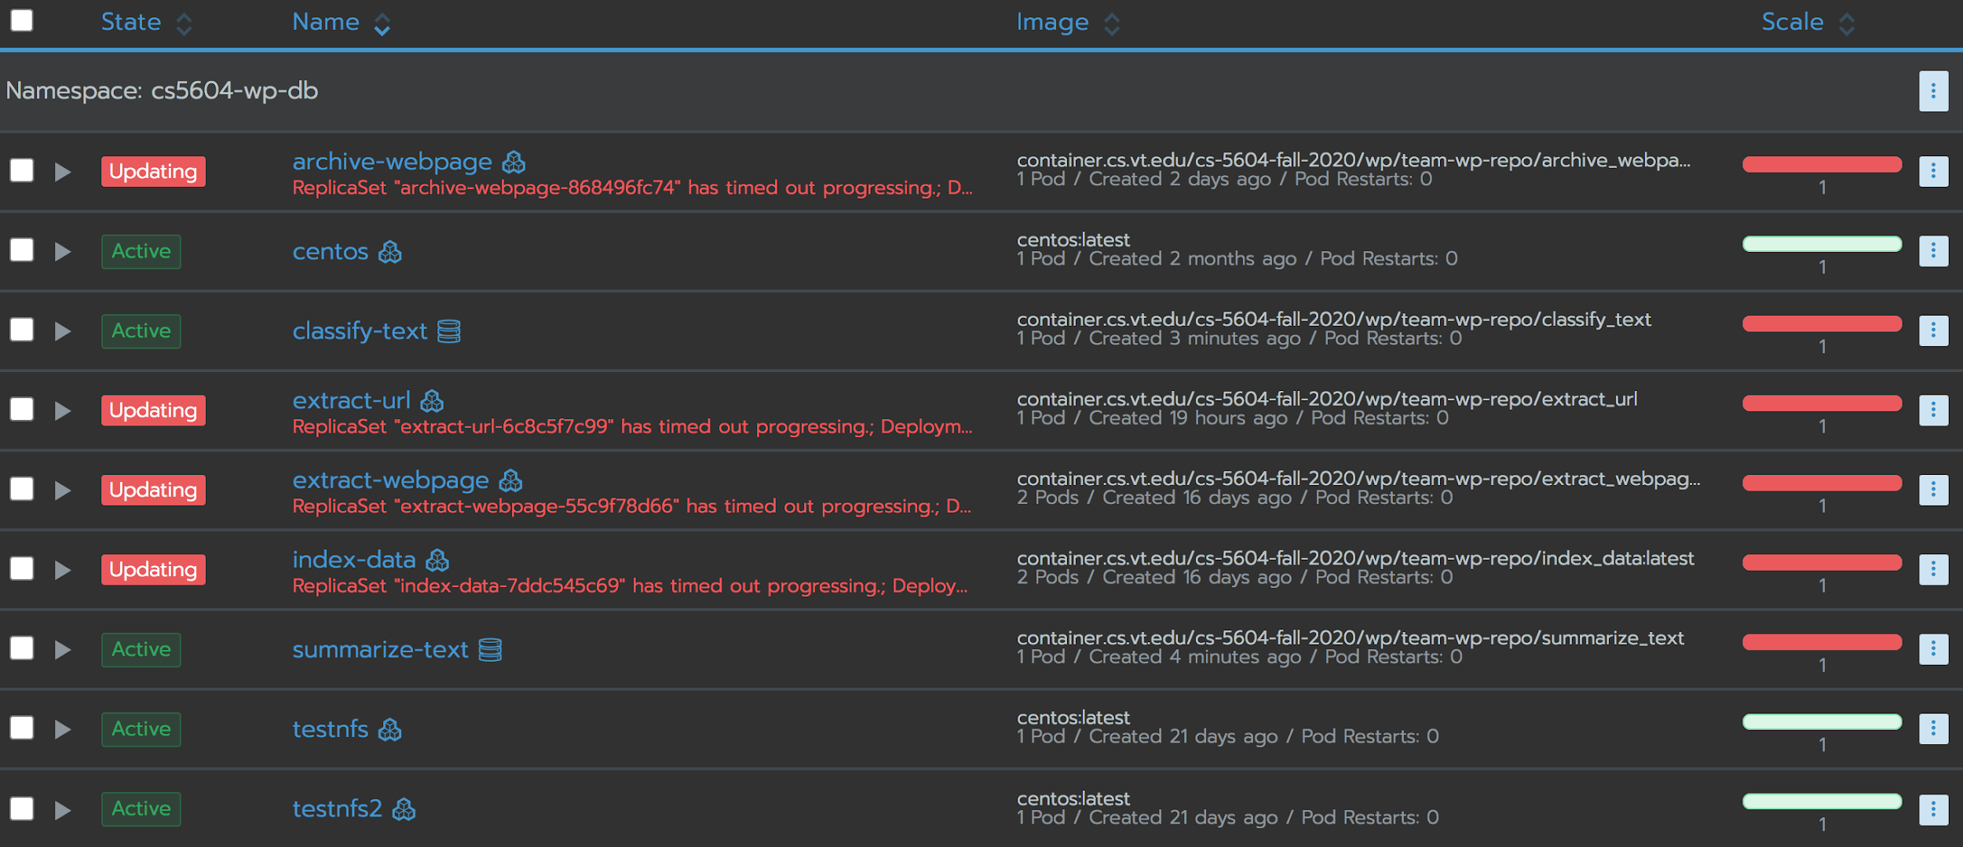
http://cloud.cs.vt.edu/
Deployed Services Status

Slide 15
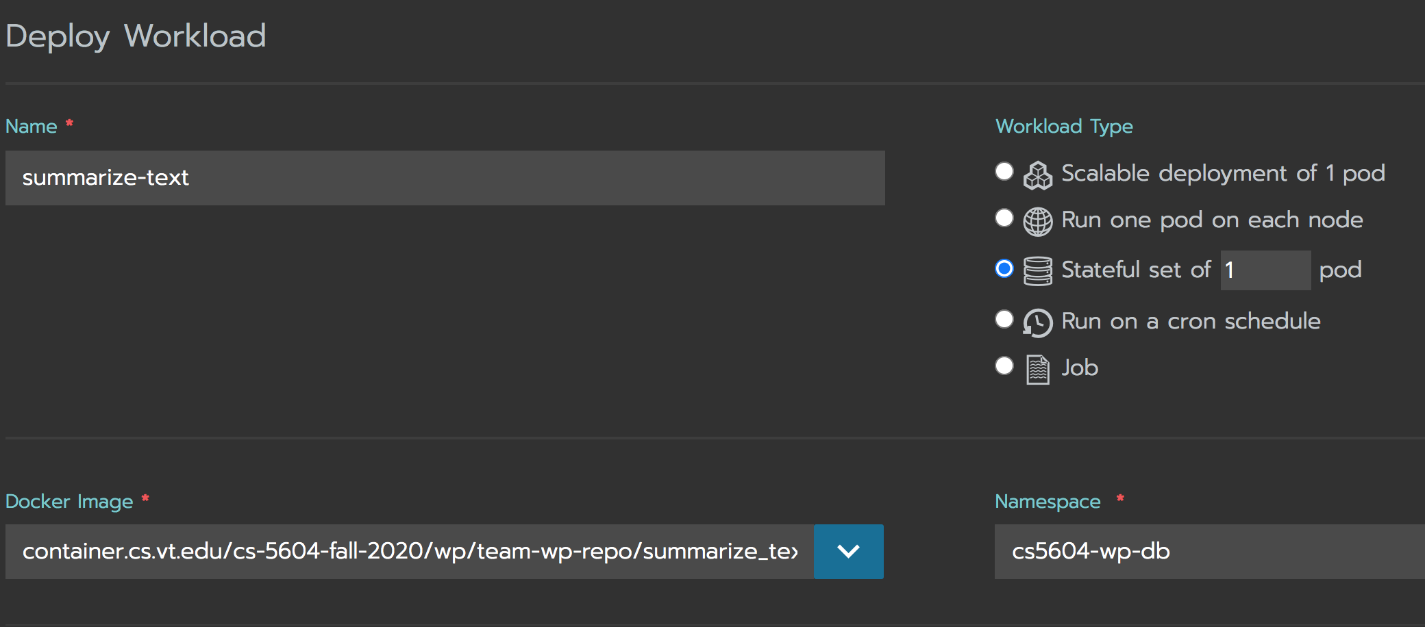
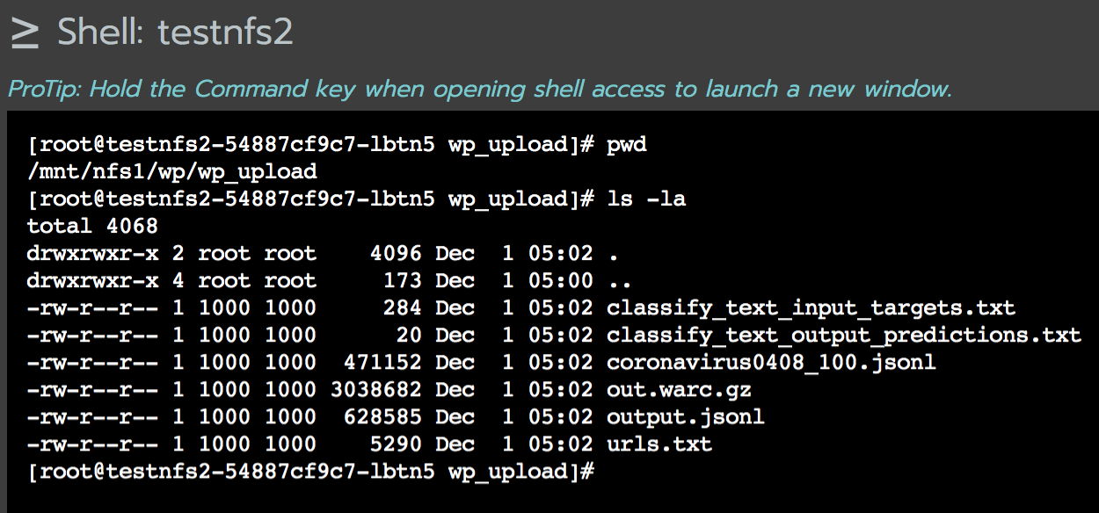
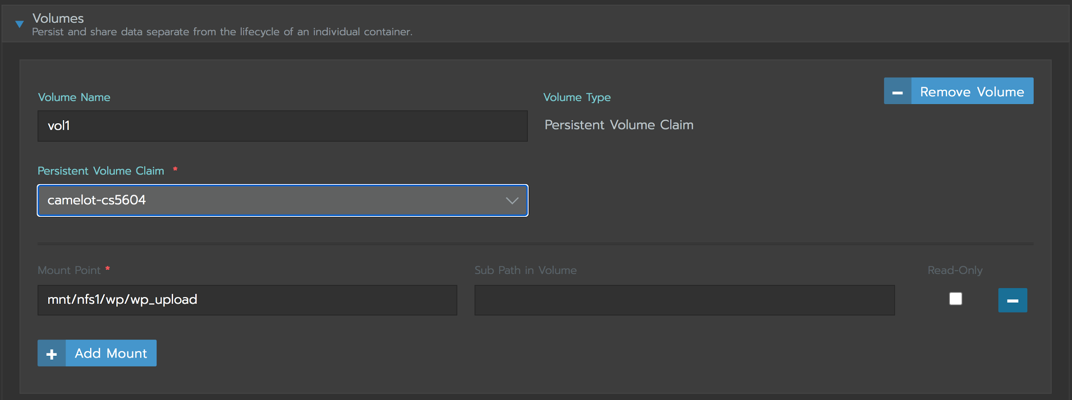
Deployed Services Setup

Slide 16

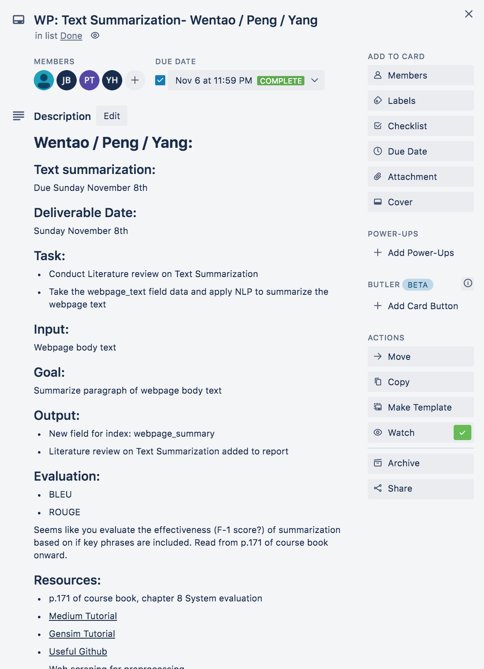

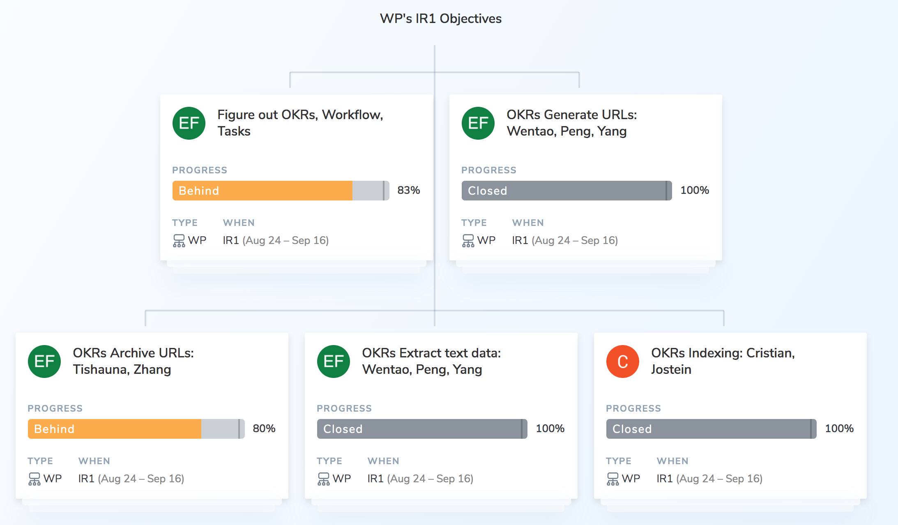
DevOps Learning Lessons
Found greater success as a team operating with Trello
Ally is too unfamiliar and low adoption rate

Slide 17
Extract URL Service:
Peng Tan, Wentao Fan, Yang Hu

Slide 18
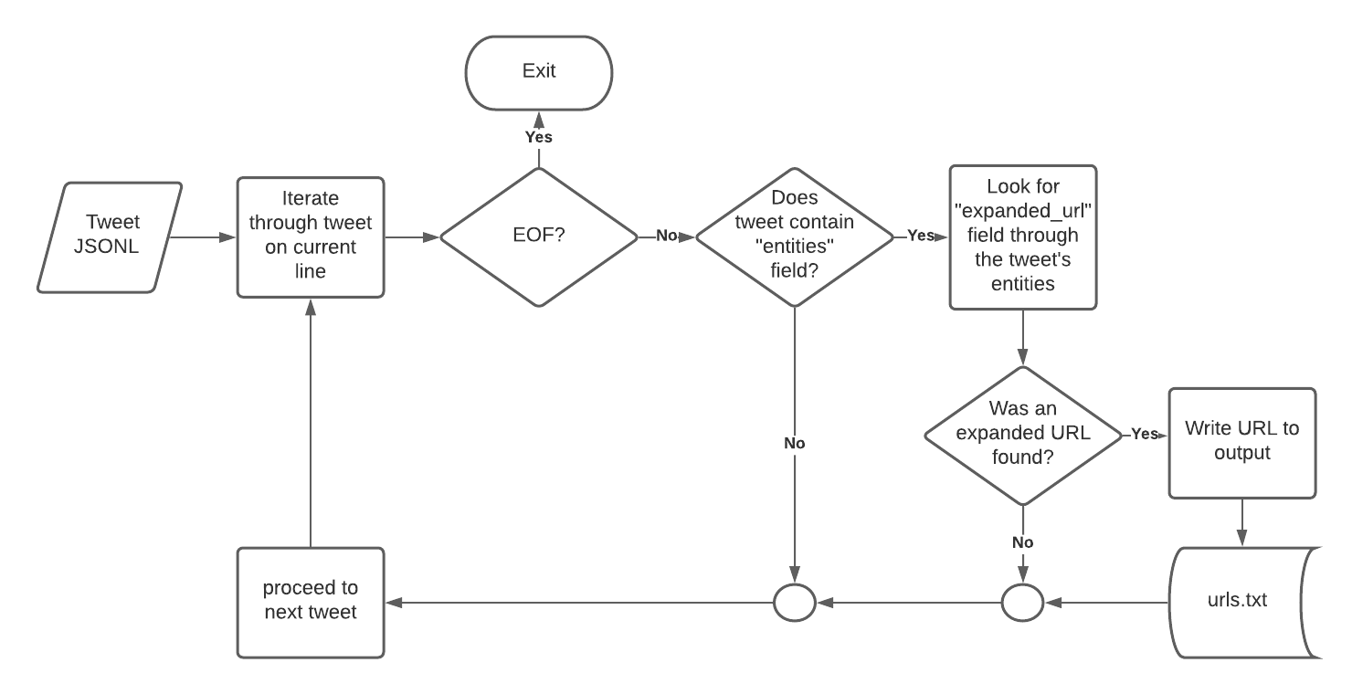
Extract URL Flow Graph

Slide 19
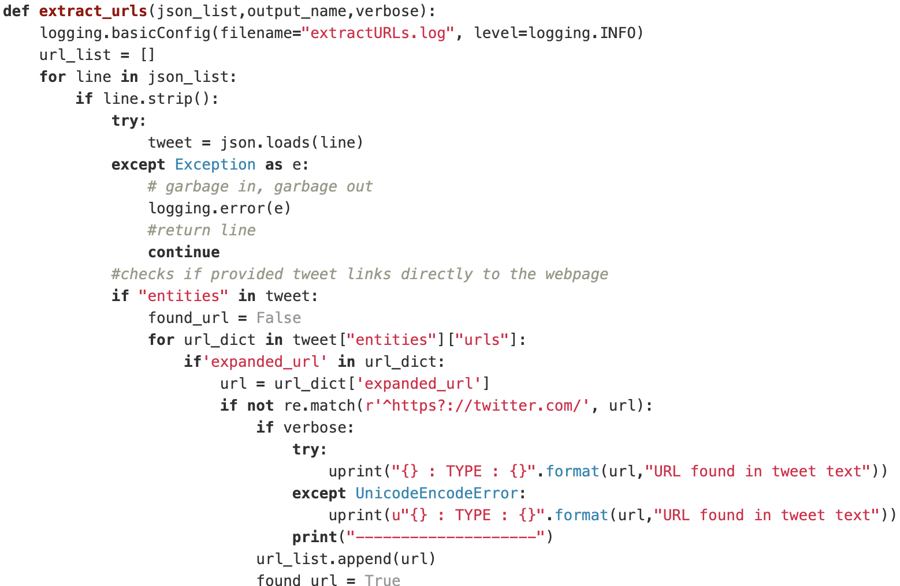

Using two package:BeautifulSoup and gensim.summarization
BeautifulSoup used to get text from html
Gensim.summarization to summarize text get from BeautifulSoup
Use Rouge_score to evaluate summarization performance
Using two packages: JSON and RE
JSON used to parse the JSON file
RE used to match the specified string
Extract URL

Slide 20
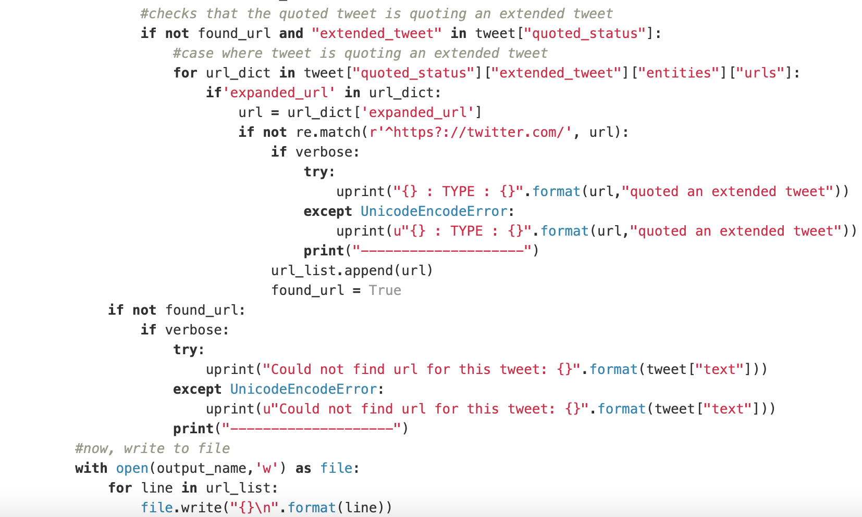
Using two package:BeautifulSoup and gensim.summarization
BeautifulSoup used to get text from html
Gensim.summarization to summarize text get from BeautifulSoup
Use Rouge_score to evaluate summarization performance
Store these URLs obtained from previous data source into JSON file for the next group
Extract URL

Slide 21
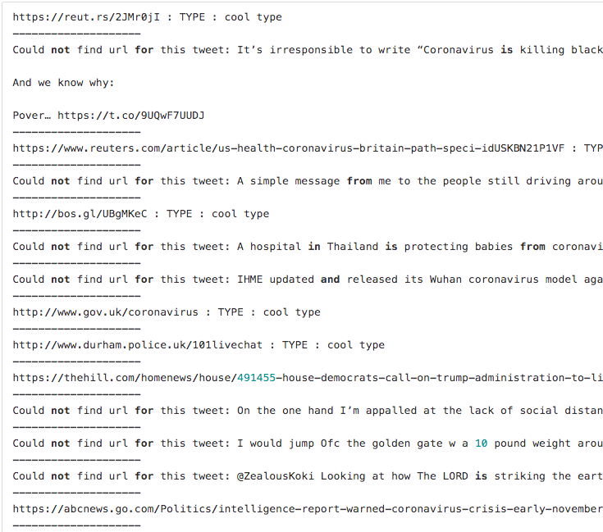
Input: JSON file containing text with embedded URLs
Grab URLs
Put URLs in list
Store them in JSON file
Extract URL

Slide 22
Archive Webpage Service:
Shuaicheng Zhang, Tishauna Wilson

Slide 23
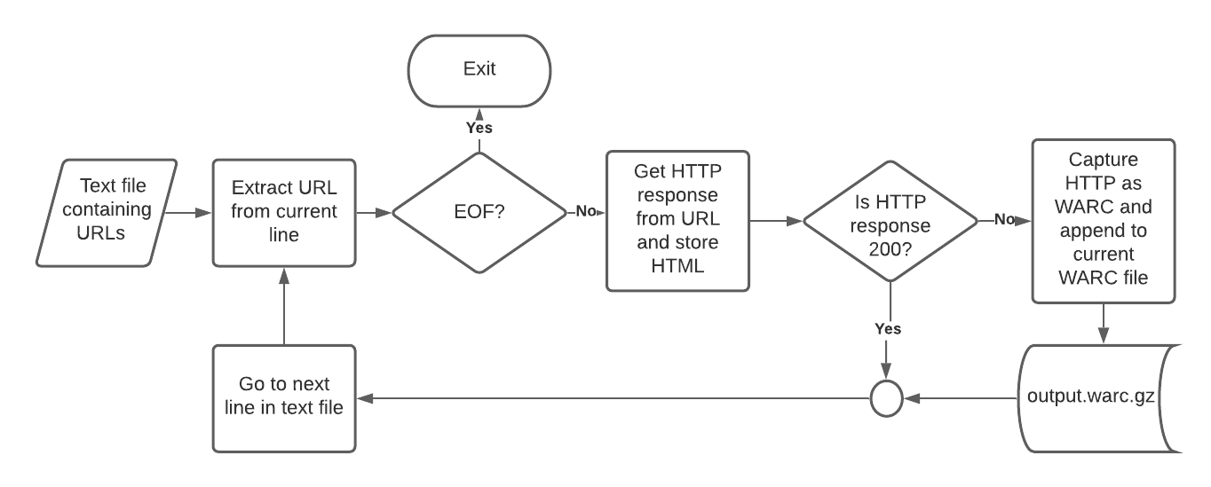
Archive Webpage Flow Graph

Slide 24
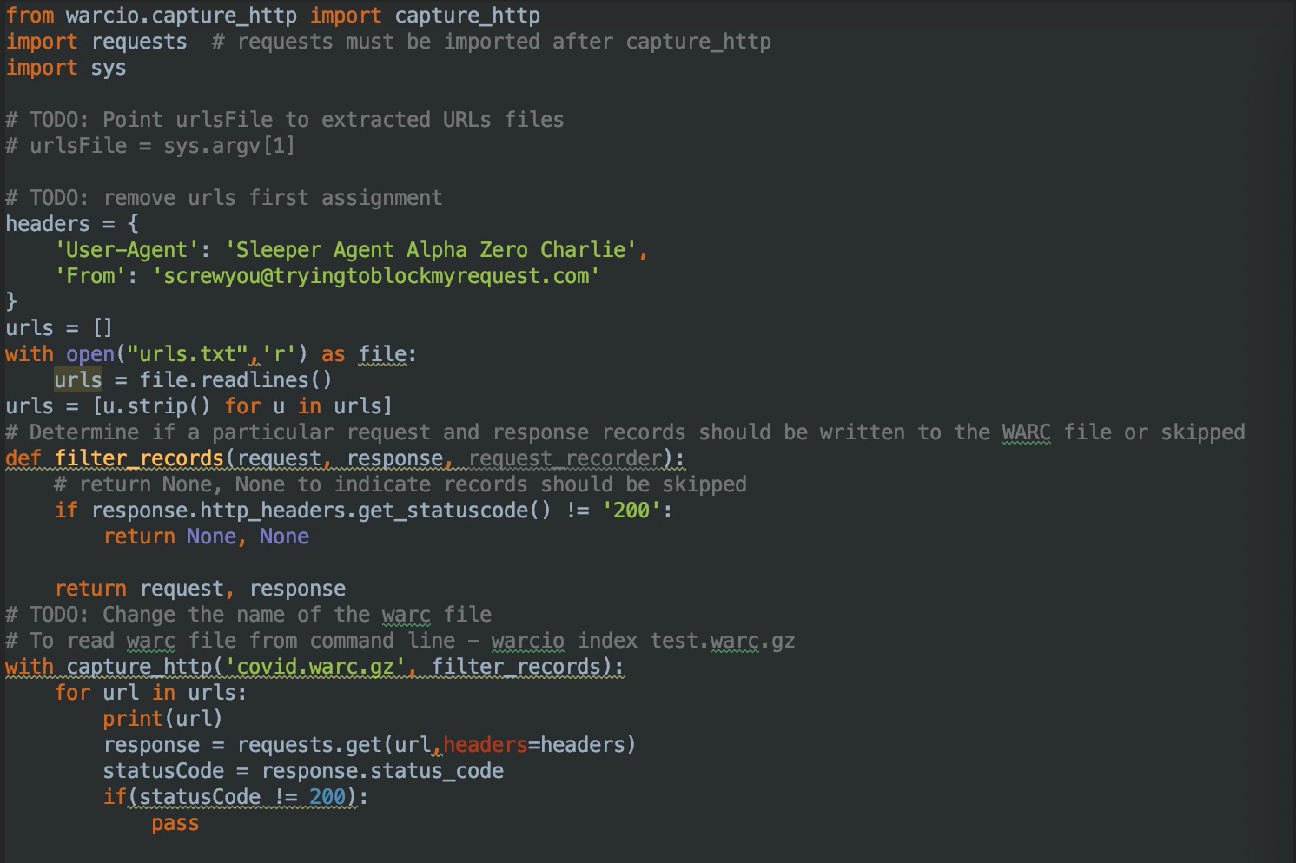
Add snippet of your code here
Copy this slide if you need more space for your content
We take URL lists from a JSON file from the previous team as an input
We iterate through actual COVID-19 webpages
We check the status when accessing each of the webpages; if the status is 200 then we accept the webpage content, otherwise ignore it
We archive all the webpages into a WARC file for indexing using WARCIO.

Slide 25
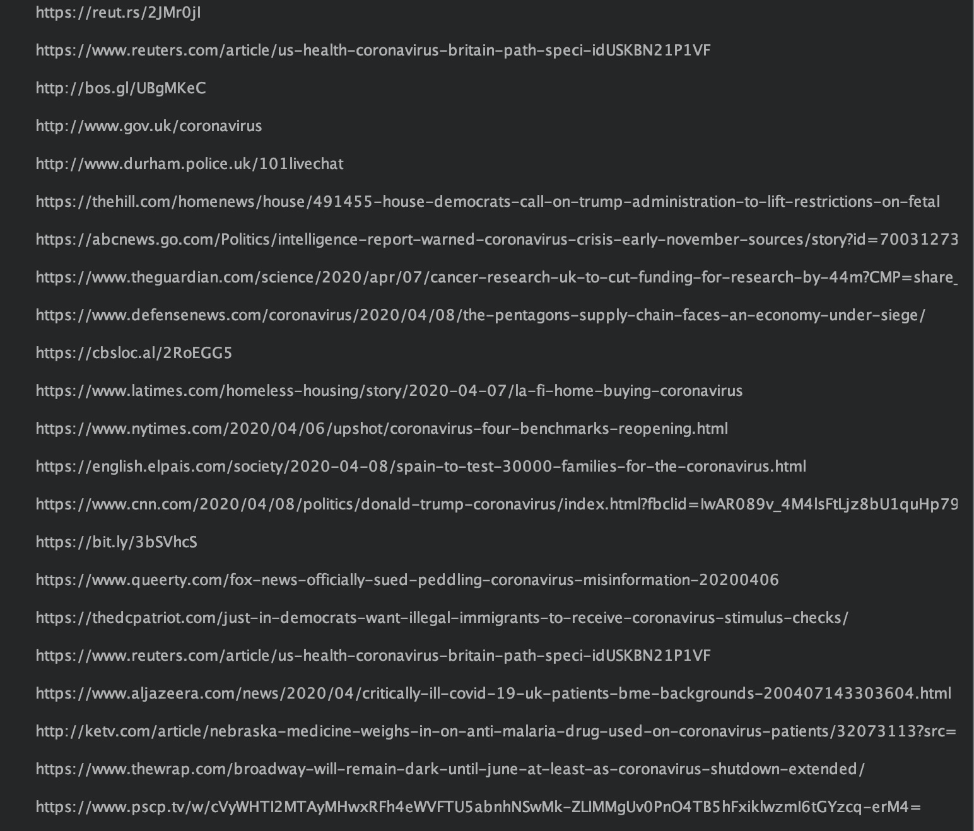
Add snippet of your code here
Copy this slide if you need more space for your content
Snapshot of web pages being archived

Slide 26
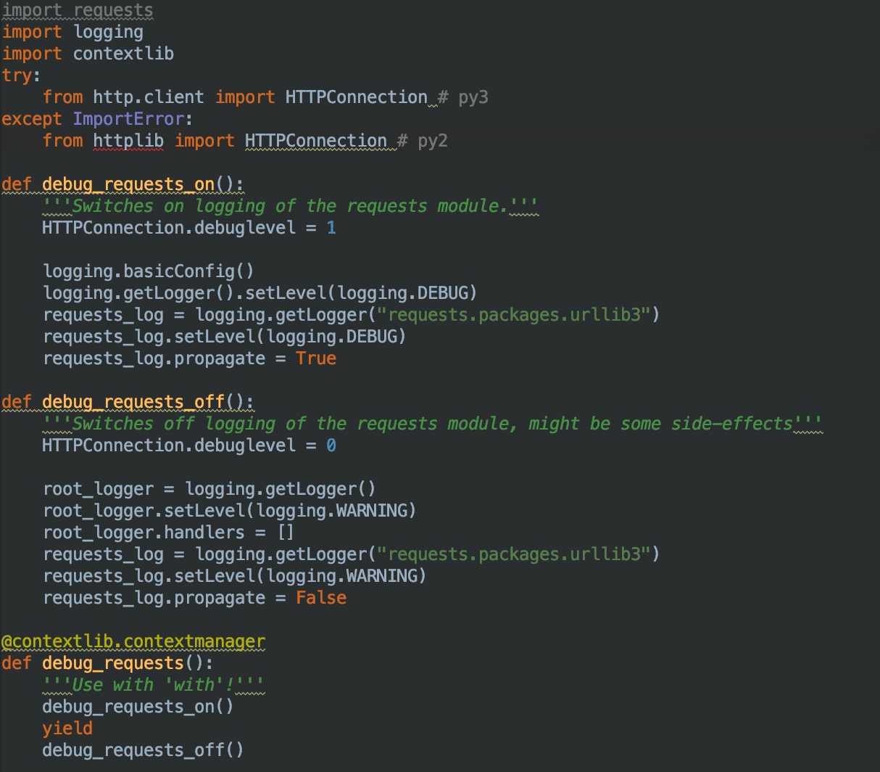
In order to test out the robustness of our code, we have set up several debug functions to test out the functionality of archiving URL functions

Slide 27
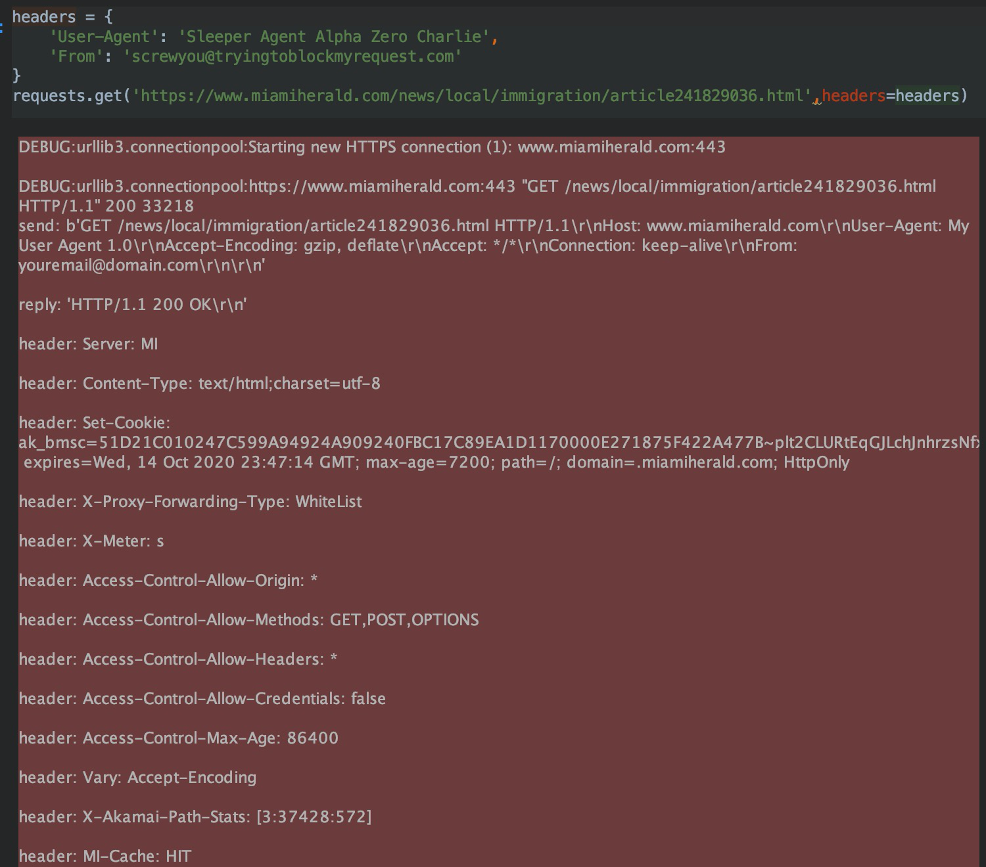
Result from the robustness test

Slide 28
Extract Data Service:
Peng Tan, Wentao Fan, Yang Hu

Slide 29
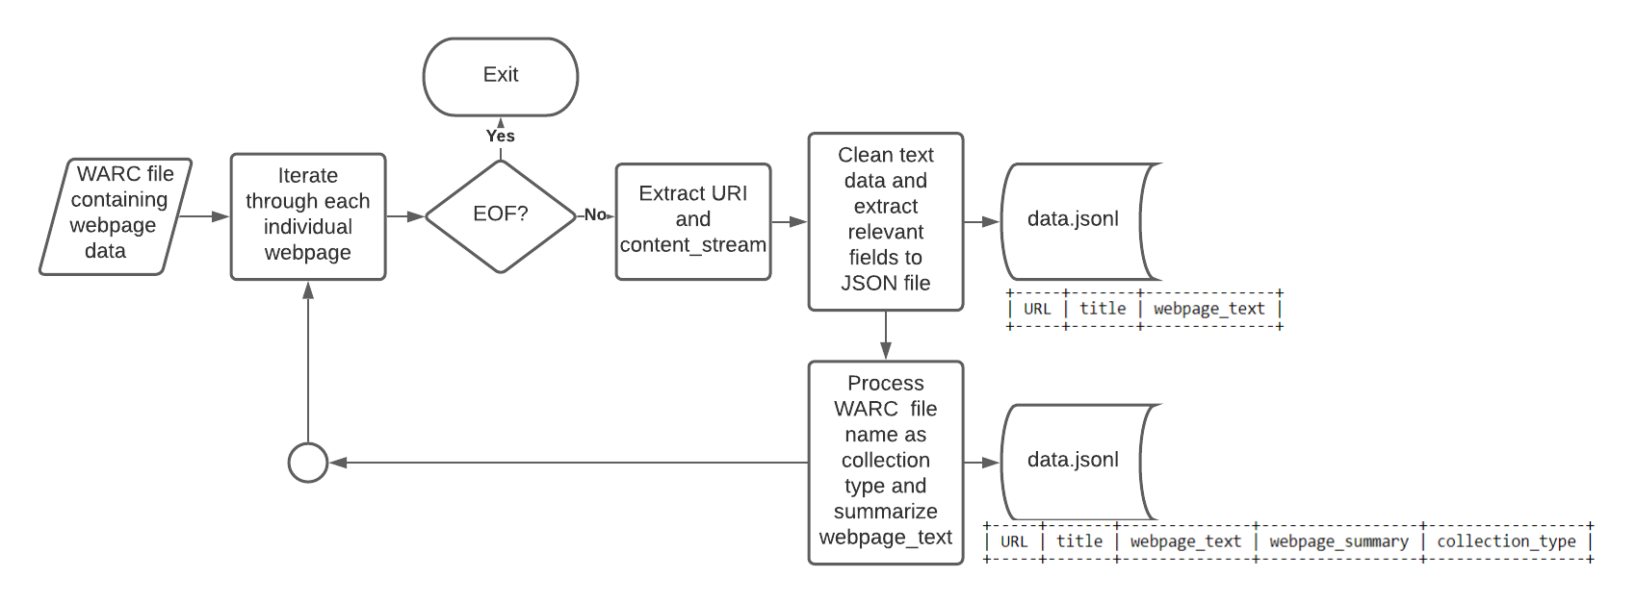
Extract Data Flow Graph

Slide 30
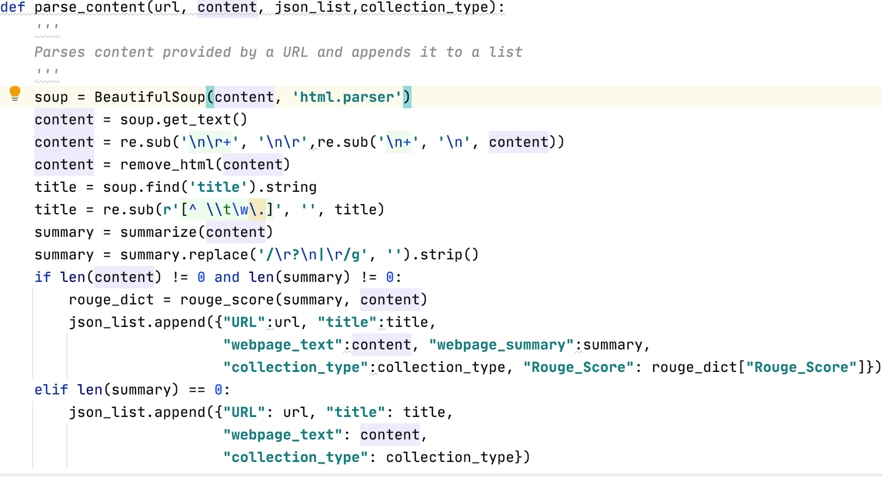
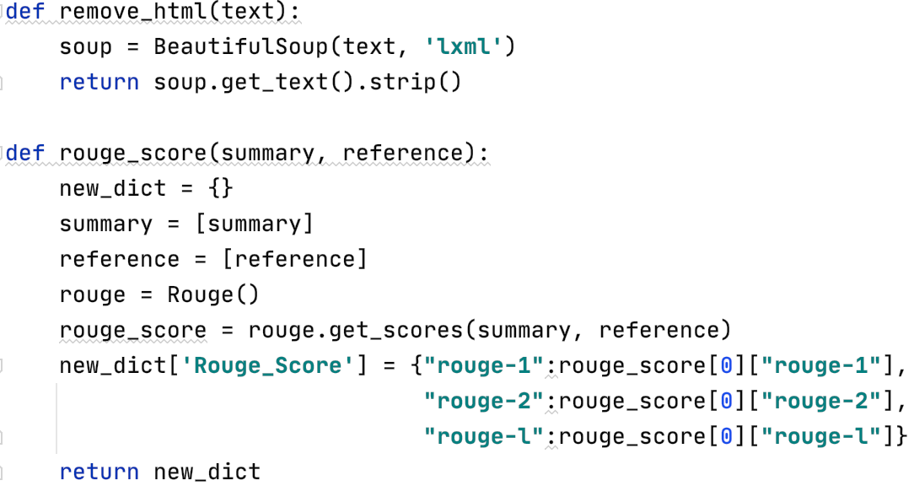
Add snippet of your code here
Copy this slide if you need more space for your content
Using two packages: BeautifulSoup and Gensim
BeautifulSoup used to get text from HTML
Gensim.summarization to summarize text from BeautifulSoup
Use Rouge_score to evaluate summarization performance

Slide 31
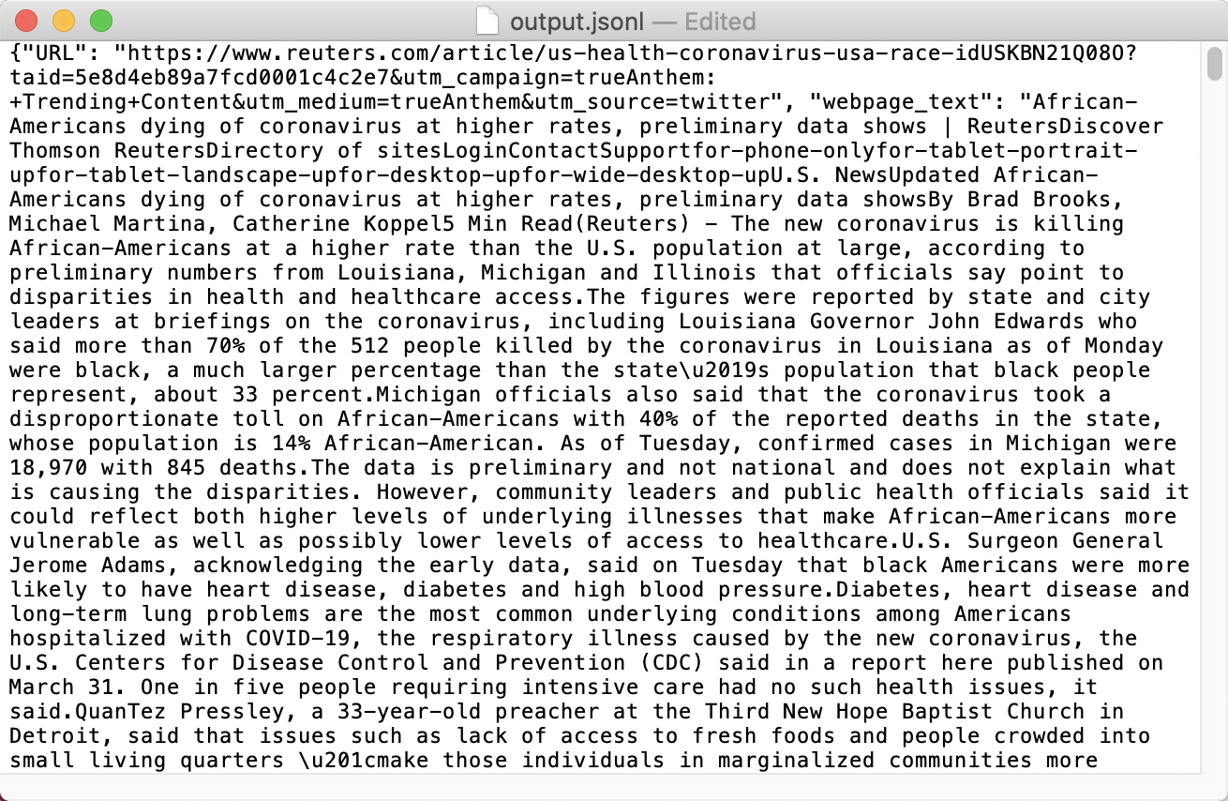
Add snippet of your code here
Copy this slide if you need more space for your content
After Extracting data from WARC files, we can get URL of HTML
Then we can get text from HTML

Slide 32
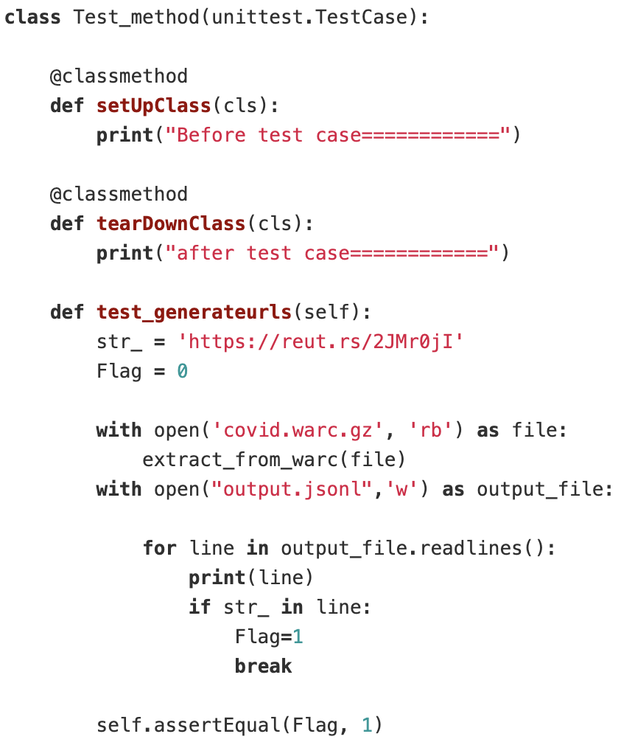
Add unit test for our extract data method
Set up test method before and after test case
Add snippet of your code here
Copy this slide if you need more space for your content

Slide 33
Index Data Service
Cristian Vives, Jostein Barry-Straume

Slide 34
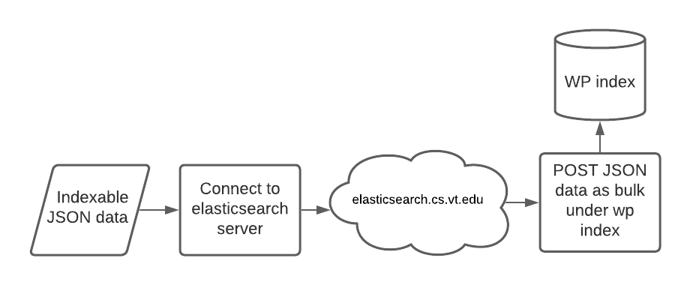
Extract Data Flow Graph
Similar to most teams
Simple script
Doesn’t preprocess any data

Slide 35
Classify Text Service:
Shuaicheng Zhang

Slide 36
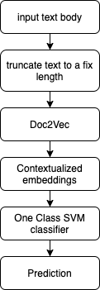
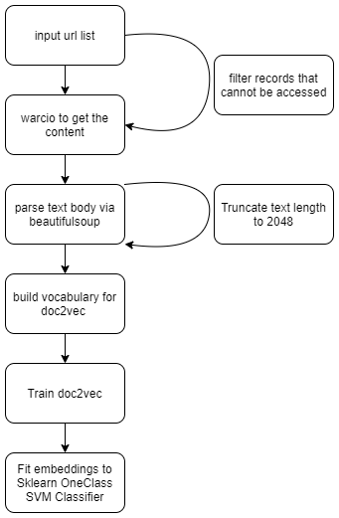
Classify text flow
Two step procedure:
Training
Classifying

Slide 37
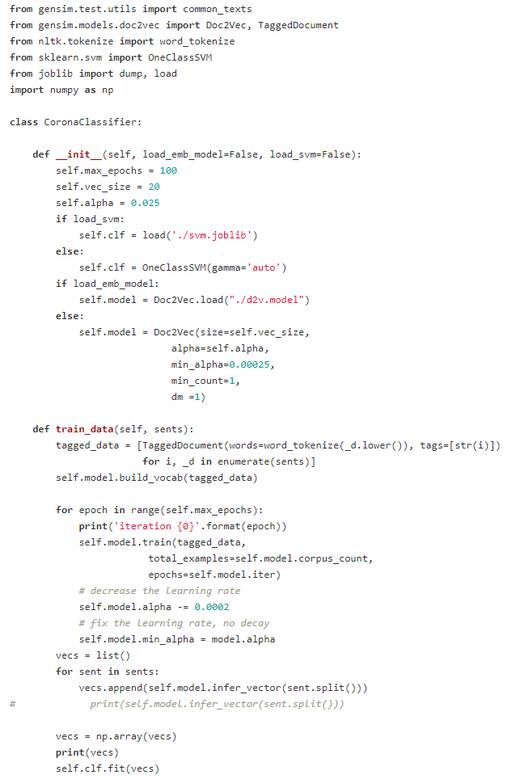
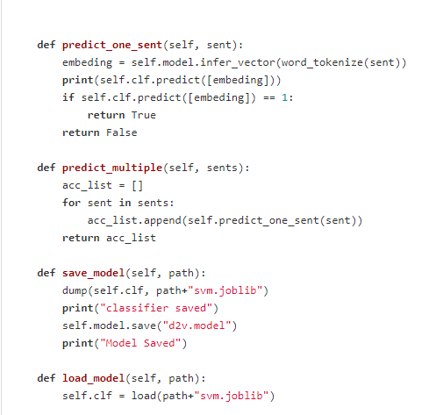
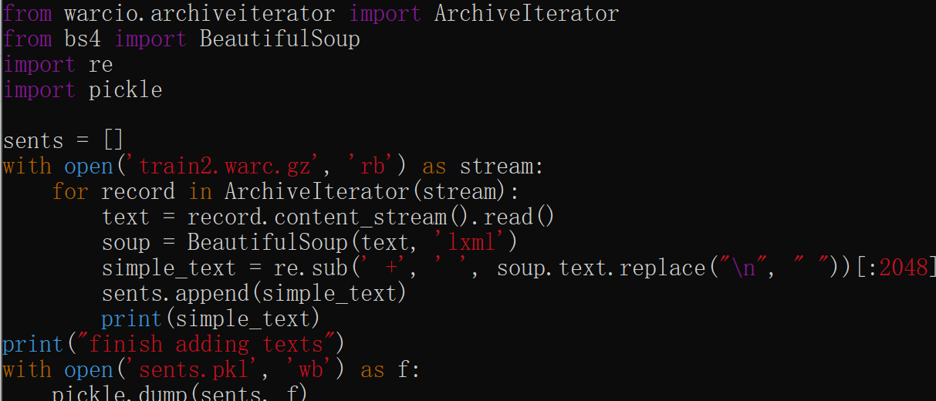
Code preview

Slide 38
Report Editor:
Tishauna Wilson

Slide 39
Report Editing
Fix spelling errors and capitalizations based on Professor’s edits
Added figures and tables
Provided example structure of each input for the four subteams
Updated sections
Read reviews by other teams
Implemented changes as needed based on other team’s feedback

Slide 40
Questions?

