Slide 1
Giles Animal Rescue
Client: Christine Link-Owens
Jackie Falatko, Devin Henslee
CS4624 Midterm Presentation
VT, Blacksburg, May 1, 2014

Slide 2
Project Description
Giles Animal Rescue needs help updating their website.
Uses Drupal for easy updating
Client is not familiar with Drupal.

Slide 3
Project Specifications
Change a few things on each page, mostly with regard to images.
Refine interface to make it easy to update content.
Create User Manual and Tutorials on how to add and update content.

Slide 4
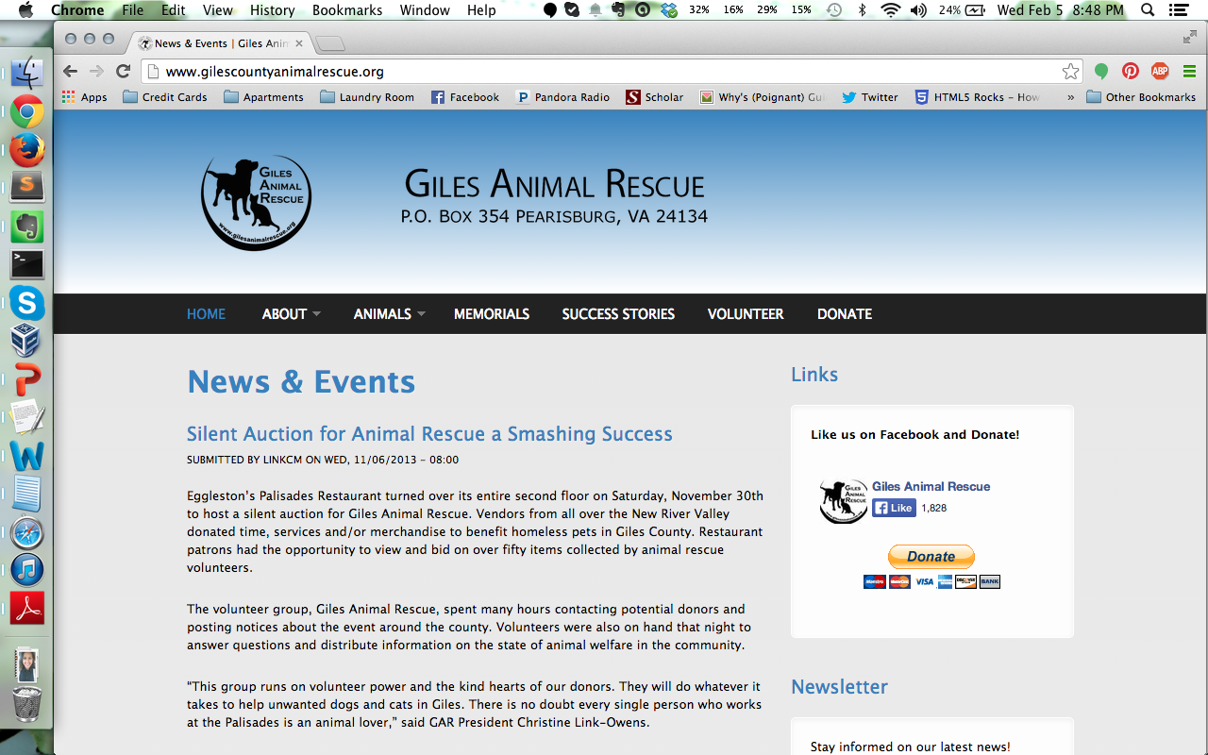
Original Website

Slide 5
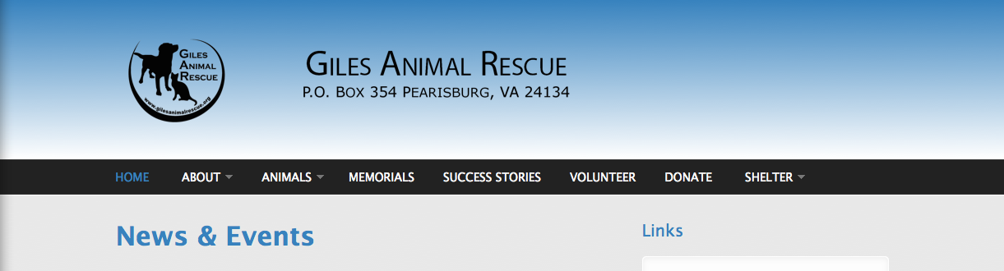
Added a Tab for Shelter

Slide 6
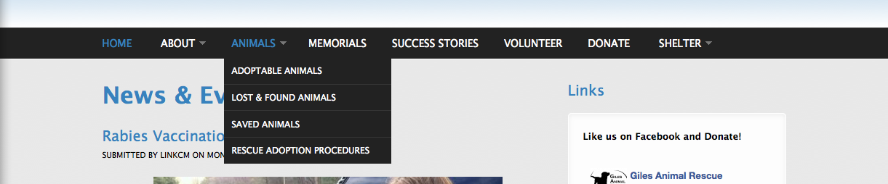
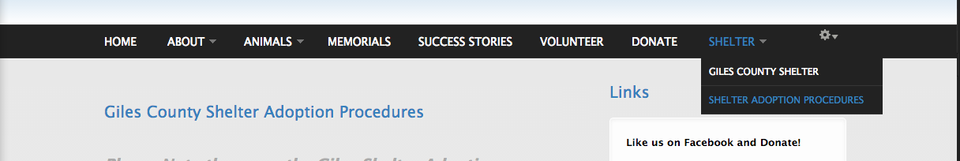
Edited Dropdowns

Slide 7
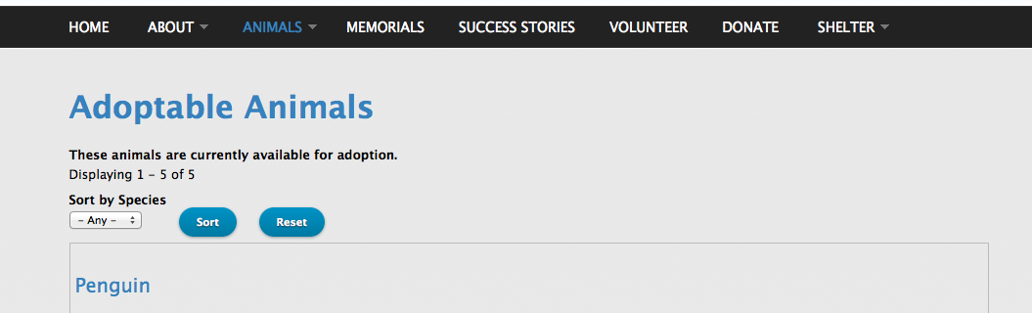
Changed Filter for Animals

Slide 8
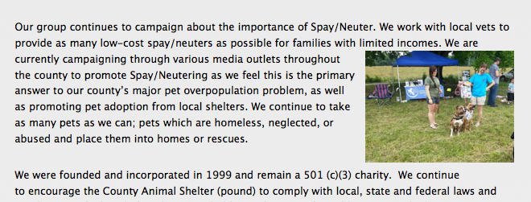
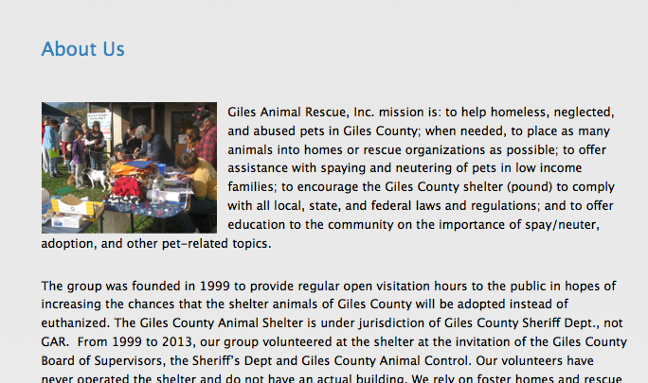
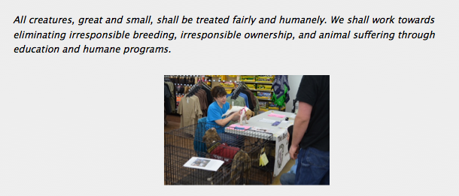
Added Pictures to About

Slide 9
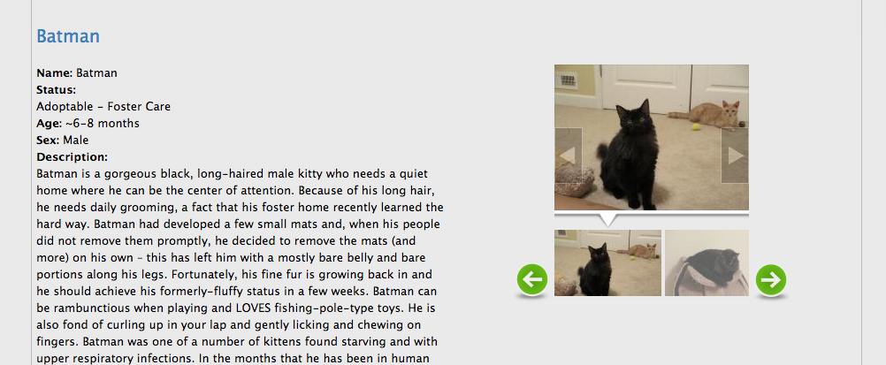
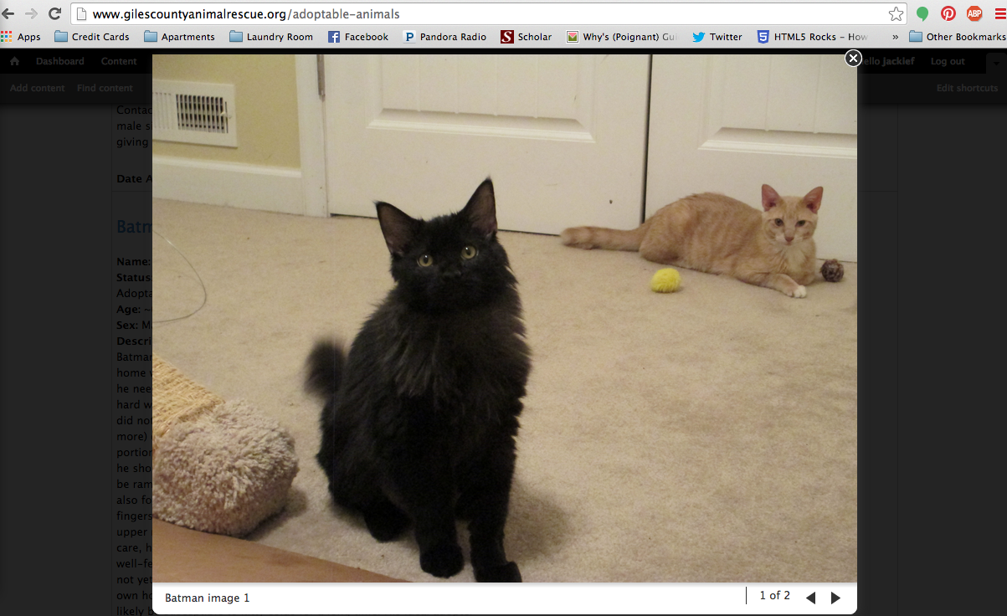
Added Ability To Enlarge Photos

Slide 10
Updated GoDaddy Information
Updated password for more security
Working on downloading all files
  Create a back up for accidental loss

Slide 11
Plans for Rest of Semester
Continue updating each page.
  Adding photos
  Changing formatting
Create a comment system for users to comment on animals.
  Comments must be approved
Recreate the Donate page.
  Add functionality to add photos
  Create option for “In Memory Of”

Slide 12
Plans for Rest of Semester
Create a “User Guide” to make it easier for client.
Do everything possible so that the client won’t need any more help.

Slide 13
Problems
GoDaddy user interface is poor.
No form of version control
No back ups
Trouble updating version of Drupal

