Slide 1
Developing an improved focused crawler for the IDEAL project
Ward Bonnefond, Chris Menzel, Zack Morris, Suhas Patel, Tyler Ritchie, Mark Tedesco, Franklin Zheng

Slide 2
IDEAL project
Integrating Digital Event Archiving and Library
Finding webpages related to an event (i.e. natural disaster)
Store found webpages locally for parsing and analysis

Slide 3
Enhanced focus crawler
Extract key words and key concepts (i.e. date, location, type of disaster)
Construct trees based on these words and concepts
Develop algorithm to compare different trees and their relationships
Make this process accessible via a web application

Slide 4
Project components
Tree construction and visual representation
Event representation (i.e. key words and key concepts) versus actual event (i.e. webpage)
Integrating updated modules into the existing focused crawler

Slide 5
Original Implementation
Start with a list of seed URLs
Web-crawler crawls through list of URLs
Searches the webpage for other URLs
Outputs a score for each URL based on keyword matchings
Adds any good URLs found to the list

Slide 6
Current Progress
Front-End
  User can enter multiple seed URLS into a textbox and submit them to Python bundle
  Python bundle returns scored webpages, which are then displayed on the front-end webpage
Back-end
    Halfway through creating an event tree from online articles
    Type of storm can be retrieved from the title of an article

Slide 7
Future Work
Finish producing the event-tree
Compare it with the tree provided by user to determine article relevancy
Make the GUI for displaying the event-tree for a specific event
Finish the UI for the webpage

Slide 8
Projected Implementation
Start with a list of seed URLs
Web-crawler crawls through list of URLs
Searches the webpage for other URLs
Outputs a score for each URL based on tree-edit distance
Adds any good URLs found to the list

Slide 9
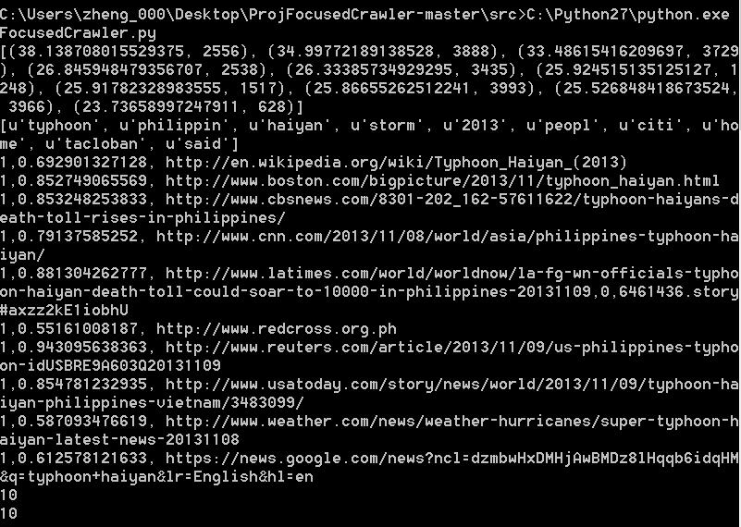
Current Back-End Example

Slide 10
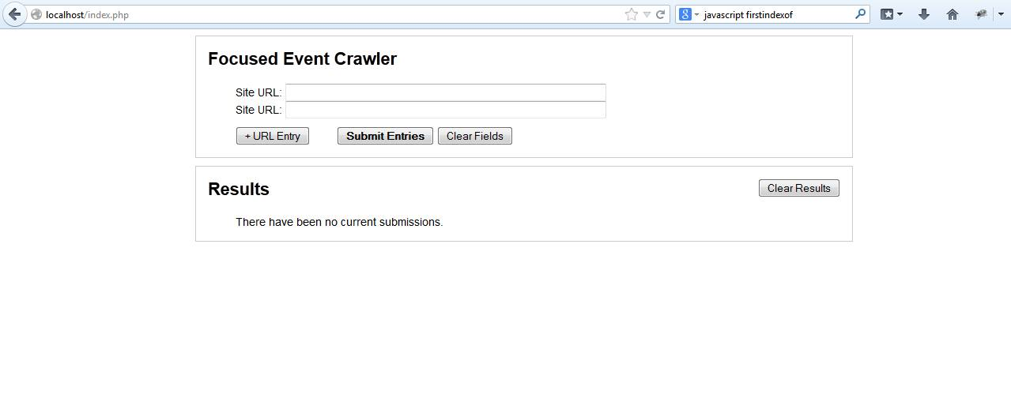
Current Front-End Example

Slide 11
Questions?

