Slide 1
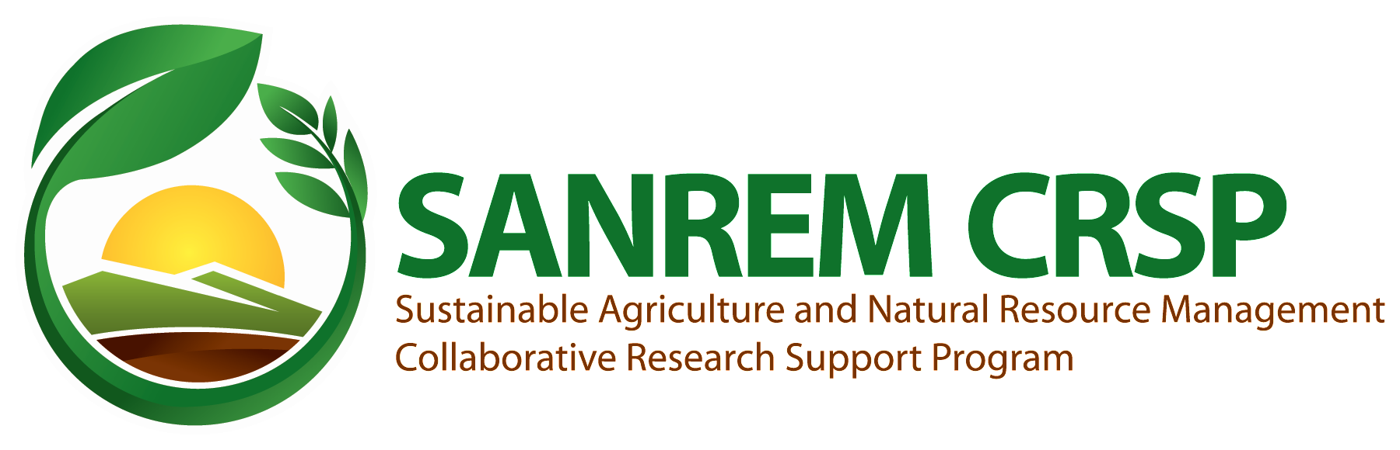


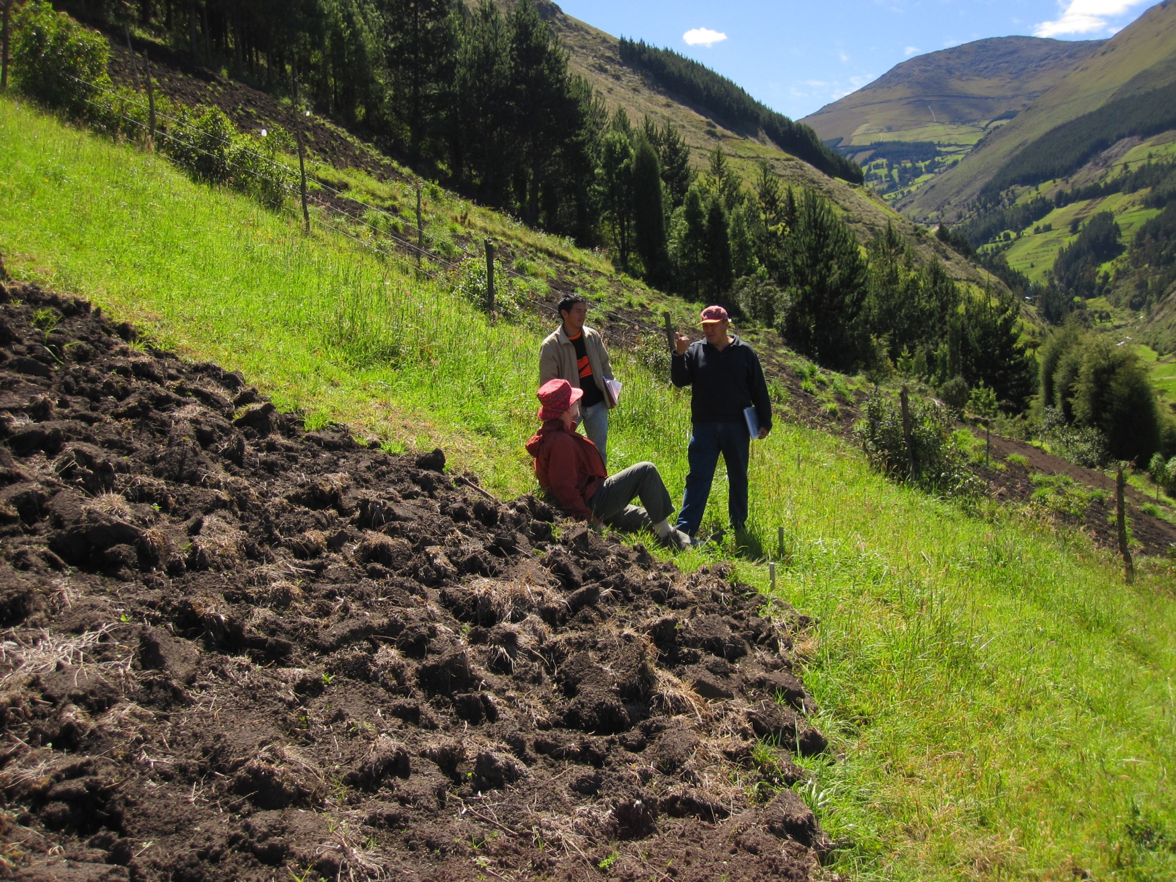
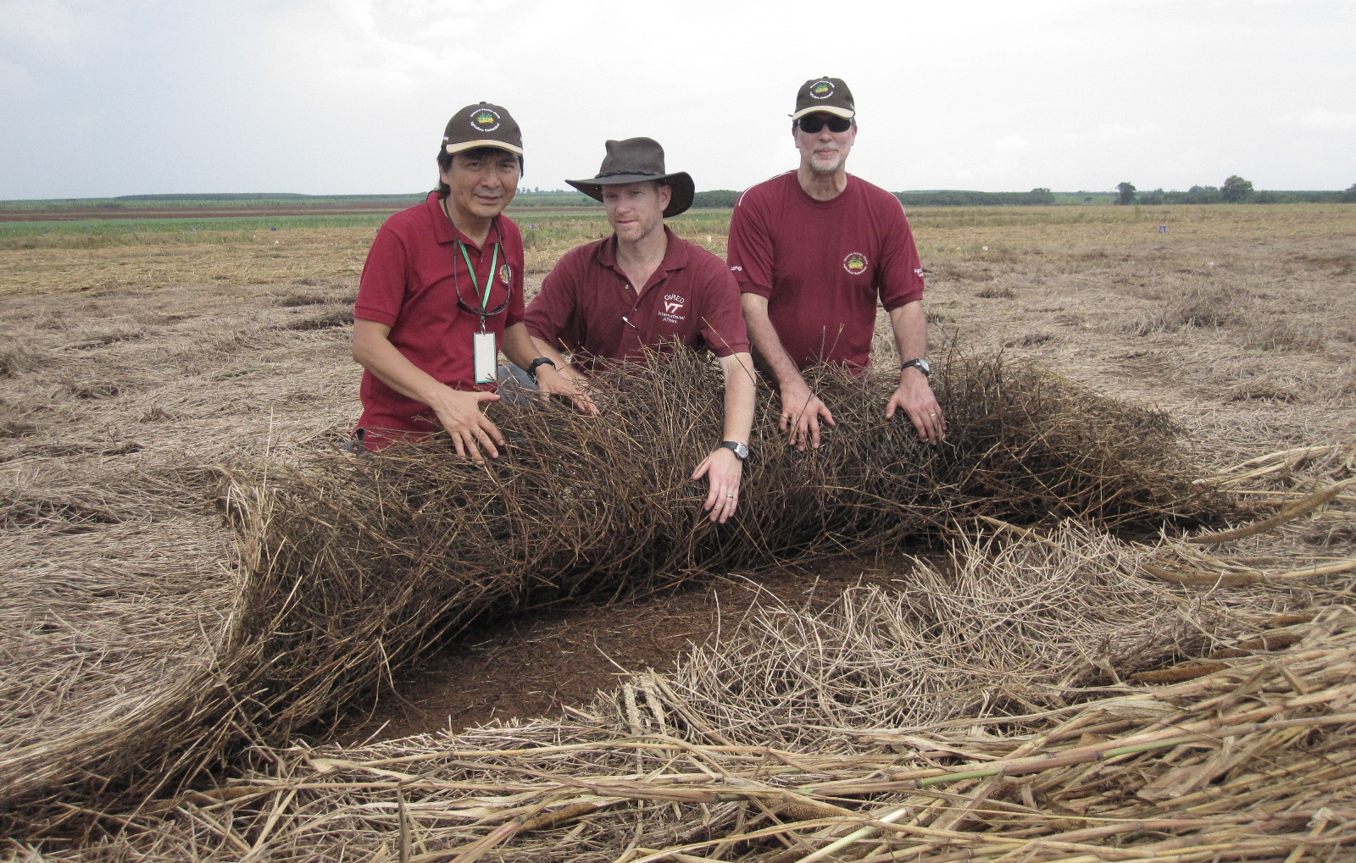
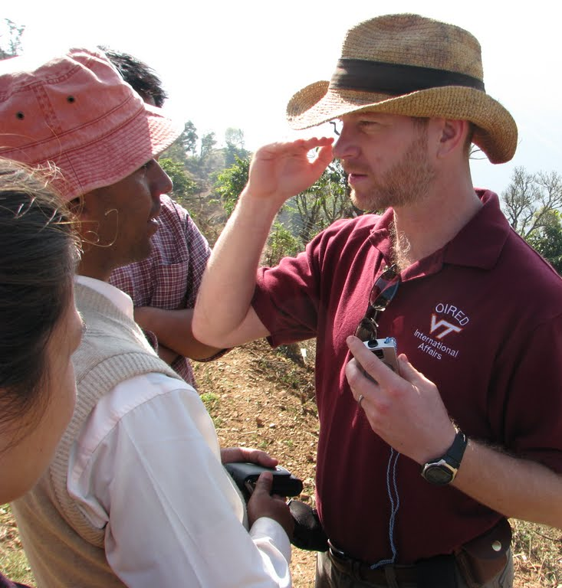
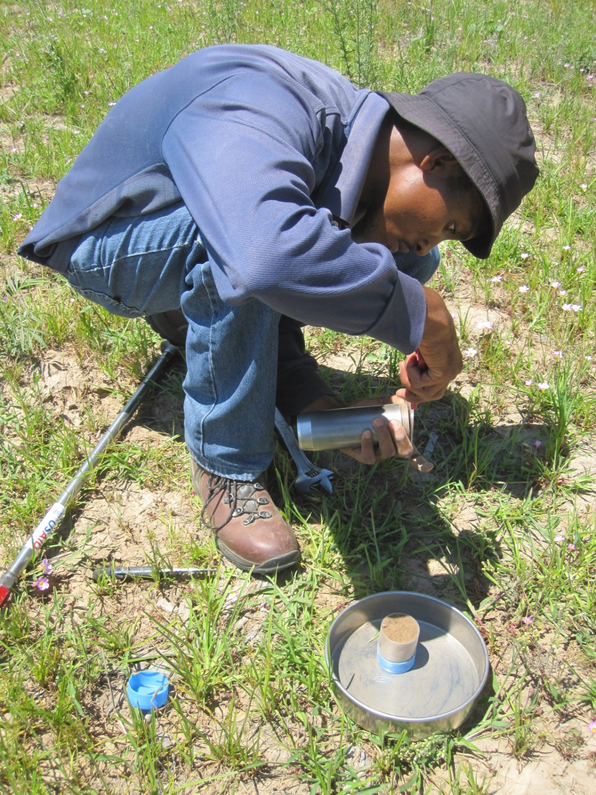
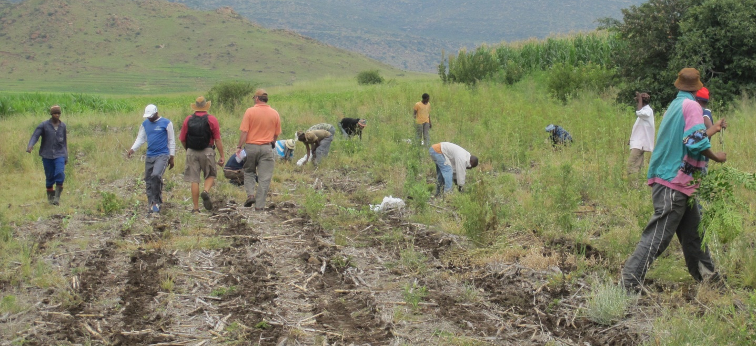
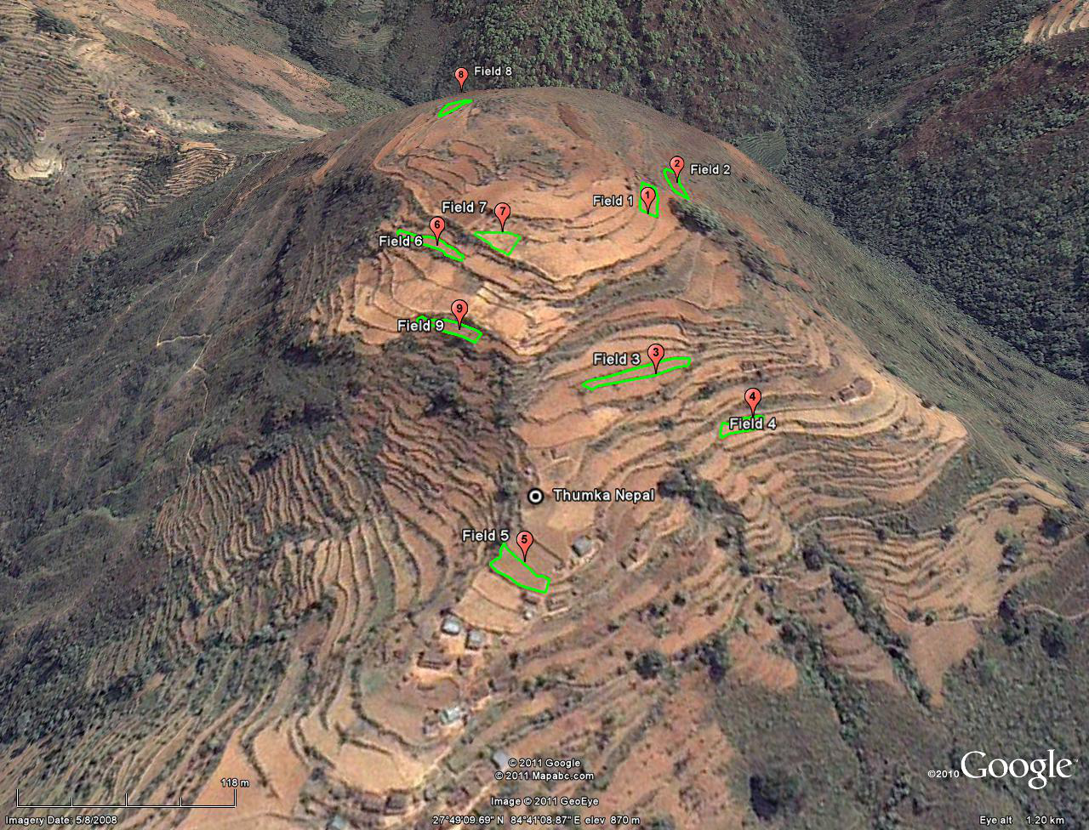
Can conservation agriculture improve soil quality and sequester carbon in the short term for dryland smallholders in the developing world?
Michael J. Mulvaney, Virginia Tech, OIRED, Blacksburg, VA, USA
mikemulvaney@vt.edu
Abstract
The United States Agency for International Development (USAID)-funded Sustainable Agriculture and Natural Resources Management (SANREM) Collaborative Research Support Program (CRSP) seeks to determine the effects of conservation agriculture (CA) on soil fertility and carbon (C) sequestration in the developing world. Time 0 and Year 3 soil samples at 0 – 5 and 5 – 10 cm depths will be compared to determine the effects of CA on soil fertility and soil C.
Materials and Methods
Bulk density and SOC data at the 0 – 5 and 5 – 10 cm depths will be collected from researcher-managed plots and will include current-practice control plots. Specific plots at each site will be selected for further sampling according to “best-bet” CA trials that show the most promise using CA as a technology that can (1) incorporate as many CA principles as possible; (2) have a good chance to improve soil quality over time; (3) improve production capacity; and (4) have the greatest potential for adoption. Samples will be collected at Virginia Tech to build a Time 0 soil library, for analysis and comparative purposes after three years. The library will also serve as an archive for other researchers who may require Time 0 soil samples from our project areas. To the extent possible, GPS data will be recorded from all field sites to provide accurate maps and GIS data relevant to crop production.
Soil samples will be composited from at least 16 cores, sieved to pass through a 2 mm sieve, and air-dried prior to shipping. Grain yield will be measured by weighing subsamples after harvest. Above-ground biomass will be measured using quarter-meter quadrats, and percent ground cover will be determined using line transects. Soil fertility parameters will include pH, N, available P, K, Ca, Mg, Zn, Mn, Cu, Fe, B, and Al, CEC, and SOC. Total SOC and N contents will be determined using dry combustion. Fields with a history of liming or those on calcareous soils will be treated with acid to account for carbonates. Density based fractionation of SOC will be conducted at 1.85 g cm⁻³ using sodium polytungstate (Six et al., 1998) at Time 0 and after three years.
Results and Discussion
This research will quantify changes to soil fertility and C sequestration due to CA treatments. One challenge with determination of C sequestration rates is that SOC may not significantly increase over the timeframe of this program. A global data analysis from 276 paired treatments indicated that an average of 0.57 ± 0.14 Mg C ha⁻¹ yr⁻¹ was sequestered after changing from conventional tillage to no-till, except in wheat-fallow rotations where no change was found (West & Post, 2002). The study noted that an additional 0.20 ± 0.12 Mg C ha⁻¹ yr⁻¹ can be sequestered by including rotations. Our CA systems employ both minimum tillage and crop rotations; therefore, we might expect to sequester approximately 0.77 Mg C ha⁻¹ yr⁻¹, and after three years, we may accumulate approximately 2.3 Mg C ha⁻¹ yr⁻¹. However, C sequestration rates reach a maximum 5 – 10 years after conversion to CA practices, so after three years of our CA trials, C sequestration rates may approach their maxima, increasing the chances of finding significant differences in total SOC between treatments. Rather than rely on total SOC changes alone, we will quantify labile and recalcitrant SOC fractions, which are more sensitive indicators of short-term management changes and their effects on soil fertility (Conant et al., 2004).
We collaborate with other CCRAs to implement trans-disciplinary research, specifically the quantification of soil fertility parameters in relation to gendered knowledge of soil quality in host-country areas, and also investigations of SOC for C credits in conjunction with the Economic and Impact Analysis CCRA.
One of the main goals of the Soils CCRA is to assist host-country institutions in biophysical data collection. Support includes building the capacity of host-country soils labs, in-field data collection training, or supporting implementation of CA components.
Discussing CA treatments in Ecuador
Stylosanthes guianensis cover crop residue in Cambodia
Introduction
During this 5-year phase, SANREM CRSP aims to determine the biophysical and socioeconomic potential of CA in 13 developing countries. Four Cross-Cutting Research Activities (CCRAs) integrate research across all 13 countries: Economic and Impact Analysis, Gendered Knowledge, Technology Networks, and Soil Quality and Carbon Sequestration.
Soil organic carbon (SOC) serves as an indicator of soil quality and fertility. It is generally observed that CA increases SOC under mechanized agriculture in the developed world (West and Post, 2003), but it is unclear if such increases are feasible for dryland smallholders growing staple crops in the developing world (Govaerts et al., 2009). Coordination of soil and agronomic investigations among all 13 countries before and after implementing CA is critical to measuring resulting changes in soil fertility and C sequestration. The objectives of the Soils CCRA are to:
Quantify SOC in host-country project sites before and after CA implementation.
Identify CA cropping systems or biophysical elements that improve soil fertility.
Relate increased soil fertility to site-specific socio-economic environments.
Demonstrating clinometer use in Nepal
Transplanting Brassicaceae using minimum tillage in Matphutseng, Lesotho
References
Conant, R. T., Six, J., and Paustian, K. (2004). Land use effects on soil carbon fractions in the southeastern United States. II. Changes in soil carbon fractions along a forest to pasture chronosequence. Biology and Fertility of Soils 40, 194-200.
Govaerts, B., Verhulst, N., Castellanos-Navarrete, A., Sayre, K. D., Dixon, J., and Dendooven, L. (2009). Conservation agriculture and soil carbon sequestration: between myth and farmer reality. Critical Reviews in Plant Sciences 28, 97-122.
Six, J., Elliott, E. T., Paustian, K., and Doran, J. W. (1998). Aggregation and soil organic matter accumulation in cultivated and native grassland soils. Soil Science Society of America Journal 62, 1367-1377.
West, T. O., and Post, W. M. (2002). Soil organic carbon sequestration rates by tillage and crop rotation: a global data analysis. Soil Science Society of America Journal 66, 1930-1946.
Collecting bulk density
samples in Roma, Lesotho
Three-dimensional field map of Thumka, Nepal
SANREM CRSP is made possible by the United States Agency for International Development and the generous support of the American people through USAID Cooperative Agreement No. EPP-A-00-04-00013-00.

