Slide 1
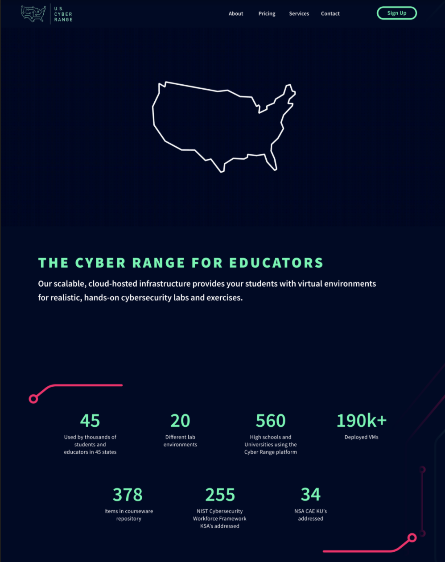
US Cyber
Range Website
Zach Amados, Tengis Gantulga, Renzo Ramos, and Brian Duong
CS 4264 - Multimedia, Hypertext, and Information Access - Edward A. Fox
Virginia Tech, Blacksburg, VA 24061
May 10, 2022

Slide 2
In this presentation, we will discuss
Recap
What’s New
Progress
Challenges
Timeline and Milestones
OKRs

Slide 3

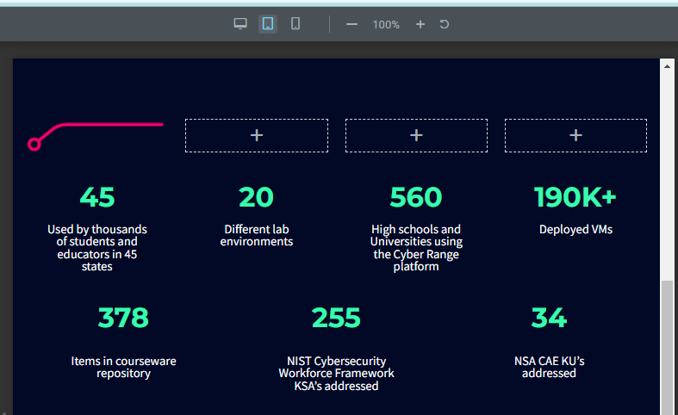
Recap
Building upon last semester’s implementation
US Cyber Range Site
WordPress
Responsive Design
Images of our team editing the website to make it have responsive design

Slide 4
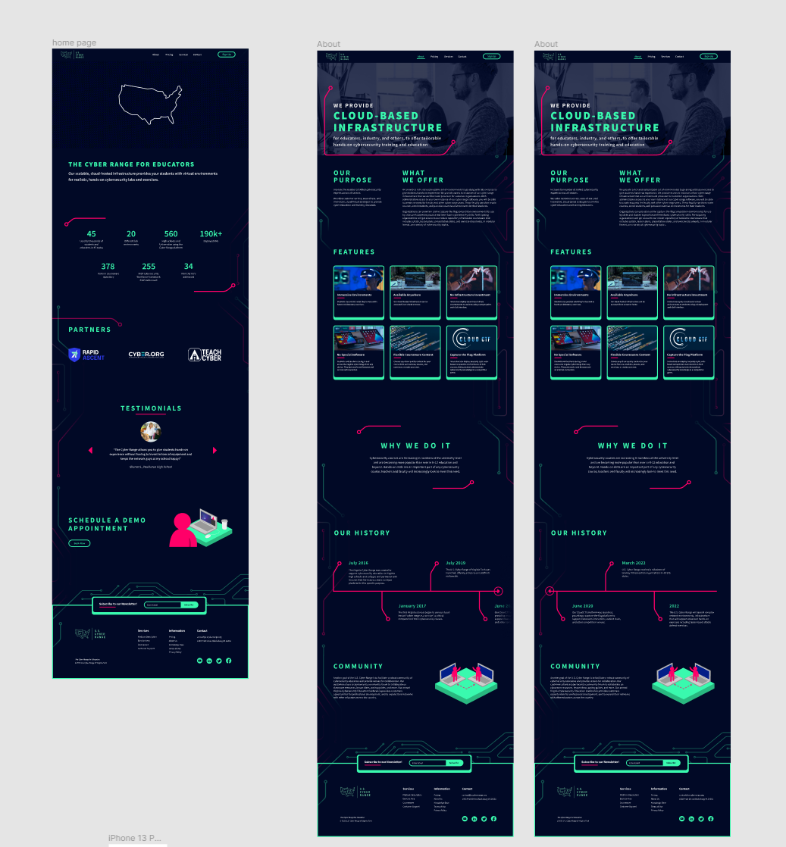
Materials Given
Figma design created by FourDesign
  all images, SVGs, animations, etc. needed.
Website through WordPress

Slide 5
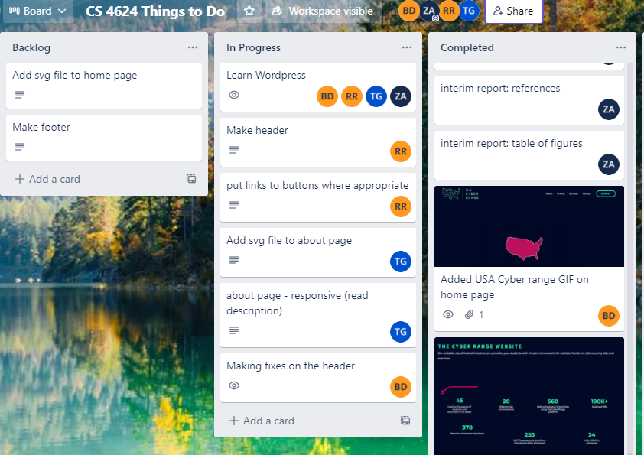
Approach, Plans, Timeline / Milestones
Primary Approach:
Elementor Plugin through the WordPress Interface
Set up quick testing for phone and computer
Scrum-like approach

Slide 6
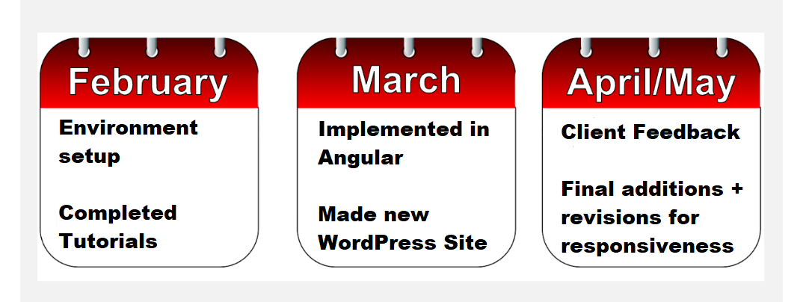
Approach, Plan, Timeline / Milestones

Slide 7
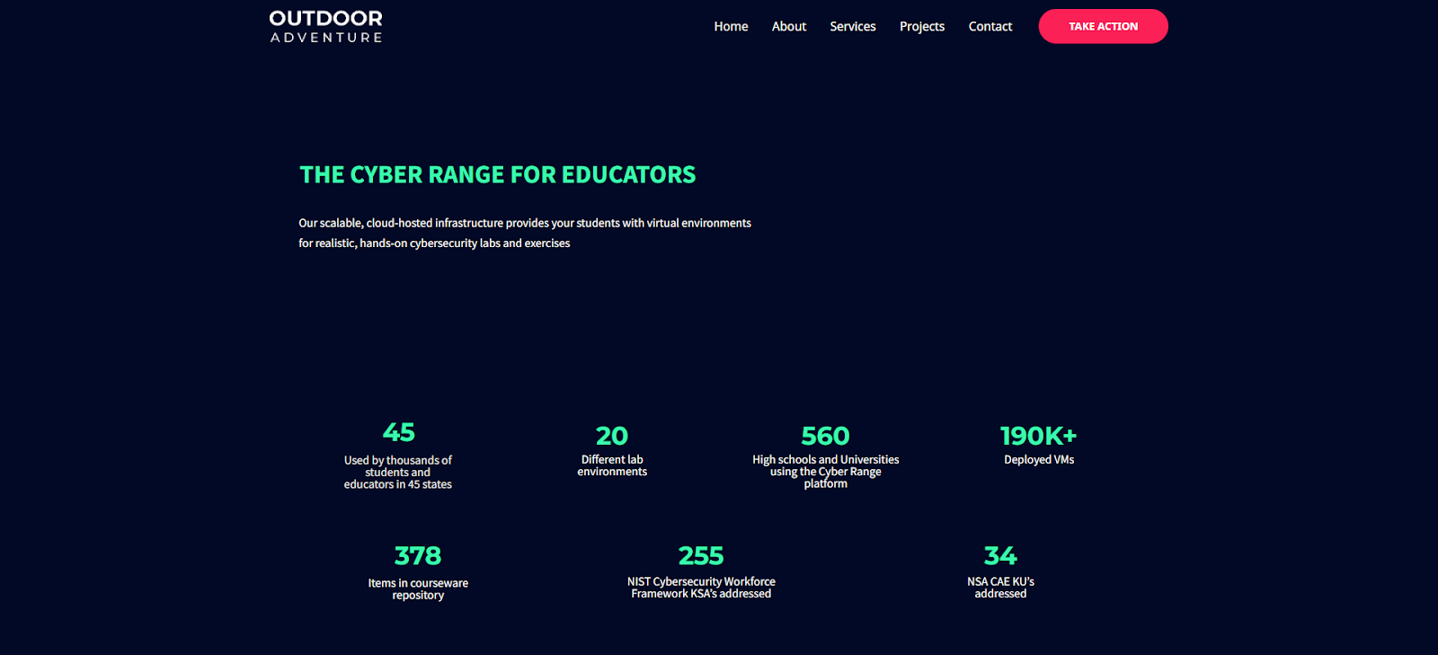
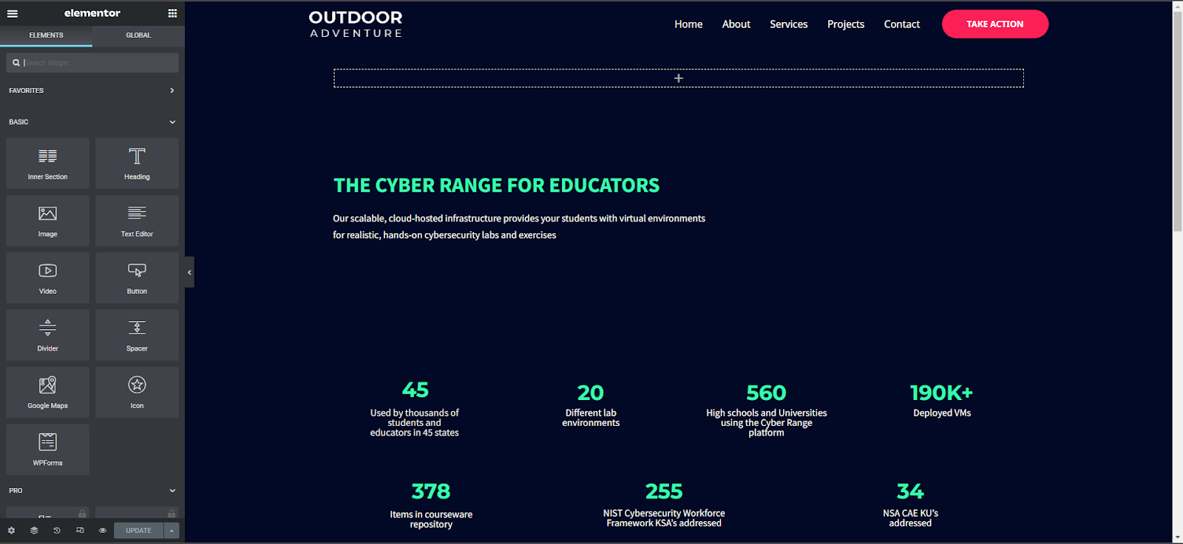
What’s New?
Deployed website on cscapstone.com
Added more pages
Used WordPress Elementor Plugin
Fixed mobile and tablet views

Slide 8
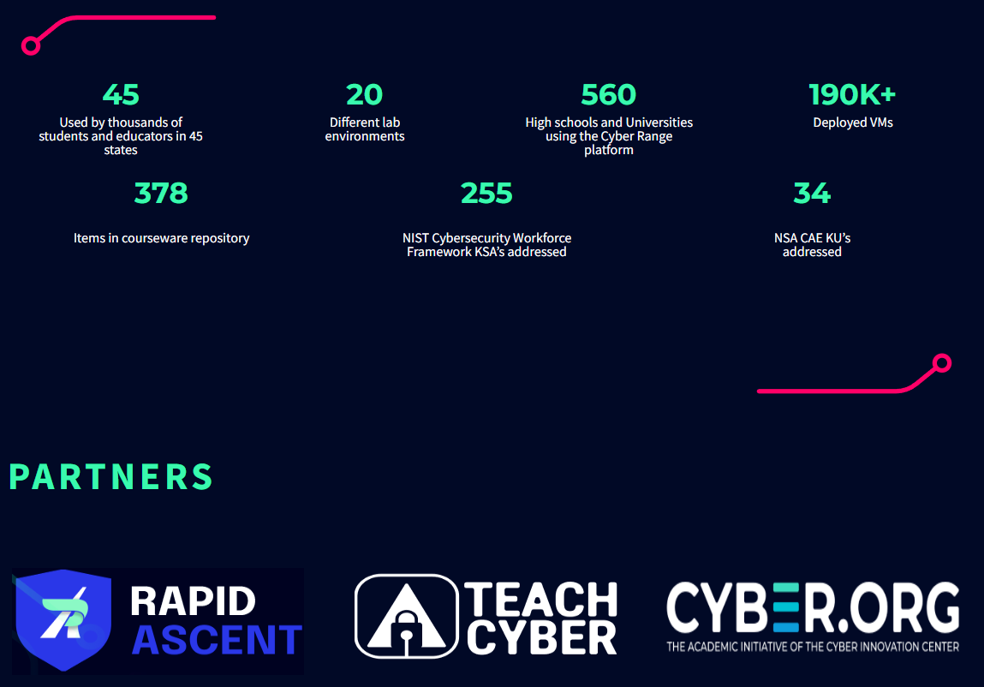
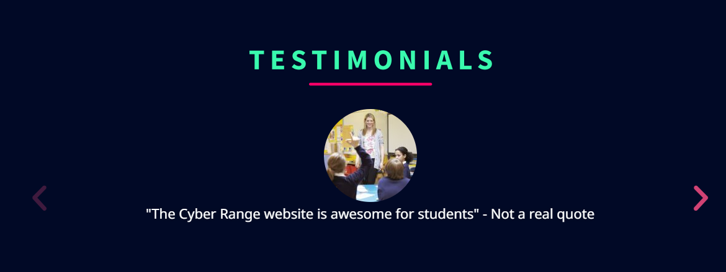
What’s New?
Adding appropriate SVG files
Added Logo and an animation to the home screen
Fixed Header + formatting
Added image gallery for testimonials

Slide 9
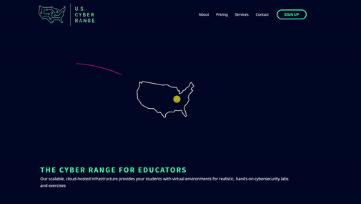
Preview of Some New Pages
Home Page

Slide 10
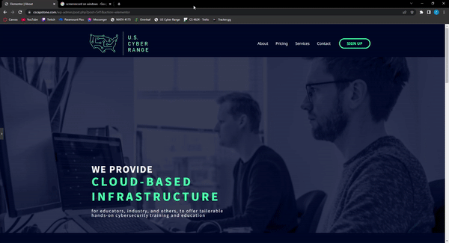
Preview of Some New Pages
About Page

Slide 11
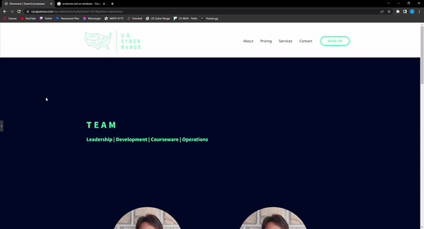
Preview of Some New Pages
TeamsCourseware Page

Slide 12
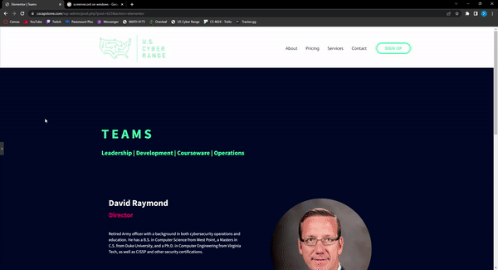
Preview of Some New Pages
Teams Page

Slide 13
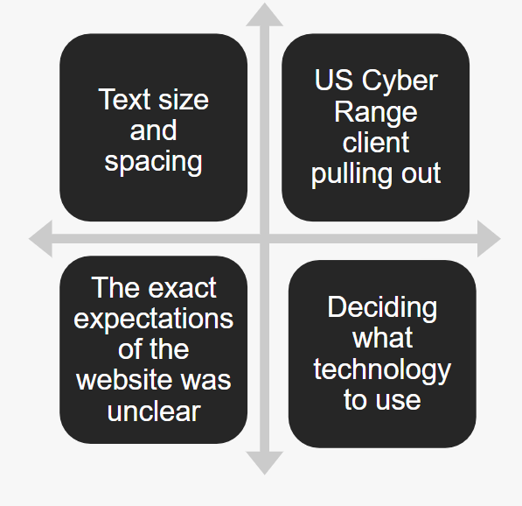
Challenges

Slide 14
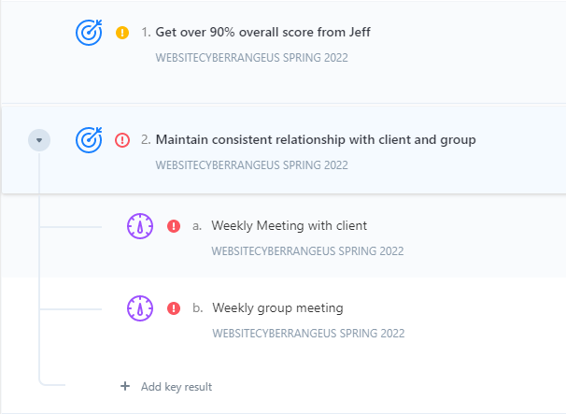
OKRs

Slide 15
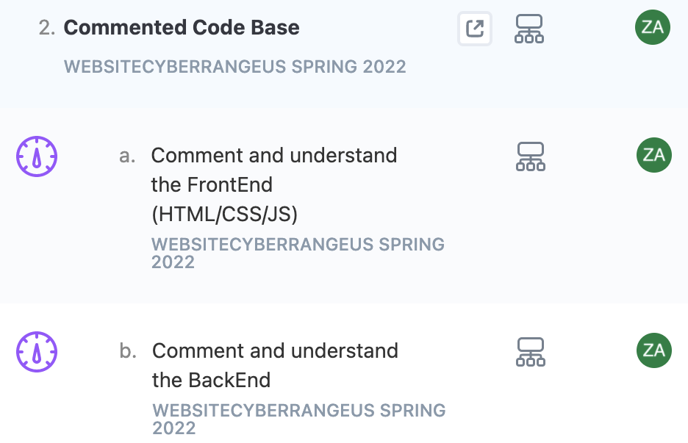
OKRs

Slide 16
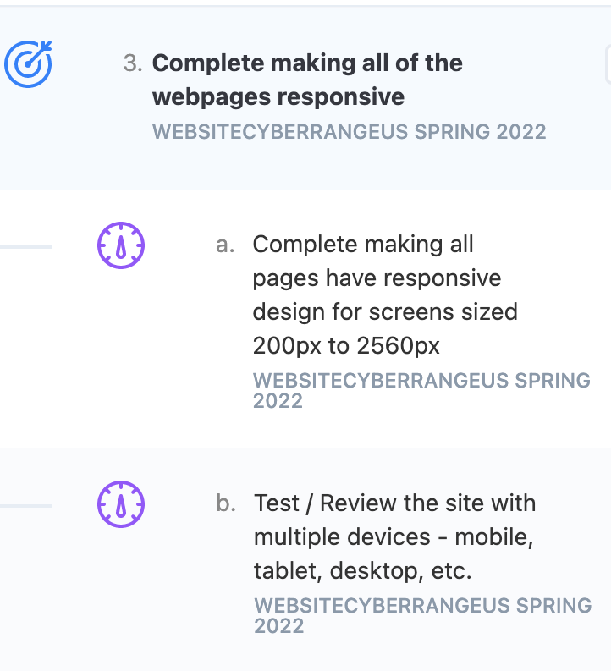
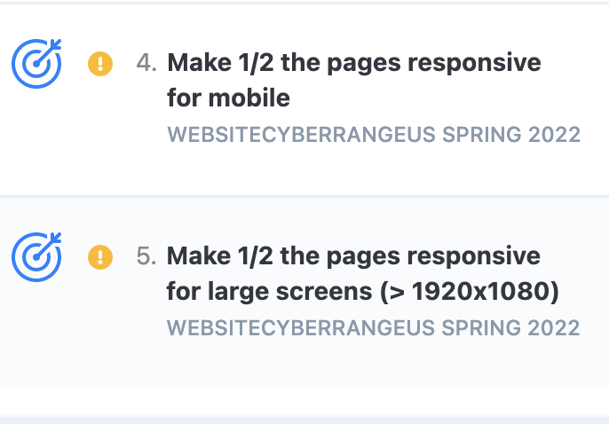
OKRs

Slide 17

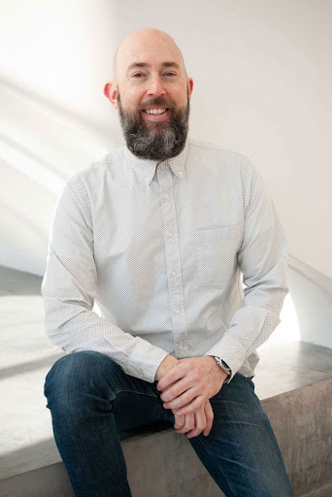
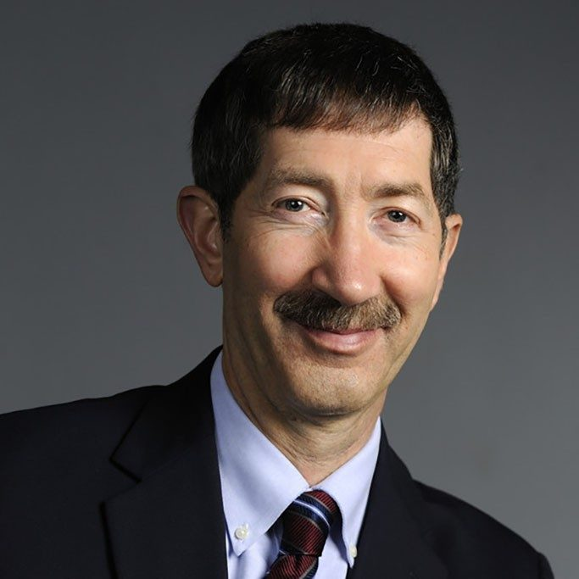
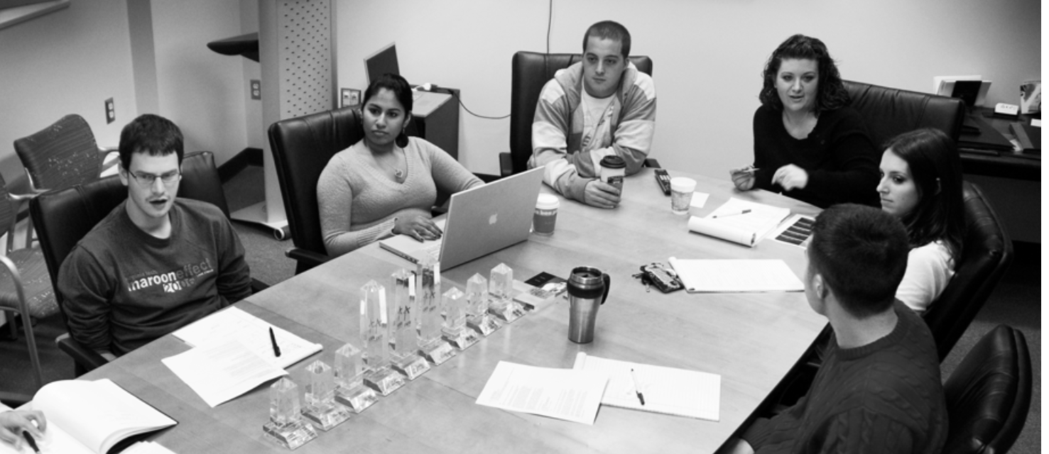
Client and Acknowledgements
Jeff Joiner
Dr. Fox

