Slide 1
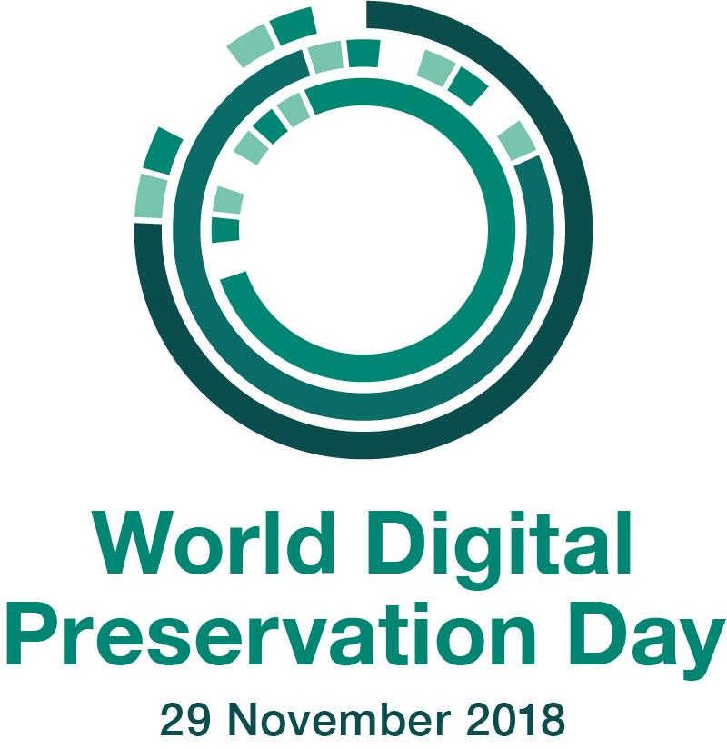

Slide 2
World Digital Preservation Day
Lightning Talks
11.07.2019
Alex Kinnaman | Luke Menzies | James Tuttle | Maureen Saverot | Jon Petters | Philip Young | Corinne Guimont

Slide 3
World Digital Preservation Day
Created by the Digital Preservation Coalition
(Usually) on the last Thursday of November
Purpose is to “create greater awareness of digital preservation that will translate into a wider understanding which permeates all aspects of society – business, policy making, personal good practice.”
Coincides with the DPC’s Bit List, which is an ongoing list of digitally endangered species

Slide 4
What is digital preservation?
Digital Preservation: “the series of managed activities necessary to ensure continued access to digital materials for as long as necessary. Digital preservation is defined very broadly [...] and refers to all of the actions required to maintain access to digital materials beyond the limits of media failure or technological and organisational change.”
Digital Preservation Handbook, 2nd Edition, http://handbook.dpconline.org/, Digital Preservation Coalition © 2015.

Slide 5
Preservation Support at VTUL
2 Library Faculty dedicated to digital preservation
2 Library IT Faculty with extensive experience in digital preservation
7 member Digital Library Platform team dedicated to a new access platform
2 subscription preservation storage services, APTrust and MetaArchive, with a community around both
2 web archiving technologies and trained personnel
Data Services department dedicated to data management planning

Slide 6
Lightning Talks
Alex Kinnaman, Digital Preservation Coordinator: Web Archiving
Luke Menzies, Digital Preservation Technologist: Personal Digital Archiving
Jim Tuttle, Associate Director of Digital Libraries: Risk, Threats, & Mitigations
Maureen Saverot, 3D Technical Artist: 3D Photogrammetry
Jon Petters, Data Management Consultant and Curation Services Coordinator: Data Management Planning
Philip Young, Institutional Repository Manager: Perma.cc
Corinne Guimont, Digital Scholarship Coordinator: Documentation

Slide 7
Web Archiving

Slide 8
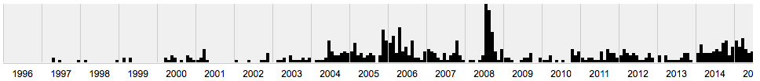
What is it?
"Web archiving is the process of gathering up data that has been recorded on the World Wide Web, storing it, ensuring the data is preserved in an archive, and making the collected data available for future research."
-- Niu, J. (March/April 2012). "An overview of web archiving." D-Lib Magazine, Vol. 8, 3/4.

Slide 9
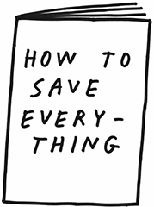
Why archive the web?
Websites are transitory
Website are dynamic and complex
Content on websites can disappear (news, social media)
Legal obligation (e.g. National Archives)
Research
Maintaining scholarly citations
It’s neat!
And also….
Notes:
Why archive information?
Websites are transitory, they change, they break, they disappear, they’re intentionally temporary (like news sites, social media, etc). They’re also complex, dynamic, and interactive, meaning they cannot be preserved with the same methods used to preserve, say a TIFF or a WAV file.
However, saving something because “otherwise it’ll go away” or because it’s complex isn’t a strong argument.
There may be a legal obligation to preserve content, such as federal documents preserved by the National Archive; websites rich with content data mining, critical analysis, cultural heritage projects, the list goes on, and provides significantly more data to work with.
And, not to steal thunder from another speaker, we can also preserve websites containing or representing scholarly citations.
Plus, it’s neat!
Credit: “How to Save Everything” by Tucker Nichols https://pandopopulus.com/store/book/published-by-pando/how-to-save-everything/

Slide 10
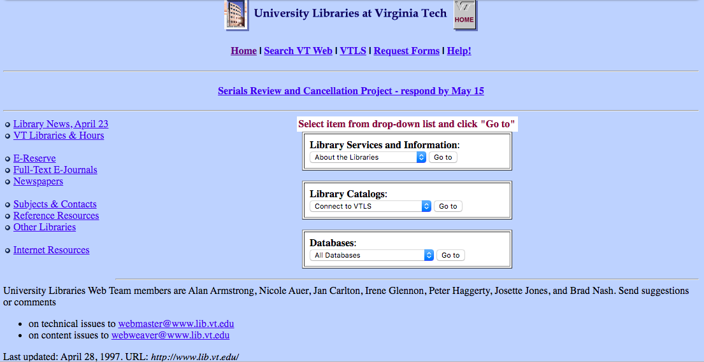
1997 lib.vt.edu
https://web.archive.org/web/19970429181700/http://www.lib.vt.edu/
Who wants to forget all of this beauty??

Slide 11
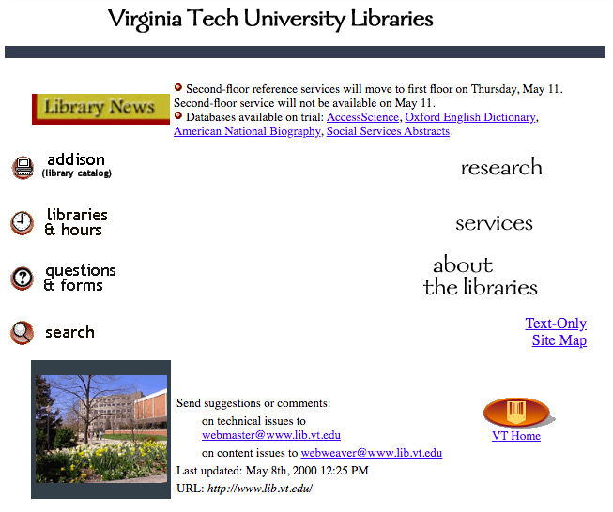
2000 lib.vt.edu
https://web.archive.org/web/20000815074739/http://www.lib.vt.edu/

Slide 12
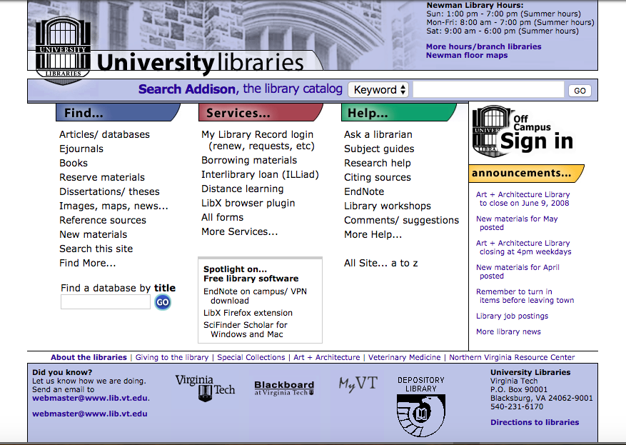
2008 lib.vt.edu
https://web.archive.org/web/20080715094929/http://www.lib.vt.edu:80/

Slide 13
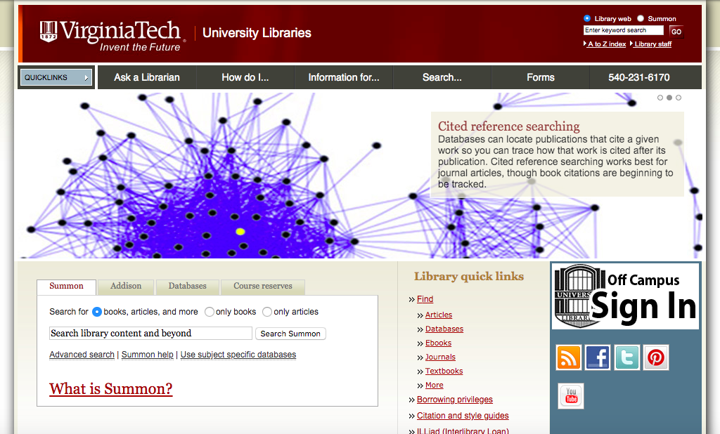
2015 lib.vt.edu
https://web.archive.org/web/20150516072158/http://www.lib.vt.edu/

Slide 14
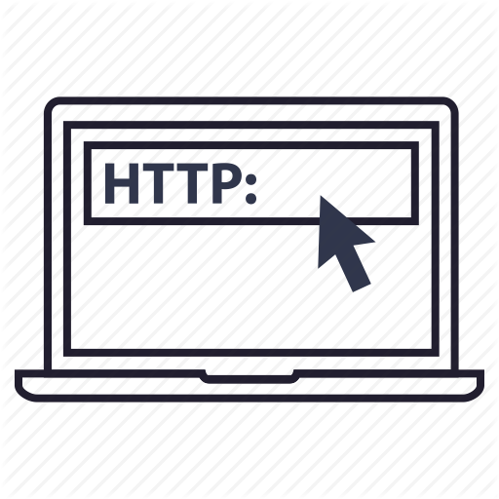
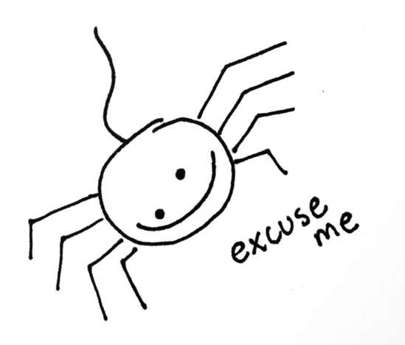
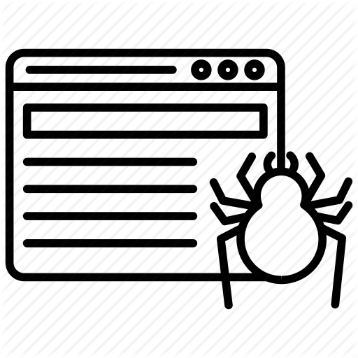
How it works (very quickly)
Web crawlers (or spiders) use HTTP protocol to access servers
If it’s polite, it identifies any robots.txt
Web crawlers follow “seeds” (URLs) and crawls it
  Captures all links in that seed
  Copies all files in that seed
  Captures all formatting
Returns that information to the operator and this becomes the web archive
Notes:
There are 3 primary methods for web crawling. The one described here is the most commonly used and is called Client-side web archiving, which generally crawls directly hosted content, and is the most straightforward and scalable option.
Polite Spider: https://society6.com/product/polite-spider-excuse-me_stretched-canvas

Slide 15
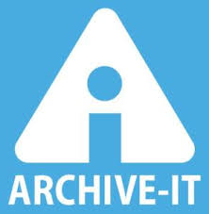
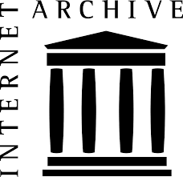
Virginia Tech Web Archive
archive-it.org/collections/5315
Uses Archive-It hosted by Internet Archive
Archived biannually and as-needed
Content includes:
  All sites with the vt.edu domain
  VT Projects
  Creative Technologies theses
Email me to add content to VTWA

Slide 16



Do it yourself!
Webrecorder.io
  Funded by The Andrew W. Mellon Foundation and the Knight Foundation
Create your own hosted web archive
Download your web archive and replay in your desktop
Free!
web.archive.org
Add seeds (URLs)
Maintained by Internet Archive
Publicly accessible an searchable
Free!

Slide 17
Personal Digital Archiving
Notes:
Introductory Slide, No Notes

Slide 18
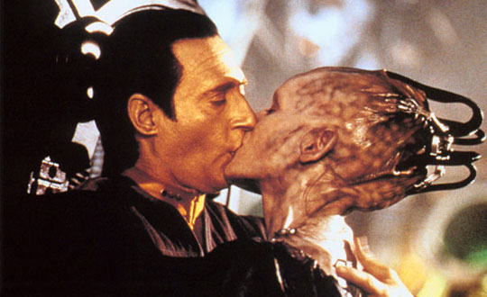
PDA
Notes:
18(2)- Today I'm going to tell you about PDA. What? No, not Public Displays of Affection, Personal Digital Archiving!
- Yes, we ARE talking about Data, but not this Data, necessarily.
- Personal Digital Archiving can be done EASILY and relatively CHEAPLY, using free software!

Slide 19
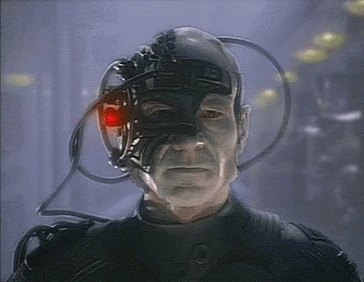
Borg Archivists
Notes:
19(3)- You may be thinking to yourself, "Yes, I DO want to prevent Data from getting lost (haha), but Where do I begin?"
-- On one hand, the Borg are great data preservationists, because they are constantly upgrading their hardware, and all of their data is accessible, via the neural link.
-- On the other hand, because they do not maintain their data, track versioning, or archive their data, all of their data is at risk of being wiped out by a virus (and apparently, they are easily overtaken if you beam in while they're sleeping).

Slide 20
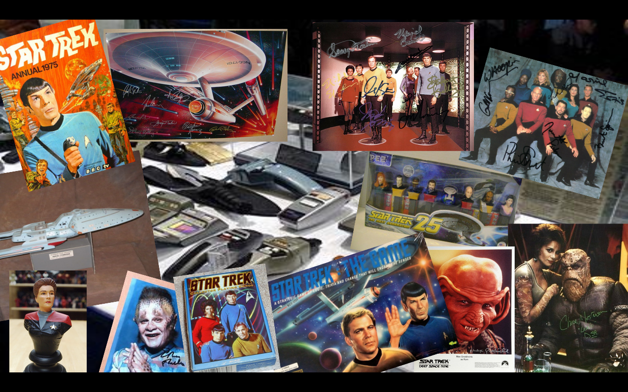
Inventory
Notes:
20(4)- The first step, is to figure out what you have.
-- Ask yourself: What types of content do you have? Where is it? How is it organized?
-- You can run a simple Python script that will inventory everything you have, tell you what it is, where it is, and collect any other information you want.
-- The best part of this is, the Python script is FREE!

Slide 21
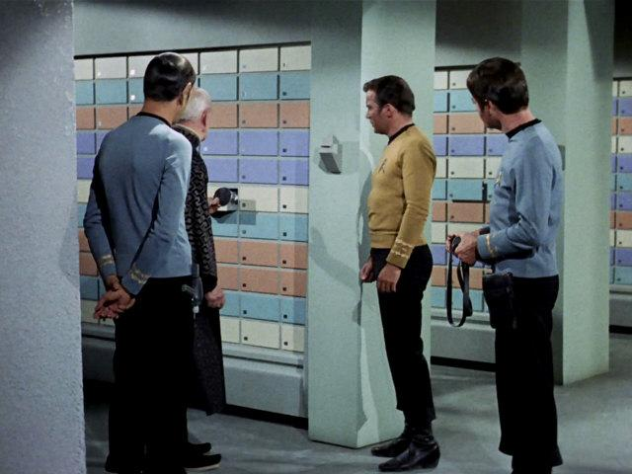
Organize
Notes:
21(5)- Next, organize your data.
-- The best strategy for organizing your data will be characterized by:
-1- It's an organizational schema that makes sense to you.
-2- It's an organizational schema makes sense to any future you, or other person who will need to access your data.
-3- The complexity of your organization should be easily repeatable and reproducible
-- Above all, your organizational strategy should be: Uniform, Documented, and Consistent

Slide 22
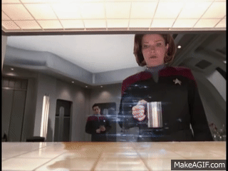
Replicate
Notes:
22(6)- Next, replicate your data, and store it.
-- The goal here is to put backup copies of everything you have into one repository so that you can replicate this 'digital archive' across a diversity of hardware, locations, and types of systems.

Slide 23
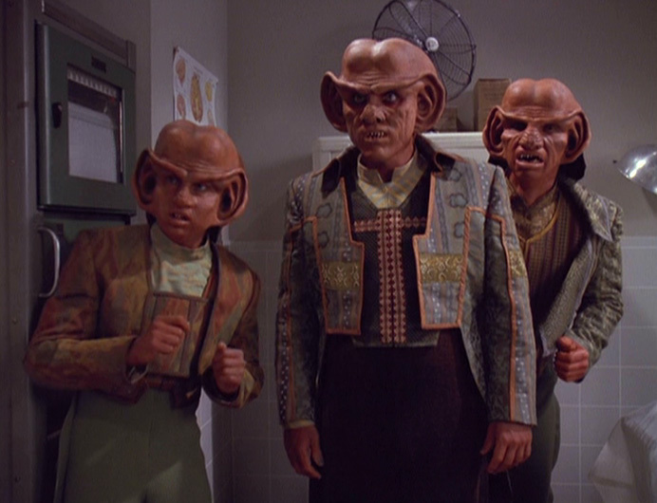
Rule of 3
Notes:
23(7)- Here at Tech we use the 'rule of 3': Local, External, and Cloud.
-- For Personal Digital Archiving:
- Local means your local machine, in your home or office
- External is going to be a machine or external hard drive that you set up as a separate place to store your archive
- the Cloud is used to store your archive somewhere far away from your home or office
(AWS, Google, Azure, Box, DropBox, etc. -- unfortunately none of these are free)

Slide 24
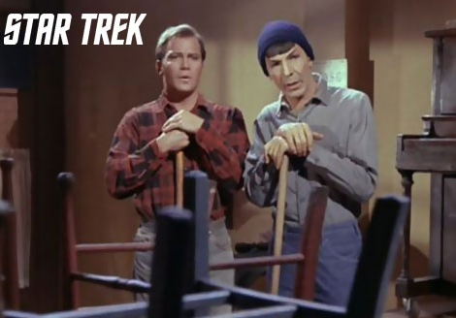
Maintenance
Notes:
24(8)- Now that your data is organized and backed up you have to perform maintenance on it.
-- Maintenance activities are designed to answer three questions:
Is your data still there?
Can you still access it?
Does anything need to be upgraded?

Slide 25
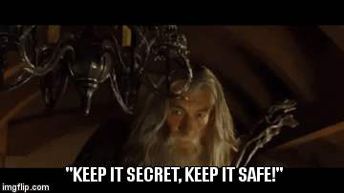
Notes:
25(9)- One, "Is it secret? Is it Safe?"
-- Wait, what? That's not Star Trek!
-- We answer this question by running an inventory and fixity checks every 3 months.
-- 3 months is also the frequency with which you should be changing your car's oil. Make a holiday of it!

Slide 26
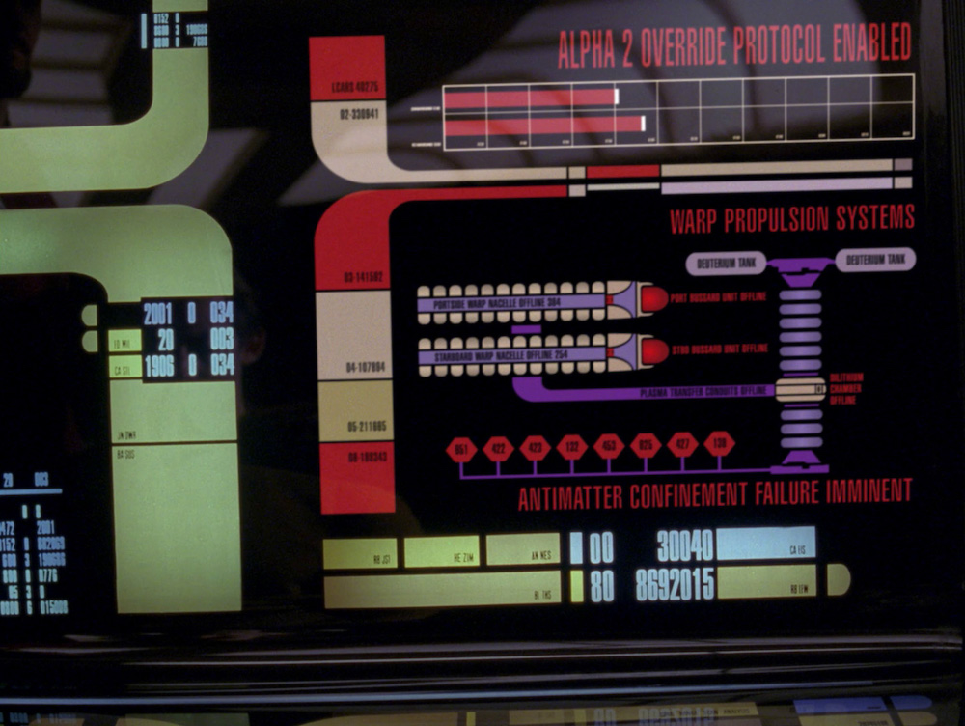
Diagnostic
Notes:
26(10)- You can perform this inventory and fixity check by running a FREE and simple command line script.
-- Depending on how much data you have, it can take seconds or up to an hour.
-- Store the results of these inventories and checks, as a CSV spreadsheet, in your archive!

Slide 27
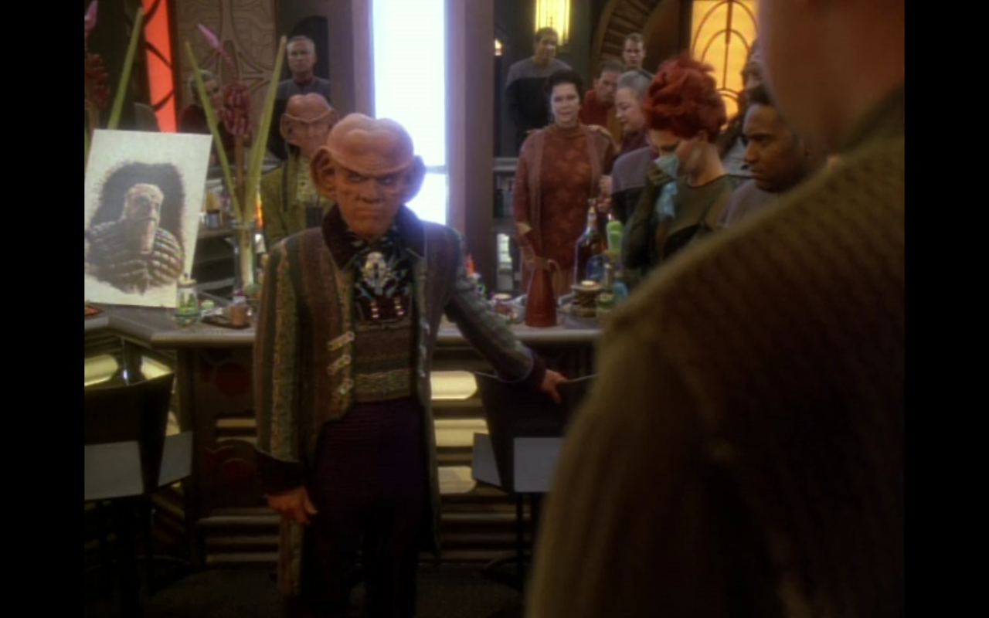
Reminisce
Notes:
27(11)- Two, Can you still use your data?
-- We answer this question by performing spot checks on particular items.
-- Reminisce with your data. Check to see if you can still open those photos, read those documents, listen to that audio track, watch that video.

Slide 28
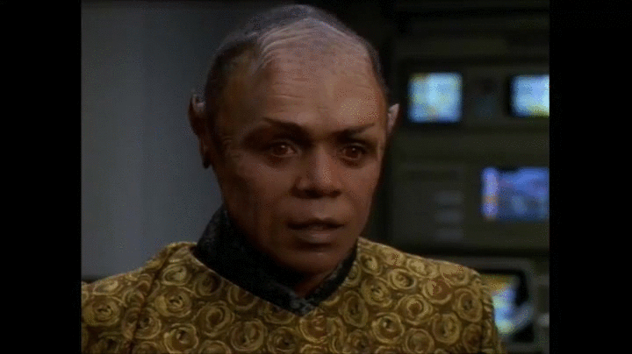
Transformation
Notes:
28(12)- Three, Does anything need to be upgraded, transformed, or migrated?
-- In order to answer this question we look at the results of our 3-month inventory to see if there are any obsolete file formats that need to be updated.
-- Also pay attention to files that require particular software in order to run (like my AppleWorks files that are now hard to open and use!)

Slide 29
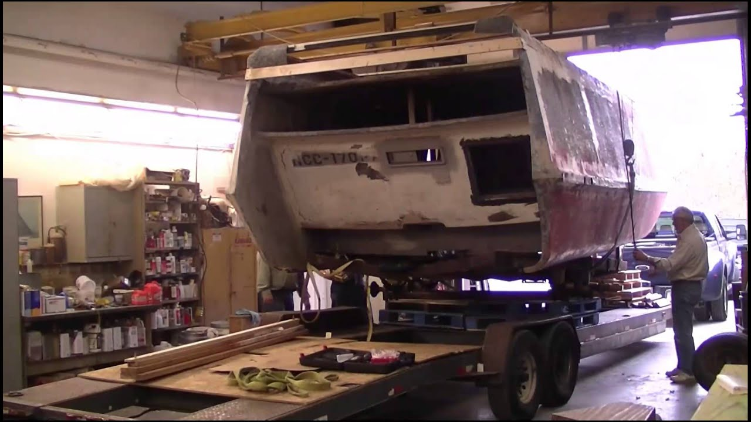
Restoration
Notes:
29(13)- What do you do if you find a problem?
-- Unlike the Borg, you have more than one copy, stored in at least 2 other locations.
-- If one copy is corrupted, replace it with one of the others.

Slide 30

Do What You Will
Notes:
30(14)- Finally, don't get overwhelmed.
-- The thing to keep in mind with all of this is "do as much as you are willing and able".
-- Every little bit helps.

Slide 31
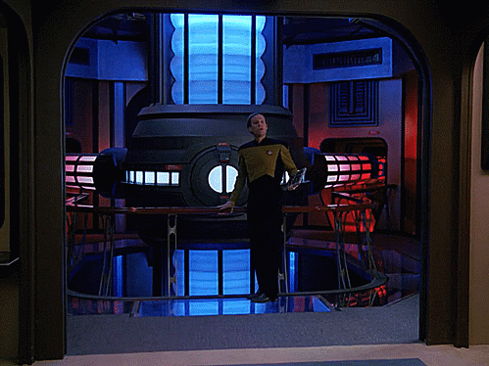
For More...
Notes:
31(15)- For More Information on digital preservation, come talk to Alex Kinnaman and Myself.
-- Attend one of our PDN sessions!
-- Thank you!

Slide 32
Risks, Threats, & Mitigations

Slide 33
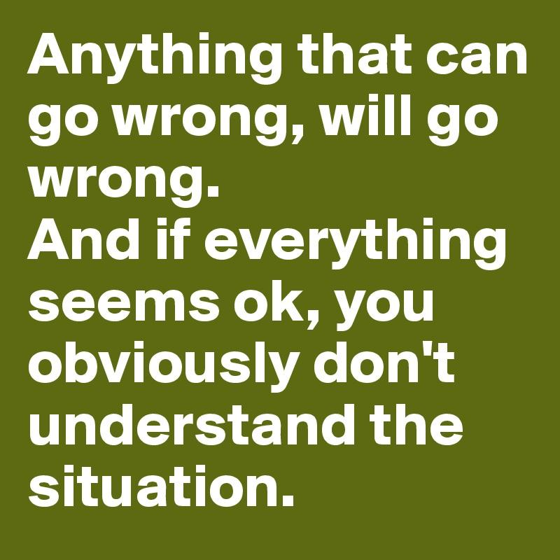
<--NOT KIDDING!

Slide 34
Risk Assessment Models
SPOT (Simple Property-Oriented Threat)
Availability
Identity
Persistence
Renderability
Understandability
Authenticity
DRAMBORA (Digital Repository Audit Method Based on Risk Assessment)
Physical environment
Personnel, Management and Admin procedures
Operations & Service Delivery
Hardware, Software of Communications Equipment and Facilities
SPOT: http://wiki.dpconline.org/index.php?title=Digital_preservation_risks#Risk_Assessment_Methodologies
DRAMBORA: http://wiki.dpconline.org/index.php?title=Digital_preservation_risks#Risk_Assessment_Methodologies
Notes:
DRAMBORA examples: Loss of key member(s) of staff, Legal liability for IPR infringement, Hardware failure or incompatibility
SPOT examples: Sufficient metadata is not captured or maintained, Object characteristics important to stakeholders are incorrectly identified and therefore not preserved, Inadvertent damage to medium and/or bit sequences via hardware, software or operator error

Slide 35
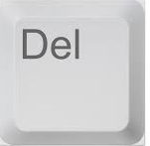
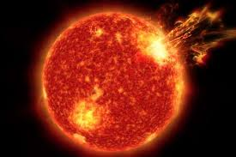
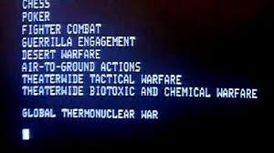
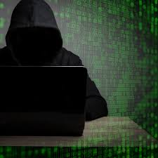
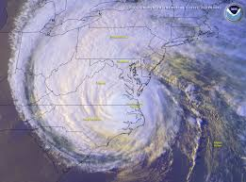
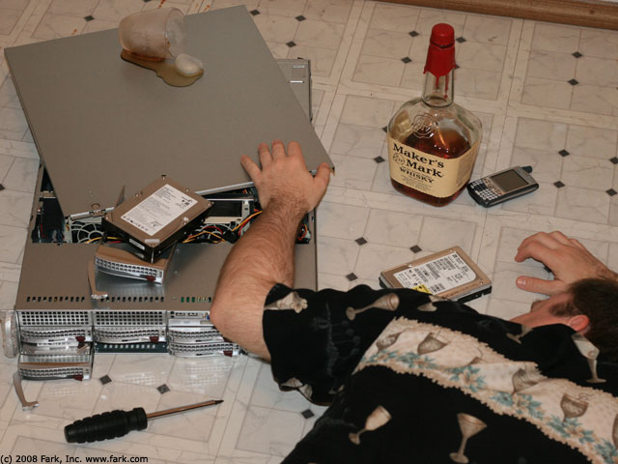

For real...
Notes:
We’re trying to be prepared for many types of risks including hackers, bad internal actors, accidental deletion, data center destruction, and funding discontinuity.

Slide 36
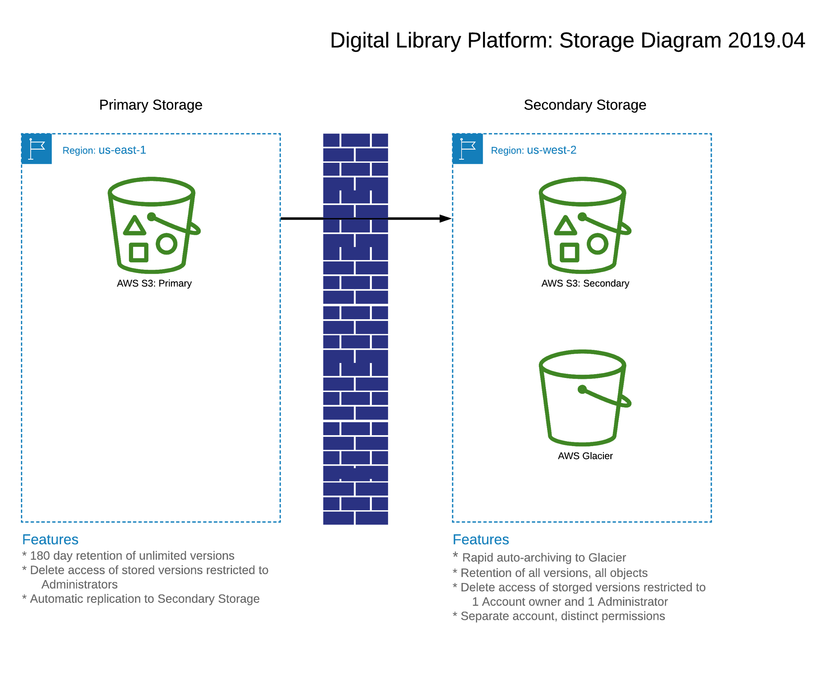
Notes:
DI&PS has been working on processes to address address preservation challenges for some time in the Libraries but now we have the opportunity to operationalize and codify these practices into systematized, automated services. The above storage diagram illustrates one aspect of that opportunity. Using AWS we can automate the geographic and administrative separation of storage nodes to maximize safety and security of our digital assets. By building automated processes into existing services like VTechWorks, VTechData, and the Digital Imaging Lab workflow, we can democratize access to preservation services.

Slide 37
Photogrammetry

Slide 38
Gathering Images
The most vital step in this process
A rotating platform is marked at 6 - 10 degree intervals, and images are taken at each
3 to 4 different camera heights with complete rotations, repeated with the object inverted
Rotation 3
Rotation 2
object
Rotation 1

Slide 39
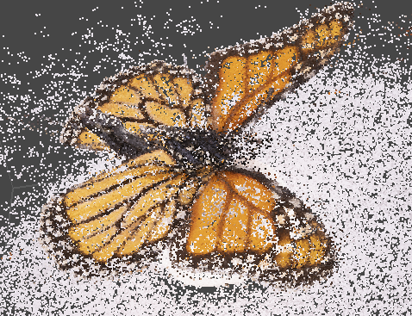
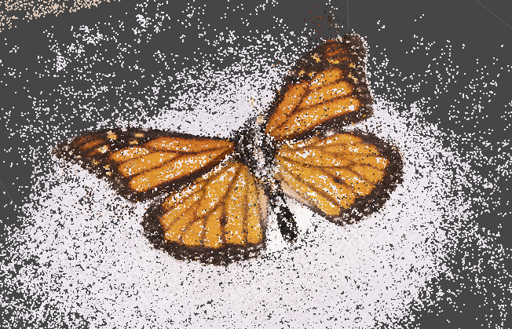
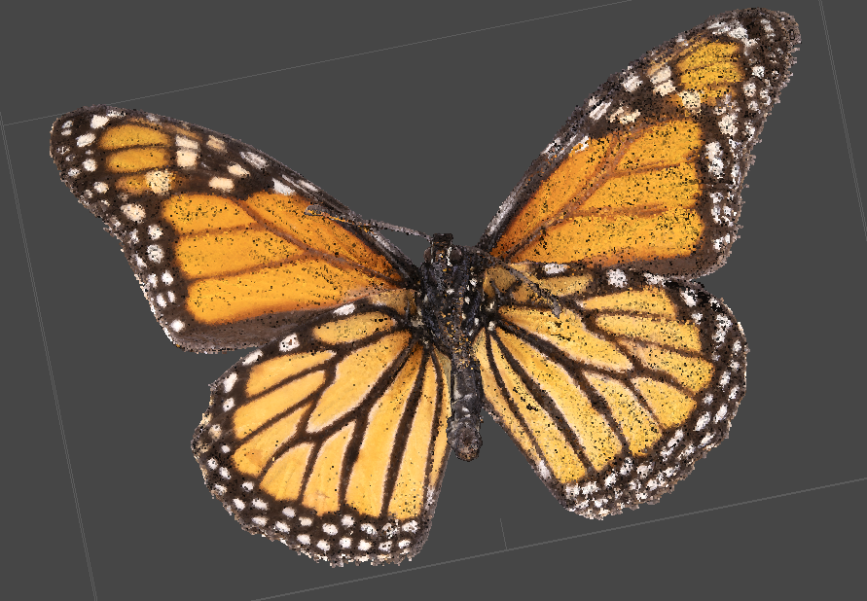
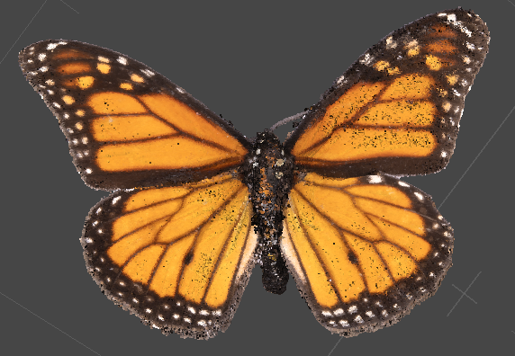
Sparse/Dense Cloud (Agisoft)
Flipped butterfly
Upright butterfly
All of these images are imported into Agisoft Metashape
Algorithm finds relationships between images in a sequence to create a “sparse cloud”, then “dense cloud” once approved by human user
Sparse Cloud
Dense Cloud

Slide 40
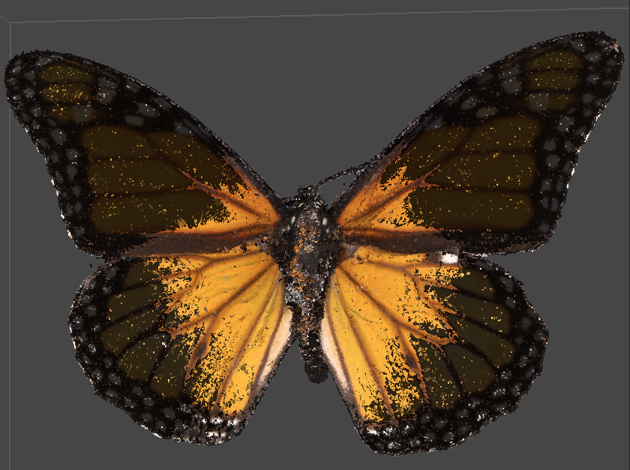
Mesh (Agisoft)
Upright and flipped chunks are aligned and merged
Metashape uses all the points to create polygons, resulting in a mesh
But! This mesh is messy and unusable outside of Metashape

Slide 41
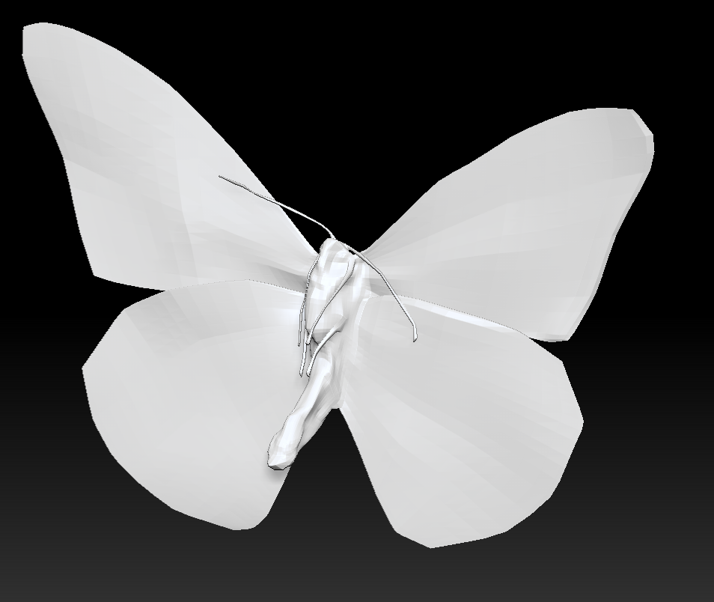
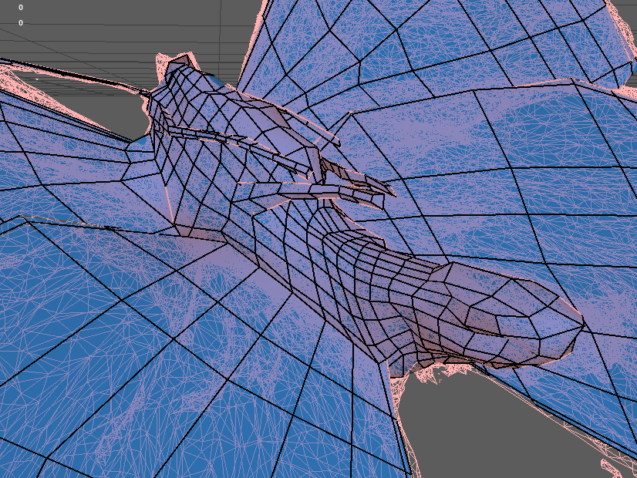
Mesh (Maya, Retopology)
Mesh from Agisoft is used as reference to create a cleaner, lighter model

Slide 42
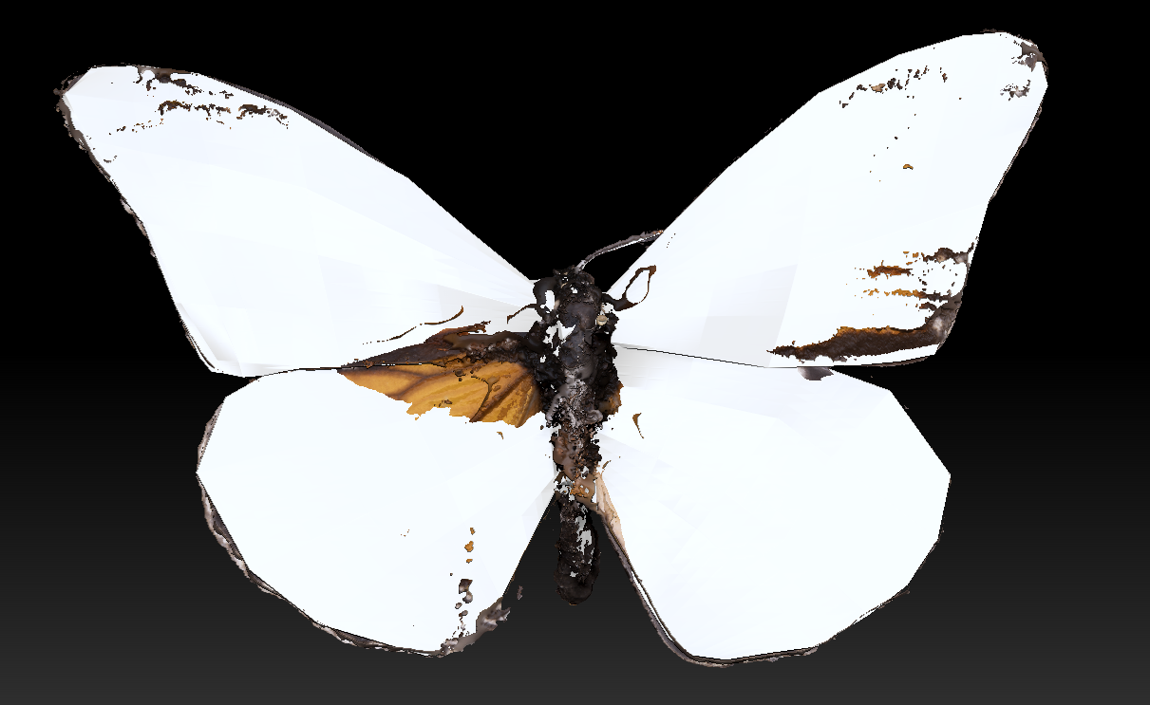
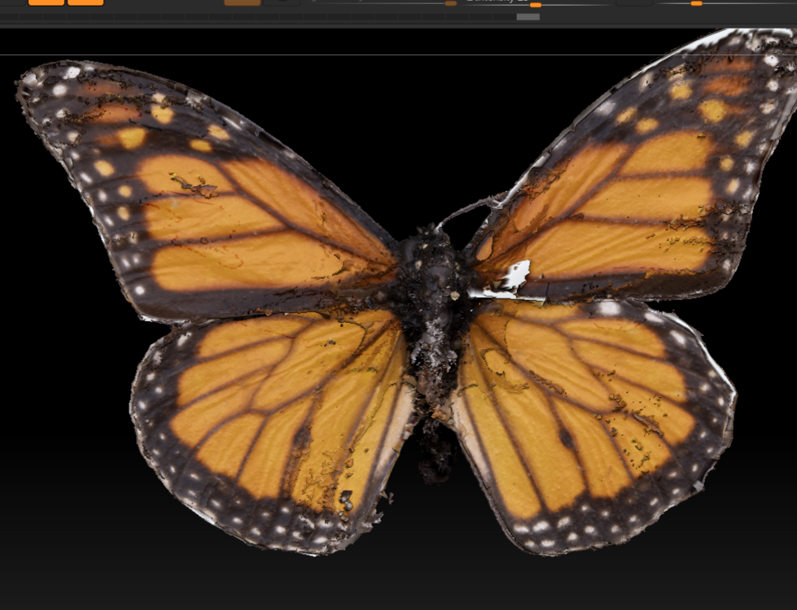
Mesh (ZBrush, Merge Detail)
Retopologized mesh gets detail from the Agisoft mesh projected on to it
This mesh now has detail *and* clean/light topology, ready to be used for web, game, AR/XR and other experiences!
(ok, I left out more clean up but you get the idea :) )
https://sketchfab.com/VirginiaTechUnivLibraries

Slide 43
Data Management Planning

Slide 44
Preservation of research data (and other products)
Providing for long-term access to data/software/research products underlying scholarship important for its transparency and integrity
Research data and other products originate from a variety of disciplines and a multitude of formats - complicates preservation of access
Notes:
We’ve heard preservation of web content and photogrammerty; now let’s talk about the preservation of something just as broad (if not more broad) - research data.
Why preserve research data and other products generated in the course or research? (Read 1st bullet)
Research data preservation is complicated (Read 2nd bullet)

Slide 45
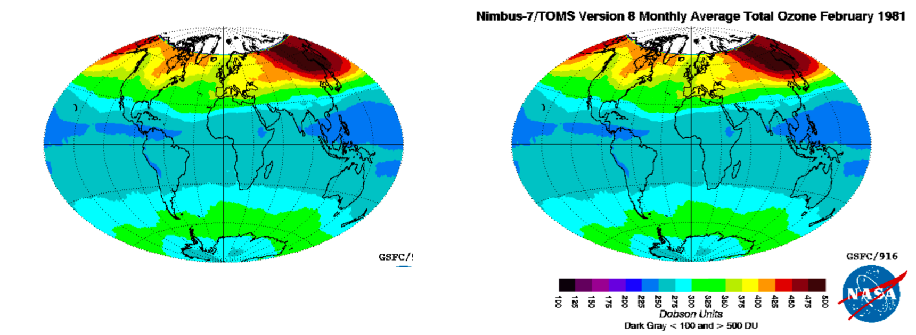
Providing for long-term access...for whom?
Notes:
Important questions when talking about preservation/long-term access to research data
Who is long-term access being provided for? (Who are the intended users?)
What metadata should accompany these products so that intended users can understand them? Would the inclusion of the context around this colorful contour map, as seen on the right, make this data more meaningful to you? Who is it meaningful for? (Satellite data users, those who study atmospheric ozone)

Slide 46

The FAIR Guiding Principles for scientific data management and stewardship
Plan to make data FAIR at the time of its creation
Notes:
Some principles towards research data management that have recently come into vogue are the FAIR data principles - making research data and other digital objets Findable, Accessible, Interoperable and Reusable.
Use of data repositories like VTechData will make data Findable and Accessible. Curators can help make data Interoperable and Reusable as well but it’s really helpful for the data creator to create documentation to make data reusable, and the easiest way to do so is to plan to do this when creating data in the first place!

Slide 47
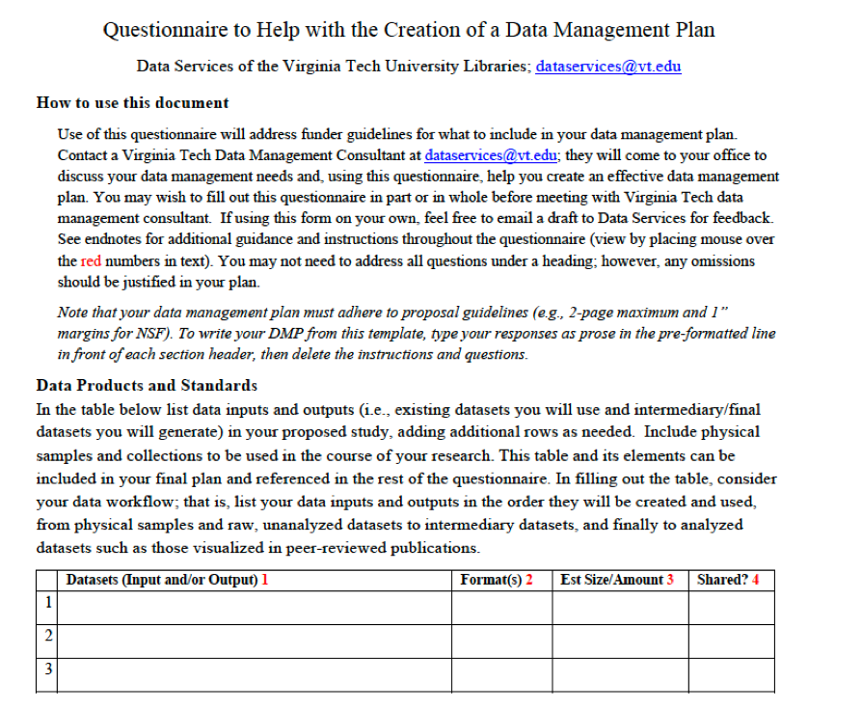
Assistance with Data Management PLanning
Includes planning for data sharing/preservation
For research projects or for proposals
In-person consultation
Feedback on written plans
dataservices@vt.edu
Notes:
Here in the Libraries we provide services to help researchers plan for their data management before they begin their research, including plans for data sharing and preservation. Data management plans can be developed for research projects to be started or those seeking funding. Our consultants (primarily Jonathan Petters who couldn’t be here sadly) meet with you in-person to talk over your data management needs using this handy Questionnaire seen on the right, and will provide feedback on as many drafts of written plans as you like. Contact them at dataservices@vt.edu.

Slide 48
Perma.cc

Slide 49
The problem
Non-persistent URLs are cited in the scholarly literature
  DOIs and Handles are persistent and generally not a problem
Over 50% of cited links in Supreme Court opinions no longer point to the intended page, one in five articles suffers from reference rot, and three out of four URI references lead to changed content.
404 Page Not Found

Slide 50
One solution
Perma.cc archives the web page and provides a short link which can be provided in addition to to the original URL
  Use for scholarly references
  Manage, annotate, collaborate, make public/private
  Browser extension, batch URL archiving
  Example citations:
    34. Duke Digital Repository Policy for Accessibility, DUKE UNIV. LIBR., www.library.duke.edu/using/policies/ddr-accessibility [perma.cc/4DZB-AJZ2] (last visited Apr. 8, 2019).
    36. Scott Althaus & Kalev Leetaru, Airbrushing History, American Style, Cline Center for Democracy (Nov. 25, 2008), http://www.clinecenter.illinois.edu/airbrushing_history, archived at http://perma.cc/G8PW-798L.

Slide 51
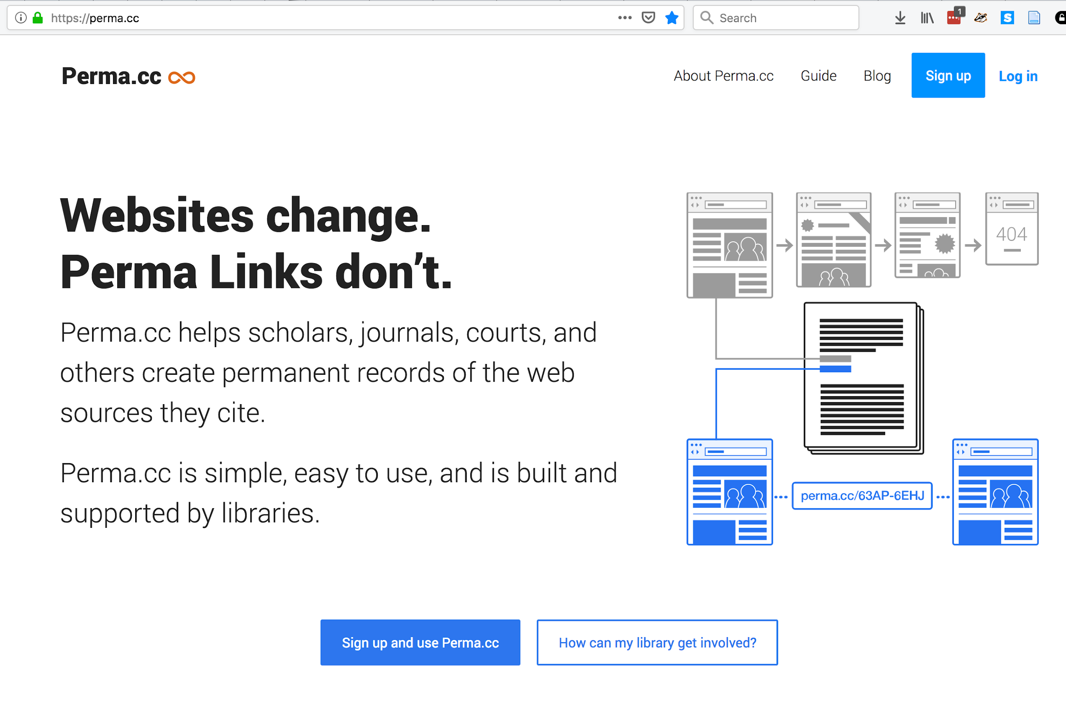

Slide 52
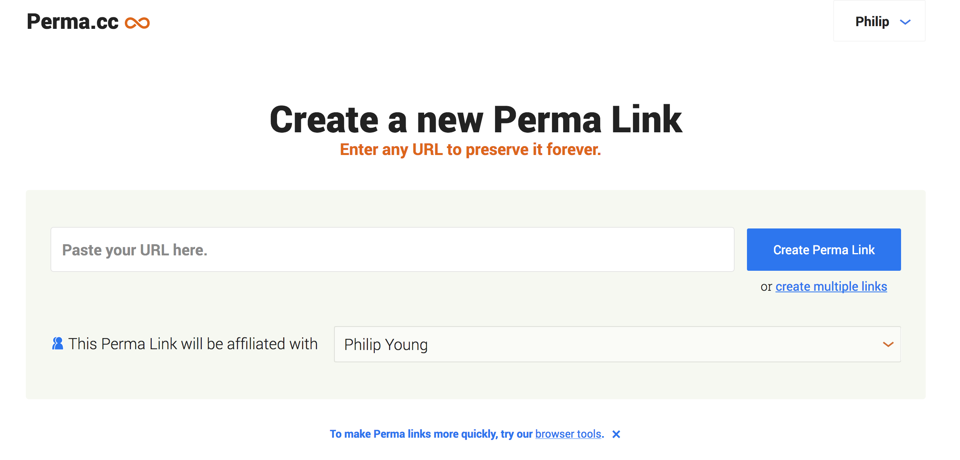

Slide 53
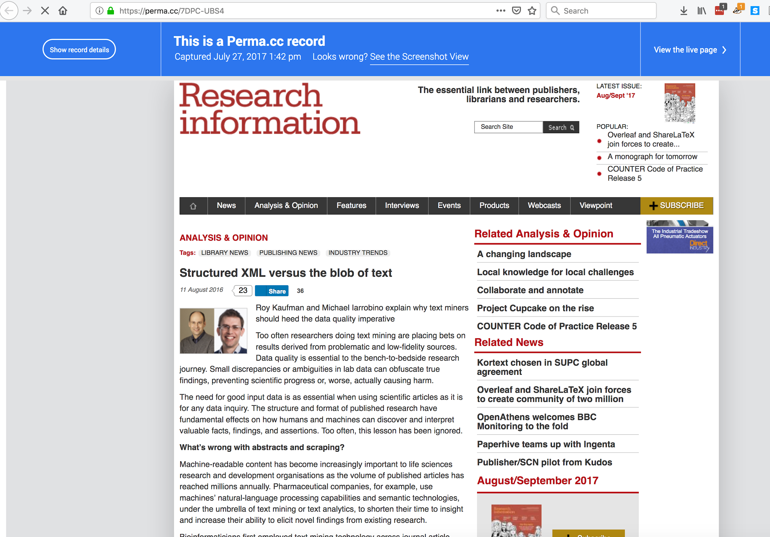

Slide 54
Other web archiving tools
Wayback Machine (Internet Archive)
  May be missing the webpage or day you need
    Crawler not aware of site
    Excluded by robots.txt
    Site owner request
Webrecorder.io
Search across mementos: https://timetravel.mementoweb.org/
  Includes Perma.cc

Slide 55
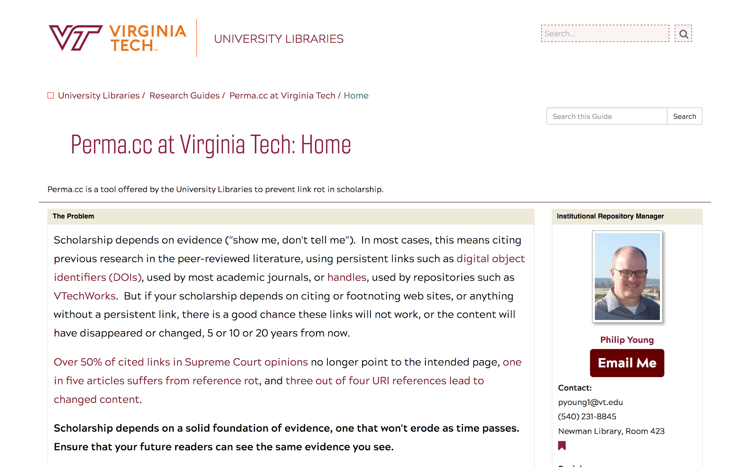
Perma.cc at Virginia Tech
VT Libraries is a registrar (17 users, 74 links)
Guide: guides.lib.vt.edu/permacc
Account: permacc@vt.edu

Slide 56
Documentation

Slide 57
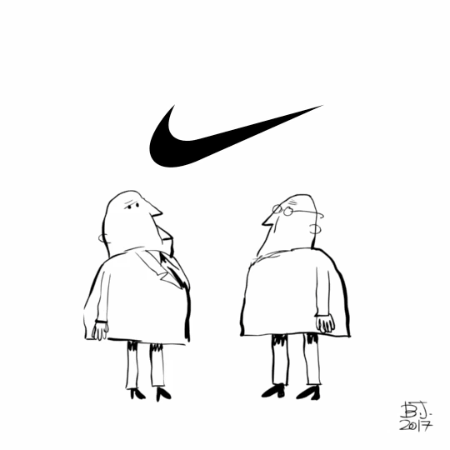
To sum up the next 5 minutes in one slide…

Slide 58

Document Everything
Workflows
Processes
Decisions
Inventory
… Literally everything

Slide 59
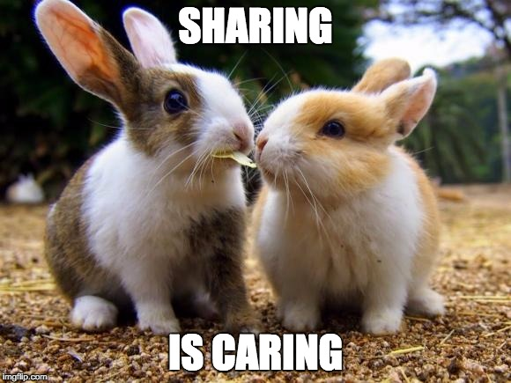
How / Where
Read Me files
Shared Drives
Project Management Tools
Repositories

Slide 60

Why
Preservation
Replication
Project Management
Staffing Changes

Slide 61


