Slide 1
Collection Management (Tweets)
Final Presentation
CS5604, Information Retrieval, Fall 2016
Faiz Abidi
Mitch Wagner
Shuangfei Fan
December 1, 2016
Virginia Tech @ Blacksburg, VA
Professor: Dr. Edward Fox
Notes:
University, other metadata

Slide 2
Additions regarding tweet updates
 |  | Before | Now
MySQL to HDFS | Mode of transfer | Batch mode | Incremental update
HDFS to HBase |  | Batch mode | Incremental update

Slide 3
What features did we improve?
What was done before? | How did we improve it?
Limited amount of tweet parsing. | We are extracting a lot more fields now as per different teams’ requirements.
Social network based on users as nodes, and links using mentions and re-tweets. Only one kind of node, with little emphasis on importance value. | Three kinds of nodes - users, tweets, and URLs. We are using the Twitter API to calculate an importance value for the users and the tweets, and taking the number of occurrences of a URL in a tweet collection as an indication of its importance within that collection.

Slide 4
Incremental Update From MySQL to HDFS

Slide 5
MySQL - CollectDB
(contains all new tweets)
MySQL - ArchiveDB
(contains all raw tweets)
Uncleaned text file
Tweets stored in MySQL server. We use pt-archiver to archive them to the ArchiveDB, and also save them to a text file.
Some statistics (3.6 GHz, 16G Memory machine)
No. of tweets | Time | %CPU | Memory (MB)
155657 | 1 min 35 sec | 29 | 19.7

Slide 6
MySQL - CollectDB
(contains all new tweets)
pt-archiver
MySQL - ArchiveDB
(contains all raw tweets)
pt-archiver
The tweets text file is parsed, and cleaned using bash (e.g., incorrectly placed “\r”, “\r\n” characters, all ASCII characters, etc.)
Uncleaned text file
Cleaned CSV file
Some statistics (3.6 GHz, 16G Memory machine)
No. of tweets | Time | %CPU | Memory (MB)
155657 | 7.89 sec | 57 | 169.9

Slide 7
MySQL - CollectDB
(contains all new tweets)
pt-archiver
MySQL - ArchiveDB
(contains all raw tweets)
pt-archiver
Uncleaned text file
Some statistics (3.6 GHz, 16G Memory machine)
No. of tweets | Time | %CPU | Memory (MB)
155657 | 13.64 sec | 92 | 18.2
Bash scripts
Cleaned CSV file
The tweets file is then converted to Avro file format using an open source tool called csv2avro.
Avro file

Slide 8
MySQL - CollectDB
(contains all new tweets)
pt-archiver
MySQL - ArchiveDB
(contains all raw tweets)
pt-archiver
Uncleaned text file
The Avro file is put into a specific location on HDFS depending on the table name from which the tweets were extracted.
Bash scripts
Cleaned CSV file
csv2avro tool
Avro file
HDFS

Slide 9
MySQL - CollectDB
(contains all new tweets)
pt-archiver
MySQL - ArchiveDB
(contains all raw tweets)
When a new Avro file is added to HDFS, the two files merge to become one using avro-tools.
pt-archiver
Uncleaned text file
Merged Avro Files on HDFS
Bash scripts
Cleaned CSV file
Some statistics (cluster machine - 3.3 GHz, 32G)
No. of tweets | Time | %CPU | Memory (MB)
155657 | 14.42 sec | 45 | 439.5
csv2avro tool
Avro file
Bash scripts
HDFS

Slide 10
MySQL - CollectDB
(contains all new tweets)
pt-archiver
MySQL - ArchiveDB
(contains all raw tweets)
pt-archiver
Uncleaned text file
Merged Avro Files on HDFS
Bash scripts
Cleaned CSV file
avro-tools
csv2avro tool
Avro file
Bash scripts
HDFS

Slide 11
Incremental Update from HDFS to HBase + Tweet Processing

Slide 12
Tweet Loading Pipeline
MySQL Server
HDFS
Processing Pipeline
Temporary
Collection Avros
HBase
Final Collection Archive Avros
ideal-cs5604f16
Cluster Servers

Slide 13
Tweet Loading Pipeline
MySQL Server
1) New data copied over to cluster
HDFS
Processing Pipeline
Temporary
Collection Avros
HBase
Final Collection Archive Avros
ideal-cs5604f16
Cluster Servers

Slide 14
Tweet Loading Pipeline
MySQL Server
HDFS
Processing Pipeline
Temporary
Collection Avros
HBase
2) New data processed and merged into HBase
Final Collection Archive Avros
ideal-cs5604f16
Cluster Servers

Slide 15
Tweet Loading Pipeline
MySQL Server
HDFS
Processing Pipeline
Temporary
Collection Avros
HBase
3) Temporary Files Merged into Archive Files
ideal-cs5604f16
Final Collection Archive Avros
Cluster Servers

Slide 16
Tweet Processing Pipeline
1. Initial Read
2. Stanford NLP
3. Final Cleaning
Avro File
HBase
HBase
Pig scripts to load basic tweet info, & initialize various other columns to simplify later processing
Java for Stanford Named Entity Recognition & lemmatization
Pig + Python for Remaining “clean-tweet” Column Family
HBase
HBase
HBase

Slide 17
Running Time Test
Collection: 312 (Water Main Break)
Number of Tweets: 155657
Initial Read: ~ 2 minutes
Lemmatization: ~33 minutes
Cleaning Step: ~27 minutes
---------------------------
Total time: 1 hour

Slide 18
Asynchronous Updates
Two clean-tweet columns are better suited for asynchronous updates:
URL Extraction (Twitter has best information on URLs in tweets, rate-limited)
Google Geolocation (rate-limited)
HBase
Scan for rows with API-dependent columns not yet populated, make API calls to gather data, and augment those rows
HBase

Slide 19
Social Network

Slide 20
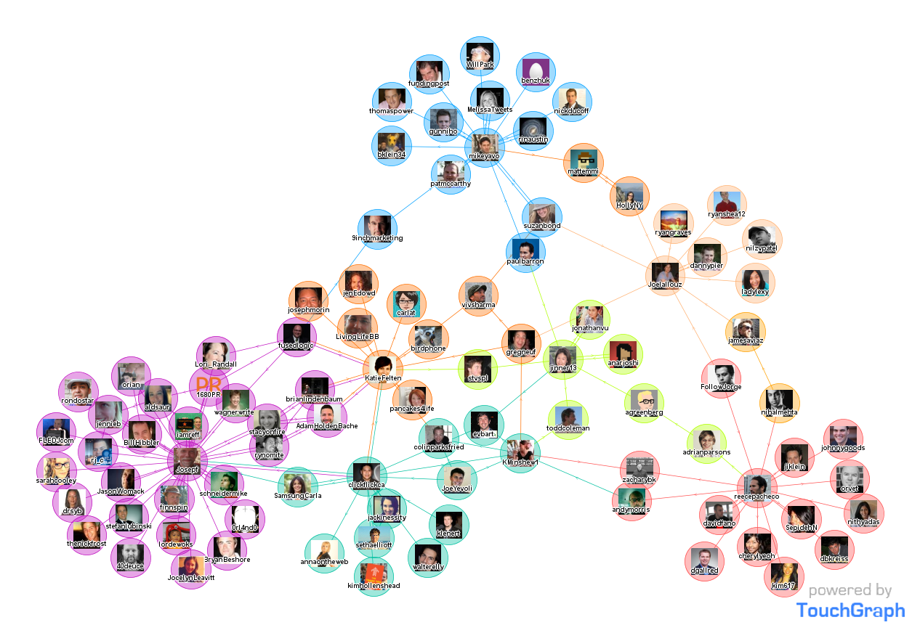
Build a social network based on the tweet collection
Credit: http://www.touchgraph.com

Slide 21

Objective
Rank the nodes for social network based recommendations
Credit: http://thenextweb.com/twitter/2014/05/09/twitter-updates-web-layout-third-column-content-recommendation/

Slide 22
Objective
Hot topics
Rank the nodes for social network based recommendations
Credit: http://thenextweb.com/twitter/2014/05/09/twitter-updates-web-layout-third-column-content-recommendation/

Slide 23
Objective
Popular people
Hot topics
Rank the nodes for social network based recommendations
Credit: http://thenextweb.com/twitter/2014/05/09/twitter-updates-web-layout-third-column-content-recommendation/

Slide 24
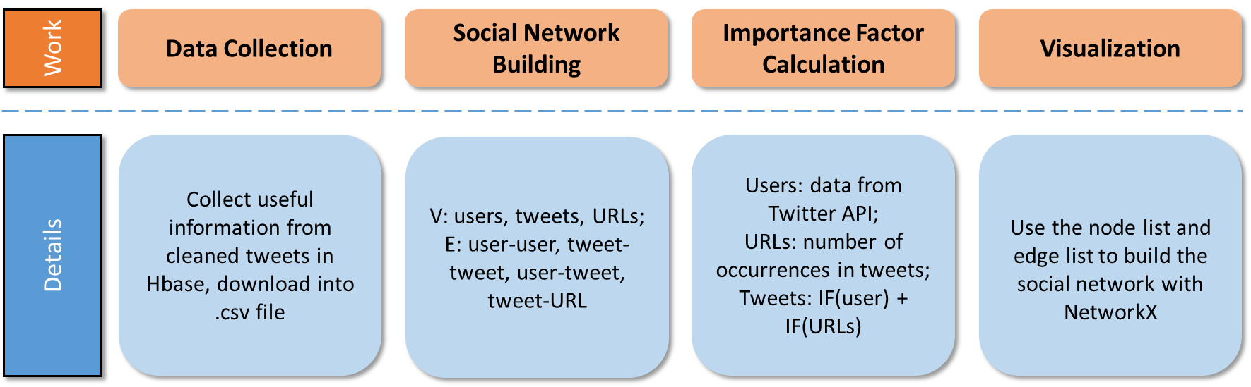
Pipeline

Slide 25
Previous work
The S16 team built a social network G(V, E) where:
Nodes (V): Users
Edges (E): Edges between users according to RTs and mentions (@)
Importance factor (IP): For edges (count)

Slide 26
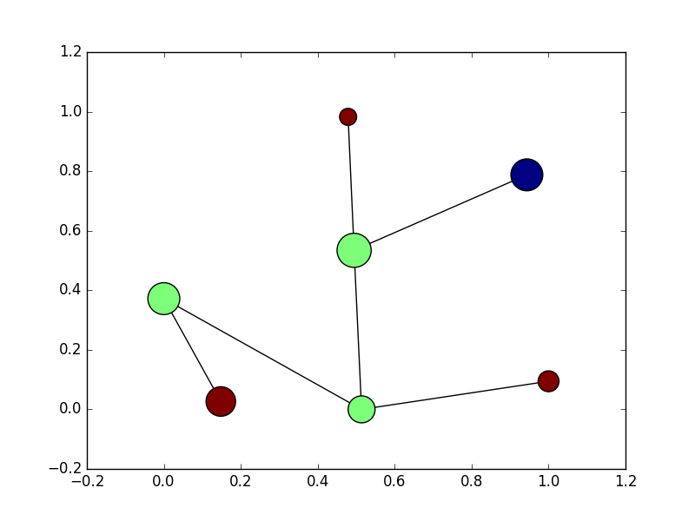
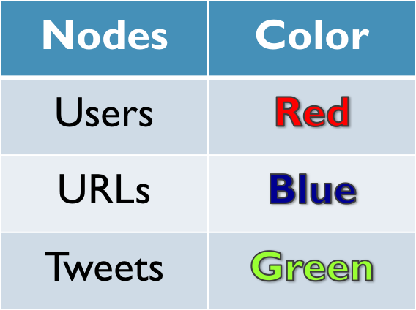
Nodes
Notes:
Explain the figure

Slide 27
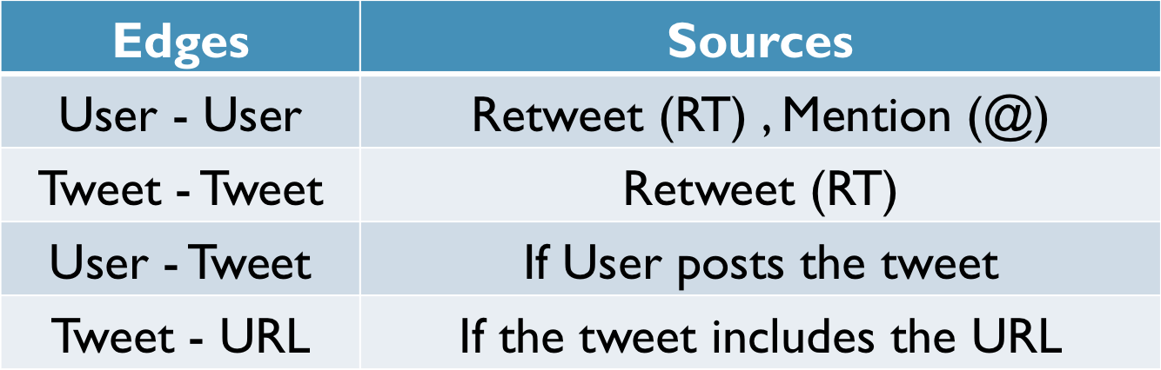
Edges

Slide 28
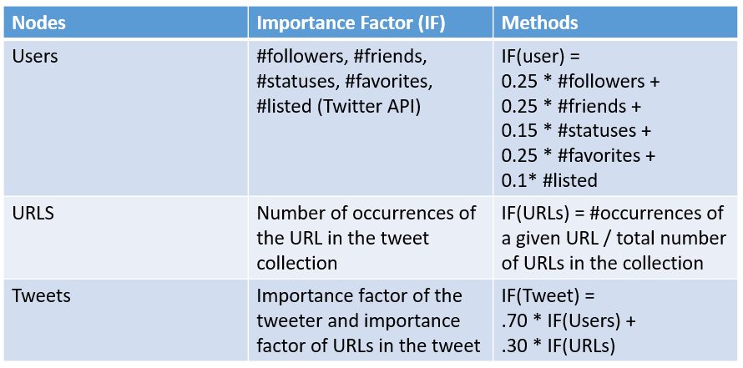
Importance Factor
Notes:
statuses _count: The number of tweets (including retweets) issued by the user.
Listed_count: The number of public lists that this user is a member of

Slide 29
Visualization
Tools
  Python (NetworkX)
Statistics
  Number of tweets: 300
    Collection z_3
  Twitter API imposes size constraints
    (180 queries every 15 minutes)
Nodes
  300 tweet nodes
  158 user nodes
  110 URL nodes
Edges
  73 user-user edges
  54 tweet-tweet edges
  300 user-tweet edges
  140 tweet-URL edges
Notes:
Work left, add the ips to HBase

Slide 30
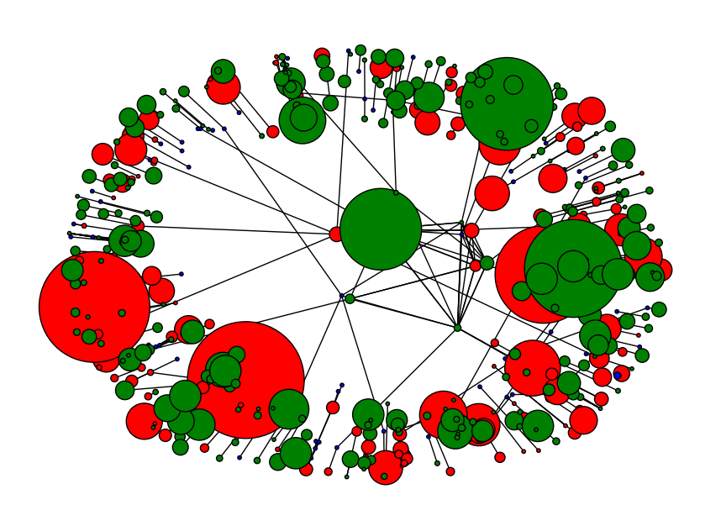
Visualization
Green: tweets
Red: users
Blue: URLs
Notes:
Work left, add the ips to HBase

Slide 31
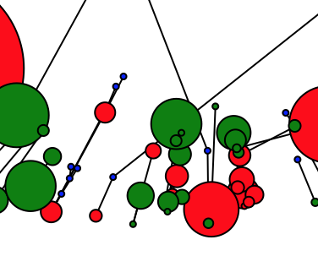
Visualization
Green: tweets
Red: users
Blue: URLs
Notes:
Work left, add the ips to HBase

Slide 32
Summary & Future Work
  Flexible scripts accommodate large or small volumes of tweets
Can store and process thousands of tweets quickly
We have delivered a robust ETL pipeline for moving tweets
Flexible scripts accommodate large or small volumes of tweets
  Can store and process thousands of tweets quickly
In the future:
  Do not remove comma, and double quotes from the text file of tweets
  Develop asynchronous scripts to enhance tweets via API calls
  Rigorous speed tests/processing pipeline optimization (including schema)
  More extensive plan for handling profanity
  Add hashtags to social network

Slide 33
Challenges Faced
Incomplete documentation from the previous semester
  Schema
Unfamiliarity with HBase, Pig, Twitter, Stanford NER
Large, pre-existing system to understand
Working in groups
  Meeting time that works for all
  Difficult to divide work based on our varying expertise
  Dilemma to work together, or individually on parts of the project
Notes:
What has been written? What hasn’t? What is the architecture of the system? What is the data pipeline? Who is responsible for what?

Slide 34
As a Learning Experience
  Exposure to different technologies:
  Hbase + Hadoop Framework
  Pig
  Stanford NLP
  Regex
  Concepts:
  Extract, Transform, Load (ETL) Pipeline
  NoSQL databases
  Text parsing
  Communication & synchronization between teams
Overall
  Divide responsibilities
  Work iteratively
  Ask questions
Notes:
Don't spend too much time on background or history, rather focus on what was discovered or learned.

Slide 35
Acknowledgement
IDEAL: NSF IIS-1319578
GETAR: NSF IIS-1619028
Dr. Edward A. Fox
GRA: Sunshin Lee

Slide 36
References
Percona, “Percona - the database performance experts.” https://www.percona.com/, 2016.
“csv2avro - Convert CSV files to Avro .” https://github.com/sspinc/csv2avro, 2016.
A. A. Hagberg, D. A. Schult, and P. J. Swart, “Exploring network structure, dynamics, and function using NetworkX,” in Proceedings of the 7th Python in Science Conference (SciPy2008), (Pasadena, CA USA), pp. 11–15, Aug. 2008.
“CMT Team’s Codebase on GitHub.” https://github.com/mitchwagner/CMT, 2016.
“Touch Graph.” http://www.touchgraph.com/news, 2016.
N. Garun, “Twitter updates its Web layout with a third column for content recommendation.” http://thenextweb.com/twitter/2014/05/09/ twitter-updates-web-layout-third-column-content-recommendation/, 2014.

