Slide 1
Object Detection / Document Accessibility
Alan Devera, Theodore Gunn, Elizabeth Keegan, Michael Nader, Gabrielle Nguyen, Luke Wevley, Zehua Zhang,
CS4624 Multimedia, Hypertext, and Information Access
Edward A. Fox
Virginia Tech, Blacksburg VA 24061
April 18, 2023

Slide 2
Outline
Background
Project Overview
Design and Implementation
Future Plans
Acknowledgements
References

Slide 3

Client and Problem
Client: Aman Ahuja (Ph.D. student in the Digital Library Research Lab)
Problem:
  Electronic Theses and Dissertations are long and often hard to read
  Make these long PDFs more viewer-friendly
  Improve upon existing machine learning model from CS 5604

Slide 4
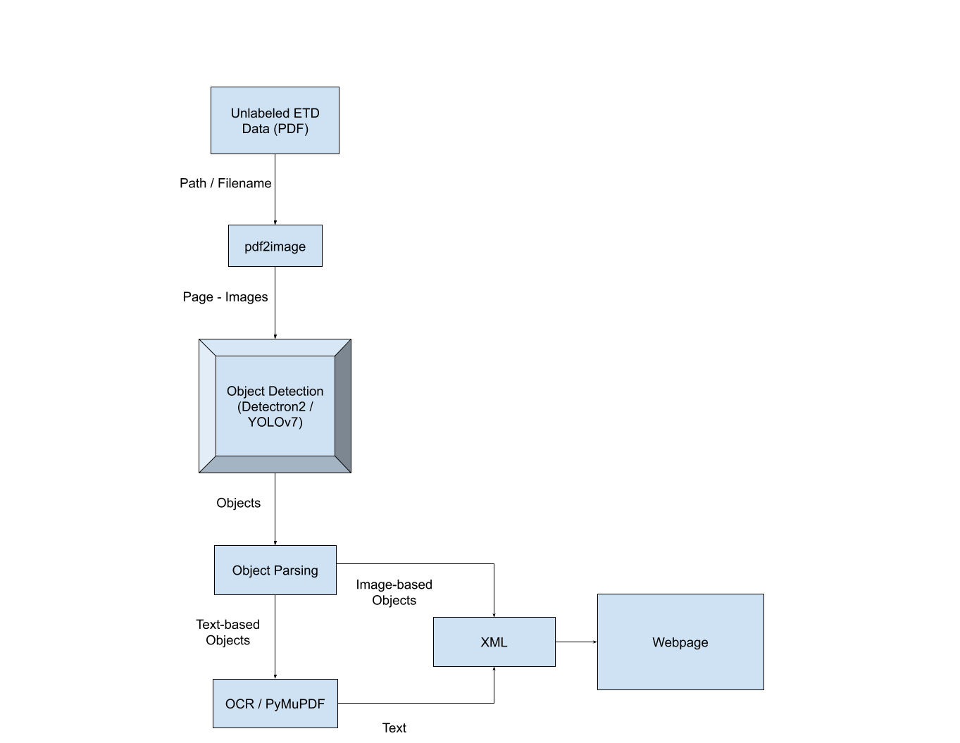
Previous Efforts
The group this semester has inherited a Flask-based web application.
Takes in a long PDF (ETD) and generates a web page.
Object detection pipeline (Adapted from CS 5604 efforts)

Slide 5
Project Overview
Build off of previous efforts to parse ETDs and create easily navigable user interfaces
Improve accessibility features for ETDs
  Screen reader
  PDF viewer
Add additional post-processing features

Slide 6
Approach/Plan
Client divided the group into three subgroups to complete deliverables
  UI/Front End (Zehua, Theodore)
  Algorithm/Back End (Alan, Luke, Michael)
  Accessibility (Elizabeth, Gabrielle)

Slide 7
UI Subgroup Deliverables
React App
Nested Table of Contents
PDF Viewer
Updated UI

Slide 8
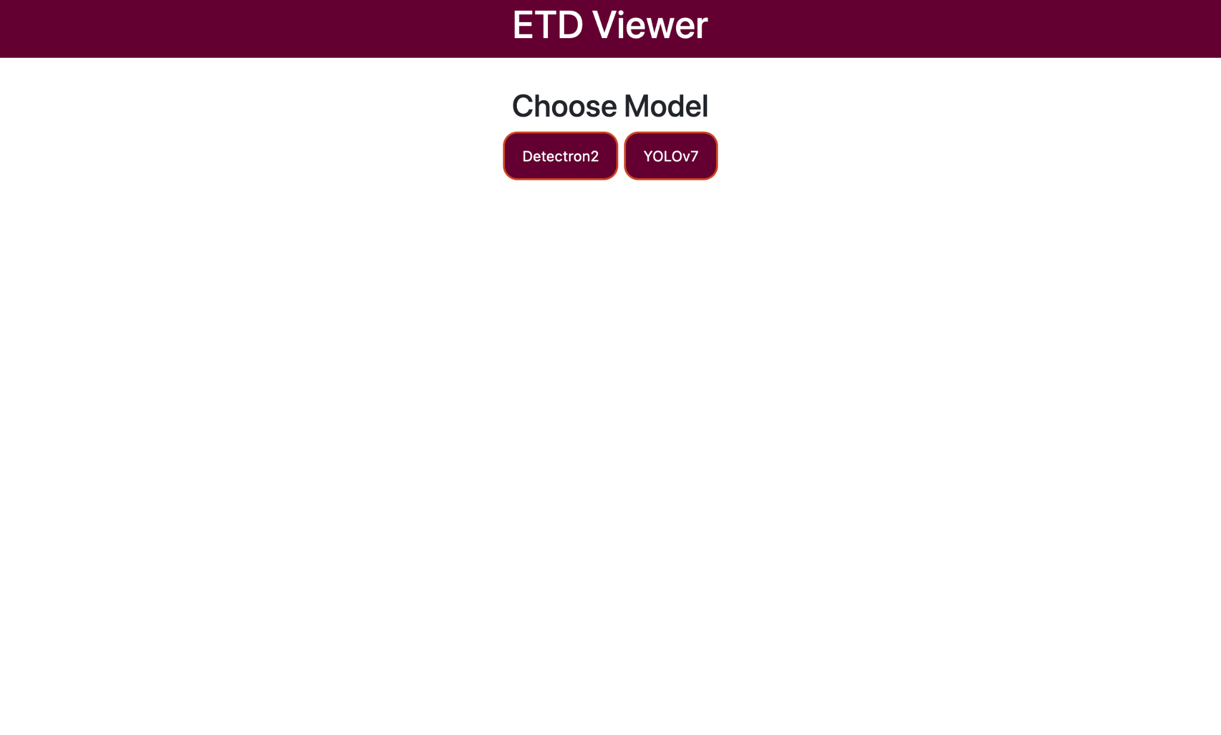
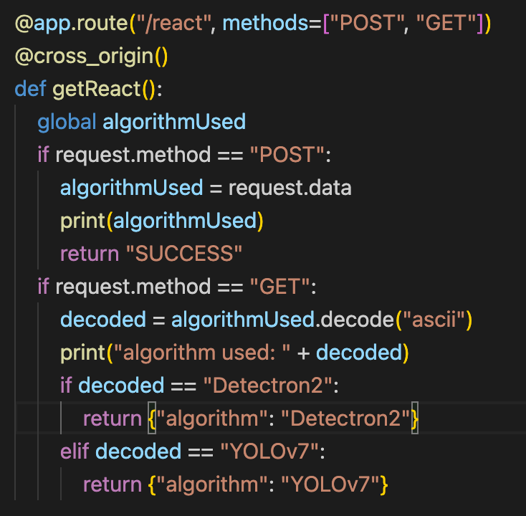
UI Design

Slide 9
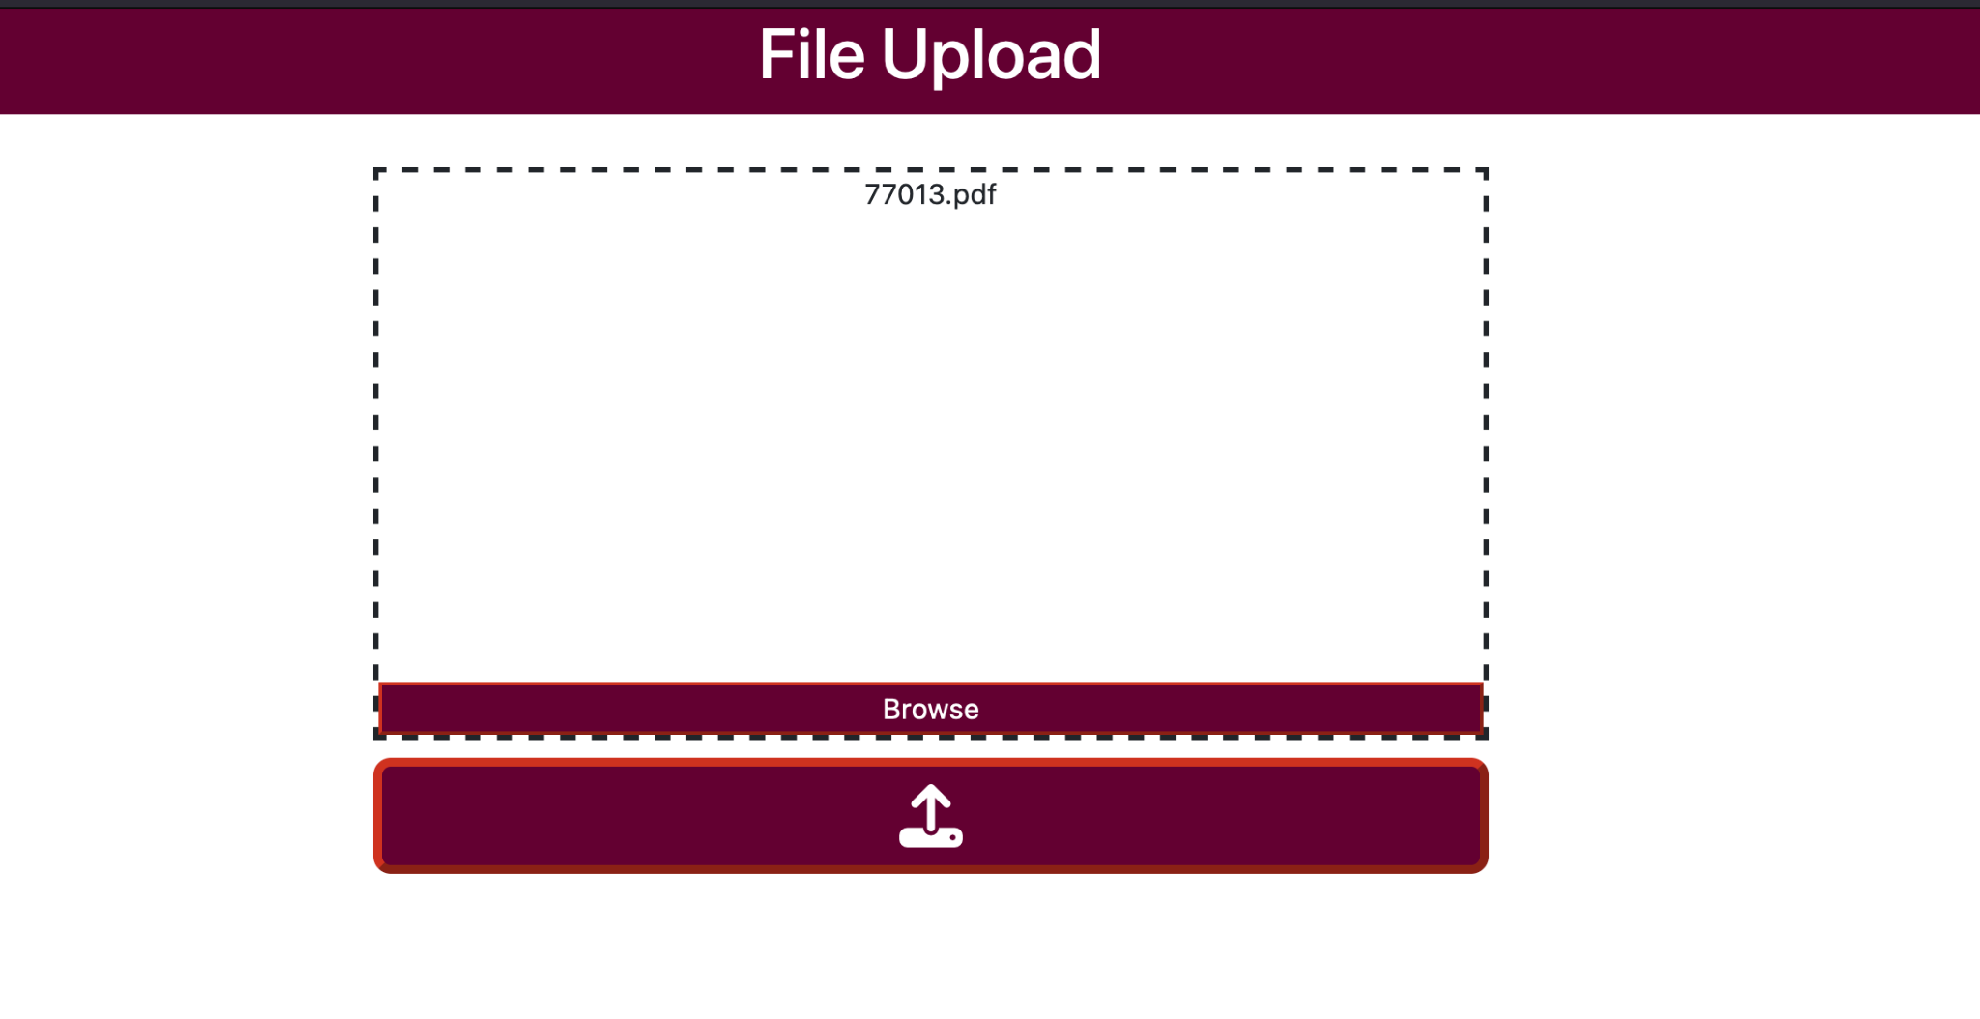
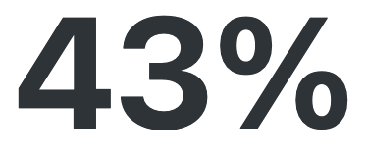
File Upload
1: Use browse button / drag a file into the rectangle area
2: Do the step above if change the file
3: Click upload to submit
4: Progress Percent appears while file loads

Slide 10
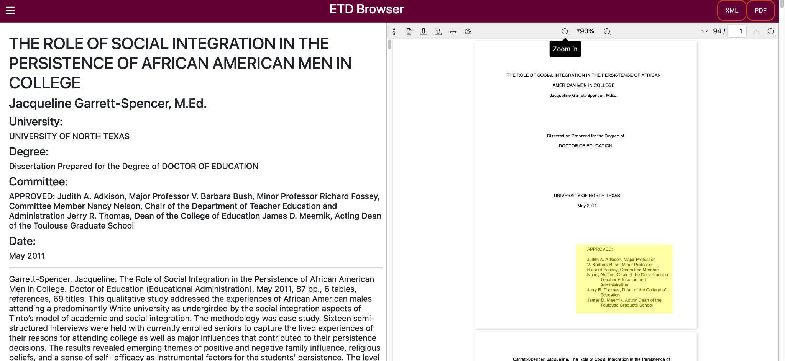
Main Page

Slide 11
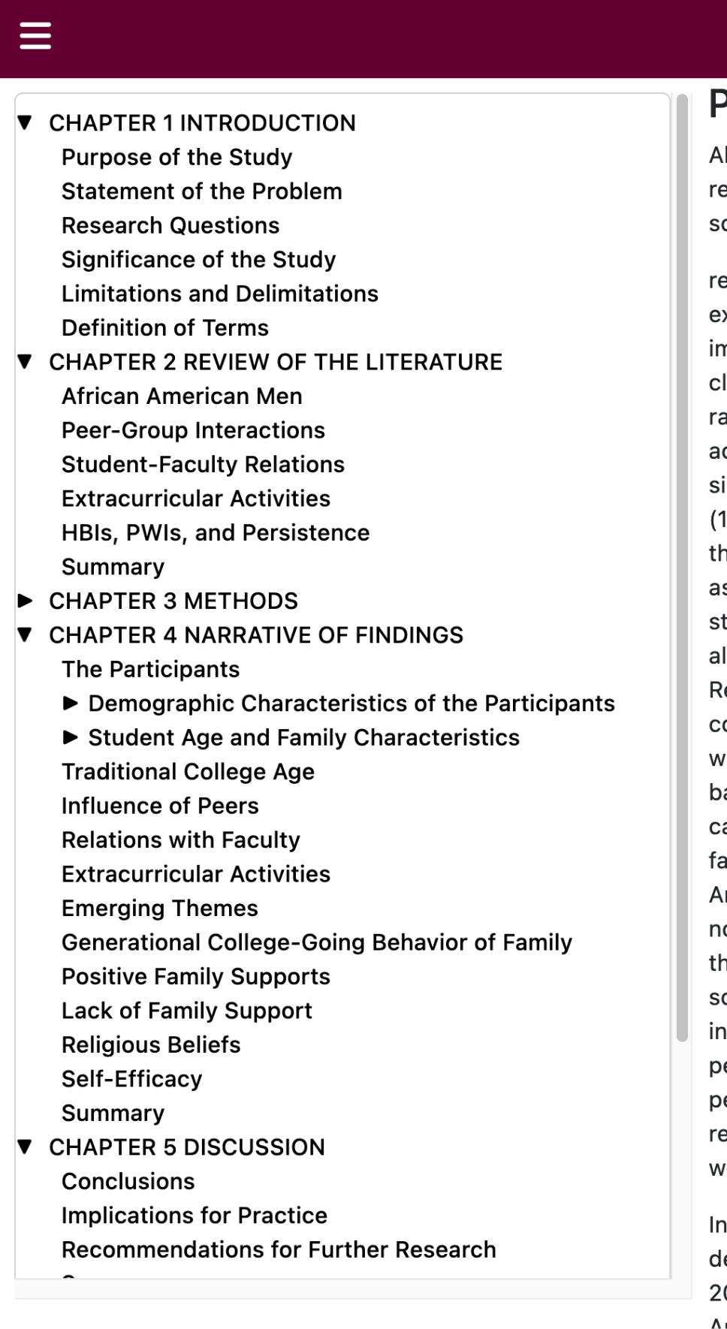
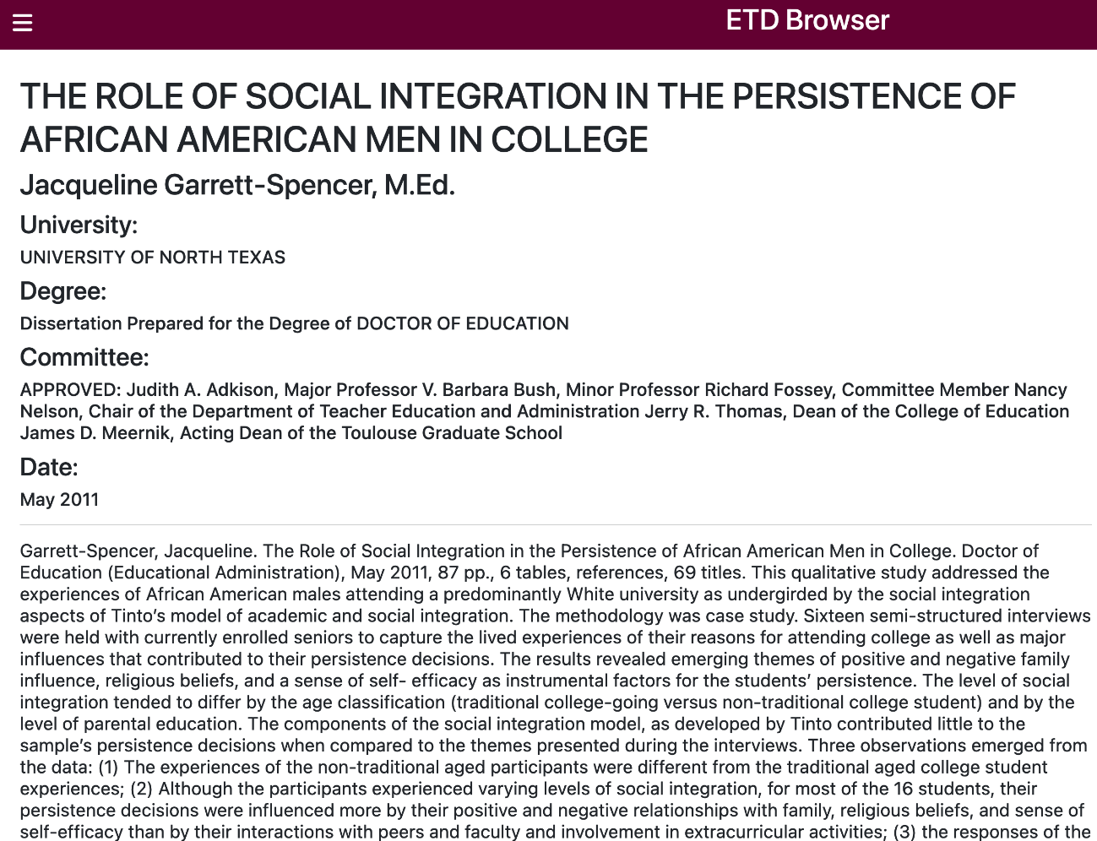
Table of Contents

Slide 12
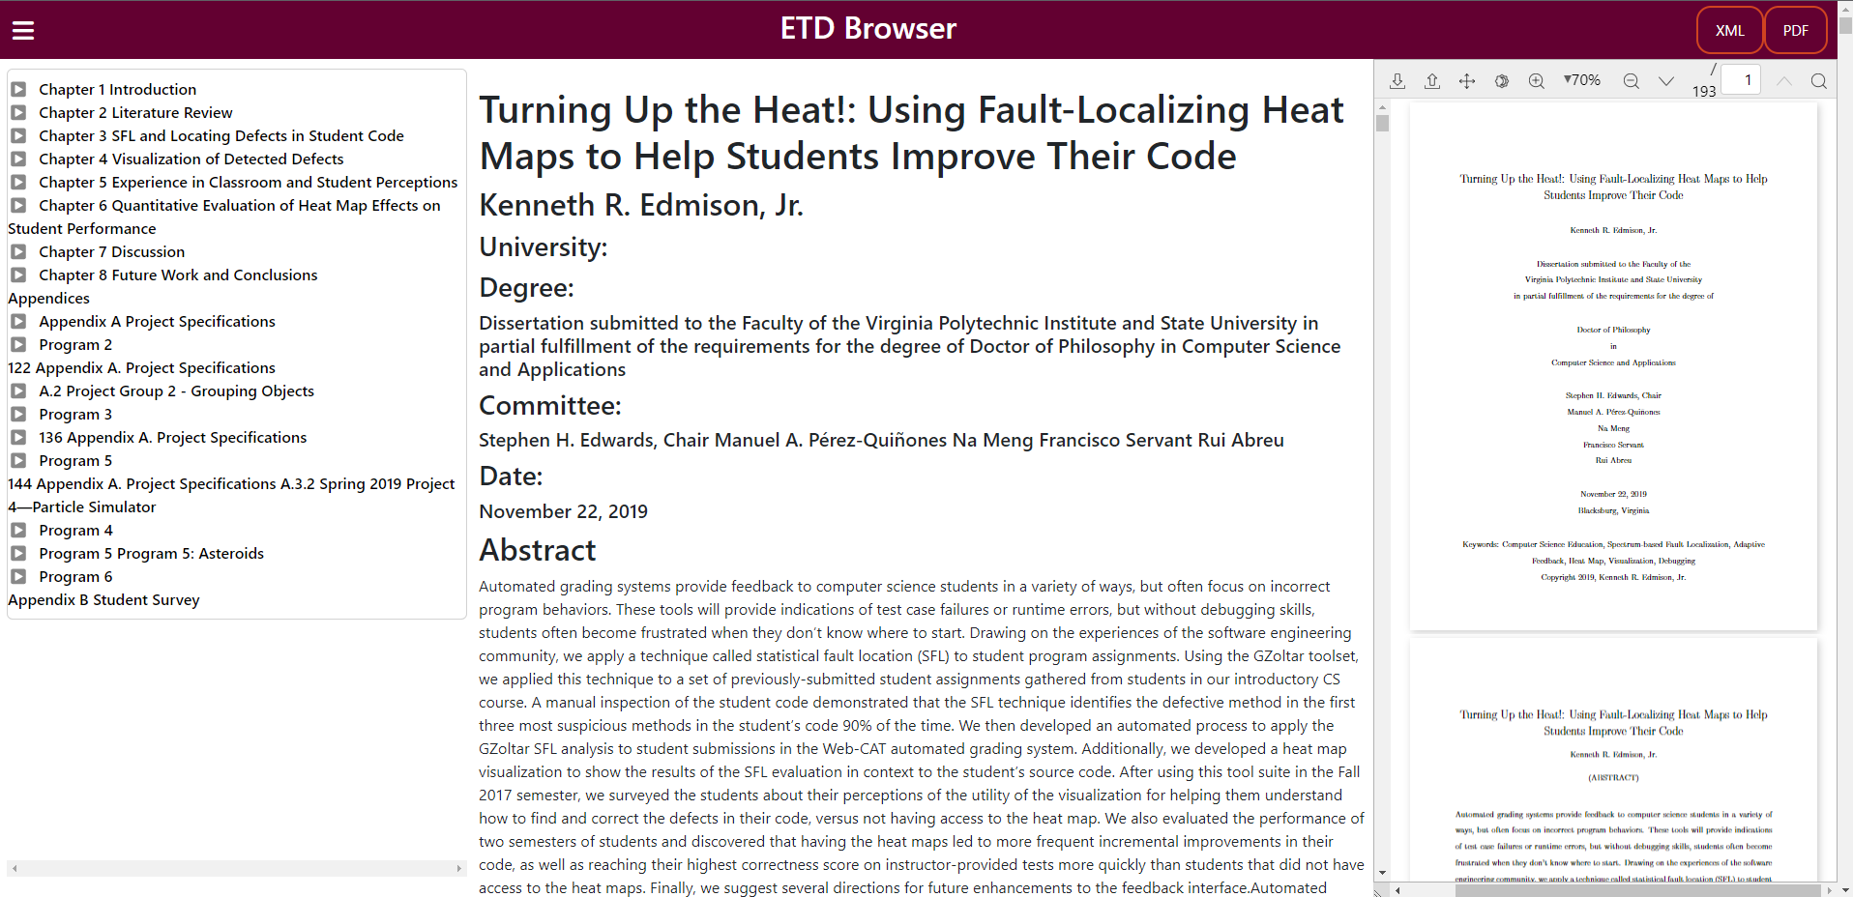
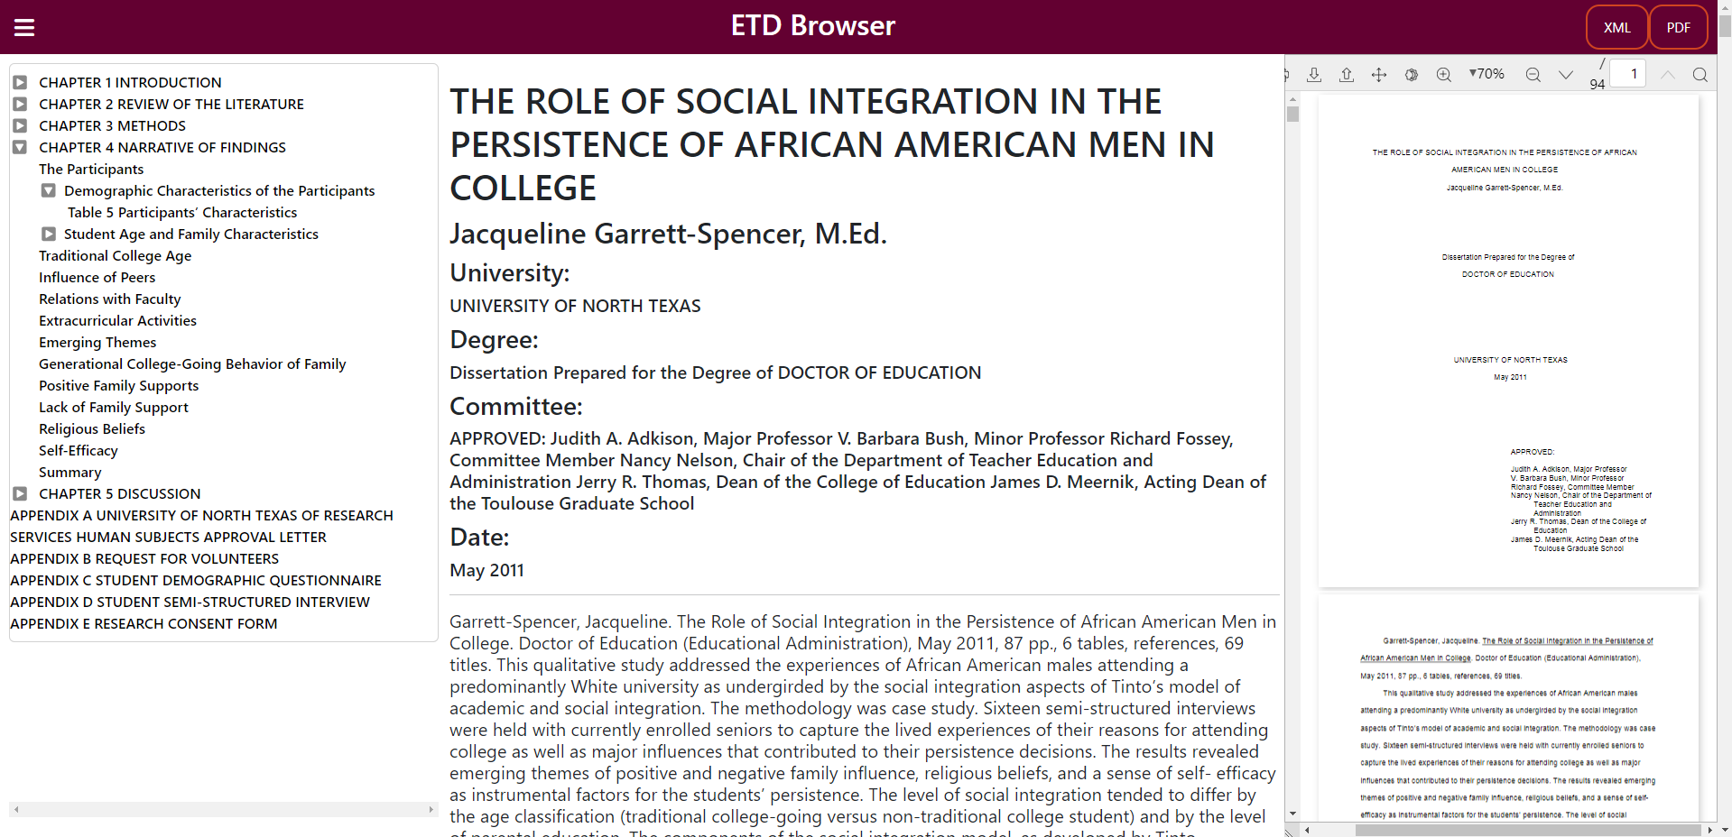
Project Overview
Improve accessibility features for ETDs
  Screen reader
  PDF viewer
Use object detection models to parse ETDs and create easily navigable user interfaces

Slide 13
Object Detection Subgroup Deliverables
Implement paragraph and reference separation
Segment references into components (i.e., author name, title, etc.)
  Unable to accomplish
Add bounding box coordinates, page number, and confidence to each tag for UI team

Slide 14
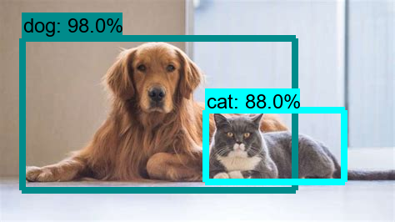
Object Detection
Object detection is a subset of computer vision.
Takes in a video or image as input and predicts an object, where it is, and the percent that it is correct.

Slide 15
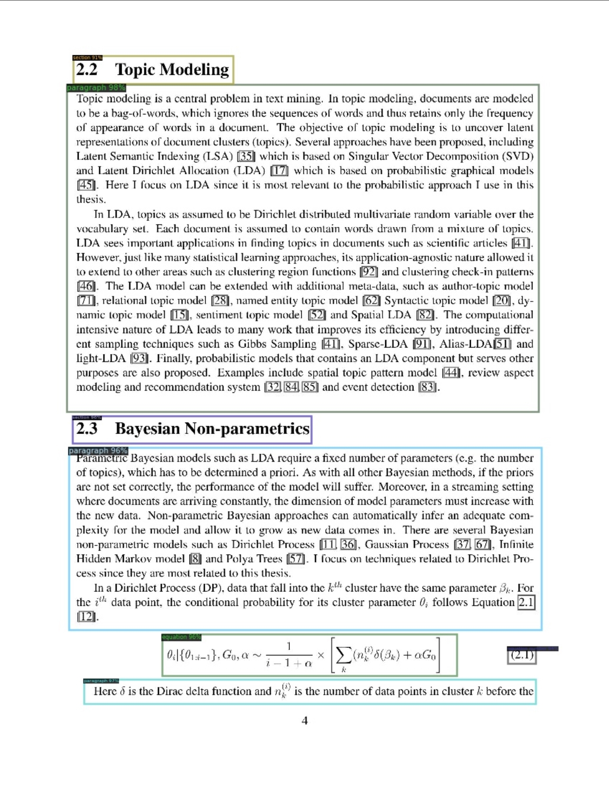
Object Detection Bounding Boxes
Bounding boxes are rectangles with the coordinates: [xMin, yMin, xMax, yMax]
  Defines an element’s location within an image or video.
Used in pdfminer implementations to determine individual paragraphs and references.
Each page object contains 4 elements:
  Bbox
  Percent confidence
  Page number

Slide 16
Implementation: Bounding Boxes to HTML
Originally XML and HTML tags only contained extracted text
XML and HTML layouts are similar
Add data as tags during generation
Titles dependent on location in document

Slide 17
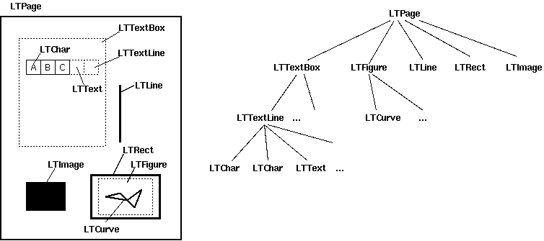
Implementation: Object Detection Pdfminer Algorithm
Pdfminer creates bboxes of its own around paragraphs
  bboxes around paragraphs, lines, chars, etc.
Used for comparison against object detection model

Slide 18
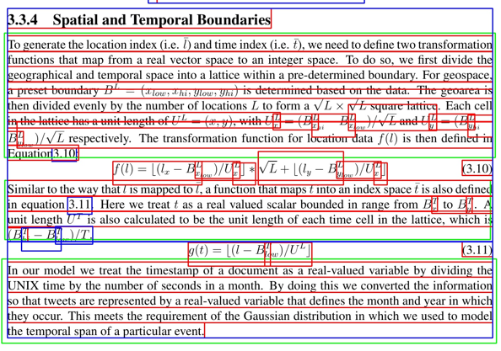
Implementation: Combining the Two
Take bounding boxes from object detection
Take LTTexLlines from Pdfminer
For each line, identify which box it’s in
Each set that shares both is treated as a paragraph
Issue: Pdfminer’s LLTTextLines become less accurate with equations appearing
  Found that issue happens even outside of equations

Slide 19
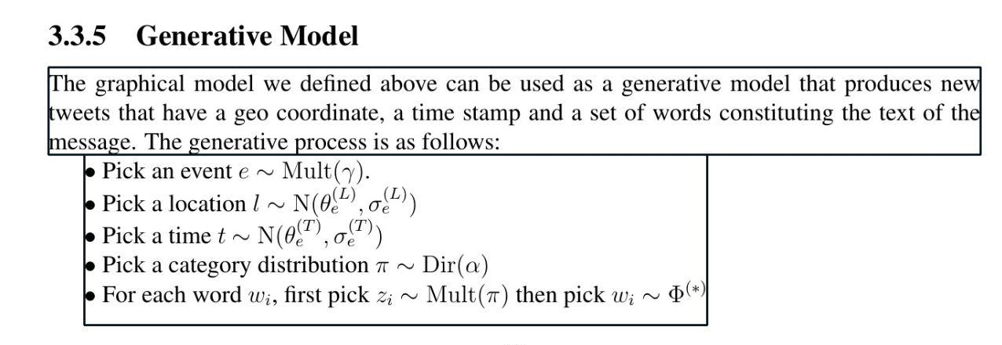
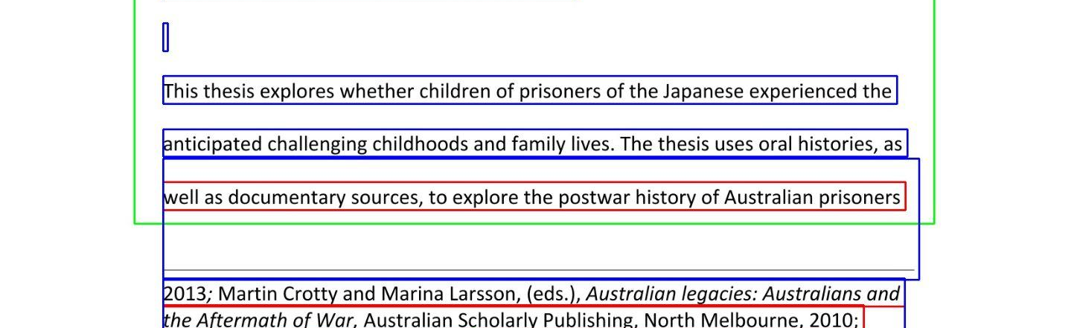
Implementation: Object Detection Pdfminer Algorithm
Pros:
Got as close to 100% accuracy as we can
Perfect bounding boxes in any non-scientific ETD
Cons:
BBoxes created are sometimes imperfect, especially with equations
Some text BBoxes are too large, creating issues with our current logic

Slide 20
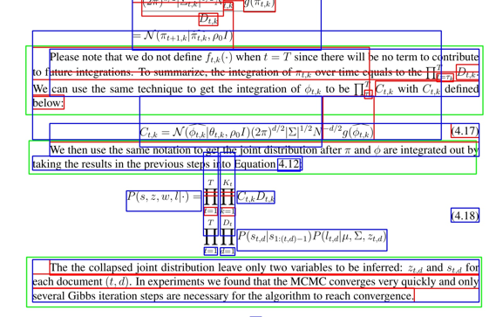
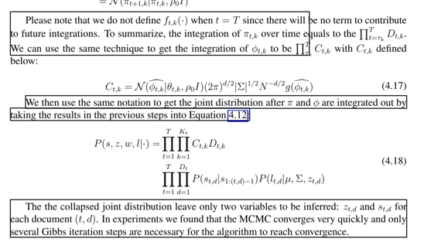
Example of Equation Issue with BBoxes
Working Example
Not Working Example
Happens because of crazy pdfminer bboxes

Slide 21

Limitations From Post-Processing
Post processing (pdfminer) on Object Detected BBoxes proved to slow down the application
Now have a trade off:
  Quality paragraph splitting, but slow render time for ETD
  Less quality paragraph splitting, but faster render time for ETD
References don’t have that same trade off since they’re only a page or two long

Slide 22
Accessibility Subgroup Deliverables
Study of our system’s tagging vs. PREP
Restructured code
Case study of program’s effectiveness on a variety of documents

Slide 23
Design: Accessibility
PREP vs. our system
Our system:
  Tagging of headings, alt-text
PREP:
  Incorrect tagging, manual tagging needed

Slide 24
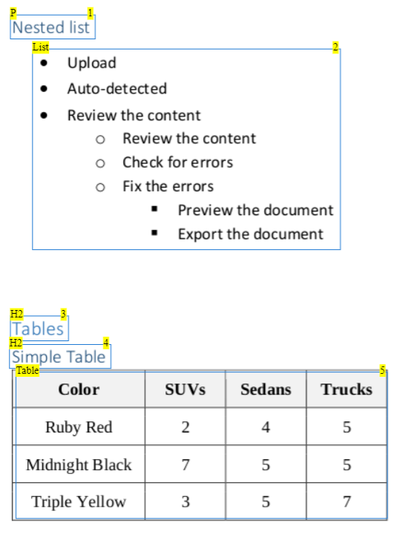
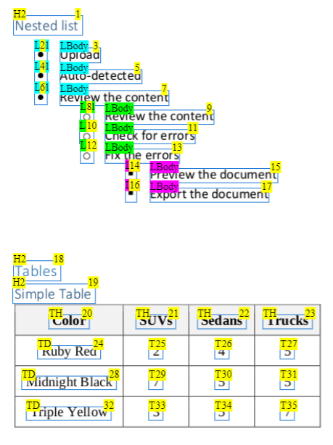

Slide 25
Implementation: Accessibility
Restructuring of code
Issues with getting images to load
  Fixed through static folder

Slide 26
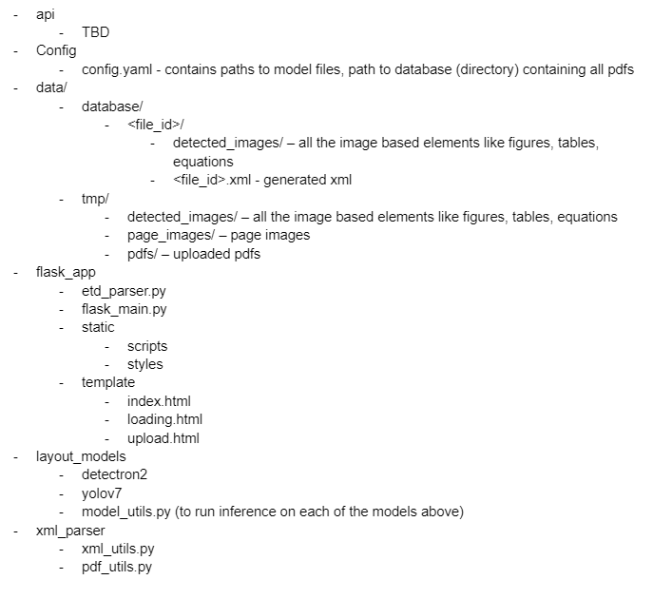

Slide 27
Testing: Accessibility
Case study of 18 documents
Variety of majors
5 universities
  Ohio
  UTA
  Georgia Tech
  Texas Tech
  Virginia Tech
Settings used
  Paragraph splitting disabled
  Highlighting enabled

Slide 28
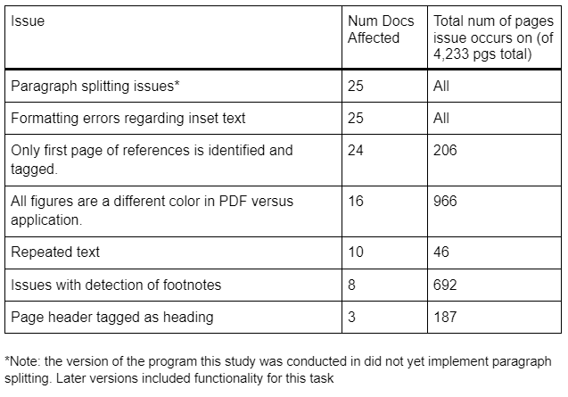

Slide 29
Future Work
UI
  Dark mode, focus mode, dyslexia font
Back end
  Continue working on getting an accurate algorithm for splitting references/paragraphs.
  Start splitting references into smaller components (i.e. publisher, year published).
  Add Optical Character Recognition (OCR) for scanned documents
Accessibility
  Fixing of errors identified in case study
  Better tagging of tables and equations for screen readers

Slide 30
Acknowledgements
Client: Aman Ahuja
Object Detection Model Student Helpers:
  Brian and Kevin Dinh (CS 4624 and 4994)
  Nila Masrourisaadat and Nirmal Amirthalingam (CS 5604)
Case Study database provider:
  Bipasha Banerjee

Slide 31
References
Previous Works:
http://hdl.handle.net/10919/114081 (Spring 2022)
https://aclanthology.org/2022.wiesp-1.14/ (Fall 2022)

