Slide 1






SANREM 2014 Annual Meeting
“Building a sustainable future from a foundation of research”
Farmers’ experiences on
Conservation Agriculture in Cambodia
Presented by Rada KONG, on behalf of farmer
Ms. Pheap PHENG
19th-21st Crystal Gateway Marriott Hotel in Arlington, Virginia
Notes:
*

Slide 2
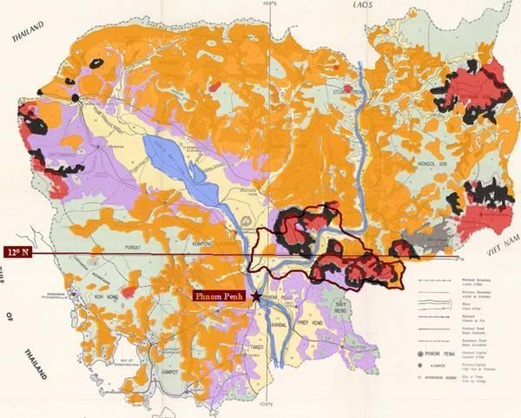
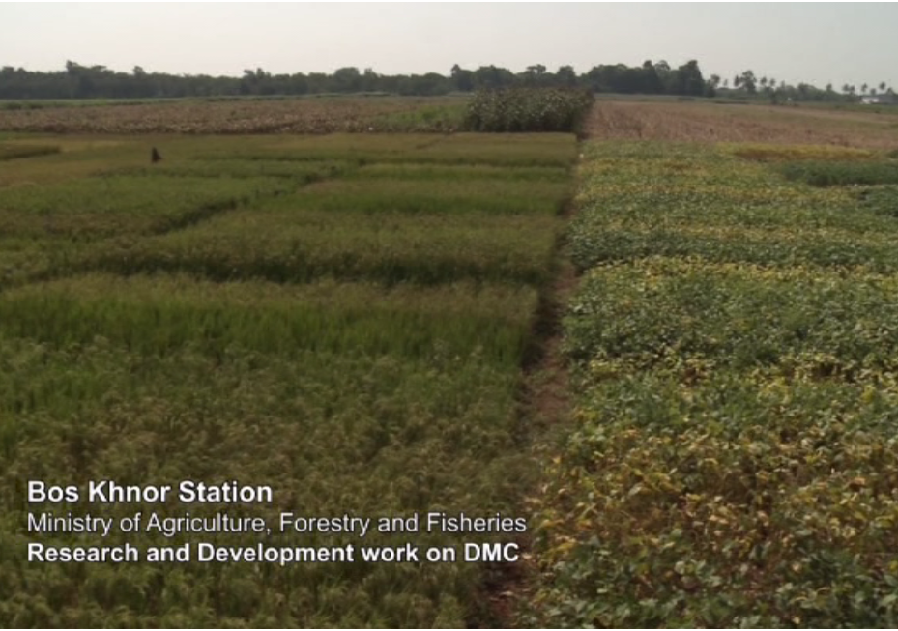
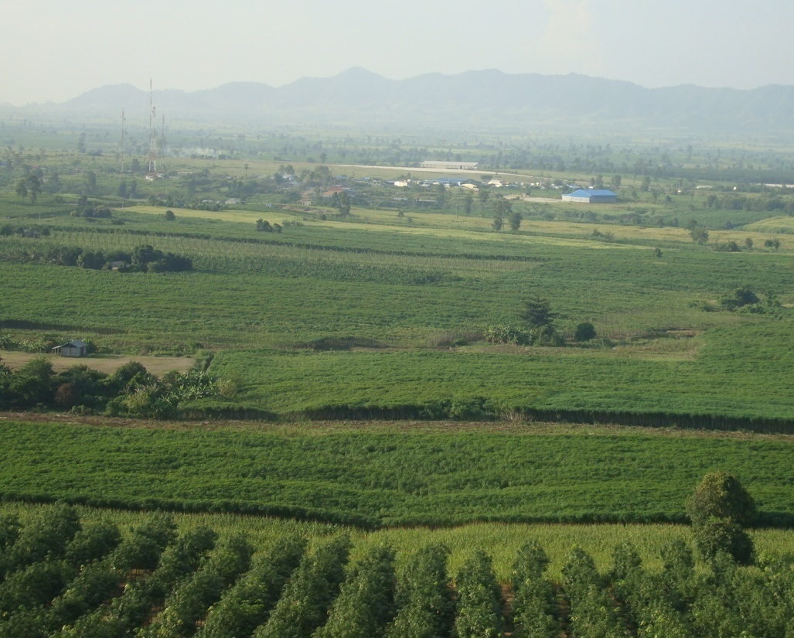
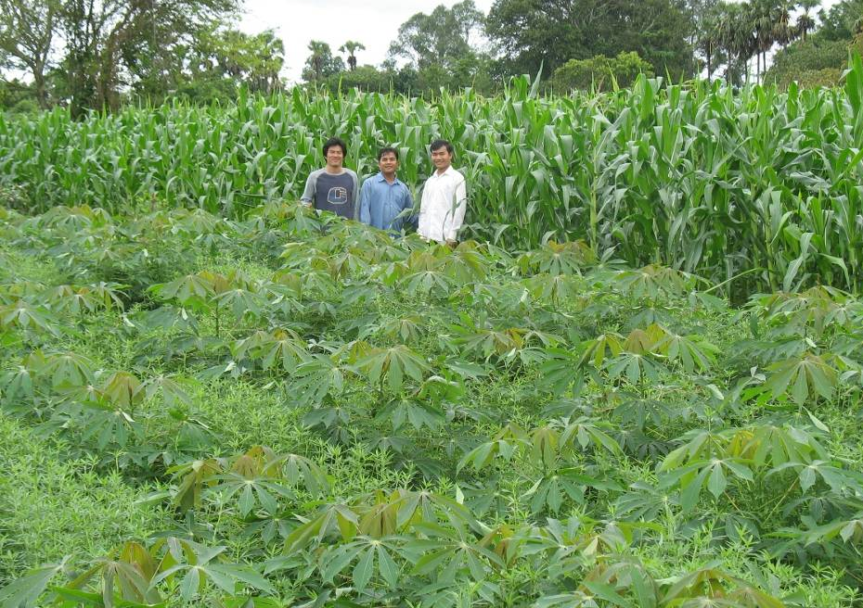
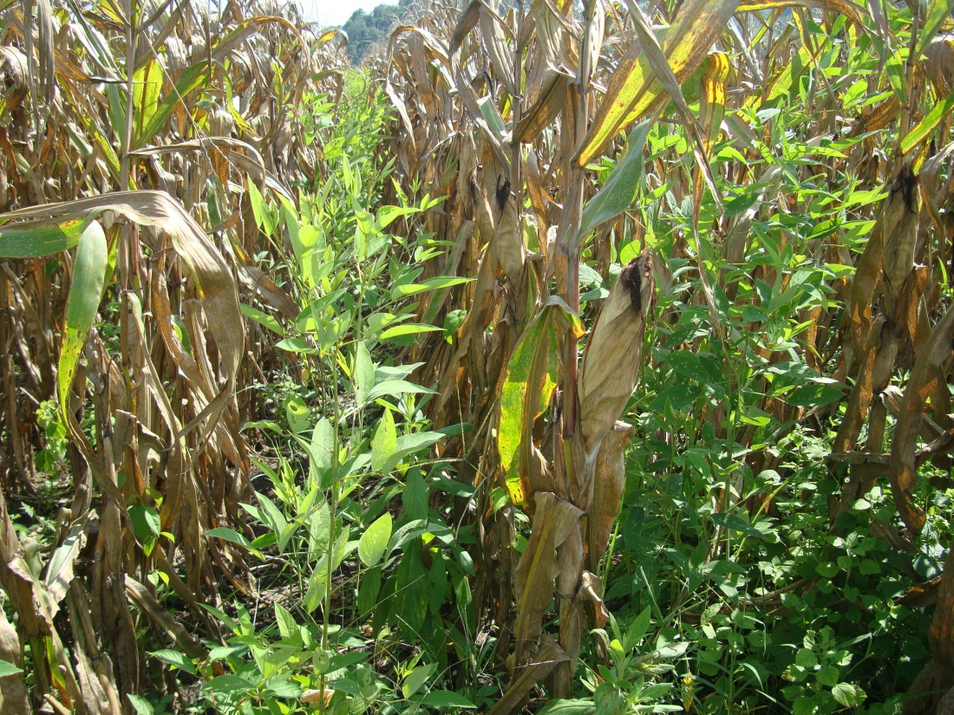
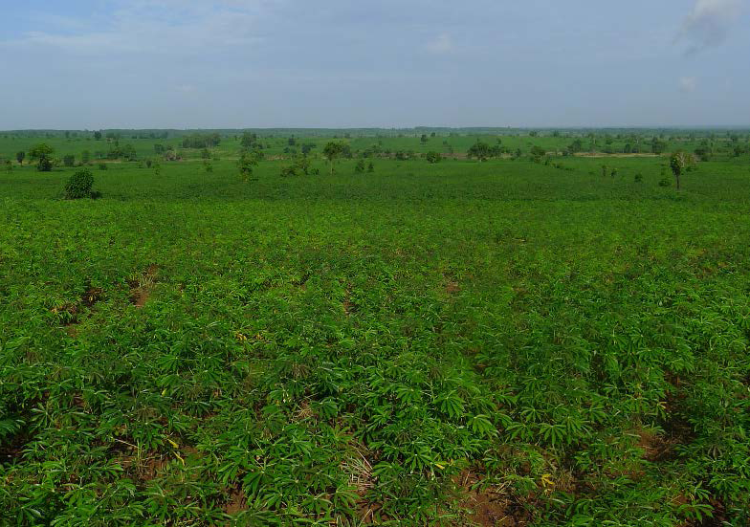
Localization of the main R&D areas
A multi-regions “on farm, with and for farmers” research sites
1
3
Boskhnor Station 14ha CA R&D on Red oxysol on basalt CA since 2004
1
2
3
2
Pilot extension: Medium-big farmer on Vertisol on limestone since 2009
Pilot extension: smallholders on Verti-oxysol on basalt since 2008

Slide 3
SANREM 2014 Annual Meeting:
“Building a sustainable future from a foundation of research”
Plan of Presentation​
General context of agrarian systems in the pilot areas ​​​​​
Proposed cropping systems and evolution of CA extension
What do the farmers have learned and constraints / need faced for DMC adoption and scaling up?
Project’s strategic plan for the 5th (“last”) year
Notes:
*

Slide 4
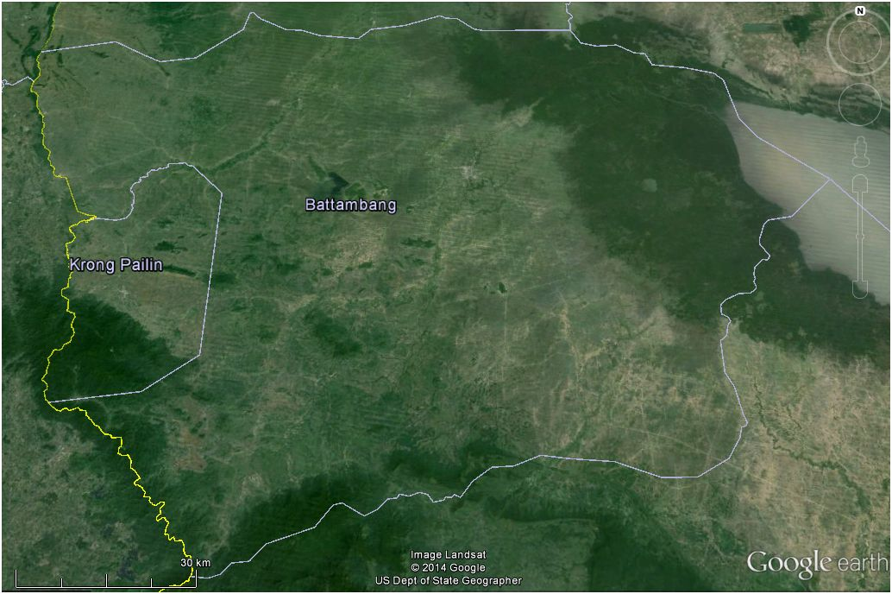
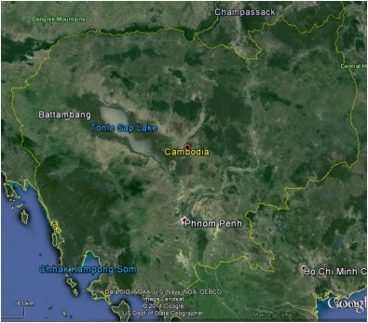
Western Areas of Cambodia
440,000 ha of forest land reclaimed as farming land in 10 years

Slide 5
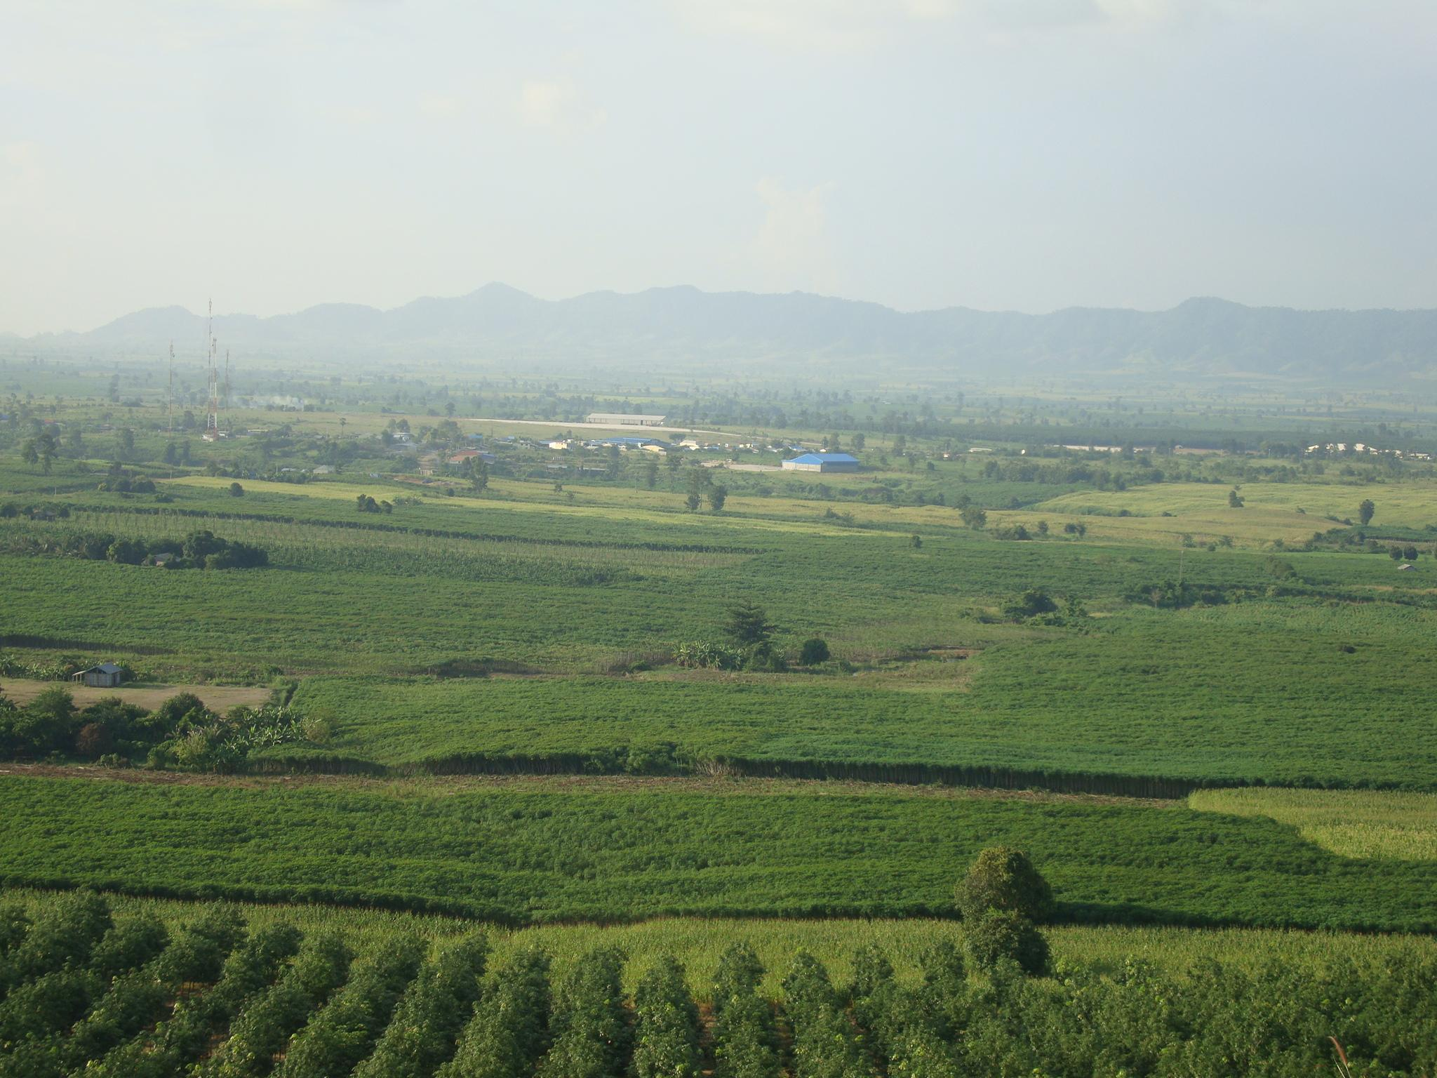
1. General context of village agrarian system
Plow-based conventional cropping system:
2000-2004: Mungbean/Peanut, Mungbean/Soybean and Peanut/Peanut
​ 2004-2008: Mungbean/Maize and Fallow/Maize
Since 2008: Farmers started to grow Maize/Maize, and recently shift to Cassava
Initially maize yield 1st cycle 4.7 t/ha and 2nd cycle 6 t/ha but now 1st cycle 2.5 t/ha and 2nd cycle 4 t/ha
Risks of 1st cycle crops: Maize and Mungbean
Notes:
*

Slide 6
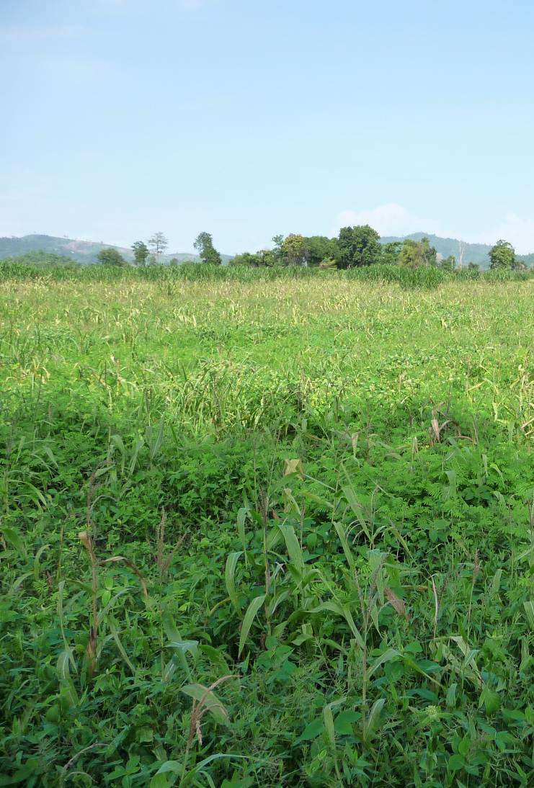
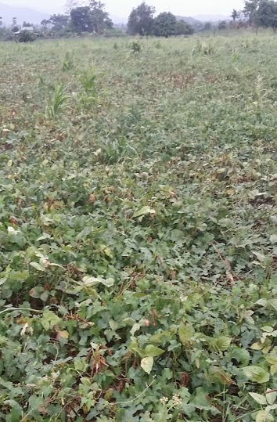
Drought effects on 1st cycle corn and mungbean
Annual rainfall (mm year⁻¹):
2013: 2104
2012: 1177
2011: 1732
2010: 1176

Slide 7
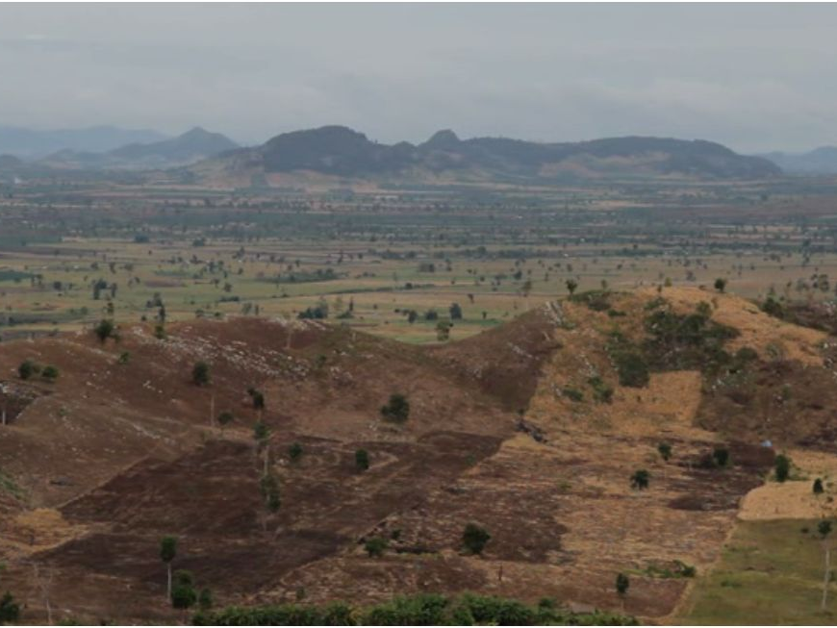
1. General context…(cont.)
Constraints of plow-based conventional cropping system:
Soil erosion and soil lost via run-off
Continuous decrease of soil fertility → soil degradation → Yield drop
Increasing weed pressure → higher cost for its control
Soil compaction and waterlogged problems
More vulnerable to climate changes (drought and flood)
Higher production cost → less profits

Slide 8
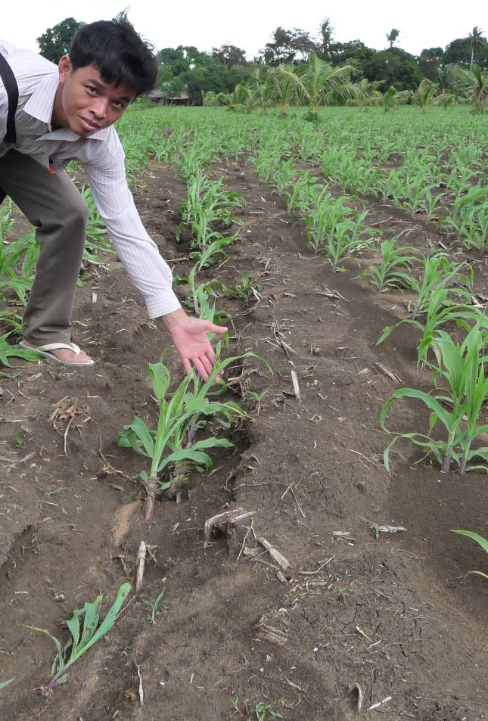
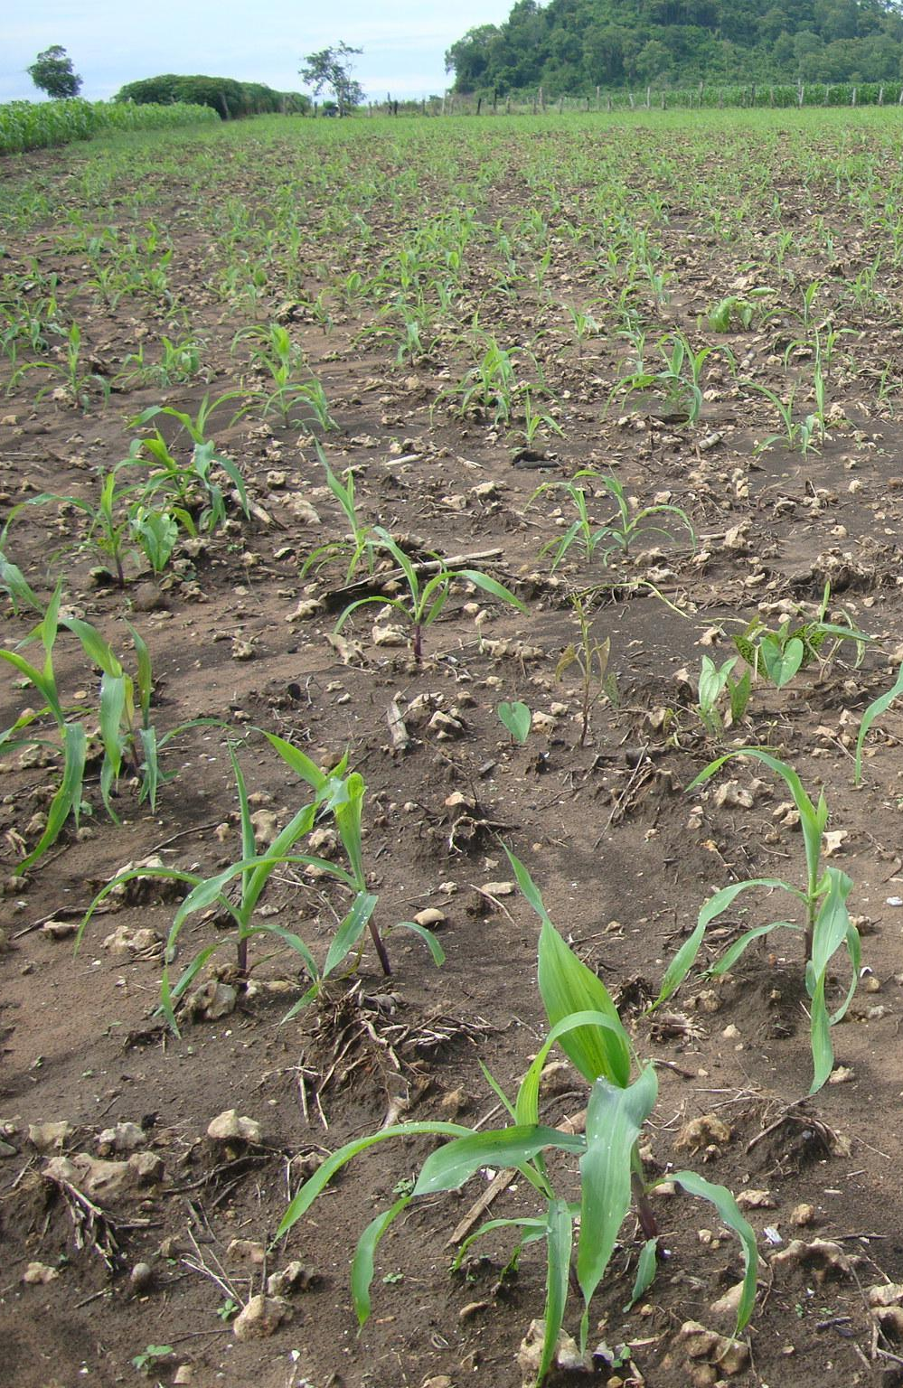
2010
2013

Slide 9
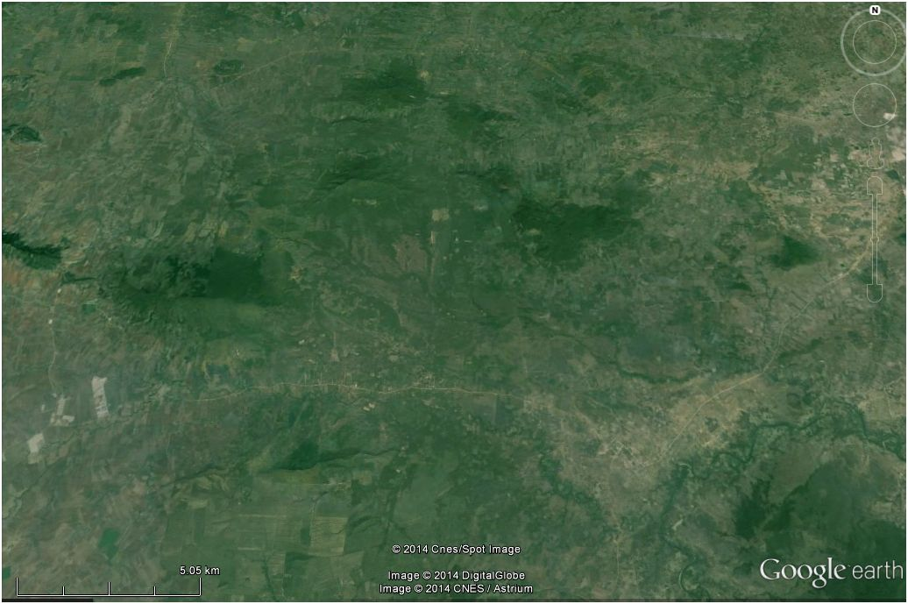
2. Proposed CA maize cropping systems and evolution of extension:
Location of Experiment Site
Site 1: 2ha in 2009
Site 2: 1ha in 2010

Slide 10
Experimentation sites:
Tested CA cropping systems
Year n
Year n+1
"scattered" rains
heavy rains
"scattered" rains
heavy rains
Mar.
April
May
June
July
Aug.
Sept.
Octo.
Nov.
Dec.
Jan.
Fev.
Mar.
April
May
June
July
Aug.
Sept.
Octo.
Nov.
Dec.
Jan.
Fev.
Mono-cropping:
Maize “mono cropping”
Biannual rotation crops:
Maize // Soybean rotation
Maize // Rice rotation
Maize // Cassava rotation
Intensified crops:
Cassava // Maize - Maize rotation

Slide 11
Targeted villages
Okhmum
2012
P. Changva
2009
Sangha
2011
Site 1
2009
Site 2
2010
Boribo
2009
Proposed cropping systems?
New pilot
2014

Slide 12
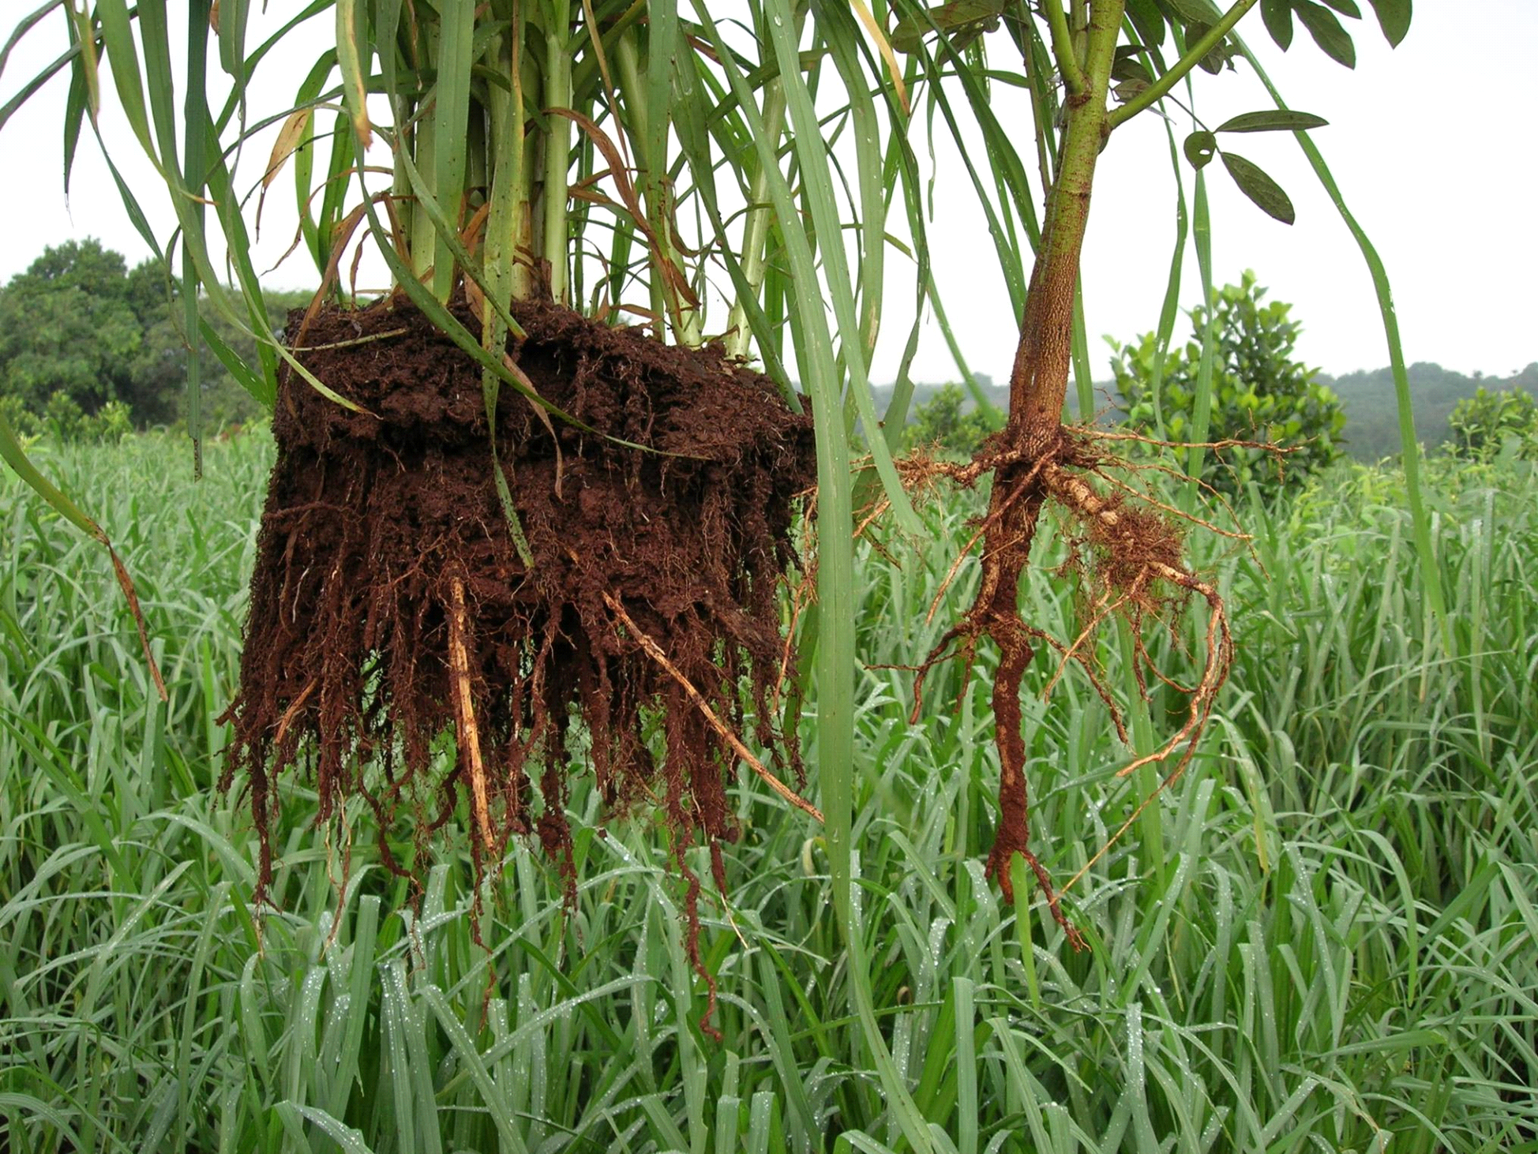
A.2/ Principles of DMC and cropping systems typology
A.2.1/ Principles of DMC technologies
“An integrated CARBON based soil’s fertility management”
Biological parameters
carbon & Soil organic matter,
weeds, pests, ...
a continuous
flux of CARBON
CARBON
The 3 principles of DMC
1/ No soil's tillage
2/ Soil's permanent plants' cover
3/ Succession / Rotation of species
Physical parameters
Chemical parameters
erosion, porosity, water, ...
pH, ECC, bases, ...

Slide 13
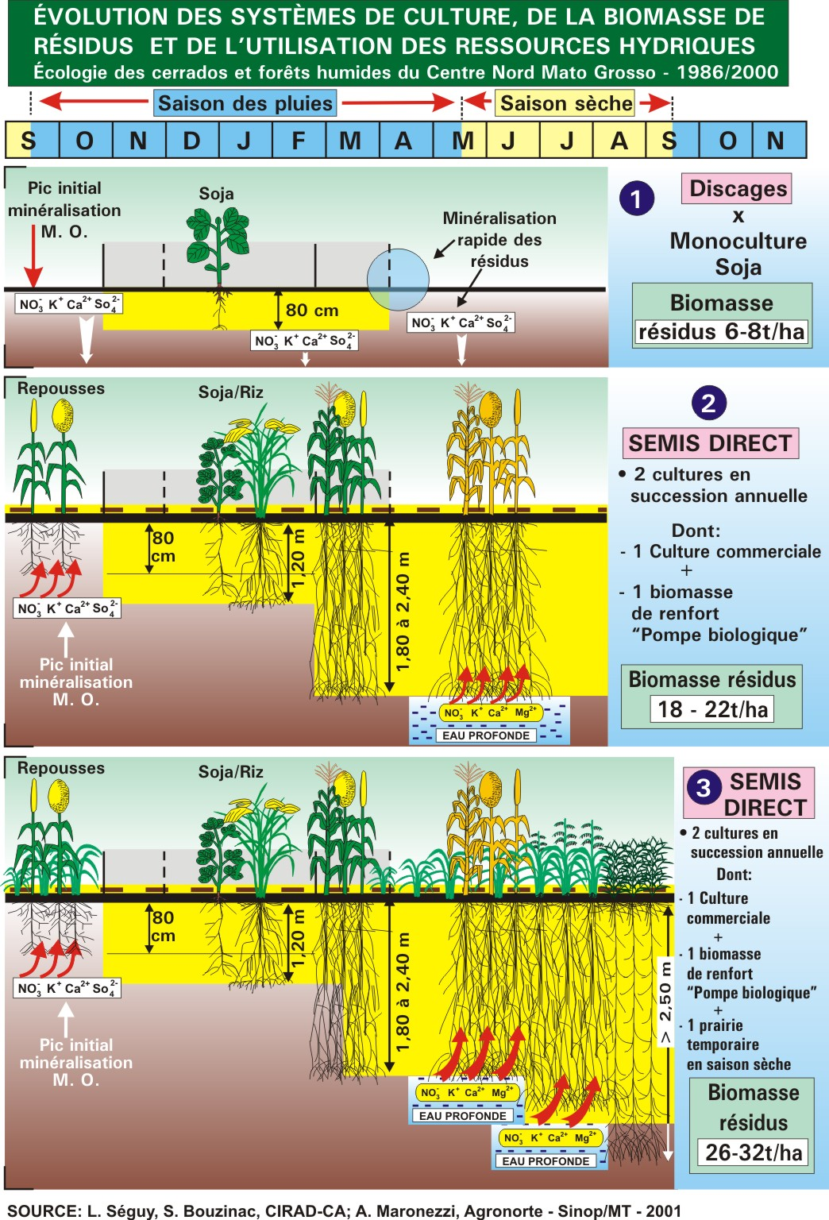
Principles of DMC and cropping systems typology
Principles of DMC technologies
The “notion” of biological pump
Scattered rains
Heavy-regular rains
Biological pump
“BEFORE”
Main Crop
Biological pump
“AFTER”
Source: L Seguy, S. Bouzinac – CIRAD – A. Maronezzi, Agronorte – Sinop/MT , 2002.

Slide 14
Principles of DMC and cropping systems typology
Principles of DMC technologies
The “Multi-functionality” of biological pump
FUNCTION
EFFECT
Above
Food
Nutrient for crops, Fodder for Cattle
Biomass for soil’s fauna/µflora chains
Protection
Erosion / run-off, Evaporation, T (°C)
Xenobiotiques bio-degradation ®
“Pest-buster”
Weed control (shade, allelopathy)
Disease (splash effect, blast on rice…®)
Insect (…via biodiv. … ®)
Below
C Loader
C storage - ECC increase, pH buffer …
Bio activity / diversity increase ® publi.)
Bio-degradation / detoxification (?) ®
Structure
Roots system matrix, decompaction
Porosity, Water reserve
Aggregation & O.M.% ®
Recycling pump
Connection to deep water i.e. maximization of the water potential
Recycling of lixiviated ions NO₃⁻, bases ®

Slide 15
Logical questions from farmers:
- Increase crop productivity?
- Reduce labor and input cost?
- More profitable?​

Slide 16
2. Proposed CA maize cropping systems:
Year n
Year n+1
"scattered" rains
heavy rains
"scattered" rains
heavy rains
Mar.
April
May
June
July
Aug.
Sept.
Octo.
Nov.
Dec.
Jan.
Fev.
Mar.
April
May
June
July
Aug.
Sept.
Octo.
Nov.
Dec.
Jan.
Fev.
Mungbean
Sesame
Maize
Mungbean
Sesame
Maize
disc
disc
disc
disc
Maize
Maize
Maize “mono cropping”
Stylo.
Maize + Stylo.
Stylo.
Maize + Stylo.
Stylo.

Slide 17
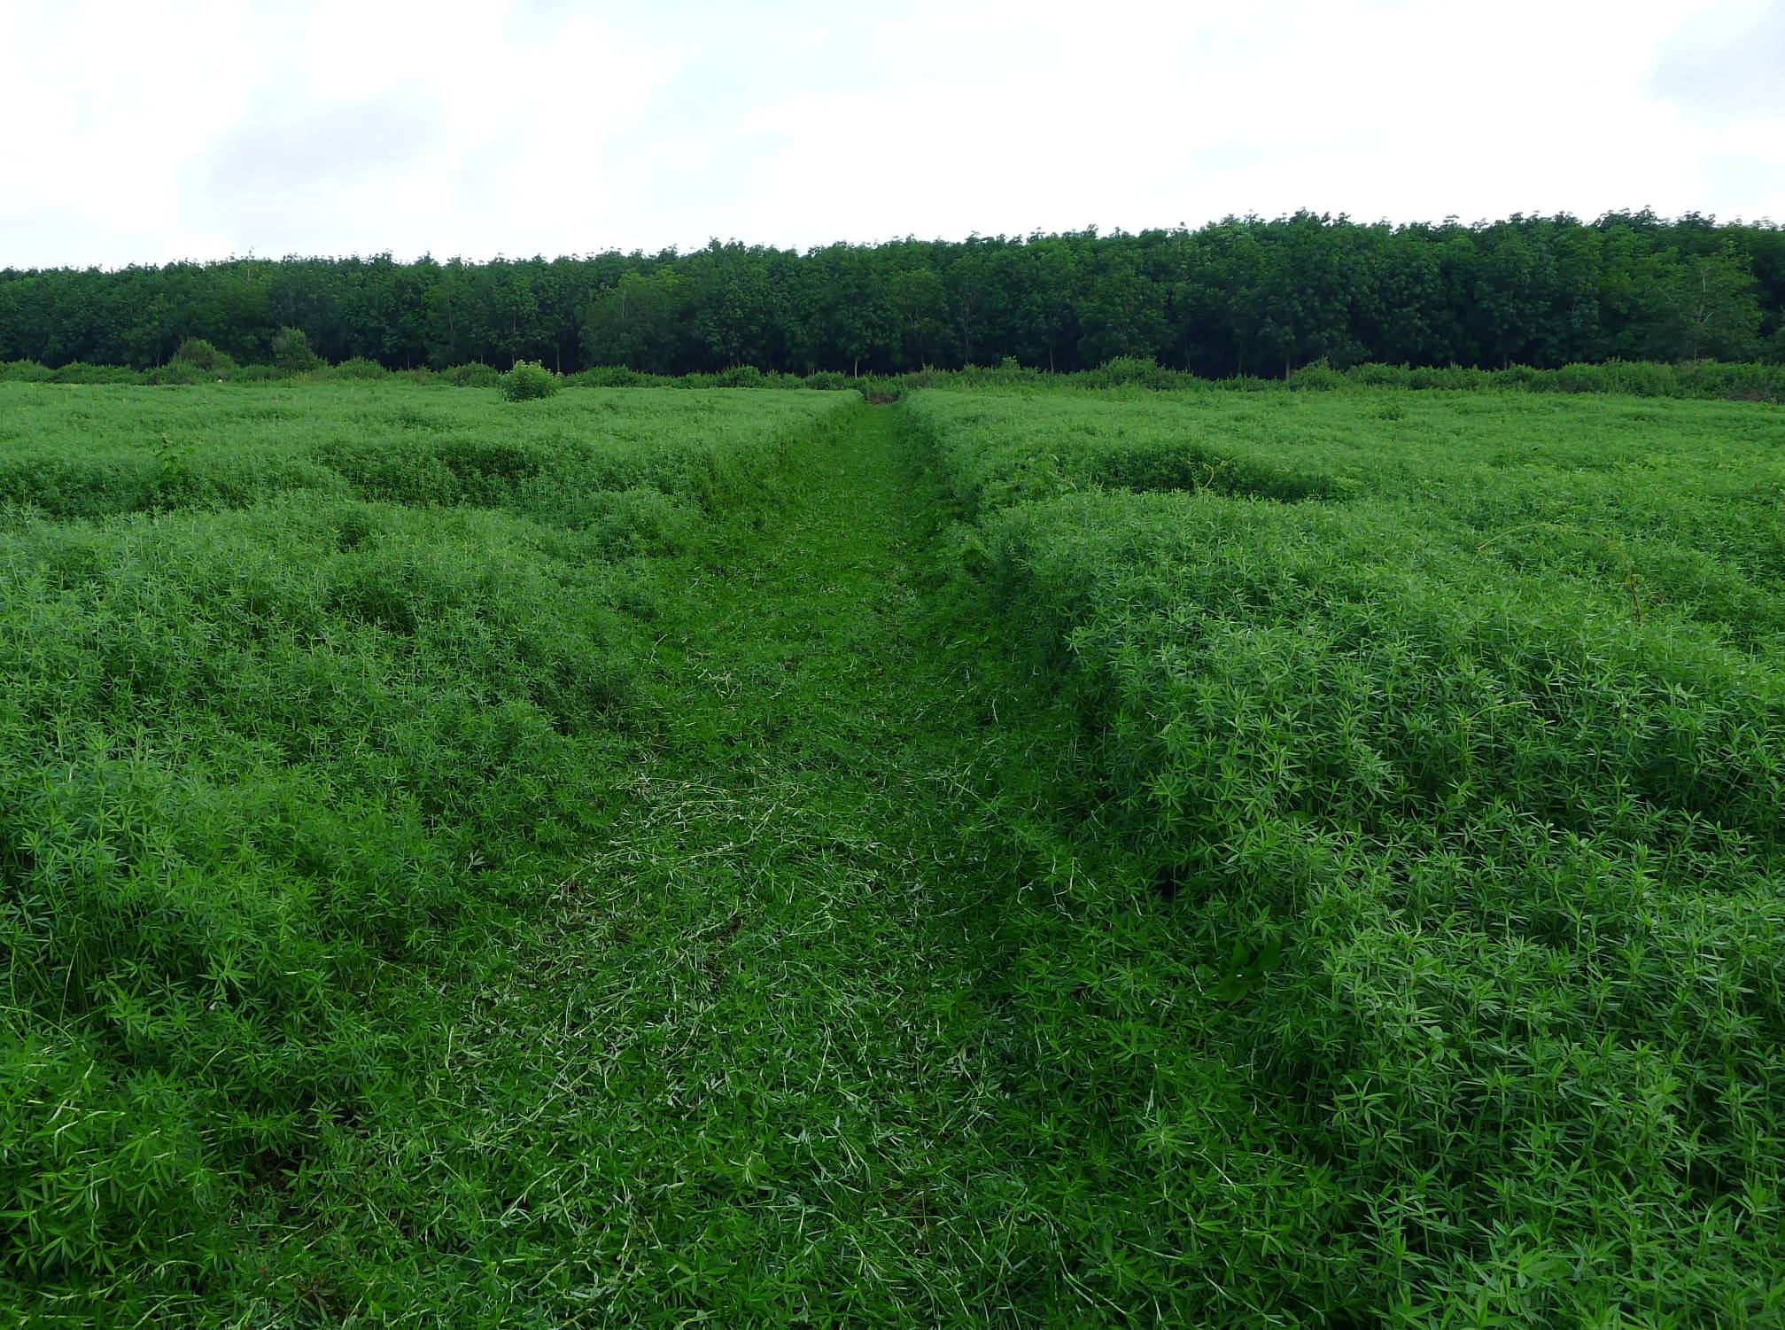
Stylo is not suitable for Alkaline soil!
Cambodia – Kampong Cham 2011

Slide 18
Moving from Stylo to Pigeon pea…
Year n
Year n+1
"scattered" rains
heavy rains
"scattered" rains
heavy rains
Mar.
April
May
June
July
Aug.
Sept.
Octo.
Nov.
Dec.
Jan.
Fev.
Mar.
April
May
June
July
Aug.
Sept.
Octo.
Nov.
Dec.
Jan.
Fev.
Mungbean
Sesame
Maize
Mungbean
Sesame
Maize
disc
disc
disc
disc
Maize
Maize
Maize “mono cropping”
Stylo.
Maize + Stylo.
Stylo.
Maize + Stylo.
Stylo.
Maize “mono cropping”
Pigeon pea
Maize + Pigeon pea
Pigeon pea
Maize + Pigeon pea
Pigeon pea

Slide 19
​Evolution of CA extension 2009-2014

Slide 20
​3. What have the farmers learned about CA ?
Some key advantages perceived by farmers are:
Stop plowing from 2nd year of DMC implementation → save labour and reduce cost
Protect soil erosion and soil lost via runoff
Reduce weed pressure and population​ esp. gramineae species → reduce labor
Restore and improve soil fertility, and proper cropping management advised by the project → increase yield
Proper use of agrochemicals so save time, labor and lower cost
Notes:
*

Slide 21
But…!
Constraints and need for adoption…
​​​​

Slide 22
3. What have the farmers learned about CA ?
​​​​
Constraints
So far not yet have suitable cover crops, the proposed cover crops pigeon pea required additional sowing labor and no market
The presence of cover crops requests for locally herbicides which require more labor​ and less efficiency without Atrazine and Paraquat
Not yet available CA based Cassava!
Limited direct seed planters, depending totally on the services provided by​ the project
Notes:
*

Slide 23
Constraints (cont.)-
Limited capacity of direct planter to sow on wet soil conditions compared to normal Thai planter
Credit access to invest fertilizers, the farmers take inputs as credit from the suppliers
Secondary constraints with insects (millipedes, cricket,s ants…) damaging young maize seedling on mulching plot
Notes:
*

Slide 24
Needs
Three key needs conditioning CA adoption for the farmers:
​ Market for cover crops to get extra income, animal feeds request more investment and labour
Making services on CA practices esp. sowing accessible with private contractors like plow and conventional sowing
Project, NGOs, GOs…provide cheap interest credit for fertilizers inputs; Farmer Cooperative credit fund is limited!
Notes:
*

Slide 25
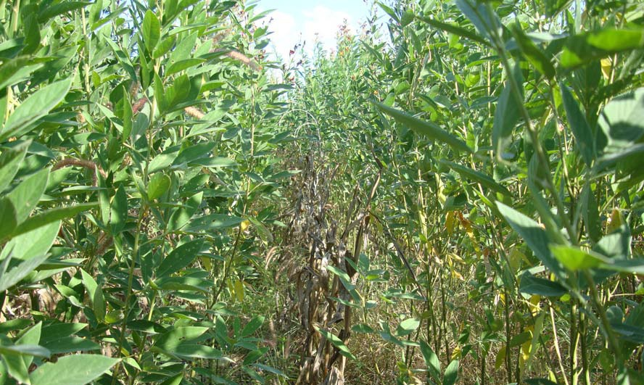
4- What project’s strategic plan 2014?
Cover crops
From PADAC-SANREM – Pigeon pea growing after maize harvest– Dec 2012

Slide 26
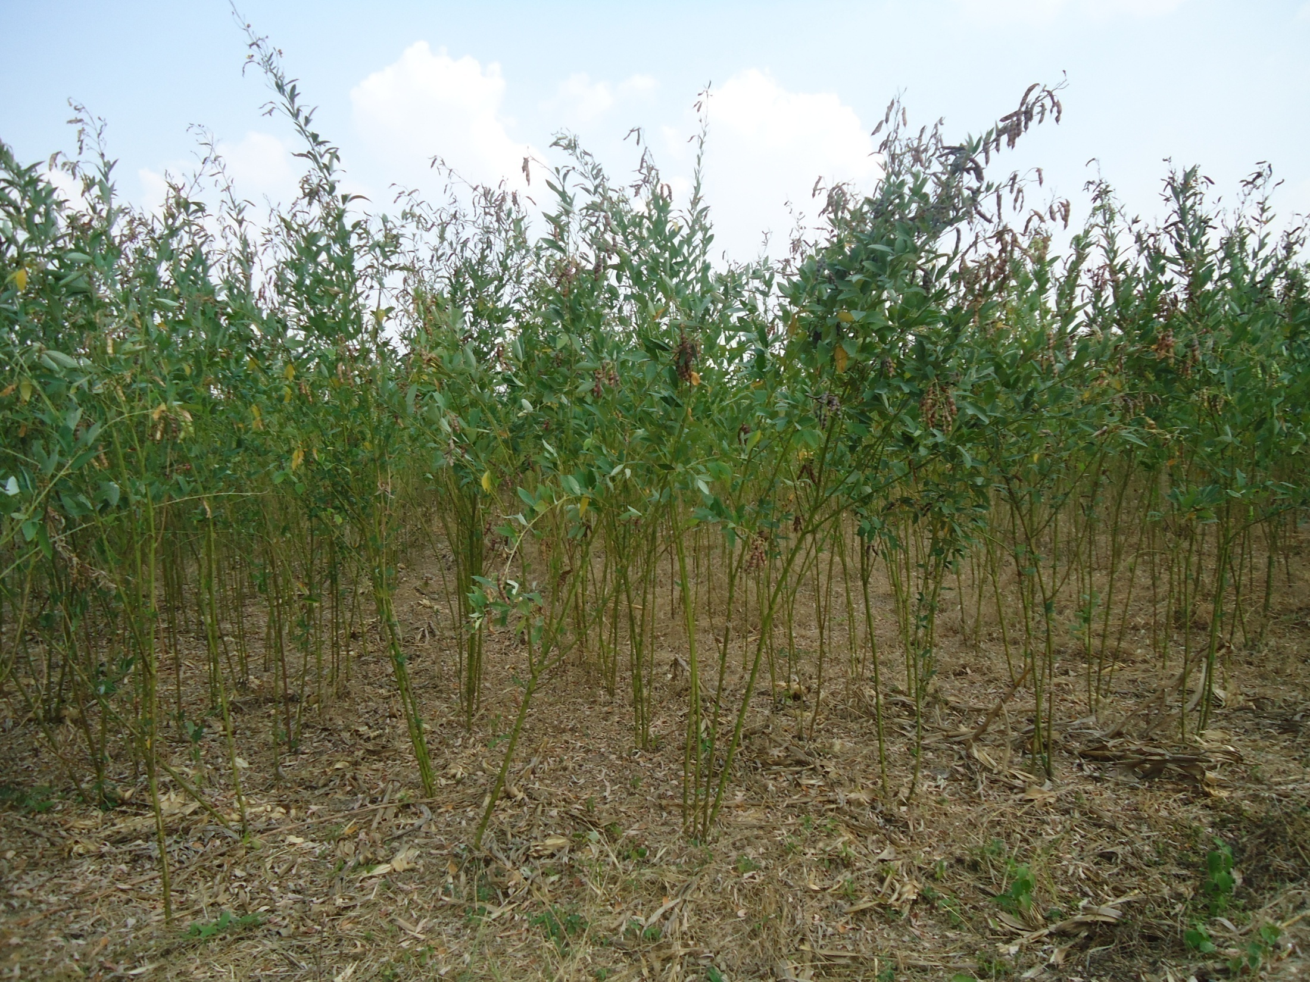
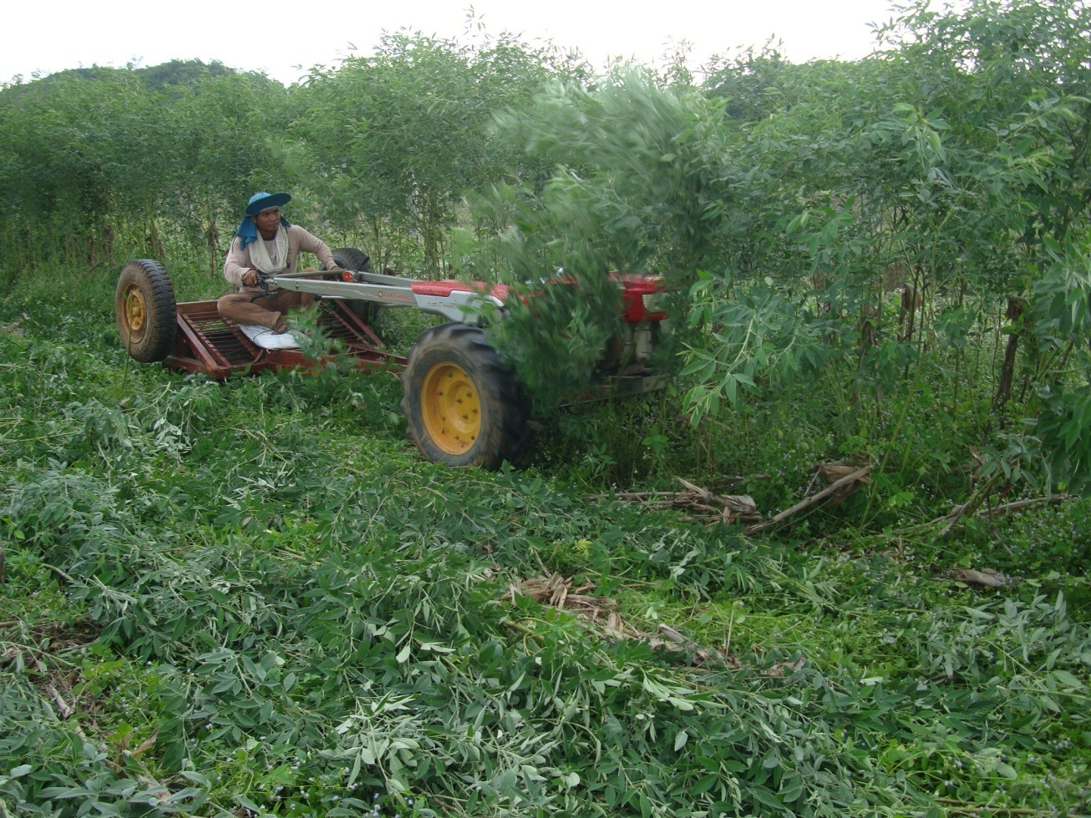
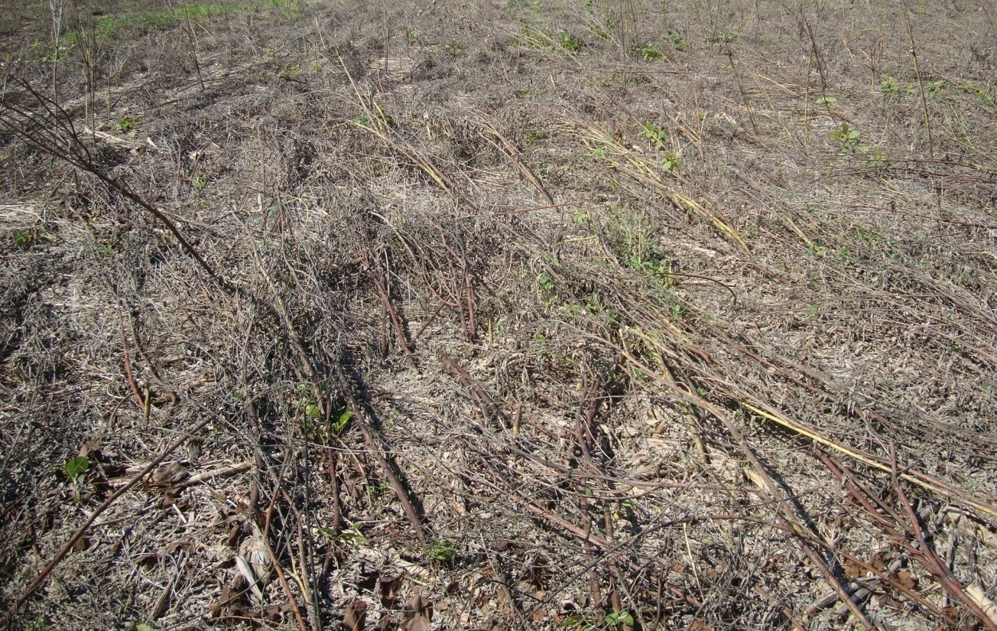
Cover crop pigeon pea sown on maize line
Rolling down pigeon pea in May-June
Pigeon pea in dry season
Pigeon pea mulch for corn sowing

Slide 27
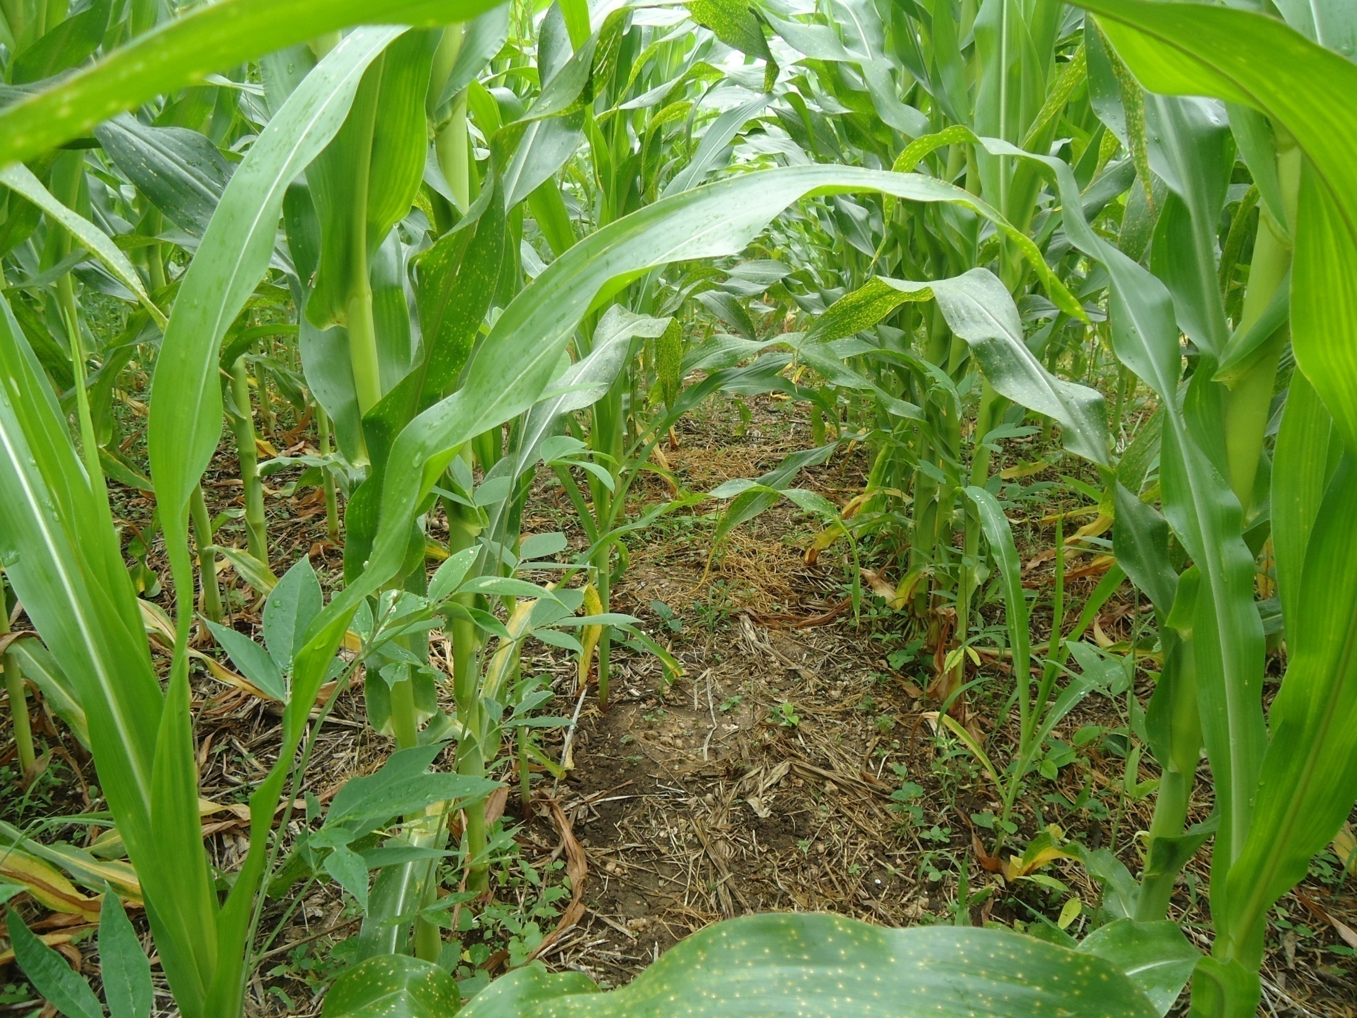
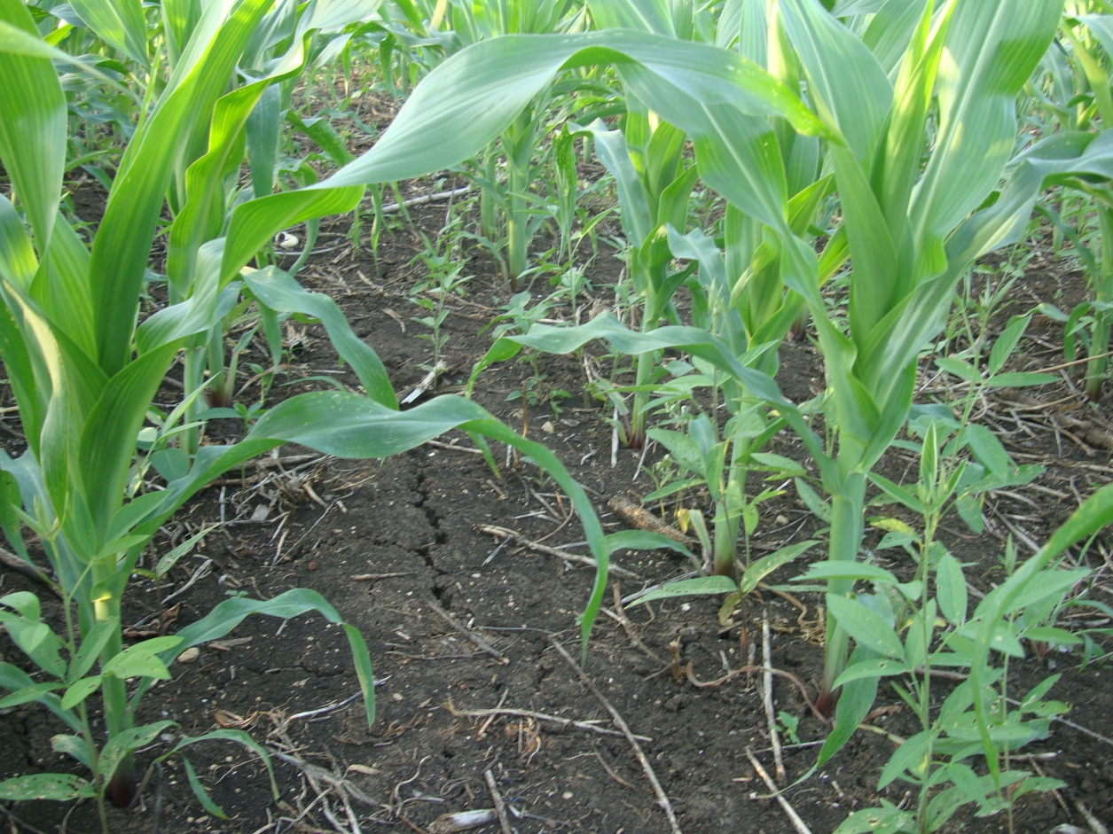
Cover crop pigeon pea sown on corn line
From PADAC-SANREM – Pigeon pea slowly growing with maize– Aug. 2013

Slide 28
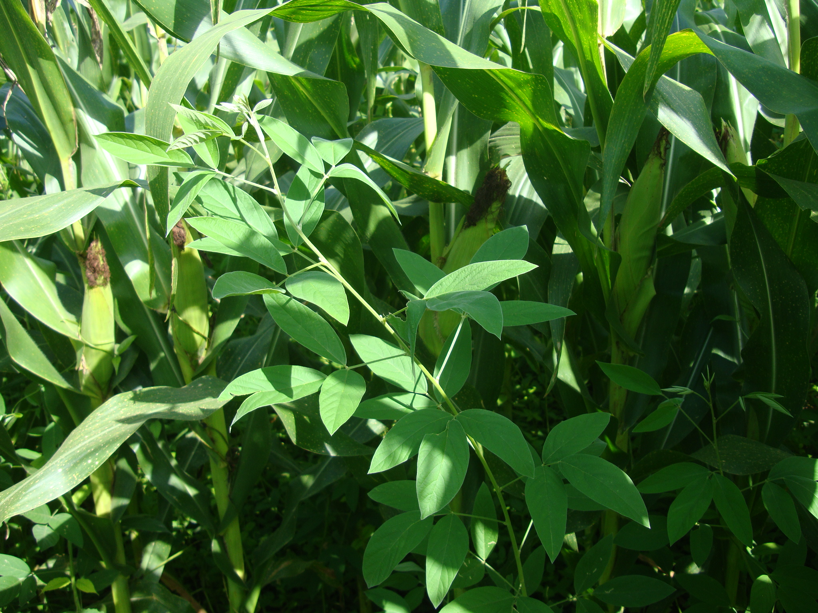
From PADAC-SANREM – Pigeon pea growing with maize– Oct. 2013

Slide 29
New proposal: Trial on 1.2m pigeon pea
- Free seed at reduced density 60,000 to 40,000 plant/ha
- Subsidized 23N/ha (12.5$/ha)
- But farmer apply basal 16N-20P-00K and spray 2,4D inter-row
Pigeon pea
No pigeon pea
Pigeon pea
Farmer:
7.5 ha
​​​​
No pigeon pea
Pigeon pea
Wider space, save spraying labor
………
1.2m
………

Slide 30
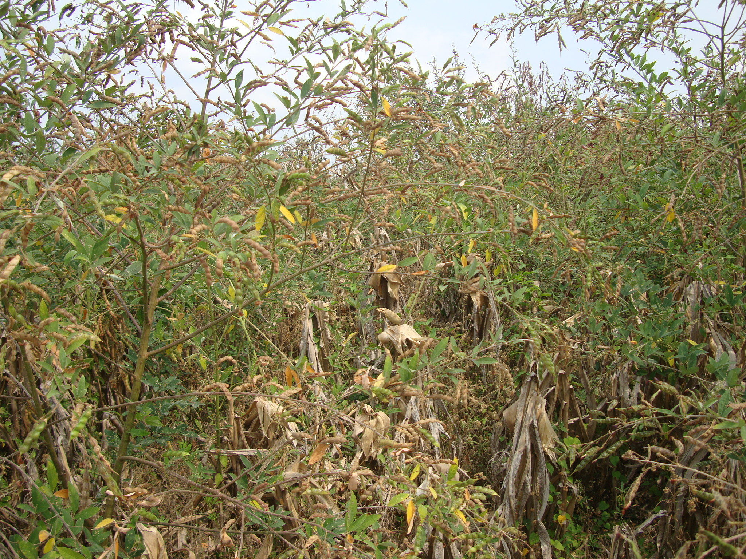
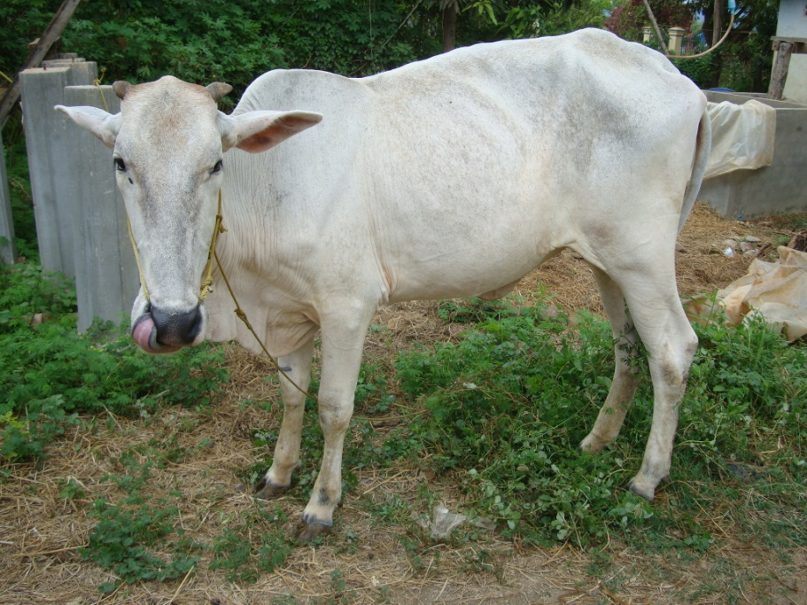



Market of Pigeon pea
Cattle fattening
Local market:
International market:
Thai market with

Slide 31
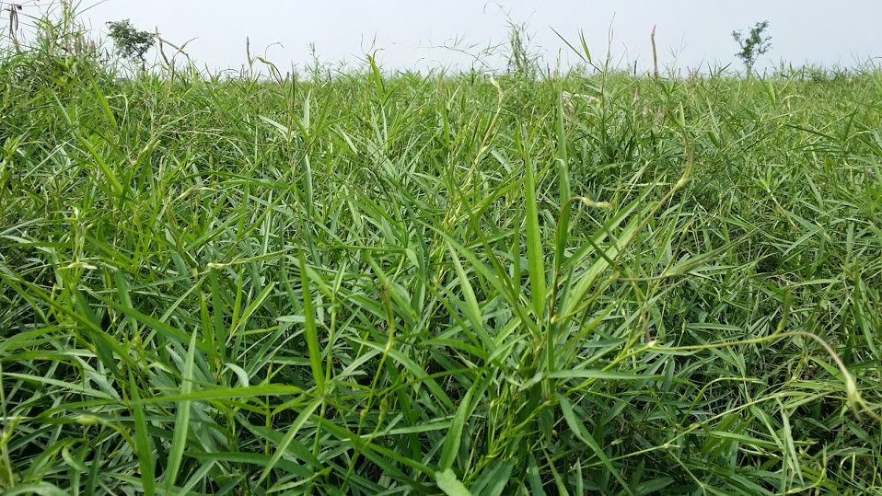
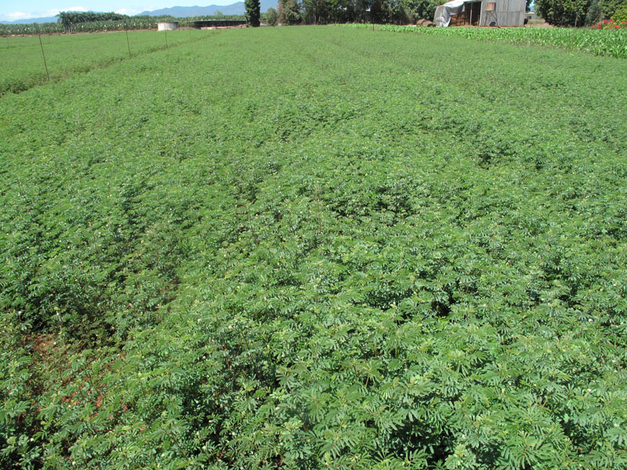
Centrosema
Desmanthus
Testing new
cover crops

Slide 32
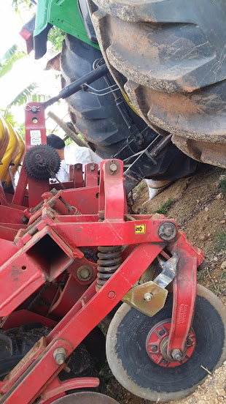
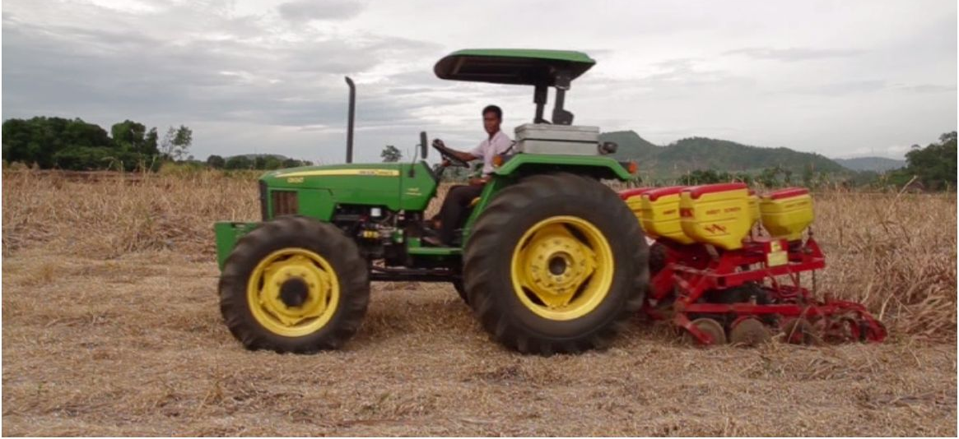
4- What project’s strategic plan 2014?
Direct planters:
- Disc scrapper allows sowing on wet conditions
- 3 direct planter meeting sowing date wanted by farmers

Slide 33
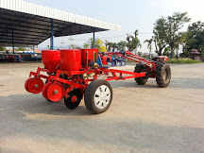

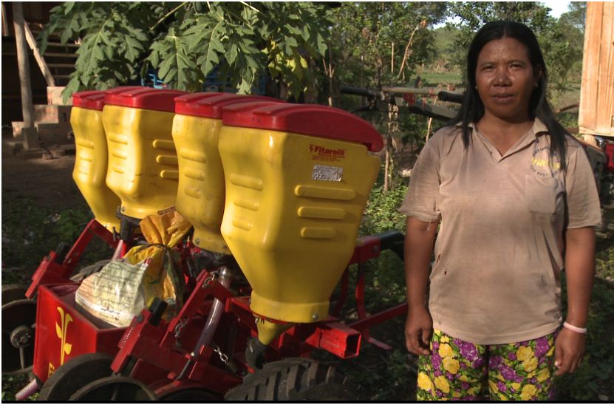
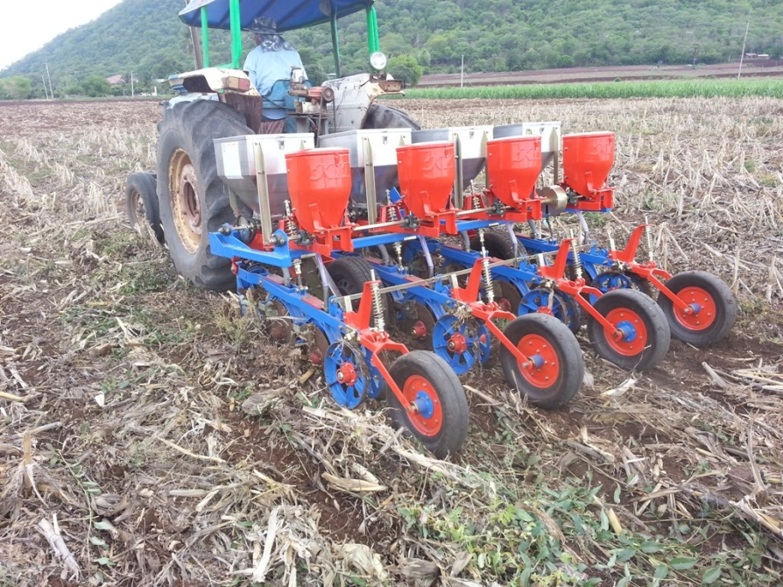
4- What project’s strategic plan 2014?
Thai 2-row direct planter: 1500$/unit
Direct planters:
Renting planter and sprayer to existing Farmer Cooperative: Agricultural Cooperative of Kaksekor Nhor Nheum
Brazilian 2-row planter: 3500$/unit in 2012
Thai 4-row direct planter: 7500$/unit

Slide 34
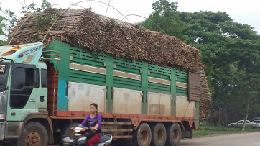
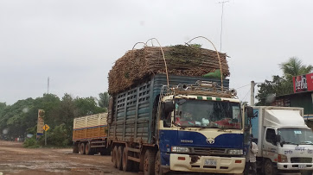
4- What project’s strategic plan 2014?
CA based cassava:
Skyrocket cassava 2014
Cassava area: ~70-80%!

Slide 35
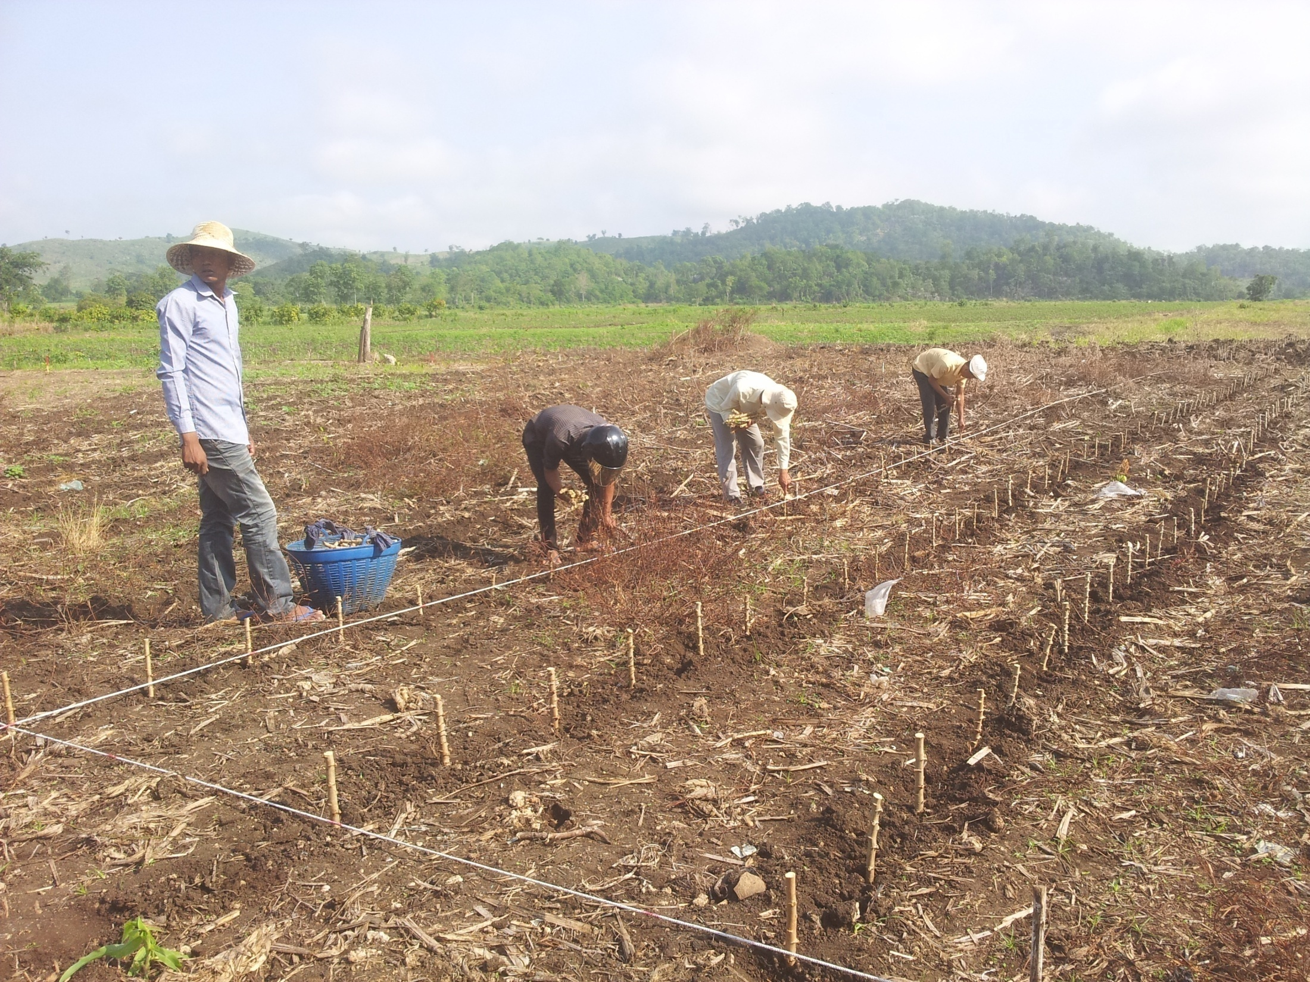
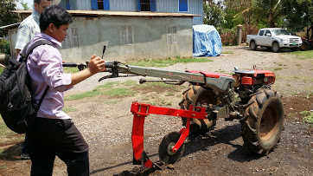
4- What project’s strategic plan 2014?
CA based cassava:

Slide 36
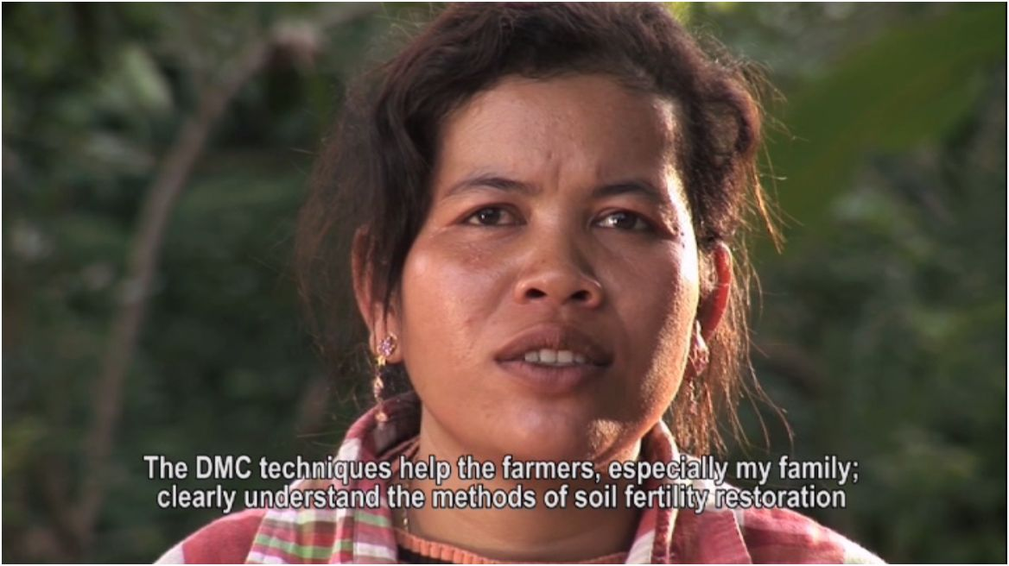


Thank you very much for your attention!
Acknowledgement:

