Slide 1

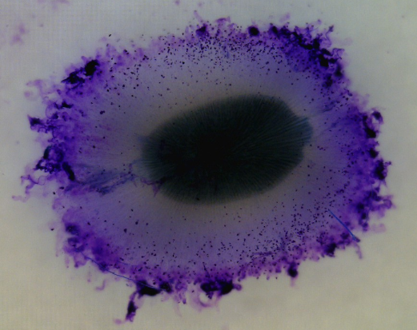
The Production and Function of Mucilage by Sweet Basil (Ocimum basilicum L.) Seed
Dongfang “Emily” Zhou
M.S. , Ph.D Candidate
Department of Horticulture
Virginia Tech
U.S.A
dfezhou@vt.edu

Slide 2
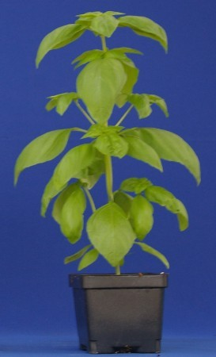
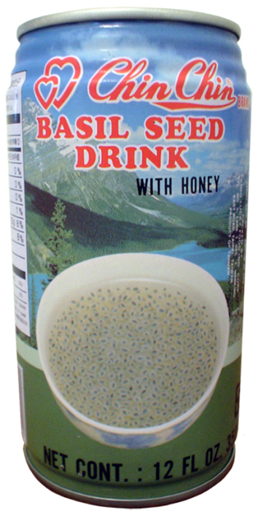
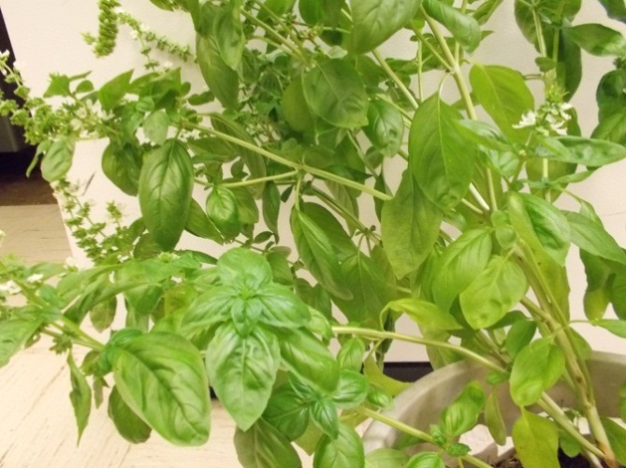
Sweet Basil (Ocimum basilicum L.)
A frost sensitive low-growing herb in family Lamiaceae (mint family)
Native to southern Asia
Grows a lot in Mediterranean area and South Asia
A summer and annual crop in North America
More than 60 cultivars

Slide 3
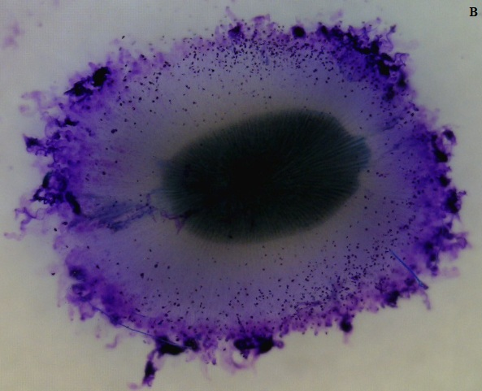
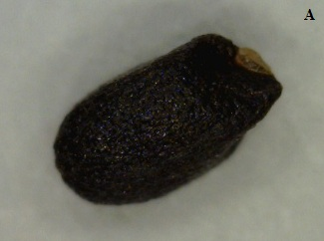
Sweet Basil Seed Mucilage

Slide 4
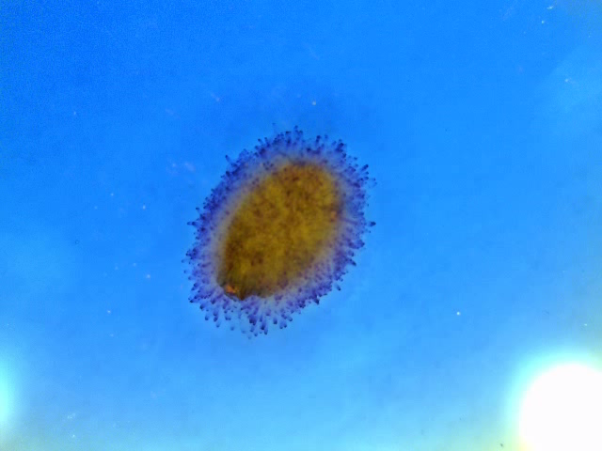
Sweet Basil Seed Imbibition with water (55x)
Notes:
The video were taken one picture every 10 seconds, and play back 15 pictures per second.

Slide 5
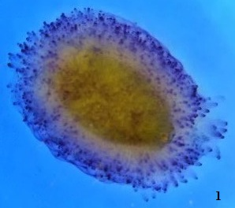
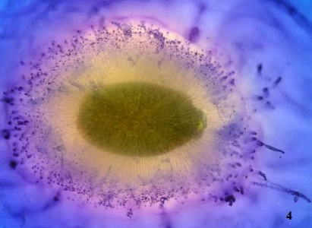
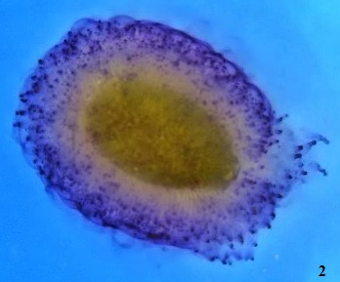
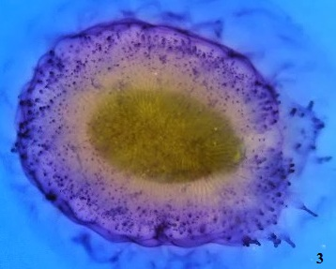
Notes:
1. One minute after imbibition
2. Five minutes after imbibition
3. Twenty minutes after imbibition
4. One hour after imbibition

Slide 6
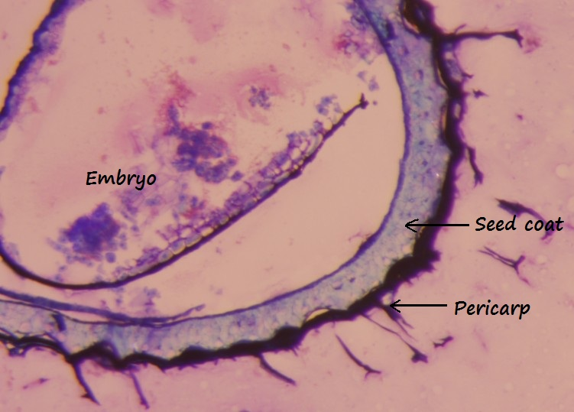
Sweet Basil Seed
Notes:
1.Placed seeds into 10% formalin
2.Processed on tissue processor in formalin, 70% alcohol, 80% alcohol, 3 changes of 95% alcohol, 3 changes of 100 % alcohol, 2 changes of xylene, 4 changes of melted paraffin wax. This is an automated stainer with protocols set for 1 hour in all solutions except paraffin, which is 30 minutes each.
3. Embedded processed seeds into paraffin mold and paraffin block made.
4. Cut paraffin sections of seeds at 4 microns, using a rotary microtome. Sections floated on water and picked up on microscope slides. Slides dried in 60 degree C blower for 20 minutes. This melts paraffin, removes water and adheres section to slide.
5. Deparaffinized in xylene 3 minutes, 2 changes .Hydrated back to water with 95% alcohol, 2 changes 3 minutes each, and then into running tap water. This is done on an automated stainer.
6. Slides rinsed in distilled water.
7. Placed slides in .002% Toludine blue for 4 minutes, dehydrated back to xylene with 95%, 100% alcohol and then into xylene.
8. Coverslipped with a resinous mounting media and glass coverslip. This makes a permanent slide for viewing under microscope and photographing.

Slide 7
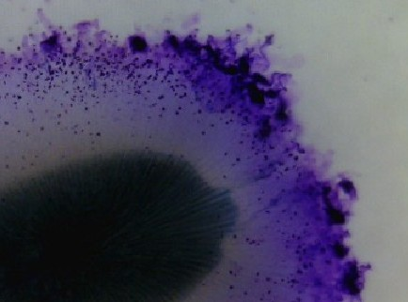
Sweet Basil Seed Coat Mucilage
The mucilage is tethered to the seed in long striated carbohydrate strands. The outer edge of the mucilage has coiled strands.

Slide 8
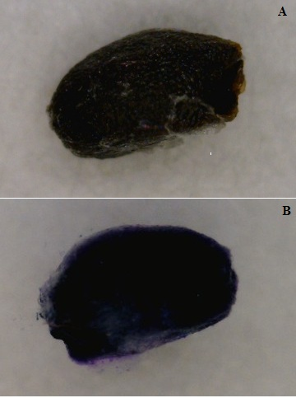
Mucilage Removal
*With diluted HCl solution
1 concentrated HCl : 2 distilled water
Drop seeds to solution for 5 minutes
Filter seeds with sieve, wash with running water and dry in dryer

Slide 9
Seeds With and Without Mucilage
A: Dry seed
B: Hydrated seed

Slide 10
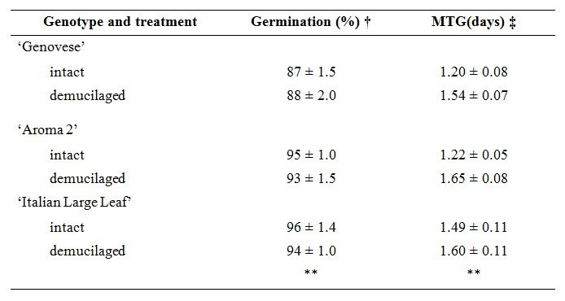
Germination test of mucilage free seeds
Three cultivars:
‘Genovese’ , ‘Aroma 2’, ‘Italian Large Leaf’
Germination test in incubator at 32°C (31.2 ± 2.0°C)
3 replications of 50 seeds each for each cultivar

Slide 11
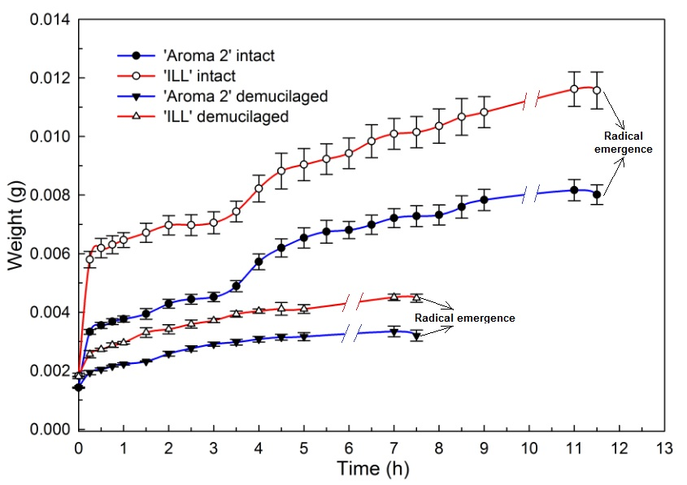
Basil Seed Hydration Time Course
Notes:
Room temperature 21°C, 39% RH
Each cultivar has 4 republications of 50 seeds each

Slide 12
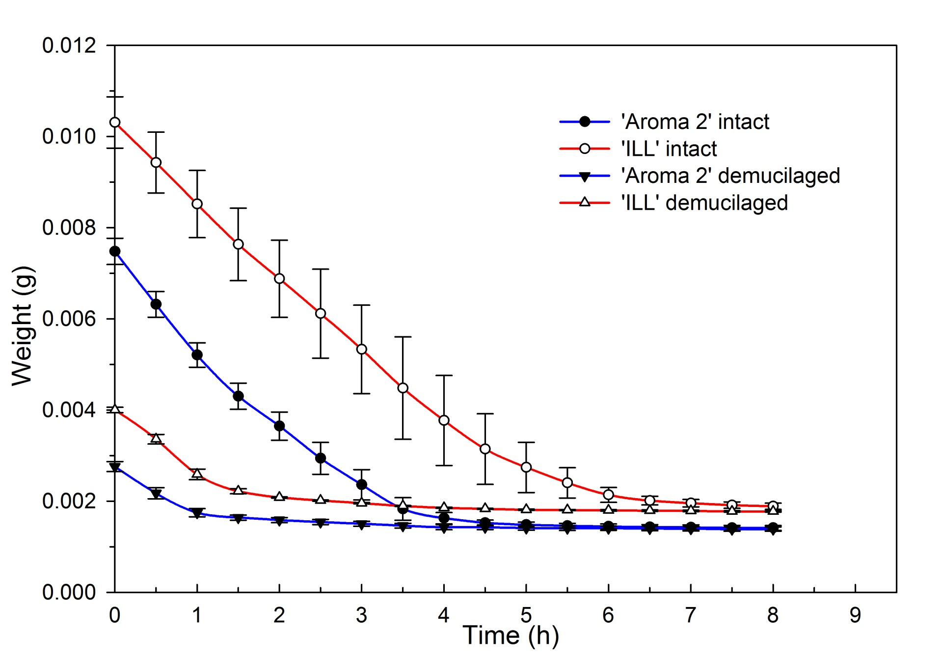
Basil Seed Dehydration Time Course
Notes:
Dryer in 103°C
Each cultivar has 4 republications of 50 seeds each

Slide 13
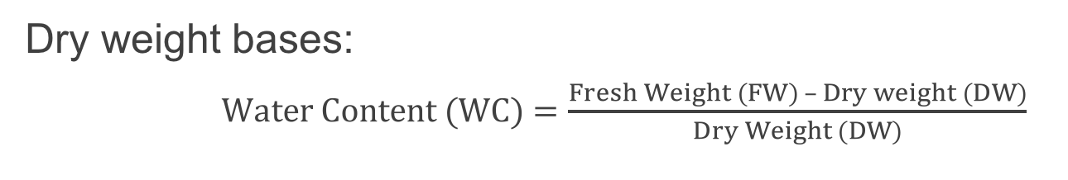
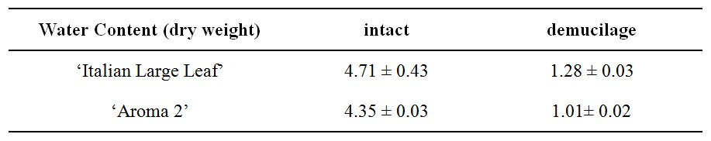
Water Content
* 4 replications of 50 seeds each.

Slide 14
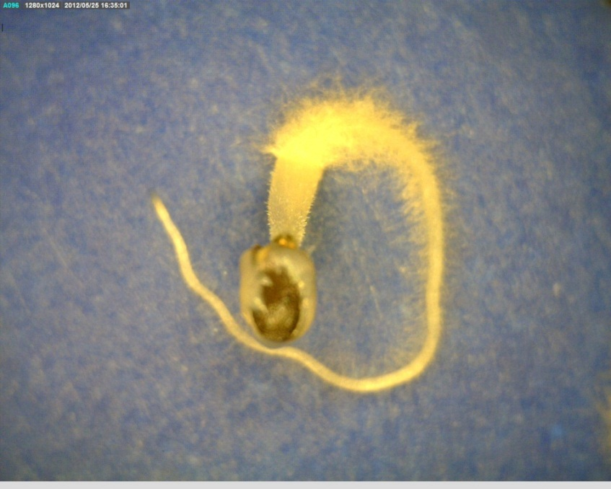
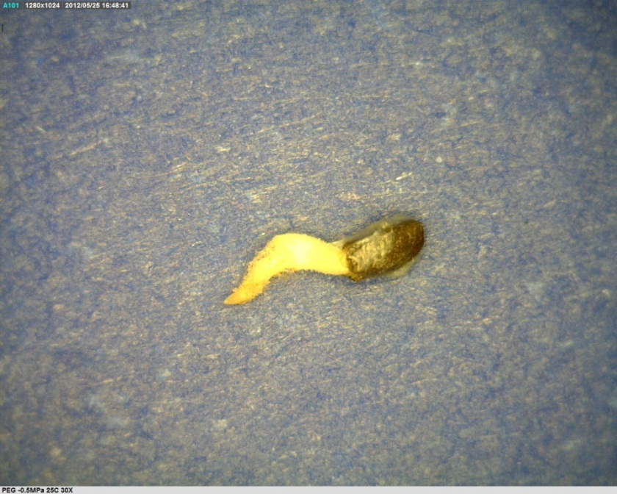
Basil Germination on PEG Solutions
PEG -0.25MPa, 25°C, 4 days
PEG -0.5MPa, 25°C, 4 days
A
B
Greater inhibition of mucilage formation at the lower water potential.
The water potential of the mucilage is approximately -0.25 Mpa
  Because some mucilage production occurs at this level of hydration
  But complete production is still not possible.

Slide 15
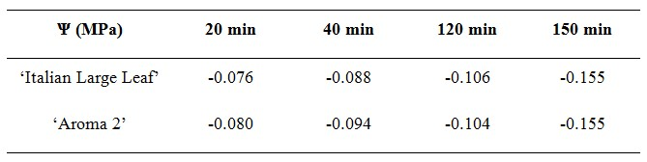
Osmotic Pressure of Basil Seed Mucilage at 25°C
The direct measurements of mucilage water potential by osmometry which for fully imbibed seeds was approximately -0.2 MPa.
Consistent with the observation of PEG (approximately -0.25 Mpa).
Water potential of the mucilage approached 0 MPa suggesting that the water was loosely bound and readily available to drive expansive growth of the germinating seedling.

Slide 16
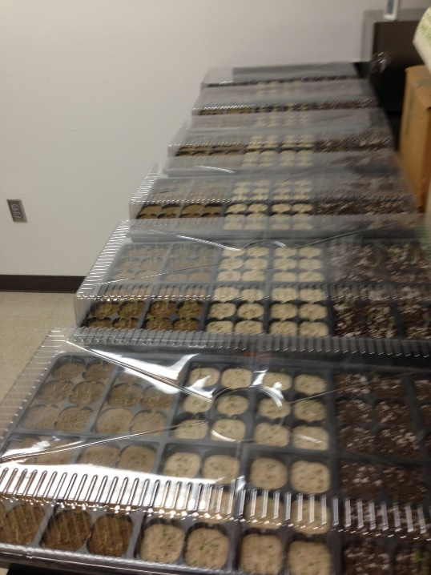
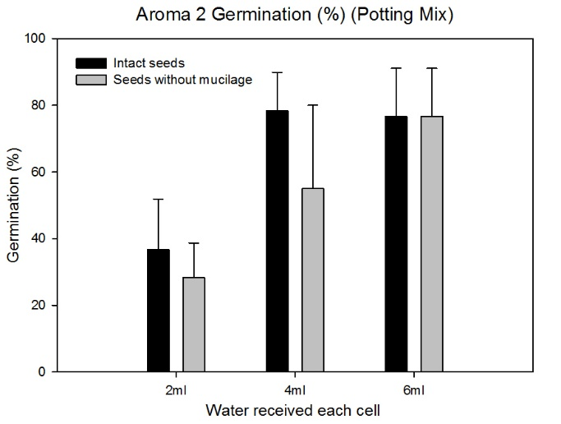
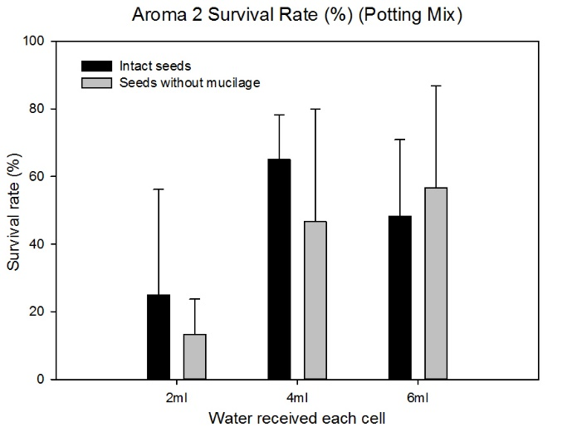
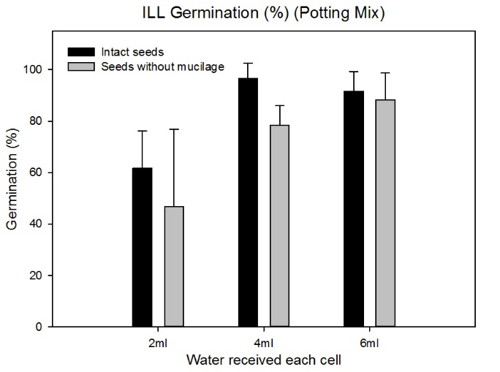
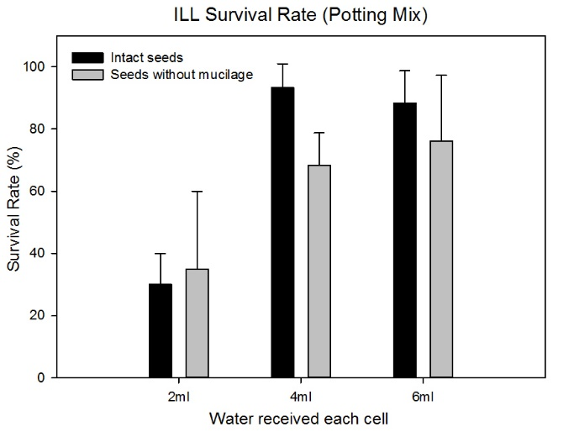
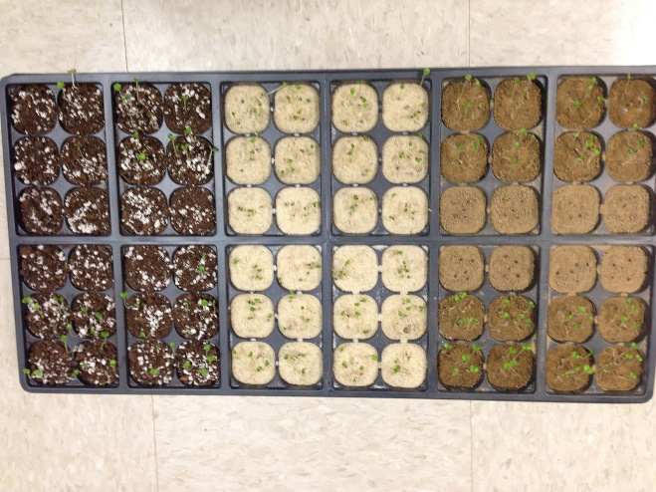
Soil (media) Test

Slide 17
Production and Function of Basil Seed Mucilage
The mucilage expands very rapidly in water especially during the first 20 minutes of hydration.
The mucilage is hydrophilic; the water potential of fully hydrated seeds approached zero water potential, so the mucilage acts as a reservoir of loosely bound water that can drive expansive growth of young seedlings in dry environments.
Intact basil seeds had almost 4 times water content than the seeds without mucilage so a primary function of the mucilage is as a water reservoir to help seeds to germinate and seedlings to grow as well as the seedling survival percentage.

Slide 18
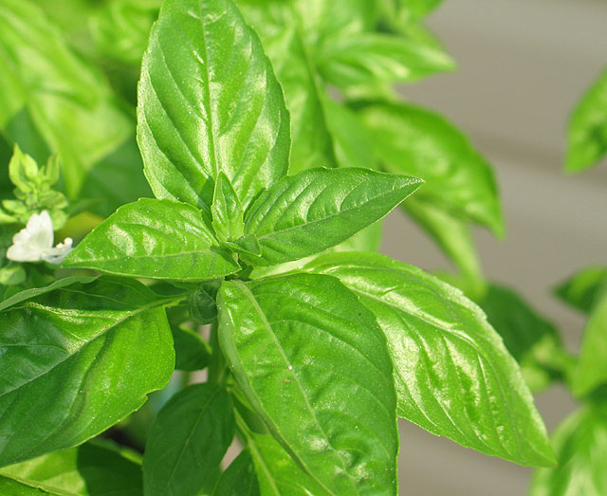
Questions

