Slide 1
Using Student Perceptions of Readiness to Improve Course Content in an Educational Leadership Program
Michael Kelly, Ed. D.
Virginia Tech

Slide 2
Introduction
Reason for the study
Program information

Slide 3
Reason for the Study
Accreditation Agencies and Standards
Council for the Accreditation of Educator Preparation (CAEP)
University Council for Educational Administration (UCEA)
Interstate School Leaders Licensure Consortium/Educational Leadership Constituent Council (ISLLC/ELCC)

Slide 4
CAEP-Advancing Excellence in Educator Prep Programs
Three CAEP standards buttress the importance of this study. Pertinent CAEP “Advanced Program Components” are as follows:
Satisfaction of Completers 4.4: The provider demonstrates, using measures that result in valid and reliable data, that advanced program completers perceive their preparation as relevant to the responsibilities they confront on the job, and that the preparation was effective.
Quality and Strategic Evaluation 5.1: The provider’s quality assurance system is comprised of multiple measures that can monitor advanced program candidate progress, advanced completer achievements, and provider operational effectiveness. Evidence demonstrates that the provider satisfies all CAEP standards.
Continuous Improvement 5.3: The provider regularly and systematically assesses performance against its goals and relevant standards, tracks results over time, tests innovations and the effects of selection criteria on subsequent progress and completion, and uses results to improve program elements and processes (CAEP, 2015).

Slide 5
UCEA Institutional and Program Quality Criteria
Two UCEA standards also highlight the need of this study. Pertinent UCEA standards are as follows:
1.Evidence of significant efforts by faculty members to identify, develop, and promote relevant knowledge of best practices focused on the essential problems of schooling, leadership, and administration.
6. Evidence that the preparation program engages in ongoing programmatic evaluation and enhancement.

Slide 6
Interstate School Leaders Licensure Consortium (ISLLC) Standards
The new DRAFT (June 2015) ISLLC Standards formed the foundation for the creation of the program internship objectives. ELCC standards will be created after the ISLLC standards are approved in November. The seven standards are:
1. Build a shared vision of student success and well-being.
2. Champion and support instruction and assessment that maximizes student learning and achievement.
3. Manage and develop staff members’ professional skills and practices in order to drive student learning and achievement.
4. Cultivate a caring and inclusive school community dedicated to student learning, academic success and the personal well-being of every student.
5. Coordinate resources, time, structures and roles effectively to build the instructional capacity of teachers and other staff.
6. Engage families and the outside community to promote and support student success.
7. Administer and manage operations efficiently and effectively.

Slide 7
Methodology
There were two phases to this study:
Establish validity and reliability of the instrument
Determine areas of focus for the cohort of students in future courses

Slide 8
Methodology – Phase One
Instrument
Internship objectives
Likert scale
Sections (6)
Population
Locations
Students

Slide 9
Methodology – Phase One
Validity
Faculty review
Panel of experts
Reliability
Cronbach’s Alpha
Section then whole
George and Mallery (2003) provide the following rules of thumb: “_ > .9 – Excellent, _ > .8 – Good, _ > .7 – Acceptable, _ > .6 – Questionable, _ > .5 – Poor, and_ < .5 – Unacceptable” (p. 231).
Section then whole
Data collection and analysis

Slide 10
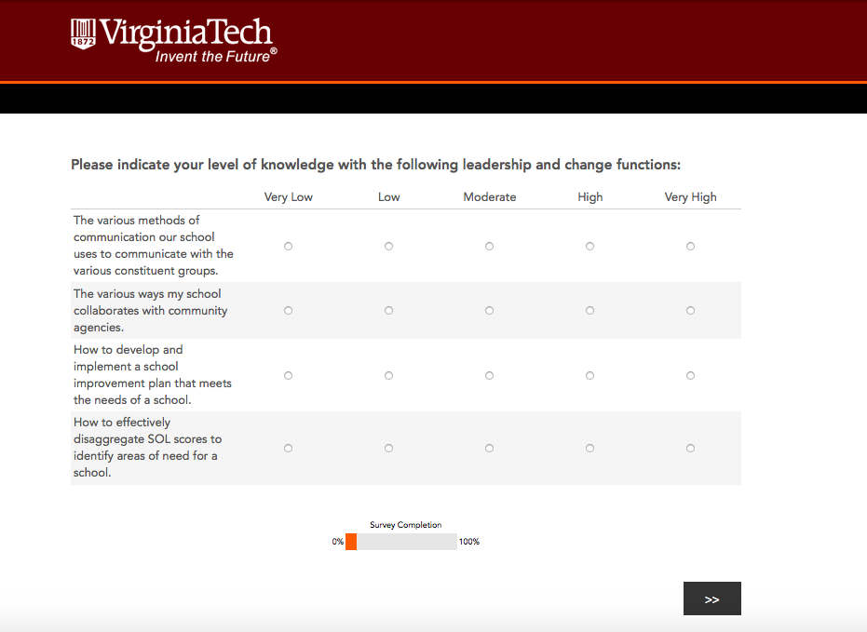
Sample Survey Question

Slide 11
Survey Questions
Knowledge of leadership and change functions
The various methods of communication our school uses to communicate with the various constituent groups.
The various ways my school collaborates with community agencies.
How to develop and implement a school improvement plan that meets the needs of a school.
How to effectively disaggregate SOL scores to identify areas of need for a school.

Slide 12
Findings – Phase One
Knowledge of leadership and change functions
Case Processing Summary |  | N | %
Cases | Valid | 48 | 94.1
 | Excludedª | 3 | 5.9
 | Total | 51 | 100.0
Cronbach's Alpha | N of Items
.632 | 4

Slide 13
Survey Questions
Knowledge of curriculum and instructional supervision
The process used by the school system to develop curriculum, pacing charts, and scope and sequence guides.
The process used by the school system to adopt textbooks and other instructional materials.
The instructional technology needs of the faculty and district or school staff.
The process of how to develop a master schedule in a school.

Slide 14
Findings – Phase One
Knowledge of curriculum and instructional supervision
Case Processing Summary |  | N | %
Cases | Valid | 48 | 94.1
 | Excludedª | 3 | 5.9
 | Total | 51 | 100.0
Cronbach's Alpha | N of Items
.872 | 4

Slide 15
Survey Questions
Knowledge of student services
The process my school system uses for identifying and providing services for students with disabilities.
The policies and procedures required for meeting the needs of students identified under the Section 504 of the Vocational Rehabilitation Act of 1973.
The process my school uses to identify students considered at-risk.
The process an administrator must follow when handling student discipline situations.

Slide 16
Findings – Phase One
Knowledge of student services
Case Processing Summary |  | N | %
Cases | Valid | 48 | 94.1
 | Excludedª | 3 | 5.9
 | Total | 51 | 100.0
Cronbach's Alpha | N of Items
.804 | 4

Slide 17
Survey Questions
Knowledge of school system operations
My school system's accounting procedures, the monthly financial statements, and the annual financial audit.
The budget process and timeline used by the central office each year to develop the school system budget.
The budget process and timeline used by my principal each year to develop the school budget.
The requirements for conducting emergency drills in our school system.

Slide 18
Findings – Phase One
Knowledge of school system operations
Case Processing Summary |  | N | %
Cases | Valid | 48 | 94.1
 | Excludedª | 3 | 5.9
 | Total | 51 | 100.0
Cronbach's Alpha | N of Items
.850 | 4

Slide 19
Survey Questions
Knowledge of school board policies
The process used to develop a school board policy.
The school board’s policy and regulations regarding professional ethics and diversity.
The crisis intervention plan for my school.
The school system's policy for "bring your own device" (BYOD) related to students.

Slide 20
Findings – Phase One
Knowledge of school board policies
Case Processing Summary |  | N | %
Cases | Valid | 48 | 94.1
 | Excludedª | 3 | 5.9
 | Total | 51 | 100.0
Cronbach's Alpha | N of Items
.896 | 4

Slide 21
Survey Questions
Knowledge of human resource functions
How to implement a professional development plan in a school.
The process administrators must go through to conduct teacher observations in my school system.
The process a principal must undergo to place a staff member on a plan of action for improvement.
The process an administrator must follow to screen, interview and hire new faculty and staff members.

Slide 22
Findings – Phase One
Knowledge of human resource functions
Case Processing Summary |  | N | %
Cases | Valid | 48 | 94.1
 | Excludedª | 3 | 5.9
 | Total | 51 | 100.0
Cronbach's Alpha | N of Items
.627 | 4

Slide 23
Findings – Phase One
Reliability of complete survey instrument
Case Processing Summary |  | N | %
Cases | Valid | 48 | 94.1
 | Excludedª | 3 | 5.9
 | Total | 51 | 100.0
Cronbach's Alpha | N of Items
.927 | 24

Slide 24
Methodology – Phase Two
Descriptive Statistics
Means
Medians
Analyzed by
Section Means
Section Outliers

Slide 25
Findings – Phase Two
Analysis of Section Means
Both the means and the medians indicate lower levels of student perceived knowledge in the areas of School Operations and School Board Policies
 | Leadership | Instruction | Services | Operations | Board | HR
Mean | 3.1198 | 2.9479 | 2.9635 | 2.1563 | 2.5313 | 2.6771
N | 48 | 48 | 48 | 48 | 48 | 48
Std. Deviation | .60799 | .77177 | .75087 | .79330 | .73410 | .88269
Median | 3.0000 | 2.7500 | 3.0000 | 2.2500 | 2.6250 | 3.0000

Slide 26
Findings – Phase Two
Knowledge of leadership and change functions
All items in the area of leadership had consistent responses from students, with an overall mean of 3.11. There is no specific area of focus for this group.
 | Q1 | Q2 | Q3 | Q4
Mean | 3.17 | 3.08 | 2.98 | 3.25
N | 48 | 48 | 48 | 48
Std. Deviation | .883 | .767 | .887 | .978
Median | 3.00 | 3.00 | 3.00 | 3.00

Slide 27
Findings – Phase Two
Knowledge of curriculum and instructional supervision
Item 8 was an outlier in the area of Curriculum and Instruction
With a mean of 2.66, students indicated a lower level of knowledge with the process of how to develop a master schedule in a school.
 | Q5 | Q6 | Q7 | Q8
Mean | 2.96 | 2.88 | 3.29 | 2.67
N | 48 | 48 | 48 | 48
Std. Deviation | .922 | .981 | .967 | 1.018
Median | 3.00 | 3.00 | 3.00 | 3.00

Slide 28
Findings – Phase Two
Knowledge of student services
All items in the area of student services had consistent responses from students, with an overall mean of 2.96. There is no specific area of focus for this group.
 | Q9 | Q10 | Q11 | Q12
Mean | 3.17 | 2.83 | 2.94 | 2.92
N | 48 | 48 | 48 | 48
Std. Deviation | .859 | .953 | .976 | .821
Median | 3.00 | 3.00 | 3.00 | 3.00

Slide 29
Findings – Phase Two
Knowledge of school system operations
Items 13, 14 and 15 were outliers in the area of school system operations.
With a mean of 1.88, students indicated a lower level of knowledge with the school system's accounting procedures and the monthly financial statements
With a mean of 1.90, students indicated a lower level of knowledge with the budget process and timeline used by the central office each year to develop the school system budget
With a mean of 2.02, students indicated a lower level of knowledge with the budget process and timeline used by my principal each year to develop the school budget
 | Q13 | Q14 | Q15 | Q16
Mean | 1.88 | 1.90 | 2.02 | 2.83
N | 48 | 48 | 48 | 48
Std. Deviation | .841 | .905 | .934 | .953
Median | 2.00 | 2.00 | 2.00 | 3.00

Slide 30
Findings – Phase Two
Knowledge of school board policies
Items 17 and 18 were outliers in the area of school board policies.
With a mean of 1.77, students indicated a lower level of knowledge with the process used to develop a school board policy
With a mean of 2.38, students indicated a lower level of knowledge with the school board’s policy and regulations regarding professional ethics and diversity
 | Q17 | Q18 | Q19 | Q20
Mean | 1.77 | 2.38 | 3.02 | 2.96
N | 48 | 48 | 48 | 48
Std. Deviation | .881 | .959 | 1.101 | 1.288
Median | 2.00 | 2.00 | 3.00 | 3.00

Slide 31
Findings – Phase Two
Knowledge of human resource functions
Item 23 was an outlier in the area of Human Resources
With a mean of 2.17, students indicated a lower level of knowledge with the process a principal must undergo to place a staff member on a plan of action
 | Q21 | Q22 | Q23 | Q24
Mean | 2.73 | 3.19 | 2.17 | 2.63
N | 48 | 48 | 48 | 48
Std. Deviation | 1.106 | 1.085 | .996 | .959
Median | 3.00 | 3.00 | 2.00 | 3.00

Slide 32
Conclusions and Future Study
Conclusions
Validity and Reliability
Areas of focus for instruction

Slide 33
Conclusions and Future Study
Conclusions
Validity and Reliability
Found the instrument to contain both face and content validity
Though there were two of six areas in the study that had low alpha (.632 and .627) The instrument overall had a strong alpha (.927) and as such feel confident in its reliability

Slide 34
Conclusions and Future Study
Conclusions
Areas of focus for instruction
All six areas will be part of the main instructional program
Two areas will be emphasized by faculty
School Board Policies
School Operations

Slide 35
Conclusions and Future Study
Conclusions
Areas of focus for instruction
In addition, emphasis will be placed in courses addressing the following:
Developing a master schedule
Dealing with financial statements
Developing a school system budget process
Developing a school site budget process
Developing school board policies
Working with diversity from an administrative perspective
Placing staff on a plan of action

Slide 36
Conclusions and Future Study
Future Study
Low n value
Qualitative study of faculty implementation
Study upon program completion

Slide 37
Questions and Close
Michael Kelly, Ed. D.
michk66@vt.edu

