Slide 1




The IMPOWR (Improving the Mapping and Prediction of Offshore Wind Resources) project: Evaluation of WRF PBL Schemes
Brian A. Colle and Matthew J. Sienkiewicz
School of Marine and Atmospheric Sciences, Stony Brook University
Cristina Archer and Dana Veron
College of Earth, Ocean, and Environment, University of Delaware
NAWEA, 2015

Slide 2
Motivation
Extraordinary offshore wind resource with seasonal variability;
Current offshore wind maps were constructed using limited/no observations at turbine hub height;
No information on the uncertainty of offshore wind maps is available;
GOAL: Provide a comprehensive Planetary Boundary Layer (PBL) verification over southern New England coastal waters, as well as some possible improvements to the PBL parameterizations using ensemble modeling.
Winter
Spring
Summer
Fall
Modeled seasonal daytime offshore wind resource at 90 m as capacity factor of 5MW REpower (Dvorak et al. 2012)

Slide 3
Research Questions
What are the systematic errors (biases) of the WRF Planetary Boundary Layer (PBL) schemes in wind speed and temperature in the region, and how do these biases vary diurnally and seasonally?
What is the climatology of the observed low-level stability (around 20-m) diurnally and seasonally?
How well does WRF simulate low-level jet and stability structures observed using field data over coastal southern New England?

Slide 4
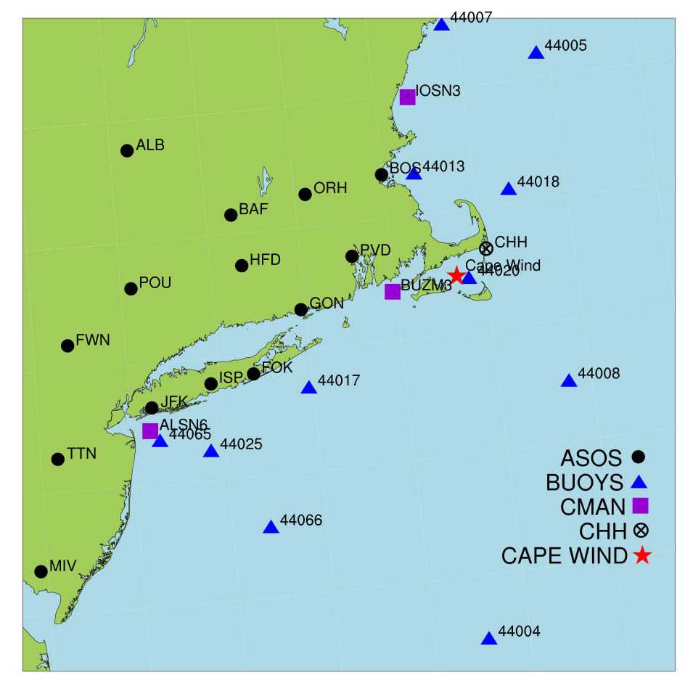
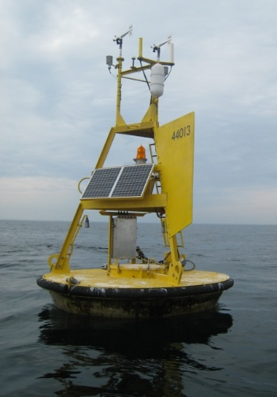
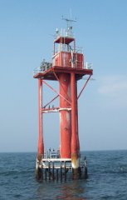
Historical observational datasets: Conventional data
11 NDBC Moored Buoys
3 NDBC C-MAN Stations
14 NWS ASOS Stations
Notes:
Point out CW and 44020 (how close they are, but 44020 was installed in 2009)

Slide 5
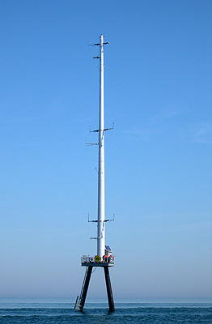
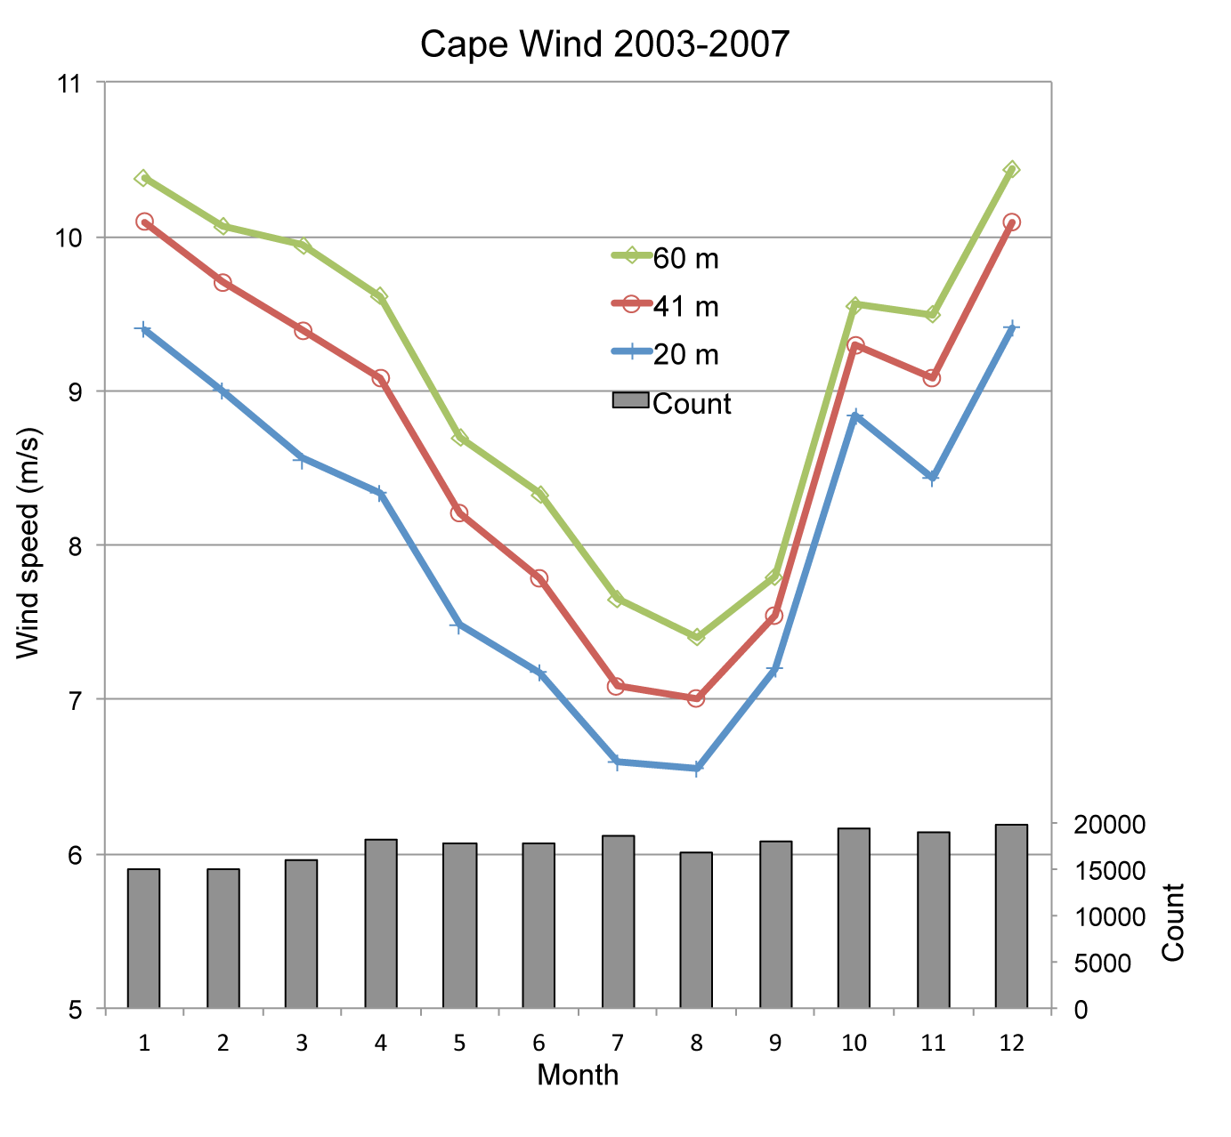
Historical observational datasets: Cape Wind (CW) tower
Multi-level wind and temperature;
Nine years of data (2003 – 2011, but only 2003 - 2007 complete).
60 meters
55 meters
Temperature, Pressure
41 meters
Wind speed, direction
20 meters
10 meters

Slide 6
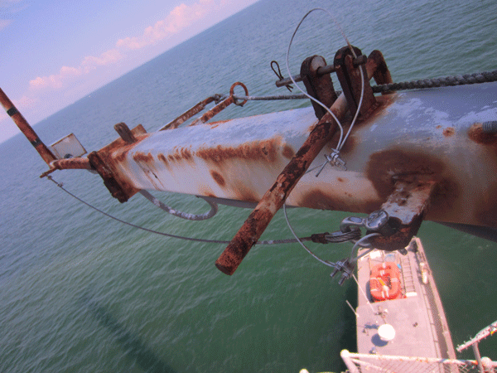
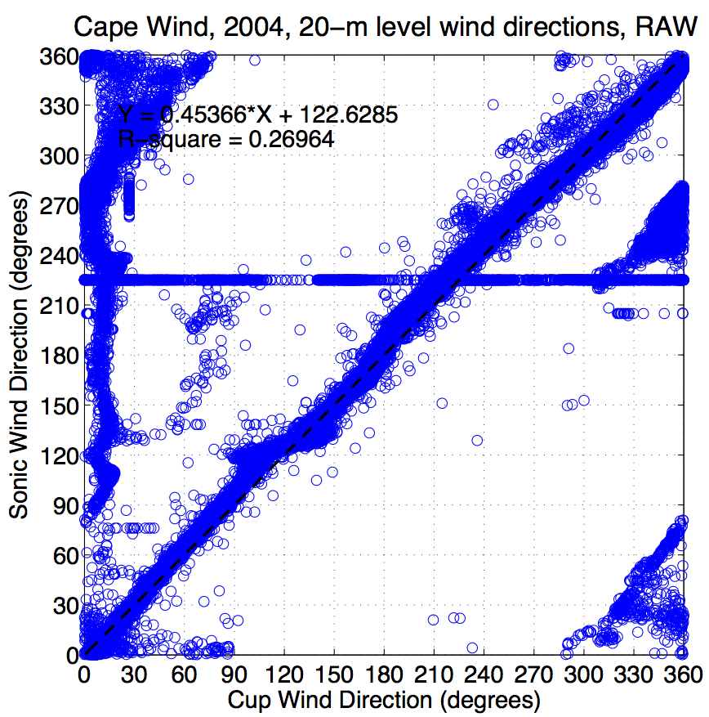
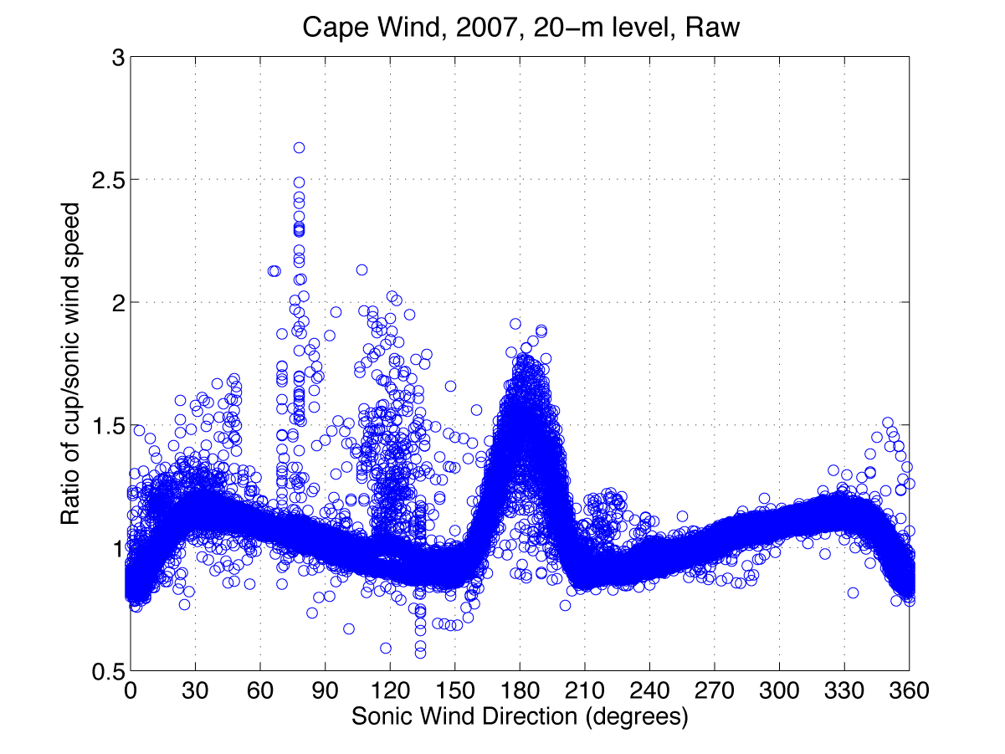
Historical observational datasets: Cape Wind (CW) tower issues
Original plan to instrument upper arms of tower with new instruments was not safe;
IMPOWR instruments only added on platform (10 m);
Lots of data quality issues.

Slide 7
WRF ensemble modeling: Six PBL schemes
Scheme | Turbulence Closure Order | Surface Layer Scheme | Summary
YSU | 1.0 | MM5 | Non-local-K scheme with explicit entrainment layer and parabolic K profile in unstable mixed layer
ACM2 | 1.0 | MM5 | Asymmetric Convective Model with non-local upward mixing and local downward mixing
BouLac | 1.5 | MM5 | Designed for use with BEP (Building Environment Parameterization) urban model
MYJ | 1.5 | MYJ | One-dimensional prognostic turbulent kinetic energy scheme with local vertical mixing
QNSE | 1.5 | QNSE | A TKE-prediction option that uses a new theory for stably stratified regions
MYNN2.5 | 1.5 | MM5 | Predicts sub-grid TKE terms

Slide 8
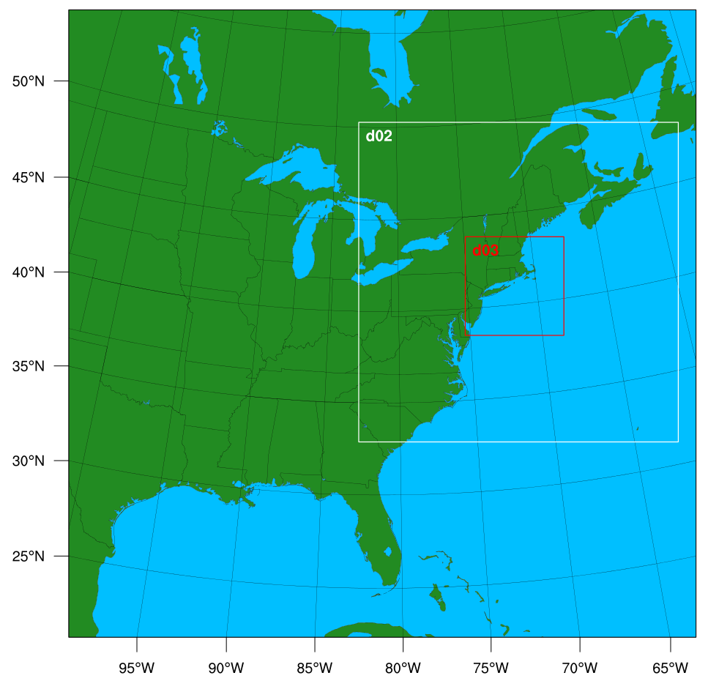
WRF ensemble modeling: Setup
WRF v. 3.4.1;
30-hour simulations;
38 vertical levels;
NARR analyses as IC/BCs;
0.5 RTG SST;
Verification used 4-km domain;
First 6 forecast hours discarded as model spin-up time.

Slide 9
WRF simulation approach for historical study 2003 – 2011
90 model simulation dates randomly and uniformly distributed between 2003 – 2011:
Equally divided between warm season (April – September) and cool season (October – March);
Equally divided between 0000 UTC and 1200 UTC model initialization times;
Verification divided into seasons (warm and cool) as well as diurnal periods:
Day (1200 – 2300 UTC);
Night (0000 – 1100 UTC).

Slide 10
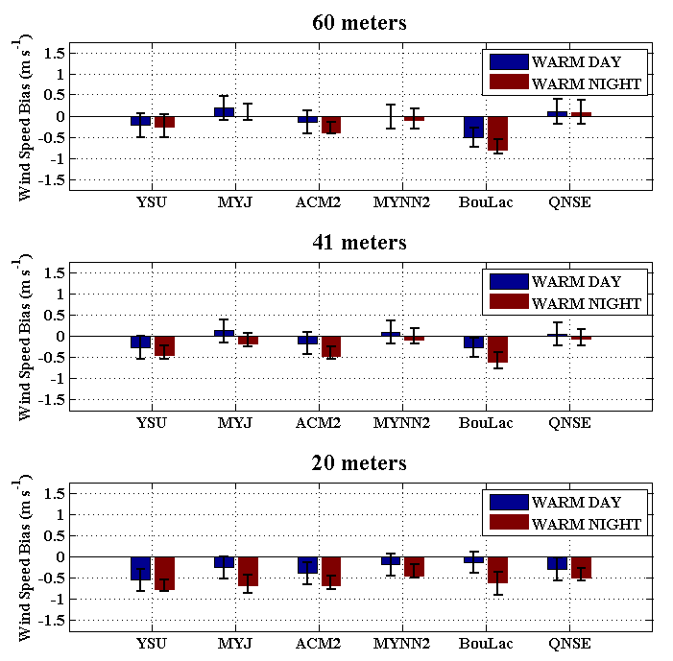
Cape Wind tower mean error: Wind speed – Warm season
MYNN2 and QNSE schemes show smallest ME;
Generally negative ME that decrease in magnitude with height;
BouLac scheme shows largest ME at 60 m;
Note: MAE values for all schemes represent 21 – 22% of wind speed magnitude;
Larger errors at night.
Notes:
Error bars represent bootstrap 95% confidence intervals.

Slide 11
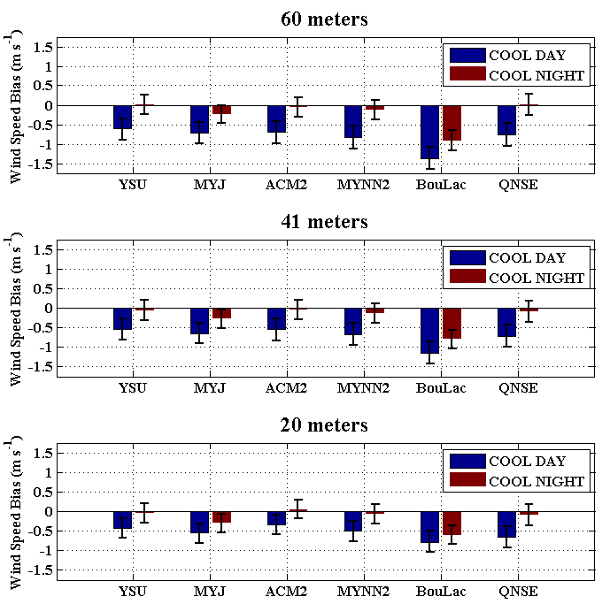
Cape Wind tower mean error: Wind speed – Cool season
Generally negative wind speed ME;
Increase in magnitude with height (opposite of warm season);
Largest for BouLac scheme;
Larger errors during day (opposite of warm season).

Slide 12
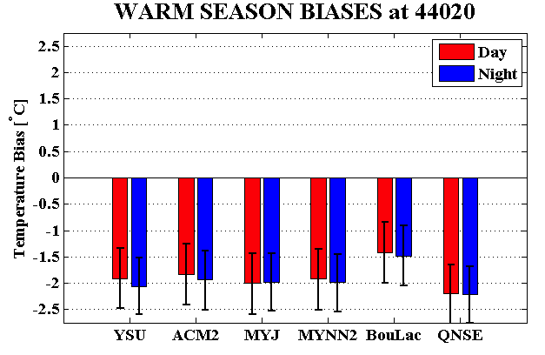
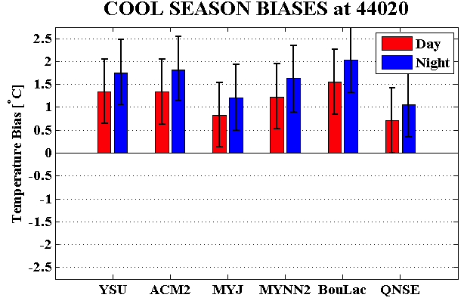
Buoy 44020 5-m mean temperature error
Surface cool bias during the warm season;
Surface warm bias during the cool season;
Possible explanations:
surface heat fluxes are too large in the WRF (not likely, explained later);
SST issue (testing undergoing);
What about atmospheric stability?

Slide 13
Research Questions
What are the systematic errors (biases) of the WRF Planetary Boundary Layer (PBL) schemes in wind speed and temperature in the region, and how do these biases vary diurnally and seasonally?
What is the climatology of the observed low-level stability (around 20-m) diurnally and seasonally?
How well does WRF simulate low-level jet and stability structures observed using field data over coastal southern New England?

Slide 14
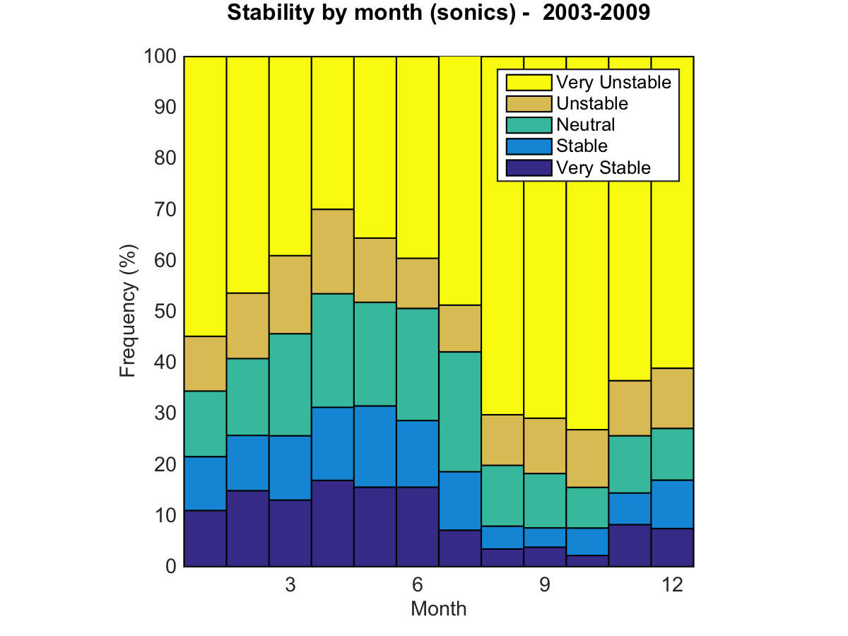
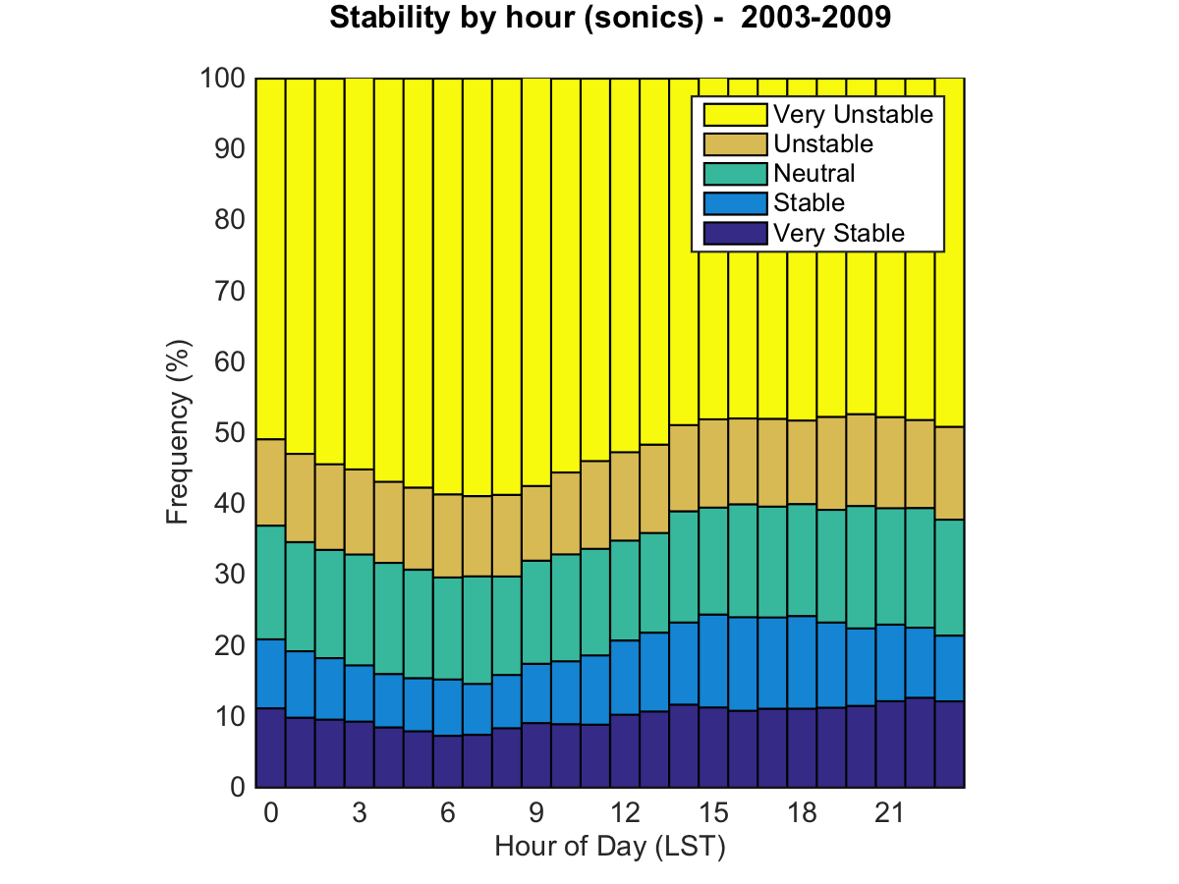
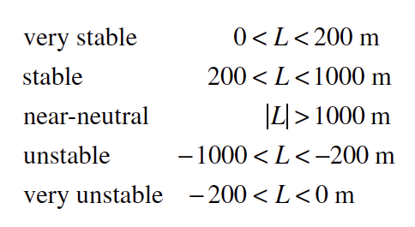
Stability analysis based on historical CW sonic anemometers: unstable conditions dominate
Notes:
Need to compare with WRF calculated L during the selected episodes

Slide 15
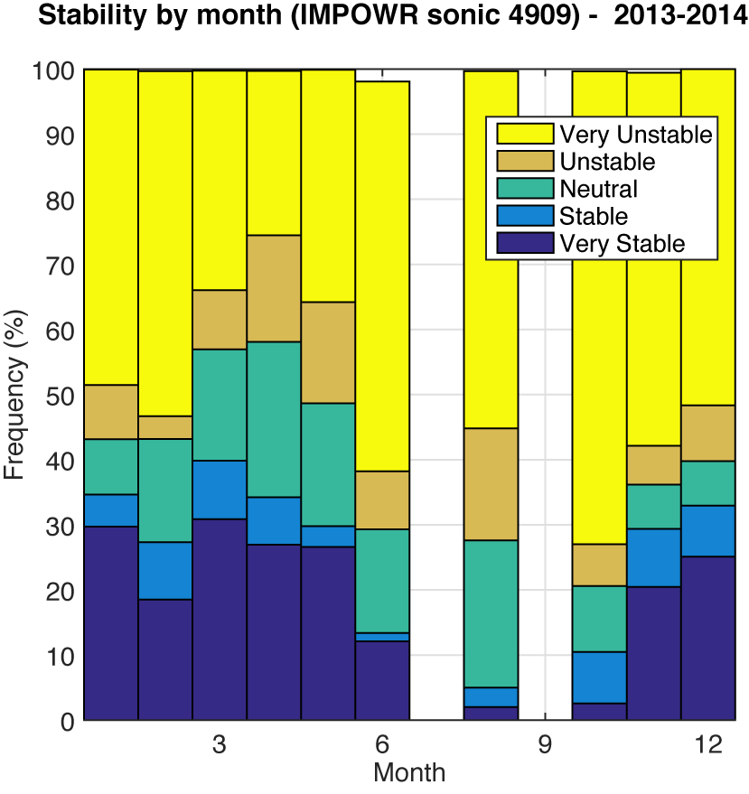
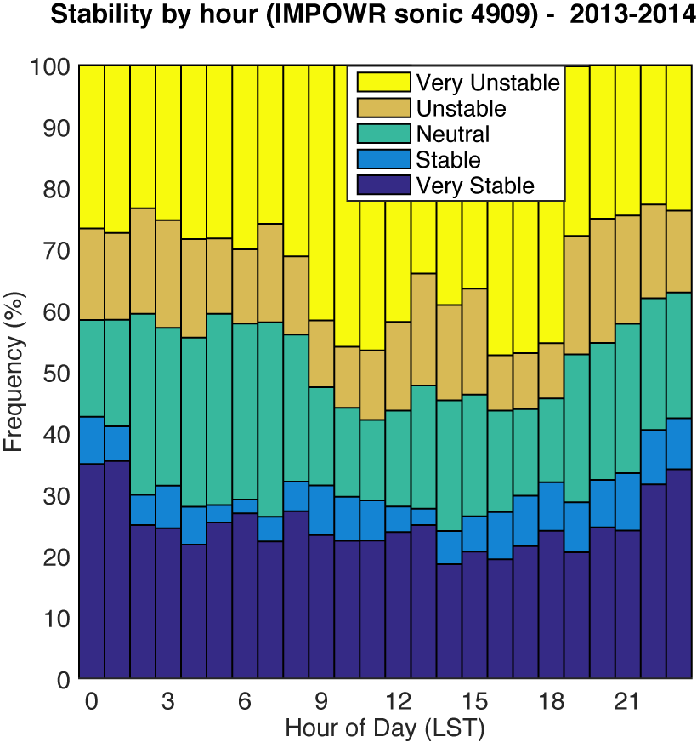
IMPOWR sonics consistent with CW sonics: unstable conditions dominate
Notes:
IMPOWR sonics are up only 6 hours/day in winter

Slide 16
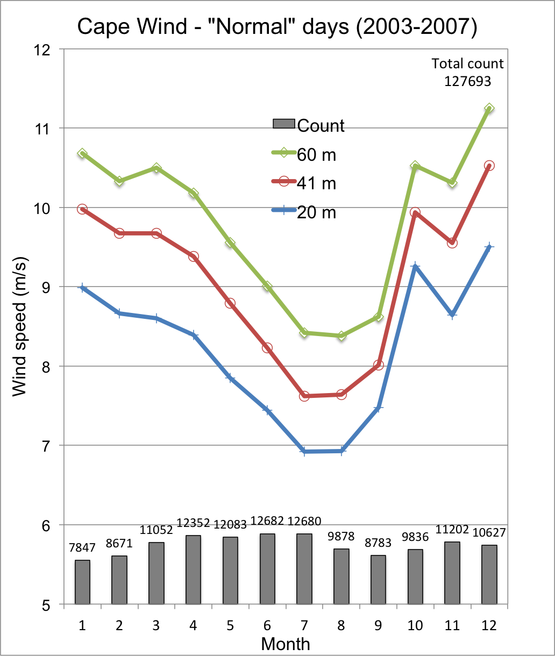
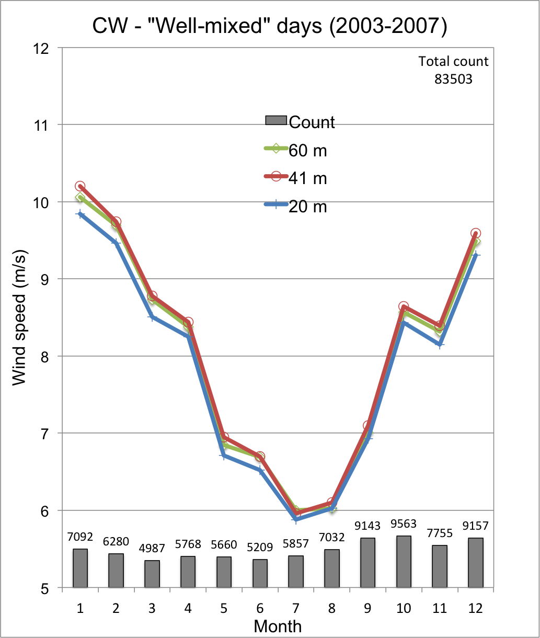
Non-log profiles occur ~40% of the time at CW
V60>V41>V20
All other 8 cases

Slide 17
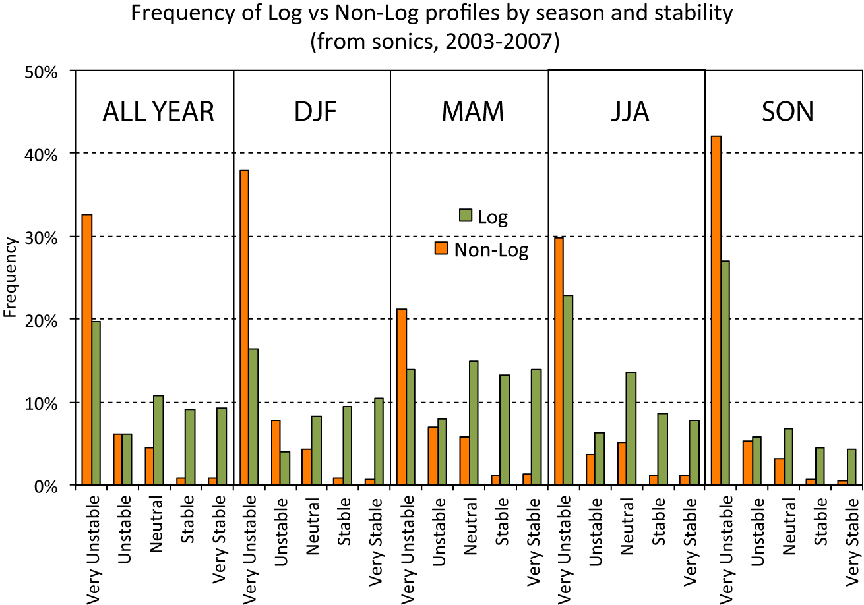
Non-log profiles are associated with unstable conditions

Slide 18
Research Questions
What are the systematic errors (biases) of the WRF Planetary Boundary Layer (PBL) schemes in wind speed and temperature in the region, and how do these biases vary diurnally and seasonally?
What is the climatology of the observed low-level stability (around 20-m) diurnally and seasonally?
How well does WRF simulate low-level jet and stability structures observed using field data over coastal southern New England?

Slide 19
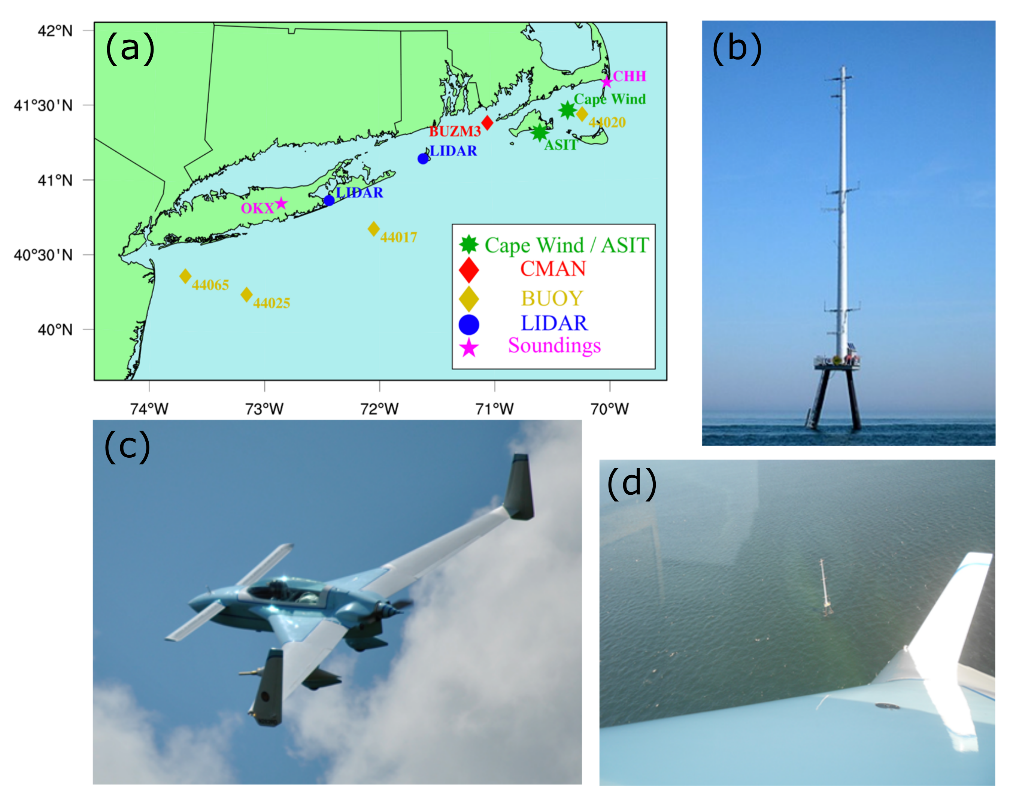
IMPOWR Experiment: Fall 2012 to present

Slide 20

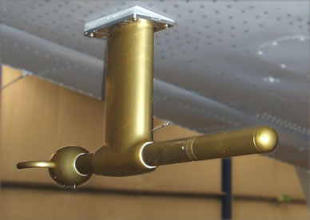
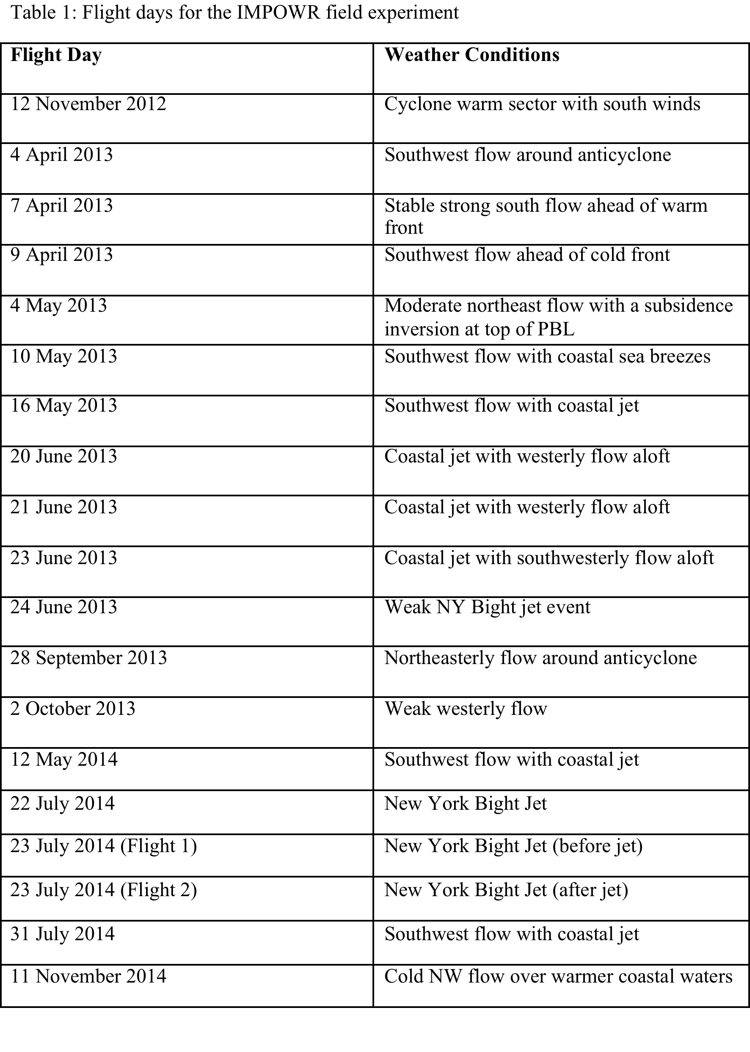
IMPOWR Flights (2012-2014)
AIMMS-20
AIMMS-20 Instrument Up to 40 Hz measurements of 3D winds, temperature, pressure and RH

Slide 21
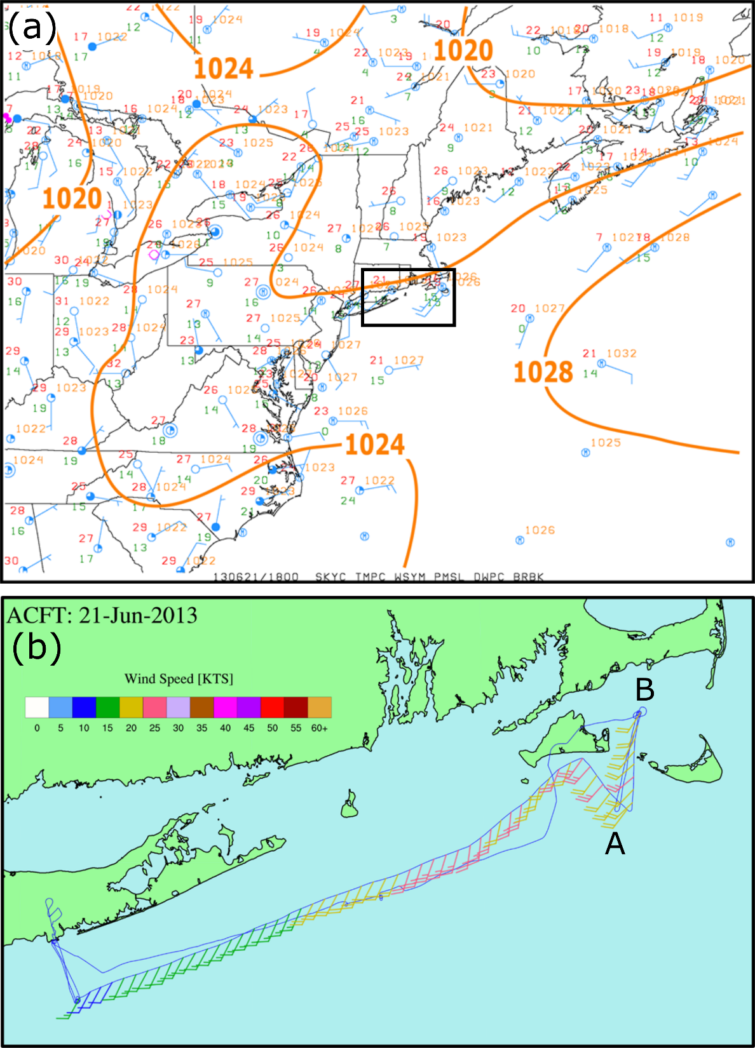
Observations at 1800 UTC 21 June 2013
General SW surface flow around high pressure offshore of New England
Inland surface temps 26-27C, while 20-21C over water
Coastally enhanced 40-50 m winds (20-25 kts) towards Nantucket Island
Surface Analysis
Flight-level winds (kts) 40-50 m ASL

Slide 22
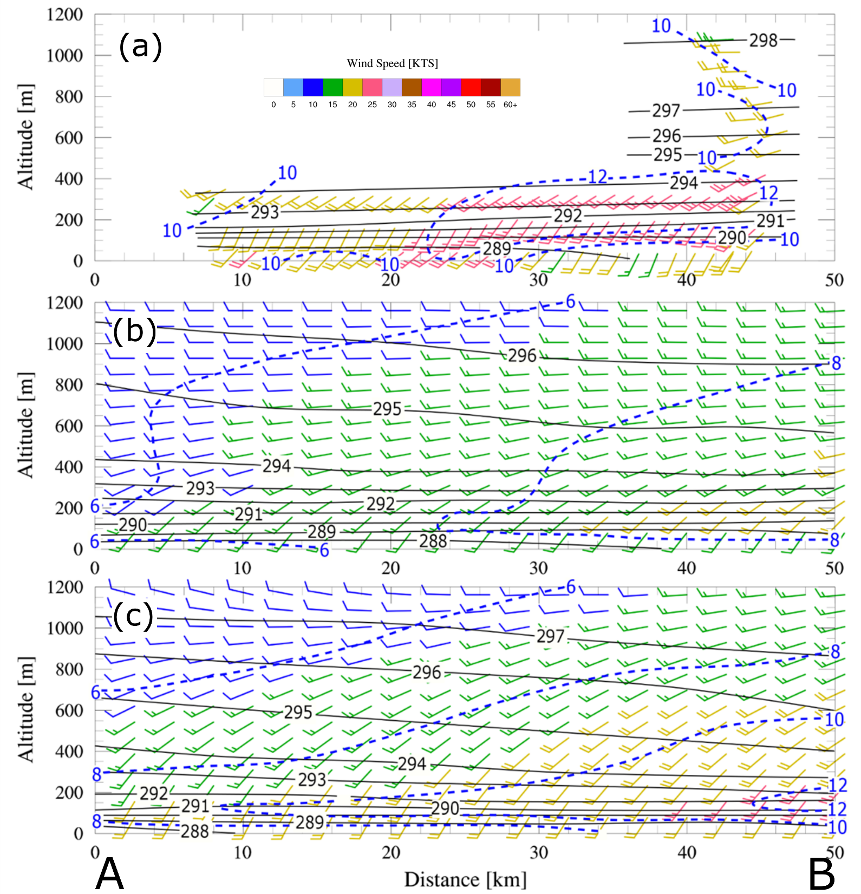
South-North Cross Section Around 1800 UTC 21 June 2013
Flight-level obs
Observed low-level jet to 25 kts below 400 m
1.33-km WRF (YSU PBL) too weak, even a few hours later after more daytime heating.
WRF marine layer is too shallow near coast.
1.33-km WRF (YSU PBL) at 1800 UTC (18-h forecast using RAP IC/BCs)
1.33-km WRF (YSU PBL) at 2100 UTC

Slide 23
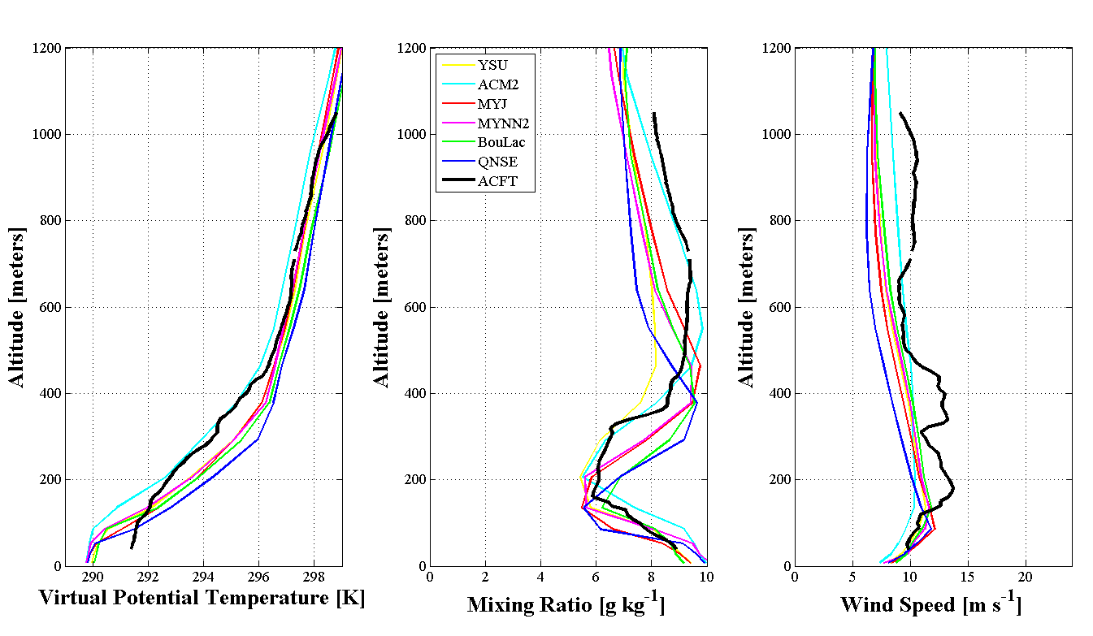
Flight: 1600 – 1900 UTC 21 June 2013 Spiral Around Cape Wind Tower 1925 UTC
ACM2 shows largest MABL depth
14 m s⁻¹
All schemes exhibit shallower / cooler (1 – 2 °C) MABL than observations
Lower wind maximum in models (100 m vs. 190 m)
Schemes underestimate 5-m winds at 44020 (1 – 2 m s⁻¹)

Slide 24
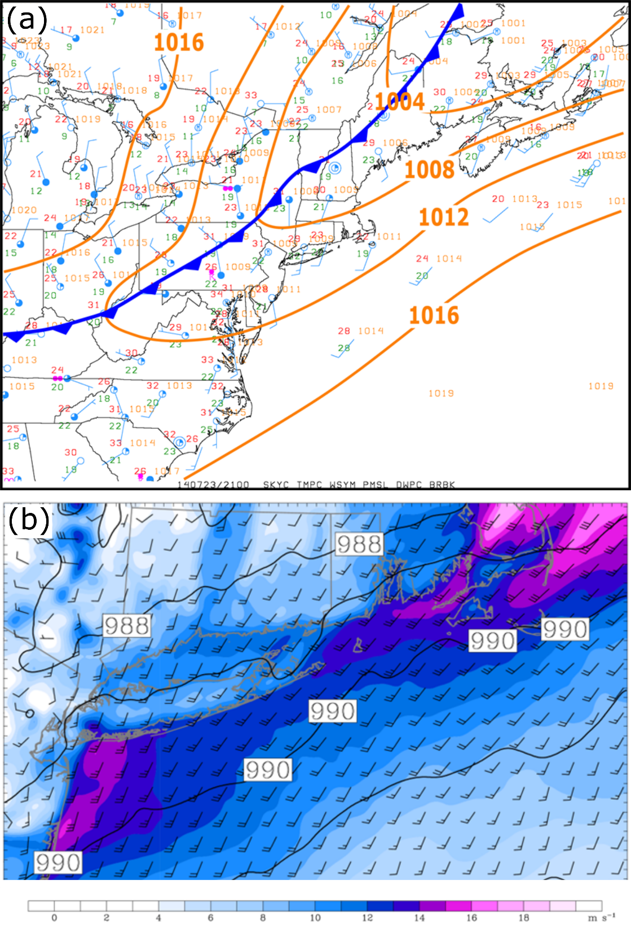
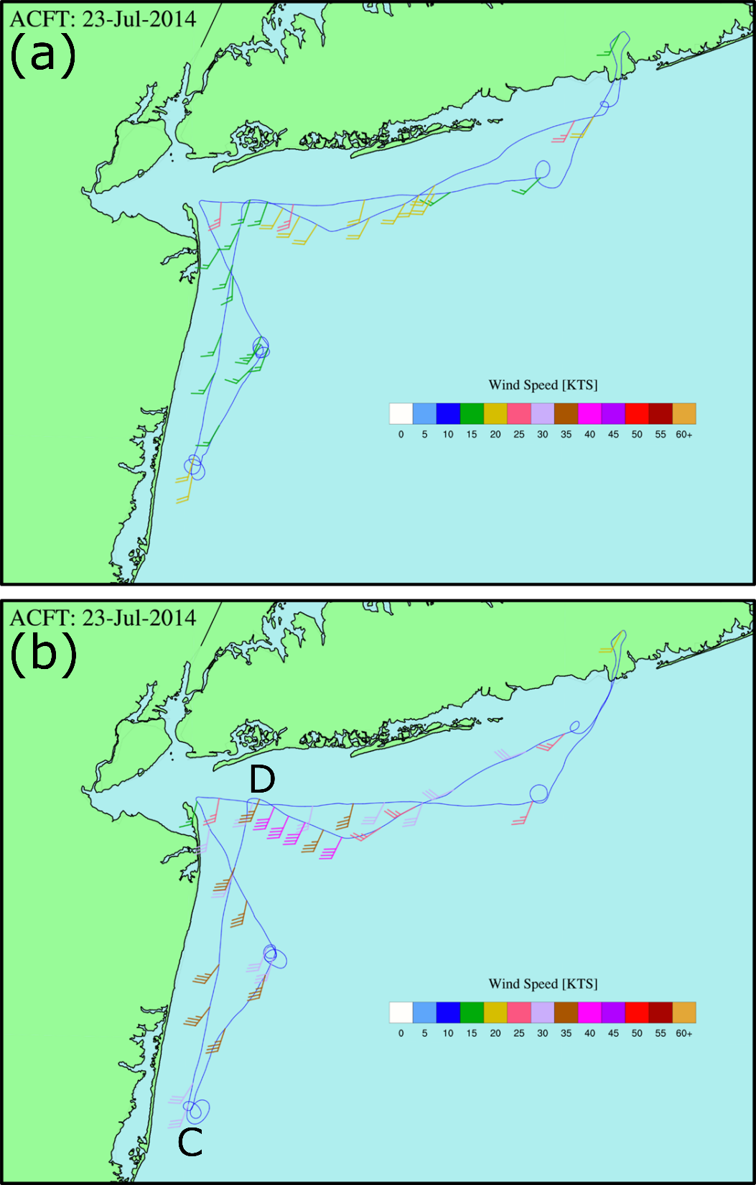
New York Bight Jet 1400-1700 UTC and 2000-2200 UTC 23 July 2014
Observed mid-late AM winds 20-25 kts at 100-225 m
Jet increases to 35-40 kts by 4-6 PM EDT
1.33 WRF (YSU PBL) are 5-10 kts too weak for the jet
Notes:
There were two motivations to keep from my end...: it provided more evidence that the WRF is underpredicting these jets (rather than just the June case), and it highlights unique obs of the NY Bight jet and its surprisingly strong magnitude (tropical storm force winds at 150 m).
The lower left WRF plot is at 180 m at 2100 UTC... It is the same plot as Fig 6 in the BAMS paper, which is there to show the WRF winds are around 30kts, but the obs are around 40kts.

Slide 25
Conclusions
WRF PBL parameterizations consistently underpredict wind speeds at Cape Wind tower at all levels;
WRF near surface temperature at Nantucket Sound buoy is too warm during the cool season and too cool during the warm season. This suggests SST bias in Sound (currently testing) or too large surface fluxes (inconsistent with next findings);
Atmospheric stability at Cape Wind is predominantly unstable based on Monin-Obukhov length from sonic anemometer at 20 m (thus strong mixing and little shear);
IMPOWR observations suggest that:
WRF diurnally-forced low-level jets are too weak during the warm season.
WRF too cool near surface;
PBL is too shallow near coast (e.g., not enough mixing);
Location too complex to verify PBL parameterizations.
Notes:
One could summarize with some concerns how representative this CW location is for PBL understanding/verification over the shelf region given the large diurnal SSTs, lack of waves in the Bay, and potential island wake effects (CW is very complex!!). We need more obs over the shelf itself.. perhaps that Chesapeake tower site will help, but that region has a different climo than southern New England coastal areas…

Slide 26
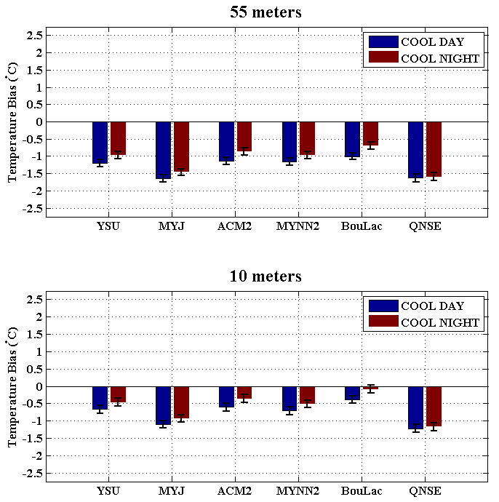
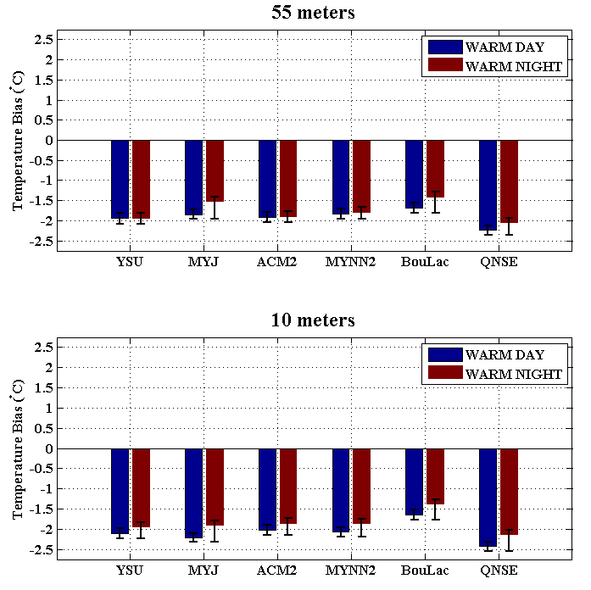
CW temperature sensors are suspicious: 1) Inconsistent T errors in cool season

Slide 27
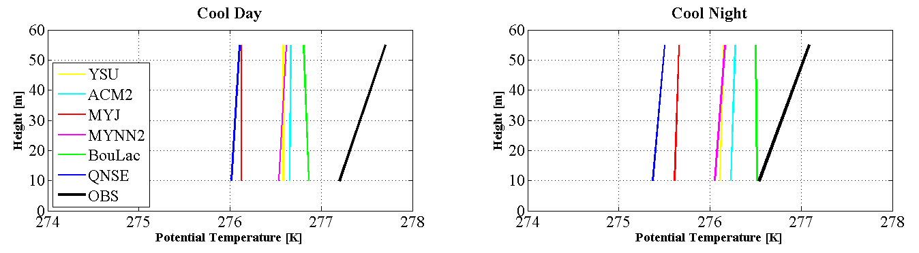
CW temperature sensors are suspicious: 2) Unrealistic stable conditions dominate in cool season (and all year)

Slide 28
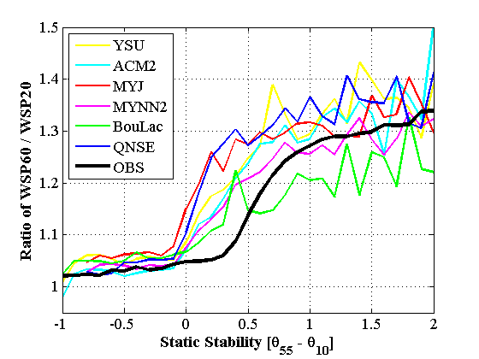
CW temperature sensors are suspicious: 3) Wrong link between stability and shear
←?→

