Slide 1
Stream Field
Final Project Presentation
CS 4624 Multimedia, Hypertext, and Information Access
May 2, 2017
Virginia Polytechnic Institute and State University
Blacksburg, VA, 24061
Jazmine Zurita, Kevin Duong, Yongjoo Ha, Stephen Bologna-Jill, Tinsaye Sume, Ryan Smith

Slide 2
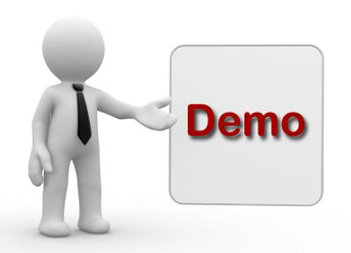

Demo
http://midches.com/images/uploads/default/demo.jpg

Slide 3
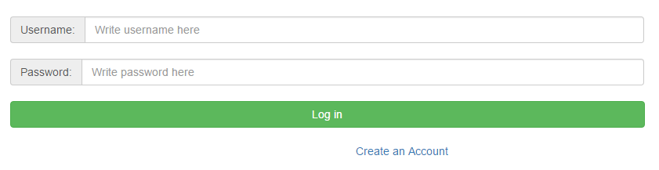
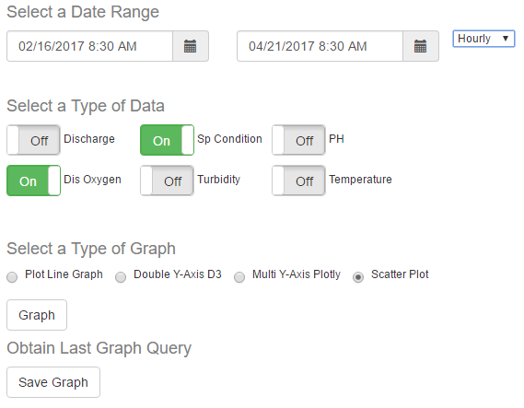
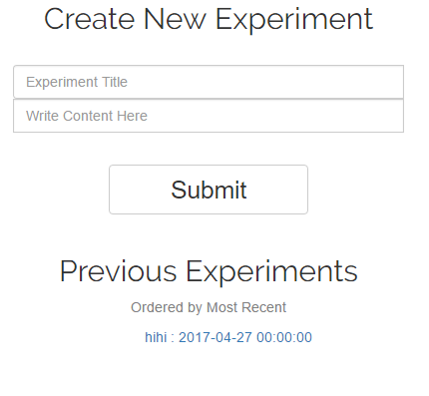
Demo (cont.)

Slide 4
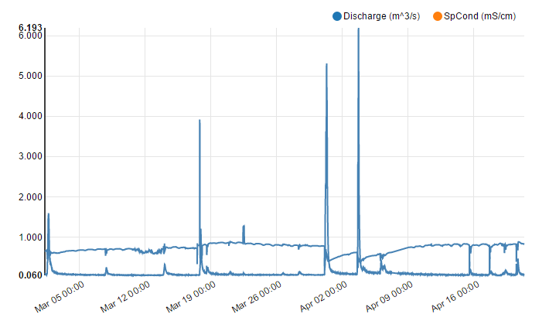
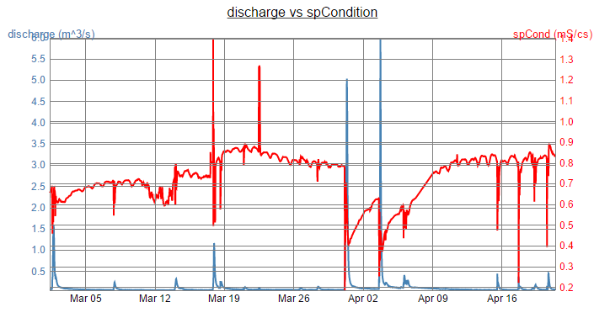
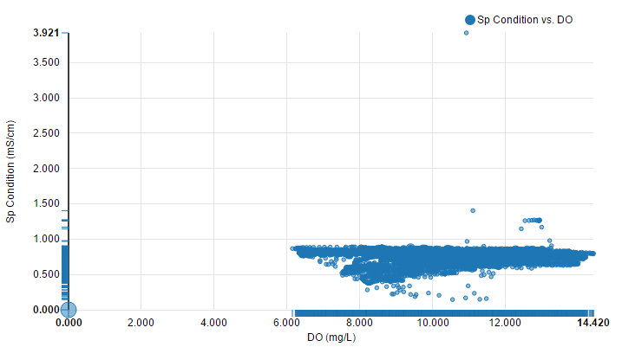
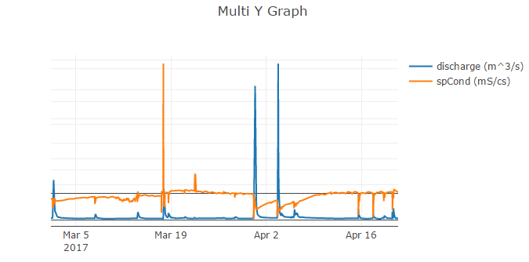
Demo (cont.)

Slide 5
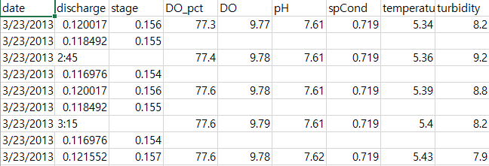
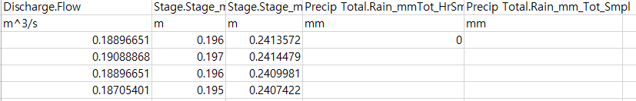
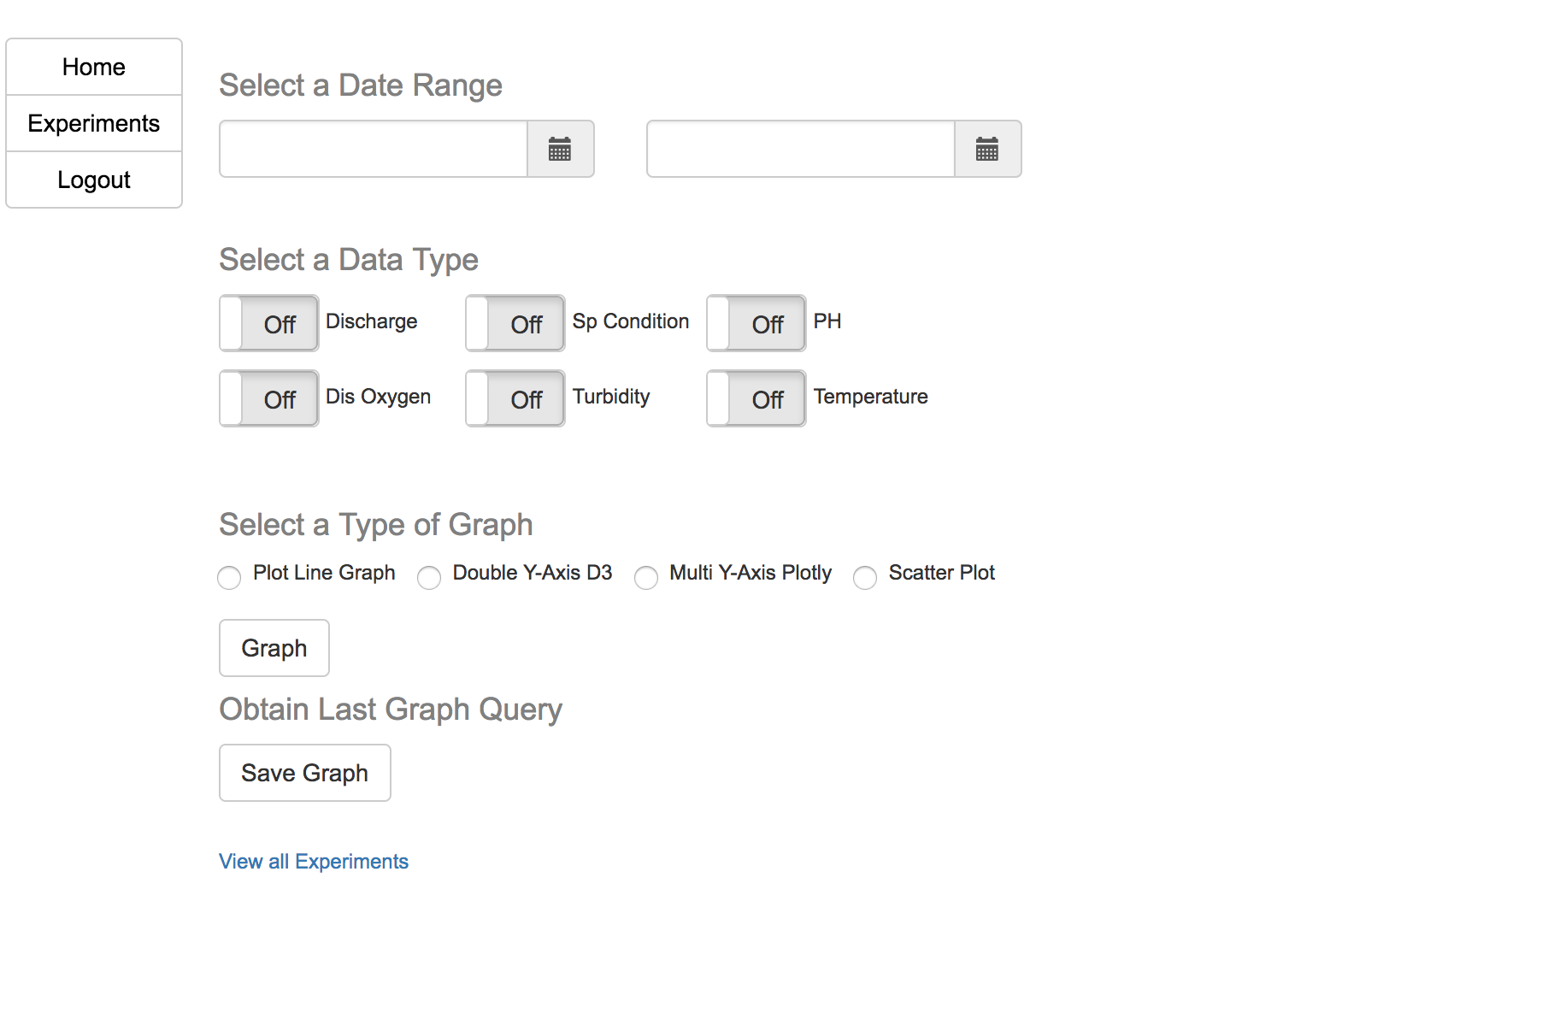
Problems and Lessons Learned
License
Different data files
Understanding old code
Combining codes
Communication
Notes:
I’m adding a picture of the graphs page so you can reference the problems we faced while implementing different things for it (Tinsaye)

Slide 6
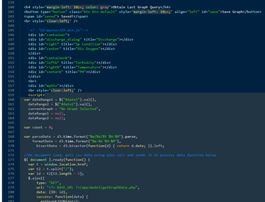
Future Work
Add equations/statistical data
Data table vs. Graphs
Data overflow
Implement data files onto website
Better formatting of code
Notes:
I’m adding an image of experiment.tpl to show that it should be better formatted (Tinsaye)

Slide 7
Key References
Gutierrez, Sebastian. "D3 Tutorial Table of Contents." DashingD3js.com. DashingD3js.com. Web. 26 Apr. 2017.
Perez, Fernando. "Visualize Data, Together." Plotly. Plotly. Web. 26 Apr. 2017.
Seidler, Kai. "Apache Friends." Apache Friends RSS. BitRock. Web. 26 Apr. 2017.

Slide 8
Acknowledgments
Client: Nicholas F. Polys, Ph.D. - npolys@vt.edu
Professor: Edward A. Fox, Ph.D. - fox@vt.edu
Members of the Past StREAM Team:
Riley Babcock
Derek Messer
Hanna Vess

