Slide 1
SOLR
Final Presentation
Team Members:
Abhinav, Anand, Jeff, Mohit, Shreyas, Siyu, Xinyue, Yu CS 5604, Fall 2017 Advised by Dr. Fox
Virginia Tech, Blacksburg, VA 24061
Notes:
Note that in the class period before a report is due, each of the teams will give an 15 minute presentation of the key points of their report, highlighting especially what the other teams should know about their accomplishments, plans, technologies, and questions.

Slide 2
Overview
Updates
In Theory
Process, Improvements & Results
Quality Control
Geolocation
Recommendation
Future Work

Slide 3
UPDATES

Slide 4
Changes made to HBase Schema from previous presentation
Fields added:
topic:topic-displaynames
cluster:cluster-displaynames
classification:classification-displaynames

Slide 5
Updates - SOLR Fall 2017
Fall 2016
Fall 2017
schema.xml | No geospatial search function Copyfields #fields = 30 | Feature added Copy and geoblacklight fields present #fields = 50+ Using DocValues to speed up faceting Index time field boosting
Morphline ETL | Datetime, multi-valued field parser, multiple field types | Extraction, cleaning, sanity check of data from HBase Timestamp conversion Records manipulation
Indexing | 1.2 billion tweets | 12,564 web pages and 5.9mil tweets
Incremental Indexing | Tested on VC | Tested on VC
Recommendation & Ranking | Didn't use clustering and classification for recommendation | Recommendation handler based on clustering and classification results; personalized recommendation

Slide 6
In Theory

Slide 7
SOLR document scoring
tf : sqrt(freq)
idf : log(numDocs / (docFreq + 1)) + 1
fieldWeight
fieldNorm : 1 / sqrt(numTerms)
Search for all tweets containing terms “vegas”
"914864995565031425": 2.2832668 = (MATCH) weight(text:vegas in 171455), result of: 2.2832668 = fieldWeight in 171455, product of: 1.4142135 = tf(freq=2.0), with freq of: 2.0; 6.4580536 = idf(docFreq=25492, maxDocs=5981684); 0.25 = fieldNorm(doc=171455)

Slide 8
Process, Improvements & Results

Slide 9
Software Packages and Versions
Cloudera CDH (Cloudera's Distribution Including Apache Hadoop) version 5.12.0
Key packages included:
hadoop-hdfs (2.6.0)
hbase-solr (1.5)
hbase (1.2)
kite (1.0.0)
solr (4.10.3)
zookeeper (3.4.5)
For complete list visit: https://archive.cloudera.com/cdh5/parcels/5.12.0/manifest.json

Slide 10
In Context
Information
Tweets and Webpages
Storage
Extract
From Hbase (using morphline)
Transform
Into Solr document (using morphline)
Cleaning (using morphline)
Deriving new field (using morphline and Hadoop)
Load
Indexing
Retrieval
Queries from GeoBlackight and Visualization team
Recommendation

Slide 11
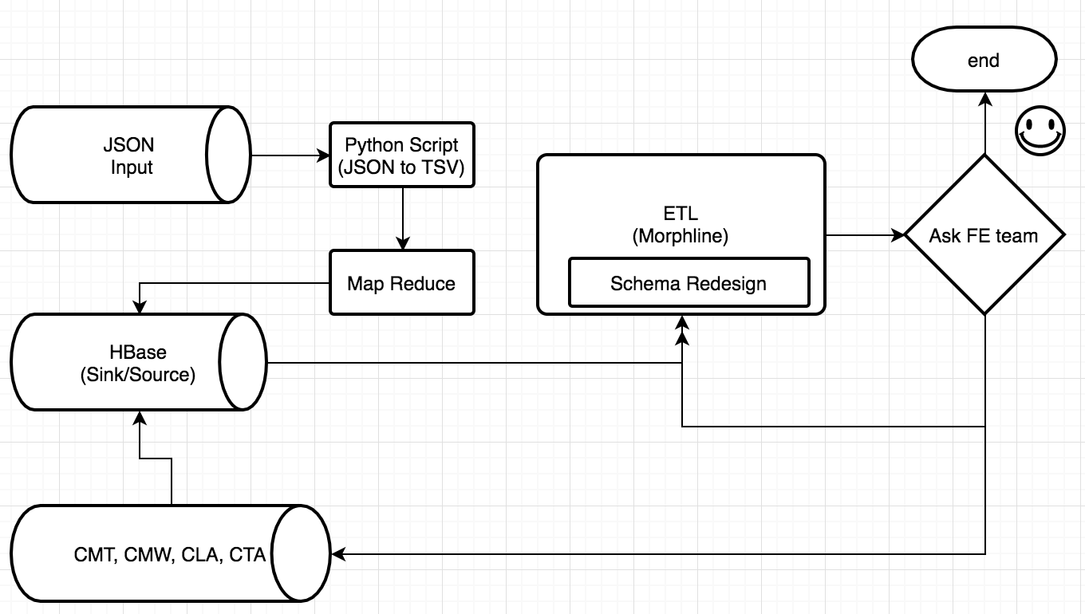
The Process

Slide 12
Solr Schema Challenges & Solutions
Challenges:
All the data needs to be indexed in a single core
Support 2 FE clients
Multiple (2) input formats (webpage, tweet) and single output format
Solution:
Separate morphline file for each input format
Separate indexing operation for each input format
Input format identified by ‘dc_format_s’ field

Slide 13
Better performance using DocValues
DocValues are a way of recording field values internally that is more efficient for some purposes, such as sorting and faceting, than traditional indexing
Traditional Solr Indexing
Document Terms Documents
Indexing with DocValues
Documents Terms
Examples
<field name="cluster" type="string" indexed="true" multiValued="false" docValues="true"/>
<field name="category" type="string" indexed="true" stored="true" multiValued="true" docValues="true"/>

Slide 14
Index time document boosting
Using copyField Solr provides a functionality to copy values from one field to another during indexing. We can use this feature to copy the field which needs to be boosted in our default search field i.e. ‘text’. <field name="keywords_boost" type="text_general" indexed="true" multiValued="true"/> <copyField source="*_boost" dest="text"/> This form of boosting works because after copying, the value of the boosted field is present twice as many times as other values.

Slide 15
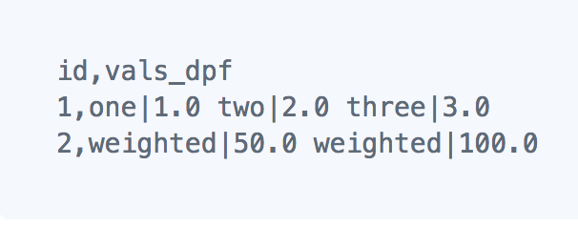
Index time document boosting
Using payloads (available from Solr 6.x) Our use cases:
Boosting NER terms
Multivalue boosting of topics, clusters and keyword terms
Example: Below we have 2 documents where content of the field ‘vals_dpf’ is boosted variably based on the words. In document id ‘1’, word ‘one’ has a boosting of 1.0, word ‘two’ has a boosting of 2.0, and so on.

Slide 16
Key Stats & Figures
Collection Type | Document Count | Time | Memory (Heap Usage)
Webpage | 12,564 | Map: 88 sec Reduce: 531 sec | 789 MB
Tweets | 5,969,120 | Map: 780 sec Reduce: 5300 sec | 3 GB

Slide 17
Quality Control

Slide 18
Index Quality Control
Validation and conversion of indexed data through morphline process in lily indexer.
Fix records that are not formatted well in HBase
Timestamp conversion: According to Solr datetime format
Geo-data conversion: from string to double
URL status code check: depends on given status code, decide whether to drop records
Sanitize unknown Solr fields: remove fields that could not be recognized by Solr to avoid Solr errors
Drop invalid and unnecessary records
Log record at debug level to SLF4J: Log record content to log file or screen for debug and test

Slide 19
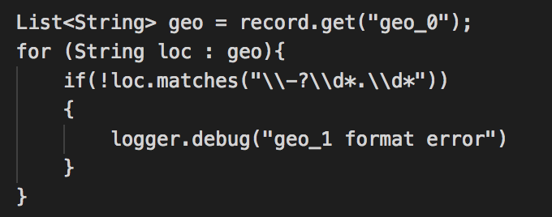
Examples
Remove unrelated categories
Use regex to validate geo coordinates format

Slide 20
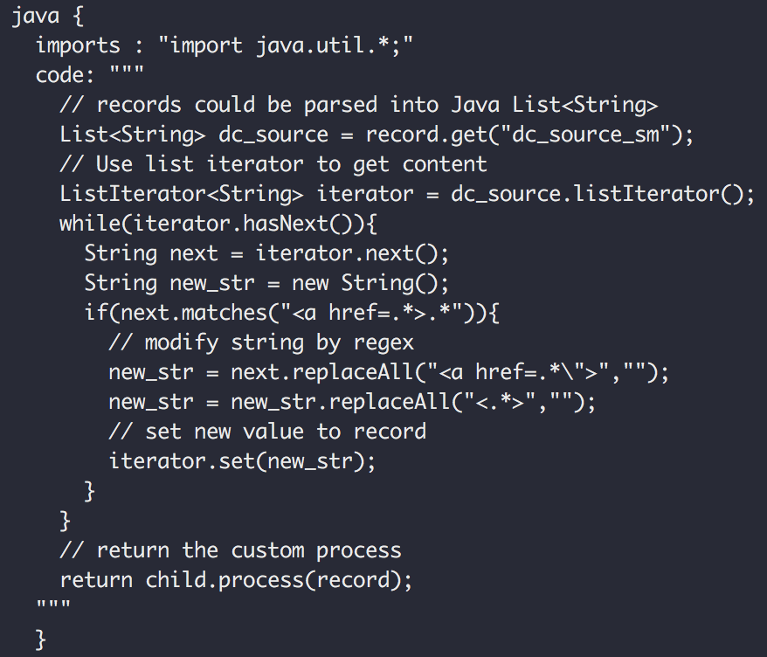
Example for fixing data format:
Input from HBase:
“<a href=\"https://about.twitter.com/products/tweetdeck\" rel=\"nofollow\">TweetDeck</a>”
Output for Solr records:
TweetDeck
This practice could be extended to many kinds of data format issues in HBase.

Slide 21
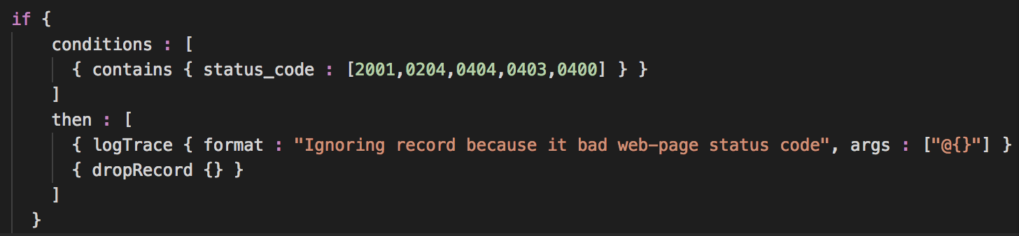
Example for dropping specific records
Drop webpage records that contain bad status code: 0404, 0400 etc.
This is a good practice showing that any data related teams could use customized indicators in HBase and then Solr team could recognize it to ensure the indexed data quality.

Slide 22
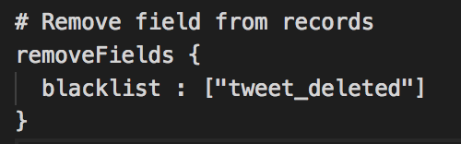
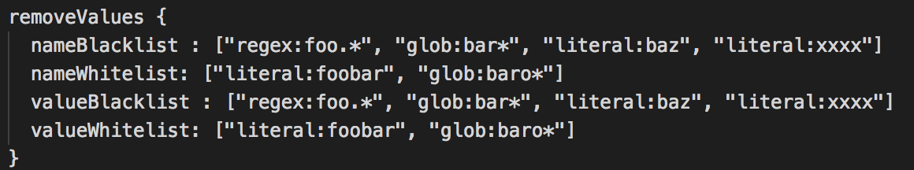
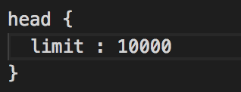
Other things could be done
Remove fields
Add/Remove values to/from fields
Index certain amount of records
Find and replace fields
More complex:
Use Grok to extract information through regex (E.g., log data)
Produce GeoIP from IP Addresses
Etc.

Slide 23
Geolocation

Slide 24
Document Geolocation
Determine bounding box for place names from SNER-location Primarily for FE/visualization, additionally for indexing/searching
Data from Mapzen, OpenStreetMap, OpenAddresses.io Countries, States, Counties, Cities, Parks, Bodies of Water, etc... >4,500,000 place names
Using map-reduce and suffix arrays, each NER location name was matched to a location name from the bounding box data. The corresponding bounding box was then added to each document. Populated solr_geom field for 324714 tweets and 4442 webpages
Considered using Google maps API but would have been slow due to rate-limiting

Slide 25
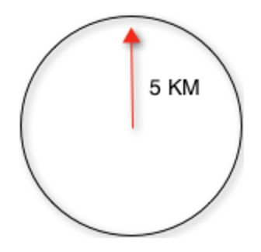
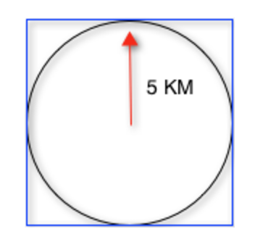
Geospatial Search
Indexed geolocation as SpatialRecursivePrefixTreeFieldTypelocation_rpt instead of string
This gives us ability to search in following ways
Geofilt
Input [centre lat,lon and radius of circle]
Bbox
Input [centre lat,lon and radius of circle]
Range query on a rectangular box
Input [lower left lat,lon TO top right lat,lon]

Slide 26
Recommendation

Slide 27
Recommendation System
1.MoreLikeThis Handler(MLT)
Based on text similarity, we made MoreLikeThis Handler recommend more similar documents to users when they are viewing one document. ----------(Specific recommendation)
2.Cluster_Classification Recommend Handler
Based on Clustering and Classification results, we made a Handler which can recommend documents belong to same cluster and class. ---------- (More general recommendation)
In order to avoid large cluster or large class problems, we first will recommend documents belonging to the same cluster and class. This can make the recommendation more accurate.

Slide 28
Recommendation System
3. Personal Recommendation System
When users share common search interests they will be recommended documents they haven’t searched but were searched by user with common search interest.
E.g. A : Hurricane,Houston,safety,shooting - Recommendation - vegas,hospitals B : Houston,safety,vegas,hospitals, - Recommendation - Hurricane,shooting
Image below shows a SQLite table (columns separated by |) , The first column is user id, second is keywords and third column are recommended items for the user.

Slide 29
Future Work
Collect more user data, implement more complex recommendation handler.
Configure Live Indexing mode on Hadoop cluster.
Load testing

Slide 30
ACKNOWLEDGMENTS
This material is based upon work in the Global Event and Trend Archive Research (GETAR) project, supported by the National Science Foundation under Grant No. IIS-1619028

