Slide 1

“Conservation Practices for Climate Change Adaptation”
Dr. Jorge A. Delgado
Soil-Plant-Nutrient Research Unit, USDA/ARS
Photo NASA

Slide 2
Thank You!
USAID, SANREM, Virginia Tech, INIAP and Universidad Estatal de Bolivar
Dr. Jorge A. Delgado
Soil-Plant-Nutrient Research Unit, USDA/ARS

Slide 3
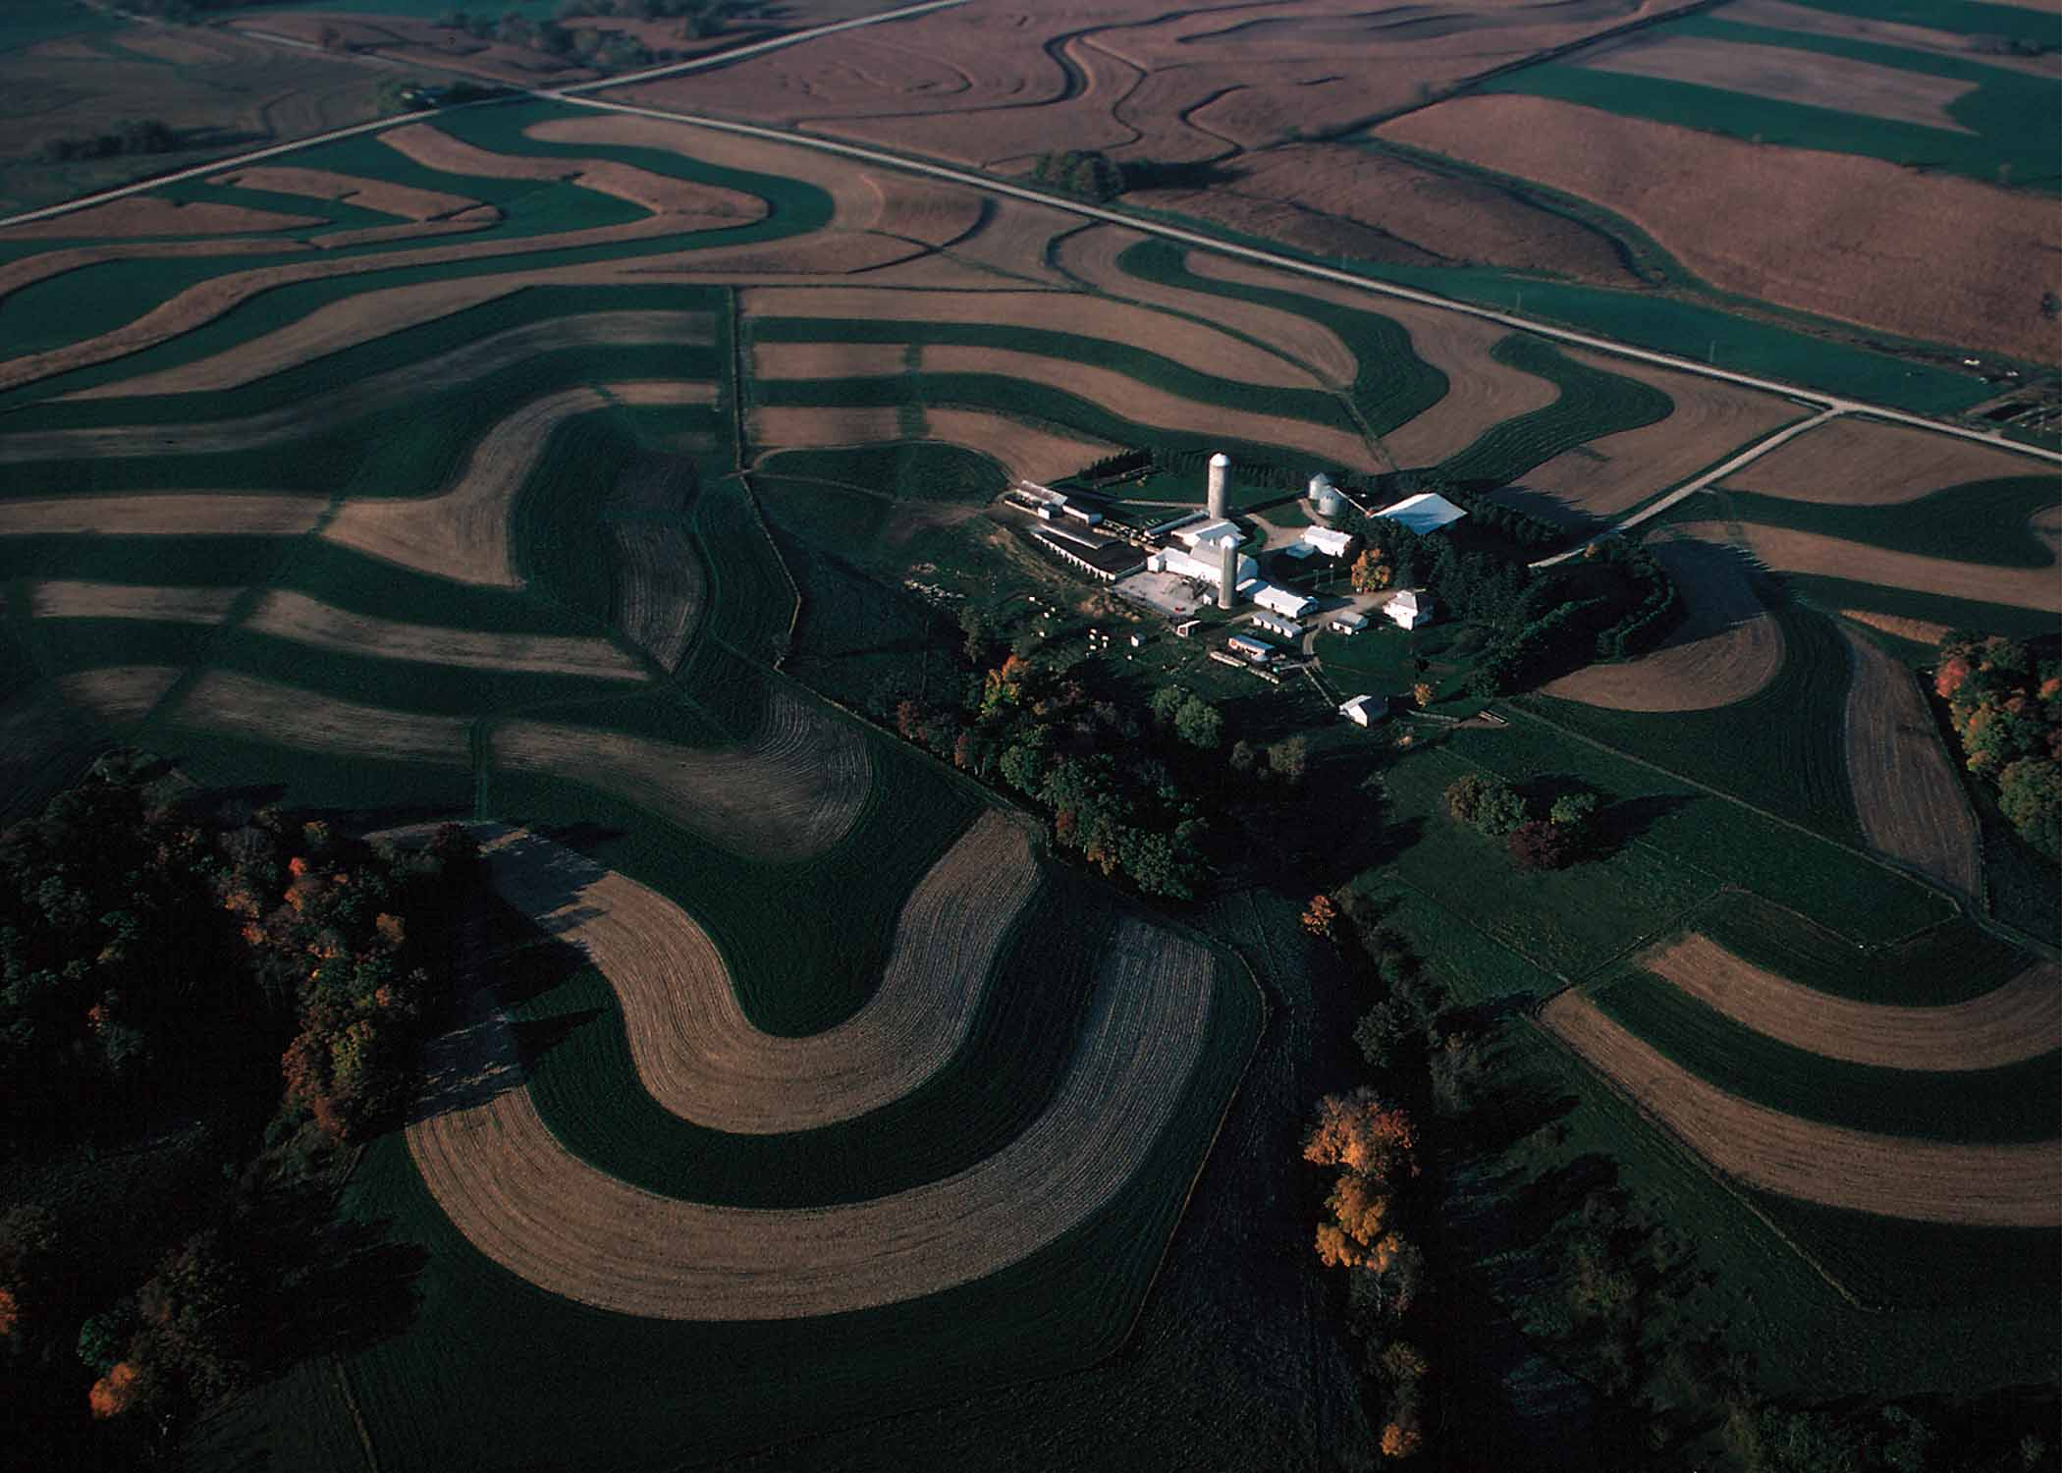
The Soil and Water Conservation Society invited the authors to review the science of conservation practices and their potential for climate change mitigation and adaptation.
Photo USDA

Slide 4
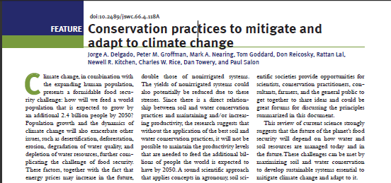

Slide 5
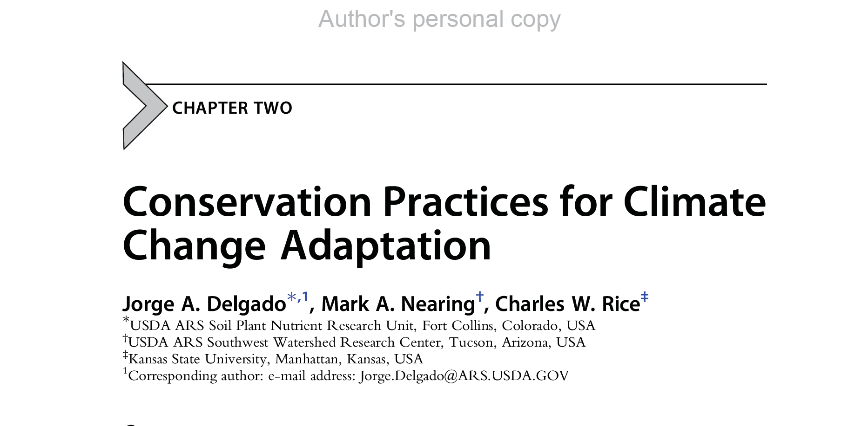
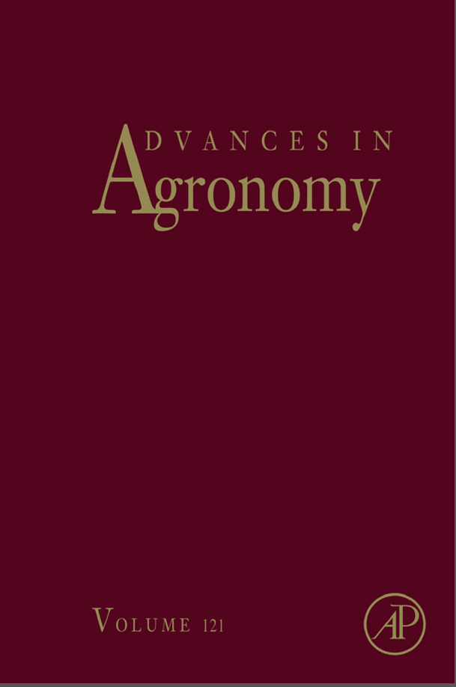
Photo NASA

Slide 6
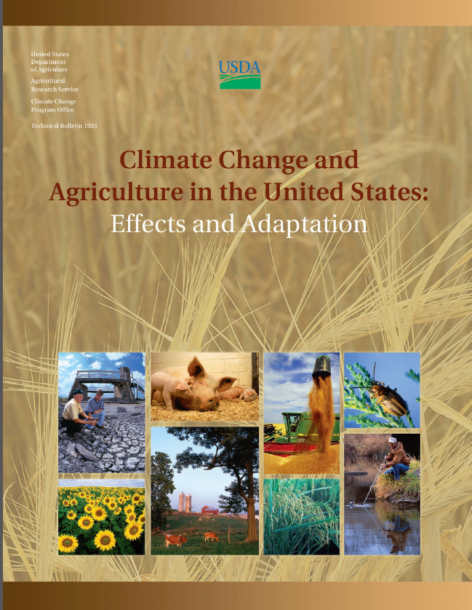
Walthall, C.L., J. Hatfield, P. Backlund, L. Lengnick, E. Marshall, M. Walsh, S. Adkins, M. Aillery, E.A. Ainsworth, C. Ammann, C.J. Anderson, I. Bartomeus, L.H. Baumgard, F. Booker, B. Bradley, D.M. Blumenthal, J. Bunce, K. Burkey, S.M. Dabney, J.A. Delgado, J. Dukes, A. Funk, K. Garrett, M. Glenn, D.A. Grantz, D. Goodrich, S. Hu, R.C. Izaurralde, R.A.C. Jones, S.-H. Kim, A.D.B. Leaky, K. Lewers, T.L. Mader, A. McClung, J. Morgan, D.J. Muth, M. Nearing, D.M. Oosterhuis, D. Ort, C. Parmesan, W.T. Pettigrew, W. Polley, R. Rader, C. Rice, M. Rivington, E. Rosskopf, W.A. Salas, L.E. Sollenberger, R. Srygley, C. Stockle, E.S. Takle, D. Timlin, J.W. White, R. Winfree, L. Wright-Morton, and L.H. Ziska.
USDA Technical Bulletin 1935. USDA-ARS, Washington, DC.
Published 2012, Released February 5, 2013
Photo NASA

Slide 7
Climate Change and Agriculture in the United States: Effects and Adaptation (USDA Technical Bulletin 1935), a USDA report that serves as a technical reference for the National Climate Assessment (NCA), was published in 2012. The National Climate Assessment (NCA) is a mandated report produced approximately every 4-5 years that provides the U.S. Congress and the President of the United States information on the status of the impact of climate change in the United States. The National Climate Assessment Technical Reference Document covered for the first time the area of soils and conservation practices. This national report stated that by 2050 climate change will impact livestock and agricultural systems and that we need to use conservation practices to enhance the ability of the United States agricultural sector to adapt to climate change.
USDA-ARS Soil Plant Nutrient Research Unit 2013 Report
Photo NASA

Slide 8
The 20th century’s Green Revolution showed that science-based solutions could provide answers to global challenges to the benefit of societies.
Despite the success of the Green Revolution, today there are new concerns, and the threat of climate change is among the most severe threats that face our planet in the 21st century (USDA NRCS 2010).

Slide 9
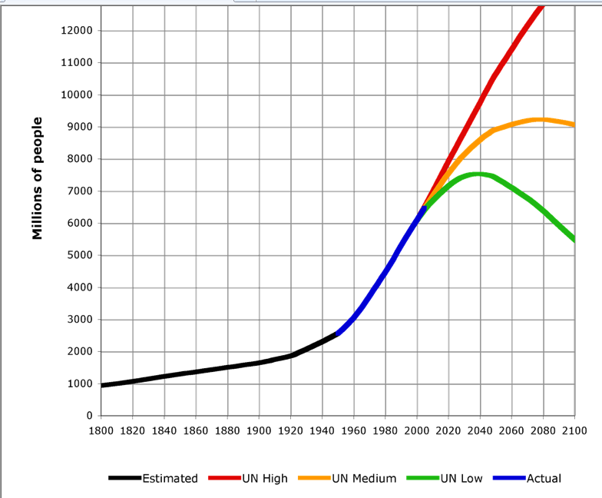
Major World Challenges Related to Soil and Water Conservation
By 2050, the world population is expected to increase by 2.4 billion people, and as the economies of countries with large populations improve, even more pressure will be put on the world’s agricultural systems. This increased demand for resources coupled with climate change could threaten the potential to achieve food security.
http://upload.wikimedia.org/wikipedia/commons/7/77/World-Population-1800-2100.png

Slide 10
Major World Challenges Related to Soil and Water Conservation
Population growth and the development of new, stronger economies, such as those of China and India, are increasing the demand for world resources.

Slide 11
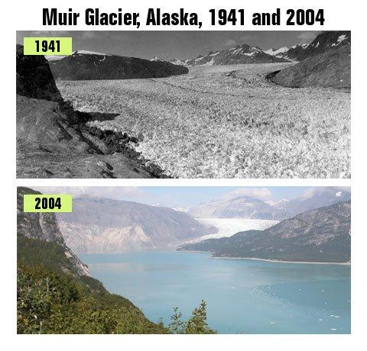
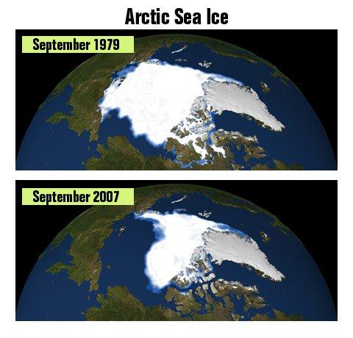
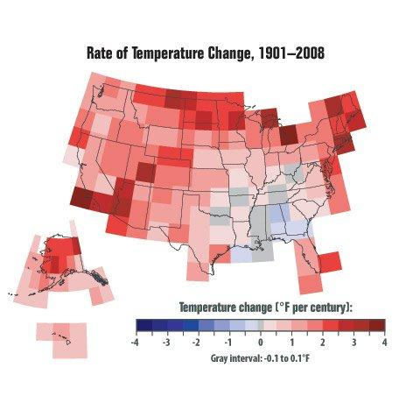
Major World Challenges Related to Soil and Water Conservation
Climate change is occurring, and the implementation of sound conservation practices will be key for each country’s health, social stability, and security.
Photos EPA

Slide 12
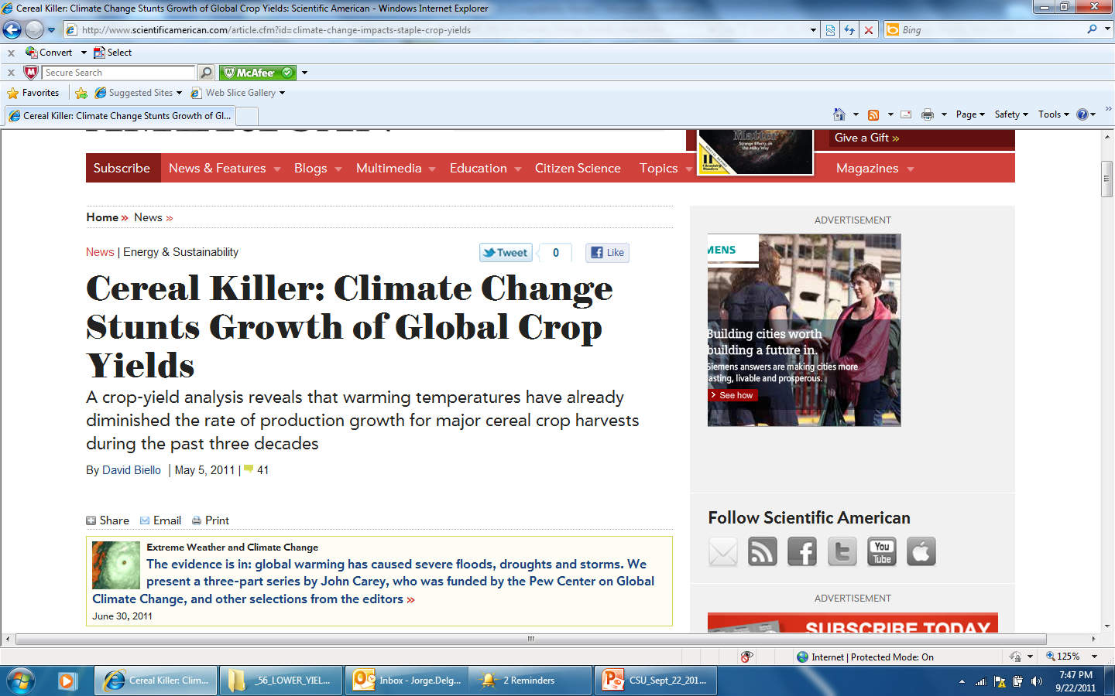
Nonirrigated systems could also see their yields potentially reduced due to these stresses since it has been reported that for every increase in temperature of 1°C (1.8°F), there is a potential reduction in yield (Grain yield declined by 10%), not only from heat stress, but also from the interaction of heat stress and drought stress that may be put on crops (Peng et al. 2004; Auffhammer 2011; Lobell et al. 2011).
http://www.scientificamerican.com/article.cfm?id=climate-change-impacts-staple-crop-yields

Slide 13
For example, across Africa, an increase in temperature of 1°C under drought conditions could affect 100% of the maize area, potentially reducing yields by at least 20% (Auffhammer 2011; Lobell et al. 2011).

Slide 14
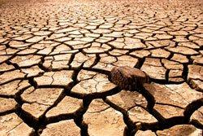
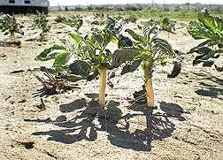
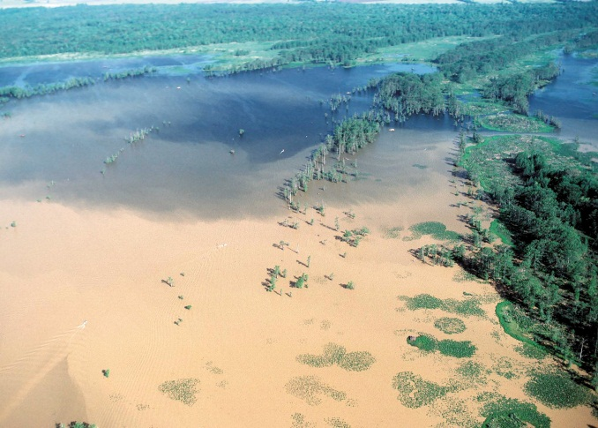
Major World Challenges Related to Soil and Water Conservation
Extreme weather events are creating environmental problems, accelerating the rate of erosion and threatening agricultural production needed for food security.
Photo EPA
Photo ARS
Photo NRCS

Slide 15
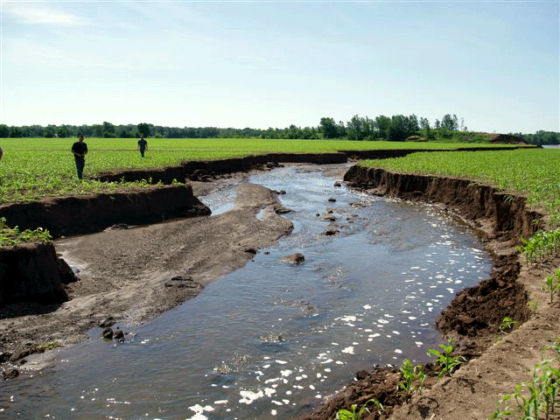
Additionally, climate change can increase the potential for higher erosion rates, which is also of concern because erosion has been reported to lower agricultural productivity by 10% to 20% (Quine and Zhang 2002; Cruse and Herndel 2009).
Source:
Iowa
NRCS

Slide 16
Bakker et al. (2004) conducted a detailed analysis of 24 studies that were published during the 1970s to early 2000s examining erosion’s effects on productivity and that measured the quantity of lost productivity per amount of eroded soil.
They found that the average yield lost across the different methodologies was 4.3%, 10.9%, and 29.6% loss in soil productivity per every 10-cm loss of soil measured with comparative plots, transect methods, and desurfacing experiments, respectively.

Slide 17
Bakker et al. (2004) concluded that the best methodology
to represent the effects of erosion was the plot methodology and that an average of 4% loss in productivity per every 10 cm of soil loss should be considered realistic as far as the negative impacts to yield production from erosion.
More important was the report from Bakker et al. (2004) showing that the relationship of yield losses to soil depth lost will be convex, so any further losses in soil depth after the first 10 cm of soil lost will become increasingly severe and damaging to soil quality, reducing yield by a greater amount.

Slide 18
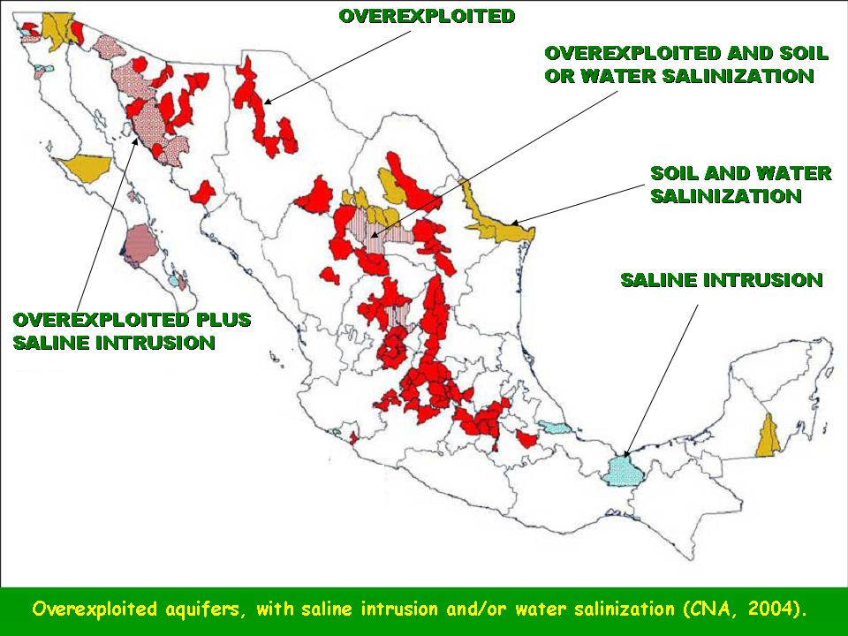
Major World Challenges Related to Soil and Water Conservation
Since irrigated systems have, on average, double the yields of non-irrigated systems, the depletion and salinization of these key world resources results in additional pressure to increase agricultural productivity.
CAN 2004

Slide 19
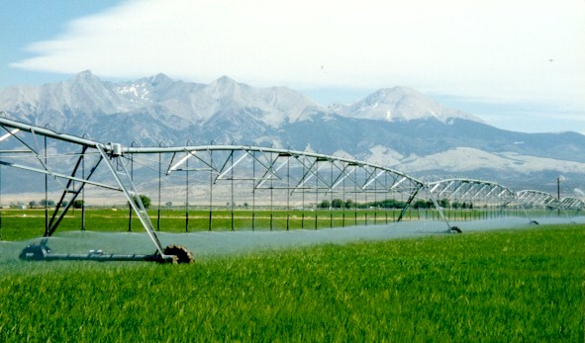
This presents a serious concern because, on average, irrigated systems have yields that are twice those of nonirrigated systems (Rangely 1987; Bucks et al. 1990; Tribe 1994).

Slide 20
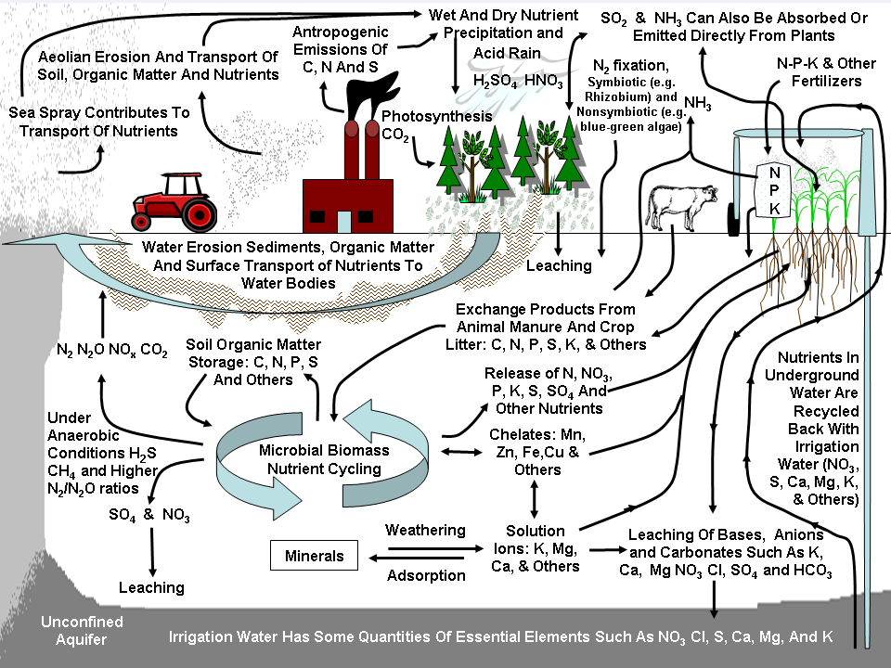
The Carbon and Nitrogen Cycles and Agricultural Influences on Greenhouse Gases
Greenhouse Gases Contributed by Agriculture are an Important Factor in Climate Change.
Agriculture plays an important role in the GHG fluxes of CO₂, N₂O and CH₄, contributing 6% of total United States GHG emissions (USEPA 2010b).

Slide 21
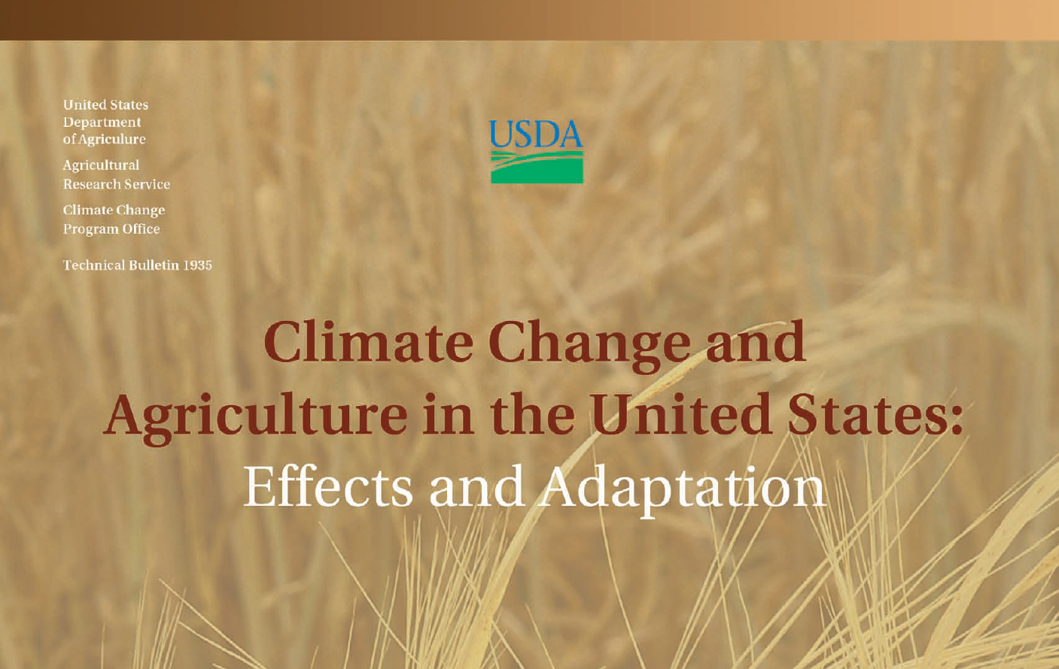

Slide 22
USDA
Quotes from the USDA report (USDA 2012 – released 2013):
“Burning of fossil fuels, deforestation, and a variety of agricultural practices and industrial processes are rapidly increasing the atmospheric concentrations of CO2 and other greenhouse gases (GHGs) (IPCC 2007a, pg. 10).”

Slide 23
USDA
Quotes from the USDA report (USDA 2012 – released 2013):
“Scientific evaluation of the effects of global climate change done as part of the Intergovernmental Panel on Climate Change (IPCC) Fourth Assessment Report (AR4), new studies in the peer-reviewed scientific literature (e.g., Allison et al. 2009), and assessments by the U.S. Global Change Research Program, the U.S. National Research Council, and other scientific bodies provide strong evidence of ongoing changes in the Earth climate system.”

Slide 24
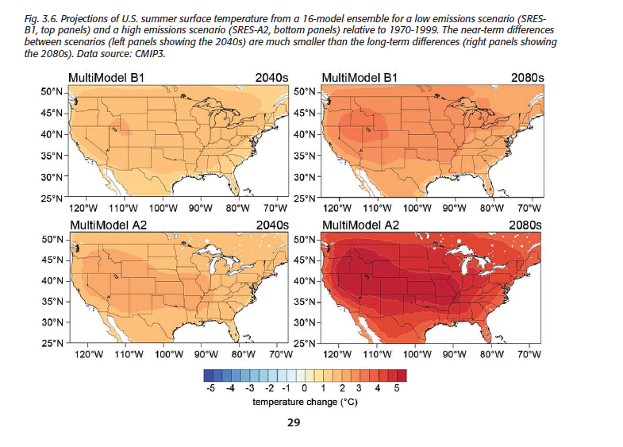

Slide 25
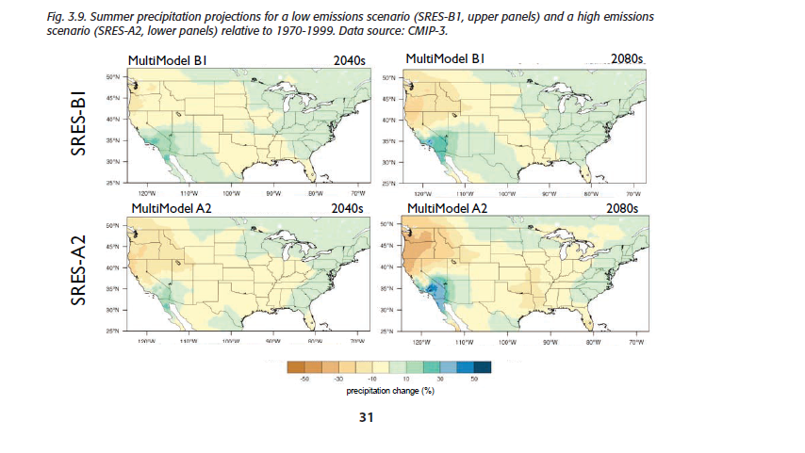

Slide 26
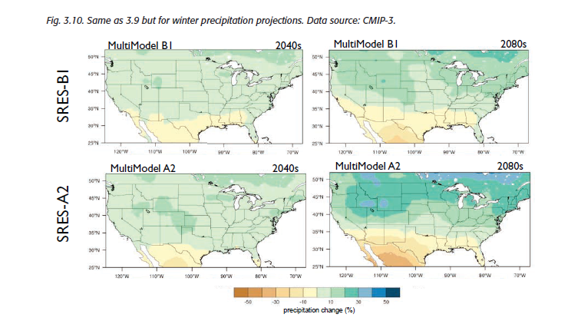

Slide 27
USDA
Quotes from the USDA report (USDA 2012 – released 2013):
“Increases of atmospheric carbon dioxide (CO2), rising temperatures, and altered precipitation patterns will affect agricultural productivity. Increases in temperature coupled with more variable precipitation will reduce productivity of crops, and these effects will outweigh the benefits of increasing carbon dioxide. Effects will vary among annual and perennial crops, and regions of the United States; however, all production systems will be affected to some degree by climate change. Agricultural systems depend upon reliable water sources, and the pattern and potential magnitude of precipitation changes is not well understood, thus adding considerable uncertainty to assessment efforts. (Key Messages pg. 1).”

Slide 28
USDA
Quotes from the USDA report (USDA 2012 – released 2013):
“The predicted higher incidence of extreme weather events will have an increasing influence on agricultural productivity. Extremes matter because agricultural productivity is driven largely by environmental conditions during critical threshold periods of crop and livestock development. Improved assessment of climate change effects on agricultural productivity requires greater integration of extreme events into crop and economic models. (Key Messages pg. 1).”

Slide 29
USDA
Quotes from the USDA report (USDA 2012 – released 2013):
“Projections for crops and livestock production systems reveal that climate change effects over the next 25 years will be mixed. The continued degree of change in the climate by midcentury and beyond is expected to have overall detrimental effects on most crops and livestock. (Key Messages pg. 1).”

Slide 30
USDA
Quotes from the USDA report (USDA 2012 – released - 2013):
“The vulnerability of agriculture to climatic change is strongly dependent on the responses taken by humans to moderate the effects of climate change” .…. “Anticipated adaptation to climate change in production agriculture includes adjustments to production system inputs, tillage, crop species, crop rotations, and harvest strategies. New research and development in new crop varieties that are more resistant to drought, disease, and heat stress will increase the resilience of agronomic systems to climate change and will enable exploitation of opportunities that may arise. (Key Messages pg. 1-2).”

Slide 31
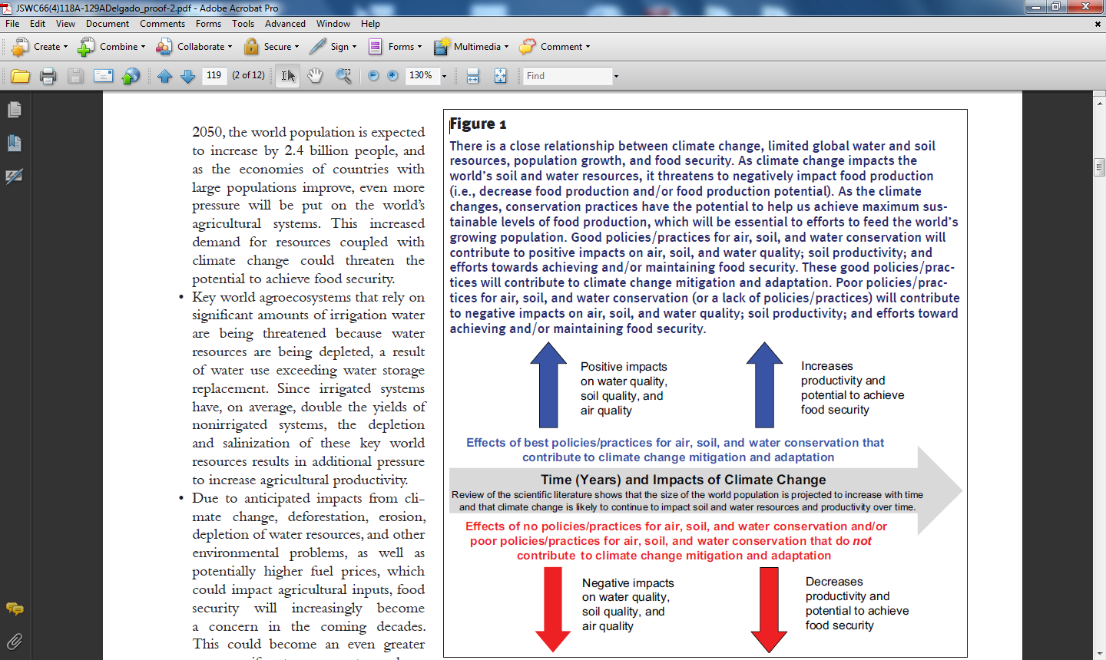
        The scientific literature suggests that with use of good policies, conservation programs, and practices we could have a better opportunity to achieve food security (good air, soil and water quality), while with bad policies and/or a lack of policies/conservation practices for climate change mitigation and adaptation, we will have lower air quality, soil quality and water quality, and there will be less potential to achieve food security.
        Delgado et al. 2011 Journal of Soil and Water Conservation

Slide 32
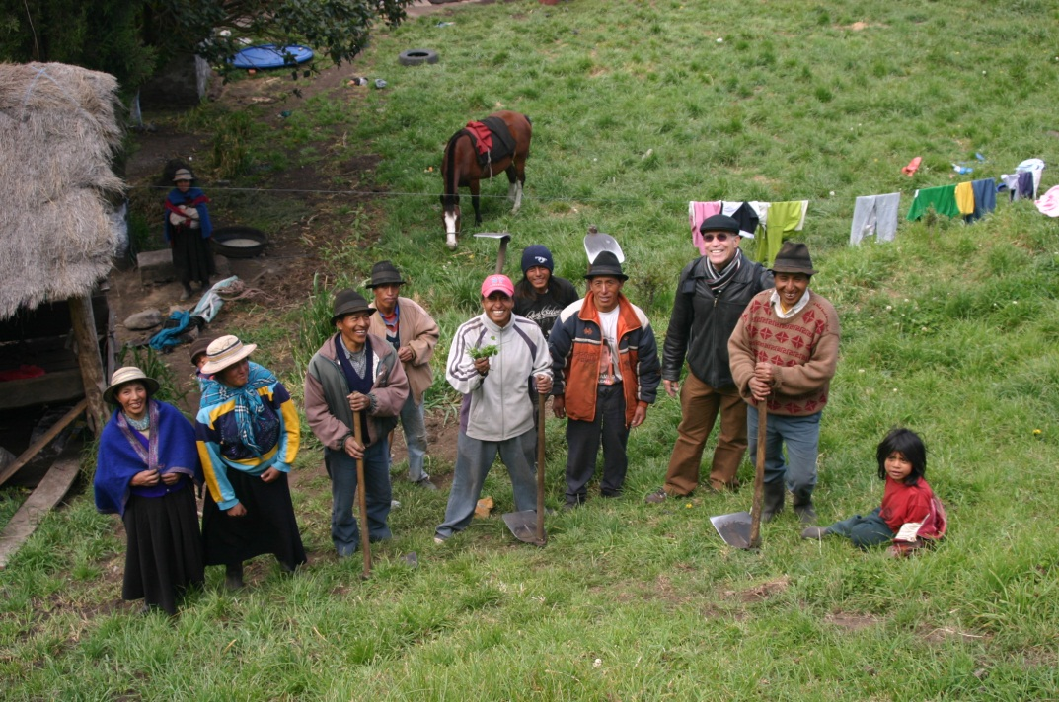
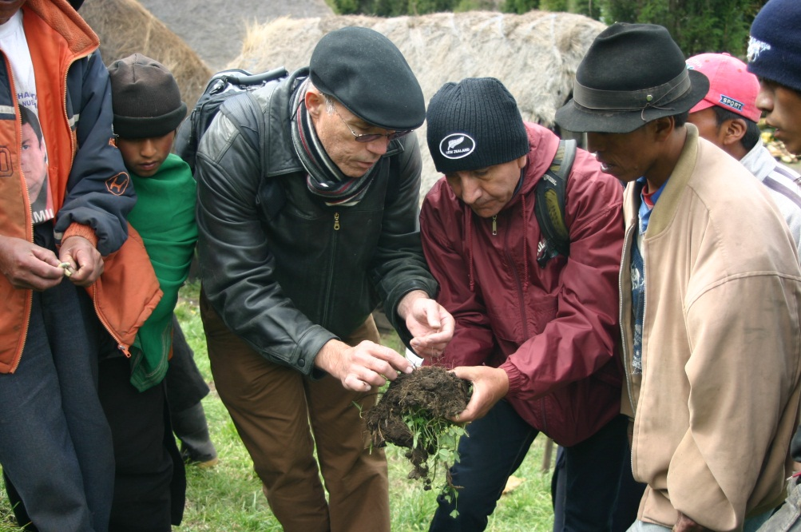
Soil and Water Conservation Principles Applied to
Climate Change Mitigation and Adaptation
Principles for Communication of Soil and Water Conservation Programs
Develop Communication that Connects Science to Land Managers.
-Better communication with farmers and farmers’ groups is key.

Slide 33
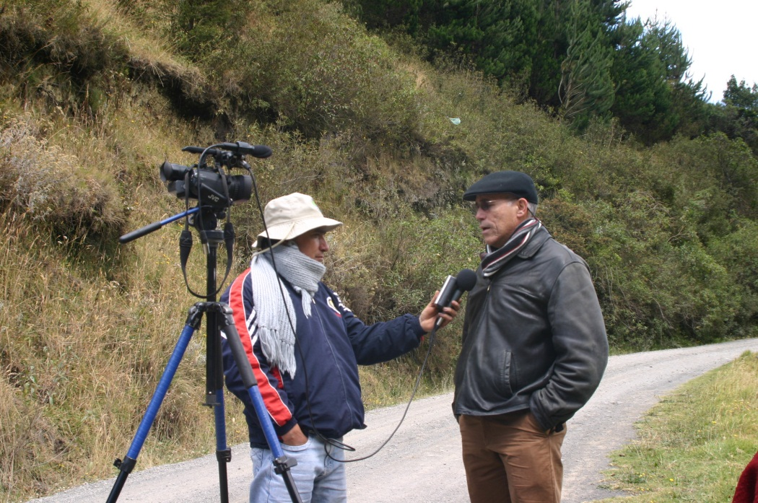
Soil and Water Conservation Principles Applied to
Climate Change Mitigation and Adaptation
Principles for Communication of Soil and Water Conservation Programs
Develop Communication that Connects Science to the Public.
-Better communication with the general public is essential to increasing awareness of the benefits of soil and water conservation

Slide 34
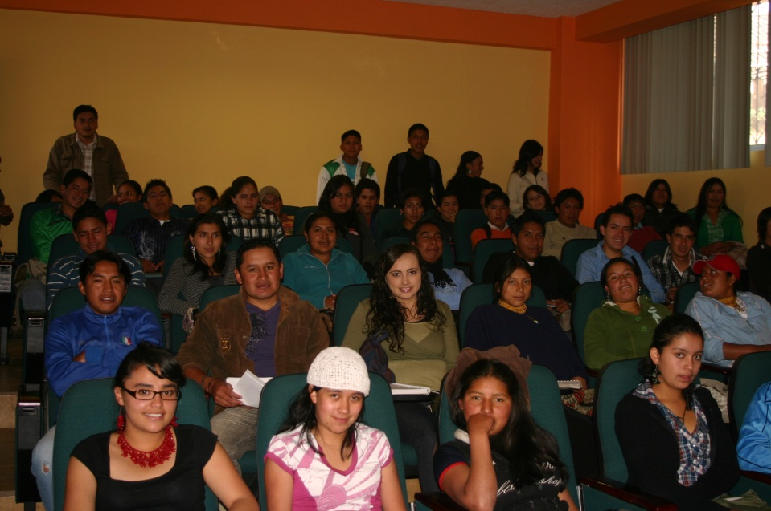
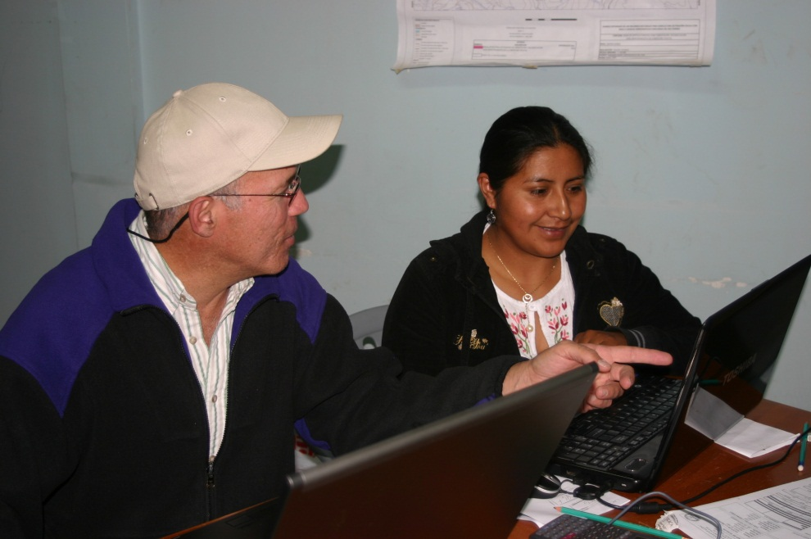
Soil and Water Conservation Principles Applied to
Climate Change Mitigation and Adaptation
Principles for Communication of Soil and Water Conservation Programs
Ongoing Training Essential.
-Education programs and the mentoring of new personnel are important for maintaining an educated workforce.

Slide 35
Soil and Water Conservation Principles Applied to
Climate Change Mitigation and Adaptation
Principles for Soil and Water Conservation Practices for Climate Change Mitigation and Adaptation
Cover the Surface.
-Harvesting of plant residues should be avoided if soil function will be compromised.

Slide 37
Soil and Water Conservation Principles Applied to
Climate Change Mitigation and Adaptation
Principles for Soil and Water Conservation Practices for Climate Change Mitigation and Adaptation
Soil Function Improves with Soil Carbon.
-Soil C sequestration is beneficial for the environment.

Slide 38
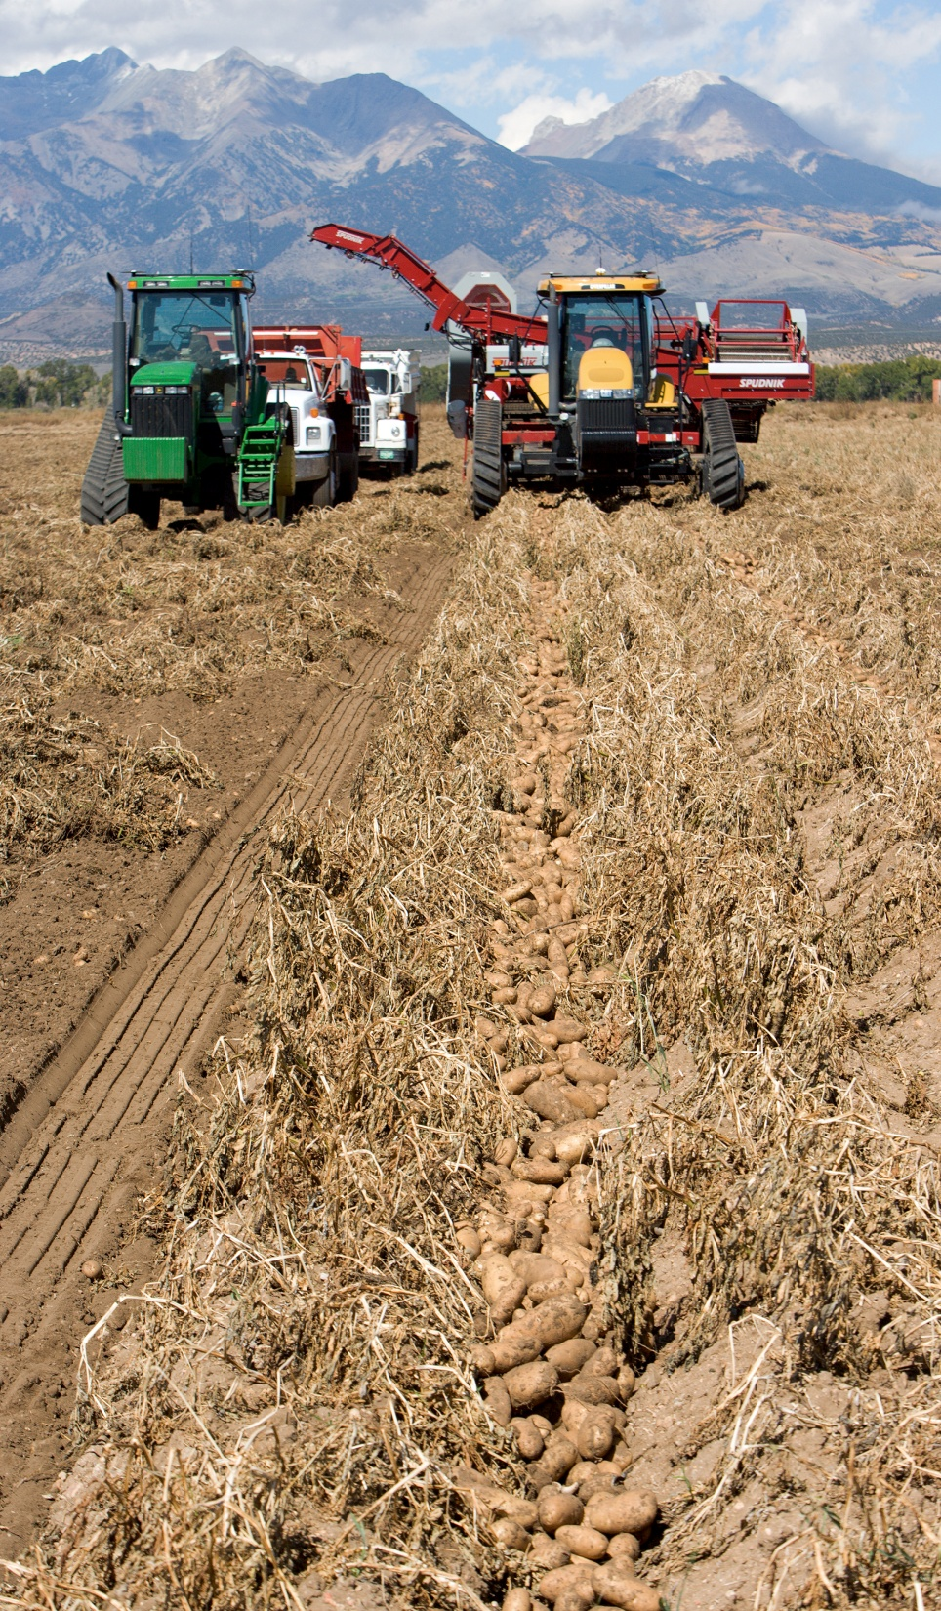
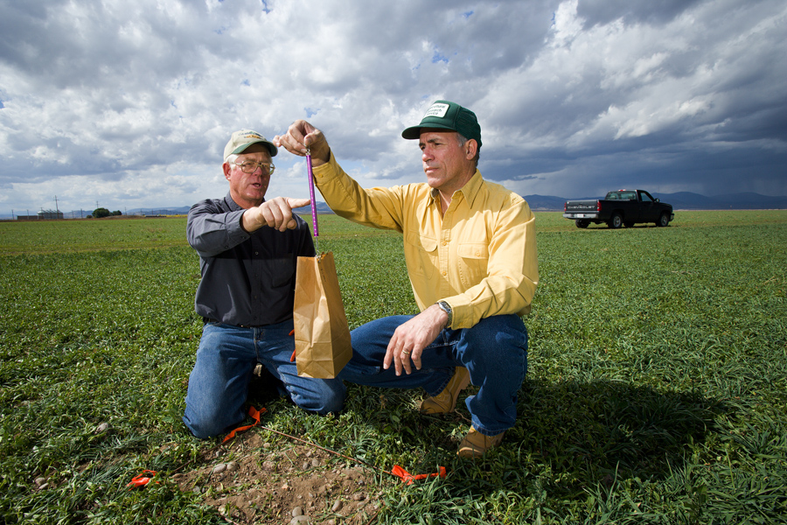
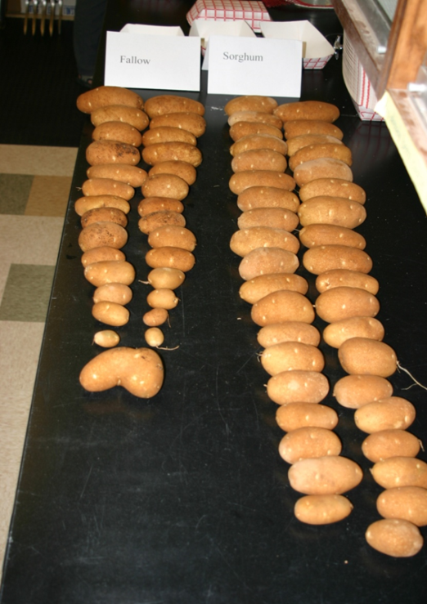

Slide 39
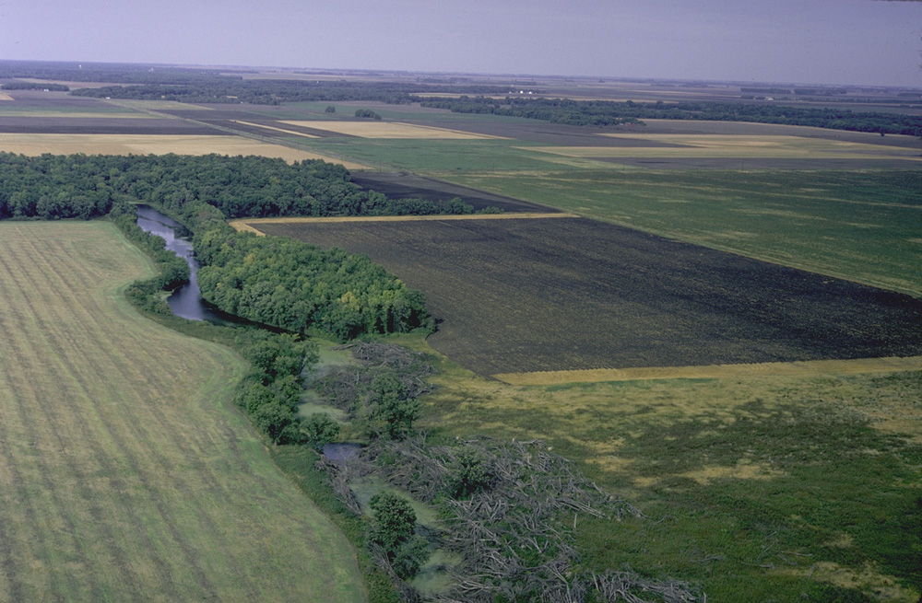
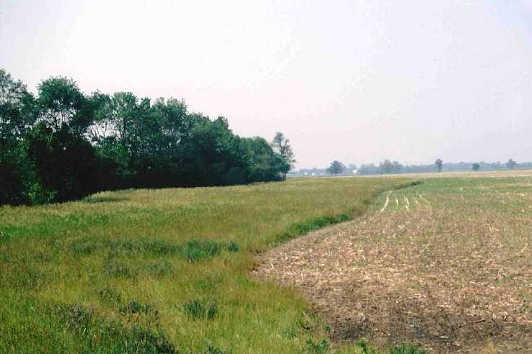
Soil and Water Conservation Principles Applied to
Climate Change Mitigation and Adaptation
Principles for Soil and Water Conservation Practices for Climate Change Mitigation and Adaptation
Off-Field Remediation Practices Are Helpful.
-Off-the-field conservation practices can contribute to climate change mitigation and adaptation ( e.g., riparian forest buffer, wetland).

Slide 40
Soil and Water Conservation Principles Applied to
Climate Change Mitigation and Adaptation
Principles for Soil and Water Conservation Practices for Climate Change Mitigation and Adaptation
Improve Landscape Diversity with Agroforestry.
-Agroforestry can contribute to landscape diversity, benefiting the environment.

Slide 41
Soil and Water Conservation Principles Applied to
Climate Change Mitigation and Adaptation
Principles for Soil and Water Conservation Practices for Climate Change Mitigation and Adaptation
Value Water More.
-Water-use efficiency needs to be increased, and water quality needs to be protected.

Slide 42
Soil and Water Conservation Principles Applied to
Climate Change Mitigation and Adaptation
Principles for Soil and Water Conservation Practices for Climate Change Mitigation and Adaptation
Greater Diversity Needed.
-Diverse cropping systems will be key to mitigating and adapting to climate change. Development of new varieties that can be used for tolerance of drought, temperature stress, and other effects of climate change will be needed.

Slide 43
Soil and Water Conservation Principles Applied to
Climate Change Mitigation and Adaptation
Principles for Development of New Science and Technologies
Research Pays Dividends Long Term.
-Research programs greatly contribute to soil and water conservation, making them important for climate change mitigation and adaptation.

Slide 45
IPCC
The IPCC has recommended accounting for several of the nitrogen inputs to agroecosystems, since these inputs are correlated with direct emissions of N₂O from soils.
The IPCC recommended that inputs from fertilizer-N, manure-N, crop residue-N, and N released via mineralization associated with soil organic matter losses (mineralization-N) be accounted for (Eggleston et al. 2006).

Slide 47
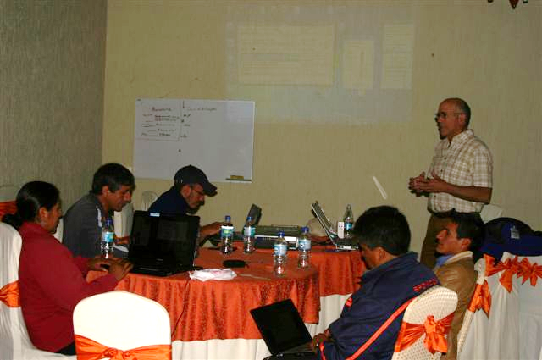

Slide 49
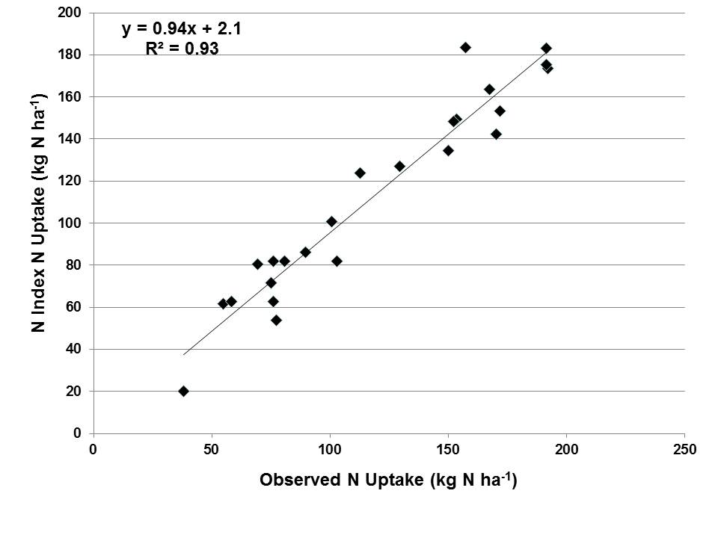
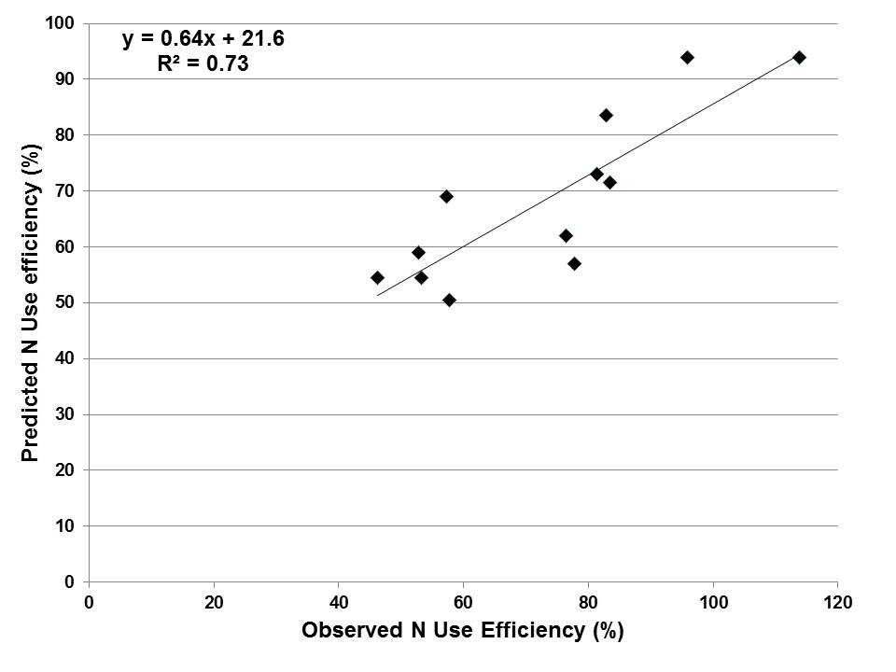
The Nitrogen Index version 4.4.2 is currently being used in Ecuador to assess nitrogen management practices.

Slide 50
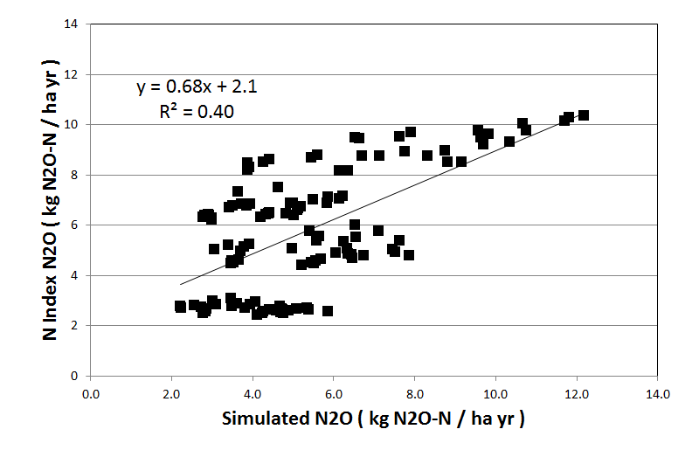
The Nitrogen Index version 4.4.2 is currently being used in Mexico to assess nitrogen management practices.

Slide 51
Table 1. Over 50 technicians and agricultural experts representing more than five institutions participated in a two-day training using the prototype of Nitrogen Index 4.5. Above are responses from participants on their level of knowledge before and after being trained in using the tool (on a scale of 1-5, where 1 is the lowest, and 5 is the highest).
 |  | Average Before | Average After
 | Understanding of Nitrogen
1 | Describe the nitrogen cycle | 3.19 | 4.21
2 | Describe the difference between direct and indirect N20 emissions | 2.44 | 4.26
3 | Describe the relationship between nitrogen inputs and greenhouse gas emissions | 2.78 | 4.15
 | Management of Nitrogen
4 | Identify and use at least four different management practices that can increase nitrogen use efficiency and reduce nitrogen losses | 3.42 | 4.38
5 | Make recommendations for fertilizer usage based on their management practices | 3.36 | 4.26
6 | Assess and estimate N20 emissions from agricultural management practices | 2.44 | 3.85
 | Technology Transfer
7 | Compare and contrast two different nitrogen management tools and their advantages and disadvantages | 3.03 | 4.12
8 | Ability to train other nutrient managers, farmers, students and peers on how to manage nitrogen | 2.86 | 4.03
9 | Ability to create a plan to manage nitrogen | 2.71 | 3.97
 | Average of differences
 |  | average before | average after
 |  | 2.92 | 4.14

