Slide 1

“The ABC’s of Hepatitis”
Updates on Screening, Treatment Guidelines, and the Primary Care Role
Mariana Gomez M.D
Infectious Diseases - Carilion Clinic
Assistant Professor of Medicine –
Virginia Tech Carilion School of Medicine

Slide 2
Disclosures
Gilead science - PI on research project

Slide 3

Notes:
Poll Title: Do not modify the notes in this section to avoid tampering with the Poll Everywhere activity.
More info at polleverywhere.com/support
Join instructions
https://www.polleverywhere.com/join_instructions

Slide 4
Objectives
Provide a comprehensive understanding of viral hepatitis, including its types and significance.
2. Discuss the latest guidelines for screening and treatment of hepatitis.
3. Highlight the crucial role of primary care in the management and prevention of hepatitis.
4. Showcase Carilion Clinic's efforts and initiatives in hepatitis awareness, screening, treatment, and collaboration with primary care providers.
5. Address any queries or concerns regarding hepatitis screening, treatment, and the integration of Carilion Clinic's efforts with primary care.

Slide 5
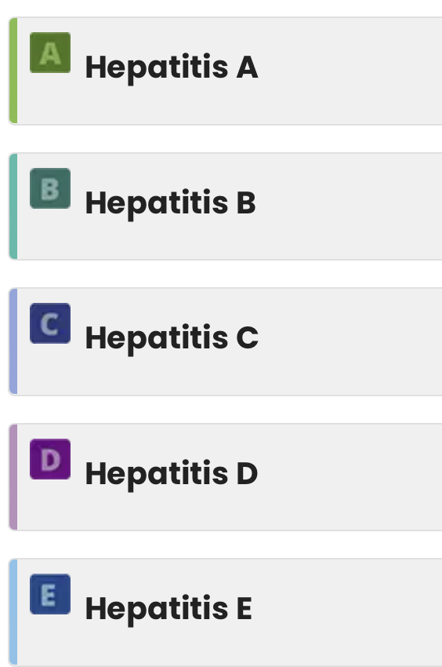

Viral Hepatitis
www.cdc.gov/hepatitis

Slide 6
Viral Hepatitis
www.cdc.gov/hepatitis

Slide 7

Case 1
Mr Smith is a 34 yo male that presents to his primary care physician office with 3 days of dark urine, yellowish discoloration of eyes and skin.
He reported eating a burger with a side of salad at a local restaurant. He heard in the news that there have been many cases of Hepatitis in the community from people that attended same restaurant and reported 3 deaths.
Which of the following tests will confirm diagnosis patient’s condition?

Slide 8
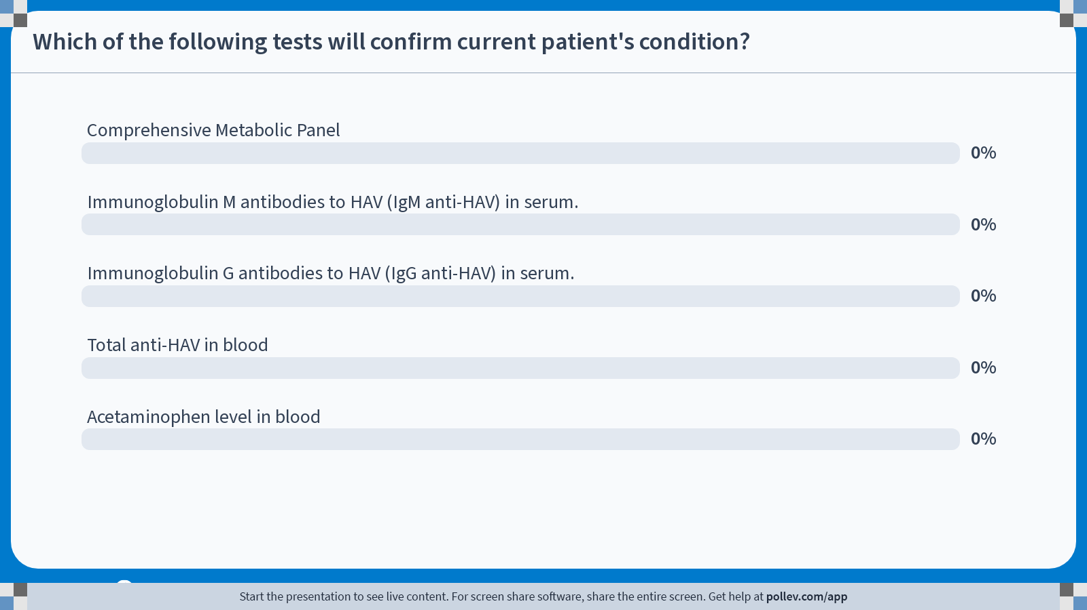
Notes:
Poll Title: Do not modify the notes in this section to avoid tampering with the Poll Everywhere activity.
More info at polleverywhere.com/support
Which of the following tests will confirm current patient's condition?
https://www.polleverywhere.com/multiple_choice_polls/mkfsAV3Ms6pTLHsNs2gV2?state=opened&flow=Default&onscreen=persist

Slide 9
Which of the following tests will confirm current patient’s condition?
Comprehensive Metabolic Panel
Immunoglobulin M antibodies to HAV (IgM anti-HAV) in serum.
Immunoglobulin G antibodies to HAV (IgG anti-HAV) in serum.
Total anti-HAV in blood
Acetaminophen level in blood
Notes:
IgM generally becomes detectable 5 to 10 days before the onset of symptoms and can persist for up to 6 months.
IgG anti-HAV appears in the convalescent phase of infection, remains present in serum for the lifetime of the person, and confers enduring protection against disease. The antibody test for total anti-HAV measures both IgG anti-HAV and IgM anti-HAV. Persons who are total anti-HAV-positive and IgM anti-HAV-negative have serologic markers indicating immunity consistent with either past infection or vaccination.
Molecular virology methods such as polymerase chain reaction (PCR)-based assays can be used to amplify and sequence viral genomes. These assays are helpful to investigate common-source outbreaks of hepatitis A.

Slide 10
HEPATITIS A
“Hepatitis A causes an ACUTE infection”

Slide 11
Hepatitis A
Facts
Laboratory markers that indicate an acute HAV infection:
  -Immunoglobulin M antibodies to HAV (IgM anti-HAV) in serum,
  or
  -HAV RNA in serum or stool.
CDC does not recommend routine hepatitis A screening.
Vaccination is the best way to prevent hepatitis A.
Hepatitis A is a highly contagious infection.
Spreads primarily through fecal-oral transmission.
Hepatitis A causes an acute infection. It does not become chronic.
Overall case-fatality estimates range from 0.3% to 0.6% for all ages and up to 1.8% adults age >50 years.
Notes:
https://www.aafp.org/pubs/afp/issues/2021/1000/p368.html
https://www.cdc.gov/vaccines/pubs/pinkbook/hepa.html#:~:text=Many%20of%20the%20high%2Dincidence,rates%20among%20children%20have%20declined.

Slide 12

Recommended routine vaccination of Hepatitis A:
  Children aged 12–23 months and catch-up vaccination for children
  Adolescents aged 2–18 years who have not previously received hepatitis A (HepA) vaccine at any age.
  Adults at risk for HAV infection or severe disease from HAV infection.
  Adults requesting protection against HAV without acknowledgment of a risk factor.
Notes:
Hepatitis A became routine childhood immunization in 2000

Slide 13
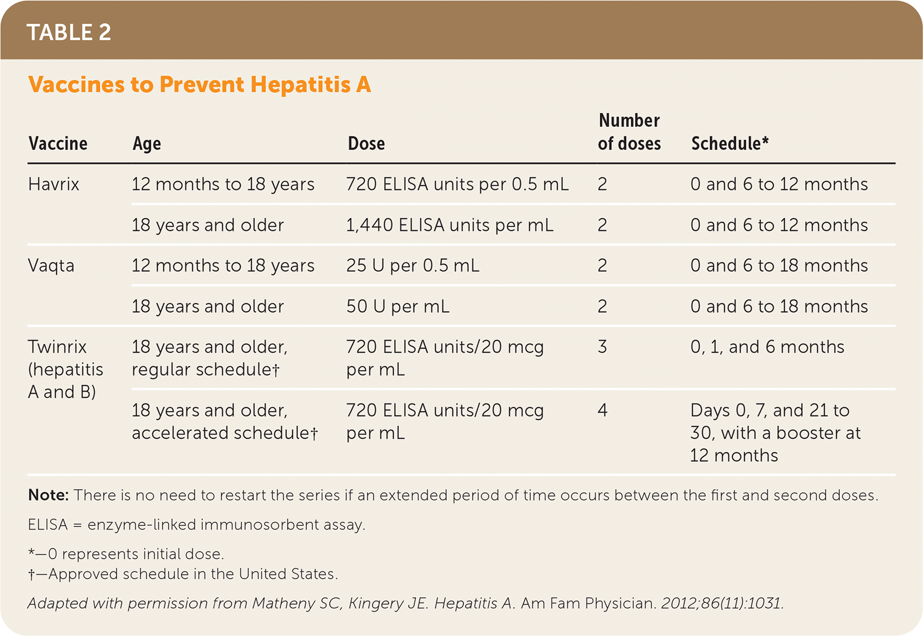
Hepatitis A. Am Fam Physician. 2021
Notes:
Langan RC, Goodbred AJ. Hepatitis A. Am Fam Physician. 2021 Oct 1;104(4):368-374. PMID: 34652109.
All are inactivated vaccines

Slide 14
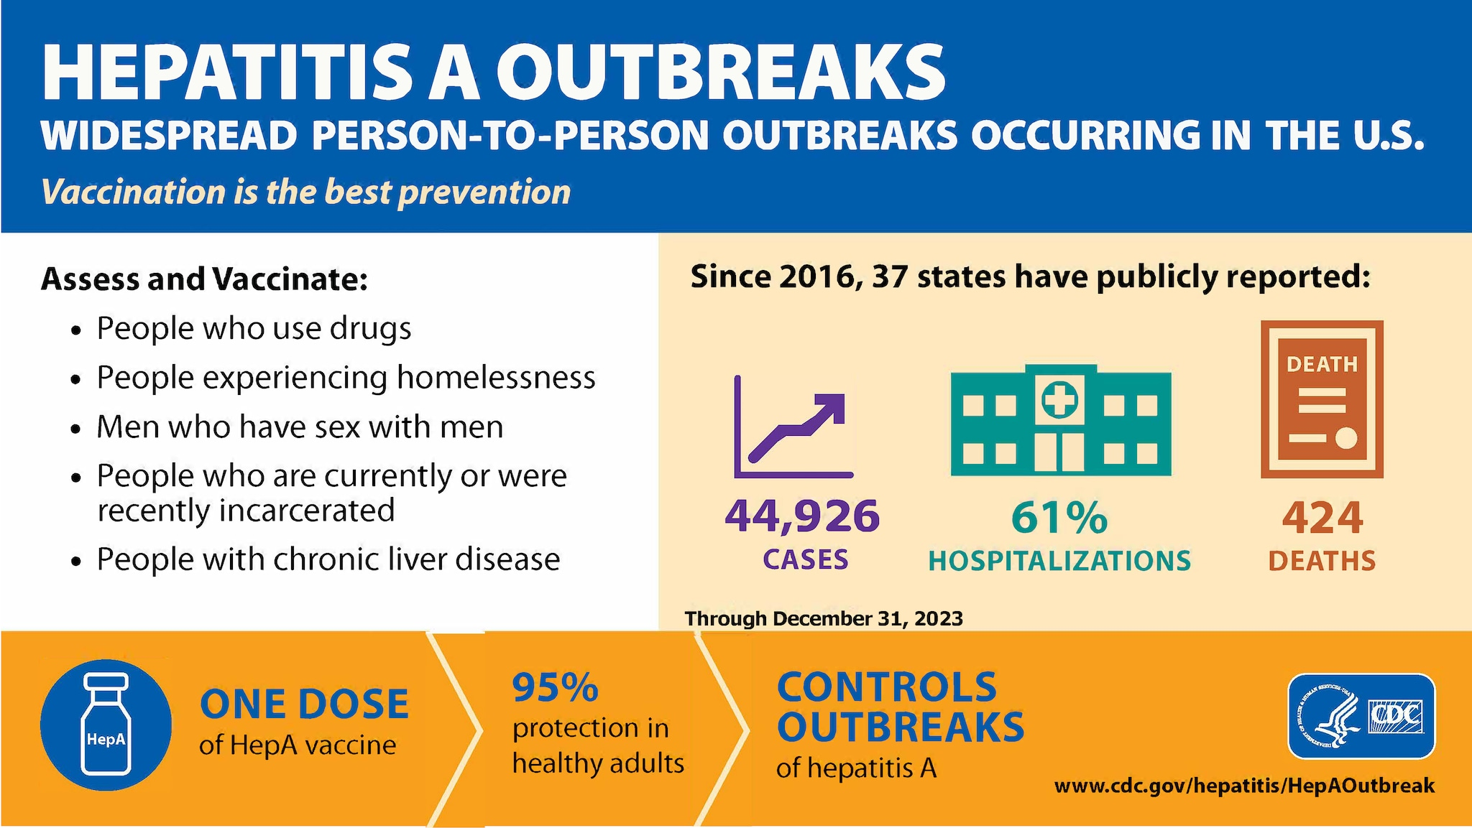

Slide 15
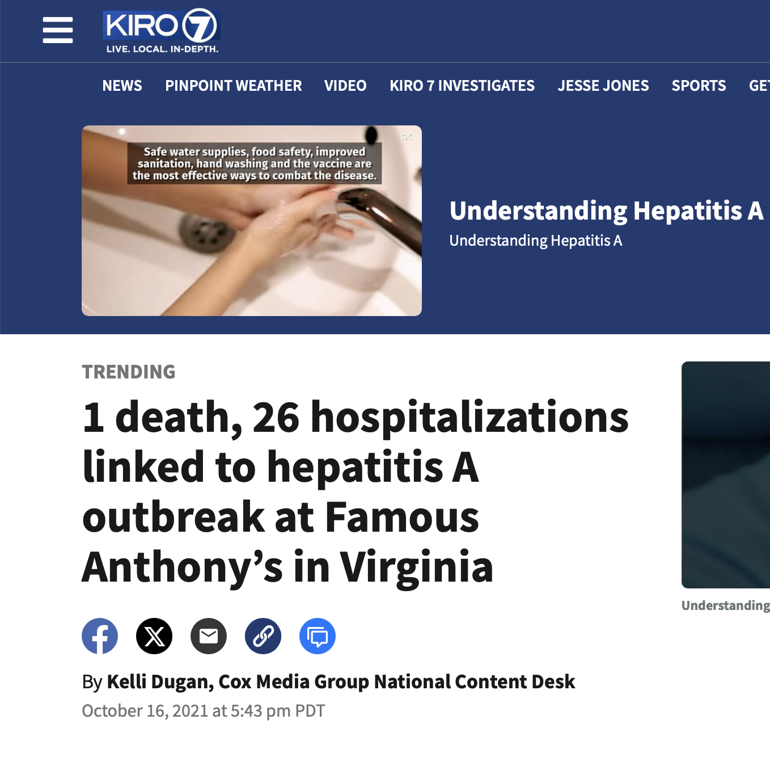
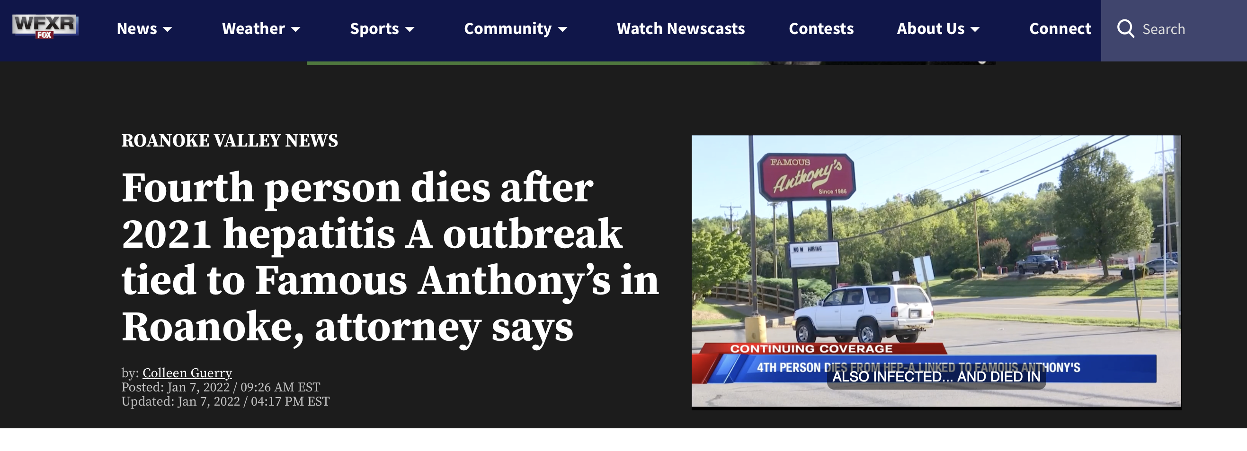


Slide 16
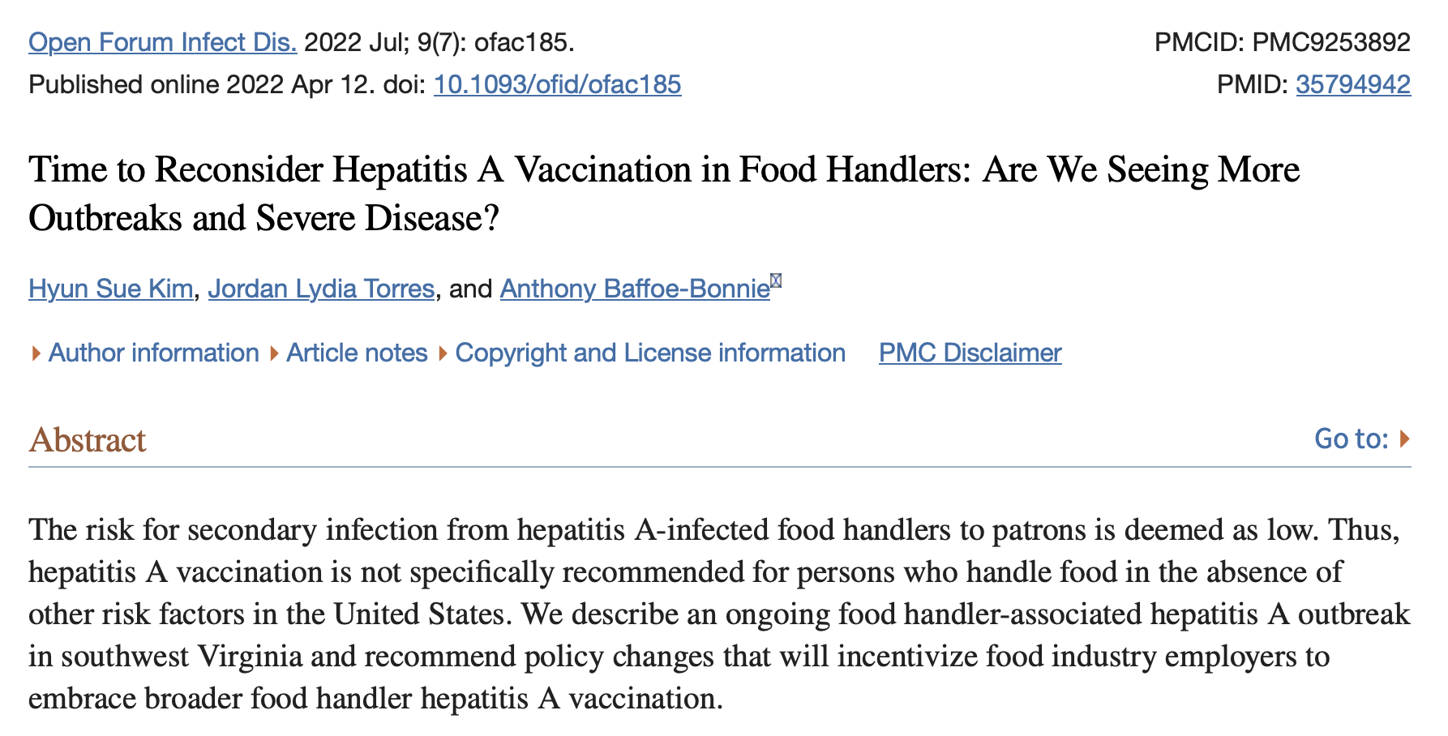
ID - Carilion

Slide 17
What can physician’s do in case of outbrake?
VACCINATE
High risk patients should be offered the hepatitis A vaccine in order to prevent or control an outbreak.
One dose of single-dose hepatitis A vaccine has been shown to control outbreaks of hepatitis A.
Pre-vaccination serologic testing is not required to administer hepatitis A vaccine.
Vaccinations should not be postponed if vaccination history cannot be obtained or records are unavailable.
Clinicians should report positive cases to local health authorities.

Slide 18
Hepatitis B
“It is complicated, but usually becomes a chronic condition”

Slide 19

Case 2
Ms Garcia is a 40 yo female that presents to primary care clinic after a long hiatus to reestablish care.
She has a PMHx of dyslipidemia and hypertension.
After reviewing the most pressing concerns, you review immunization status tab on EPIC, and there is no record of prior immunization, and she is unsure if she has ever been vaccinated for Hepatitis B.
Does she need to be screened for Hepatitis B?

Slide 20
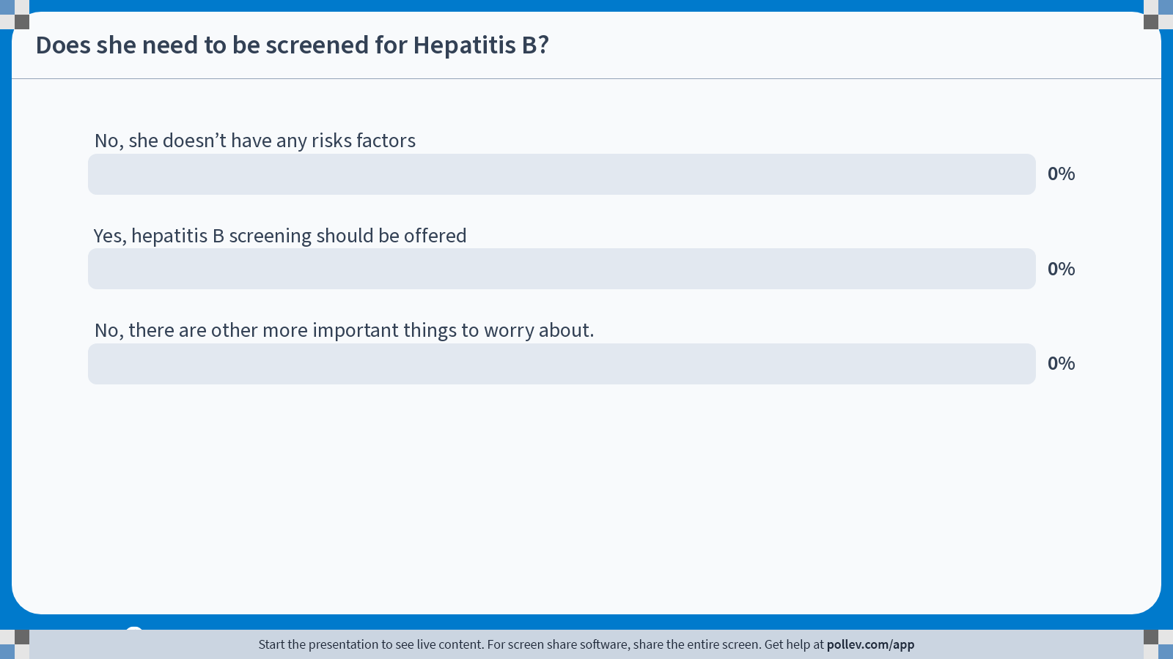

Notes:
Poll Title: Do not modify the notes in this section to avoid tampering with the Poll Everywhere activity.
More info at polleverywhere.com/support
Does she need to be screened for Hepatitis B?
https://www.polleverywhere.com/multiple_choice_polls/SWkoOH8to8zlNqCuz5N5a?state=opened&flow=Default&onscreen=persist

Slide 21
Does she need to be screened for Hepatitis B?
No, she doesn’t have any risks factors
Yes, hepatitis B screening should be offered
No, there are other more important things to worry about.

Slide 22
Chronic Hepatitis B Virus Infection (HBV)- FACTS
Proportion of persons with acute HBV that progress to chronic HBV
    As many as 90% of infants
    30% to 50% of children between age 1 and 5 years
    5% of adults
Often asymptomatic
Fulminant hepatitis in about 1% to 2% of acutely infected adults
25% of persons infected as children and 15% of persons infected as adults will die prematurely

Slide 23
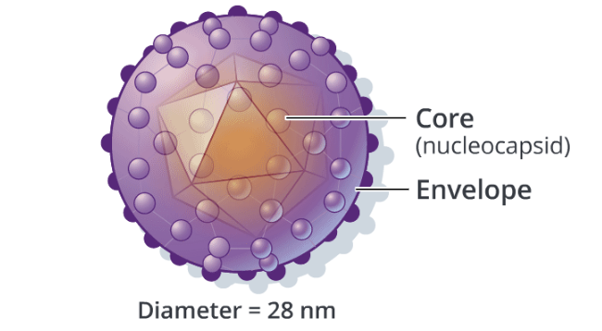
Hepatitis B Virus: Key Structures
Hepatitis B is partially double-stranded DNA virus.
Transmission by parenteral or mucosal exposure
Replicates in hepatocytes
Unique reverse transcription replication
Hepatitis B surface Ag
Image Credit: Cognition Studios, Inc.
Notes:
Hepatitis B is partially double-stranded DNA virus. The main marker of active infection is the HB surface antigen. This is lipoprotein – it is a component of the envelope and is the major site for binding of neutralizing antibody.
Hepatitis B Pathogenesis
Transmission by parenteral or mucosal exposure
Replicates in hepatocytes
Unique reverse transcription replication

Slide 24
Recommended Screening Tests
UNIVERSAL SCREENING
The CDC recommends universal HBV screening for all adults (18 years of age and older) using a 3-test panel, which includes:^{[5]}
  Hepatitis B surface antigen (HBsAg)
  Antibody to hepatitis B surface antigen (anti-HBs)
  Total antibody to hepatitis B core antigen (anti-HBc)
SCREENING OF PREGNANT PEOPLE
Pregnant people should be screened for HBV using the 3-test panel of HBsAg, anti-HBs, and anti-HBc.
Pregnant people who have previously undergone HBV screening with a 3-test panel and do not have any subsequent risk for HBV can be screened using HBsAg alone.
RISK-BASED TESTING
Susceptible persons at increased risk for HBV should be screened using the 3-test panel of HBsAg, anti-HBs, and anti-HBc.
Notes:
https://www.hepatitisb.uw.edu/custom/self-study/diagnosis-hbv/3
The benefits of using a 3-test panel are that it can identify individuals with current HBV infection, those with prior HBV infection, those with immunity due to prior vaccination, and those who are susceptible to HBV and would benefit from vacci
The USPSTF recommends screening for hepatitis B virus (HBV) infection in adolescents and adults at increased risk for infection.

Slide 25
Hepatitis B Serologies
Profile | HBsAg | Total core Ab | Anti-HBs | Core IgM Ab | HBV DNA
Never infected (susceptible) | - | - | - | - | -
Acute infection | + | + | - | + | +
Recovery from past infection | - | + | + | - | -
Chronic infection | + | + | - | - | +
Isolated core antibody | - | + | - | - | +/-
Immunized (or passive Ab receipt) | - | - | + | - | -
Notes:
And finally, the individual who was immunized against hepatitis B should only have surface antibody but nothing else present in their blood.
So that is hepatitis B serologies – there may be exceptions to these rules when you encounter a patient who has a false positive (which occasionally happens) or in those who are transitioning from one phase to another but for the vast majority of patients, they should fall into one of these categories.

Slide 26
Continuation of Case 2
You discussed with Ms Garcia the recommendation for screening testing.
Should you recommend vaccination against Hepatitis B on this visit?
No, you need to wait for HBV serologic results
Yes, she should receive first dose of Hepatitis B vaccine today
No, she is not at high risk

Slide 27
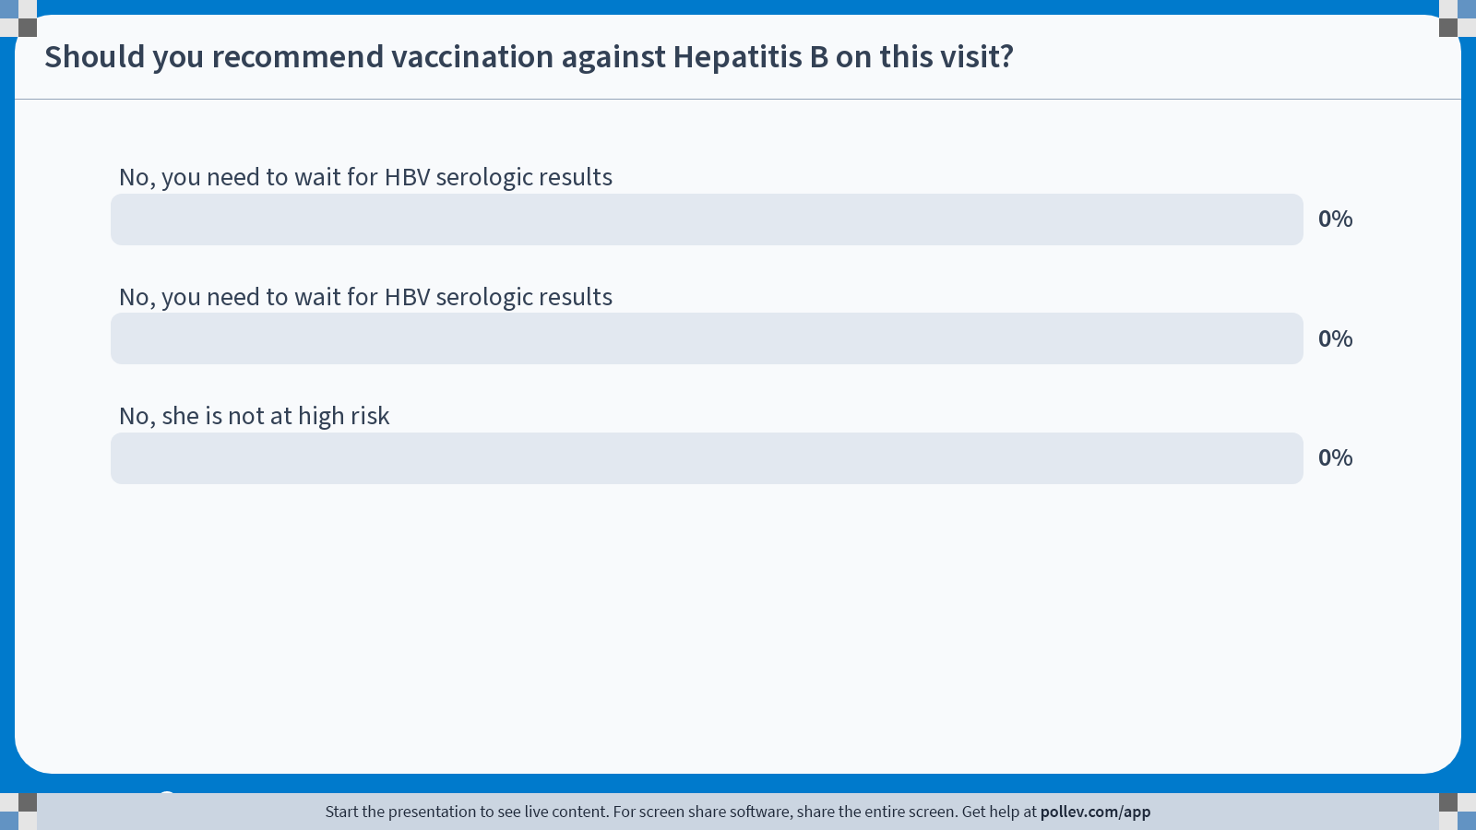
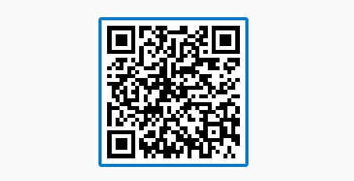
Notes:
Poll Title: Do not modify the notes in this section to avoid tampering with the Poll Everywhere activity.
More info at polleverywhere.com/support
Should you recommend vaccination against Hepatitis B on this visit?
https://www.polleverywhere.com/multiple_choice_polls/MiXzYMWc14XN9wBu89HQx?display_state=chart&activity_state=opened&state=opened&flow=Engagement&onscreen=persist

Slide 28
Hepatitis B Prevention Strategies
Hep B vaccination is the mainstay of hepatitis B prevention efforts.
A comprehensive strategy to eliminate HBV transmission includes:
  Universal vaccination of infants beginning at birth,
  Routine vaccination of previously unvaccinated children less than age 19 years
Notes:
https://www.cdc.gov/mmwr/volumes/71/wr/mm7113a1.htm

Slide 29
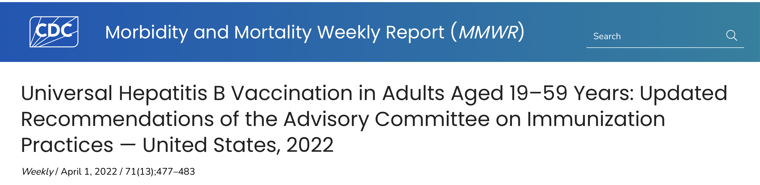
Persons who have completed a Hep B vaccination series at any point or who have a history of HBV infection should not receive additional Hep B vaccination, although there is no evidence that receiving additional vaccine doses is harmful.
Testing is not a requirement for vaccination, and in settings where testing is not feasible, vaccination of persons recommended to receive the vaccine should continue.
Notes:
What are the implications for public health practice?
Universal adult HepB vaccination through age 59 years removes the need for risk factor screening and disclosure and could increase vaccination coverage and decrease hepatitis B cases.
Removing the risk factor assessment previously recommended to determine vaccine eligibility in this adult age group (2) could increase vaccination coverage and decrease hepatitis B cases.
Persons who have completed a HepB vaccination series at any point or who have a history of HBV infection should not receive additional HepB vaccination, although there is no evidence that receiving additional vaccine doses is harmful.¶ However, there are cases where revaccination might be indicated as specified in the 2018 ACIP recommendation (e.g., nonresponder infants born to persons testing positive for hepatitis B surface antigen [HBsAg], health care providers, and persons on hemodialysis) (2). Providers should only accept dated records as evidence of HepB vaccination. Vaccination of persons immune to HBV infection because of current or previous infection or HepB vaccination does not increase the risk for adverse events. However, in settings in which the patient population has a high rate of previous HBV infection,** prevaccination testing, which may be performed concomitantly with administration of the first dose of vaccine, might reduce costs by avoiding complete vaccination of persons who are already immune. Prevaccination testing consists of testing for HBsAg, antibody to HBsAg (anti-HBs), and antibody to hepatitis B core antigen (anti-HBc). The presence of HBsAg indicates current HBV infection. The presence of anti-HBs is generally interpreted as indicating immunity, either from HepB vaccination after a complete series or after recovery from HBV infection. The presence of total anti-HBc indicates previous or ongoing infection with HBV. Detailed interpretations of serologic markers for HBV infection are available (2). Lack of access to serologic testing should not be a barrier to vaccination of susceptible persons, especially in populations that are difficult to reach. Testing is not a requirement for vaccination, and in settings where testing is not feasible, vaccination of persons recommended to receive the vaccine should continue (2).

Slide 30
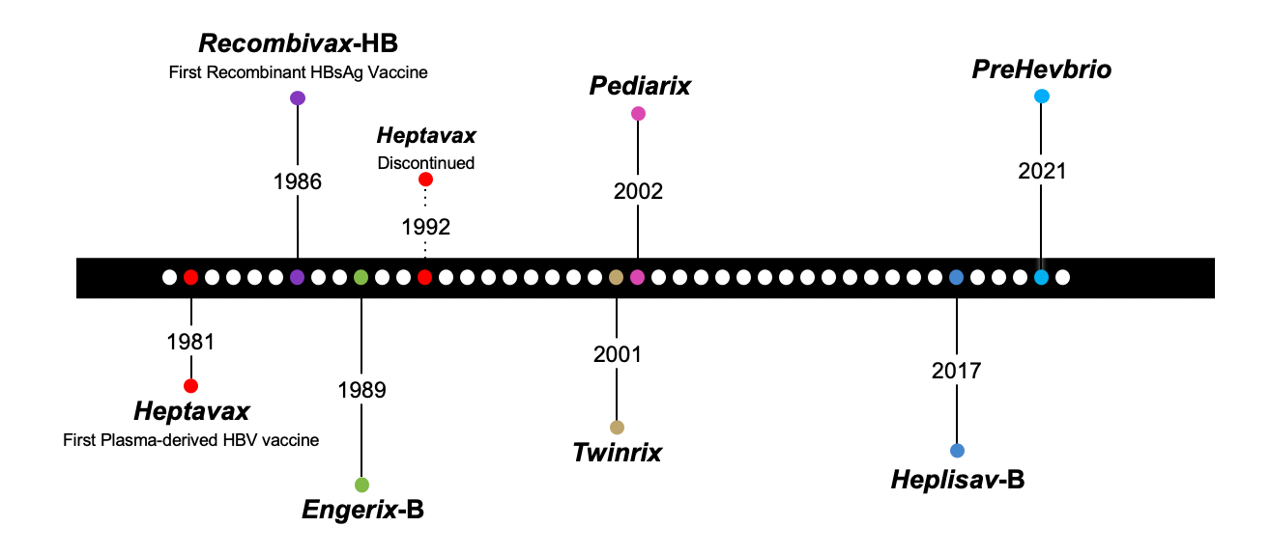
HBV vaccination
Notes:
News & Views: What's Different about the Latest Hepatitis B Vaccine, PreHevbrio?
Published on Apr 27, 2023
Vaccine Update for Healthcare Providers
Do you care for adult patients? If yes, do you routinely offer hepatitis B vaccine?
In 2022, the Centers for Disease Control and Prevention (CDC) recommended routine vaccination of adults up to 59 years of age and those 60 years and older at increased risk. The updated recommendations also indicate that those 60 and older who wish to protect themselves against hepatitis B can be vaccinated.
These recommendations were made based on recent data:
More than half of acute cases in 2019 were in those 30 to 49 years of age.
Over the last several years, rates of hepatitis B have been increasing in those 40 years of age and older.
Vaccination rates in adults are low, even if individuals are at increased risk of hepatitis B.
Some adult conditions, like chronic liver disease, decrease vaccine effectiveness.
Recently, a new option for hepatitis B vaccination of adults became available, PreHevbrio™. As adult healthcare providers increase efforts to protect their patients against hepatitis B, we thought it would be useful to describe how this vaccine differs from previously available hepatitis B vaccine options.
A little virology on the way to discussing the active ingredients
Hepatitis B virus famously tricks the immune system by manufacturing extra surface proteins that flood the bloodstream. By doing this, many antibodies bind to the excess surface protein, allowing whole viral particles to remain free to infect other cells. Indeed, Dr. Hilleman used this fact to create the first hepatitis B vaccine, isolated from the blood of infected individuals.
Because making a vaccine from the blood of hepatitis B-positive individuals limited its acceptance, Dr. Hilleman made a second hepatitis B vaccine using genetic engineering. It’s the approach still used today. Specifically, the gene for the surface protein was inserted into yeast cells, so as the yeast reproduced, the hepatitis B protein was also produced. Indeed, all previously approved hepatitis B vaccines approved for use in adults (Engerix-B®, Heplisav-B®, and Recombivax HB®) are made this way.
But the surface protein of hepatitis B virus is complex in that it appears in three sizes: small, medium and large. The small version is made from 226 residues (in proteins a residue is a single amino acid), and it is the version used in existing vaccines. An additional 55-residue portion is known as pre-S2, and when combined with the small version residues, it makes the medium size surface protein. Finally, the largest surface protein includes both portions as well as an additional 108 or 119 residues, called pre-S1. PreHevbrio contains all three differently sized proteins (small, pre-S2 and pre-S1). When this vaccine is made, the proteins are produced in mammalian cells rather than yeast cells.
What else is in the vial?
PreHevbrio contains an aluminum adjuvant. Each dose also contains a series of salts, water, and very small amounts of materials that remain from the manufacturing process, including proteins and DNA from the mammalian cells used to grow the virus, serum albumin (of bovine origin), and formaldehyde.
Other hepatitis B vaccines used in adults also include an aluminum-based adjuvant except for Heplisav-B, which contains a novel adjuvant, called CpG 1018. The “C” stands for cytosine, and the “G” stands for guanine. The “p” stands for the phosphodiester linkage that links the two nucleotides. Nucleotides are the building blocks of DNA.
Immunogenicity
PreHevbrio was compared with Engerix-B in clinical trials. Seroprotection was defined by the presence of antibodies against hepatitis B surface protein that were greater than or equal to 10 mIU/mL four weeks after the last dose. PreHevbrio seroconversion rates were as good as or slightly better than those of Engerix-B for all age groups evaluated.
Safety
All safety profiles for adult hepatitis B vaccine are similar. The most common side effects include pain and redness at the injection site, fatigue, headache and irritability. A small number of people develop mild fever.
PreHevbrio and Heplisav-B are not recommended during pregnancy due to lack of safety data; however, other hepatitis B vaccines can be used if vaccination is needed.
People with history of severe allergic reaction after a previous dose of hepatitis B vaccine should not be vaccinated, and those with severe allergic reactions to yeast should not receive versions grown in yeast cells (Engerix-B, Heplisav-B, and Recombivax HB).
Recommended use
PreHevbrio is recommended for those 18 years and older. It is administered in three doses using a schedule similar to most other hepatitis vaccines. The second dose is given one month after the first, and the third dose is administered six months after the first dose.
Due to the more powerful adjuvant, Heplisav-B requires only two doses separated by one month.
A combination vaccine, known as Twinrix®, contains hepatitis A and hepatitis B components. The hepatitis B component of this vaccine is Engerix-B. Adults who get this vaccine can get three doses at 0, 1 and 6 months or use an accelerated schedule of 0, 7 and 21-30 days. When an accelerated schedule is used, a fourth dose should be administered at 12 months. People with severe allergic reactions to yeast, neomycin, or a previous dose should not receive Twinrix.

Slide 31
Hepatitis C
“It is rare to have the opportunity, using a single and safe oral medication, to eliminate a lethal disease”
Dr. Francis Collins

Slide 32

Case presentation
Ms H is a 59 yo female that presents to the FP clinic to establish care.
CC: left hip pain after fall
HPI:
She reports a fall few weeks ago, denies any other symptoms.
  PMHx: Hypertension, Sleep apnea, and GERD
  Past surgical Hx: none
  Social Hx: active smoker, married

Slide 33
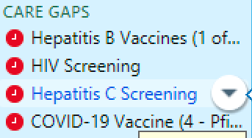
Case presentation
After addressing treatment for Hypertension and left hip pain, you try to check other care gaps in her chart.

Slide 34
Question
Does she need HCV screening?
A.- No, she is not a baby-boomer
Or
B.- Yes, all adults 18-79 need HCV screening.

Slide 35
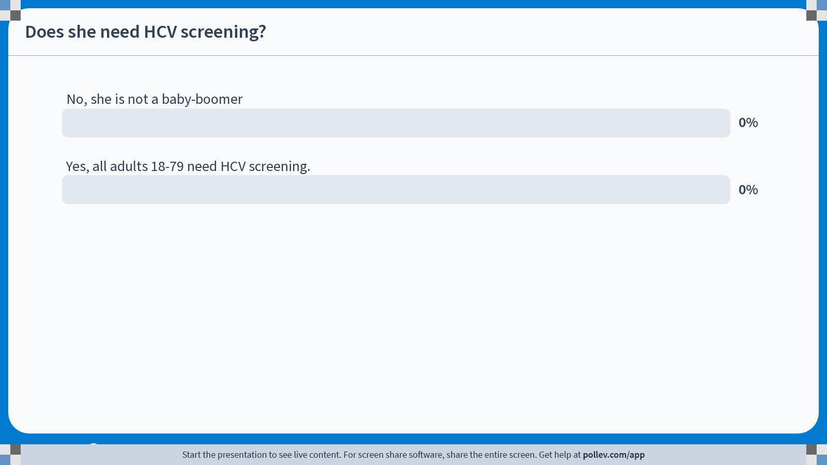
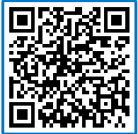
Notes:
Poll Title: Do not modify the notes in this section to avoid tampering with the Poll Everywhere activity.
More info at polleverywhere.com/support
Does she need HCV screening?
https://www.polleverywhere.com/multiple_choice_polls/BUHJdYdzp0xGABU12D8EH?state=opened&flow=Default&onscreen=persist

Slide 36
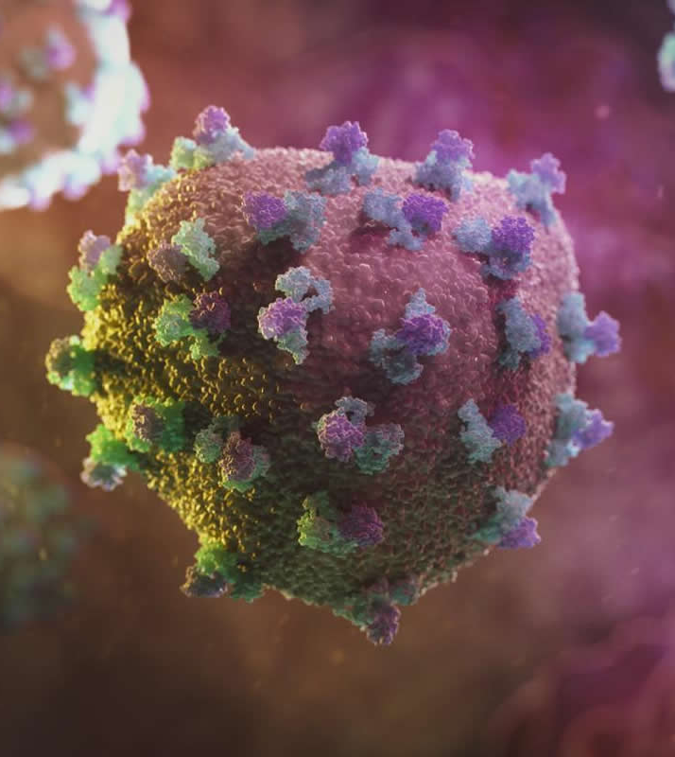
Hepatitis C virus (HCV)
It is an enveloped, positive sense, single-stranded RNA virus
The HCV particles are spherical and heterogenous in size, typically ranging 40-80 nm in diameter.
Does not replicate through a DNA intermediate and does not have the ability to integrate its genetic information into chromosomal DNA.
Catanese MT. Proc Natl Acad Sci U S A. 2013;110:9505-10.
Notes:
positive sense RNA virus comprises viral mRNA, which can be translated into viral proteins directly.
Unlike HBV, HCV doesn’t replicate through DNA intermediate

Slide 37
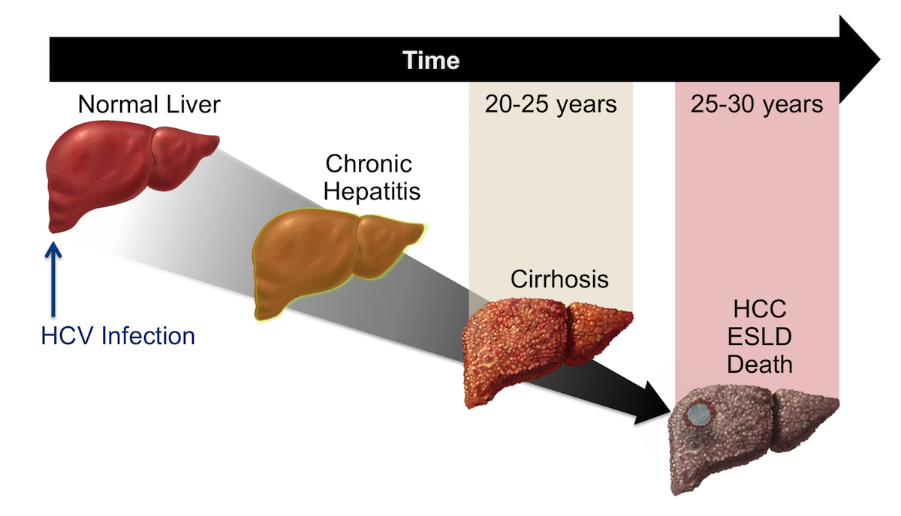
Time Course of Progression with HCV infection
Illustration: David H. Spach, MD
Notes:
This graphic shows the time course for the natural history of chronic hepatitis C infection. Following initial HCV infection, there is typically a lag of 20 to 25 years before cirrhosis develops.
Abbreviations: HCC = hepatocellular cancer; ESLD = end-stage liver disease
Once chronicity is established, available data suggest the process runs an indolent course for the first two decades after infection. Serious liver disease related to chronic HCV infection, such as cirrhosis, end-stage liver disease (ESLD), and hepatocellular cancer (HCC), are likely to emerge in the third and fourth decades after initial infection (Figure 2)

Slide 38
Number Of Reported Cases Of Acute Hepatitis C Virus Infection
And Estimated Infections United States, 2013–2020
.Am J Public Health 2014
CDC, National Notifiable Diseases Surveillance System
.
Notes:
Reported confirmed cases. For the case definition, see https://ndc.services.cdc.gov/conditions/hepatitis-c-acute/
Reference: Klevens RM, Liu, S, Roberts H, et al. Estimating acute viral hepatitis infections from nationally reported cases. Am J Public Health 2014; 104:482. PMC3953761
† The number of estimated viral hepatitis infections was determined by multiplying the number of reported cases that met the classification criteria for a confirmed case by a factor that adjusted for underascertainment and underreporting. The 95% bootstrap confidence intervals for the estimated number of infections are displayed in the Appendix.
Centers for Disease Control and Prevention. Viral Hepatitis Surveillance Report – United States, 2020. https://www.cdc.gov/hepatitis/statistics/2020surveillance/index.htm.
Published September 2022.

Slide 39
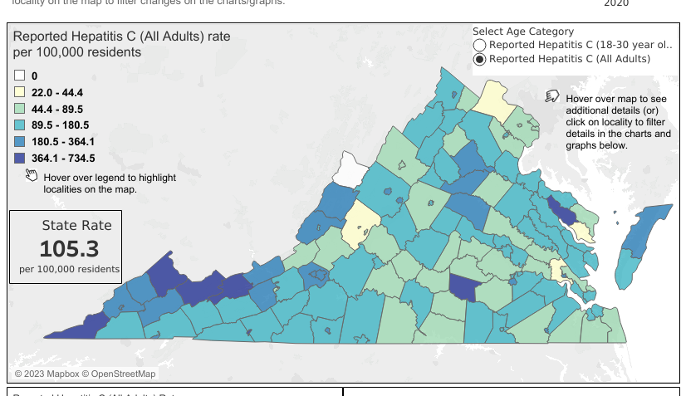
Hepatitis C cases among adults >18 yo in Virginia in 2020
Notes:
The WV and Kentucky neighboring counties: Buchanan county 387 rate per 100 k, Tazewell County, Bland County have the higher rates of Hepatitis C infection in Virginia.
VDH website
https://www.vdh.virginia.gov/opioid-data/hepatitis-c-hcv/

Slide 40
Evolution of Screening guidelines timeline
1998
2003
2012
“Baby boomers”
2020
May
1991
2020
April
Focused on screening and follow-up of blood, plasma, organ, tissue, and semen donors/recipients
People with risks factors only
HCV AB testing reflex to supplemental PCR
USPSTF
“Universal screening”
CDC
“Universal screening”
Notes:
1 MMWR Recomm Rep, Volume 47, Issue RR-19, p.1-39 (1998) –
Recommendations.
In 1998, the Centers for Disease Control and Prevention (CDC) issued recommendations for risk-based HCV testing as part of an overall strategy to prevent and control HCV infection and HCV-related disease. These recommendations categorize groups of persons who should undergo routine testing for HCV infection based on their risk for infection and based on a recognized exposure.
Birth.
In 2012, the CDC issued a recommendation that all adults born from 1945 through 1965 should undergo one-time testing to ascertain HCV. The 1945-1965 birth cohort, often referred to as the “baby boomers”, accounts for a large proportion of chronic HCV infections in the United States

Slide 41






In general, major guidelines now recommend:
  Routine one-time universal HCV testing for adults 18 years of age and older.
  Routine HCV screening of pregnant individuals,
  Screening younger persons at risk of acquiring HCV,
  Repeat screening for those with ongoing risk for HCV acquisition.
Notes:
Recently, several organizations have issued hepatitis C virus (HCV) screening recommendations.

Slide 42
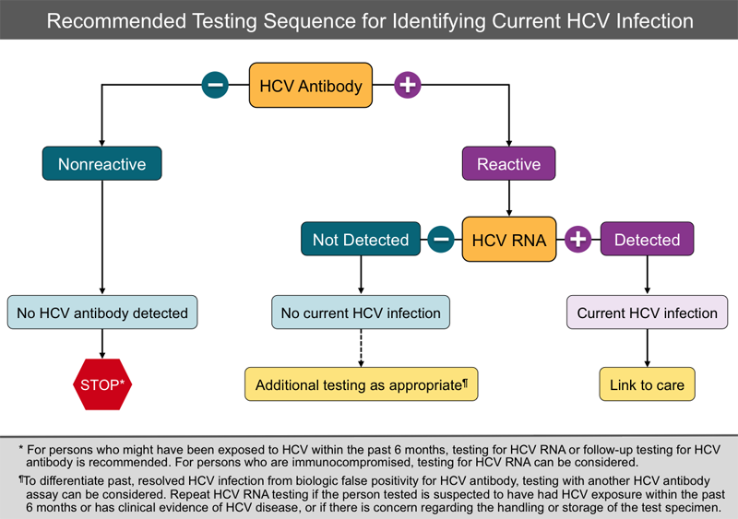

Slide 43
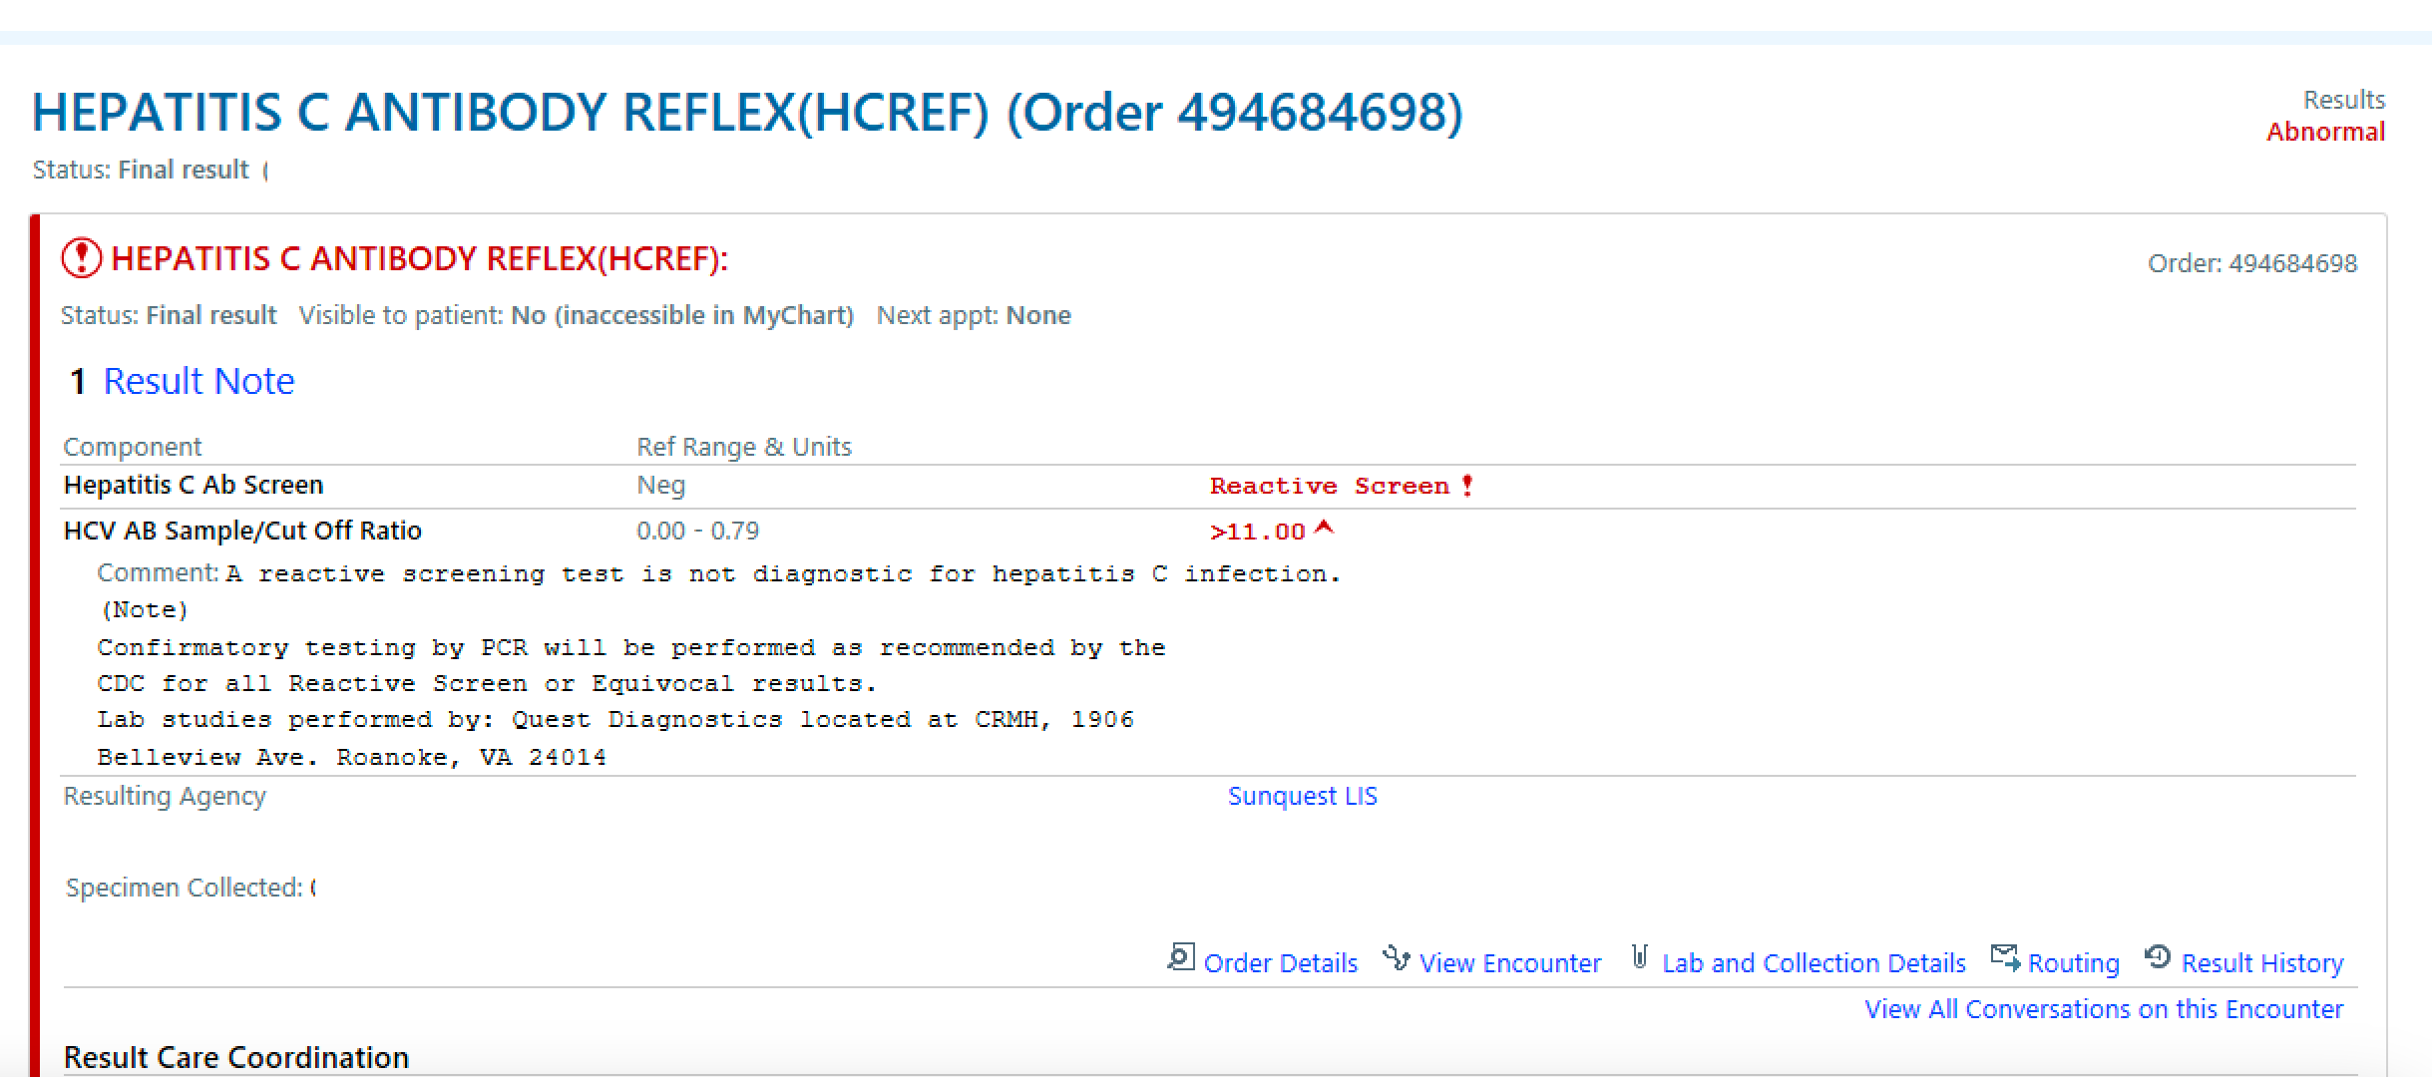
Case presentation

Slide 44
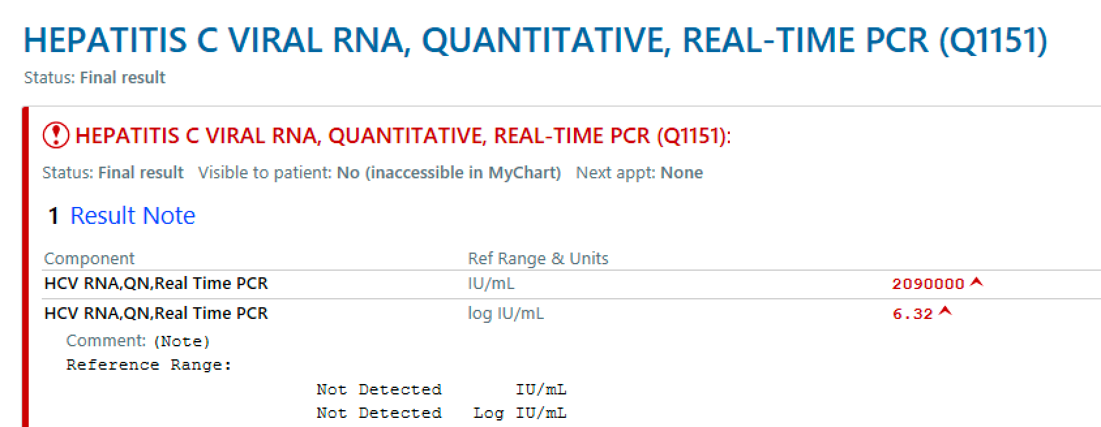

Slide 45
AASLD/IDSA HCV Guidance –Treatment Recommendation
Recommendation for When and in Whom to Initiate Treatment
Recommended
Treatment is recommended for all patients with acute or chronic HCV infection, except those with a short life expectancy that cannot be remediated by HCV therapy, liver transplantation, or another directed therapy.
Patients with a short life expectancy owing to liver disease should be managed in consultation with an expert.
Rating*
I
A
*
I = Evidence and/or general agreement that a given diagnostic evaluation, procedure, or treatment is beneficial, useful, and effective;
A = Data derived from multiple randomized clinical trials, meta-analyses, or equivalent
AASLD/IDSA HCV Guidance: Recommendations for Testing, Managing, and Treating Hepatitis C. Available at: https://www.hcvguidelines.org/evaluate/monitoring. (Accessed December 2022)

Slide 46
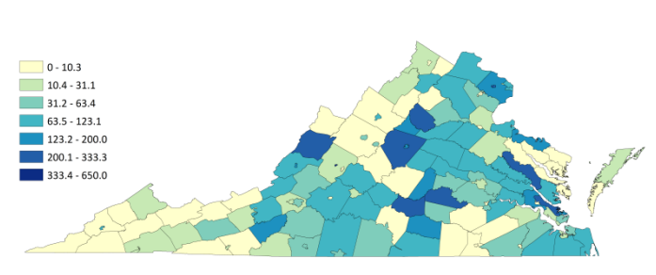
SW Virginia has a disproportionately low amount of HCV treatment relative to disease burden
Hepatitis C Treatment Prescriptions per 100 New Hepatitis C Diagnoses
Source: Virginia Department of Health (2016). Virginia Hepatitis C Epidemiologic Profile 2016. Retrieved from https://www.vdh.virginia.gov/content/uploads/sites/10/2016/06/Virginia-Hepatitis-C-Epidemiologic-Profile-2016.pdf

Slide 47

People with Hepatitis C Face Multiple Barriers to Receiving Treatment
Thompson WW, MMWR Morb Mortal Wkly Rep 2022;71:1011-1017
Notes:
Eliminating insurance restrictions and expanding the number of primary care doctors treating the infection can improve access to treatment

Slide 48
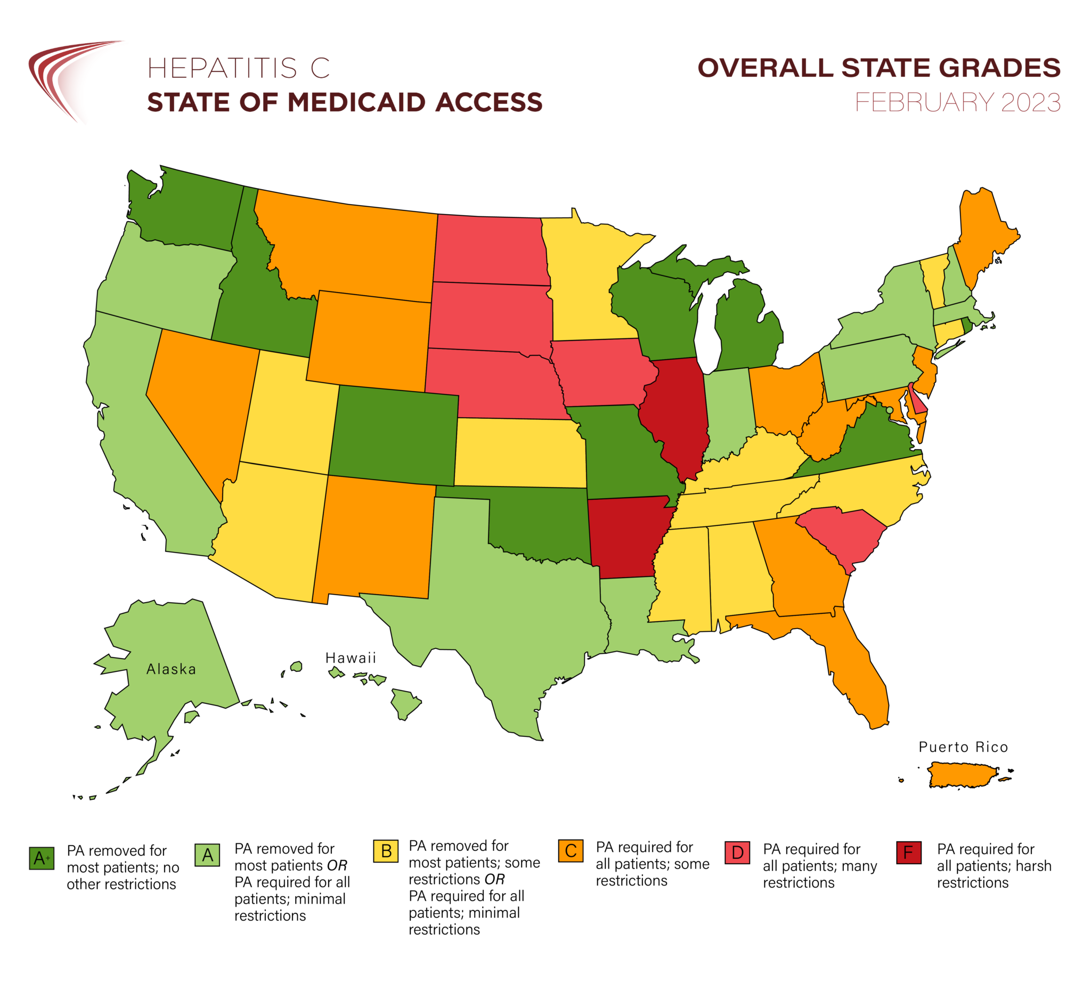
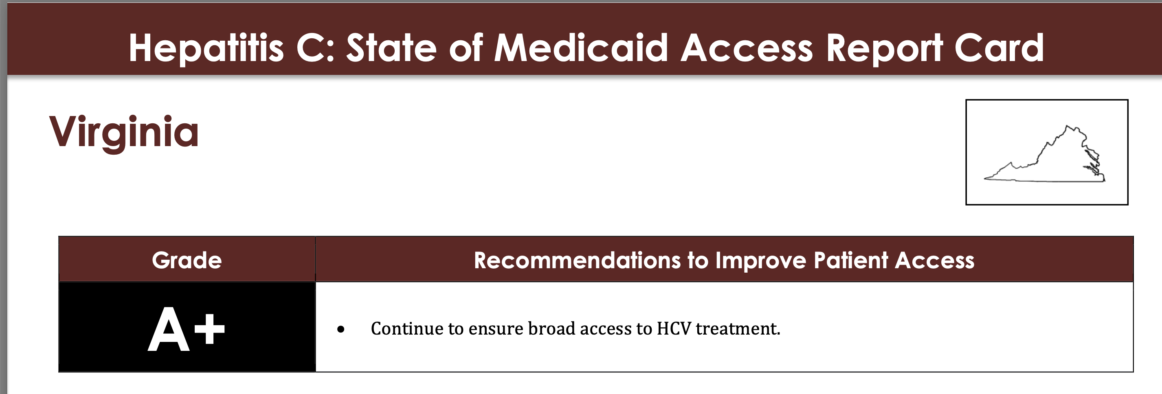
31 states require prior authorization for treatment of Hepatitis C infection, however 21 states have removed prior authorization requirement.
State of Virginia:
-No Substance Use Restriction
-No Prescriber Restrictions
-No Retreatment Restrictions
SOURCE: STATEOFHEPC.ORG

Slide 49
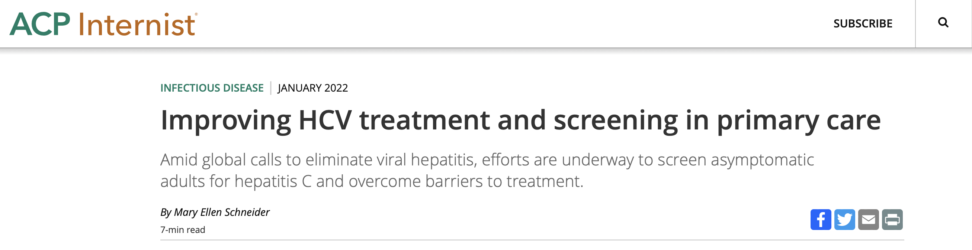
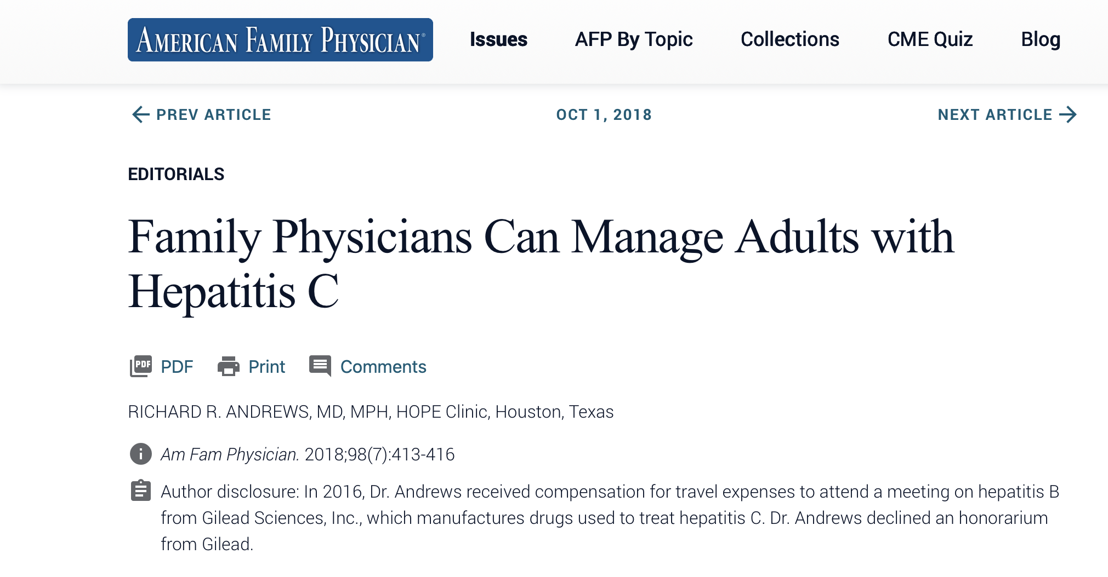
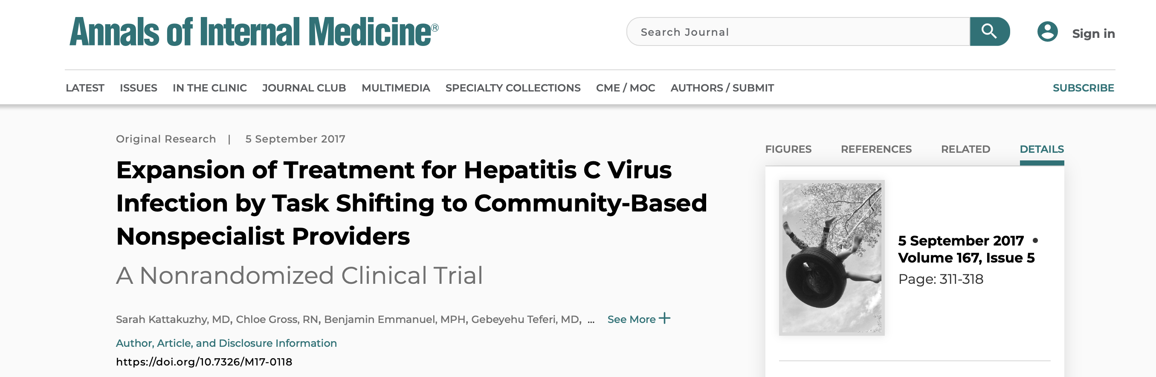

Slide 50
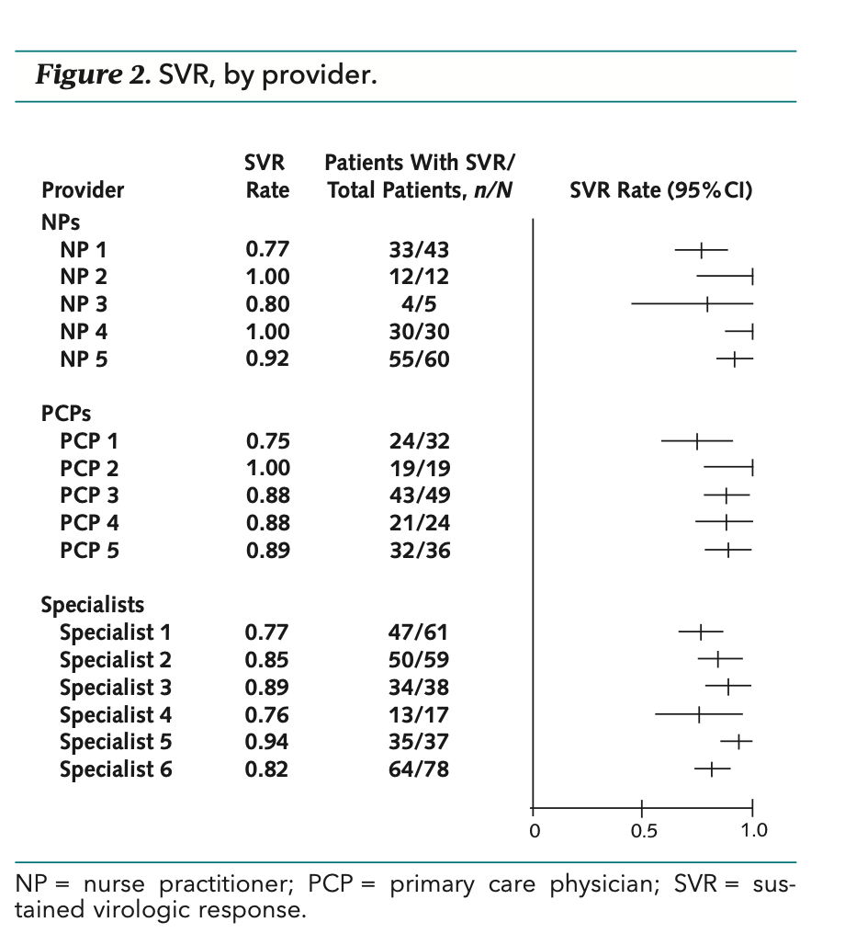
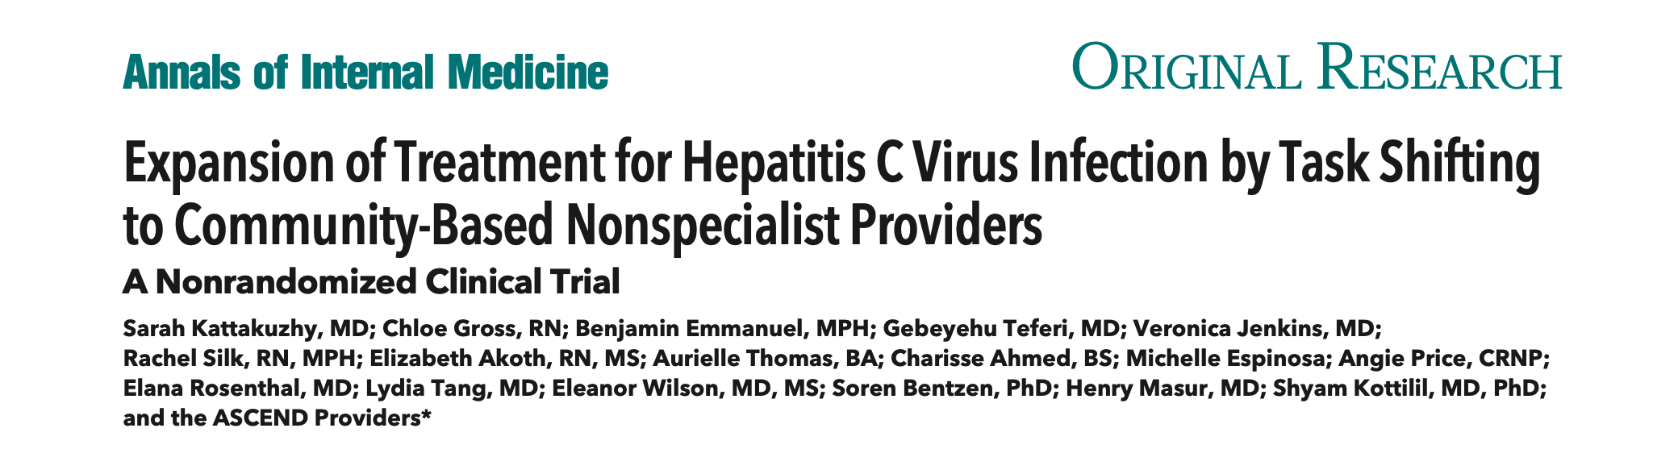
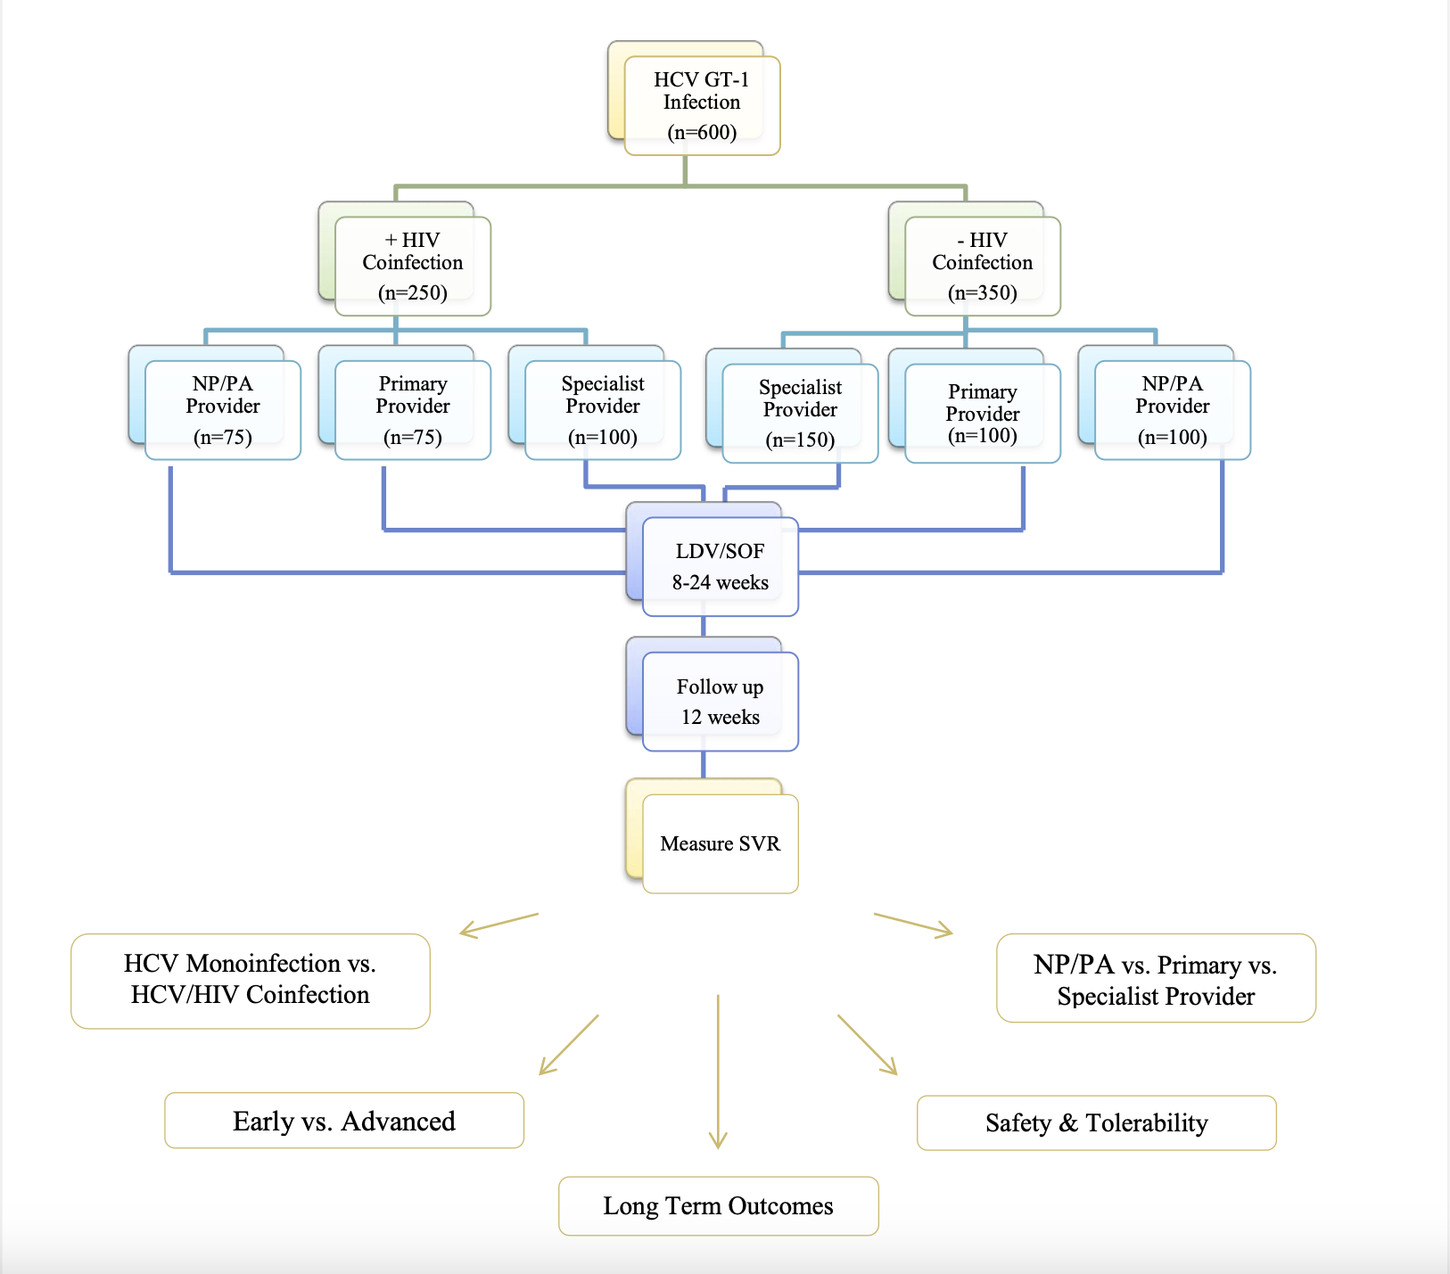
Notes:
Background: Direct-acting antiviral (DAA) therapy for hepatitis C virus (HCV) infection has resulted in high rates of disease cure; however, not enough specialists currently are available to pro- vide care.
Objective: To determine the efficacy of HCV treatment inde- pendently provided by nurse practitioners (NPs), primary care physicians (PCPs), or specialist physicians using DAA therapy.
Design: Nonrandomized, open-label clinical trial initiated in 2015. (ClinicalTrials.gov: NCT02339038)
Setting: 13 urban, federally qualified health centers (FQHCs) in the District of Columbia.
Patients: A referred sample of 600 patients, of whom 96% were black, 69% were male, 82% were treatment naive, and 20% had cirrhosis. Seventy-two percent of the patients had HCV genotype 1a infection. The baseline characteristics of patients seen by each provider type were similar.
Intervention: Patients were assigned in a nonrandomized but specified manner to receive treatment from 1 of 5 NPs, 5 PCPs, or 6 specialists. All providers underwent an identical 3-hour train- ing session based on guidelines. Patients received treatment with ledipasvir–sofosbuvir, which was provided on site, accord- ing to U.S. Food and Drug Administration labeling requirements.
Measurements: Sustained virologic response (SVR).
The recent introduction of highly effective, well- tolerated direct-acting antiviral (DAA) therapy for hepatitis C virus (HCV) infection has raised the possibil- ity of rapid treatment expansion and widespread cure. Despite this scientific breakthrough, of the 43% of pa- tients aware of their HCV diagnosis and linked to care, only 16% have begun treatment (1). With an estimated 20 000 gastroenterology– hepatology and infectious disease physicians in the United States (2), the current specialist workforce (3, 4) is insufficient to meet the treatment demands of the 2.7 million Americans living with HCV infection (5).
Several studies of partial task shifting—shared treat- ment between specialists and primary care providers— demonstrated its success in improving access to HCV care (6–11). Project ECHO (Extension for Community Healthcare Outcomes) (4) used a model of primary care physician (PCP)–based HCV treatment with specialist mentorship to demonstrate equivalent cure rates be- tween PCPs and specialists. However, few of these studies were prospective or comparative, and all used interferon-based regimens, limiting their applicability
Results: 516 patients achieved SVR, a response rate of 86% (95% CI, 83.0% to 88.7%), with no major safety signals. Response rates were consistent across the 3 provider types: NPs, 89.3% (CI, 83.3% to 93.8%); PCPs, 86.9% (CI, 80.6% to 91.7%); and specialists, 83.8% (CI, 79.0% to 87.8%). Patient loss to follow-up was the major cause of non-SVR.
Limitation: Nonrandomized patient distribution; possible refer- ral bias.
Conclusion: In a real-world cohort of patients at urban FQHCs, HCV treatment administered by nonspecialist providers was as safe and effective as that provided by specialists. Nurse practitio- ners and PCPs with compact didactic training could substantially expand the availability of community-based providers to esca- late HCV therapy, bridging existing gaps in the continuum of care for patients with HCV infection.

Slide 51

CARILION STRATEGIES TO IMPROVE HCV TESTING AND TREATMENT
EXPANDING MEDICAL PROVIDER CAPACITY

Slide 52
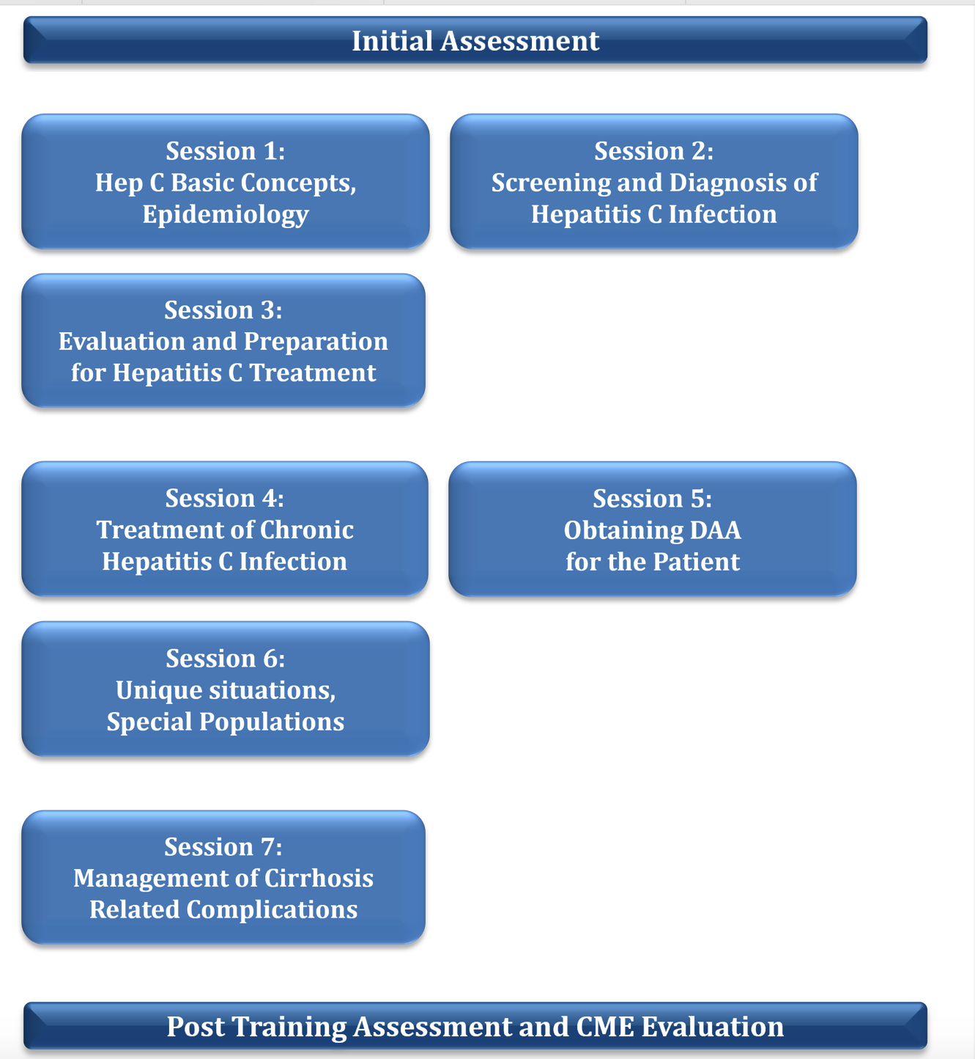



  7 asynchronous training videos
  15 – 30-minute sessions
  CME credits
  Ongoing support and mentoring available after training
  Access to HCV treatment coordinator

Slide 53
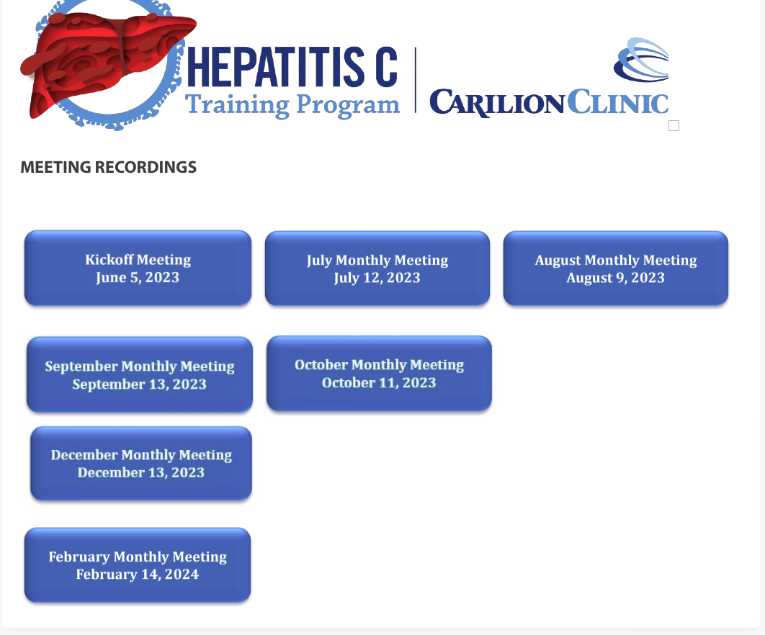



Invited guests:
- Dr Nathan Everson
Dr Bansal Ekta
Dr Sadiq Saima

Slide 54
Provider Composition enrolled on the Program

Slide 55

Many Provider Offices Are Engaged

Slide 56
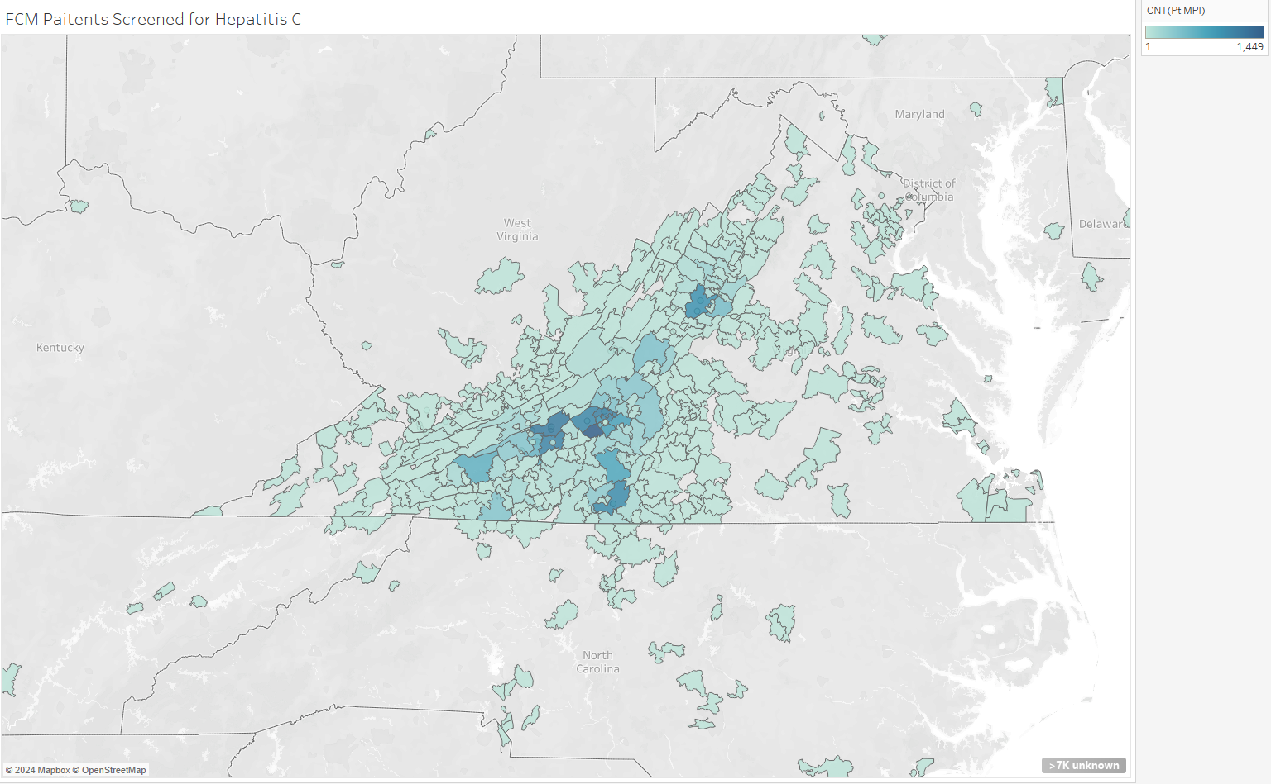
FCM Patients Screened for Hepatitis C

Slide 57
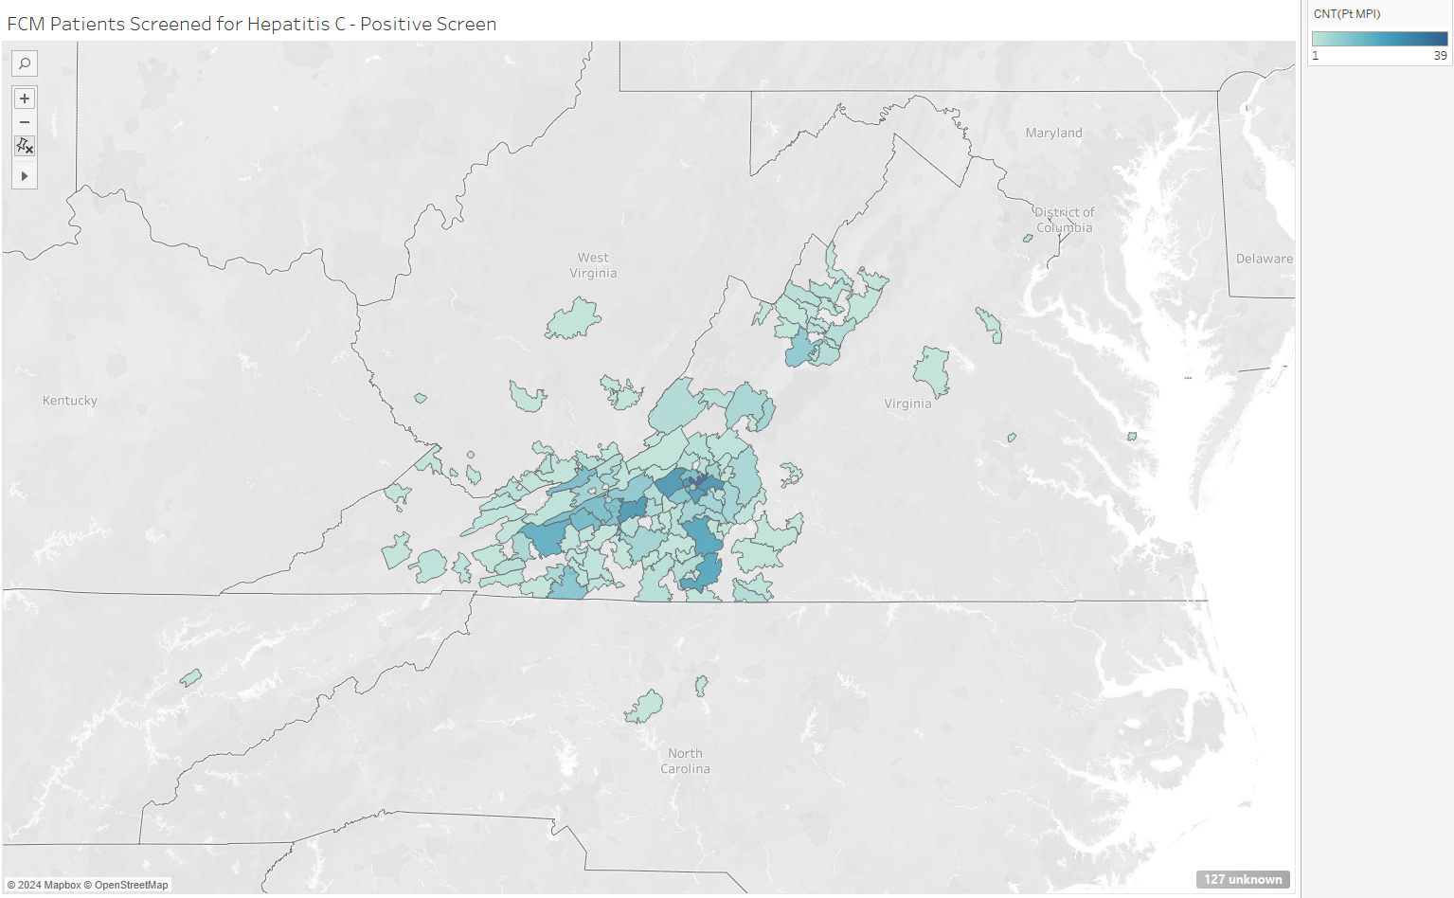
Distribution of Patients with a Positive Screen for Hepatitis C

Slide 58
Greater Access to Screening

Slide 59
Streamlined Care
Decreased interval between diagnosis and treatment initiation

Slide 60


Feedback from providers
“I always enjoy learning something new. I do have a hepatitis C patient who is about to start treatment and I feel comfortable doing so. Providers in our office went through the training together and it was helpful to be able to ask questions of each other and remind each other about the training”.
“I think initial material was at a good pace. Questions were appropriately answered in timely manner.
“I think it should be online series with follow up live sessions for questions and practical aspects specially for drug interaction, treatment, and complications.
“I do appreciate the opportunity to participate in the course, the content was to the point, Dr. Gomez and nurse coordinator readily available for any questions or concerns I have for patient care”.

Slide 61
Case follow up…
Ms H was diagnosed with Hepatitis C without cirrhosis.
She was started on treatment with glecaprevir-pibrentasvir 100-40 mg Tablet for 8 weeks
Vaccinated against Hepatitis A and Hepatitis B.
 | PCR before therapy | PCR after 12 weeks after therapy
HCV RNA,QN,Real Time PCRIU/mL log IU/mL | 2090000 (H) 6.32 (H) | <15 <1.18

Slide 62
SUMMARY POINTS
Hepatitis A causes an acute infection. It does not become chronic.
The CDC recommends universal HBV screening for all adults 18 years of age and older. And universal vaccination in people 19-59 yo.
Hepatitis C the most common blood-borne infectious disease in the United States.
Routine one-time universal HCV testing for adults 18 years of age and older.
Since 2014, hepatitis C has become one of the few chronic viral infections that can be cured using safe, well-tolerated, oral direct- acting antiviral (DAA) medications, with cures HCV infection in 95% or greater.
There is a need to increase the number of providers to screen and treatment HCV.

Slide 63
References:
Kim HS, Torres JL, Baffoe-Bonnie A. Time to Reconsider Hepatitis A Vaccination in Food Handlers: Are We Seeing More Outbreaks and Severe Disease? Open Forum Infect Dis. 2022 Apr 12;9(7):ofac185. doi: 10.1093/ofid/ofac185. PMID: 35794942; PMCID: PMC9253892.
https://www.cdc.gov/hepatitis-a/hcp/diagnosis-testing/index.html#cdc_hcp_diagnosis_interpreting-how-to-interpret-test-results
Langan RC, Goodbred AJ. Hepatitis A. Am Fam Physician. 2021 Oct 1;104(4):368-374. PMID: 34652109.
https://www.cdph.ca.gov/Programs/CID/DCDC/CDPH%20Document%20Library/HepatitisBandCScreeningToolkitforPrimaryCare.pdf
https://www.cdc.gov/mmwr/volumes/69/rr/rr6905a1.htm
https://www.cdc.gov/mmwr/volumes/71/wr/mm7113a1.htm
1.- Feinstone SM, Kapikian AZ, Purcell RH, et al.: Transfusion-associated hepatitis not due to viral hepatitis type A or B. N Engl J Med. 292:767-7701975 163436
2.- Prince AM, Brotman B, Grady GF, et al.: Long-incubation post-transfusion hepatitis without serological evidence of exposure to hepatitis-B virus.Lancet. 2:241-246 1974 4136143
3.- Choo QL, Kuo G, Weiner AJ, Overby LR, Bradley DW, Houghton M. Isolation of a cDNA clone derived from a blood-borne non-A, non-B viral hepatitis genome. Science. 1989 Apr 21;244(4902):359-62. doi: 10.1126/science.2523562. PMID: 2523562.
4.- Bennett, Raphael Dolin, Martin J. Blaser. Mandell, Douglas, and Bennett's Principles and Practice of Infectious Diseases. Philadelphia, PA :Elsevier/Saunders, 2015. Hepatitis C, chapter 156
5.- Chevaliez S, Pawlotsky JM. HCV Genome and Life Cycle. In: Tan SL, editor. Hepatitis C Viruses: Genomes and Molecular Biology. Norfolk (UK): Horizon Bioscience; 2006. Chapter 1. Available from: https://www.ncbi.nlm.nih.gov/books/NBK1630/
6.- Lingala S, Ghany MG. Natural History of Hepatitis C. Gastroenterol Clin North Am. 2015;44:717-34
7.- Treatment of chronic hepatitis C infection overview.3rd edition. Hepatitis C Online. (n.d.). Retrieved April 25, 2023, from https://www.hepatitisc.uw.edu/go/treatment-infection
8.- Schillie S, Wester C, Osborne M, Wesolowski L, Ryerson AB. CDC Recommendations for Hepatitis C Screening Among Adults — United States, 2020. MMWR Recomm Rep 2020;69(No. RR-2):1–17. DOI: http://dx.doi.org/10.15585/mmwr.rr6902a1external icon.
9.- Centers for Disease Control and Prevention. Viral Hepatitis Surveillance Report – United States, 2020. https://www.cdc.gov/hepatitis/statistics/2020surveillance/index.htm.
Published September 2022.
10.- Centers for Disease Control and Prevention. (n.d.). Hepatitis C - chapter 4 - 2020 yellow book. Centers for Disease Control and Prevention. Retrieved April 25, 2023, from https://wwwnc.cdc.gov/travel/yellowbook/2020/travel-related-infectious-diseases/hepatitis-c
11.- CDC. https://www.cdc.gov/hepatitis/statistics/2019surveillance/Figure3.8.htm. Accessed December 7, 2022. 2. Akyar E, et al. Emerg Infect Dis. 2016;22(5):907-909
12.- Jon E. Zibbell, Alice K. Asher, Rajiv C. Patel, Ben Kupronis, Kashif Iqbal, John W. Ward, and Deborah Holtzman, 2018:Increases in Acute Hepatitis C Virus Infection Related to a Growing Opioid Epidemic and Associated Injection Drug Use, United States, 2004 to 2014.American Journal of Public Health 108, 175_181,https://doi.org/10.2105/AJPH.2017.304132
13.- -Ryerson AB, Schillie S, Barker LK, Kupronis BA, Wester C. Vital Signs: Newly Reported Acute and Chronic Hepatitis C Cases ― United States, 2009–2018. MMWR Morb Mortal Wkly Rep 2020;69:399–404. DOI: http://dx.doi.org/10.15585/mmwr.mm6914a2.
14.- Ogawa E, Chien N, Kam L, et al. Association of Direct-Acting Antiviral Therapy With Liver and Nonliver Complications and Long-term Mortality in Patients With Chronic Hepatitis C. JAMA Intern Med. 2023;183(2):97–105. doi:10.1001/jamainternmed.2022.5699
15.- Chhatwal J, Chen Q, Bethea ED, Hur C, Spaulding AC, Kanwal F. The impact of direct-acting anti-virals on the hepatitis C care cascade: identifying progress and gaps towards hepatitis C elimination in the United States. Aliment Pharmacol Ther. 2019;50:66-74.
16.- https://acphospitalist.acponline.org/archives/2023/01/11/free/hospitalists-can-help-eliminate-hcv.htm
17.- https://stateofhepc.org/about/#the-authors
18.- Murphy DG, Sablon E, Chamberland J, Fournier E, Dandavino R, Tremblay CL. Hepatitis C virus genotype 7, a new genotype originating from central Africa. J Clin Microbiol. 2015 Mar;53(3):967-72. doi: 10.1128/JCM.02831-14. Epub 2014 Dec 17. PMID: 25520447; PMCID: PMC4390628.
19.- Klevens RM, Liu, S, Roberts H, et al. Estimating acute viral hepatitis infections from nationally reported cases. Am J Public Health 2014; 104:482. PMC3953761
20.- Mahale P, Engels EA, Li R, et al. The effect of sustained virological response on the risk of extrahepatic manifestations of hepatitis C virus infection. Gut. 2018;67:553-61.
21.- Office of Infectious Disease and HIV/AIDS Policy (OIDP). (2021, July 9). Data and Trends. HHS.gov. Retrieved April 25, 2023, from https://www.hhs.gov/hepatitis/learn-about-viral-hepatitis/data-and-trends/index.html
22.-Catanese MT, Uryu K, Kopp M, et al. Ultrastructural analysis of hepatitis C virus particles. Proc Natl Acad Sci U S A. 2013;110:9505-10.

