Slide 1
Rdoc2vec
Jake Clark, Austin Cooke, Steven Rolph, Stephen Sherrard
CS4624: Multimedia, Hypertext, and Information Access
Final Presentation
Dr. Edward A. Fox
Virginia Tech Blacksburg VA 24061
Surge 109 5/2/2017

Slide 2
Parsing and Neural Network
Added Functionality
  Allows for custom stop words
  Can trim vocabulary for words below a certain frequency
Reduces the Size of the Problem Space
  Less weights to keep track off
    Reduces the size of the neural network [1]
  Less weights to train
    Reduces the time spent training [1]

Slide 3
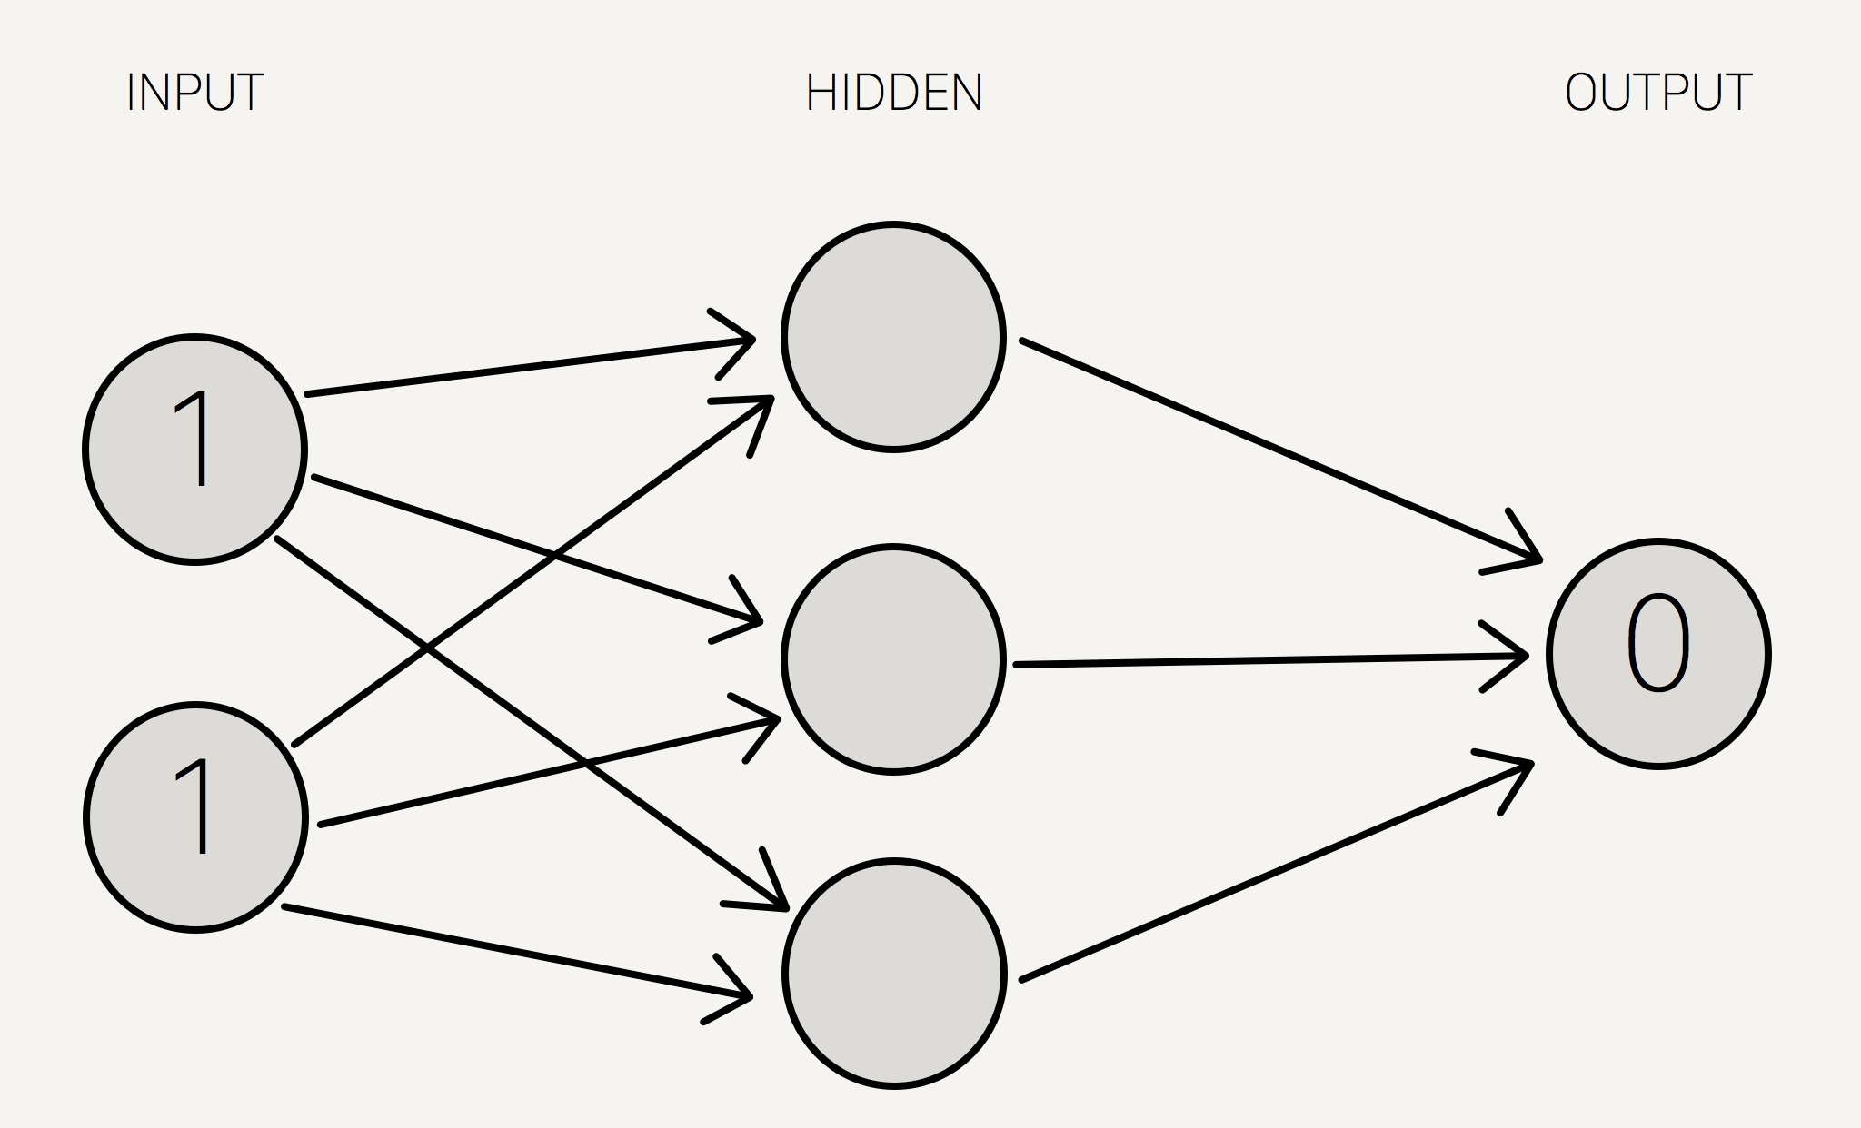
Building our own Neural Network
The basic structure of a neural network
Hidden = Weight1 * Input1 + Weight2 * Input2 + ...

Slide 4
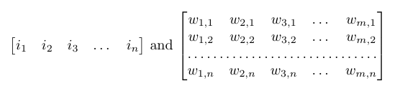
Building our own Neural Network
These operations can be imagined as matrix operations
“One-hot” vector

Slide 5
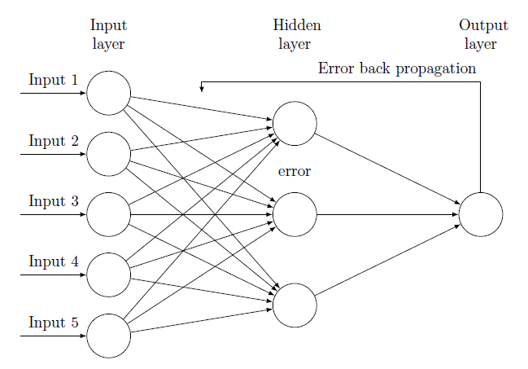
Building our own Neural Network
Back Propagation is the training phase
Incomplete and untested as of yet

Slide 6
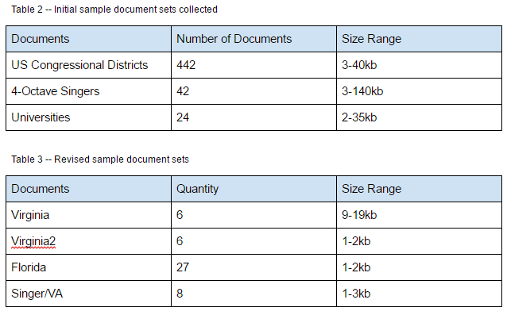
Sample Documents
Notes:
Eastman unable to provide their document sets due to proprietary concerns
Scrape from wikipedia
Beautiful Soup Library
Wikipedia Python Library
Bluescreens
Running out of memory
Collected new smaller document sets

Slide 7
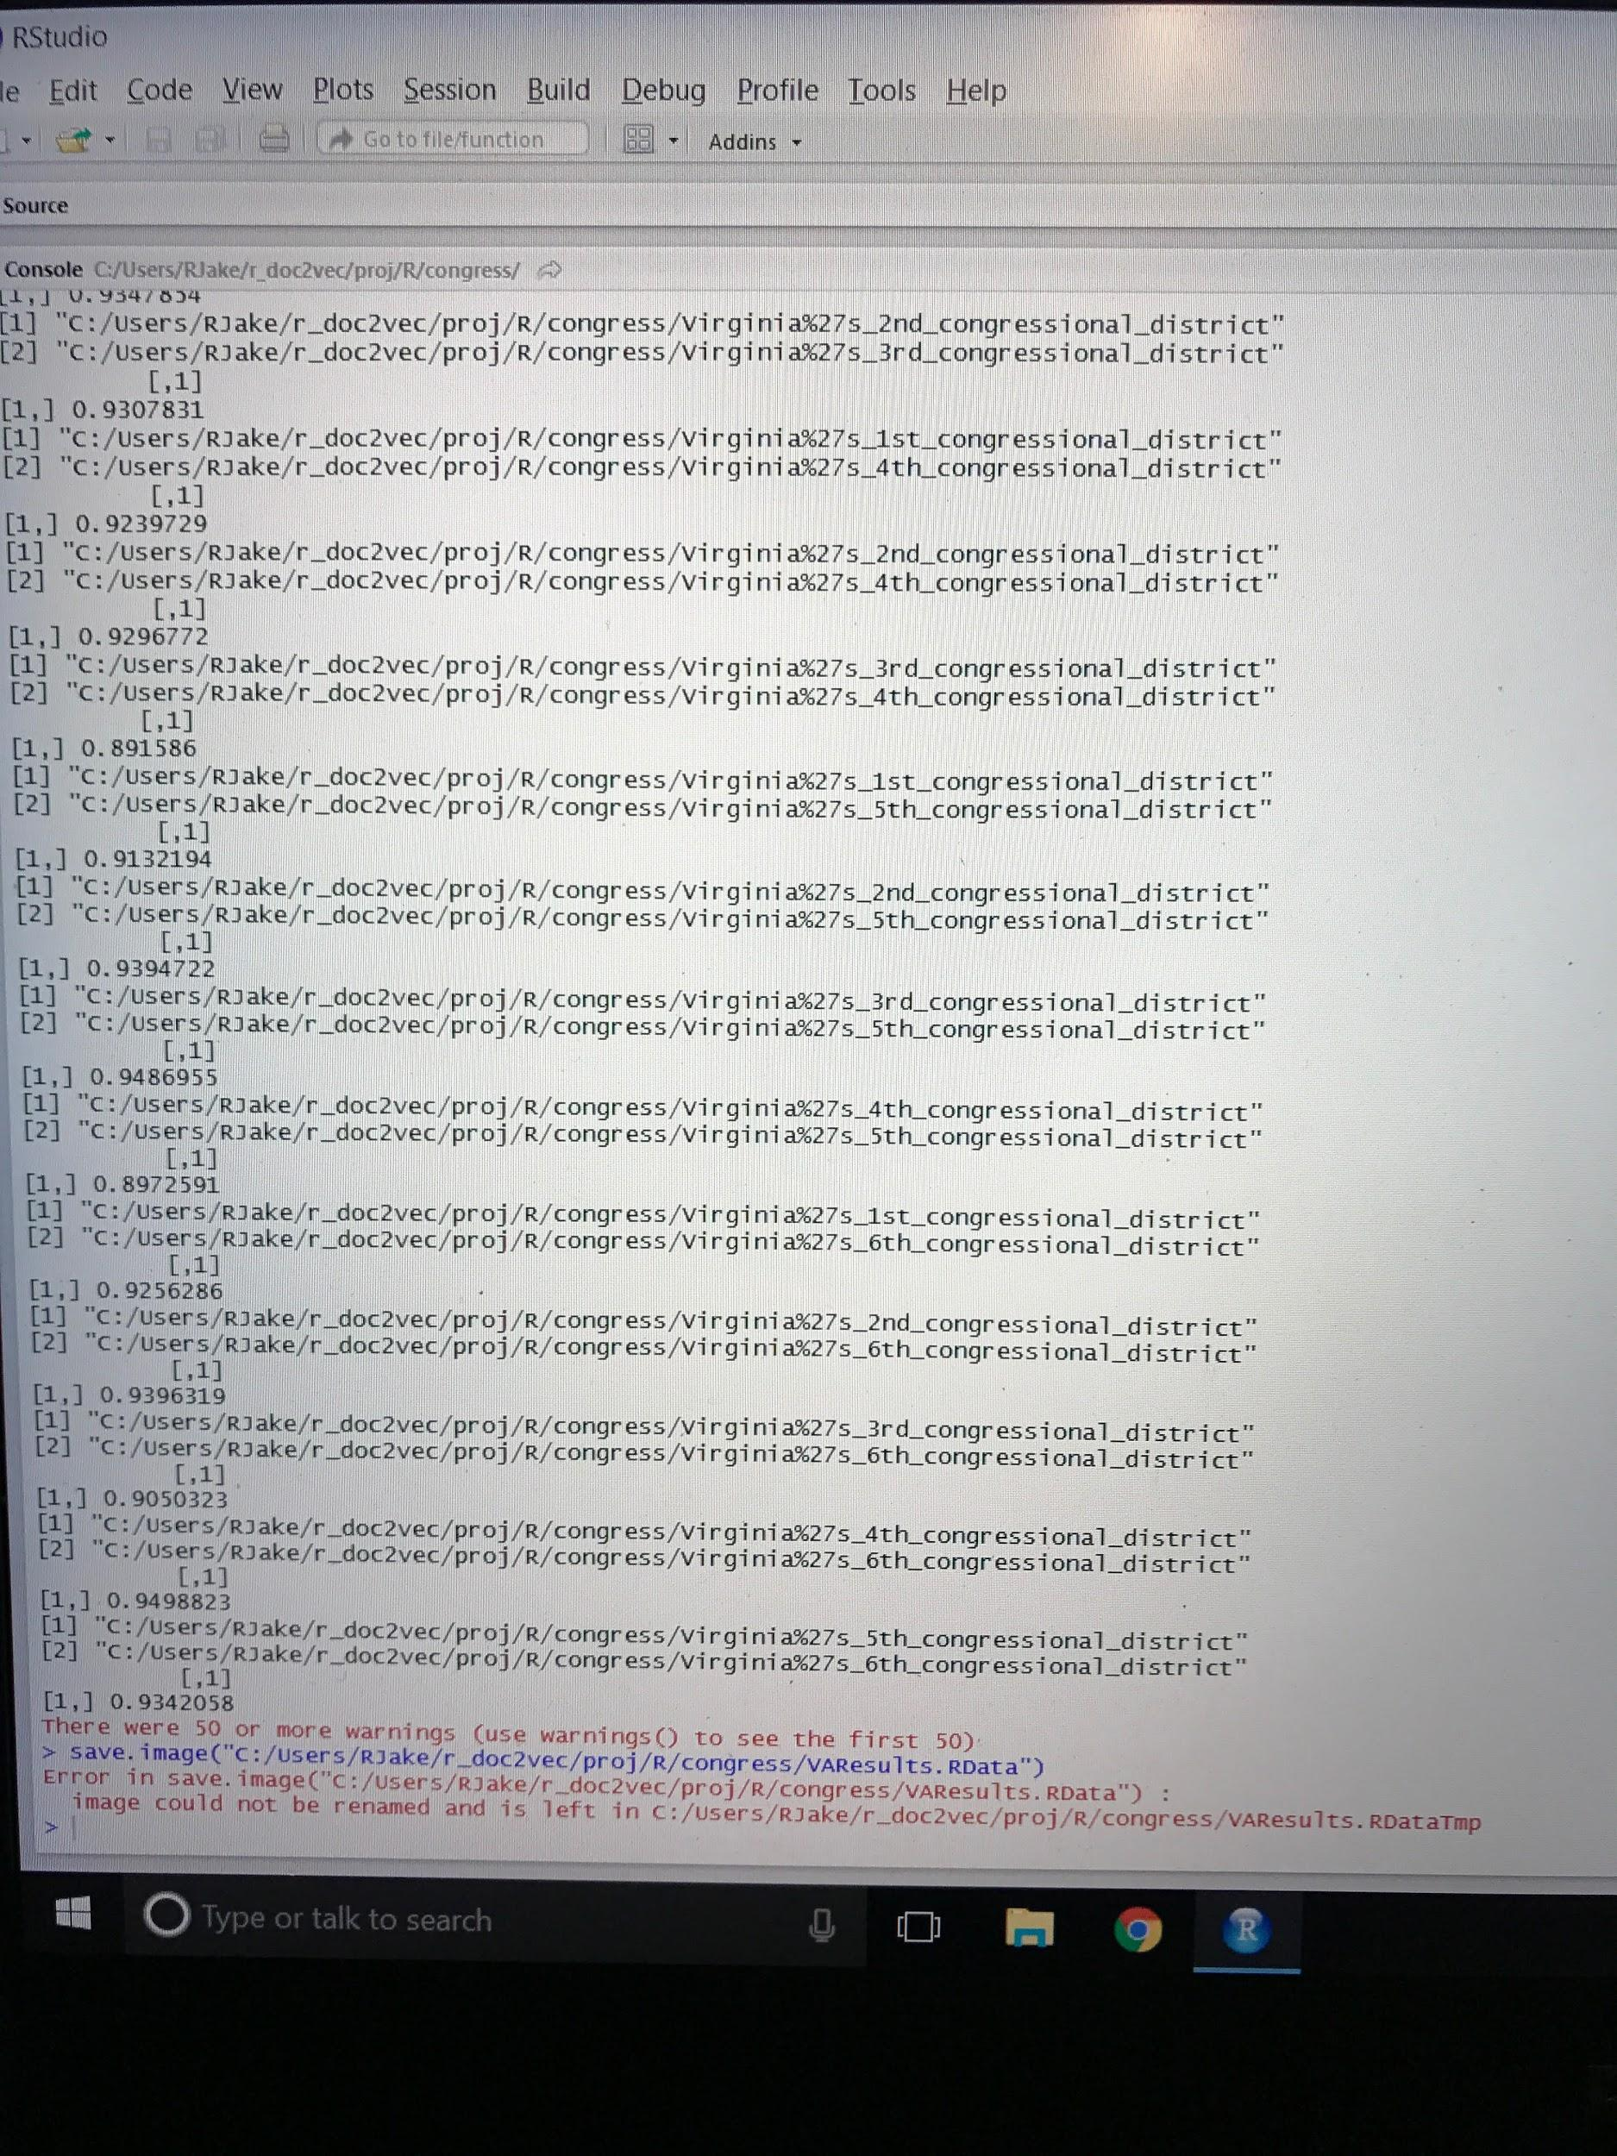
Testing Results (Virginia)
Notes:
Achieved decent results (Similarity <.9)
Ran into memory issues
Googling says that windows begins to kill key processes when running out of memory and this R error message typically indicates that this has occurred

Slide 8
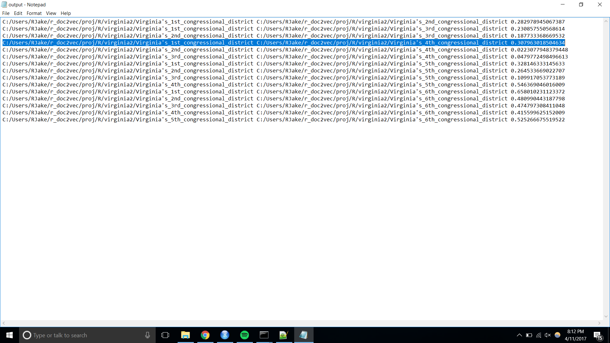
Testing Results (Virginia2)
Notes:
.931 (Original)
.307 (Truncated)
Moving forward
Acquire additional computing resources
Hone in on the size/quantity of documents that can be tested (Get more information from client)
Use existing gensim Rdoc2vec to compare against our results once meaningful data has been collected and stored

Slide 9
Saving Results
Results saved to .csv file
  Can save new file or append to file and return full data set
Built using ‘readr’ library for increased performance
  ‘readr’ write_csv is twice as fast as R base ‘write.csv’[5]
Future Work:
Extend to handle other file types

Slide 10
Plotting Results
t-SNE Algorithm & Reducing Dimensions
  Allows visualization of high dimensional data in 2D and 3D
  ‘Rtsne’ package uses the Barnes-Hut-SNE algorithm
  Barnes-Hut: O(n log n) [6]
  Baseline t-SNE: O(n²) [6]
Future Work:
  Implement using ‘rtsne’ R package

Slide 11
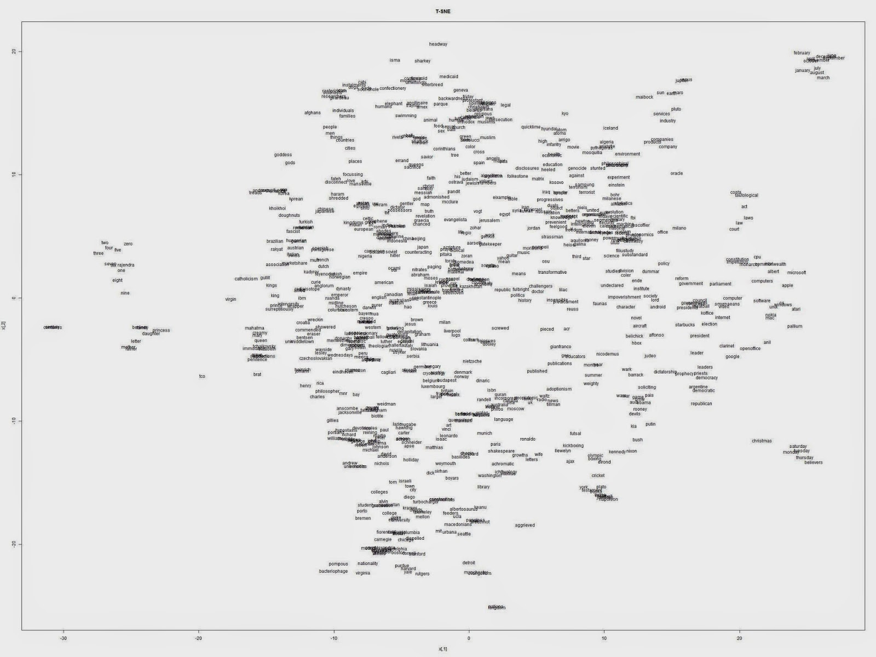
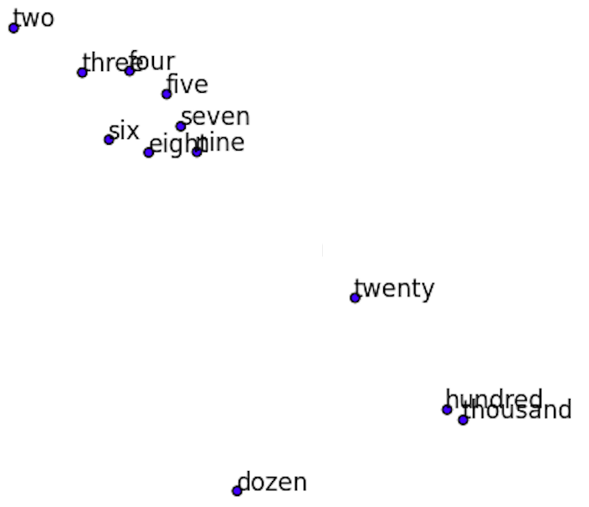
t-SNE Example
2,000 most common English words (300 dimensions to 2) [6]

Slide 12
Lessons Learned
Timeline / Schedule
  Attempting DBOW and Distributed Memory
Research
  Finding a balance between research and decision making
Better defining goals
  Be more realistic about scope

Slide 13
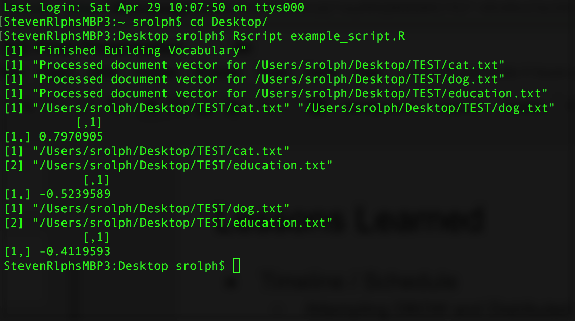
Demo
Running the script
First we build a shared vocabulary
Then we create a document vector for each document
Finally we have a list containing cosine similarity between two documents.

Slide 14
References
[1] https://amsterdam.luminis.eu/2017/01/30/implementing-doc2vec/
[2] https://en.wikipedia.org/wiki/Cat
[3] https://en.wikipedia.org/wiki/Dog
[4] https://en.wikipedia.org/wiki/Education
[5] http://www.sthda.com/english/wiki/fast-writing-of-data-from-r-to-txt-csv-files-readr-package
[6] http://learningaboutdata.blogspot.com/2014/06/plotting-word-embedding-using-tsne-with.html
[7] https://tex.stackexchange.com/questions/162326/drawing-back-propagation-neural-network

Slide 15
Acknowledgements
Dr. Edward Fox
CS 4624 Professor
fox@vt.edu
Don Sanderson
Service Manager, Marketing Solutions
Eastman Chemical Company
donsanderson@eastman.com
Adam Spannbauer
R Programmer and Data Scientist
Eastman Chemical Company
adamspannbauer@eastman.com

